Slide 1

Update and insights from conference organized by A. Bulgac, J. Randrup, I. Stetcu, J. Wilson
This “donnybrook” conference generated considerable insight in its “wake”!
Fragment spin generation in Fission:
What we know, can’t know, and should know.
L. G. Sobotka (referee)
Theoretical concepts Jorgen
S_{L} S_{H}, L correlations Aurel
S_{L}, S_{H}(A) Petar Marevic
Spin reorientation George Bertsch
Axial break to rotation Guillaume Scamps
Prompt gamma in 235(n_{th},f) Katsuhisa Nishio
L from AMD Satoshi Chiba
Metropolis random walk ➔ S Thomas Dossing
S ⬅➔ E* Nathan Ghia
M_g correlations & KE Valentin Piau
Exp – spin related Jonathan
Model dep of spin removal Ionel
FIFRELIN Olivier Litaize
FREYA Ramona Vogt
Isomer Yields Stephan Pomp
Spins in ¹³²Sn from n_{th} Abelaziz Chebboubi
Isomer Yields Dorthea Gjestvang

Slide 2
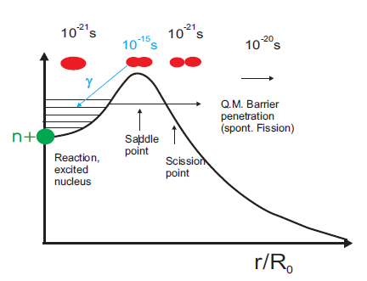
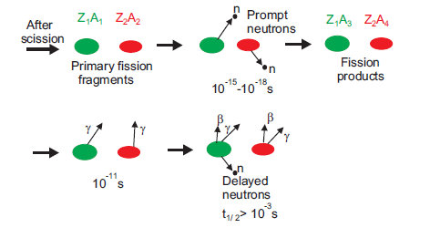
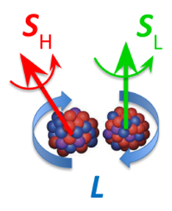
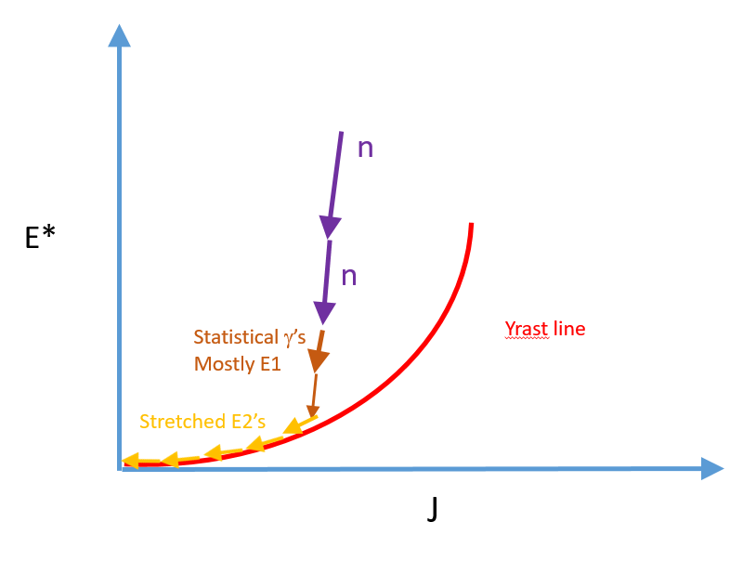
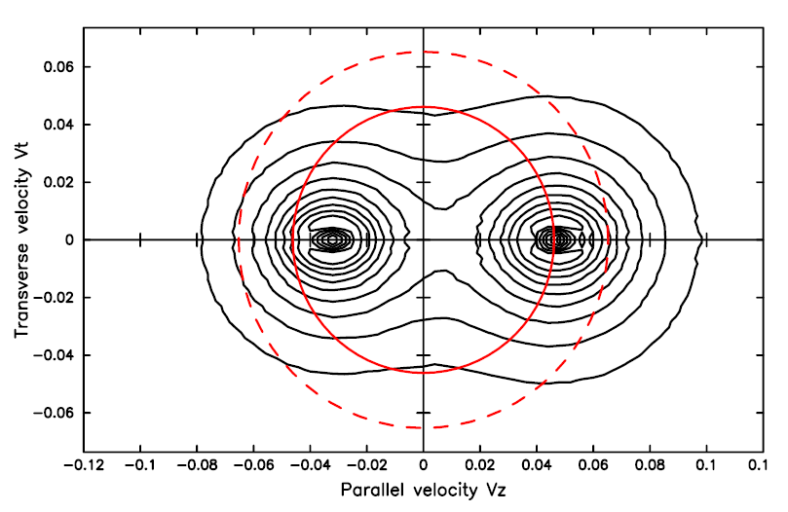
Conventional image of fission. (We may need a “mental” adjustment)
<S_{H/L}>_{i} ~ 10 hbar & σ ~ 0.4 < >
-- ~ 1 hbar/n
-- a few more hbar
<S_{H/L}>_{e} ~ 6 hbar below entry
S_{H} + S_{L} + L = S₀ = 0 (²⁵²Cf)
Most neutrons are kinematically focused Angular momentum is conserved

Slide 3
Pivotal fission-fragment spin references
EXPERIMENT
Angular Momentum if primary products in … fission of ²⁵²Cf,
J. B. Wilhelmy, R. Cheifetz, R. C. Jared, S. G. Thompson, H. R. Bowman, and J. O. Rasmussen, PRC 5, 2041 (1972).
2. Angular distribution of specific gamma rays in … ²⁵²Cf, A. Wolf and R. Cheifetz, PRC 13, 1952 (1976).
3. Angular correlations in the prompt neutron emission in …. ²⁵²Cf, A. Chietere, Eur Phys. J. A 54, 98 (2018).
4. ➔ Angular momentum generation in nuclear fission, J. Wilson et at, Nature 590, (2021).
THEORY
1. V. M. Strutinsky, Sov. Phys. JETP 10, 613 (1960).
2. J. R. Nix and W. J. Swiatecki, NP 71, 1 (1965).
J. O. Rasmussen et al, NPA 136, 465 (1969).
L. G. Moretto and R. P. Schmitt, PRC 21, 204 (1980) & LGM, Lecture 2, Varenna Conference 1979, LBL-9130.
P. Moller et al, Nature 409 , 785 (2001).
➔ G. F. Bertsch, T. Kawano, and L. M. Robledo, PRC 99, 034603 (2019), Guillaume Scamps and GB, preprint.
➔ J. Randrup, PRC 106, L051601 (2022), J. Randrup and Ramona Vogt, PRL 127, 062502 (2021) ….. FREYA
➔ A. Bulgac, PRL 128, 022501 (2022), PRC 106, 014624 (2022)….. TDSLDA (TD Superfluid DFT).
J. Chen, C. Ishizuka, and S. Chiba, AMD unpublished thesis, (2022).
With apologies for omissions!! (I have a limited focus in this talk.)

Slide 4
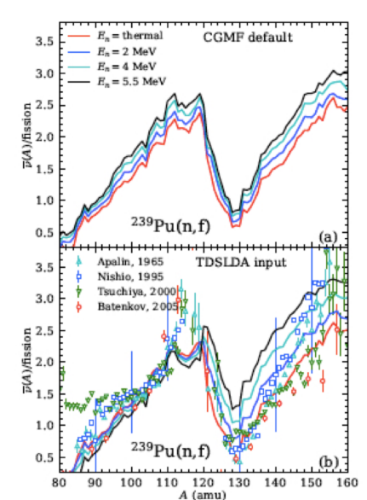
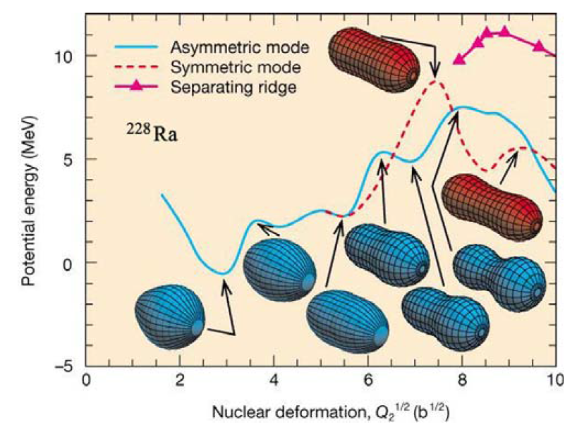
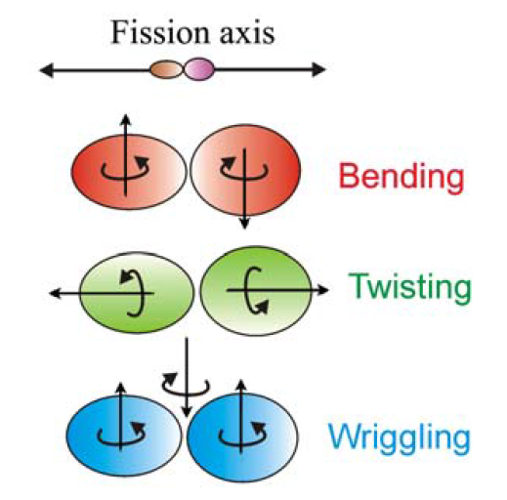
Micro-Macro (FREYA) TDSLDA - TD & Superfluid (beyond BCS) DFT
Many field defining success: Masses (FRLDM+SE),
fission isomers (5+ shape dof), mass distributions,
TKE, mean # neutrons, ……
Many – and recent - successes
FULLY MICROSCOPIC
Spontaneous fission occurs with creepy,
overdamped dynamics.
One can ague that fission occurs because
the decrease in surface tension
(induced by internal excitation) drives up
fissility
[Wheeler’s X == (Coulomb) / (2 Surface E)].
Mass(asy), mean # neutrons(asy) and spins (asy) & spin variances…
come out naturally.
The exceedingly damped dynamics justifies the dynamics used In
⬅ phenomenological models.
(However the fragment KE’s provided a rational decades ago.)
This is the (dynamical) theory Araceli is asking for. Yesterday.
➔ Superfluidity mediates shape changes.
Two nucleons (generally) jump concertedly at level crossing with
deformation. Even starting at the outer saddle,
fission would not occur wo pairing.
In Freya: shape evolution
modeled by METROPOLIS
Walk in a multi-d PES.
Shape dependent
level densities guide shape
evolution.
But inertias are ad hoc,
(to get TKE) AND
angular momentum
generation statistical.
…. model “mobility
Coefficients” for rel;ative
Excitation of ➔
phenomenological

Slide 5
Selected (Spin-Spin) CONCLUSIONS
What we know:
1. The spin saw tooth exists, is robust, and - like the neutron saw tooth & mass distribution, - is pinned by the heavy fragment. [JW]
2. There is little to no spin-spin (magnitude) correlation |S_{L}| ⬅ ➔|S_{H}|
and fragment spins are independent of partner. [JW]
3. This was the a priori expectation [JR+RV – FREYA] and posteriori explained by others
|S_{L}| ⬅ ➔|S_{H}| independence [JR+RV,TD,AB|.
4. There is a huge difference in theory predictions for the S_{L} ⬅➔ S_{H} vector correlations.
[JR+RV and AB]. Old experiments say 2d but new experiments are (largely) silent.
5. a) IF fragment spins confined in 2d plane perpendicular to fission axis S_{L}⬅ ➔S_{H}.
b) IF fragment spins ~ random in 3d ………. S_{L}⬅ strong ➔S_{H}.
6. 1-2 hbar CAN be obtained post-scission due to CoulEx. [GB + GS]
This spin contribution is largely confined to have m = 0 (i.e. in plane perp to beam).

Slide 6
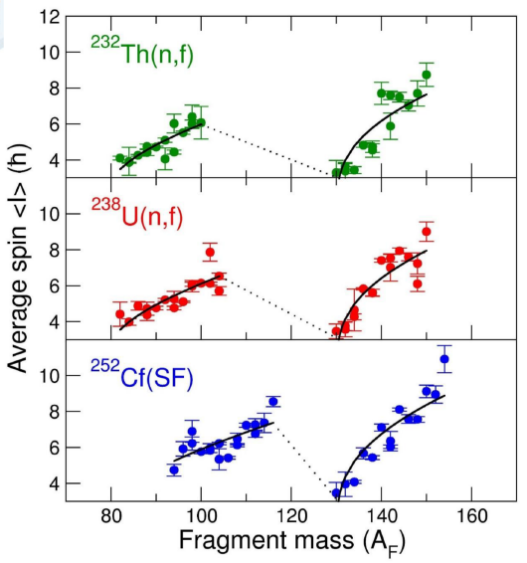
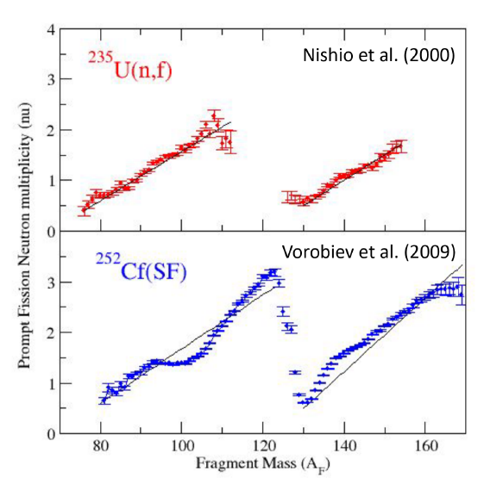
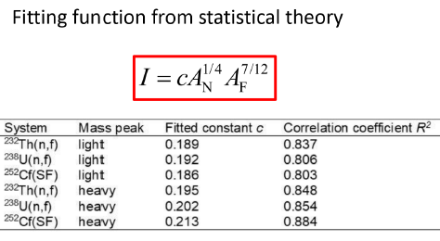
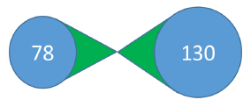
Jonathan Wilson (JW): new (below entry line) data
Μ
γ
Definitive spin saw-tooth
Like Mass and <ν> distributions
Heavy fragment pins.
2. “Dance partner” irrelevant
Fluctuations in S_{H} :S_{L} uncorrelated,
but why?
ν
Bethe, FG, ~ rigid I, E* ~ neck volume
Note: The shell effects of importance are those for octopole/”pear”/kissing shapes (Z ~ 54).

Slide 7
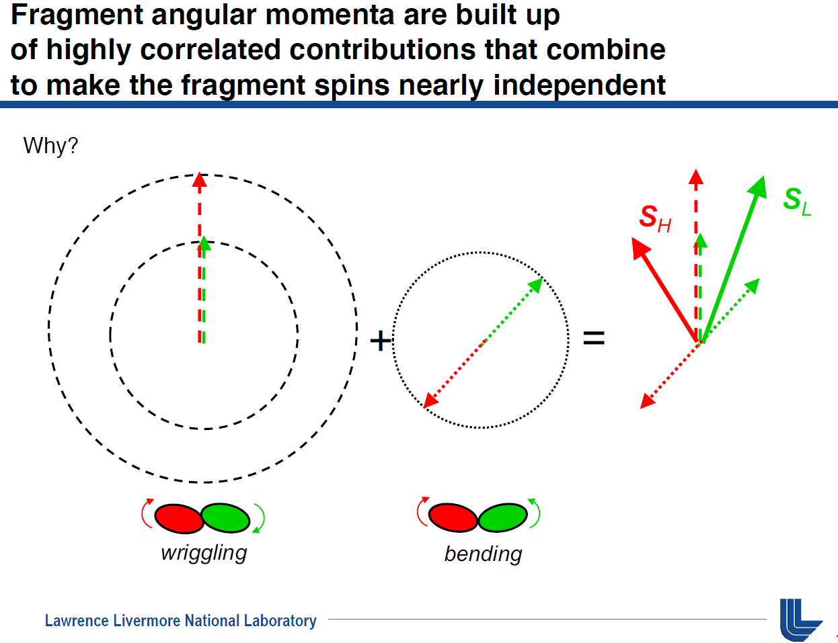
Ramona Vogt explained why fragment spins are UNcorrelated

Slide 8
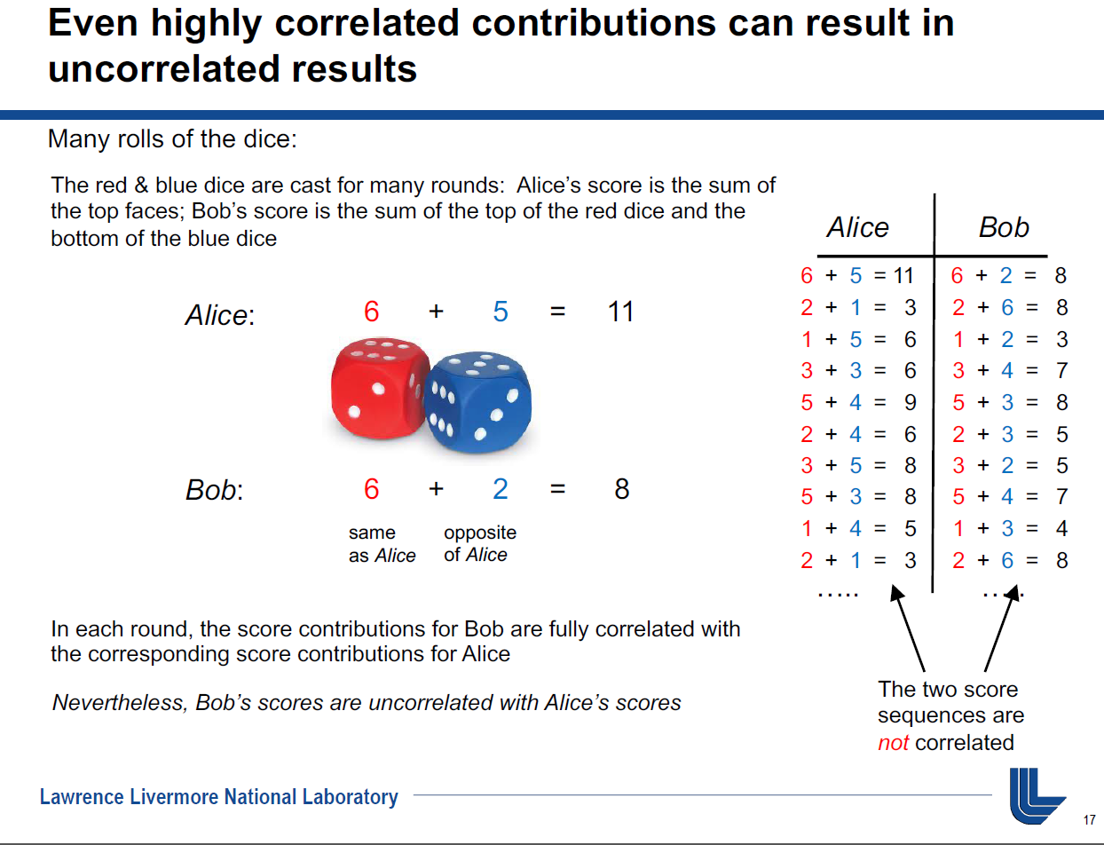
Ramona Vogt’s
Clear explanation
W B

Slide 9
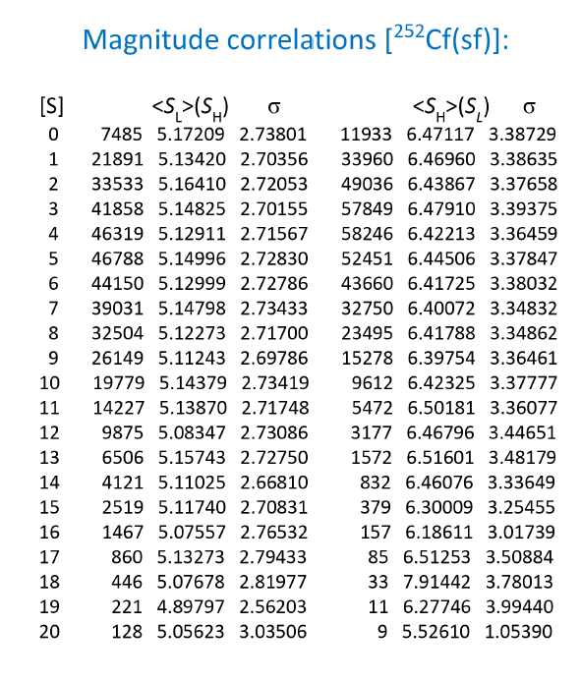
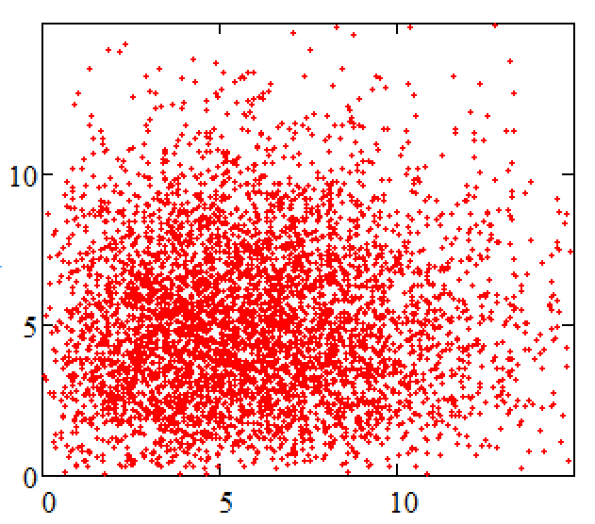
⬅ Randrup: Magnitude Independence.
My own Wriggling-Bending mode script confirmed.
S_{H}
S_{L}
TDSLDA came to same conclusion wo phenomenology. If integrate over L…….
P(S_{H},S_{L}) = P(S_{H})P(S_{L}) distributions factorize

Slide 10
Another pocket explanation of why MAGNITUDES |S_{H}|:|S_{L}|are UNcorrelated.
S_{L} and S_{H} are but two of the three AM. The third – the orbital – has a
significantly larger momentum of inertia, i.e. lower energy cost
to generate L than S_{L} or S_{H}. Thus L serves as a (AM) bath for the spins and
therefore the fragment spin magnitudes should be uncorrelated.
➔There is no escaping this conclusion ➔ as long as wriggling² + bending² .
➔The lack of spin-spin magnitude correlation is NOT evidence of post scission generated spin as suggested by JW et al.
CoulEx can generate some 1 - 2 hbar, post-scission (2d) spin. [GB + GS]
DIRECTIONAL issue
L, the orbital component, is in the plane ⊥ to the fission axis.
The fragment spins need not be, but conspire L (Λ) + S_{L} + S_{H} = S₀ = 0 (for ²⁵²Cf).
The directional fragment spin-spin correlations are more interesting.

Slide 11
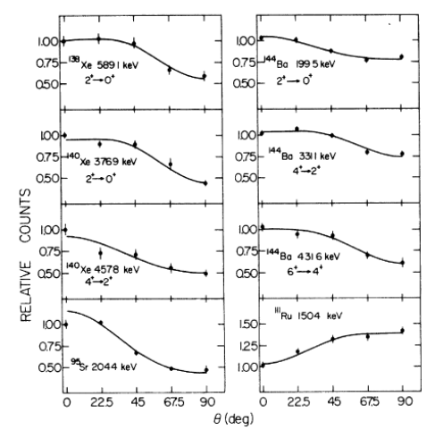
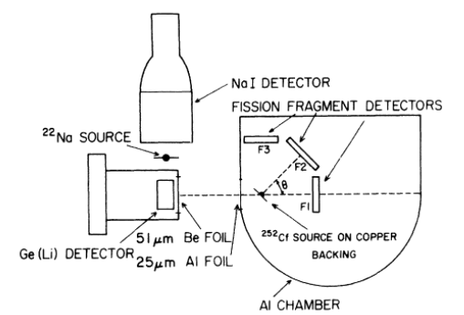
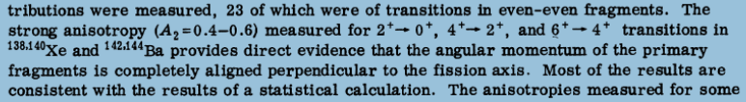
Wolf and Cheifetz: ²⁵²Cf
Si detectors
0.14 mSr
22º opening angle

Slide 12
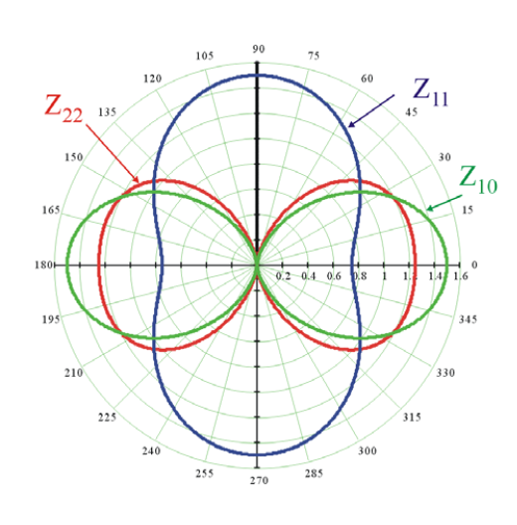
Backtrack to make sure we are all on the same page.
Z_{Q}
Y_{F}
Wolf and Cheifetz
X
These anisotropies are large actually surprisingly large.
These data have not been significantly challenged in~ 50 years.
Rotate red donut around Y_{F} (fission axis).

Slide 13
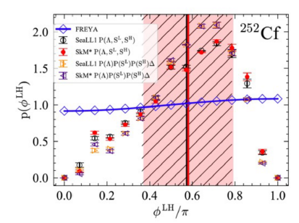
I will focus on the issue that excited many of us at the conference and generated a flurry of work & papers.
“Da” issue
Initial variance of fragment
Spin along fission axis = 0.
Substantial variance of fragment
Spin along fission axis.
ϕ
θ
Standard (1,1,0) FREYA
(W,B,T)
TDDFT & AMD
No spin constraints
φ^{LH} = relative angle BETWEEN L and H spin vectors (projected on plane perpendicular to fission axis).
& φ (ψ sometimes) normal polar coordinates relative to fission axis.

Slide 14
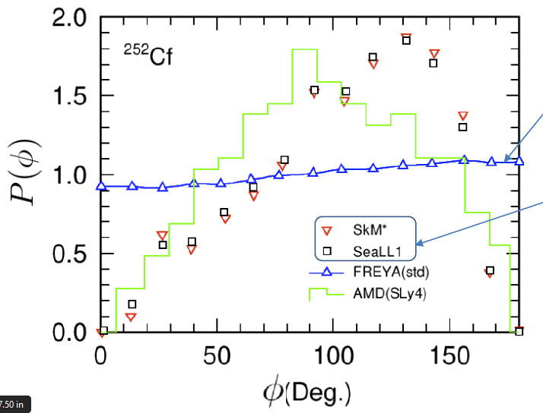
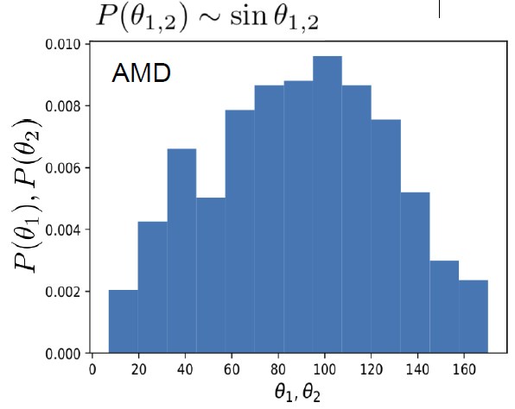
The “tell” was provided by Satoshi Chiba (Chen thesis) using … boost induced or jump-started AMD
LD-like fission as E* high
Nice verification of what has been modelled in ternary fission (John Rasmussen)
Does not get <S> saw tooth but high E* should kill shell effects AND could excite “Twisting”.
P(phi) ~ sin (phi) P(th) ~ sin(th) , i.e. just solid angle
Substantial initial spin projection along fission axis
Macro suggestion: strong “Tilting/twisting” agitation

Slide 15
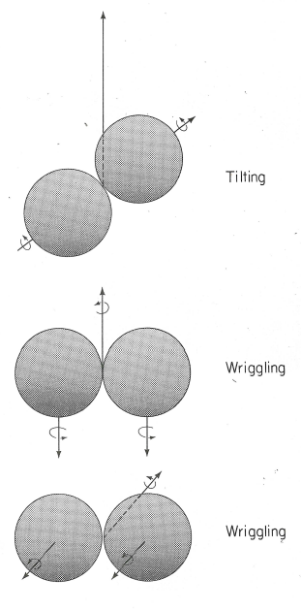
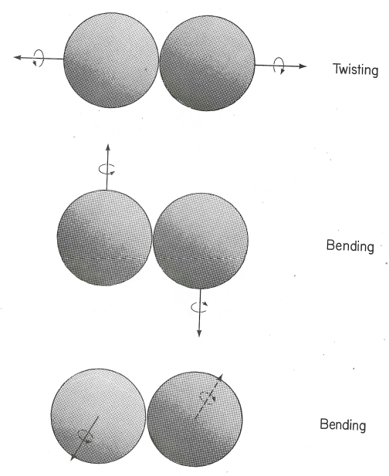
Nix & Swiatecki’s AM bearing modes
Significant Twisting Tilting
will generate out-of-plane spin variance as can pair breaking
S_{H} + S_{L} + L = S₀ = 0 (²⁵²Cf)
(Bending)²
(Wriggling)²
Bending & Wriggling ⊥ to fission axis
Twisting & Tilting || to fission axis

Slide 16
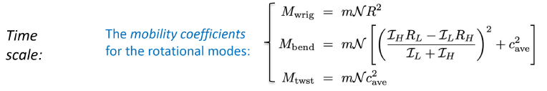
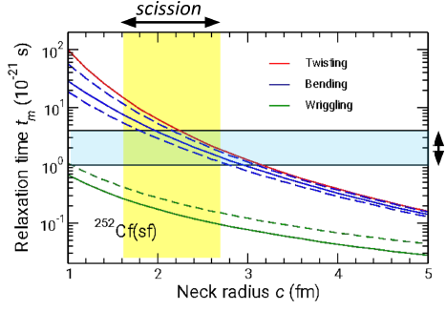
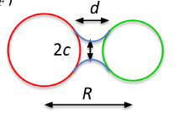
Randrup and Vogt
The logic here is that these modes
are “agitated” by nucleons going
through the neck
(between Saddle and scission)
LDSLDA
The larger X, the longer saddle-to-scission,
& larger c ➔ more twisting,
the more out-of-plane!

Slide 17
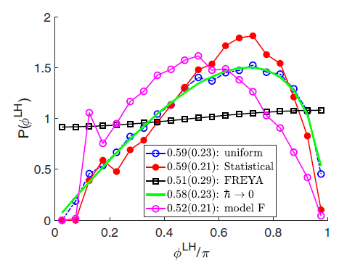

Aurel’s triangle sampling.
+ Various models for generation
of the parent P(S^{L}), P(S^{H}), P(S^{Λ})
Distributions….
P(Δφ) ➔ 0 at 0º and 180º
P(Δφ) ➔ max at ~ 120º
is easy to understand from “triangle phase space”.
The point is: IF AM ONLY need obey “triangle rule”:
P(Δφ) will have strong ϕ correlation and
out-of-plane spin variance.
(1)
(1)
L
H
“triangle phase space”

Slide 18
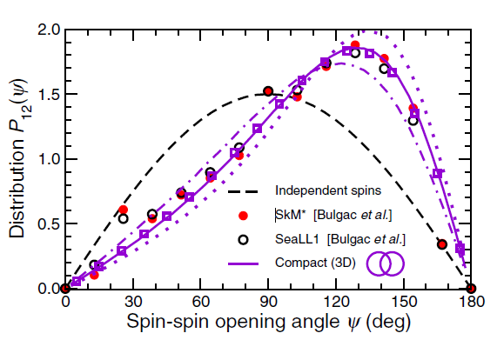
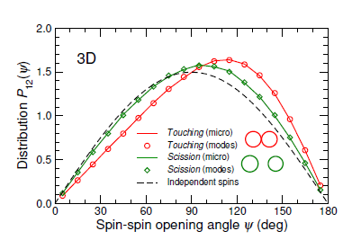
Jorgen [PRC 106, L051601, (2022)] shows …..
IF spins confined in 2D x-y plane, i.e. P(θ) = δ₉₀ ➔ P(ψ) = constant (like FREYA)
IF spin free in 3D, P(θ) ~ sin(θ) ➔ P(ψ) = peaked (like TDDFT)
WHAT fantastic insight! Now issue becomes 2d or 3d and why?
“What is the GO of it?” Maxwell -- Faraday

Slide 19
George Bertsch argues …..
➔ Any mean-field model wo pair breaking compels P(θ) = δ₉₀
Jorgen argues this comes naturally in any IPM
➔ Spin components along Z (fission) - axis are generated IF(F?) there is diabatic pair breaking.
This sends formally paired nucleons in opposite directions TO populate different fragments.
➔ IF(F?) some fraction of Fermi crust is pair separated ➔ 3D, P(θ) ~ sin(θ)
Must happen at high E* ! Does it happen in SF of ²⁵²Cf?
So it just might be that differentiating 2d vs 3d ➔ pair breaking in fission
If 2d ➔ pairs if 3d ➔ pair breaking
FREYA (statistical approach) does not need “pair breaking” BUT CAN acquire longitudinal spin projections with tilting/twisting modes.

Slide 20

Mental (meant two ways) view.
Noah
Anti- Noah
Adiabatic – 2d – P(θ) ~ δ diabatic - 3d - P(θ) ➔ sin(θ)

Slide 21
The macro “go of it” is “Twisting or Tilting”.
As Moretto showed in 1978 IF (T) fully statistically excited ➔ fragment spins are virtually isotopic.
“…. Hence, titling and wriggling together generate an angular momentum that is almost random.”
Varenna lectures and elsewhere (1979).
S^{rms}_{L/H} (1,1,0) ~ 1.2 (I T)^{0.5} ………….…. S^{rms}_{L/H} (0,0,1) ~ 0.84 (I T)^{0.5} = aka K^{rms}_{L/H}
σ_{L/H} (1,1,0) ~ 0.5 (I T)^{0.5}
The tension:
Old data indicates initial spins are 2d.
➔This motivated Jorgen and Ramona to favor 2D (1,1,0) FREYA model.
It can also be ~ justified/rationalized by (DIC) nucleon-exchange model.
New theory favors initial spins ~ fully populate 3d.
➔ Indication of (Moretto’s) thermal excitation of W,B,T (1,1,1) model.
Challenge for next few years: 2d or 3d?

Slide 22

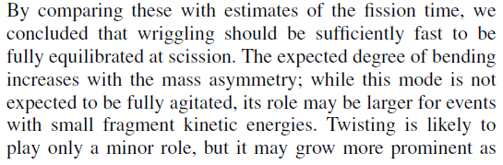

Randrup, Vogt and Do”ssing.
Yes but no
Micro says:
Macro
always needs T

Slide 23
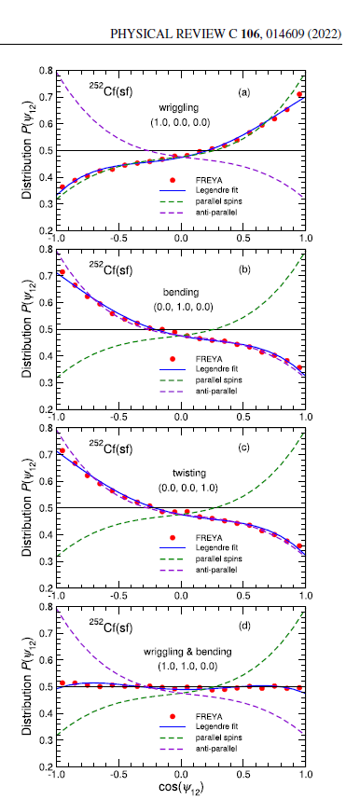
One approach:
JR, T. Dossing, and R. Vogt.
Photons double helicity measurements would tell all.
Fission + E2_{L}(Hel) + E2_{H}(Hel)
First pass – I laughed.
Second pass – perhaps an experiment for the next generation.

Slide 24
Series of HF (GEMINI) calculations.
Full angular momentum coupling during deexcitation
Initial either 2d or 3d
i.e. either no or substantial σ_{L/H} (m_{z})
1. L-H spins either 2d or 3d
2. Different spin models, e.g. FREYA, TDSLDA
3. Examine both neutron and gamma observables
4. intra-fragment (L-L & H-H) distributions
- as sanity check.
5. Examine BOTH inter-fragment P(Δφ)
and P(θ) distributions
Figure partially from Ramona

Slide 25
n-n-fission correlations
worthless
All agree no spin-spin information in n-n correlations

Slide 26
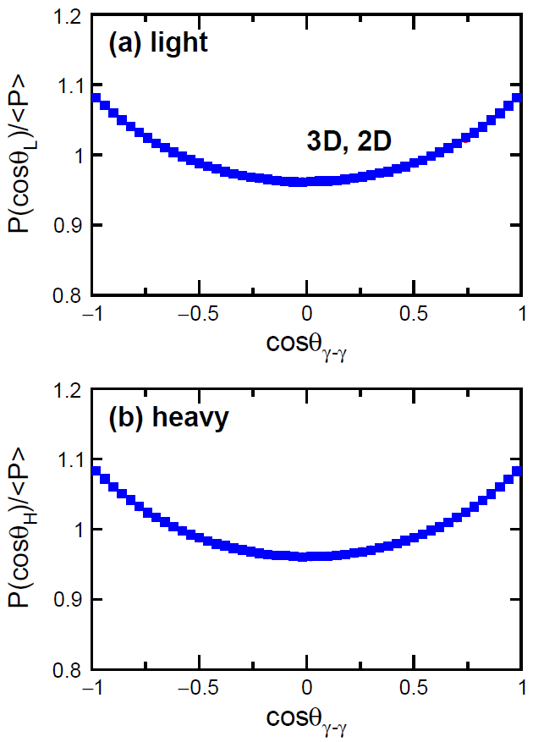
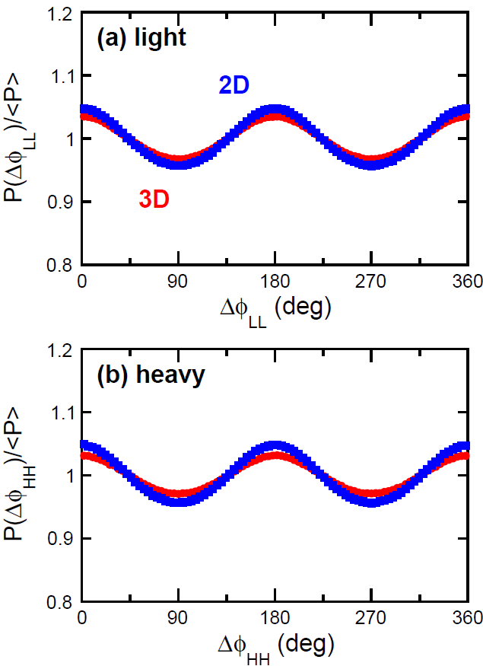
Sanity checks γ (θ) and γ−γ (θ & ϕ) Ε2 correlations from same fragment
➔ Self alignment
Valuable as checks – must be there

Slide 27
γ (Ε2) correlations
now gammas from different fragments
J_{yrast}>=8
Forced 2d to have TDSDFA correlation – nothing survives
worthless
Is all lost ? Of course not i.e. J. B. Wilhelmy, R. Cheifetz and Wolf observable.

Slide 28
Back off (a la J. B. Wilhelmy, R. Cheifetz) & consider γ (Ε2) - ff (θ) correlations
Z_{Q}
Y_{F}
X
Hook – i.e. not worthless (This is “back to the future”)
3D = Bulgac spin correlations

Slide 29
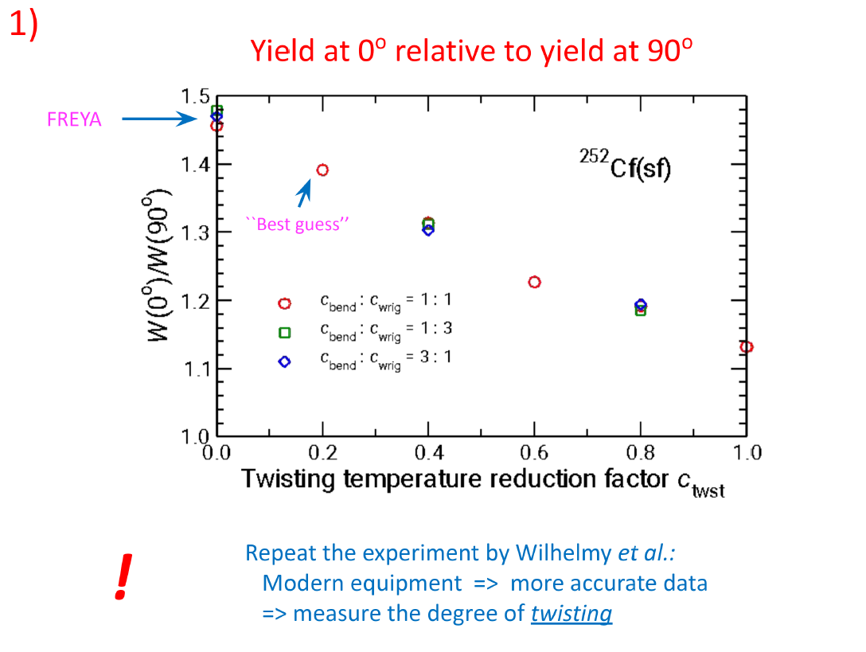
I ended up where Jorgen & Ramona were a year ago.

Slide 30
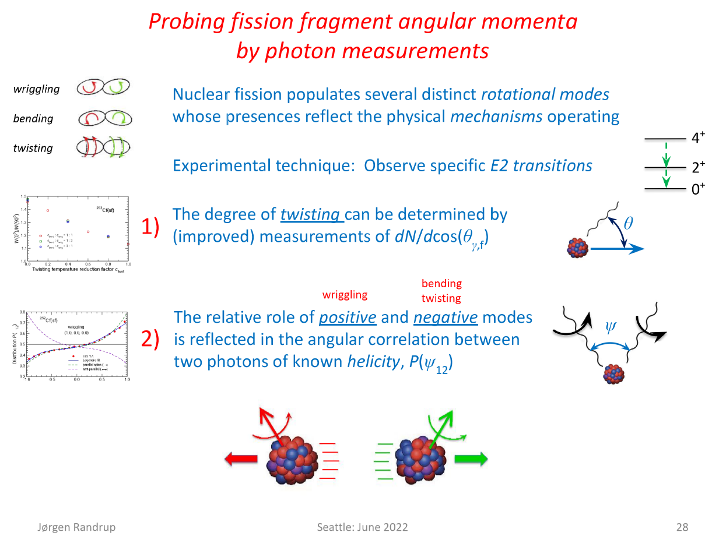

Slide 31
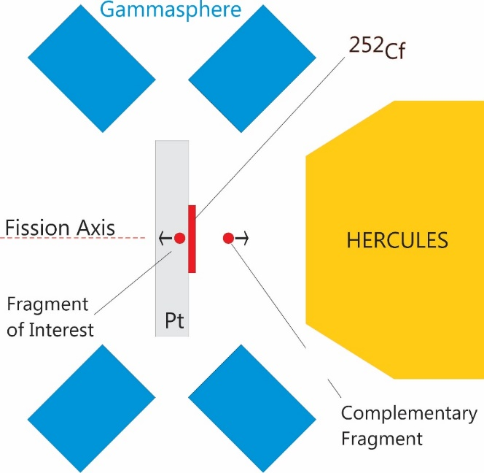
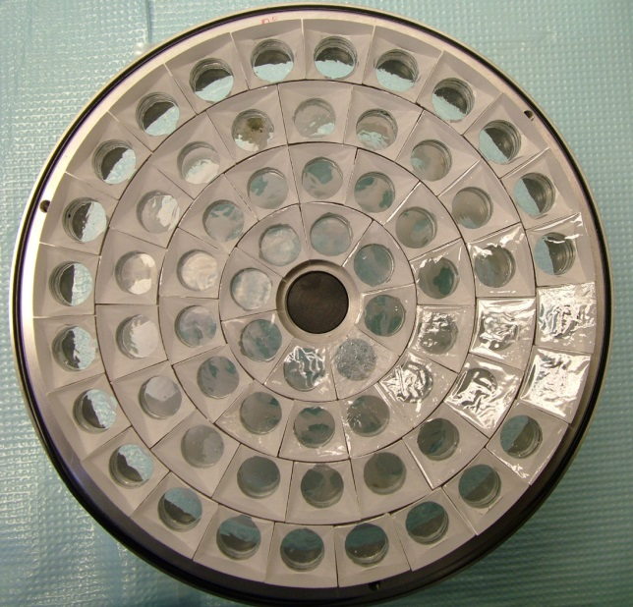
Conclusions
DGS
experiment
Spin magnitudes are uncorrelated.
There is a spin vector correlation tension between theories.
old data & standard macro implementation ➔ 2d,
BUT new micro theory implies 3D (as one would expect if “hot”)
HOWEVER
Data exists – and can be acquired - that is far superior to the
“old data” and
Now HF can include spin-spin (vector) correlations (Gemini does)
and below the entry-line nuclear structure. (Gemini does not)
split Ge’s ➔ helicity ?
Thank you and I apologize for the omissions and simplifications
GS + “Hercules” scint wall
Snyder et al. PLB 723, 61 (2013)

Slide 32

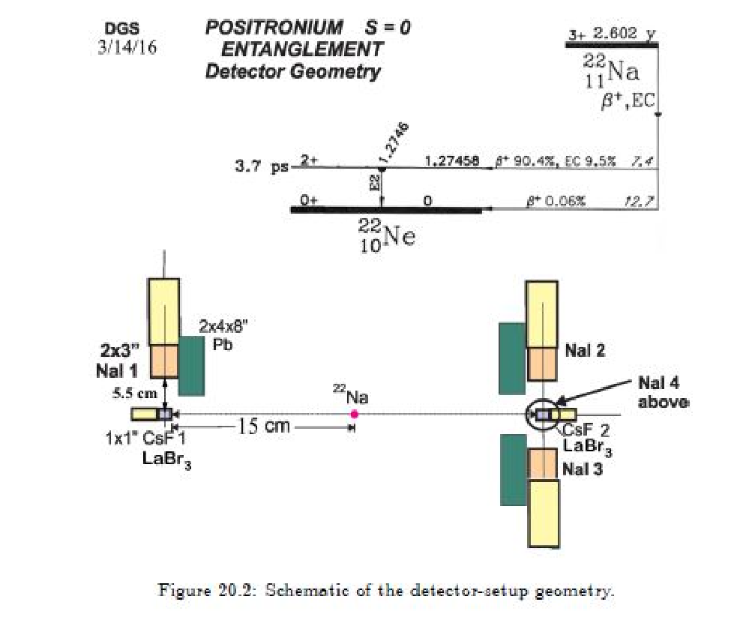
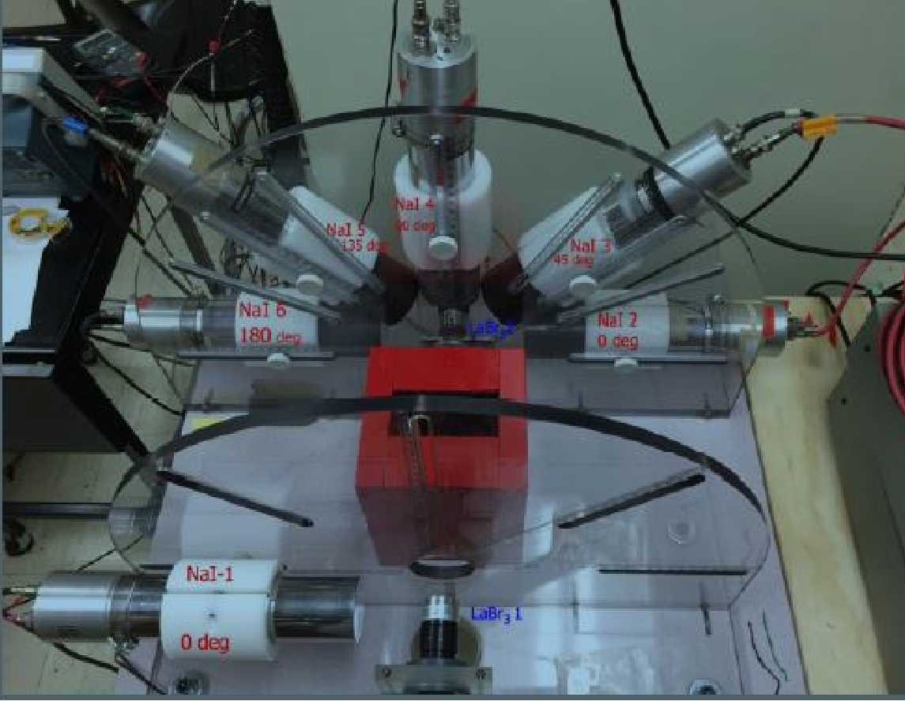
Helicity of entangled PS photons (Feynman)
(Fission photons not “entangled” but correlated by AM bearing mode.)
Perhaps it can be done – need experimental skills of “da man” DGS ➔

Slide 33


G. Bertsch & G. Scamps
1. Torque from the Coulomb field generates angular momentum (Strutinsky)
2. This POST scission AM from Coul-ex is a function of (Q-mom, I, relax ➔ CN)
3. ➔ Δ (J^{rms}) ~ 1-2 hbar
M = 0 but what is spin-spin correlation?

Slide 34
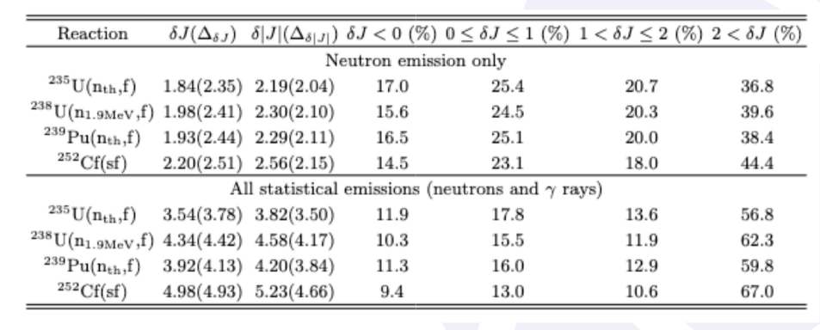
Ionel Stetcu (CGMF) and Olivier Litaize (FIFRELIN) fission models coupled to HF (wo substate tracking)
Optical model (Koning-Delaroche) - spherical
Gamma-ray strength function
Bethe J distribution but both need to increase “I” (spin cut off) to get gamma spectrum correct.
without the gamma spectrum is too hard.) This is a fix masking an error somewhere else.
Incomplete nuclear data, isomers
➔model for E* region melding {DoS ➔ structure, deformation, spin cut off E*} OLD problems that have not gone away
n spin removal
This much ??

Slide 35
30 < θ_{n} < 60º
E_{n}^{lab} > 1 MeV
“light”
x
φ_{L}
J_{light}
z
120 < θ_{n} < 150º
V_{light}
V_{n}
“heavy”
φ_{H}
V_{heavy}
y
J_{heavy}

Slide 36
All agree no spin-spin information in n-n correlations

Slide 37


n
E*
n
Statistical γ’s
Mostly E1
Yrast line
Stretched E2’s
J

Slide 38
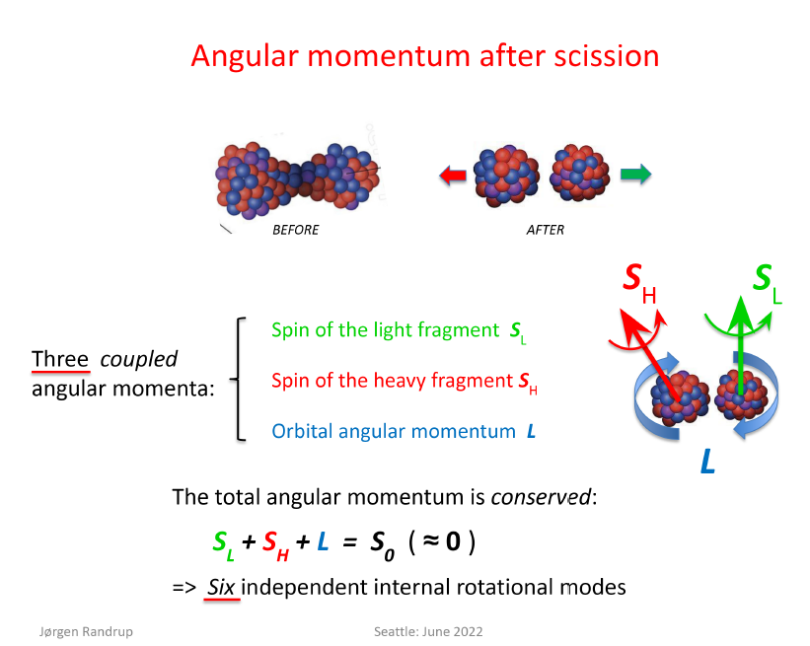
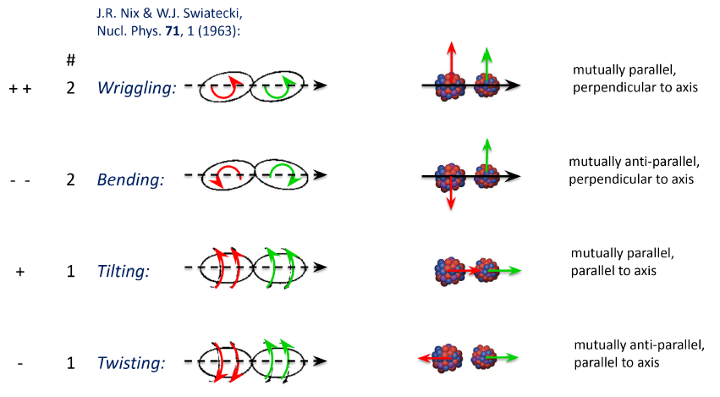
J. Randrup & Ramona Vogt – Macro theory concepts
1 Framing language & 2. Agitation: Wriggling, Bending, Twisting… (1,1,0)
Significant Tilting/Twisting will generate out-of-plane spin as can pair breaking

Slide 39
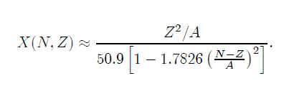
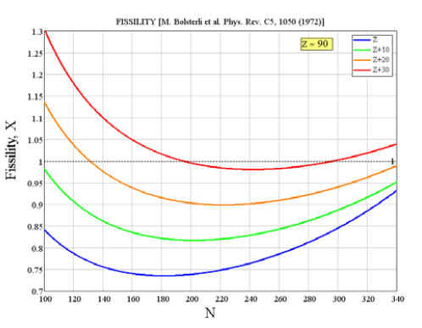
For Kyle – fission topics – musings from WU
Major issue: is the fragment spin distribution 2d or 3d?
Another long-standing issue that we may finally be able to address is the
Wheeler to Bolsterli “fissility” X.
As n/p asymmetry increases, the surface energy weakens driving X up.
This helps drive fission recycling SE of stability. (A bit counter intuitive.)
Need systematic fission probability removed from the standard cases.
Mental image: expand “Wahl” systematics away from the usual suspects
i.e. 235,238,239,252
3. Interesting case of ²⁵⁴Cf: fission partial width increases 540 times from ²⁵²Cf.
Is this understood?
CAUTION for all experiments to be relevant.
MUST AVOID HIGH ANGULAR MOMENTUM
As total transferred L goes up, fission will fractionate, i.e.
higher L’s will generate more symmetric mass distributions.
Do E* tagged transfer or better (p,p’) or (a,a’).
Likely need both low and high (beam) energy data to unfold
AM-fractionation issue.

Slide 40
CENTAUR fission projects being considered
A. Fission fragment spin correlations
1. ²⁵²Cf ff-g-g from Sarantites – GREAT data NEVER been plumbed for angular correlations between gammas from DIFFERENT fragments ➔ FSU (Vandana Tripathi)
B. Actinide fission nuclei through transfer and inelastic reactions
1. ²⁴⁰U* : ²³⁹U(n,f) via ²³⁸U(t,p)²⁴⁰U ➔ (FSU – Mark Spieker + IW)
2. ²³⁷Np*: ²³⁶Np(n,f) via ²³⁶U(³He,d)²³⁷Np* ➔ (FSU – Mark Spieker + IW)
3. ^{x}Pu fission asymmetry (E*) using (p,p’) and (α,α’) ➔ (TAMU – Phil Adsley)
Together with the more detailed data expected from the proposed experiments, the analysis tools will also be updated to contemporary reaction models from LLNL. The proposed programs at both laboratories will make use of a spectrometer for the light-particle detection and a Si array for the fission fragments.
C. Fission excitation function for hard to reach nuclei using (d,p), (³He,t), and (³He,a)
employing Inverse kinematics & active gas targets.
➔ (TAMU&FSU) Rogachev (TPC) and Almaraz-Calderon (MUSIC)

Slide 41
fini
Extension of Wheeler’s fissility (Coul/2*Surface) to include weakening of surface energy with increasing asymmetry
Oh yea …
This drives fission recycling in the R-process

