Slide 1
Studying Fission near ¹⁹⁸Pb with AT-TPC at FRIB
Curtis Hunt

Slide 2
Outline
Fission in AT-TPC
Interest in Fission
Method
Setup
AT-TPC
HEavy ISotope Tagger (HEIST)
Challenges
Finding Window and Pad Plane in Time
Identifying Fission Events
Algorithmic Method
Machine Learning Method
Space Charge
Signal Processing
Preliminary Results
Summary

Slide 3
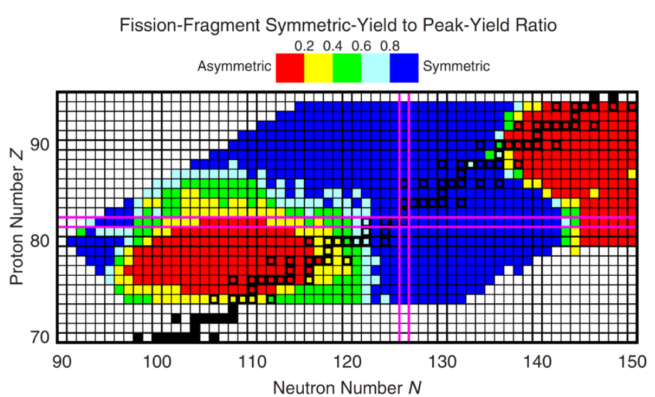
Fission In AT-TPC
Probe of nuclear structure
Unexpected region of asymmetry in mass yields near ¹⁸⁰Hg
Our interest is in the transition region near ¹⁹⁸Pb
Probe of low-density equation of state
Compare barrier and mass distributions to different effective interactions
Z
N
Moller P and Randrup J 2015 Phys. Rev. C 91 044316
Notes:
2:15. symmetry energy term at low density. Drew Pype making calculations of potential energy surfaces to compare to experiment.

Slide 4
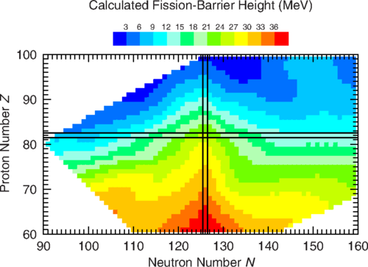
Fission In AT-TPC
Goal is to measure fission properties of short-lived isotopes
Fission barrier, cross-section, asymmetry of fission fragments
Nucleus excited through light ion induced fusion-fission -> low angular momentum
Fission of compound nucleus
Using an Active Target TPC provides several advantages to the study of fission using fusion-fission
Moller P et. Al. J 2015 Phys. Rev. C 91 024310
Notes:
3:15 In 190Hg, mass asymmetry survives at E* up to 70 of MeV from ANU data

Slide 5
Fission In AT-TPC
Using an Active Target allows for probing a large range of excitation energies
Allows for measuring cross section over range of energies with single beam
Active Target allows for accurate determination of reaction vertex and reconstruction of the event
Vertex used to obtain excitation energy and the angle between fission fragments
Inverse kinematics allows for the use of radioactive isotopes in study of fusion-fission reactions
Inverse kinematics boosts fragments forward
Fission events form a characteristic Y pattern toward the pad plane

Slide 6
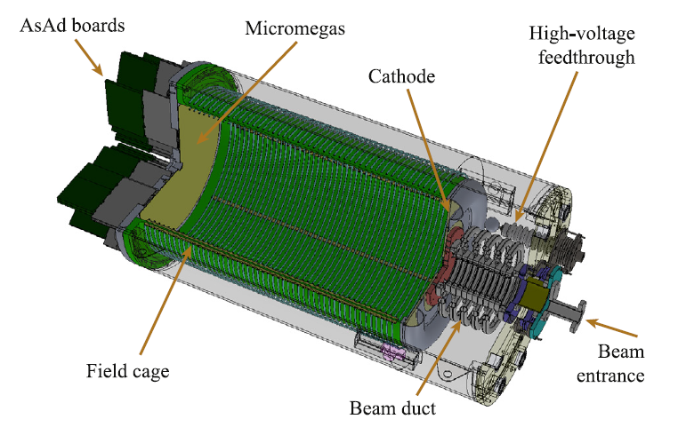
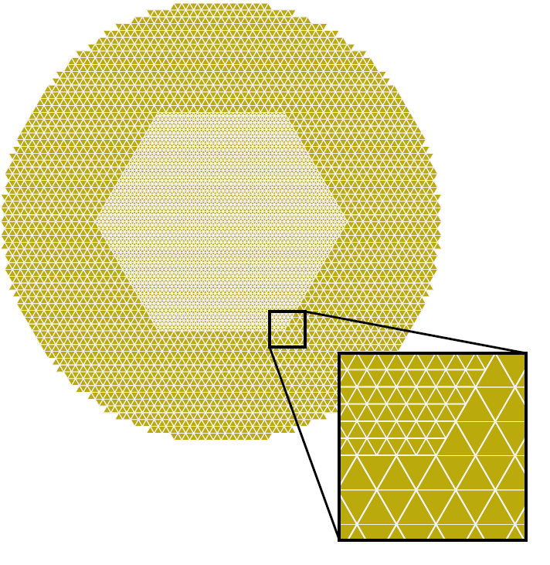
AT-TPC
AT-TPC (Active Target Time Projection Chamber)
Reactions occur inside the gas volume of the TPC with the gas
1000 mm long x 250 mm radius cylindrical active volume
10240 micromegas pads
Perpendicular to beam direction
Triangular pads
Highly segmented inner region
Cylindrical design allows for use in magnetic field
We did not use a magnetic field for fission study

Slide 7
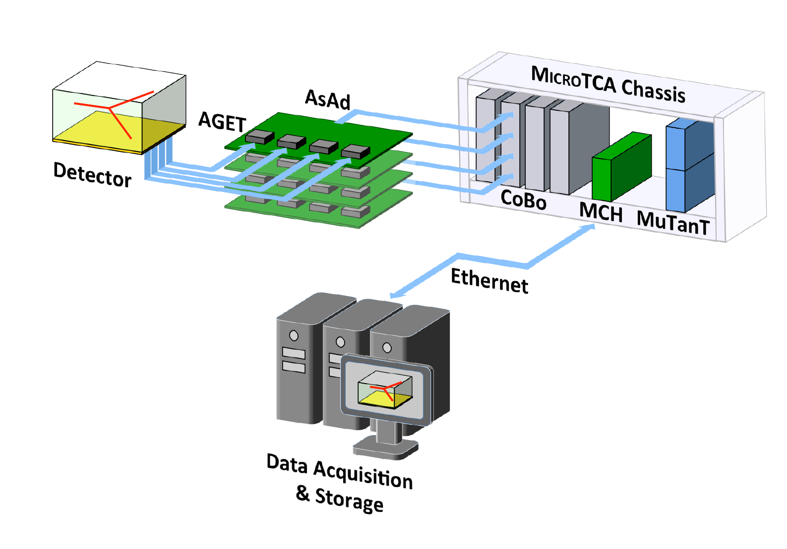
AT-TPC - GET
Generic Electronics for TPCs (GET)
AGET chips
64 data channels + 4 FPN channels
Fixed Pattern Noise (FPN) channels measure the baseline due to electronics
Preamplification and Shaping
AsAd (ASIC and ADC) boards
4 AGET chips per board
Digitizes signal from the AGET
CoBo (Concentration Board) Module
Up to 4 AsAd per CoBo
MuTAnT (Multiplicity, Trigger and Time)
Manages the trigger for the connected CoBos
E.C. Pollacco et al. NIMA 887 (2018) 81-93

Slide 8
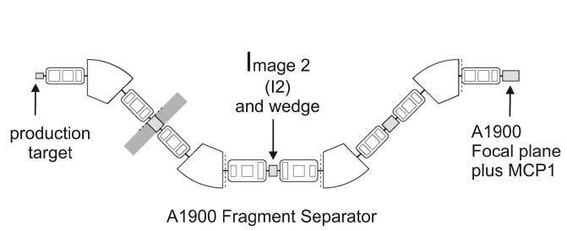
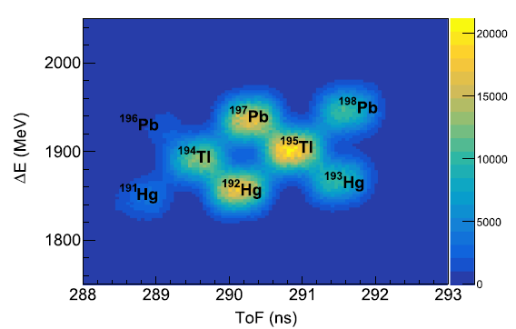
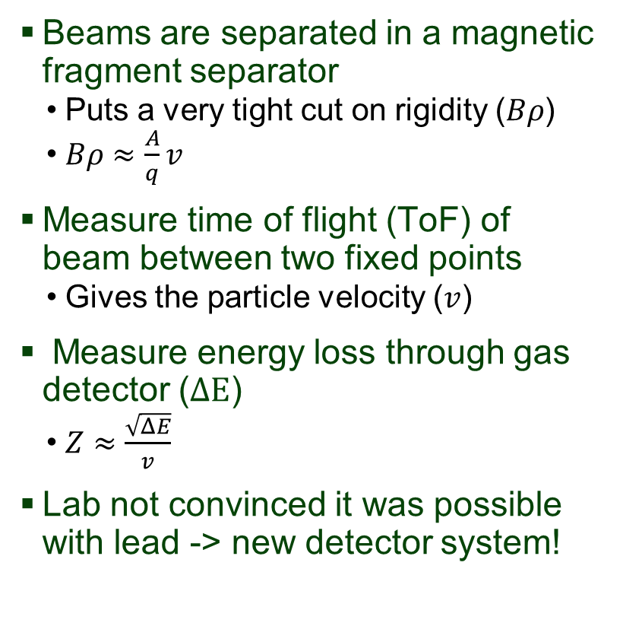

Identifying Rare Isotope Beams
Beams are separated in a magnetic fragment separator
Puts a very tight cut on rigidity ($Bρ$)
$Bρ≈\frac{A}{q}v$
Measure time of flight (ToF) of beam between two fixed points
Gives the particle velocity ($v$)
Measure energy loss through gas detector ($ΔE$)
$Z≈\frac{\sqrt{ΔE}}{v}$
Lab not convinced it was possible with lead -> new detector system!
Z: Element number
A: Mass number
q: Charge-state
Simulated PID plot
$$\frac{m}{Z}=2.4$$

Slide 9
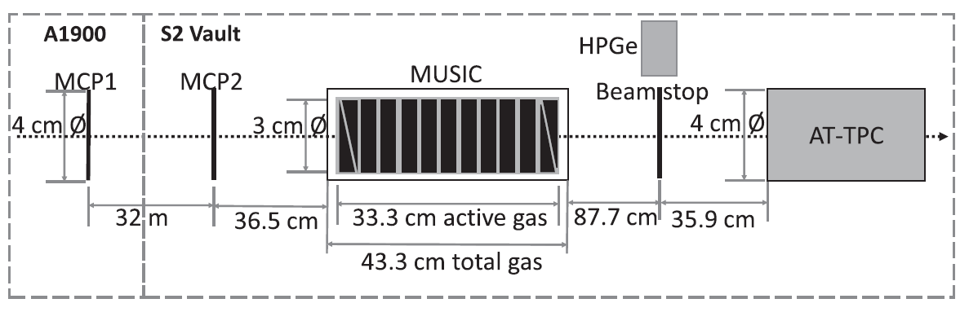
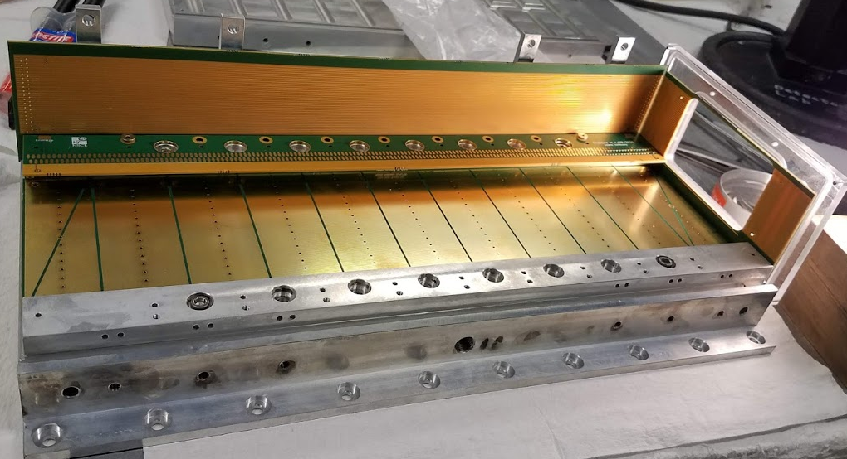
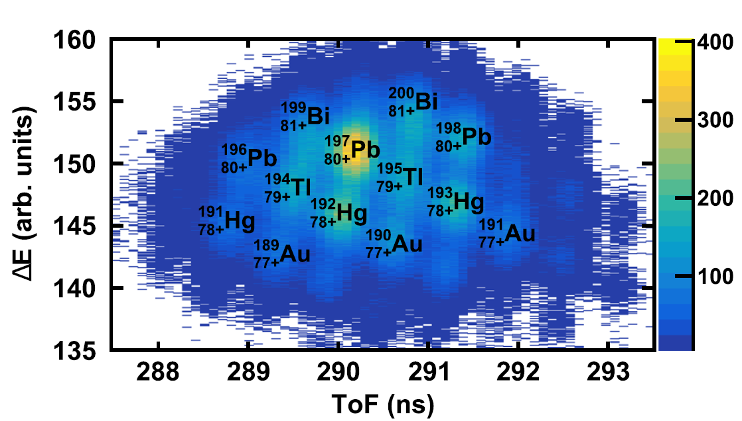


HEavy ISotope Tagger (HEIST)
ToF
$$ΔE$$
Adam Anthony
MSU Grad Student

Slide 10
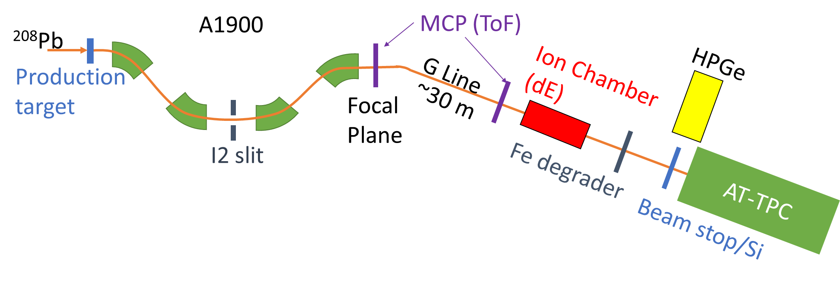
Experimental Setup
PID system (HEIST)
MCP and ion chamber
Si and HPGe support system
Degrader system
Fe degrader and ion chamber
Active target (AT-TPC)
⁴He gas target
E* from 65 MeV down to 30 MeV
Trigger on MCP2 and pad plane coincidence
Notes:
5:00 Walk through path of beam, and discuss detectors as you hit them

Slide 11
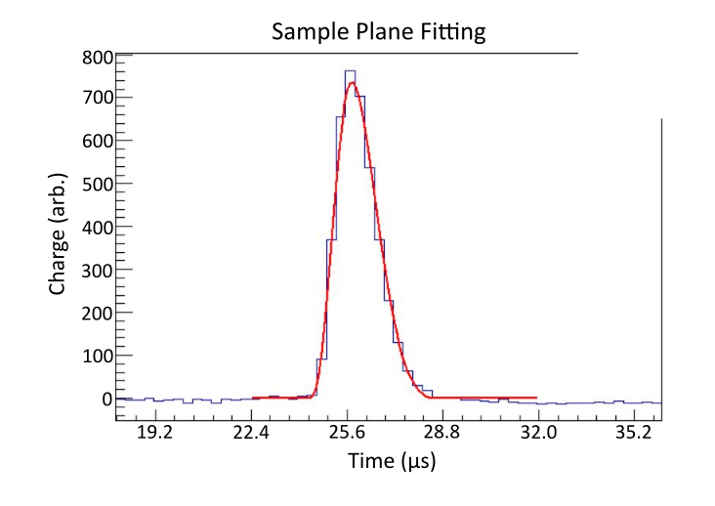
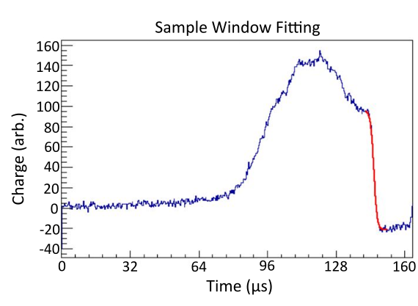


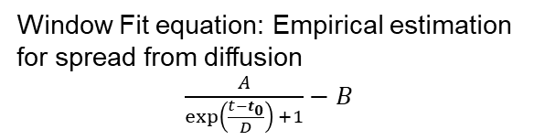
Finding Window/Pad Plane Time
Identify pads showing energy deposition near window and pad plane
Fit leading edge of pad traces
Window: t₀ gives time electrons drifted from window reach pad plane
Plane: t₀ gives time fission fragment hits pad plane
Pad Plane
Window
Pad Plane Fit equation:
Response function from electronics
A$∗\exp\left(−\frac{C\left(t−t_{0}\right)}{τ}\right)∗\sin\left(\frac{t−t_{0}}{τ}\right)∗{\left(\frac{t−t_{0}}{τ}\right)}^{3}$
Window Fit equation: Empirical estimation for spread from diffusion
$\frac{A}{exp\left(\frac{t−t_{0}}{D}\right)⁡+1}−B$
Bergen Kendziorski
MSU Undergraduate

Slide 12
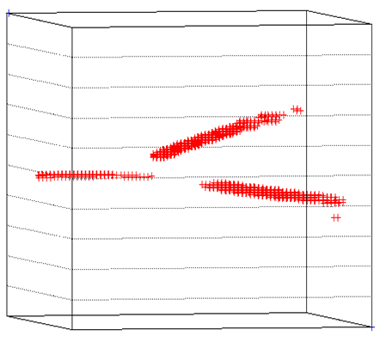
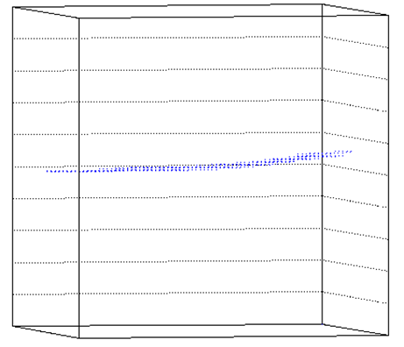
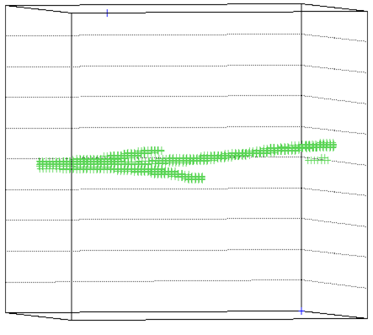
Sorting Fission From Beam
Low gain region in center of TPC should omit beam events
In practice, we still record orders of magnitude more beam than fission
~ 2-3% of events are fission events
Algorithm was developed to tag as many unwanted events as possible
Set of ~2500 hand labeled events was used for development
Parameters that can be quickly & automatically calculated were found
Polar angles of straight-line tracks, spread of e⁻ hits recorded in x-y plane, etc.
Events are either labeled fission, beam, or “other” if parameters are ambiguous
Fission
Beam
Other?
Notes:
Consider animations to introduce set up.

Slide 13



Sorting Fission From Beam: Results
Events are sorted into “beam”, “fission”, and “other” categories.
~2-3% of all events are sorted into the “other” category
~15-30% of fission events are sorted into “other”
Combining “fission” and “other” categories yield 100% fission event capture with ~30-40% events being beam events
Run: 206
Beam Rate: 3809
Gas: CF4 @ 150 Torr
“Other”:
27 Fissions
111 Beams
Run: 261
Beam Rate: 2136
Gas: CF4 @ 200 Torr
“Other”:
25 Fissions 44 Beams
Joe Wieske
MSU Grad Student
Notes:
Consider animations to introduce set up.

Slide 14
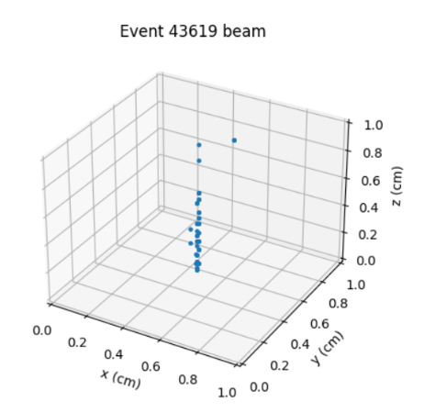
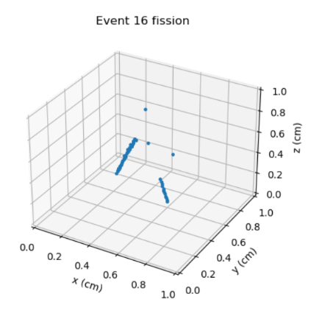



Machine Learning Approach To Classifying Fission and Beam Events
Use a machine learning model to classify these “Other” events.
Worked with Michelle Kuchera and Raghu Ramanujan (Davidson College)
Train the model on labeled Fission and Beam events from the algorithmic approach
Apply the trained model to a small subset of hand labeled “Other” events for testing
81% Fission events in “Other” correctly identified
~94-97% Fission events captured with algorithmic + ML methods combined
Beam
Fission
 | Guess Beam | Guess Fission
True Beam | 902 | 0
True Fission | 6 | 25
Confusion matrix from testing on hand-labeled data from the other category
Poulomi Dey
MSU Undergraduate

Slide 15
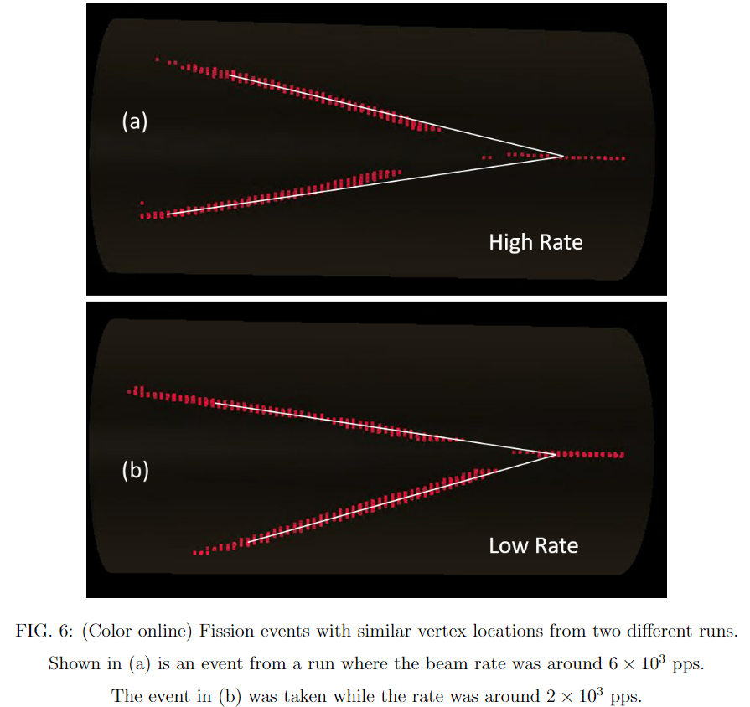
Space Charge: The Problem
Accumulated positive ions (He⁺) drift much slower than e⁻ because of their significantly lower mobility
Creates a line of positive charge along the beam path
Some fission fragment tracks curve inward
Drifting e⁻ are pulled inwards by the resulting ion transverse E-field
Effect is rate dependent
Results in wider folding angles and reaction vertices offset downstream
Vertex location gives the excitation energy
Fragment directions give mass split
Notes:
Consider animations to introduce set up.

Slide 16
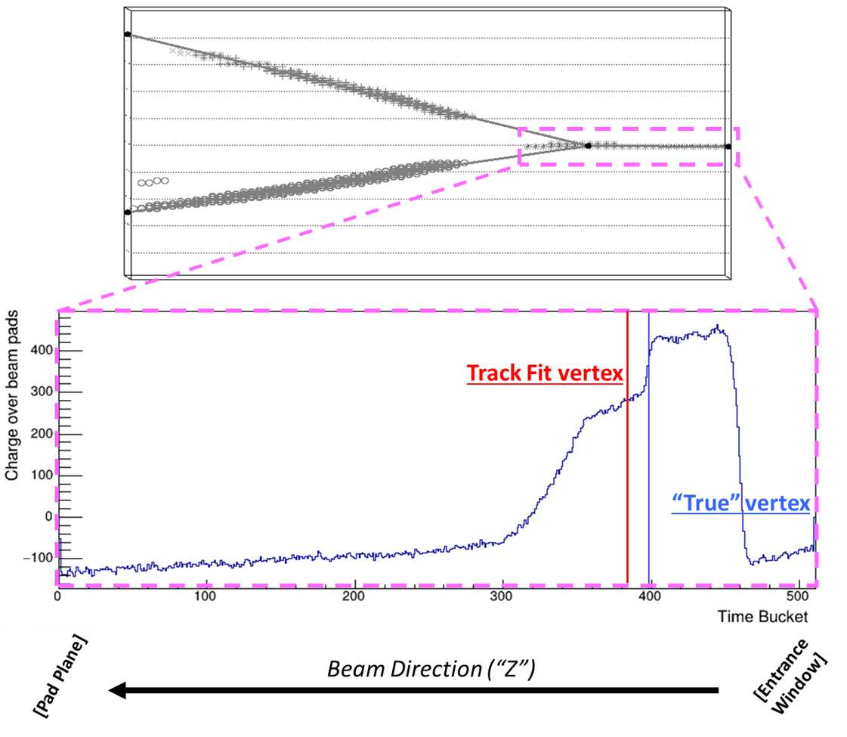
Space Charge: How To Correct Distortions
Fission events are fit with “Y-track” to extract observables (vertex, angles)
For certain events we can determine the vertex separately from Y-track
The lighter fission fragments loose much less energy over distance than the heavier beam, creating a discontinuity in dE/dx
These provide a metric to quantify how well corrections are tuned
Proper correction will result in vertex agreement between the two methods
***Before correction***
Beam region dE/dx
Notes:
Consider animations to introduce set up.

Slide 17
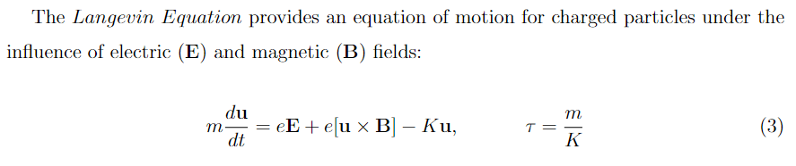
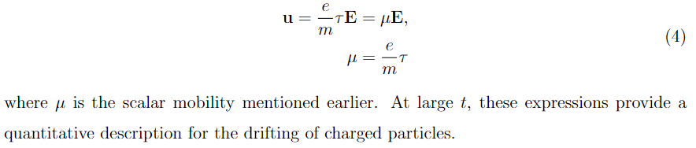
Space Charge: How To Correct Distortions
Distortions to e⁻ drift path can be modeled by solving Langevin Equation
Electric field is a combination of the known TPC drift field and the unknown space charge distribution
Space charge should build up more strongly towards entrance window
Input a model for the space charge distribution, then solve for drift corrections
Notes:
Consider animations to introduce set up.

Slide 18
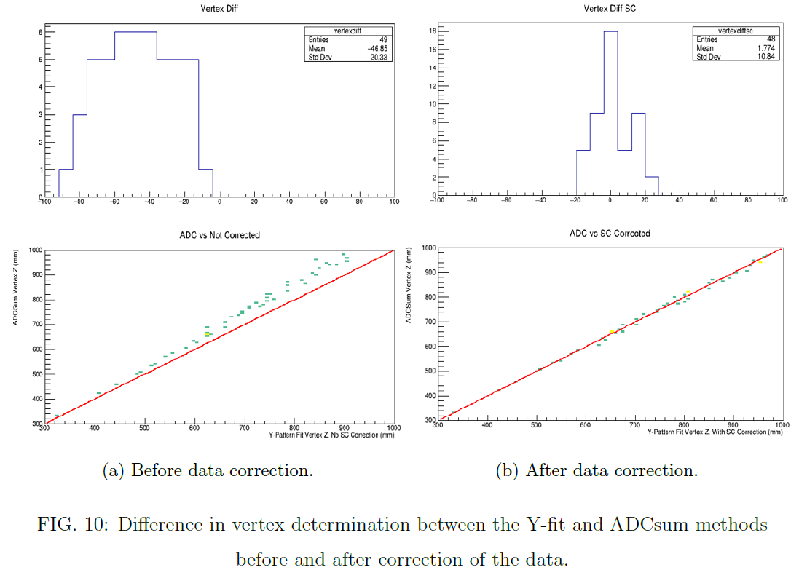
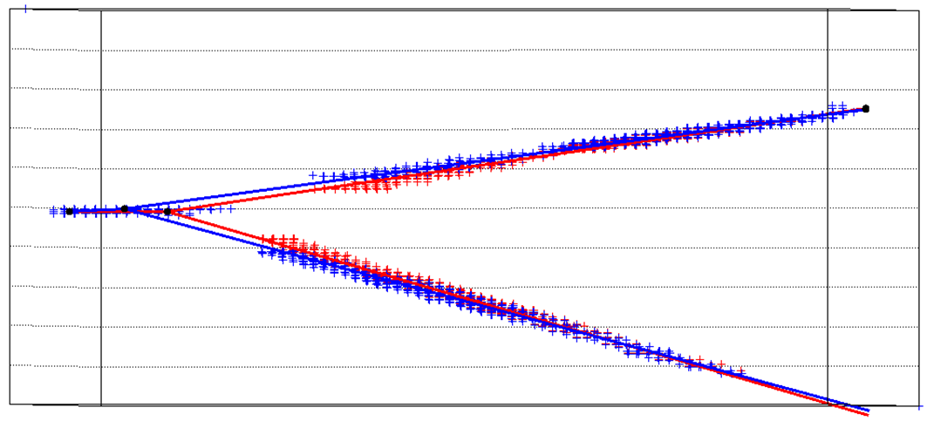
Space Charge: Correction Results
Vertex Difference
- Before -
Vertex Difference
- After -
***Example Corrected Event***
ADC Vertex (mm)
RED = Before correction
BLUE = After correction
Y-Fit Vertex (mm)
Y-Fit Vertex (mm)
Joe Wieske
MSU Grad Student
Notes:
Consider animations to introduce set up.

Slide 19
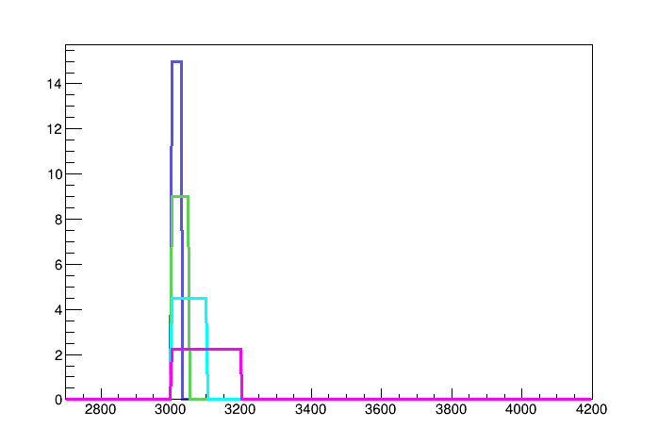
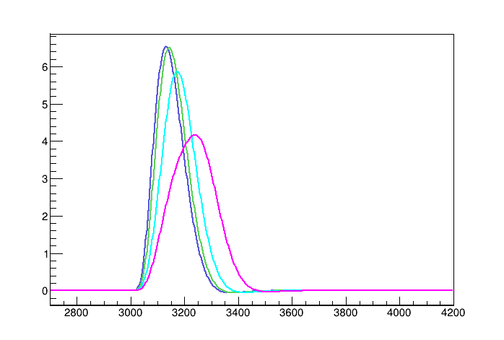
Deconvolution – Shaper Effects
Input Charge
Output Signal
When the charge distribution is short relative to the shaper rise time, the total charge is measured by the shaped pulse height
When the distribution is long the pulse height does not represent the total charge
Fission fragments move toward the pad plane, spending notable distance over a given pad

Slide 20
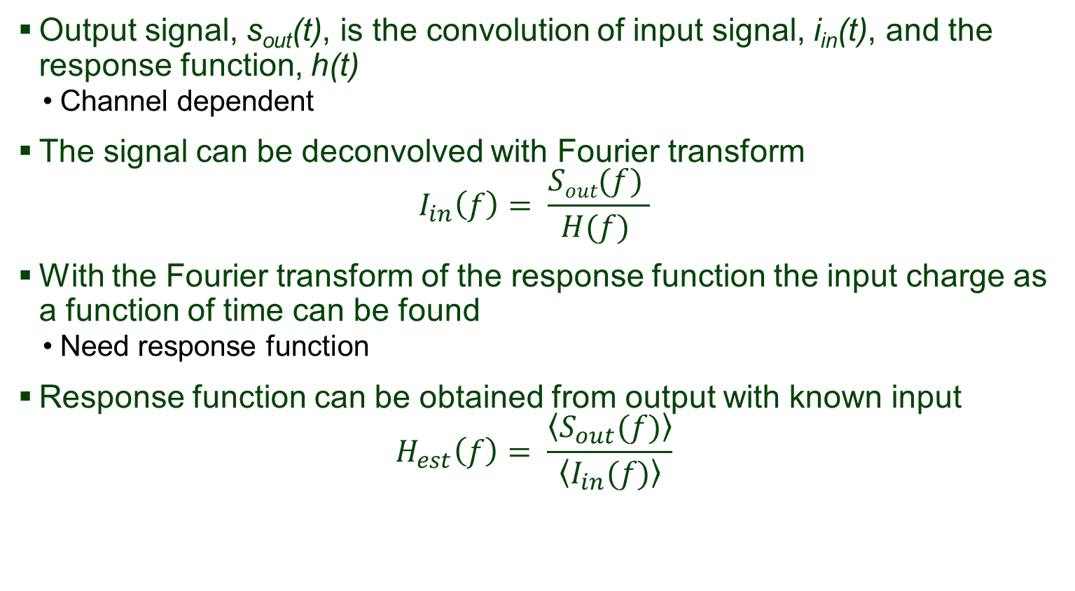
Deconvolution – Reconstruction Principle
Output signal, s_{out}(t), is the convolution of input signal, i_{in}(t), and the response function, h(t)
Channel dependent
The signal can be deconvolved with Fourier transform
$$I_{in}\left(f\right)= \frac{Sout(f) }{H(f) }$$
With the Fourier transform of the response function the input charge as a function of time can be found
Need response function
Response function can be obtained from output with known input
$$H_{est}\left(f\right)= \frac{\left\langle S_{out}(f)\right\rangle }{\left\langle I_{in}(f)\right\rangle }$$
J. Giovinazzo et al. NIMA 840 (2016) 15-27

Slide 21
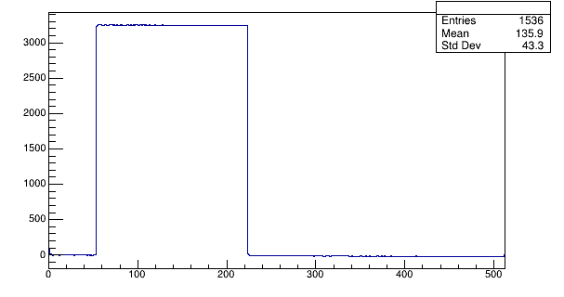
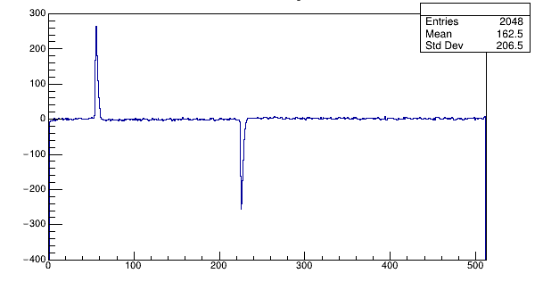
Deconvolution – Response Function
Shaped Pulser Signal
[s_{out}(t)]
Pulser Signal
[i_{in}(t)]
650 mV internal AsAd pulser test used to get response function
Pulser signal is recorded by the FPN channels
Deconvolution of the pulser signal did not work due to very few time buckets involved in the signal
Pulser signal is effectively a delta function
Shaped pulser signal was used as the response function

Slide 22
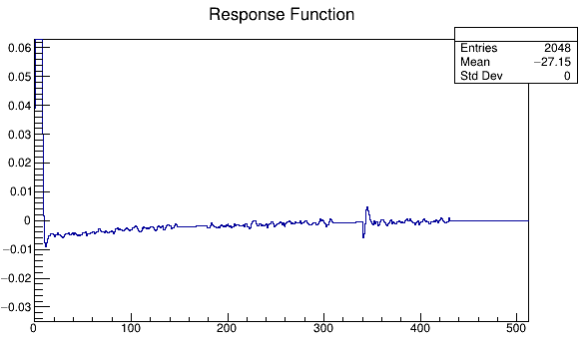
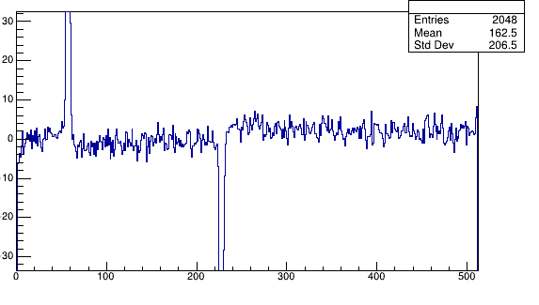
Deconvolution – Response Function
Shaped Pulser Signal
[s_{out}(t)]
Response Function
[h(t)]
The inverted signal messes up the return to zero
Add the positive signal to the negative signal to cancel it out
Some “glitches” needed to be removed and extrapolated
Shifted response function to start at 0 and normalized height to 1

Slide 23
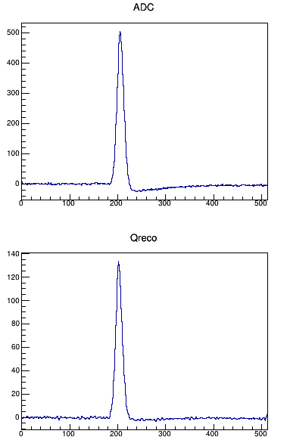
Deconvolution – Results
Shaped Signal [s_{out}(t)]
Reconstructed Charge [i_{in}(t)]
Deconviolution corrects shape for undershoot due to response function
Gives reliable dQ/dt results for fission fragments

Slide 24
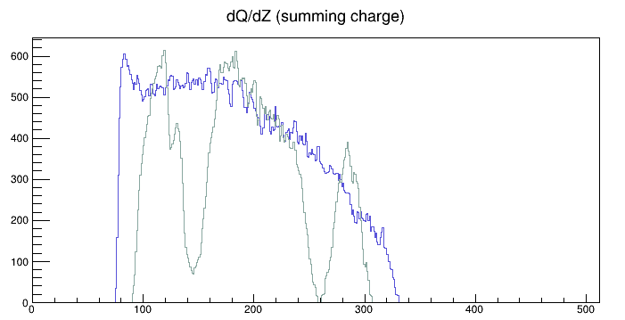
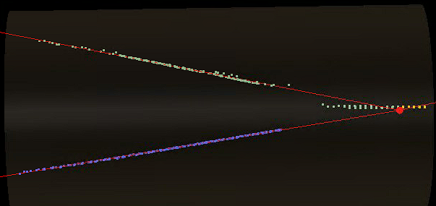

Preliminary Results
Charge asymmetry
Energy loss of products
$\frac{dE}{dx}∝ Q$
$\frac{dE}{dx}≈\frac{Z^{2}}{v^{2}}f(v)$, where $f(v)$ varies slowly
Energy Loss related to mass of particles
Adam Anthony
MSU Grad Student
Charge
- Fragment A
- Fragment B
Missing pads
Time Buckets

Slide 25
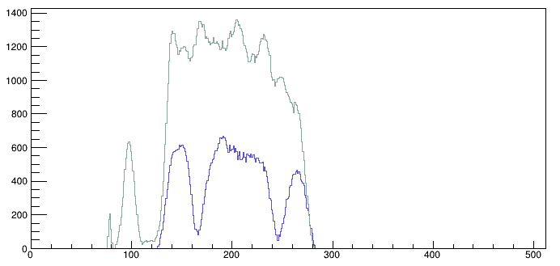
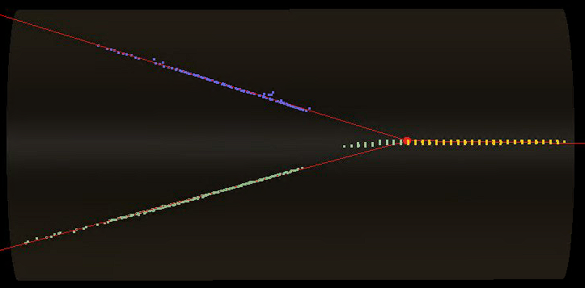
Preliminary Results
Charge asymmetry
Energy loss of products
$\frac{dE}{dx}∝ Q$
$\frac{dE}{dx}≈\frac{Z^{2}}{v^{2}}f(v)$, where $f(v)$ varies slowly
Energy Loss related to mass of particles
Adam Anthony
MSU Grad Student
Charge
- Fragment A
- Fragment B
Missing pads
Time Buckets

Slide 26
Summary
Fission in AT-TPC
Experiment looking at fission near ¹⁹⁸Pb has been performed with AT-TPC
Challenges Solved
Beam particle identification
HEavy ISotope Tagger (HEIST)
Identifying Fission Events
Use a combination of algorithmic and machine learning methods
Space Charge
Solved Longevin equation to correct fission tracks
Signal Processing
Deconvolution for accurate dQ/dt (related to dE/dx)
Preliminary fission fragment asymmetry measurements
More results, including cross sections, to come
Future
Use rare isotope beams from FRIB to look at fission of more exotic isotopes

Slide 27
Questions?
Questions?

Slide 28
Backup Slides

Slide 29
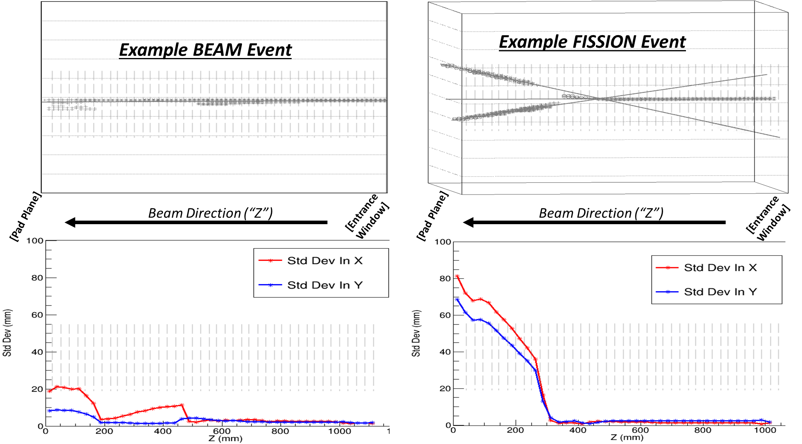
Sorting Fission From Beam: Example Parameter

Slide 30




Sorting Fission from Beam: Results
“Other” = 27 Fissions 111 Beams
Run: 206
Beam Rate: 3809
Gas: CF4 @ 150 Torr
Trigger: DS Singles + coinc
Run: 210
Beam Rate: 3335
Gas: CF4 @ 150 Torr
Trigger: DS Singles + coinc
Run: 211
Beam Rate: 6467
Gas: CF4 @ 150 Torr
Trigger: DS Singles + coinc
“Other” = 25 Fissions 44 Beams
Run: 271
Beam Rate: 7665
Gas: CF4 @ 200 Torr
Trigger: DS Singles (500) + coinc
Run: 260
Beam Rate: 2106
Gas: CF4 @ 200 Torr
Trigger: DS Singles (5000) + coinc
Run: 261
Beam Rate: 2136
Gas: CF4 @ 200 Torr
Trigger: DS Singles (500) + coinc
Notes:
Consider animations to introduce set up.

Slide 31
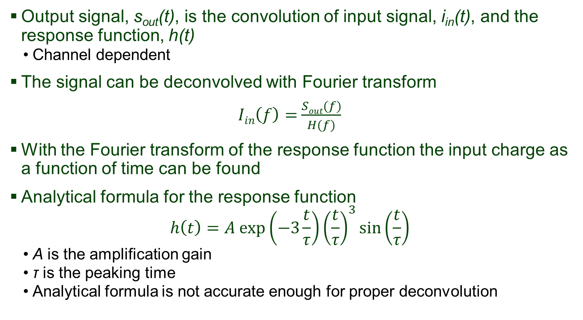
Deconvolution – Reconstruction Principle
Output signal, s_{out}(t), is the convolution of input signal, i_{in}(t), and the response function, h(t)
Channel dependent
The signal can be deconvolved with Fourier transform
$Iin\left(f\right)=$ $\frac{Sout(f)}{H(f)}$
With the Fourier transform of the response function the input charge as a function of time can be found
Analytical formula for the response function
$$h\left(t\right)=A exp\left(−3\frac{t}{τ}\right){\left(\frac{t}{τ}\right)}^{3}\sin\left(\frac{t}{τ}\right)$$
A is the amplification gain
τ is the peaking time
Analytical formula is not accurate enough for proper deconvolution

Slide 32
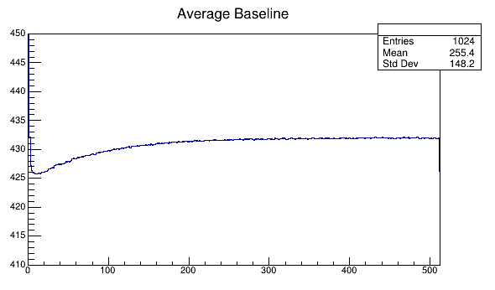
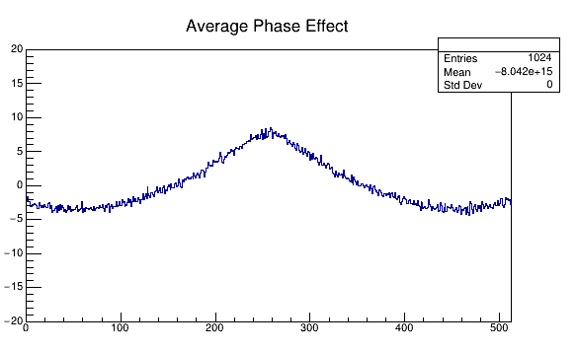
Deconvolution – Baseline Corrections
Pulser tests with internal AsAd pulser were used to obtain response function of the GET preamp and shaper
0 V test to get backgrounds
Channel dependent baseline
Phase effect from circular buffer
Baselines usually corrected by FPN channels, but in pulser test FPN channels have the pulser signal

Slide 33
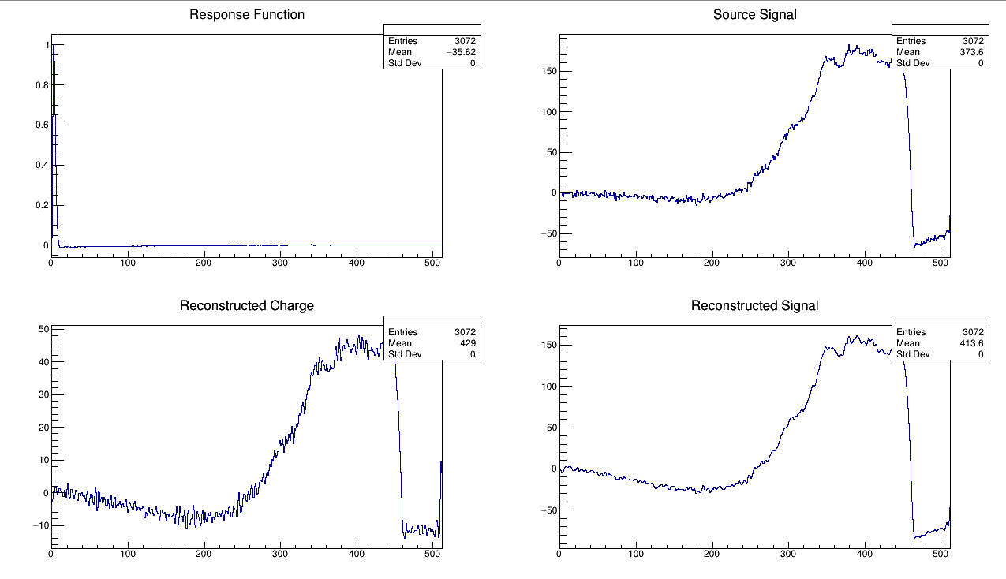
Iterative Deconvolution
For long signals (such as for the beam) the deconvolution does not reconstruct charge perfectly

Slide 34
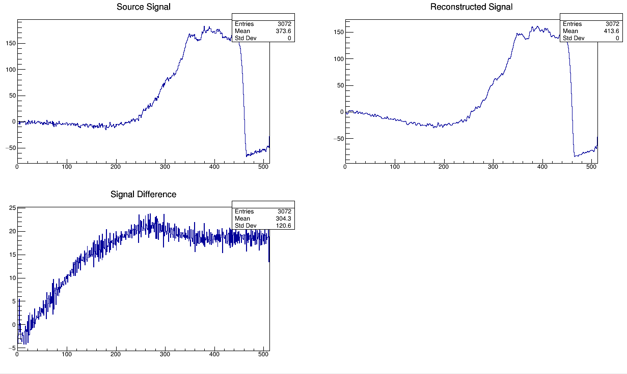
Iterative Deconvolution
Signal can be reconstructed by convoluting the charge with the response function using the summation method
The difference between the source signal and the reconstructed signal is not 0

Slide 35
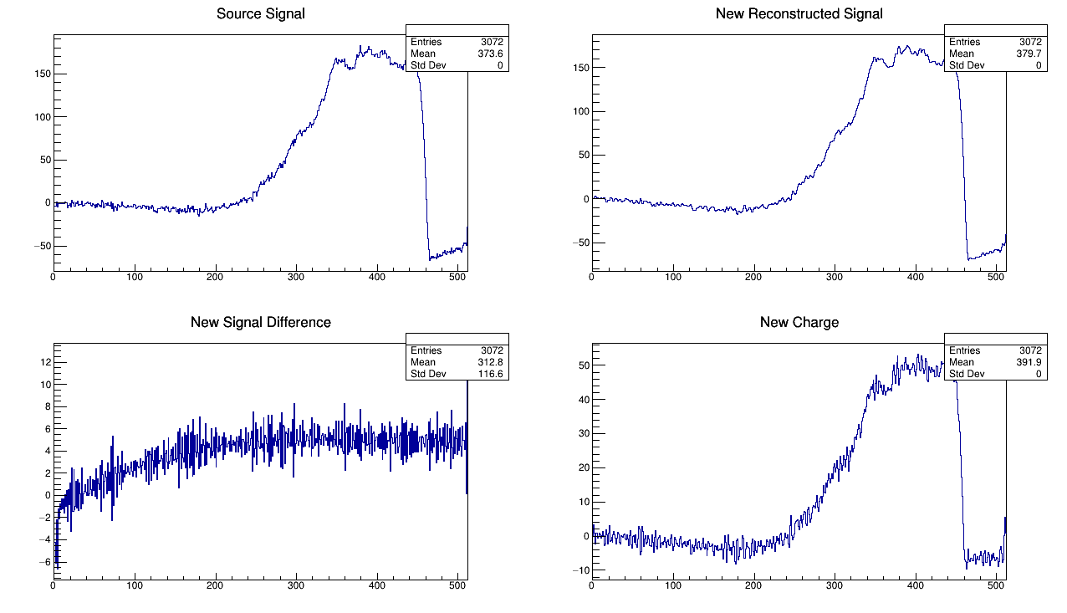
Iterative Deconvolution
The difference between the actual signal and the signal from the reconstructed charge can be iteratively used to correct the charge.
1) Use the deconvolution method on the signal difference to obtain the difference in “charge space” (go from “signal space” to “charge space”)
2) Subtract the result from the charge and obtain a new reconstructed signal
3) Calculate the difference between the source signal and new reconstructed signal
4) Repeat

Slide 36
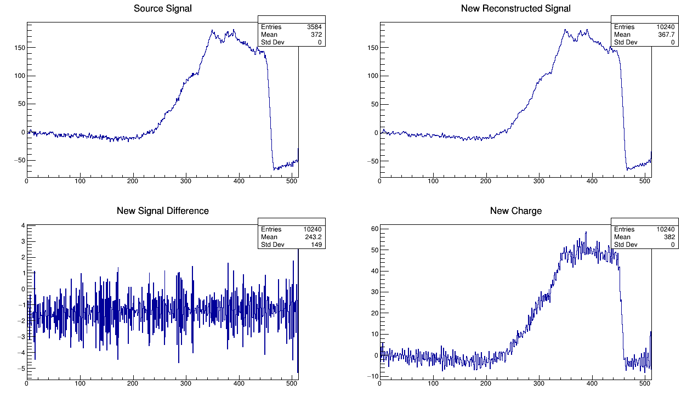
Iterative Deconvolution
4 iterations appears to be sufficient to obtain a relatively flat difference

Slide 37
Observables from AT-TPC
Cross-section
Energy determined from vertex location
Space Charge corrections crucial
Determination of Fission vs Beam
Standard + ML methods

Slide 38
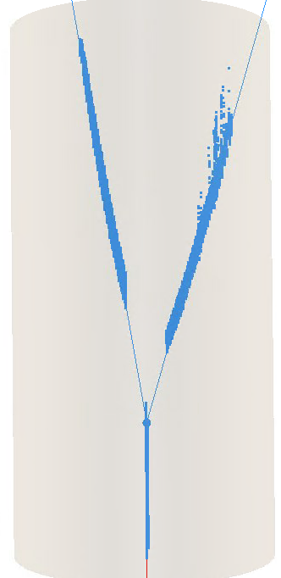
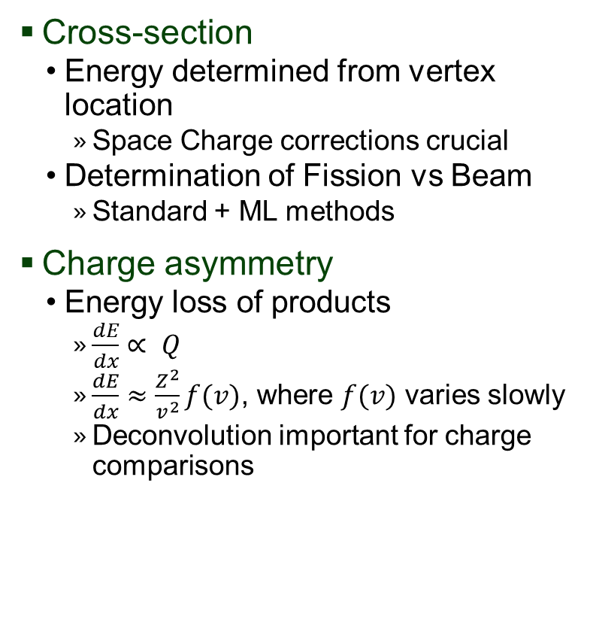
Observables from AT-TPC
Cross-section
Energy determined from vertex location
Space Charge corrections crucial
Determination of Fission vs Beam
Standard + ML methods
Charge asymmetry
Energy loss of products
$\frac{dE}{dx}∝ Q$
$\frac{dE}{dx}≈\frac{Z^{2}}{v^{2}}f(v)$, where $f(v)$ varies slowly
Deconvolution important for charge comparisons

Slide 39




Simulation of fission events
Experimental fission events (all beam species)
Simulated fission events
Z ~ 32
Z ~ 52
$Δ\frac{dE}{dx} \backslash Σ\frac{dE}{dx}$
$Δ\frac{dE}{dx} \backslash Σ\frac{dE}{dx}$
Notes:
26

