Slide 1
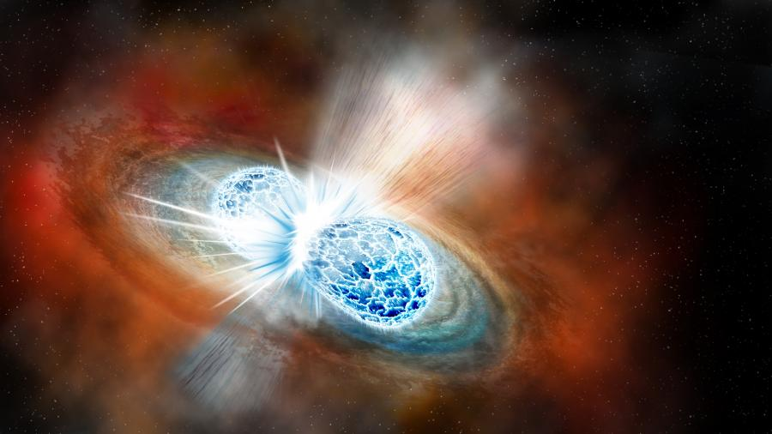



Outlook for an Equation of State TPC with the High Rigidity Spectrometer
Kyle W. Brown
(brownk@frib.msu.edu)
TPC 2023
College Station, TX
Picture Credit: Robin Dienel

Slide 2
Outline
Current state of the nuclear EoS
Physics observables HRS and FRIB 400
Possibility for modifying SπRIT TPC

Slide 3
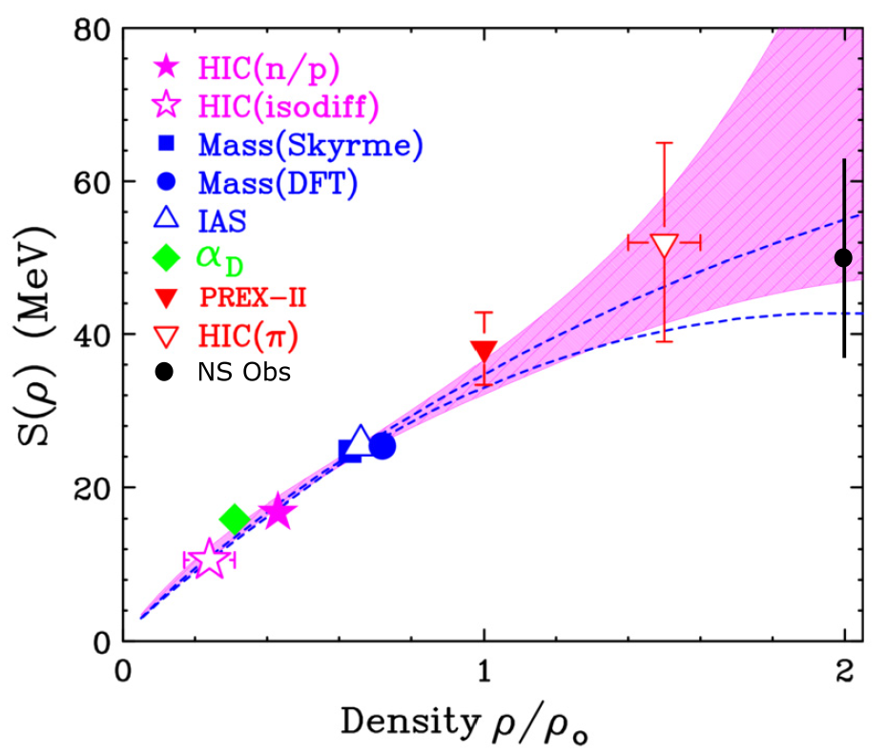
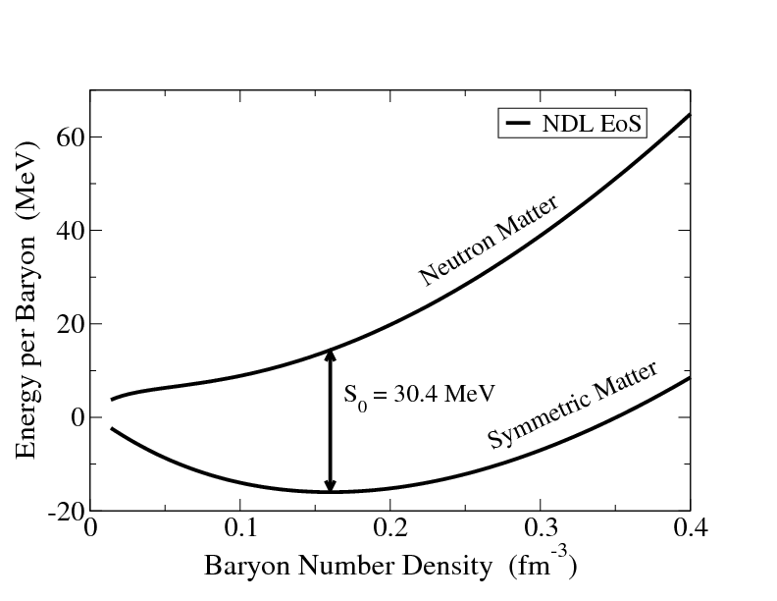
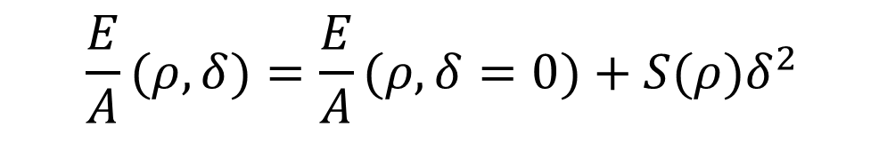


Nuclear Equation of State
Symmetric Matter
$$\frac{E}{A}(ρ,δ)=\frac{E}{A}(ρ,δ=0)+S(ρ)δ^{2}$$
Asymmetric Matter
$$δ=1$$
$$δ=0$$
M. Meixner arXiv:1303.0064 [astro-ph.HE]
Lynch and Tsang PLB 830, 137098 (2022)

Slide 4
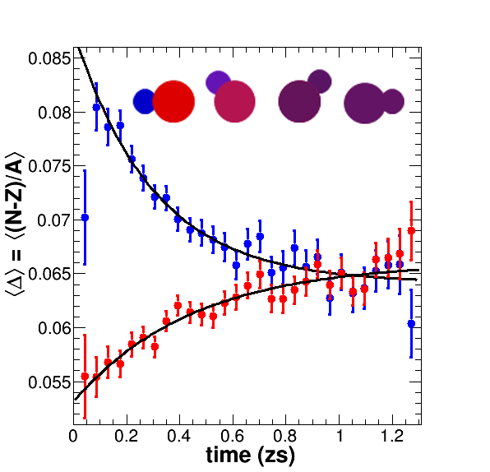
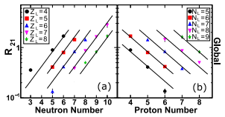
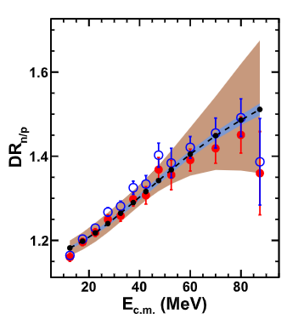
Symmetry Energy @ ρ < ρ₀
Prc 101 (2020) 034605
PLB 799 (2019) 135045
PRL 118 (2017) 062501
PRC 95 (2017) 044604
PRC 101 (2020) 034605

Slide 5
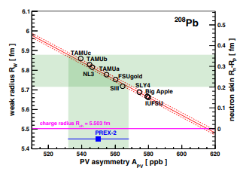
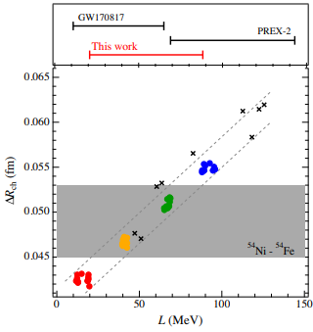
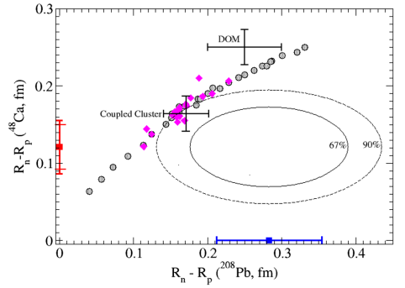
Symmetry Energy @ ρ ≈ ρ₀
PRL 126 (2021) 172502
PRL 129 (2022) 042501
PRL 127 (2021) 182503

Slide 6
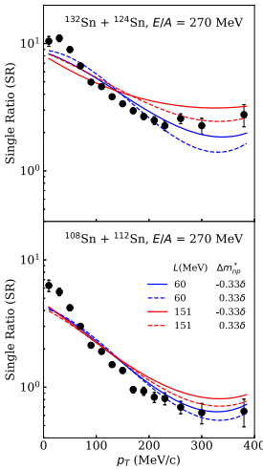
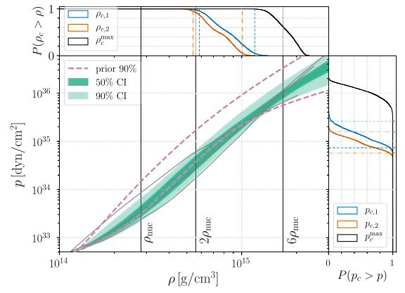
Symmetry Energy @ ρ > ρ₀
PRL 126 (2021) 162701
PRL 121 (2018) 161101

Slide 7
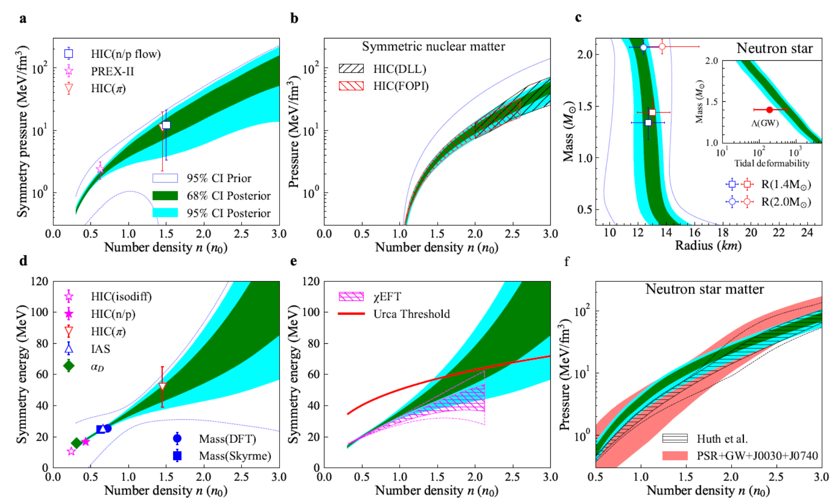
Nuclear EoS near and above ρ₀

Slide 8
Future Perspectives and Experimental Needs

Slide 9
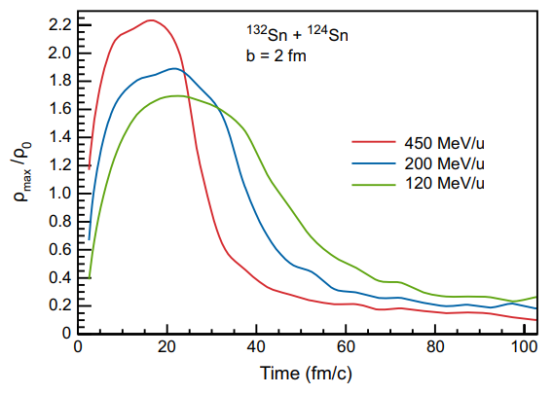
EoS Studies at FRIB
FRIB Upgrade Whitepaper

Slide 10
EoS observables to measure with HRS and HRS/TPC
Neutron to proton yield ratio
Momentum dependence of the symmetry energy (effective masses)
TPC and LANA
Neutron/Proton Elliptical flow
Density and Momentum dependence
TPC and LANA
Pion yield ratios
Density dependence
TPC
Fission
Surface symmetry energy
Full HRS

Slide 11
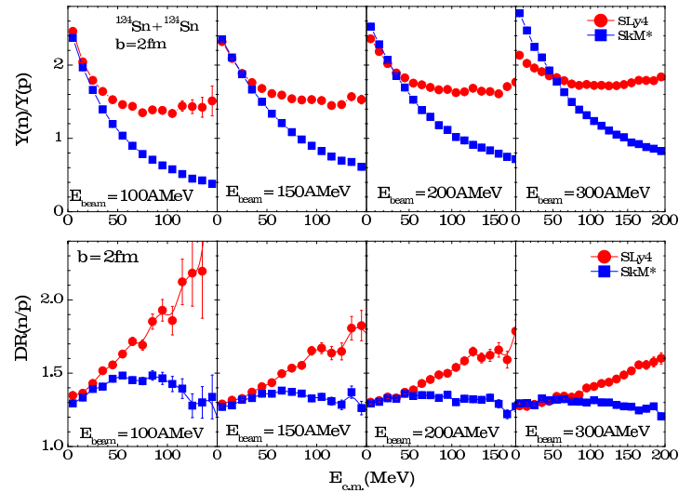
Momentum dependence
The sensitivity of the n/p ratio on the effective mass (momentum dependence) drops off with beam energy
If we want to measure this for higher density, we need another observable
Zhang et al. PLB 2014

Slide 12
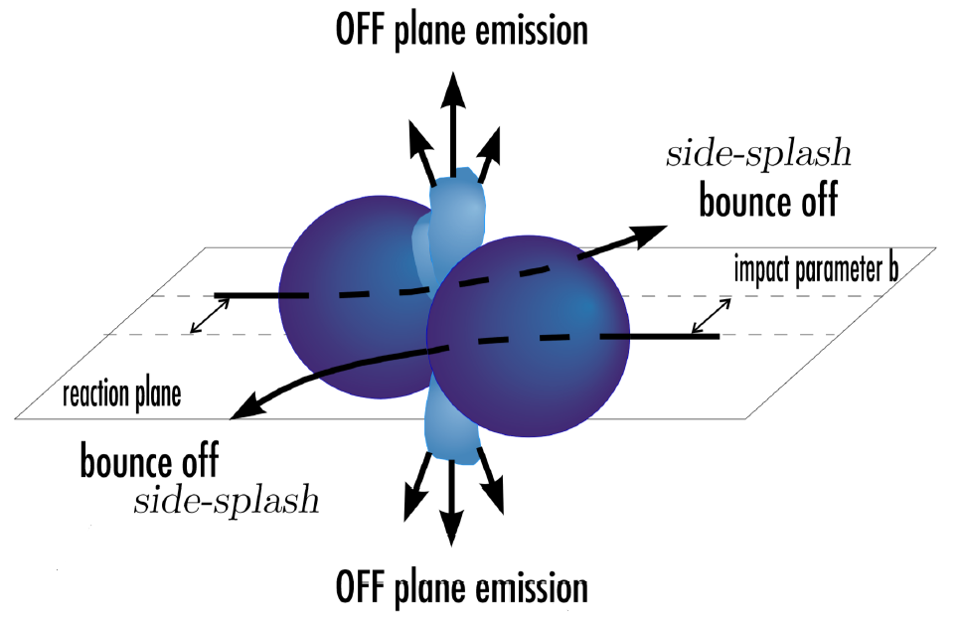
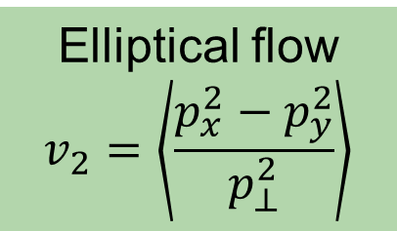
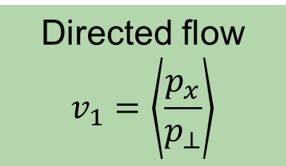
Directed and Elliptical Flow
Directed flow
$$v_{1}=\left\langle \frac{p_{x}}{p_{⊥}}\right\rangle$$
Elliptical flow
$$v_{2}=\left\langle \frac{p_{x}^{2}−p_{y}^{2}}{p_{⊥}^{2}}\right\rangle$$
Neutron
Proton
Projectile and target “spectators” block the escape of matter rom the high P region and force it out of plane.
Magnitude of this enhancement reflects the pressure in the central region
v₂ more selective probe than n/p spectral ratio of the symmetry with smaller systematic errors

Slide 13
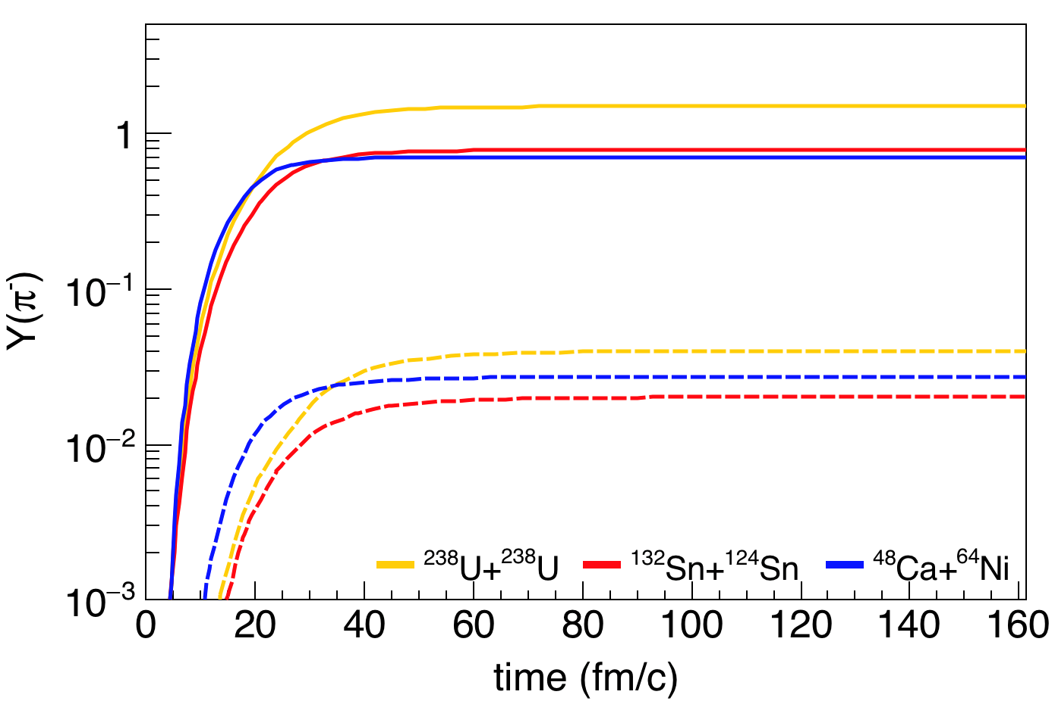
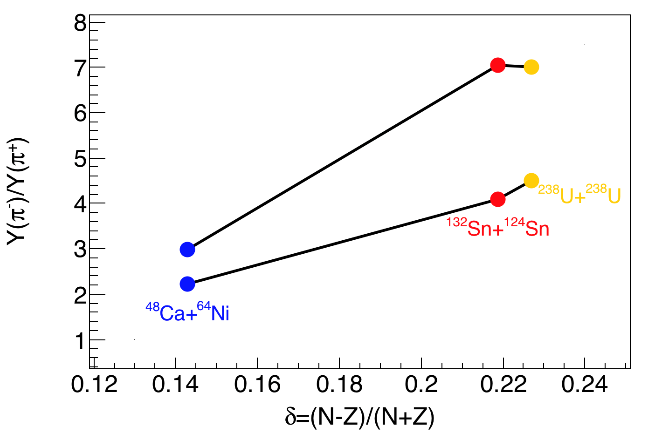
Pions @ FRIB
FRIB-400
FRIB
FRIBU boost intensities, asymmetry and pion cross-sections
Intensity increase: Allow explorations of more asymmetric systems.
Energy increase: yields increase exponentially above pion thresholds
Regions at ρ>1.8ρ₀ become more extensive

Slide 14
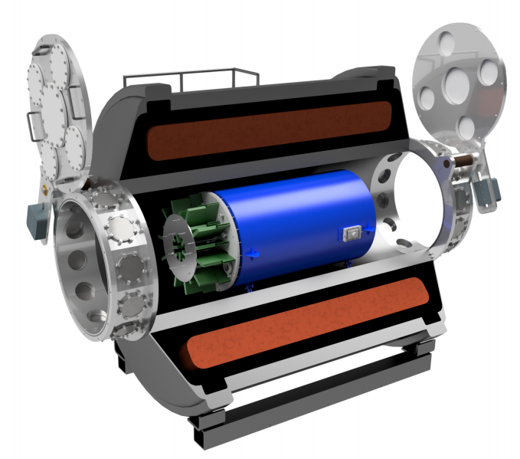
SOLARIS/AT-TPC in Fast Beam Area
4 T solenoidal spectrometer fitted with the Active Target Time Projection Chamber
Could be moved to the fast beam area for measuring Pion production from HIC
Requires the fabrication of a new readout pad plane with a higher density of pads in the central region.
Need to have inner field cage for high ionization in beam region
SOLARIS Whitepaper

Slide 15
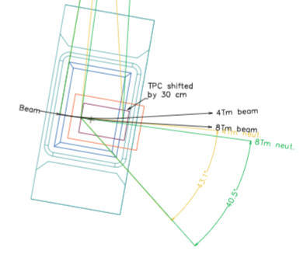
Future with HRS
The SπRIT TPC could be modified to fit into the High Rigidity Spectrometer or a similar detector could be built with modern improvements
Needs to fit in 60 cm gap of D1
This will enable measurements of pion production and elliptical flow
Can be coupled with LANA or upgraded neutron walls

Slide 16
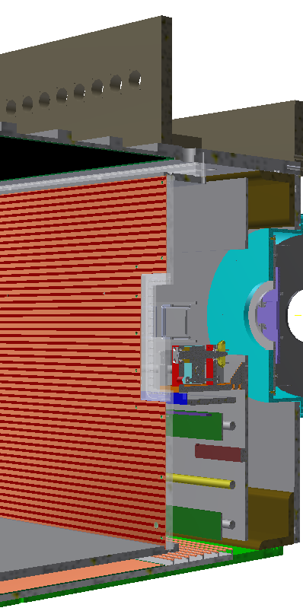
Current Height Budget & Easy Changes
Readout electronics (168.5 mm)
Current TPC is 50.5 x 86.4 x 134.4 cm³ in size and has ~12k anode pads
Designed for use in the SAMURAI magnet
Total height of current TPC – 75 cm – Too large for D1 gap
Fitting the TPC in at HRS:
Moving GET electronics off of the top and reducing support structure (replace GET with something else)
Requires R&D for preamps
Reduction of a bit more than 10 cm
Small reduction of the drift cage
Structure (19.05 mm)
Wire /pad planes (14 mm)
Field cage drift (503 mm)
Cathode(10.54 mm)
Voltage step down (17.7 mm)
Structure (12.7 mm)

Slide 17
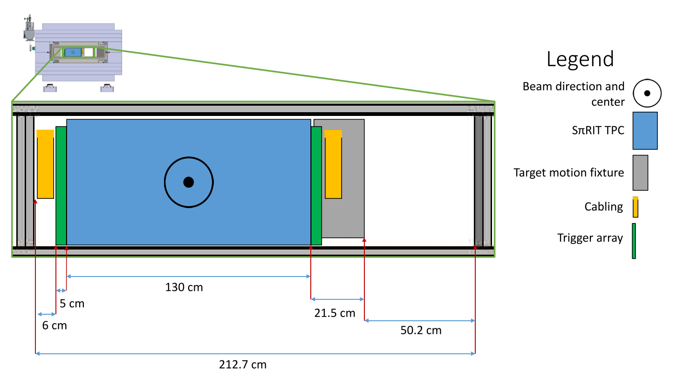
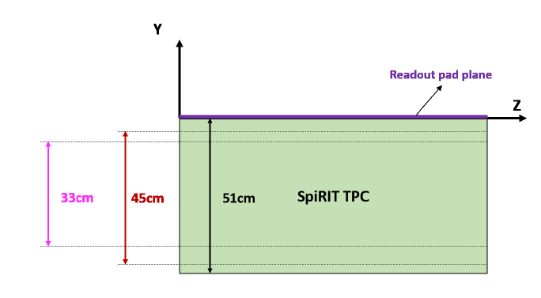
Fitting the TPC into the DS1 gap
Main Constraints to fit TPC:
Need a DS1 vertical gap of 60 cm
Need a DS1 horizontal gap of 212.7 cm
Figure from J. Barney
Notes:
Vertical gap is a balance between

Slide 18
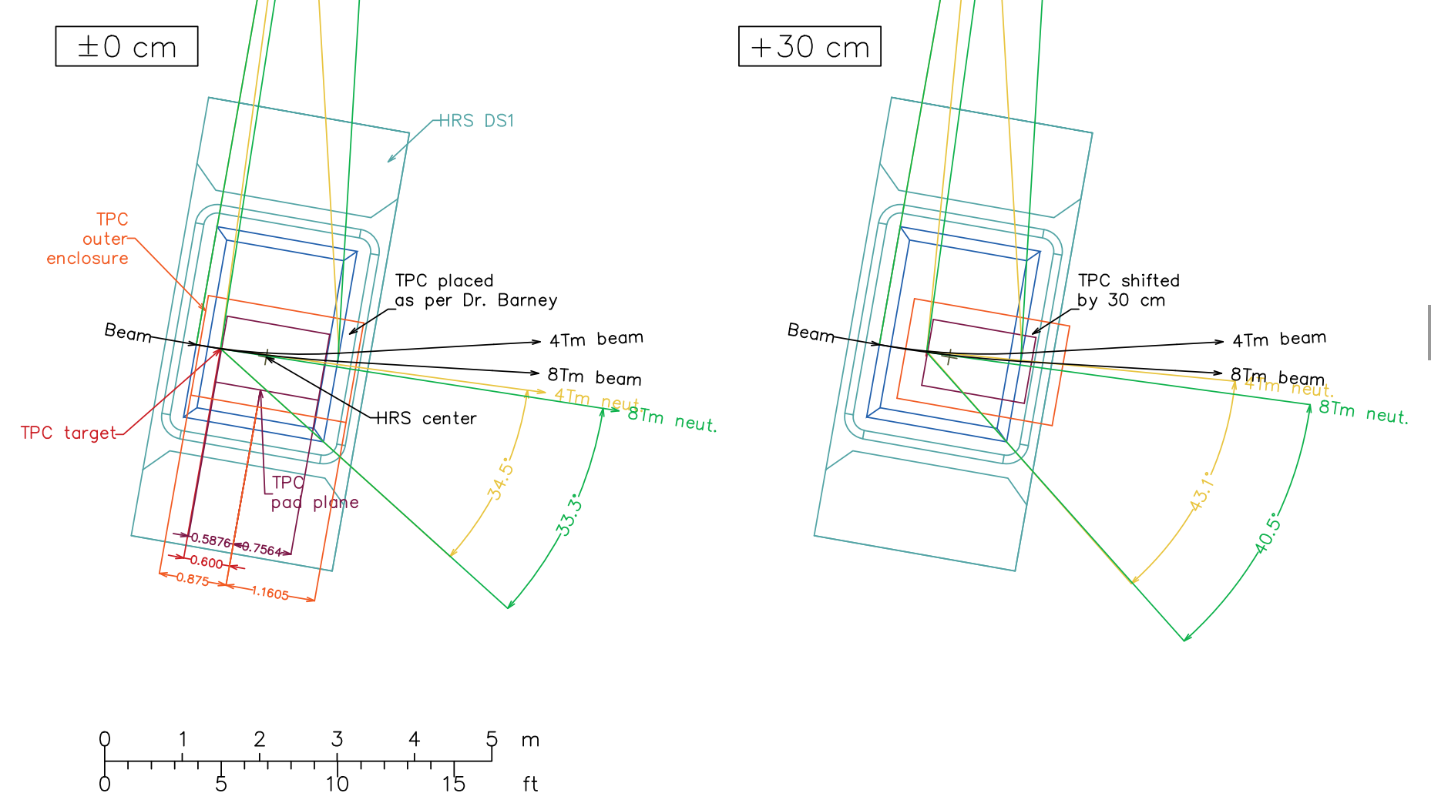
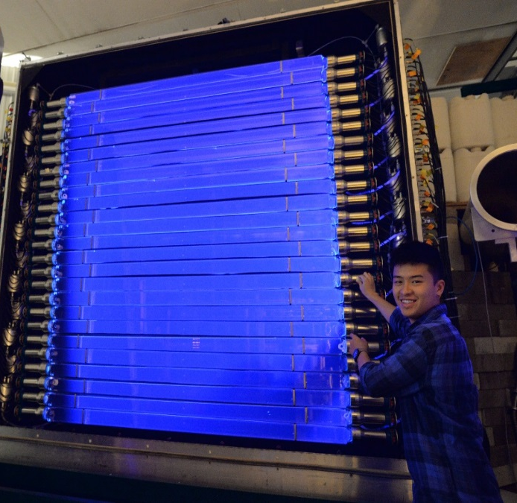
Neutron measurements
Figure from S. Noji
Notes:
Vertical gap is a balance between

Slide 19
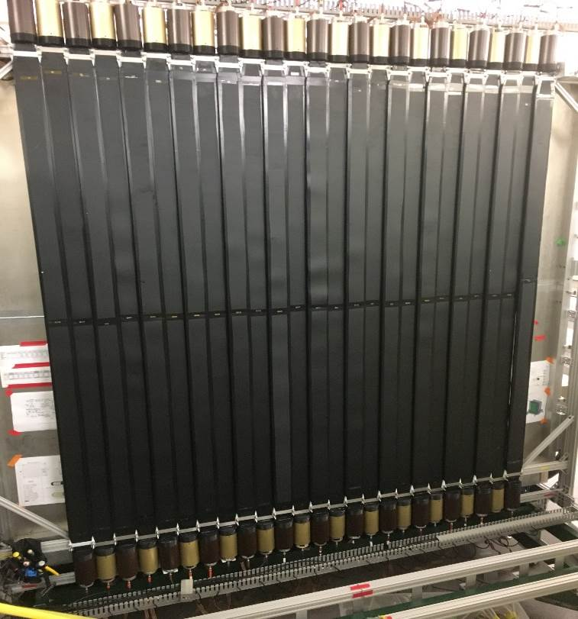
Experiment: Neutron Detection
Made at WMU
25 Plastic Scintillator bars
Used to veto charged particles
50 -- 8 cm x 8 cm x 2 m long bars
Liquid-scintillator filled for PSD

Slide 20
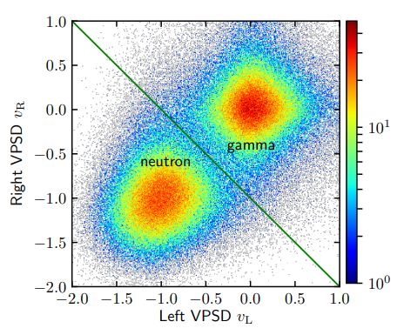
Large Area Neutron Array (LANA)
LANA is comprised of:
Two Walls of 25 scintillator bars
2 meters long, 7.7 cm square cross-section
NE-213 liquid scintillator → Being replaced with EJ-309 (No more xylene!)
~8 cm position resolution
500 ps time resolution
~10% detection efficiency
Excellent Neutron/Gamma discrimination
https://arxiv.org/pdf/2001.07518.pdf

Slide 21
Take away
FRIB and especially FRIB 400 will enable new experimental constraints on the nuclear Eos at high density.
A TPC for the HRS is ideal to take full advantage of these opportunities.
Modifications to the SπRIT TPC are possible, but only the pad plane can be used as-is.
A new TPC, with the HRS in mind from the start, is likely best.

