Slide 1
The SPiRIT TPC for heavy ion collision experiments at RIKEN-RIBF
Tadaaki Isobe (RIKEN Nishina Center)
TPC2023 Workshop at Texas A&M University
May 17th 2023
Notes:
アニョハセヨ
ネイ、イレムン、イソベイブニダ
36min

Slide 2
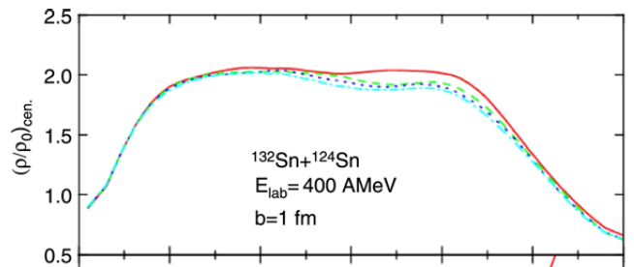
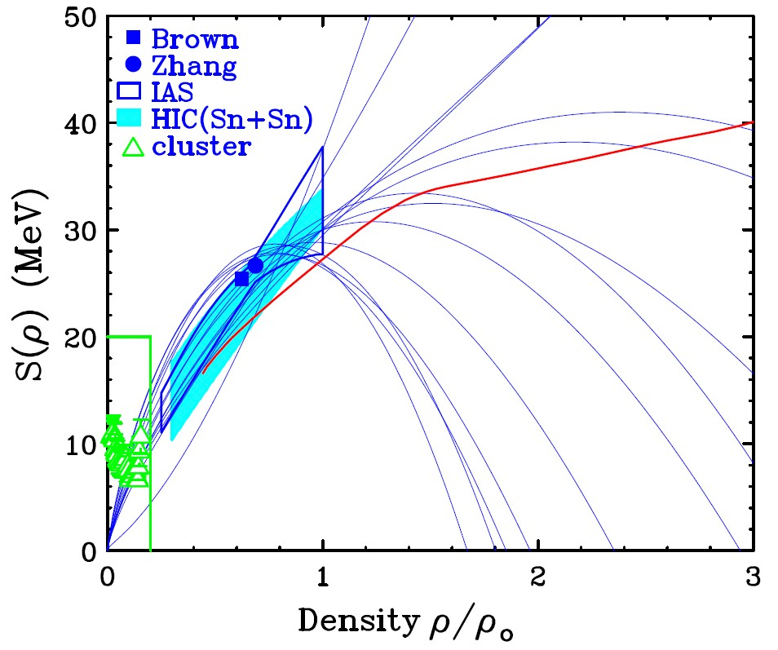

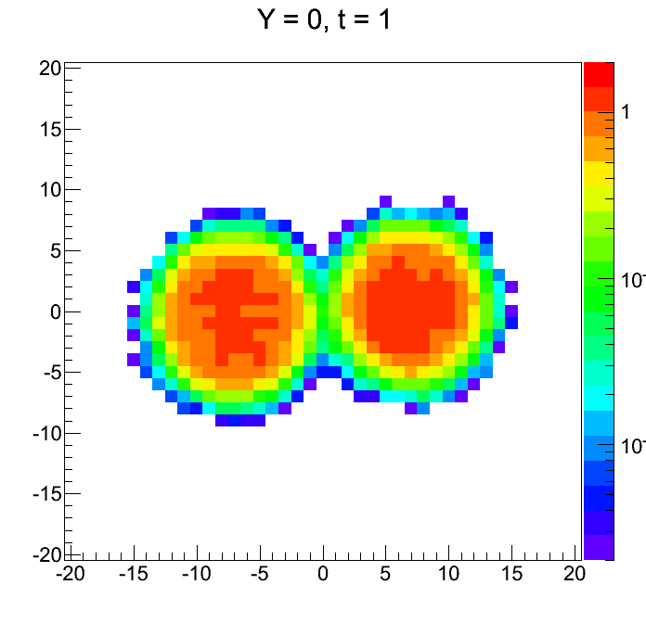
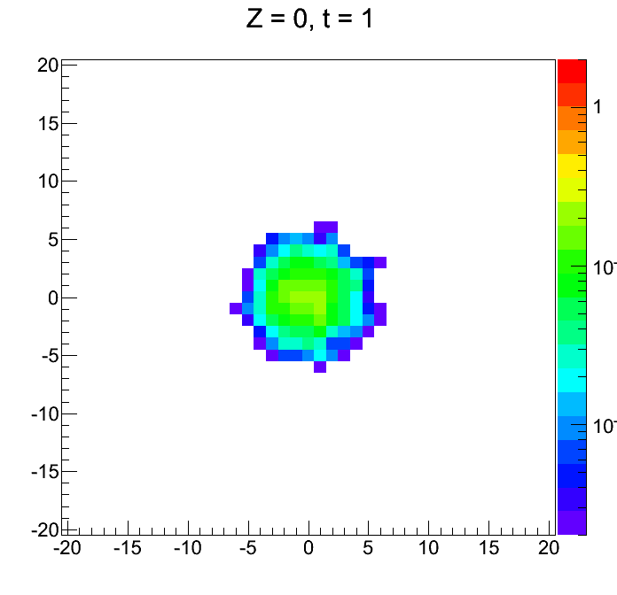
Heavy Ion Collision Exp. w/ TPC to study the density dependent symmetry energy
PRC71 (2005) 0146a08
?
?
?
Sn+Sn IBUU
EOS of pure neutron matter
Large uncertainty on nuclear symmetry energy at ρ≫ρ₀ compared with that for ρ≦ρ₀ region.
Heavy ion collision is currently unique way to produce high dense matter in the laboratory.
New experimental project at RIBF for the study of density dependent symmetry energy. ρ~1.5-2ρ₀ nuclear matter at RIBF energy HIC.

Slide 3
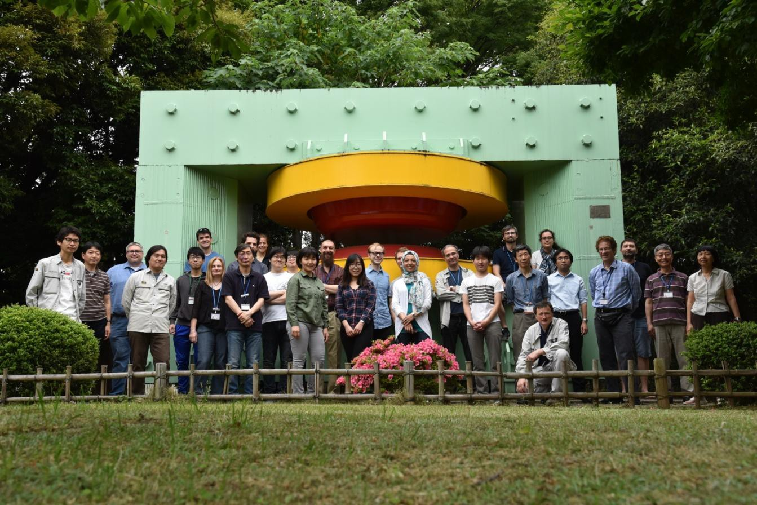













Collaboration for Device at RIKEN-RIBF: SPiRIT SAMURAI Pion Reconstruction and Ion Tracker
Collaboration formed in 2009
First experiment in 2016
First physics paper in 2021

Slide 4
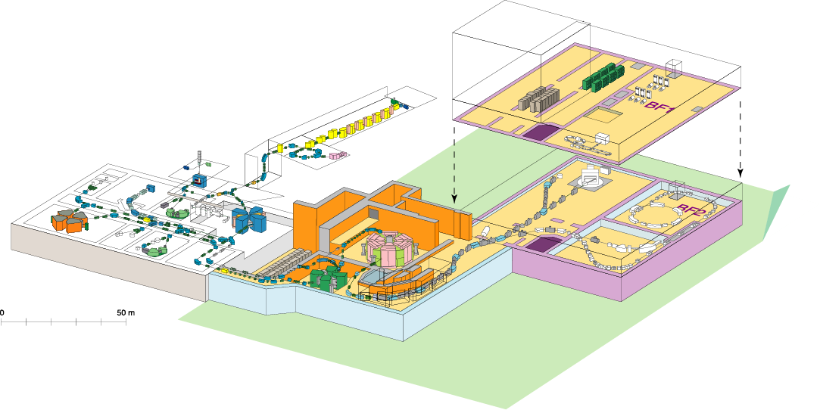
RIKEN RI Beam Factory (RIBF)
Experiment facility
Old facility
SHE
Z=113
Accelerator
RIPS
GARIS
60~100 MeV/nucleon
SCRIT
~5 MeV/nucleon
RILAC
AVF
ZeroDegree
SAMURAI
fRC
RRC
SRC
SLOWRI
IRC
RI-ring
CRIB (CNS)
SHARAQ (CNS)
BigRIPS
<10 MeV/nucleon
350-400 MeV/nucleon
New facility
Intense (80 kW max.) H.I. beams (up to U) of 345AMeV at SRC
Fast RI beams by projectile fragmentation and U-fission at BigRIPS
Operation since 2007

Slide 5
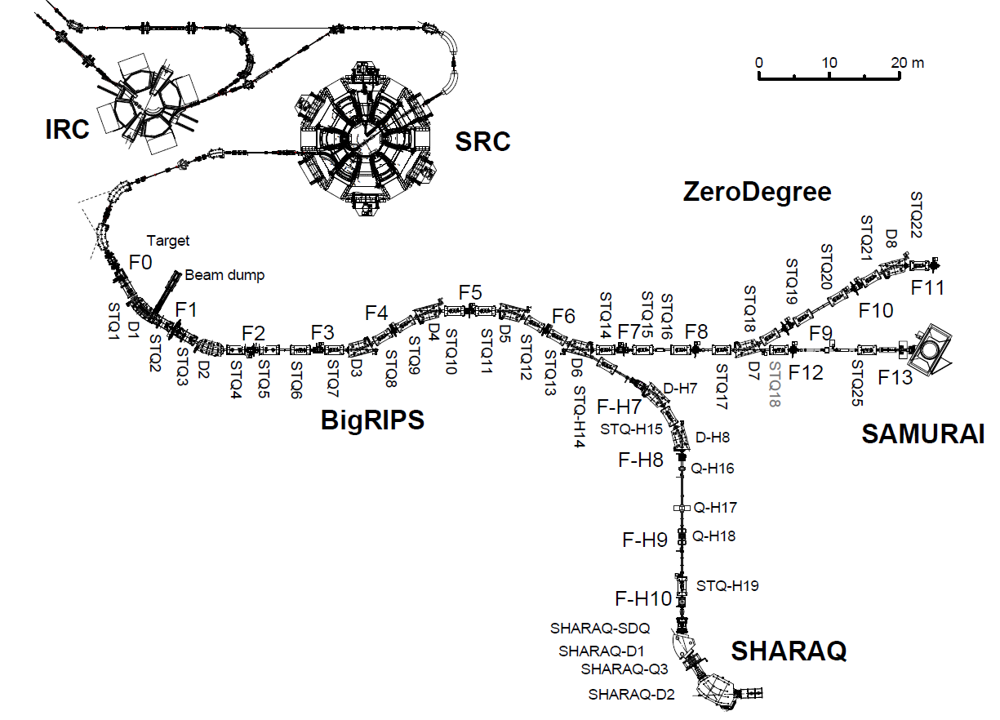
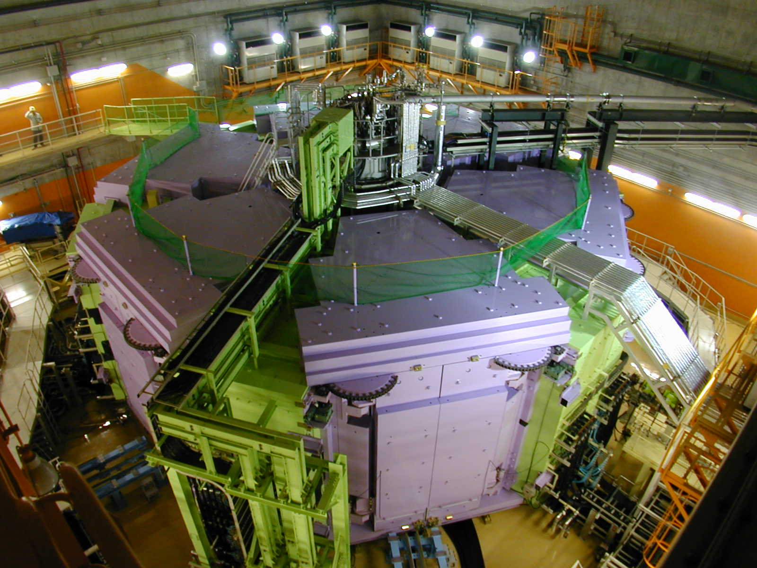
Super Ring Cyclotron
To accelerate Uranium ion to 345 AMeV.

Slide 6
F0-F11: 125.983m
ZeroDegree
BigRIPS
Max. rigidity = 9Tm
SAMURAI
Fragment separation and PID
Field integral =7Tm
High-resolution
beam line
SHARAQ by U. of Tokyo
Max. rigidity
=6.8Tm max.

Slide 7
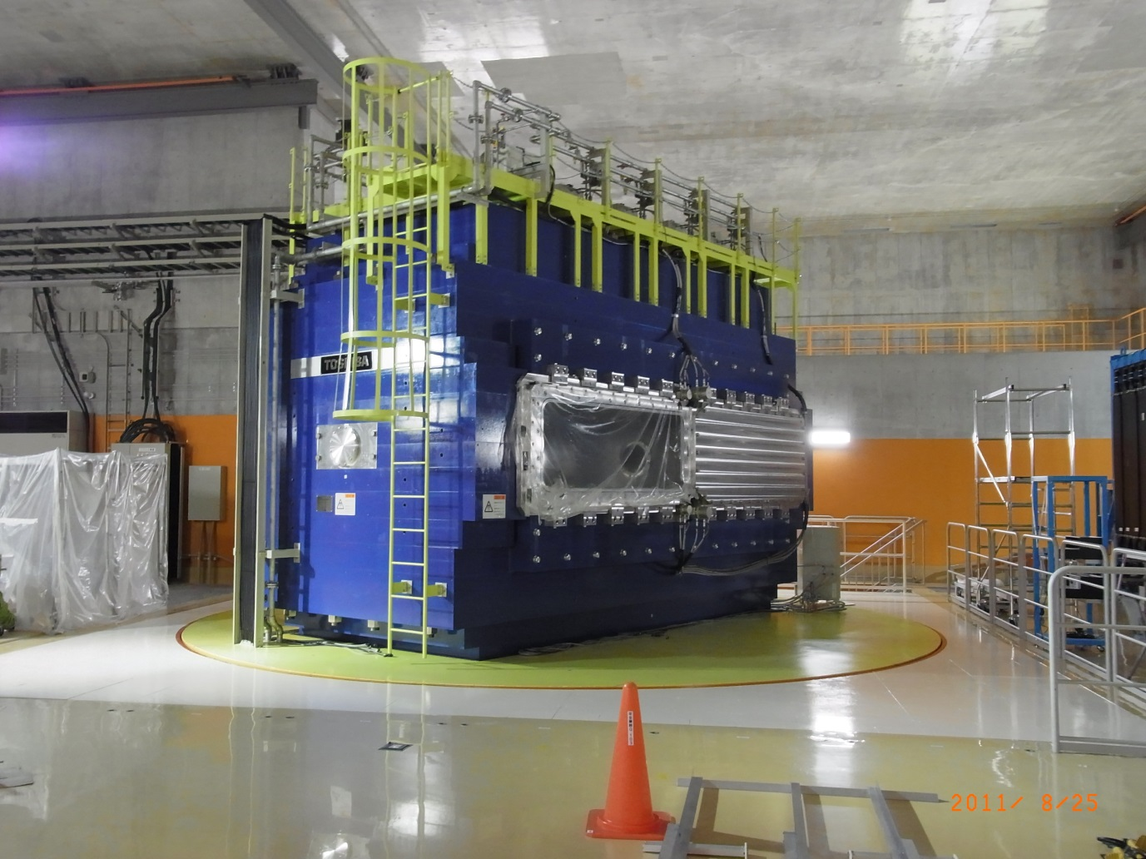
SAMURAI Spectrometer
Superconducting Analyzer for Multi particles from Radio Isotope Beams
F0-F11: 125.983m
ZeroDegree
BigRIPS
Max. rigidity = 9Tm
SAMURAI
Field integral =7Tm
High-resolution
beam line
B<3T
R: 1m
Gap: 80cm
SHARAQ by U. of Tokyo
Max. rigidity
=6.8Tm max.

Slide 8
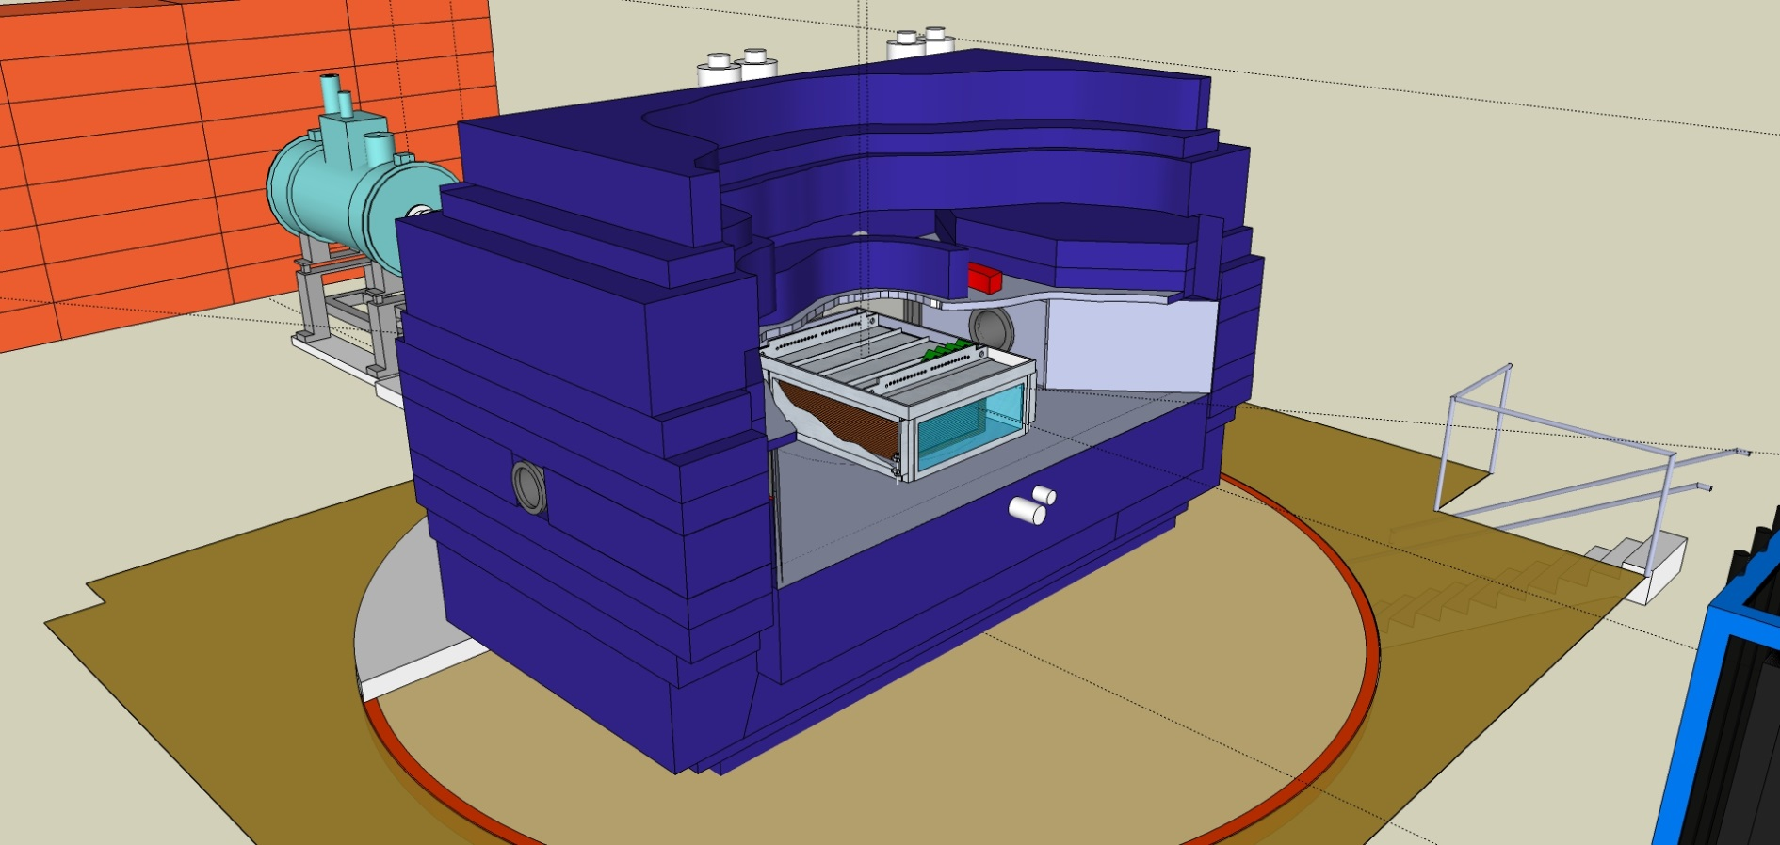
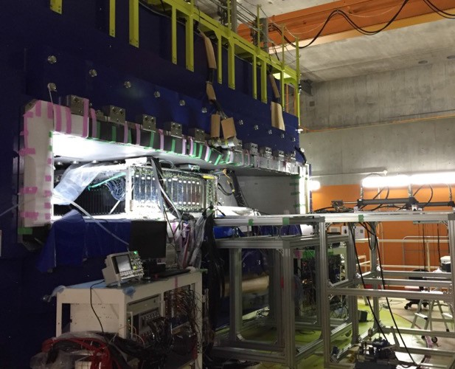

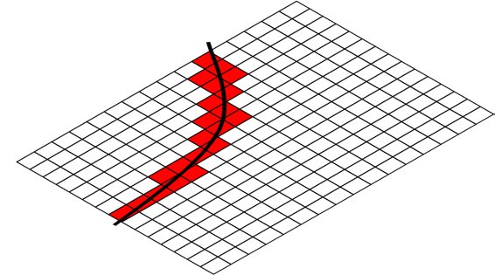
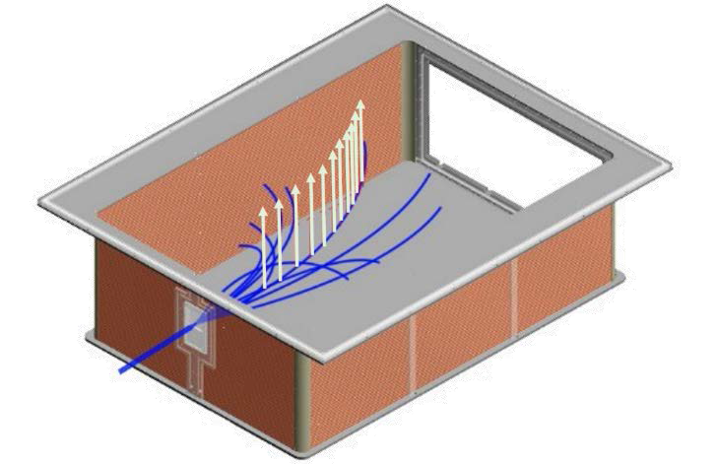
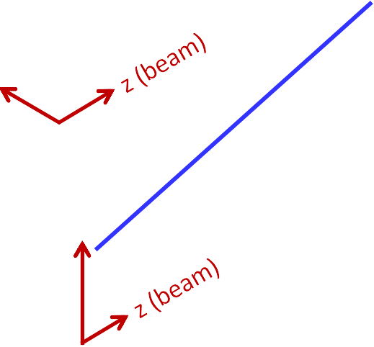

SPiRIT-Time Projection Chamber
for the measurement of charged particles in HIC
NIMA 784 (2015) 513
SAMURAI dipole magnet
80cm
B field
dE/dX – Bρ particle identification.
Readout with ~12000 pads.
Operation under B~0.5T
53cm
E field
x
y

Slide 9
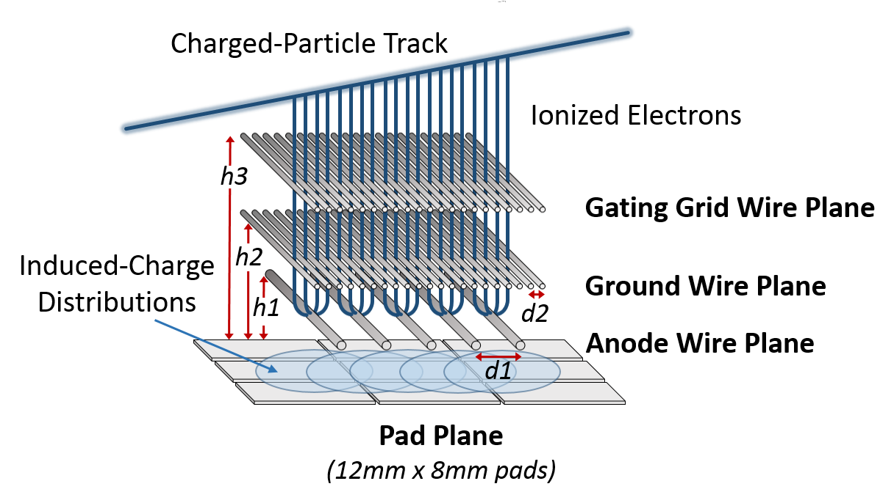
The SPiRIT TPC
Based on Bevalac EOS TPC.
Wire amplification with P10 gas (1atm).
Target at the entrance of chamber.
~12000 readout pads. 12x8 mm²
Multiplicity: 10~100.
Beam passes through chamber as well.
Rev. Sci. Instrum. 92, 063302 (2021)

Slide 10

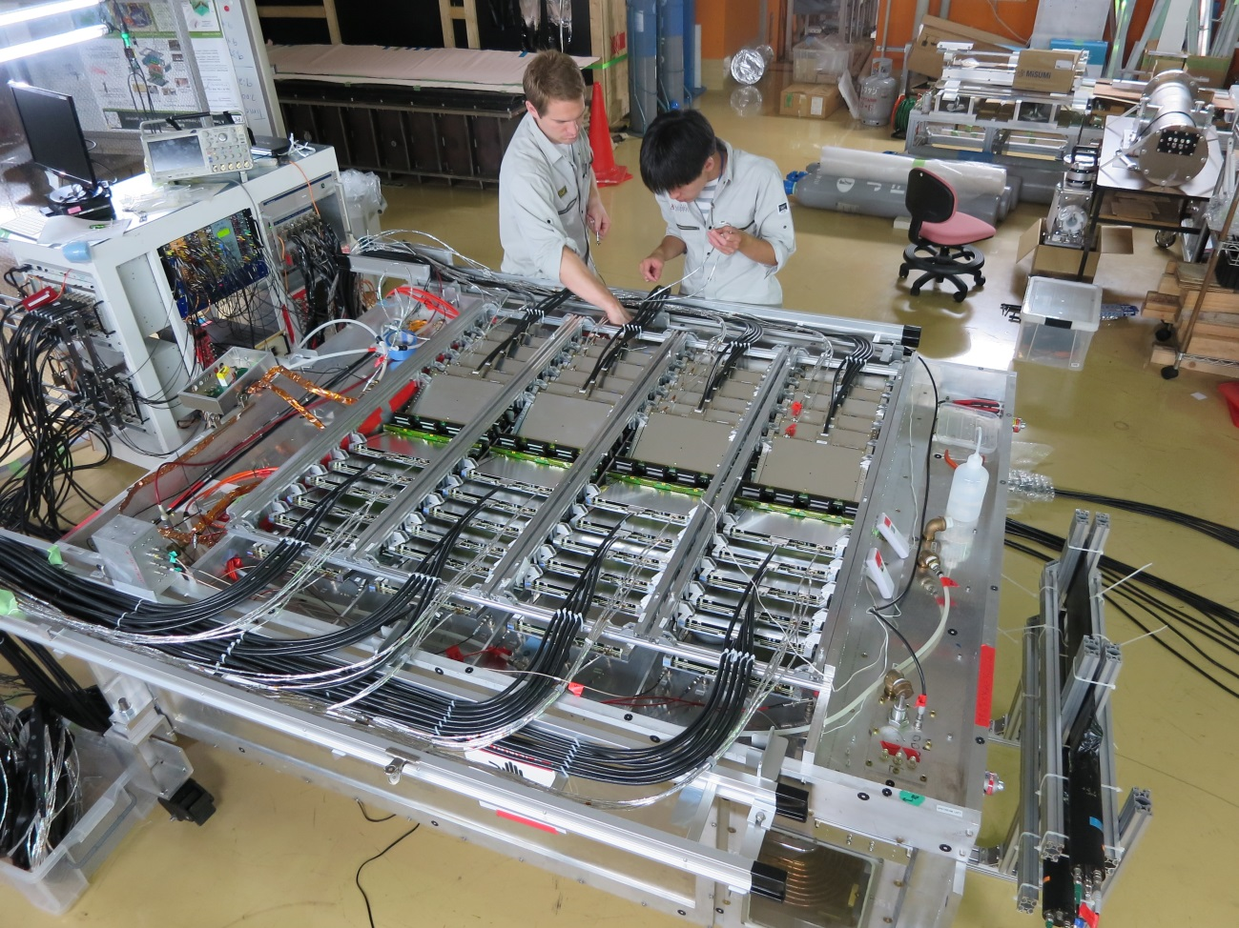
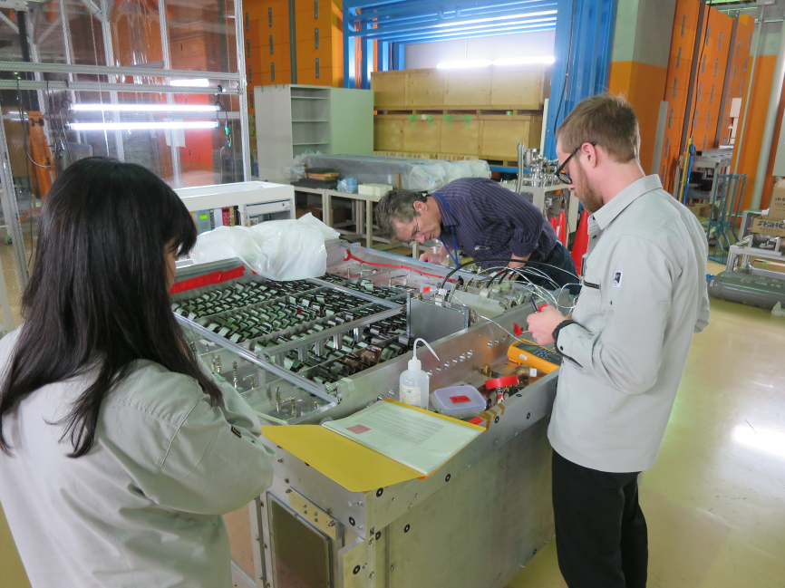
Readout Electronics for TPC: GET
48 AsAds, 12 CoBos, 2 MuTANTs, 2 μTCA shelf
2 DAQ servers with 100 TB RAID array in total.
Used as cache of raw data → HPC in RIKEN
NARVAL(GANIL) as DAQ software.
Soap server to control RIBF DAQ
Checking the connection one board by one board.
NIMA 887 (2018) 81, NIMA 899 (2018) 43

Slide 11
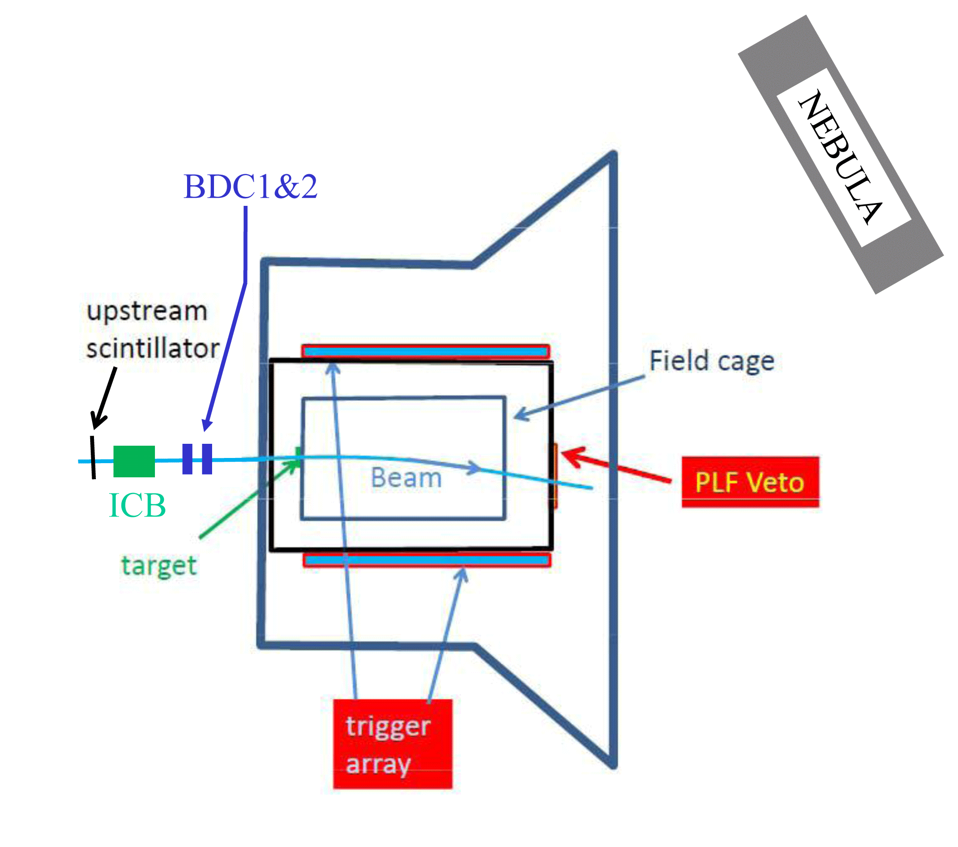


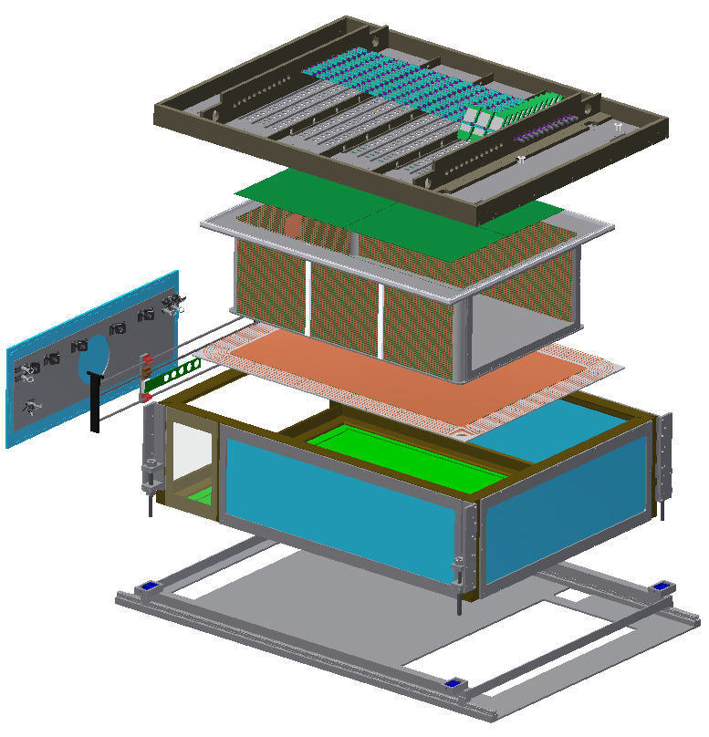
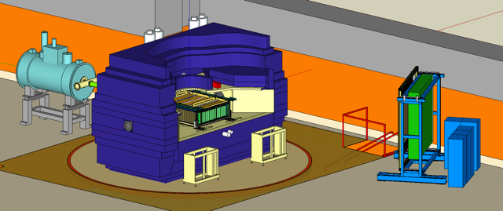
SPiRIT dayone experiment setup
Chamber in SAMURAI magnet B=0.5T
NeuLAND
Beam Tracker
beam
STQ
MWPC type
Time Proj.
Chamber
12k channel

Slide 12
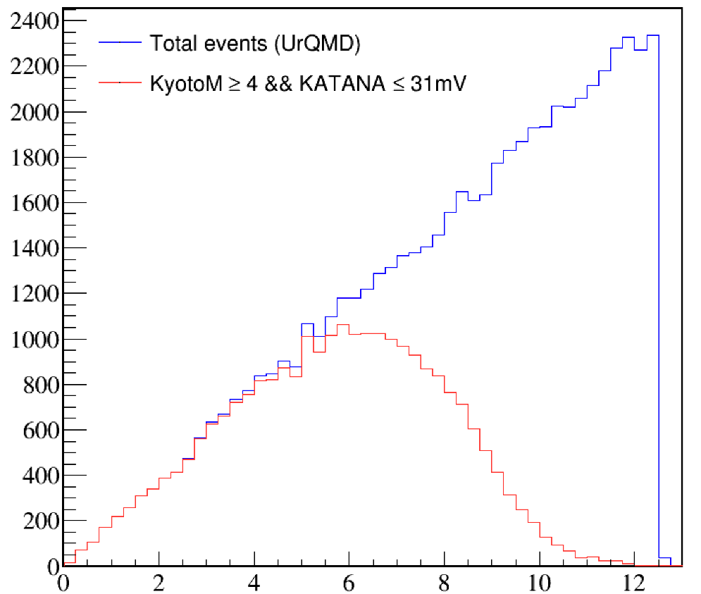
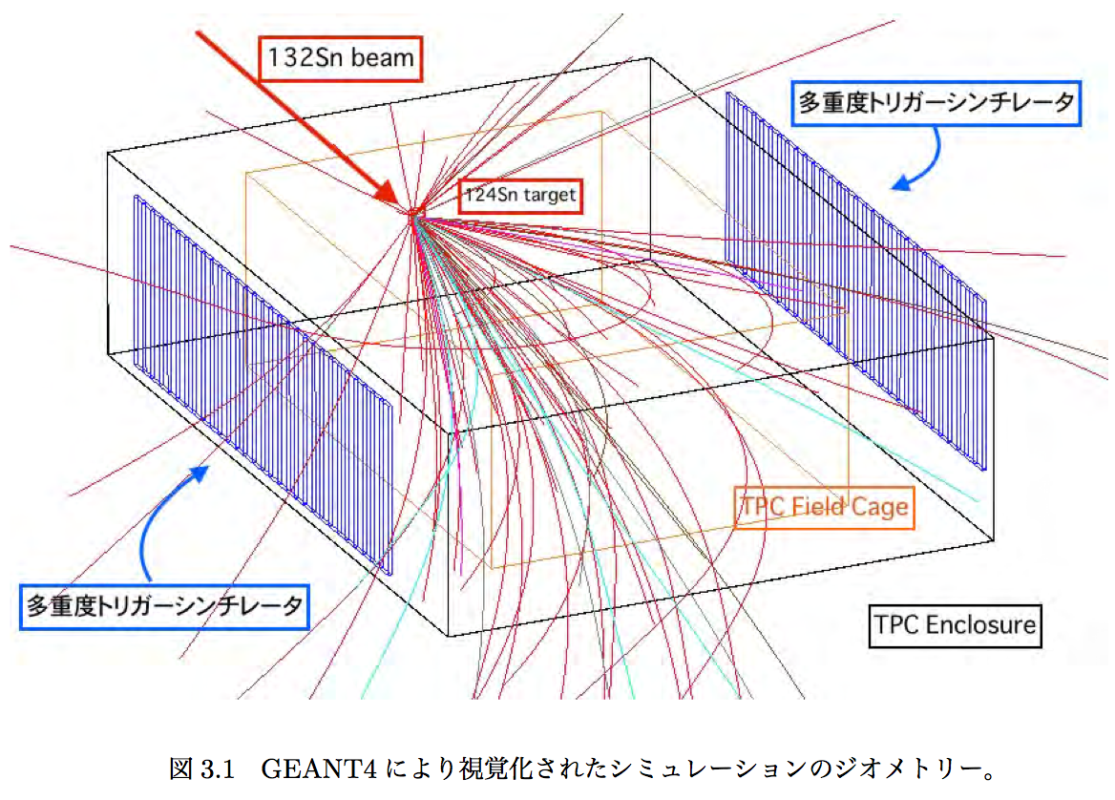
Trigger system for high dense matter #hits(side)>4 && Z<20
“Participants”
p
n
b
n
p
Low Z
nuclei
“Spectators”
Multiplicity Trigger Array
Impact parameter b (fm)
Multiplicity Trigger Array
Krakow Veto and Trigger Wall
Suppress background events and take “central” collision events
The fraction of events that we are interested in is only O(0.1)%
Sophisticated trigger system to take central collision data: side array + Forward VETO.
NIMA 856 (2017) 92, NIMA 1039 (2022) 167010

Slide 13
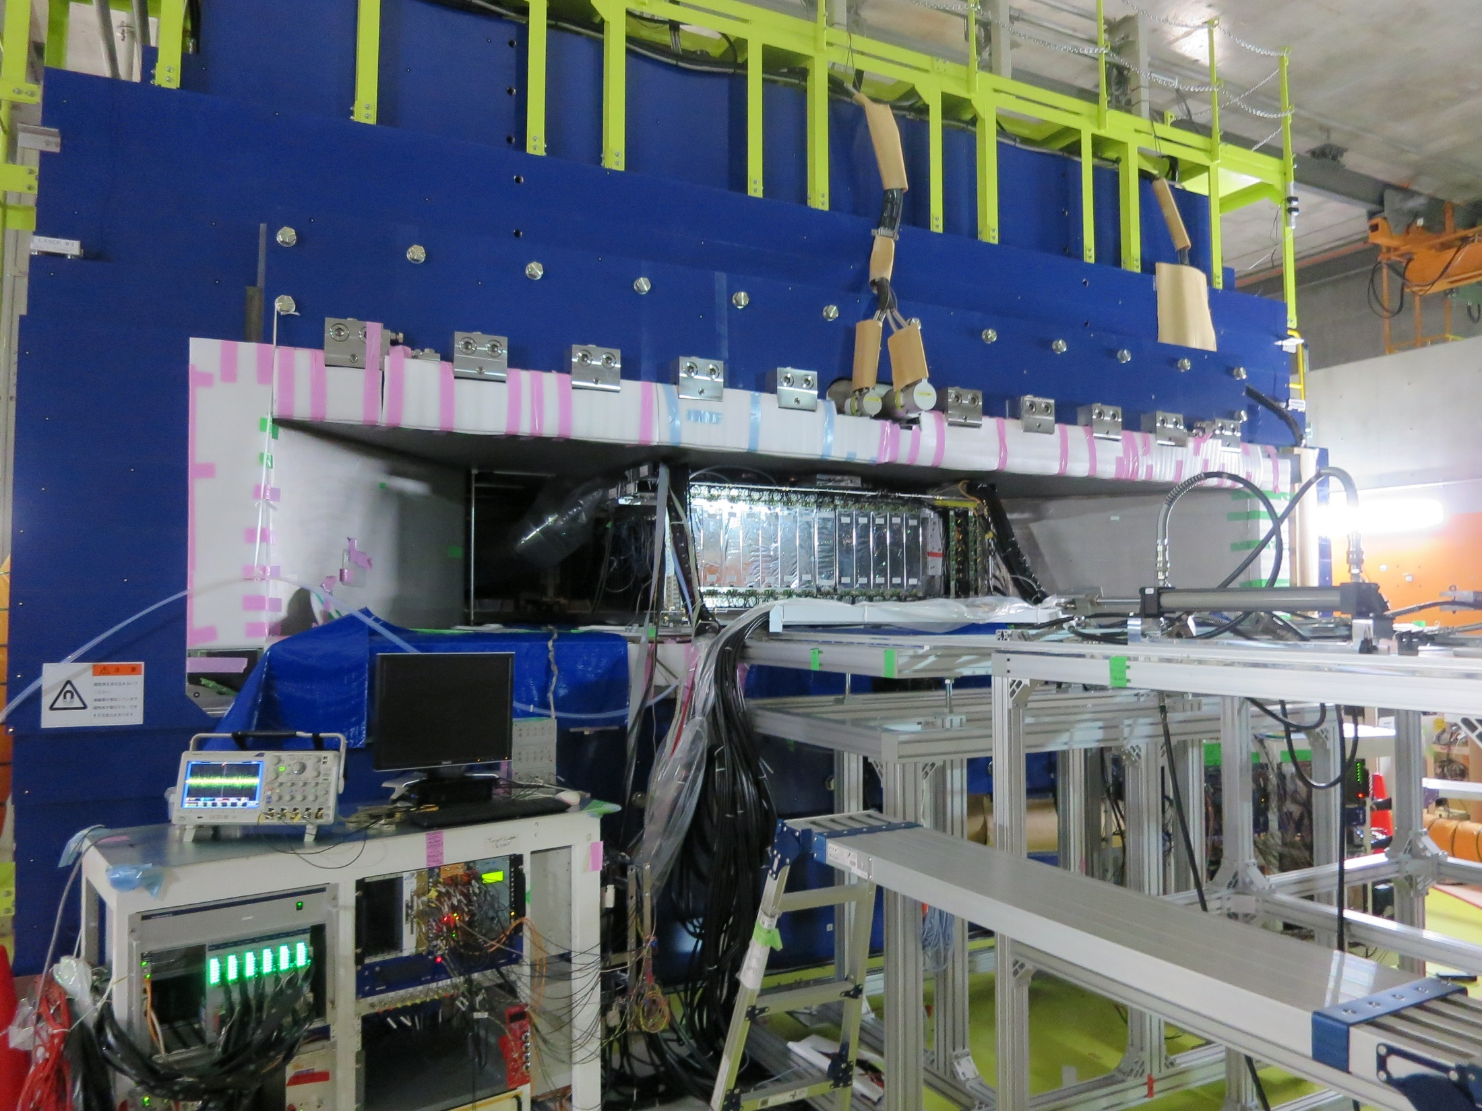
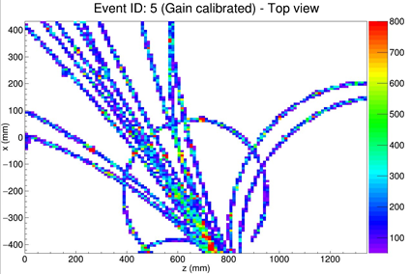
Cosmic ray in magnet

Slide 14
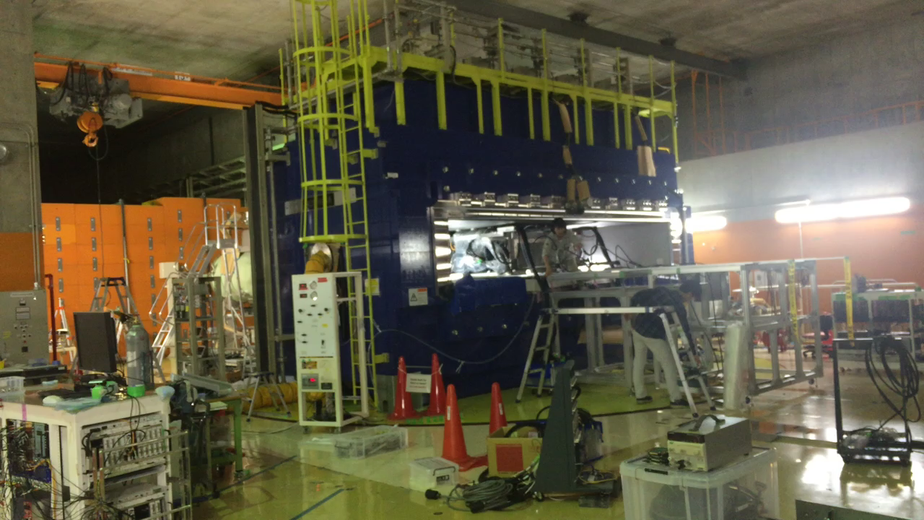
Cleaning up experimental area
5 sec./frame. No cut ! It was ~2.5 hour.

Slide 15
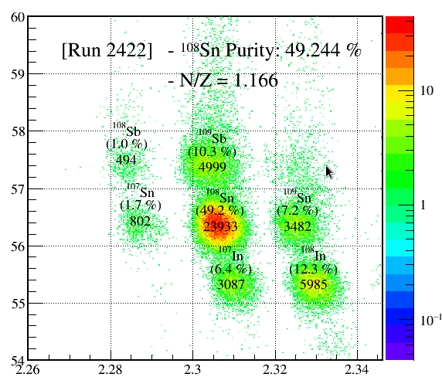
Dayone Heavy RI Collision experiment
Systematic measurements of multiple observables in heavy RI collisions in same Z (Z=50) but different N system.
Charged pion is main observable.
Successfully finished. 2016 Apr. – Jun.
Beam rate: 10kHz, trig. rate: 70Hz
30M Events: 60Hz, 5MB/eve →300MB/sec
250TB/2week
Selective digitization/zero suppression was not employed.
Beam PID (¹³²Sn)
Primary | Beam | Target | E_{beam}/A | (N-Z/A)_{sys}
²³⁸U | ¹³²Sn | ¹²⁴Sn | 270 | 0.22
 | ¹²⁴Sn | ¹¹²Sn | 270 | 0.15
¹²⁴Xe | ¹⁰⁸Sn | ¹¹²Sn | 270 | 0.09
 | ¹¹²Sn | ¹²⁴Sn | 270 | 0.15
Z(A.U.)
A/Q(A.U.)

Slide 16
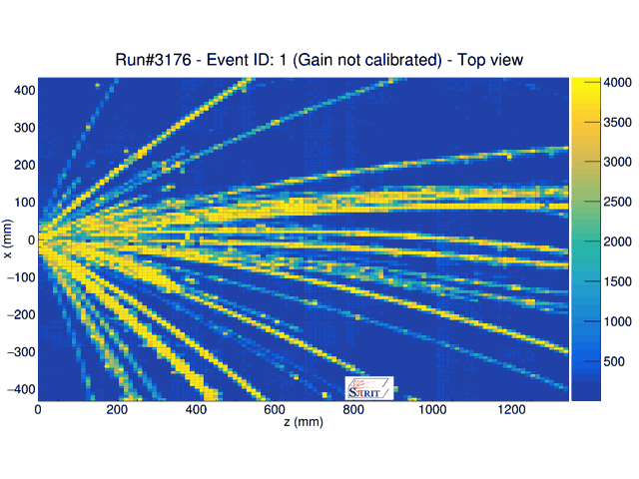
First Physics Run at 2016 spring
TPC Event Display
Milestones
Feb, 2014
1 pixel: 1 pad

Slide 17
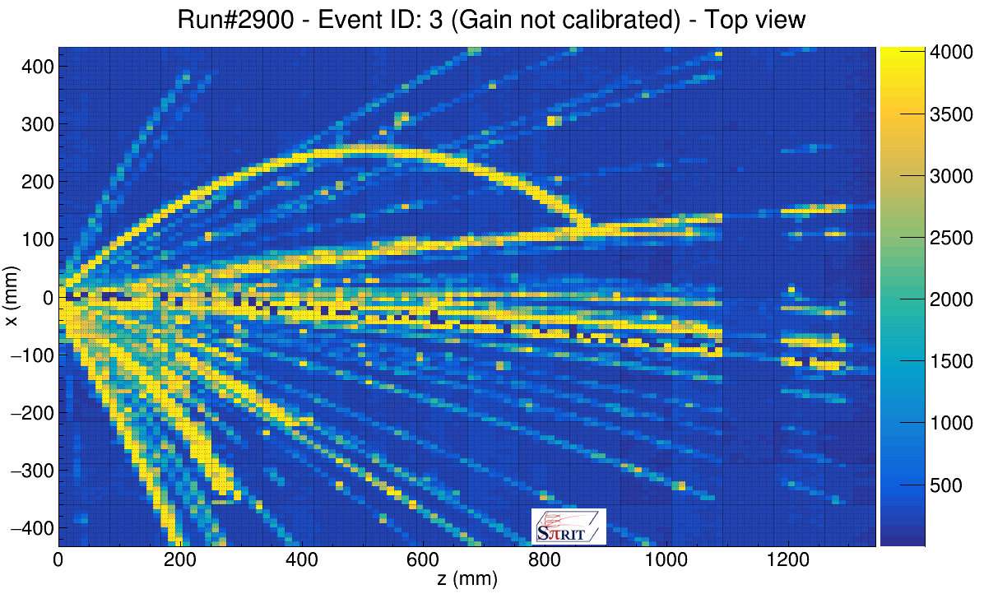
Dead channels along beam trajectory
Seen along beam trajectory → due to δ-ray?
→ but δ-ray is supposed to be suppressed with Gating Grid (GG) + B-field.
Could not be seen in the case of cosmic
Location varies event by event

Slide 18
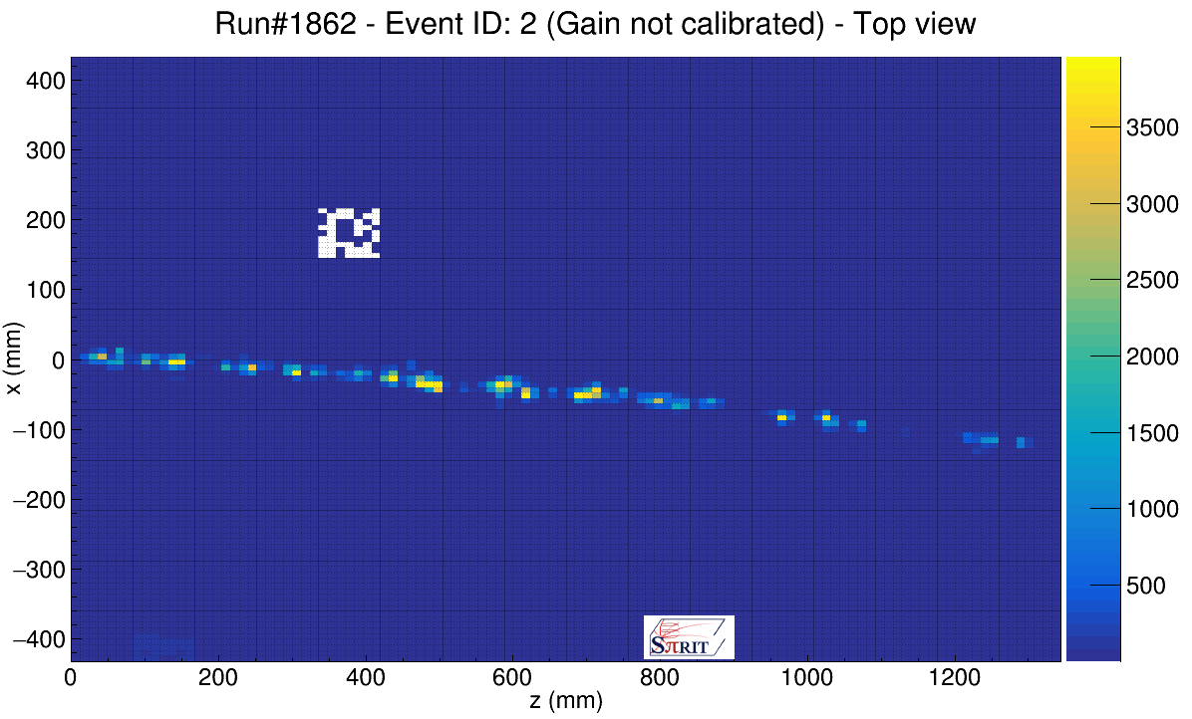
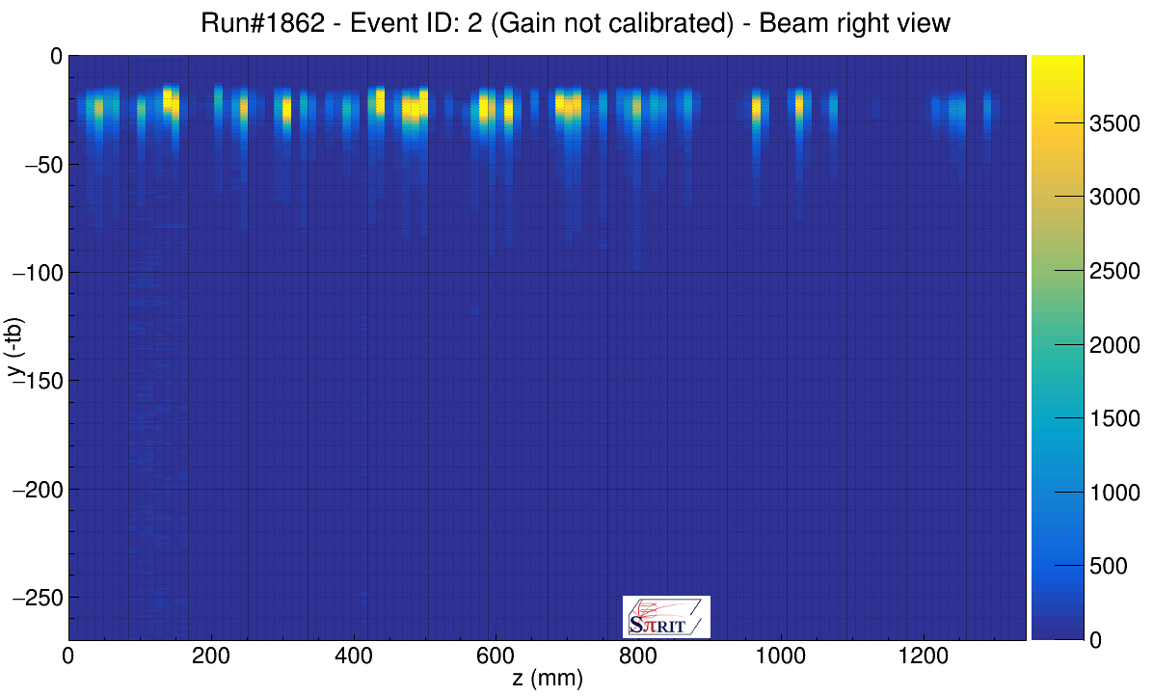
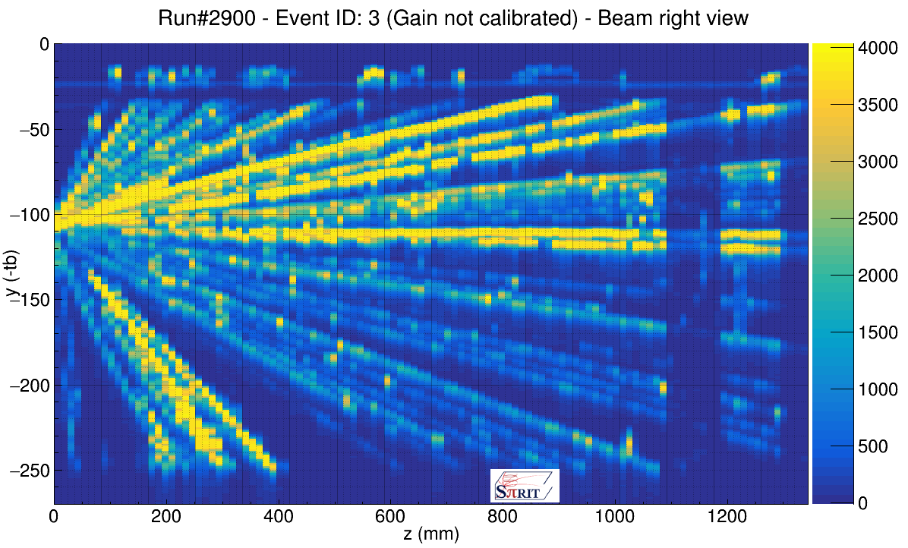
δ-ray which cannot be blocked with Gating Grid (GG) → Preamp becomes dead for a certain time due to large signal of multiple δ-ray
Top view
Top view
GG
Side view
Side view
Beam event
Reaction event

Slide 19
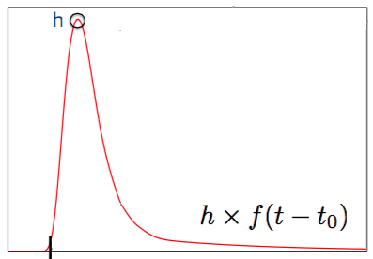
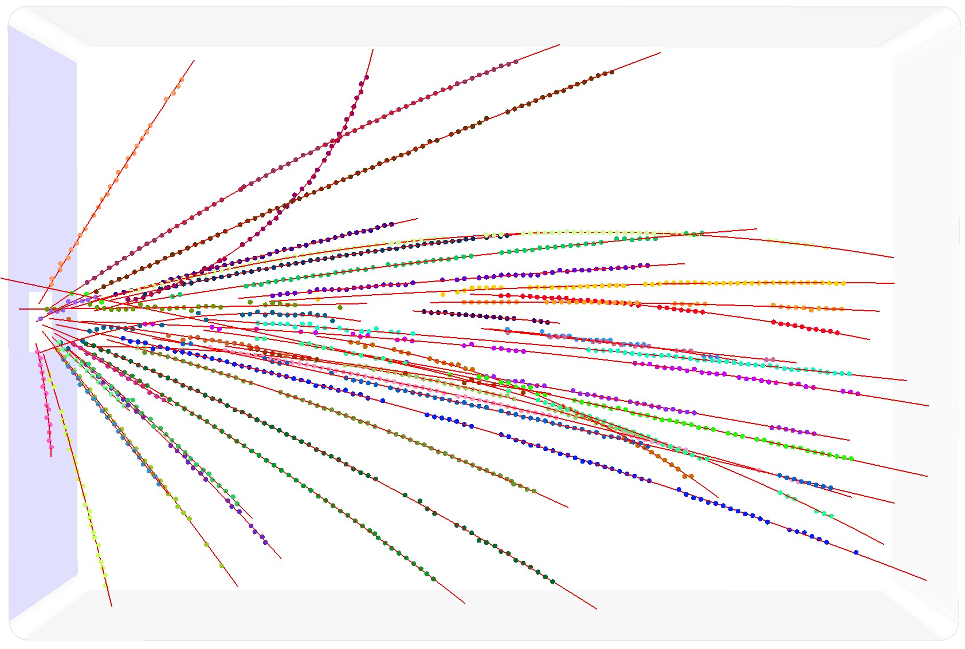
Offline analysis: Charged particle tracking
Pulse Shape Analysis
in each of 12096 pads
Helix tracking: 3D momentum
Track separation
Riemann fit: 2D
Helix fit: 3D
Clustering Hits
Initialize GENFIT parameters
GENFIT: precise fitting (Parameterization, extrapolation)
RAVE(Reconstruction vertices)
f: Fixed shape
t₀: time at 5% of h
NIMA 965 (2020) 163840

Slide 20
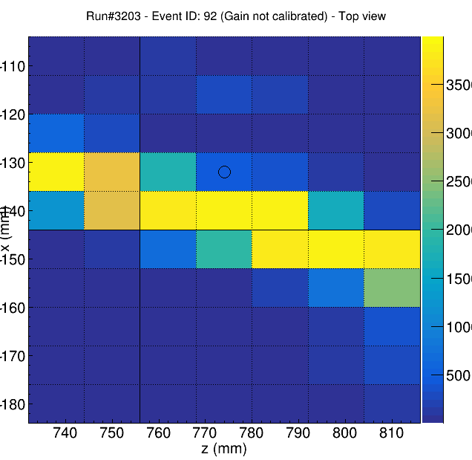
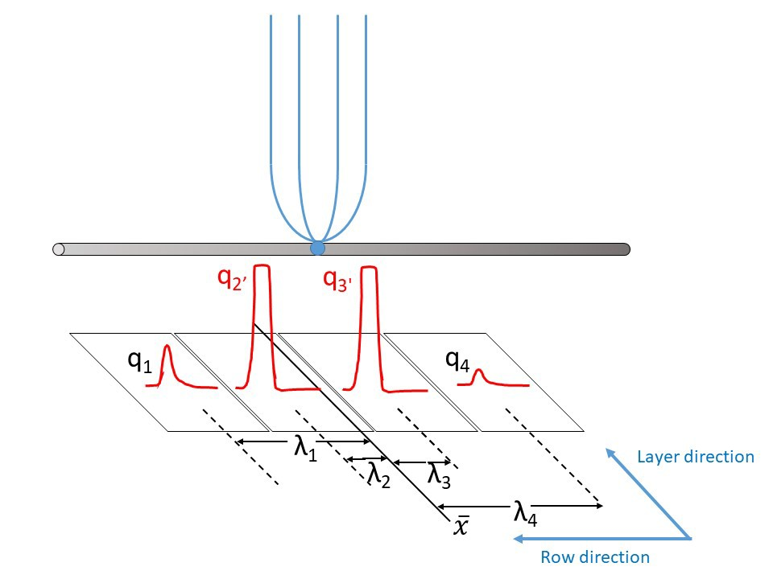
Pad Desaturation to recover PID and momenta of particles with saturated pads
Goal: extend the dynamic range of the TPC
Problem: saturated pads lose charge info
650
3500
2950
150
How do we correct and use the PRF?
From the charge pads the distribution we can estimate the charge of a saturated pad
Find the charge center of gravity
Calculate the distance of the center of each pad from the c.o.g.
Calculate the fraction of charge of the pad over the total charge to get the PRF.
NIMA 944 (2019) 162509

Slide 21
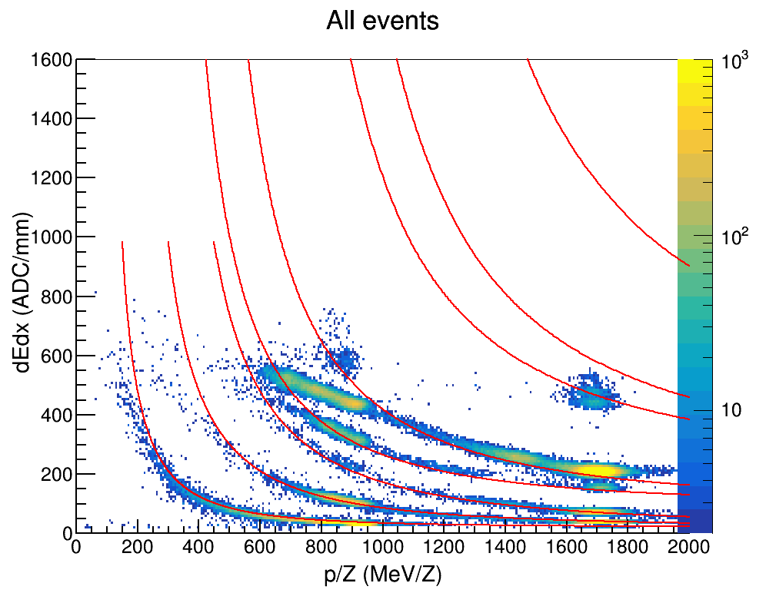
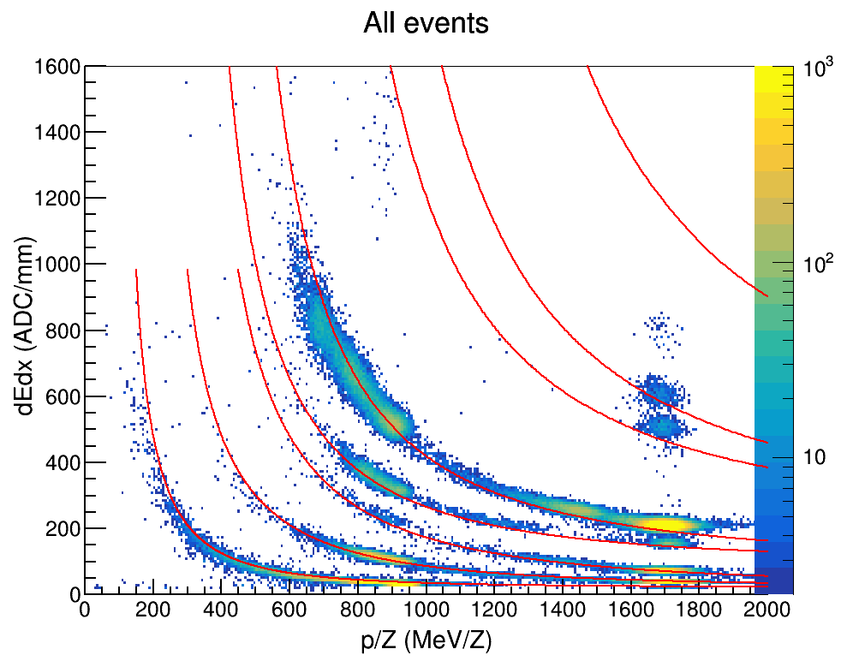
Pad Desaturation
Test performed on the E=100-300MeV Z=1-3 cocktail beam
Overlap of energy loss calculation (Bichsel curves) with data
Before correction
After correction
³He
⁴He
³He
⁴He
p
t
d
p
t
d
⁷Li
⁷Li
⁶Li
⁶Li
NIMA 944 (2019) 162509

Slide 22
Particle trajectories are distorted due to the large amount of charge made by HI beam
Z~50 10kHz beam: p 25MHz beam
Electrons from beam distort the E-field around beam trajectory
Electrons from produced particles are displaced.
Left hand side trajectories and right hand side trajectories are displaced mainly around vertex.
Drifting
ions made by beam
NIMA 959 (2020) 163477

Slide 23
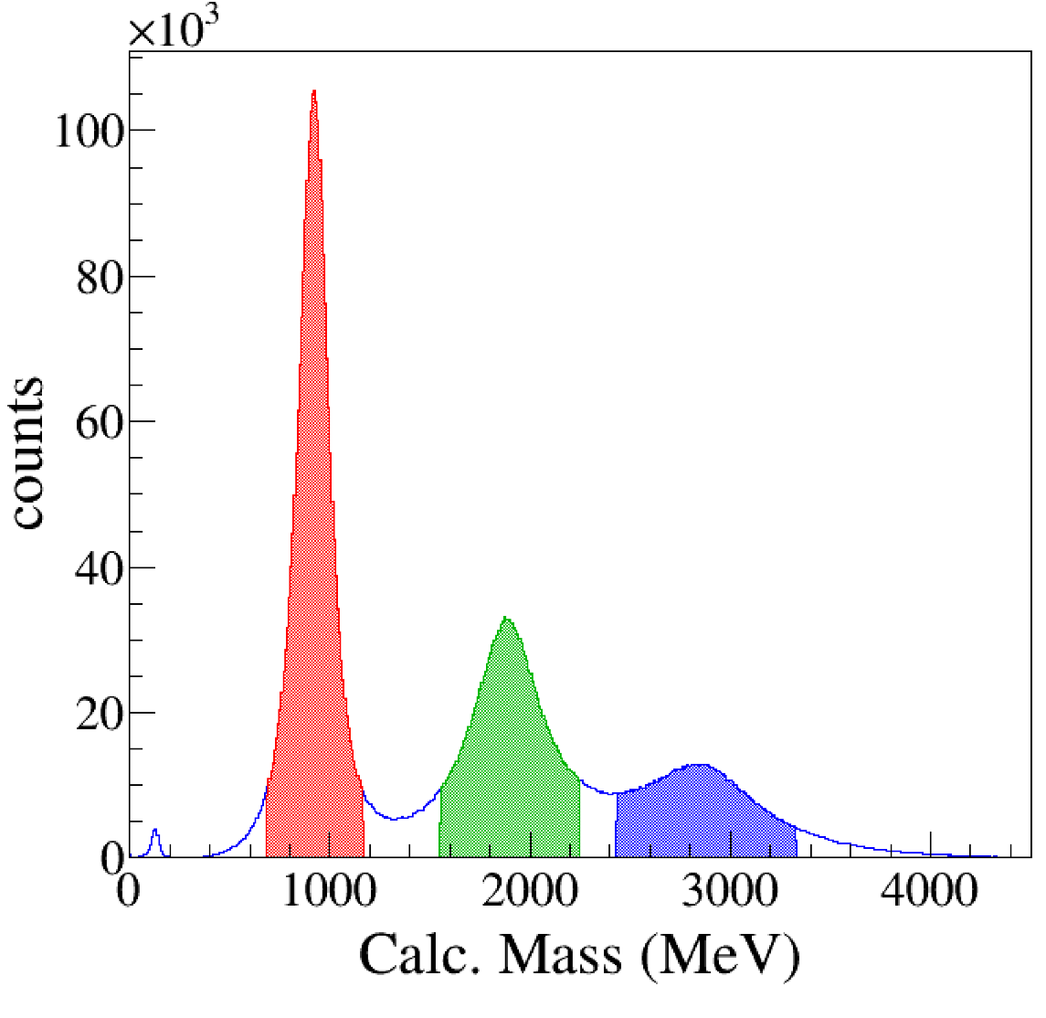
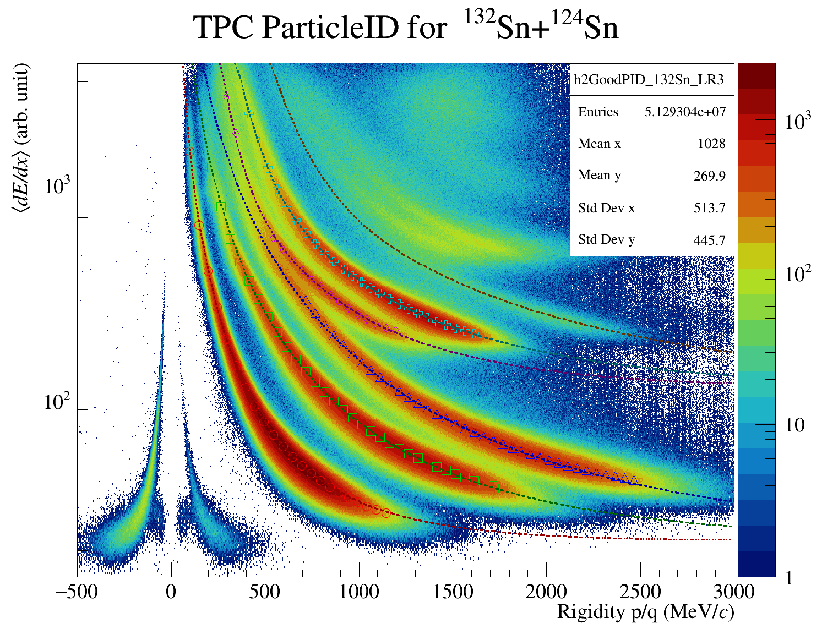

Particle identification by TPC ¹³²Sn + ¹²⁴Sn E_{beam}=270 AMeV
Z=1
⁷Li
⁶Li
⁶He
³He
⁴He
t
d
π⁻
π⁺
p

Slide 24
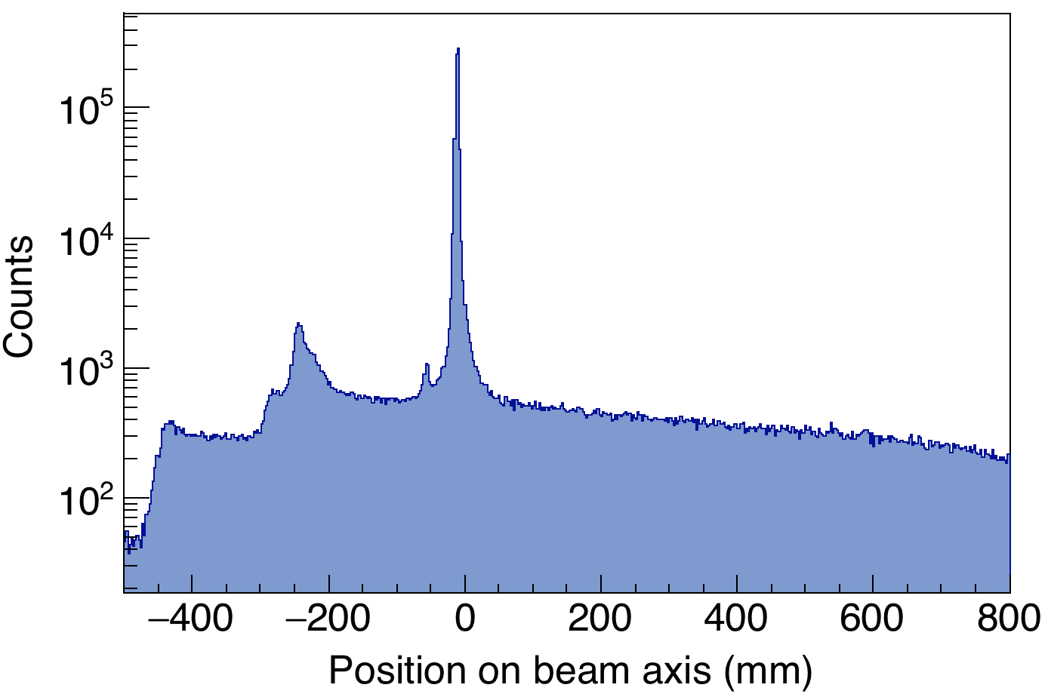
Reconstruction of vertices: junk event removal
Vertex finding by RAVE package (Reconstruction in an Abstract Vertices Environment)
End of
beam pipe
Start of
TPC
Active
Veto
Target
holder
Inside TPC
Vertices are reconstructed as 3D points at the converging point of the tracks event by event.
On target
Vertexing efficiency 99.3%
On the ¹²⁴Sn target
Before target
Active target

Slide 25
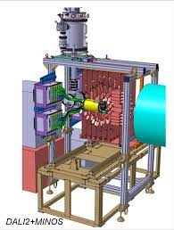
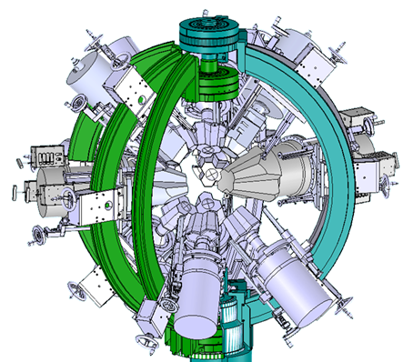
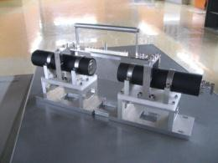
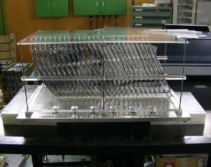
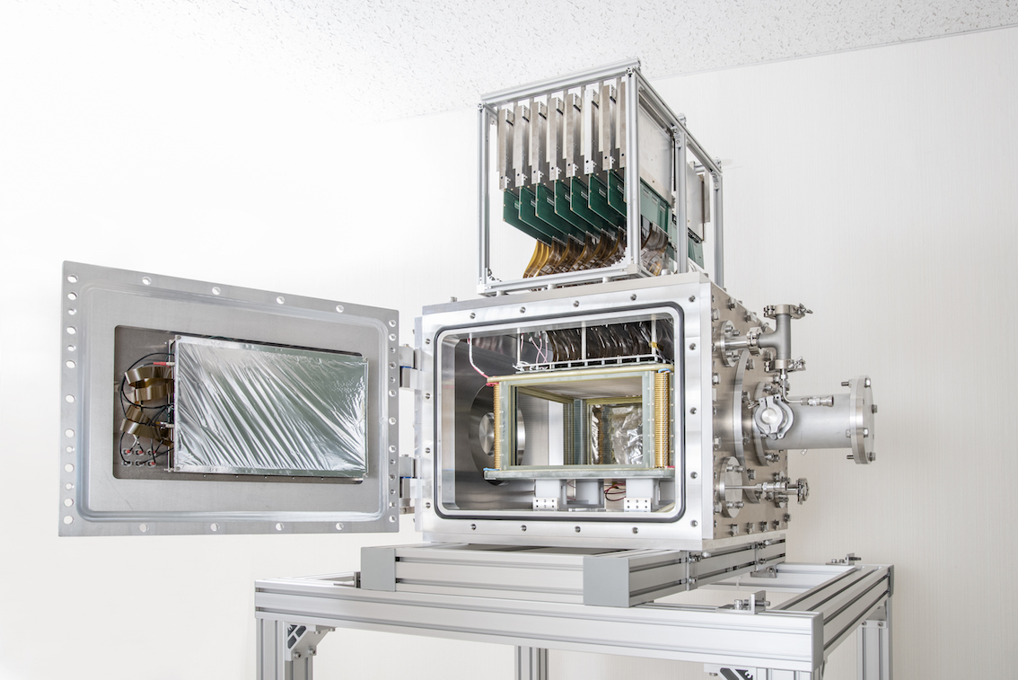
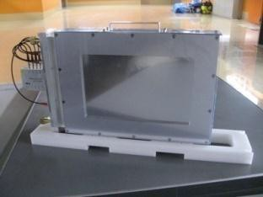
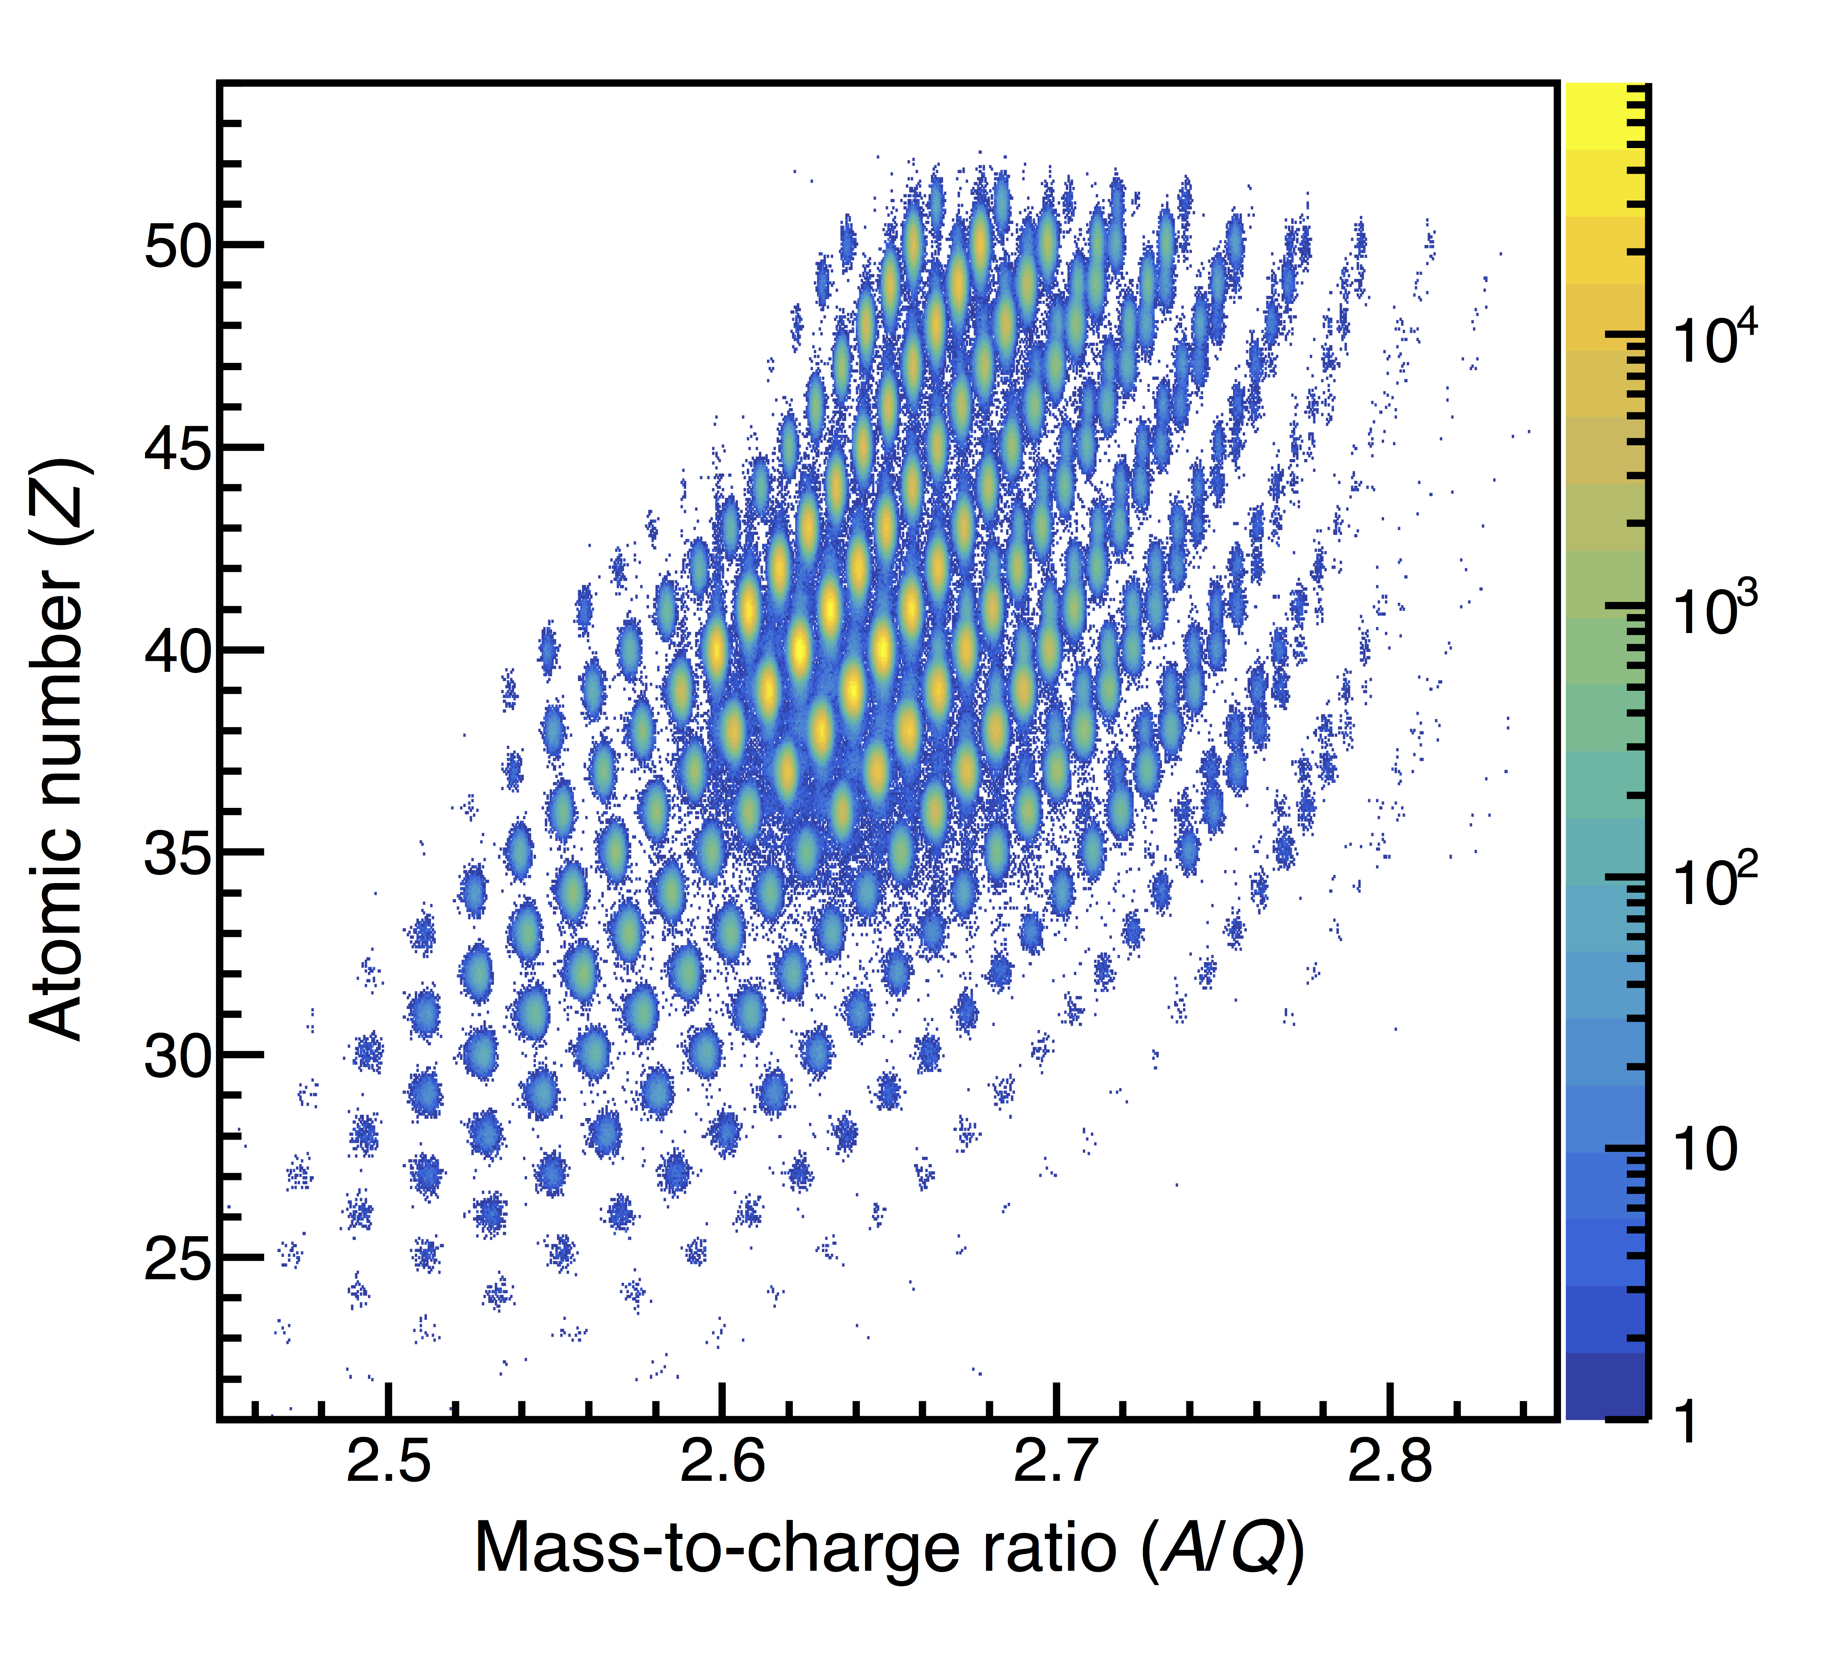
Next step of RIBFDAQ : performing several experiments simultaneously
Upgrade BigRIPS DAQ so that multiple trigger from different experiments can be accepted without interference.
F0-F11: 125.983m
BigRIPS
Data
Trigger
Common Devices
Data
DAQ for RI beam PID
→ no dead time
Trigger
Data
Trigger
Plastic
MUSIC
PPAC
Courtesy of Baba

Slide 26
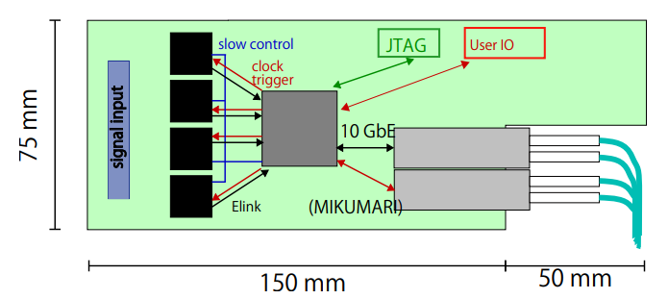
Development of TPC-FEE based on SAMPA chip
R&D within Japanese high/low energy nuclear physics community for next generation TPC readout.
motivated by the discontinuity of GET system.
To adapt for streaming readout.
Designing of prototype board is on going
Both triggered and trigger less mode are available by changing the FW.
4 SAMPA chips
Artix Ultrascale+
SFP+ x2
Ext. trigger from User IO

Slide 27
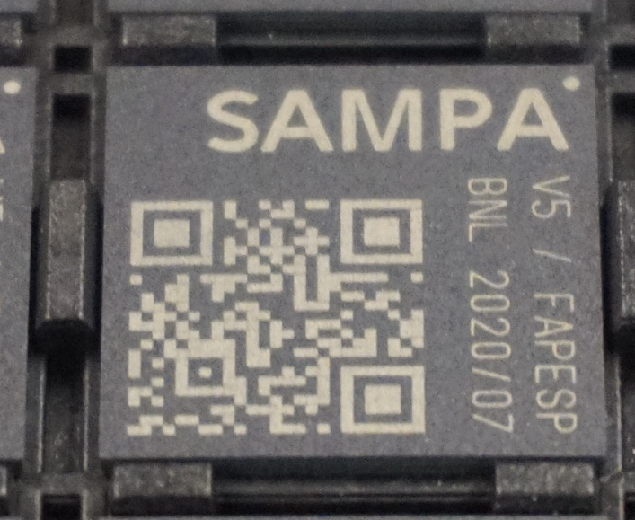
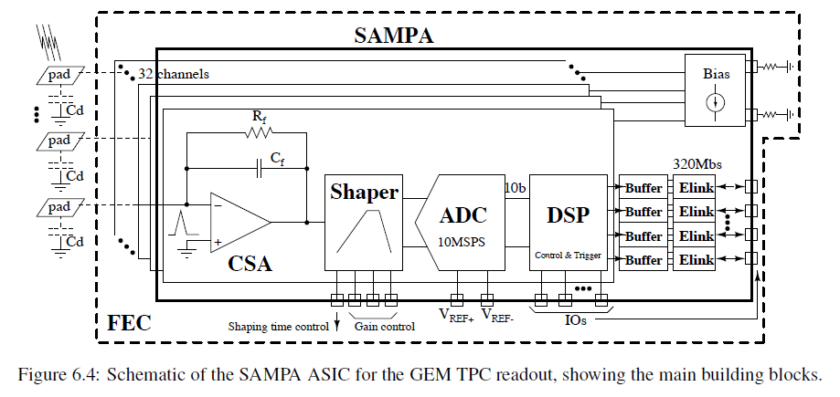
SAMPA chip feature (v4)
SAMPA = 32 ch * (CSA + Shaper + FADC) + DSP
CSA (pos/neg input) + Shaper: see table
FADC (10bits) sampling: 5, 10, and 20MHz.
DSP functions:
Data buffering and packeting (header etc.)
Three baseline correction (restoration) schemes
Data reduction schemes are simple zero-suppression (ZS), cluster-sum after ZS applied, and Huffman compression (Never used)
Operation mode
Triggered and trigger-less (continuous) readout mode
Direct ADC serialization
Output: 11 e-links per chip.
320Mbps per line → 3.2Gbps per chip
10MHz sampling without zero-suppression is possible
Power: ~1W per chip

Slide 28
Summary
Experimental program of SPiRIT to constrain the density dependent symmetry energy.
TPC with readout system of GET.
First experiment campaign by using Sn isotopes was successfully finished at 2016.
¹³²Sn+¹²⁴Sn, ¹⁰⁸Sn+¹¹²Sn, … @E/A=270MeV
Correction of charge saturated hits based on PRF.
Dynamic range of electronics can be gained by using slope information instead of height of signal.
Distortion of particle trajectories due to the large amount of charge made by HI beam.
R&D with SAMPA chip is on-going.

