Slide 1
Analysis of ¹¹Be excited states via the ¹⁰Be(d,p) reaction
Zach Serikow
TPC2023

Slide 2
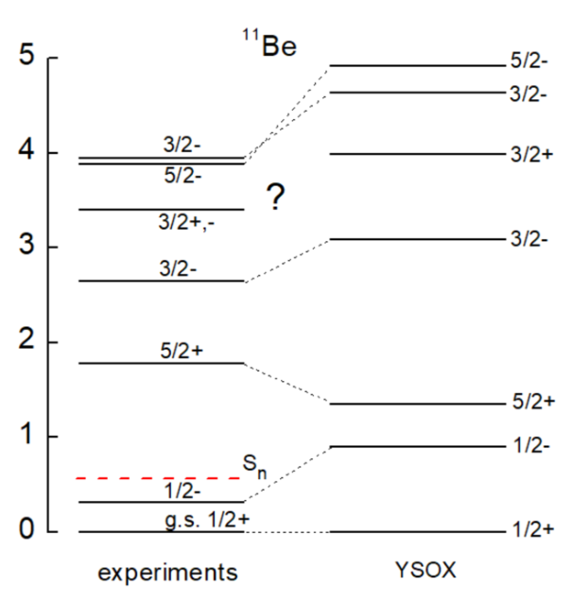
¹⁰Be(d,p) in the AT-TPC
¹⁰Be(d,p) experiment performed at NSCL during summer 2021 with AT-TPC in SOLARIS solenoid
  Data analysis ongoing
For the fourth excited state with J = 3/2 at 3.41 MeV, experiments suggest π = -1 while theory suggests π = 1
Physics goal: determine the parity of this fourth excited state through angular distribution of cross section
Notes:
Need to demonstrate capability to measure transfer reactions in inverse kinematics in AT-TPC
We ultimately want to perform our 32Mg(d,p) experiment, but we need to show that such a measurement with the AT-TPC is feasible.
¹⁰Be(d,p) experiment performed at NSCL during summer 2021
This experiment, which is still undergoing data analysis, was our proof-of-concept that the AT-TPC can be used to measure transfer reactions. This was the “experimental program” goal of this experiment. Of course, we still had physics goals as well.
As you can see by looking at this level diagram, past experiments have deduced the J_{π} assignments for six of the seven first excited states of ¹¹Be (seventh excited state not shown).
For the fourth excited state with J = 3/2 at 3.41 MeV, experiments suggest π = -1 while theory suggests π = 1
Again, looking at the level scheme we see the levels of 11Be predicted using this YSOX interaction where it has the fourth excited state at 3.41 MeV with positive parity. (YSOX interaction gives good match to data in the psd shells and is based on the monopole universal interaction.)

Slide 3
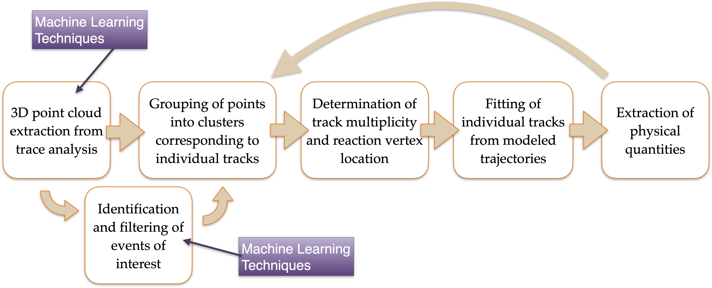
Analysis pipeline

Slide 4
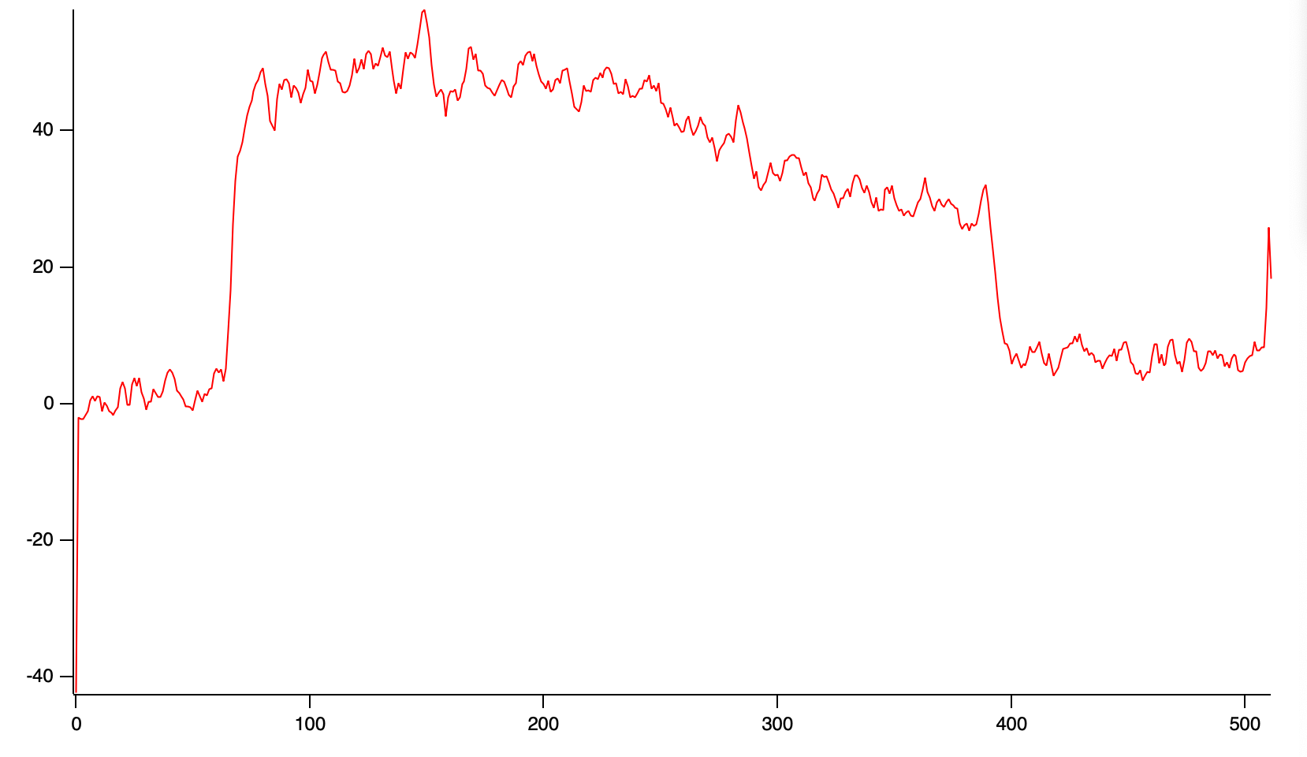
Analysis – drift velocity
Important parameter for track reconstruction is the electron drift velocity
Necessary because drift velocity can change over course of experiment
Utilize unreacted beam events
Window edge
Window
Micromegas
Unreacted beam
ADC units
ADC units
Micromegas edge
AT-TPC active volume
Time buckets
Notes:
Important parameter for track reconstruction is the electron drift velocity
When we reconstruct a particle’s track, we need to find its x,y, and z coordinates. The pad plane that the electrons drift to gives the x and y information. We must use the time that these electrons drift to reconstruct their z coordinate, which requires us to know their drift velocity.
Necessary because drift velocity can change over course of experiment
There are multiple factors that can change the drift velocity of electrons through a gas. The accumulation of space charges over time could change the fields. The purity of the gas could change over time due to contaminants. Changing the ambient temperature could change the pressure as we know from the ideal gas law. Because of these factors, we need to calculate the drift velocity as a function of time for the experiment.
Utilize unreacted beam events
There are many ways to measure the drift velocity, but the way we did it was utilizing our ion chamber to tag unreacted beam events. In unreacted beam events, the beam traverses through the entirety of the detector. We know where the beam enters the AT-TPC, and since the unreacted beam traverses the entire detector, we know where it ends. This is shown in the left diagram. Knowing where the beam enters and ends gives us a distance, so we just need to get the time it took the earliest electrons to cover this distance and we will have the drift velocity. To find the time, we sum all the pad traces where the beam hits the pad plane to get a signal as pictured. This signal is the total charge deposited by the beam in the beam region. This signal has a clear rising edge and falling edge, which correspond to the window and pad plane. The time difference between the two is the time that it took the unreacted beam to cover this distance, so we have all the ingredients to determine the drifty velocity.

Slide 5
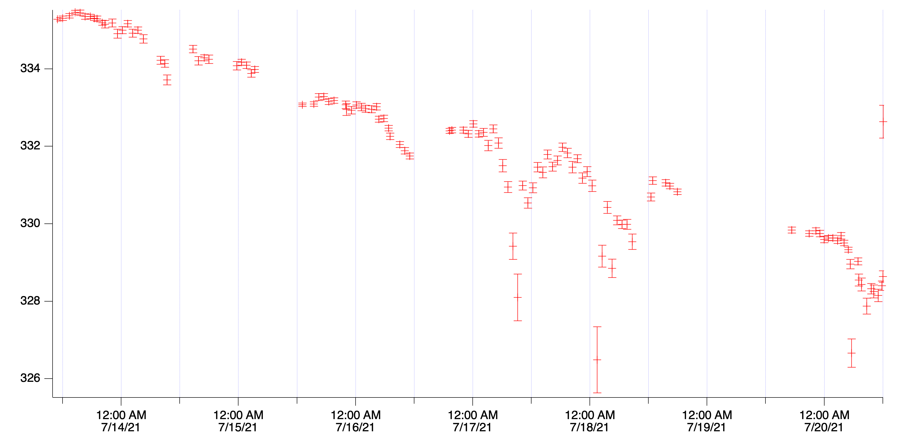
Analysis – drift velocity
Time difference (time buckets)
9.38 × 10⁶ cm/sec
Peisert and Sauli: 9 × 10⁶ cm/sec
A. Peisert, F. Sauli, Drift and Diffusion of Electrons in Gases: A Compilation. CERN Yellow Reports: Monographs (CERN, Geneva, 1984)
Notes:
Here is the drift velocity as a function of time over the course of the experiment. Note that the y-axis is not truly a velocity but the time bucket difference between the two edges of the signal as shown on the previous slide. It can easily be converted to the true velocity by dividing the distance between the window and micromegas by each point and doing some unit conversions.
Each dot corresponds to a run a data which is, on average, about one hour. Since each run has many unreacted beam events, I took the first 500 from each run and histogrammed their window and micromegas edges to extract their mean values. I used these mean values to calculate the time difference.
The trend of the time difference is to decrease as the experiment goes on, which means that the drift velocity is increasing. The maximum and minimum time difference only differ by around 2%, which is quite good. To give you an idea of the actual drift velocity, I calculated it for a time difference of 333 TB which is 9.38 × 10⁶ cm/sec. This value is close to the reported electron drift velocity of 9 × 10⁶ cm/sec in deuterium found by Peisert and Sauli, which is good to see.
Note that one TB is equal to 0.32 microseconds!
Note that we see the temperature changes observed during experiment

Slide 6
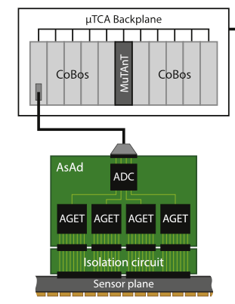
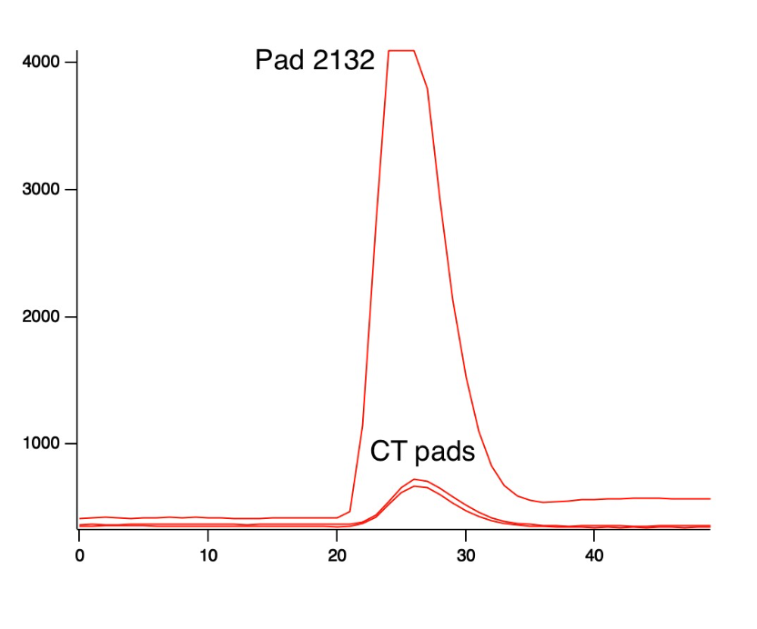
Analysis – cross talk
AT-TPC uses the GET electronics
Check signals of neighboring pins to those that have large signals on AGET
ADC units
Adapted from “J. Bradt et al. Nucl. Instrum. Meth. Phys. Res. A 875, 65 (2017)”
Time (time buckets)
Notes:
AT-TPC uses the GET electronics
GET stands for “General Electronics for TPCs”. This data system is hierarchical, as the bottom-left figure illustrates (point out that the top level is the CoBo, then AsAd, then AGET. There is also the MuTAnT). I will not go into what each of these modules does, but all of the AT-TPC’s 10,240 pads each belong uniquely somewhere in this hierarchy such that they can be identified by their CoBo, AsAd, AGET numbers. For our cross-removal code, we find the cross talk by analyzing the traces at the AGET level.
Check signals of neighboring pins to those that have large signals on AGET
Our cross-talk removal code works at the basic level by finding pads with large signals and then checking the signals of neighboring pins to those that have large signals on the AGET chips. Seen in the bottom-right figure is the trace of a pad with cross talk. The cross-talk trace is the large signal that saturates, which you can tell occurs by the top of the signal being cut off. There are traces of cross-talk pads underneath it which are much smaller in amplitude and that align in time with the saturated signal, which one would expect.

Slide 7
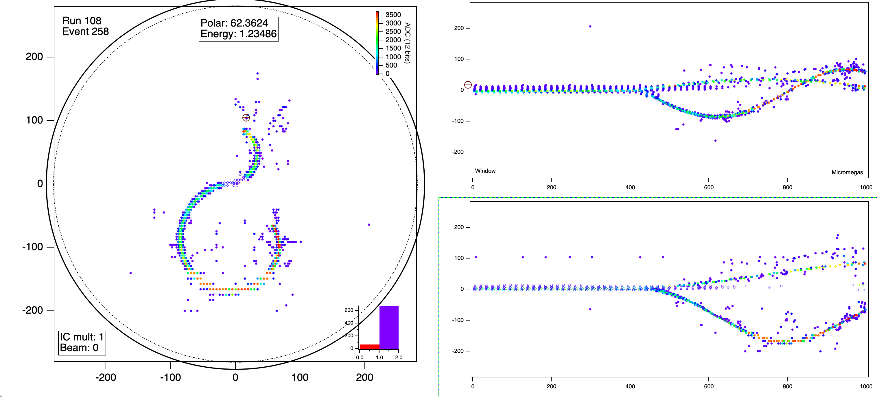
Analysis – cross talk
Notes:
Here is some event from the 10Be(d,p) experiment. You can easily identify two tracks that are sprinkled with dots all around them. This is the suspected cross talk. From this image it is easy to see how cross talk and noise could make clustering hard.
Now here is the same event with the cross-talk filter applied. We see that it is much better than before and that many of those points sprinkled around the tracks are removed. However, not all the spurious points are gone. This is because the cross-talk code is not perfect and indicates that there may be some other forms of noise present.

Slide 8
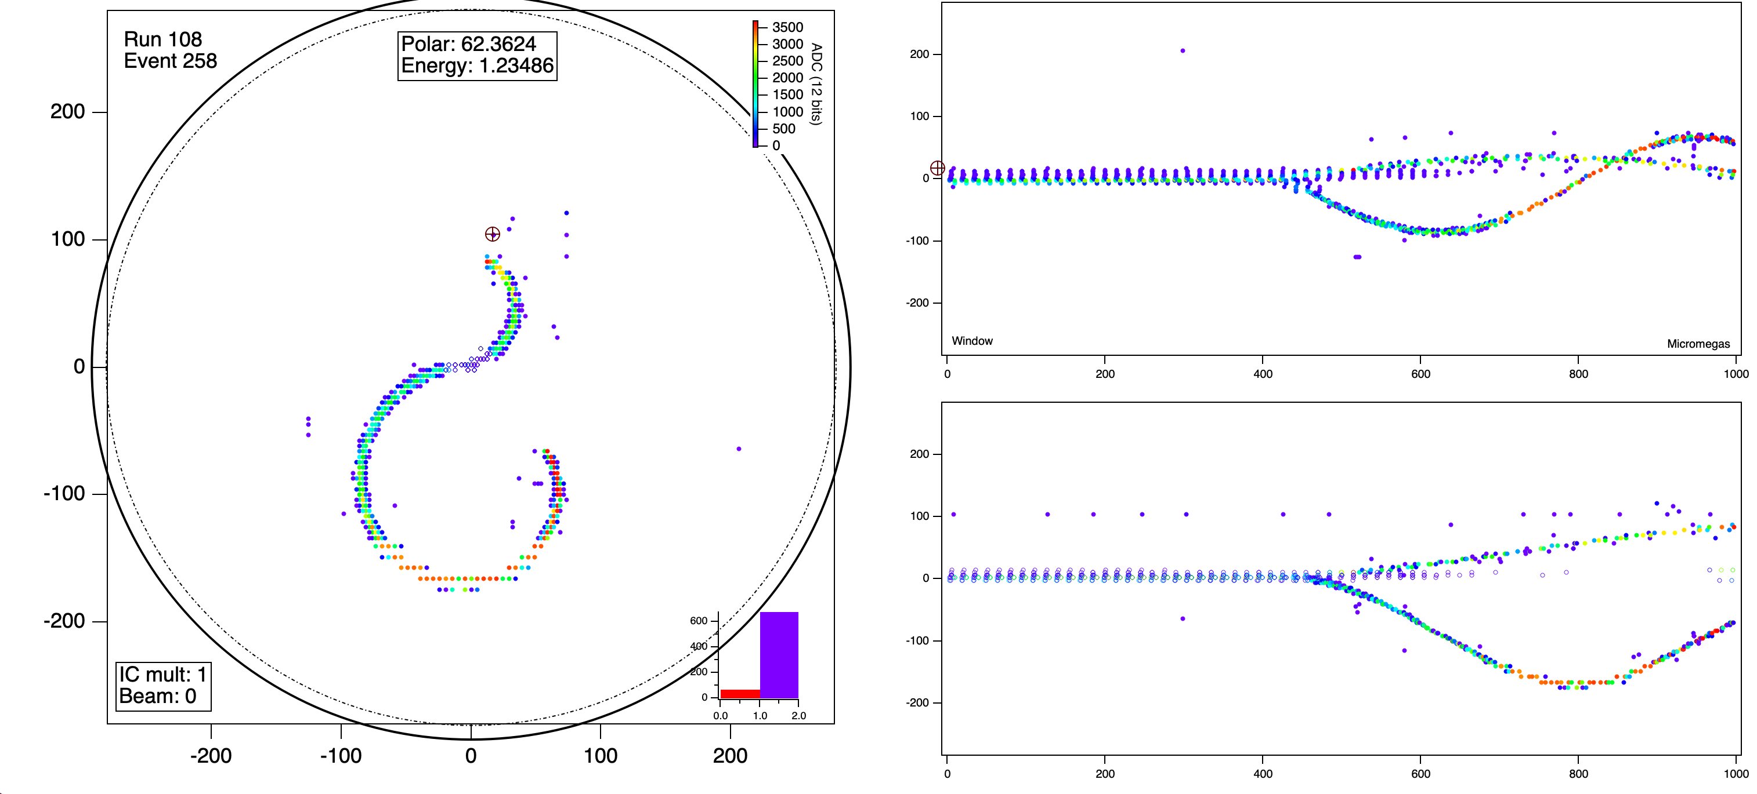
Analysis – cross talk
Notes:
Here is some event from the 10Be(d,p) experiment. You can easily identify two tracks that are sprinkled with dots all around them. This is the suspected cross talk. From this image it is easy to see how cross talk and noise could make clustering hard.
Now here is the same event with the cross-talk filter applied. We see that it is much better than before and that many of those points sprinkled around the tracks are removed. However, not all the spurious points are gone. This is because the cross-talk code is not perfect and indicates that there may be some other forms of noise present.

Slide 9
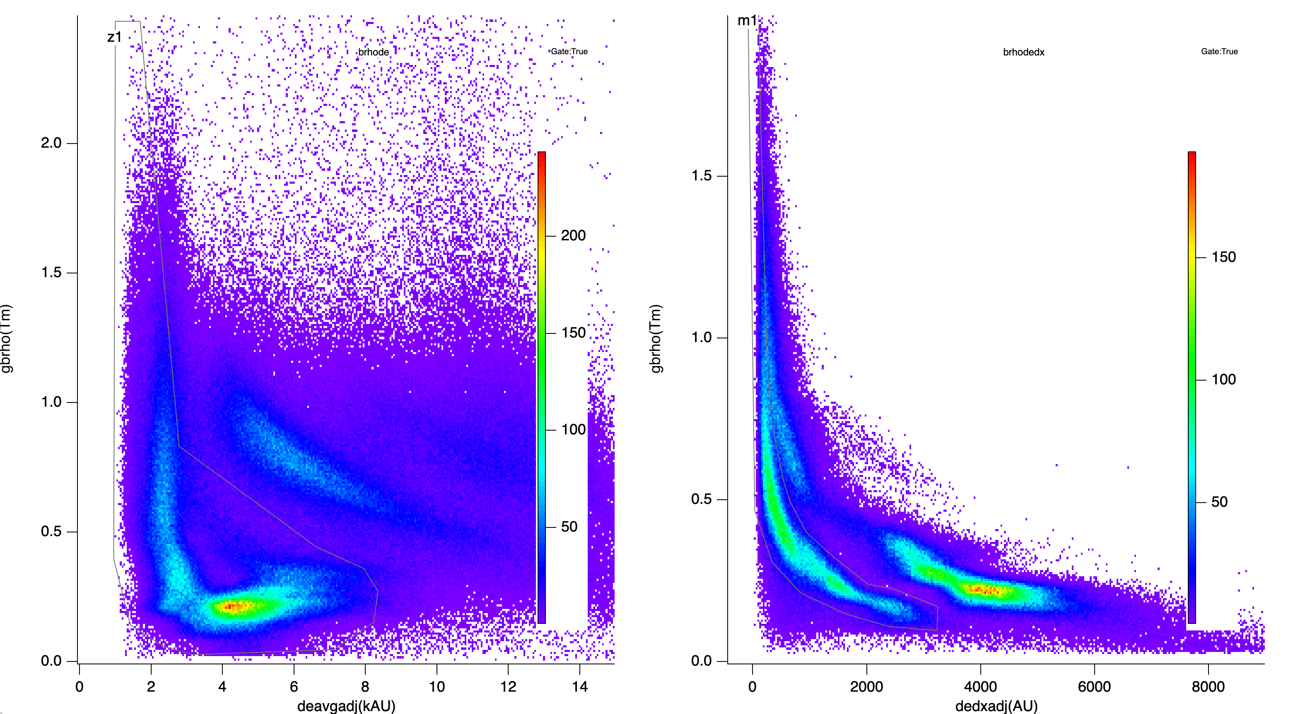
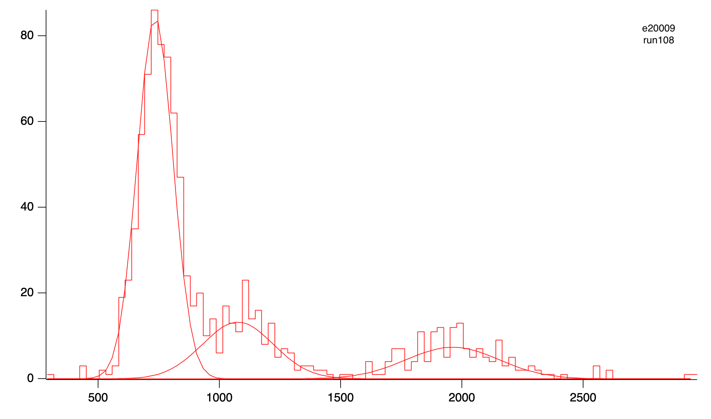




Reaction channel selection
Based on identification of incoming ion from IC
Identification of target residue using Bρ vs. energy loss
Gated on Z=1
¹⁰Be
Z=1
$$βρ$$
$$βρ$$
protons
Z=2
deuterons
¹⁰B
¹⁵N
IC signal amplitude
$<∆E>$/pad
$$dE/dx$$
Notes:
The cross-talk reduction code and drift velocity calculation are both required to perform an accurate analysis of our data to determine the parity of the fourth state of 11Be, which is unknown and our motivation for this experiment. However, the AT-TPC records all events inside that cause a trigger, so we need to make sure that we are only looking at the 10Be(d,p) events through a series of three gates on the target residue.
The leftmost histogram shows the composition of the beam during some run found from our IC. We first gate on our IC signal to ensure that we have 10Be entering the AT-TPC.
The second gate is shown in the middle PID plot. Because we have the AT-TPC inside the solenoid, we can measure the Brho of the products, which is the y-axis. The x-axis is the average energy lost per pad over the first 20% of the track. We have two bands here for Z=1 and Z=2, and since the target residue is a proton for 10Be(d,p), we want Z=1.
The rightmost PID plot is of Brho vs dE/dx of the first 20% of the track. At this stage, we can select to gate on either the protons for 10Be(d,p) or the deuterons for the elastic and inelastic channels.

Slide 10
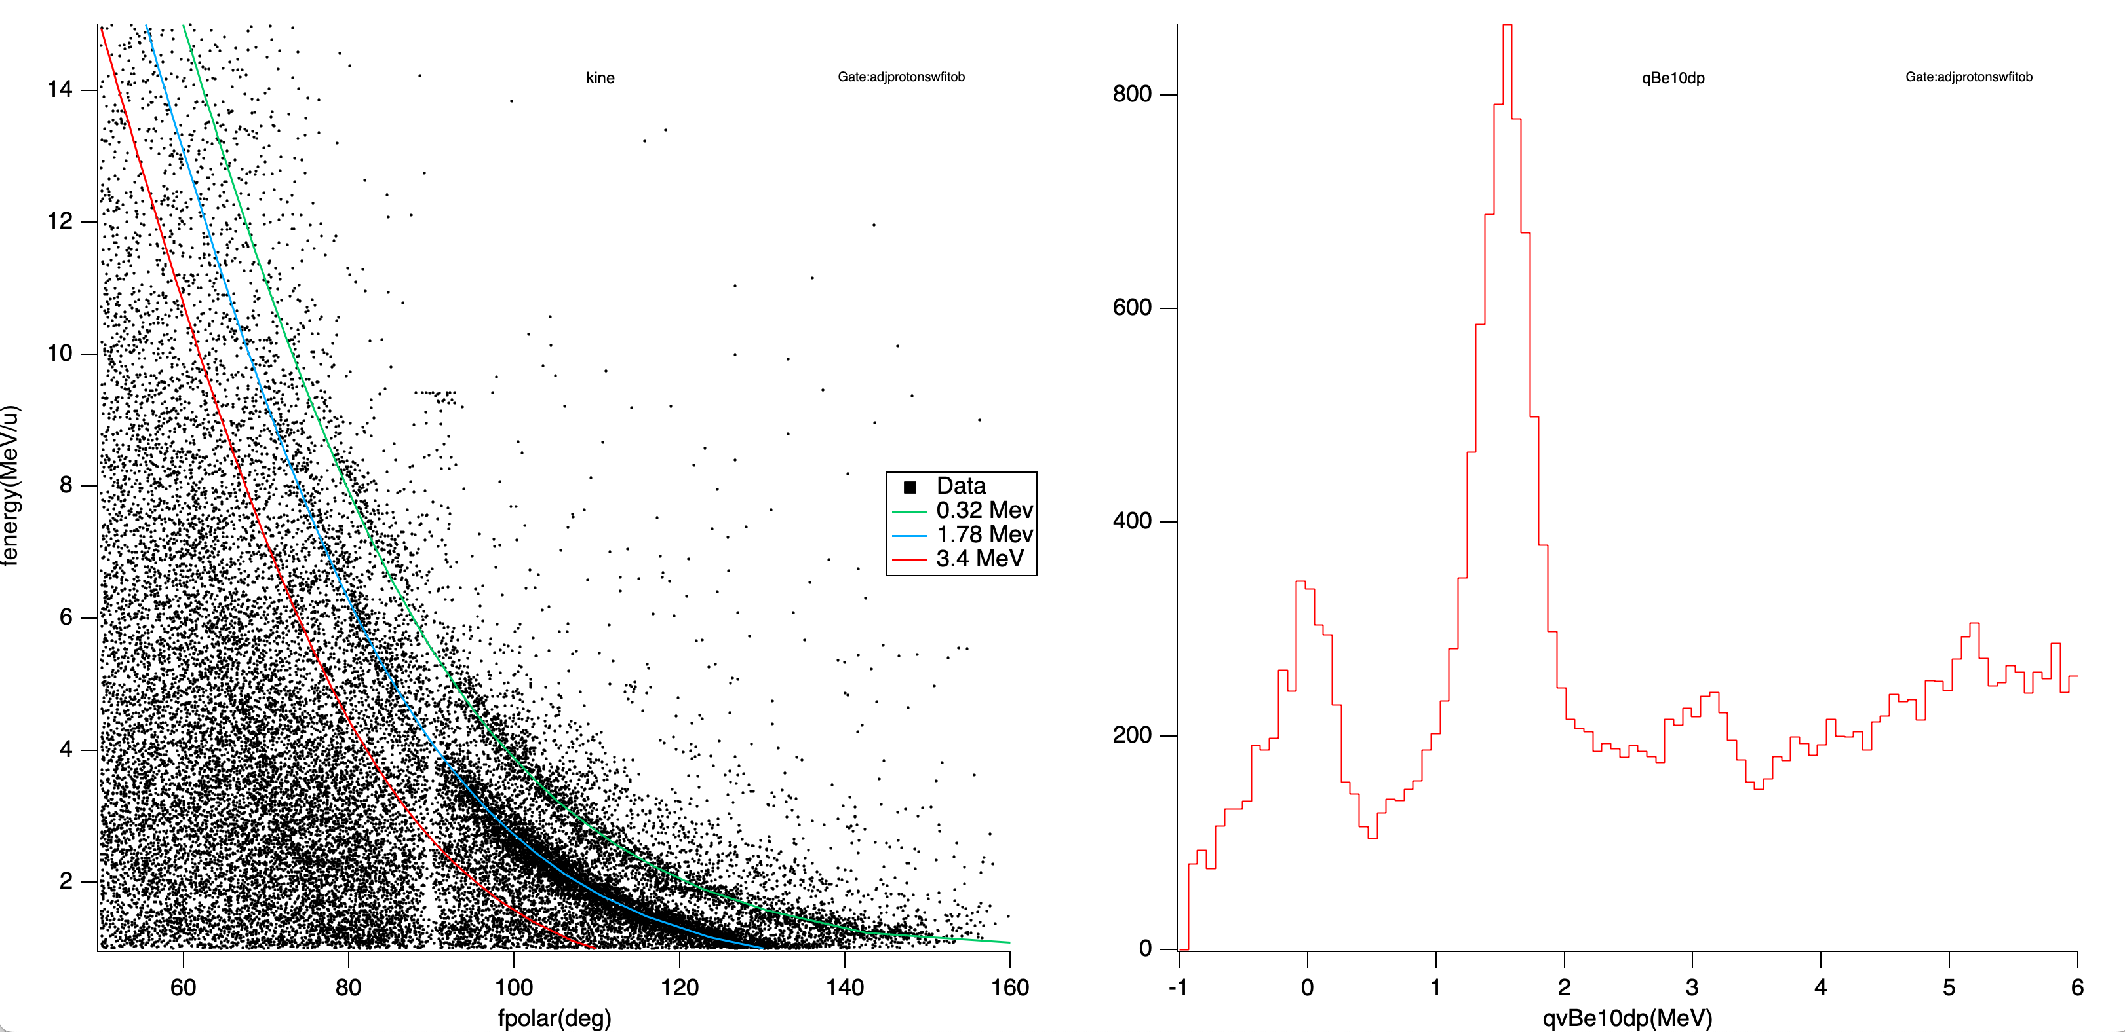
¹⁰Be(d,p) transfer
5/2⁺
Resolution ≈ 0.25 keV
Proton energy (MeV)
Counts
1/2⁻
1/2⁺
3/2^{+/-}
Proton lab angle (deg)
¹¹Be excitation energy (MeV)
Notes:
If we gate on protons, we find the events corresponding to 10Be(d,p). On the right is a histogram of the calculated excitation energy of the heavy residue (with a correction for the beam energy). We clearly see the 1/2- and 5/2+ levels in 11Be. Note that we do not see the 3.41 MeV level in this diagram. This is because these plots shown only include two hours worth of data at 1000 pps. (plus we have a background). We need to include much more statistics from our many other hours of runs. This also shows a strength of the AT-TPC and why active targets are well-suited for rare isotope beams: they have a large luminosity. We can obtain kinematic lines with little data.
We can also see that our contamination is affecting these results. On the right histogram we find negative excitation energies, which do not make sense. We have pile-up from 10B(d,p) which can cause identification of the incident beam particle to be incorrect, as in these events. This 10B pile-up stems from us not having a pure beam as mentioned earlier. On the left you can see the kinematic line constructed for the 5/2+ state (also notice the contamination).

Slide 11
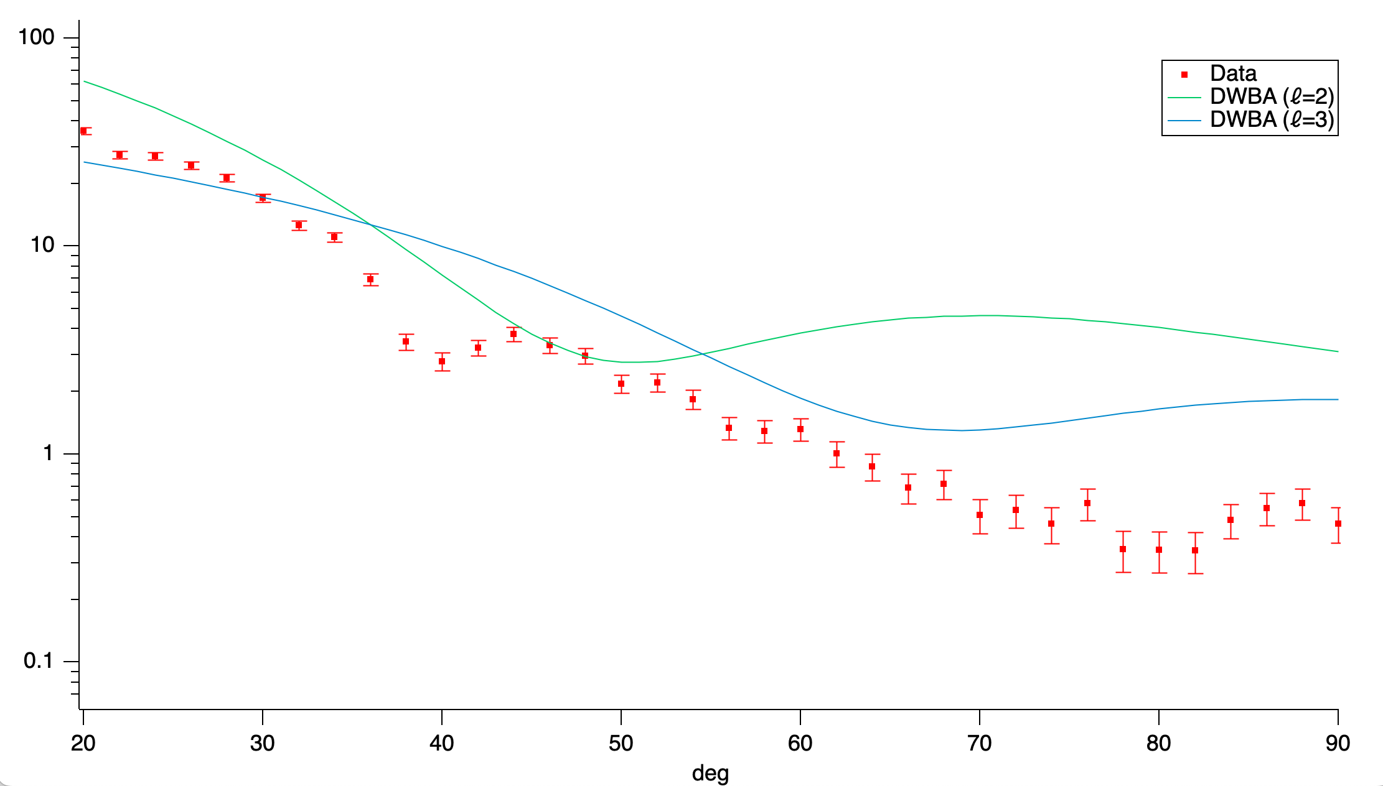


5/2⁺ 1.78 MeV resonance
$dσ/dΩ$ (mb/sr)
$θ$_{cm}
Notes:
From the previous slide, we can create angular distribution plots of the differential cross section for different energy levels of 11Be. Here we compare our data to theoretically calculated values from DWBA. We only show the DWBA line with the l-value that best fits the data. The experimental points are expected to better fit the DWBA predictions as we increase the amount of data analyzed. This should also decrease the error. With these plots, we can determine the angular momentum between the residual proton and 11Be (in the left plot, we have l=1 and in the right plot we have l=2). Since we know the parity of 10Be, the neutron, and the relative angular momentum, we can determine the parity of the excited 11Be state (remember I did this earlier with the angular momentum distribution plots). Of course, in these two plots we already know the parity of these two states, but we want to apply this method to the fourth state of 11Be whose parity is unknown. We show here that this method is viable with our experimental setup. We need to analyze more of our data set to start looking at this fourth excited state.
Optical model used was Konig and Delaroche for outgoing channel and An and Cai for deuteron incoming channel

Slide 12
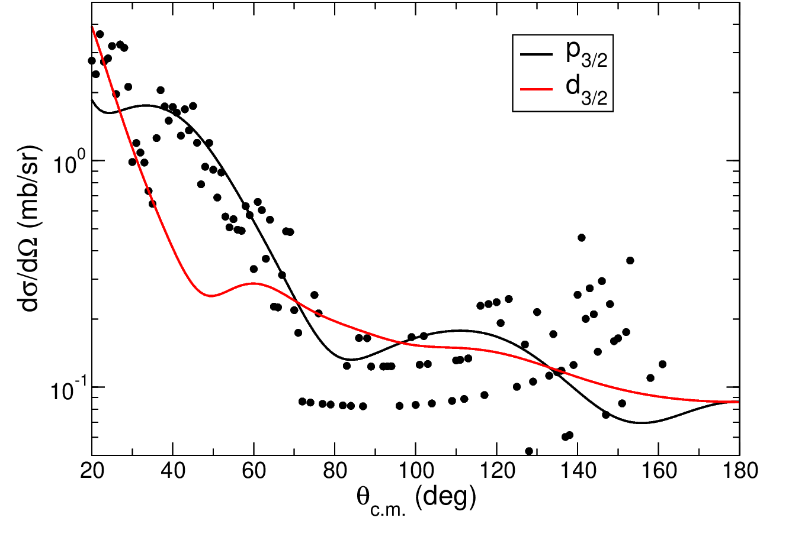
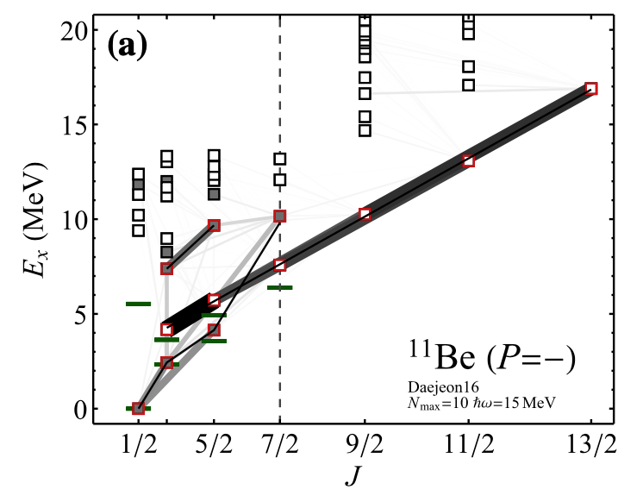
3.4 MeV resonance
Angular distribution supports ℓ =1 transfer which gives a negative parity
Caprio et al theoretical prediction of K^{P}=3/2⁻ band head at this resonance
PRELIMINARY
Reaction calculation by Nick Keeley
Caprio, M.A. et al. Probing ab initio emergence of nuclear rotation. Eur. Phys. J. A 56, 120 (2020)

Slide 13
Remaining work
Remove ¹⁰B(d,p) contamination and background
  Enhance fitting procedure
Have non-DWBA theoretical calculations done for gs, 0.32 MeV state, and 1.78 MeV state
Determine experimental uncertainties
Calculate detector efficiencies
Analyze entire data set
Overall, demonstrated AT-TPC can measure transfer reactions in inverse kinematics with beams intensities up to 1000 pps
Notes:
Plot differential cross sections and compare to calculations
Again, this is our main physics goal. We have yet to reach this stage for reasons I previously mentioned and will mention in a second.
Determine the parity of the 3.41 MeV resonance
Remove ¹⁰B(d,p) contamination
Tighten IC gate
Resolve pile-up when more than one incoming ion in time window
Towards end of experiment: pure ¹⁰Be beam provided by ReA6
Evaluate incoming ¹⁰Be flux
Use downscaled beam events to count number of ¹⁰Be in IC gate
Analyze entire data set
Calculate detector efficiencies
Simulate ¹⁰Be(d,p) reaction in AT-TPC
Determine energy and angular acceptances as a function of vertex position
Unbound states may require more complex calculations involving the continuum. Have nick keeley perform more calculations for the 1.78 mev state and at this point might as well do ground state and first excited state as well

Slide 14
Acknowledgements
Daniel Bazin, Nabin Rijal, Jie Chen, Wolfgang Mittig, Saul Beceiro-Novo, Yassid Ayyad, Clementine A Santamaria, Nick Keeley
This work is supported by the U.S. Department of Energy, Office of Science, Office of Nuclear Physics under Grant DE-SC0020451.

Slide 16
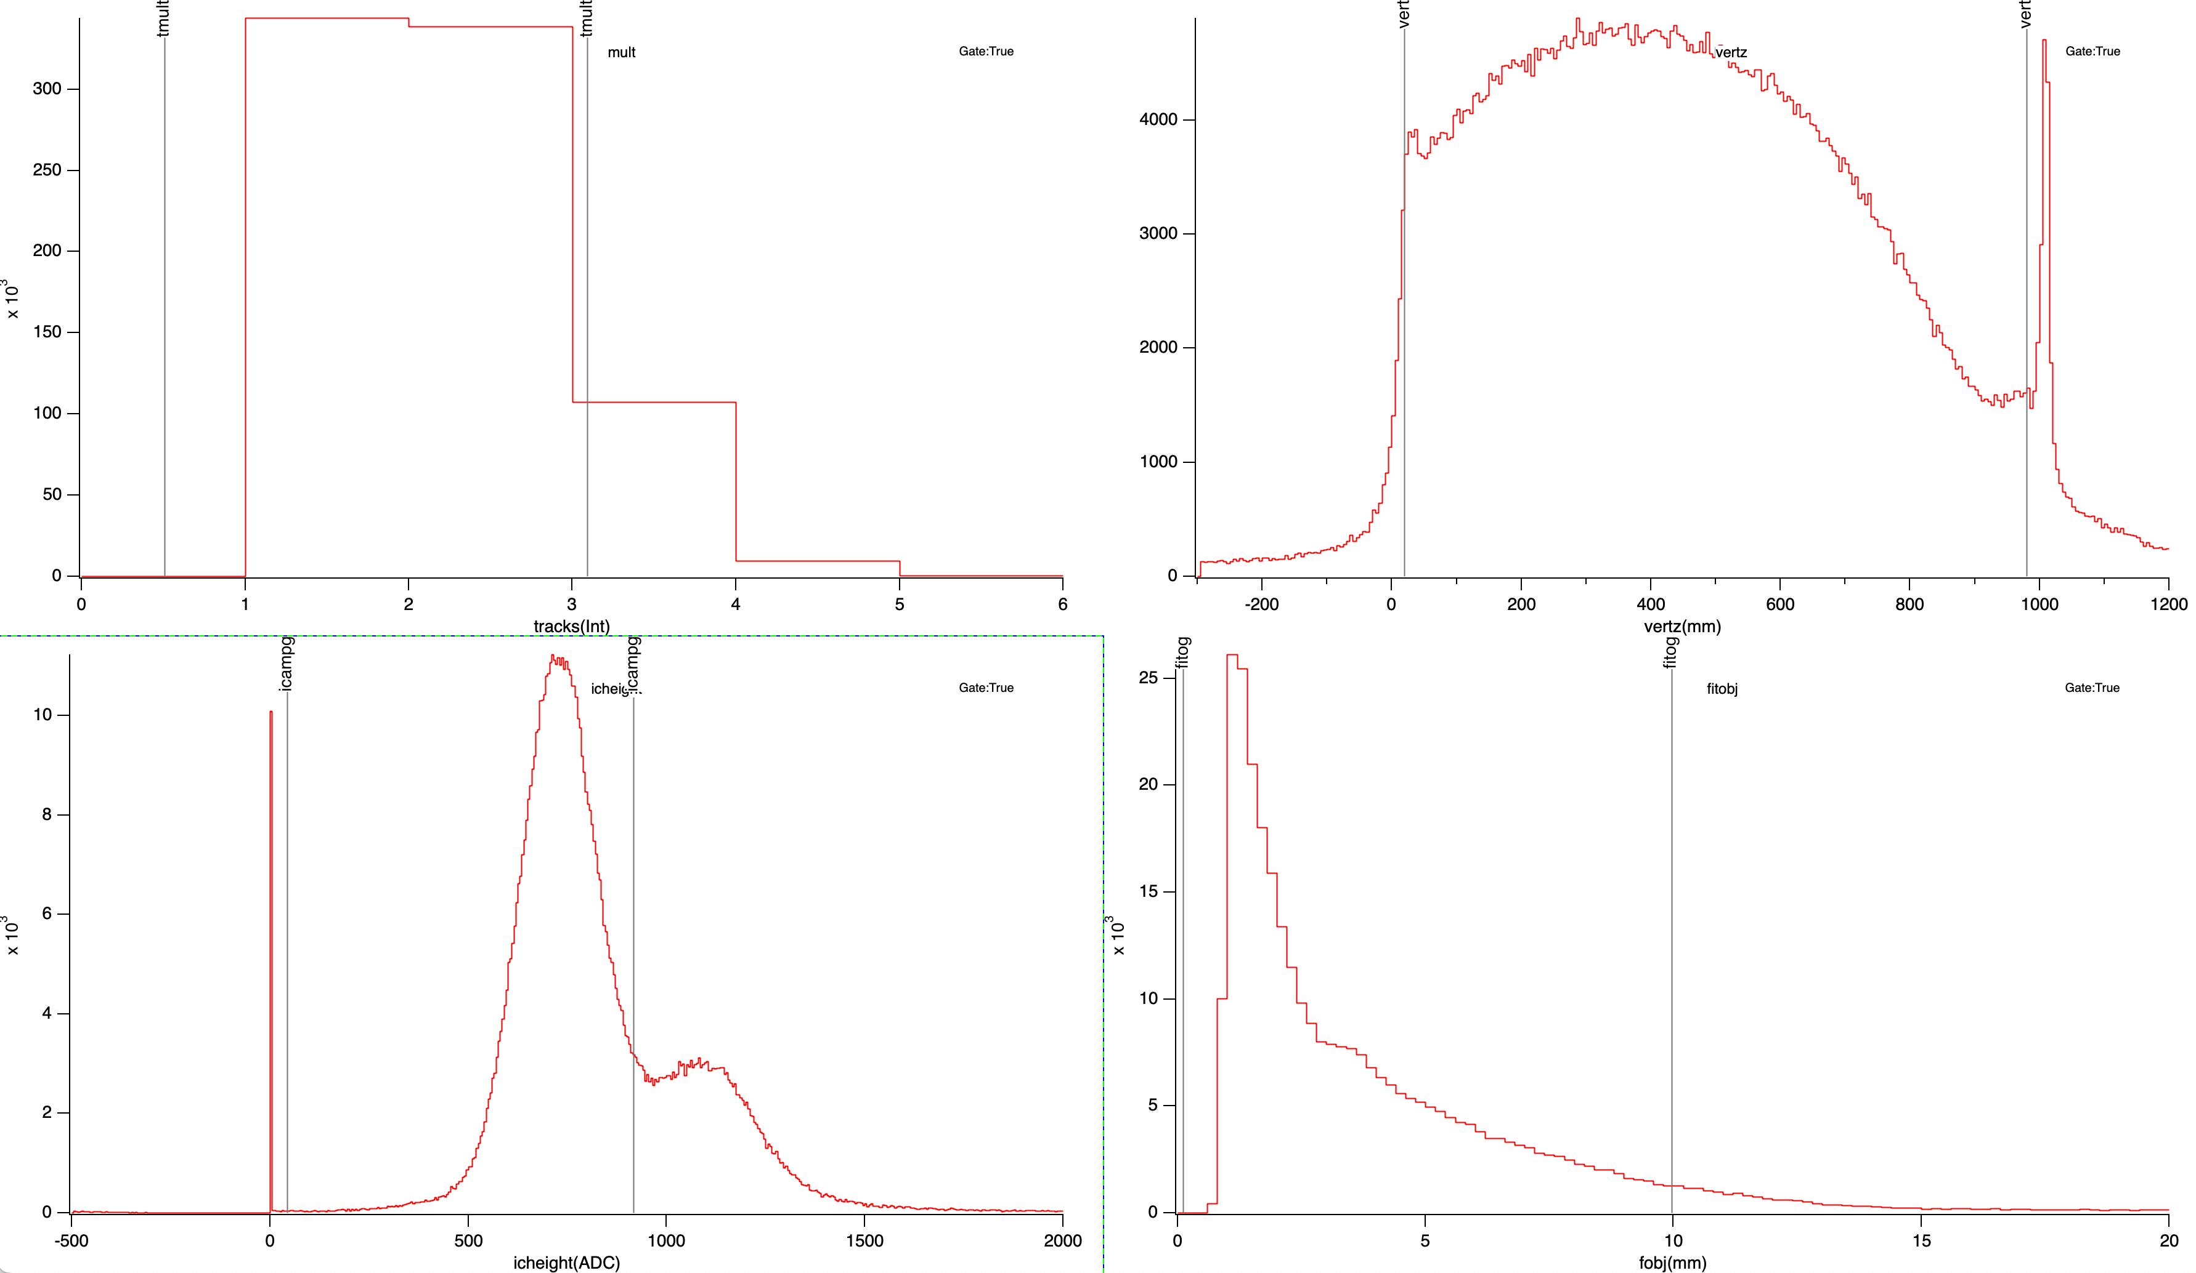
Additional gates
Track multiplicity
Vertex z-position
IC signal amplitude
Fit objective function

Slide 17
AT-TPC
Active Target – Time Projection Chamber
250 liters (1 m long by 55 cm wide)
Oriented on beam axis
Notes:
Active Target – Time Projection Chamber
AT-TPC is an active target, thus the target is the gas filling the detector
Having such a big active target gives us a high luminosity, which is an advantage over passive targets. This will become apparent later when you see how such little beam time yields a relatively large amount of data.
Note that this insulator gas is to prevent sparking between inner and outer volumes near the cathode which supplies HV

Slide 18
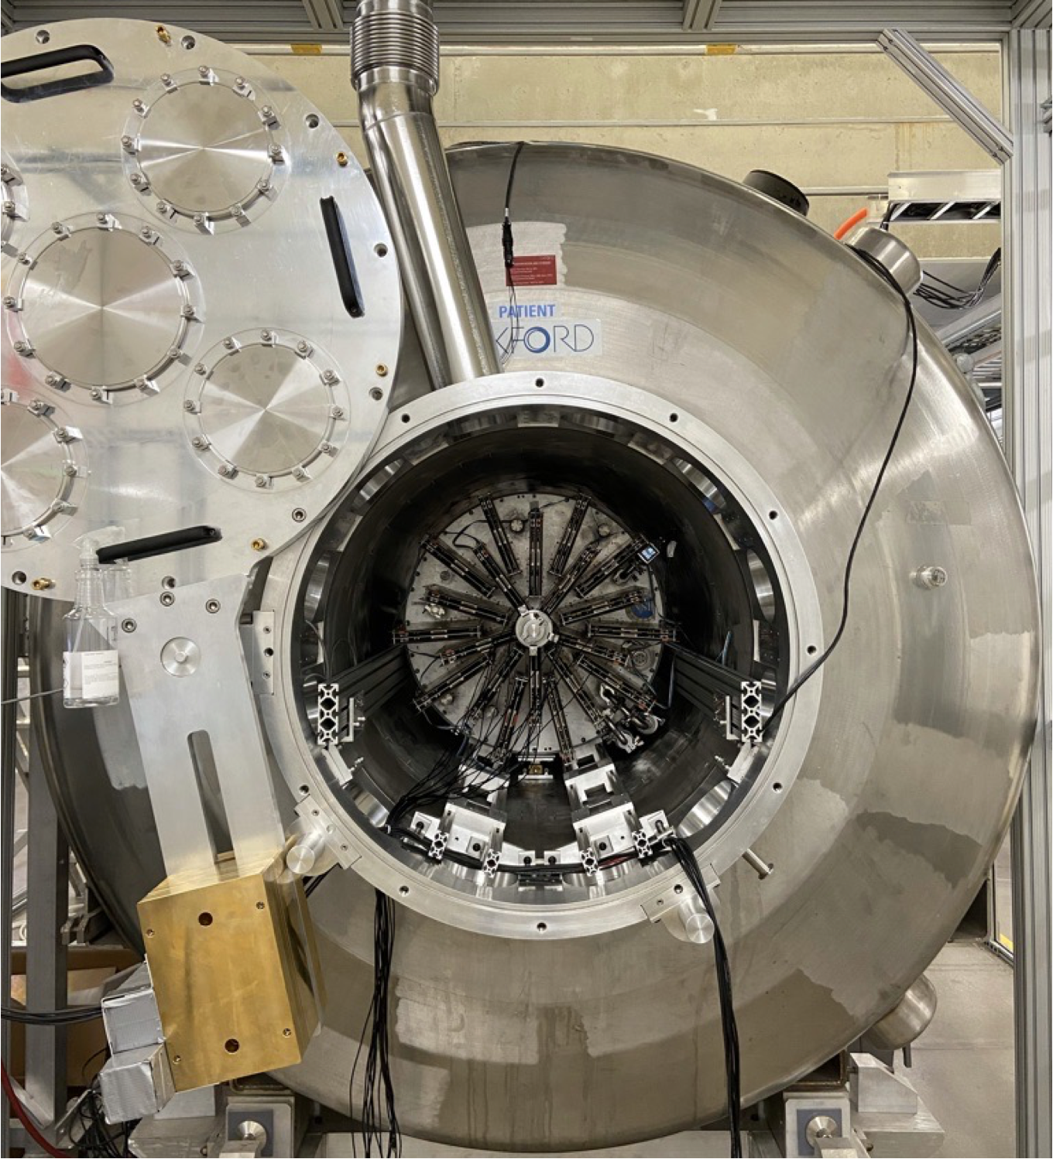
SOLARIS solenoid
AT-TPC placed inside large bore MRI solenoid
SOLARIS solenoid can go up to 4 Tesla
Curve trajectories of scattered particles
  Increase their trajectory length and measure their range
  Measure their magnetic rigidity
Notes:
Curve trajectories of scattered particles
Curving the trajectories of scattered particles is convenient because we increase their tracks in the detector which means we have more information about them. The particles are significantly more likely to deposit their entire energy rather then fly out of the active volume
Its also useful because it allows us to measure their magnetic rigidity for PID.

Slide 19
¹⁰Be(d,p) in the AT-TPC
¹⁰Be beam from the ReA6 linac
  Energy of 9.6 MeV/u
  Rate of ≈ 1-2k Hz
  Contamination of ¹⁰B and ¹⁵N
AT-TPC filled with 600 Torr of pure deuterium gas
SOLARIS solenoid set to 3 Tesla
Small ion chamber placed upstream of the AT-TPC
Trigger set on mesh signal with signal suppression in beam region
Ran for 120 hours
Notes:
Here I list some of the experimental parameters and conditions (go through them).

Slide 20
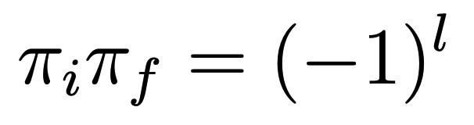
Equations for determining spin/parity
1.
2.
Notes:
These are parallel momenta distribution plots of the 33Mg fragments produced from the knockout reaction for different levels in 33Mg. The eikonal approximation was used to calculate these momenta distributions for the removal of a neutron from different orbitals. For the ground state of 33Mg, we see that momentum distribution is best represented by neutron removal from the 2p3/2 orbital. This implies that the ground state of 33Mg has a negative parity, as illustrated by the equation.
Note the large error bars for the 484 keV state and the 1850 keV state. For the 484 keV state these errors come from the feeding of this state by other higher energy states. For the 1850 keV state, it’s simply because there are not enough statistics
From these momenta distributions, we clearly see the exclusion of any relative angular momentum of l=3. This is intriguing because all shell model calculations predict the lowest 7/2- state to be populated with a significant strength. It’s possible that this state is an isomer. Bazin et al showed that the l=3 strength does exist by fitting their found inclusive parallel momentum distribution.

Slide 21
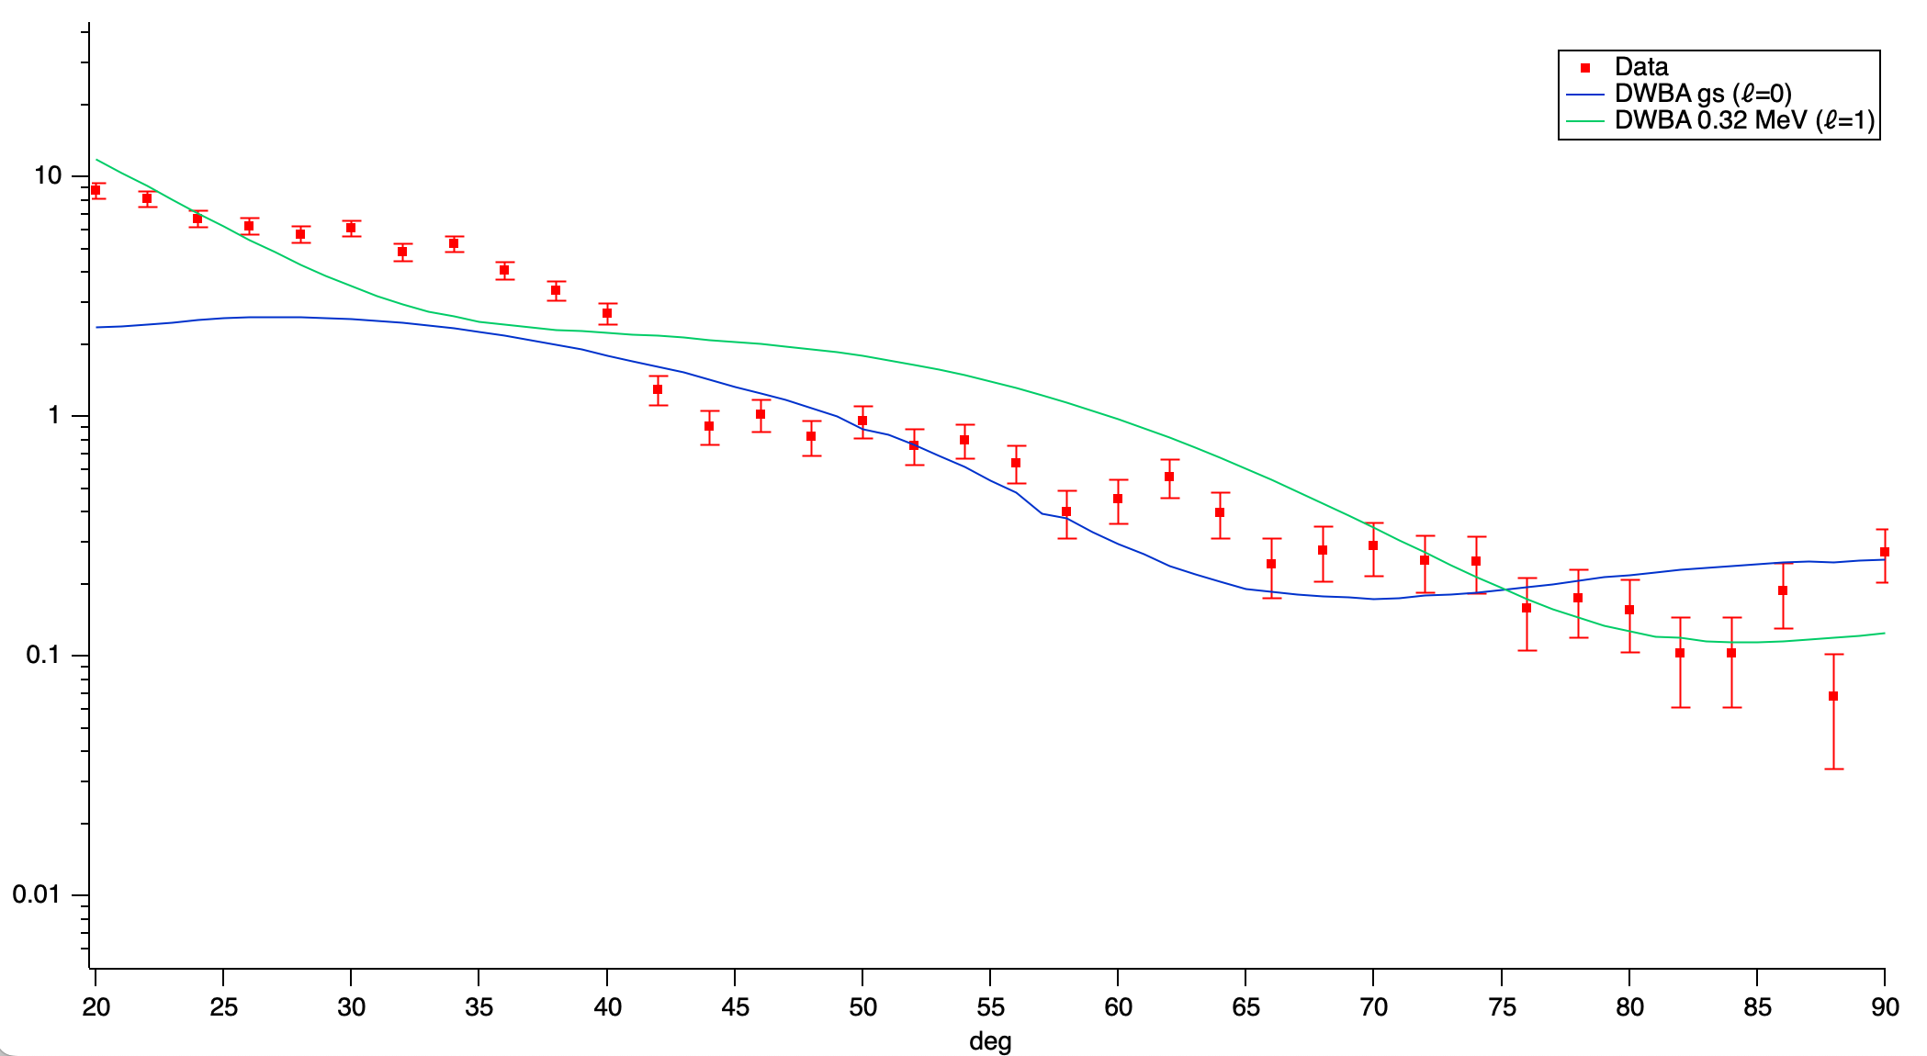


1/2⁺ gs and 1/2⁻ 0.32 MeV state
$dσ/dΩ$ (mb/sr)
$θ$_{cm}
Notes:
From the previous slide, we can create angular distribution plots of the differential cross section for different energy levels of 11Be. Here we compare our data to theoretically calculated values from DWBA. We only show the DWBA line with the l-value that best fits the data. The experimental points are expected to better fit the DWBA predictions as we increase the amount of data analyzed. This should also decrease the error. With these plots, we can determine the angular momentum between the residual proton and 11Be (in the left plot, we have l=1 and in the right plot we have l=2). Since we know the parity of 10Be, the neutron, and the relative angular momentum, we can determine the parity of the excited 11Be state (remember I did this earlier with the angular momentum distribution plots). Of course, in these two plots we already know the parity of these two states, but we want to apply this method to the fourth state of 11Be whose parity is unknown. We show here that this method is viable with our experimental setup. We need to analyze more of our data set to start looking at this fourth excited state.

Slide 22
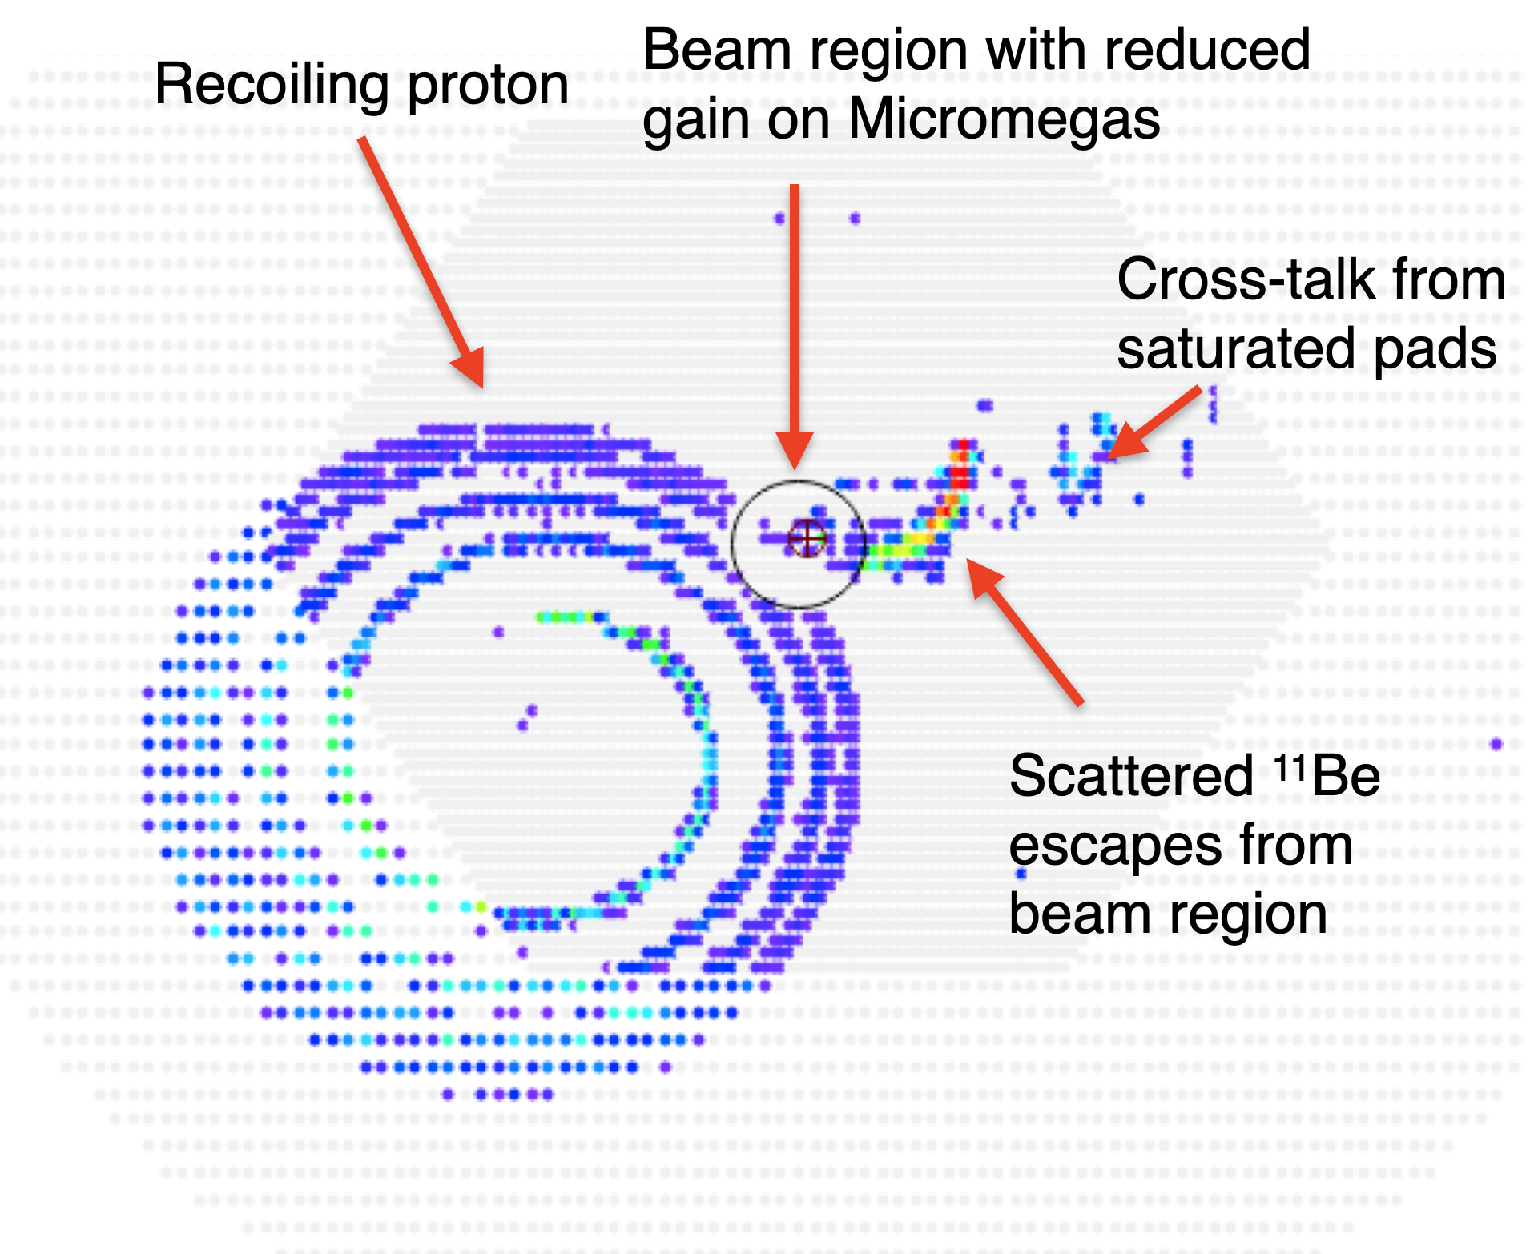
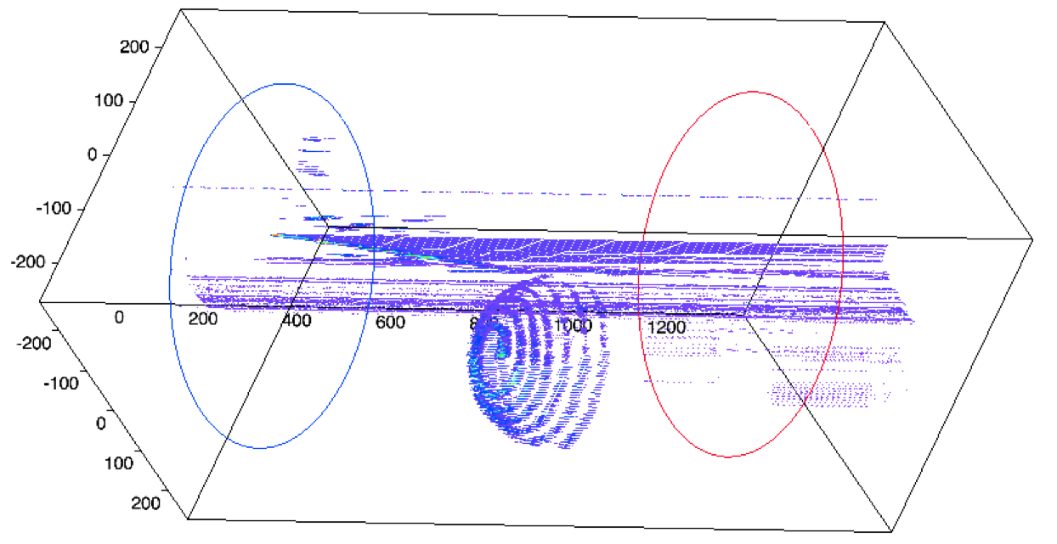
¹⁰Be(d,p) in the AT-TPC
Notes:
Here is a 10Be(d,p) event. The top left image is the pad-plane projection. We can see the recoiling proton left from the deuteron transferring a neutron to the incoming 10Be. We also see the scattered 11Be. Note that we see the signal suppressed in the beam region as the proton’s track is cut here. We do this so our trigger is not set off by just the beam but that we require a reaction that leaves tracks outside the region of the beam. In the bottom right image we see the 3D reconstruction. There is quite a bit of noise in this which was not removed.

Slide 23
Pros/cons of active targets
Pros
  Target thickness and resolution no longer compete as in passive targets
  Very large solid angle coverage (essentially 4π)
  Light nuclear probes are naturally gas at room temperature, so they are used in their purest form in active targets
    p, d, t, ³He, α
Cons
  Usually must use low intensity beams
  Target gas properties are not always great for a detector gas
  Triggers are tricky
  Complex data analysis
Slide adapted from “D. Bazin, Why active targets? What is all the buzz about?, Personal communication, 2021. Presentation given at ECT 2021 summer school.”
Notes:
Pros
Target thickness and resolution no longer compete as in passive targets
We now the location of the interaction in an active target, not in a passive target
Very large solid angle coverage (essentially 4π)
Only eventually excluded regions are where the beam is present

Slide 24
E20009 Trigger

Slide 25
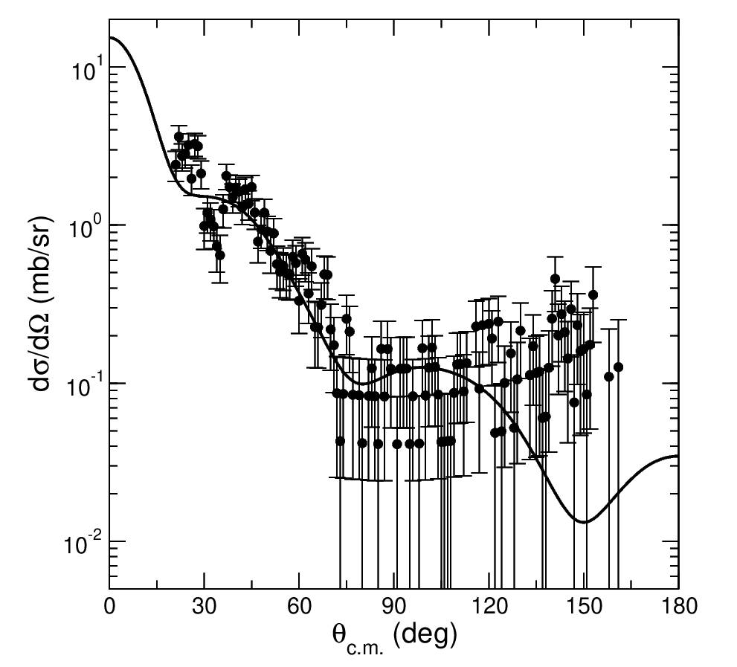
3.4 MeV resonance
PRELIMINARY
Reaction calculation by Nick Keeley

Slide 26
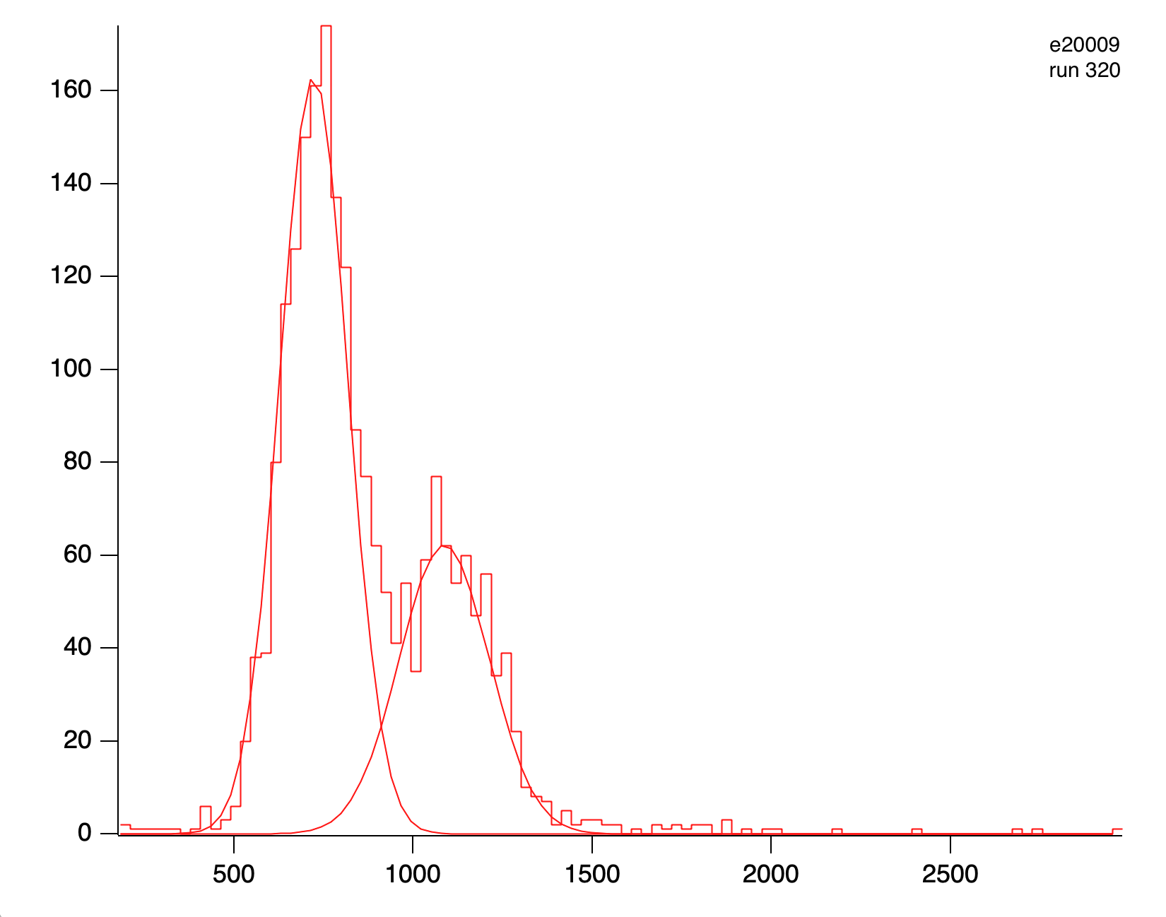
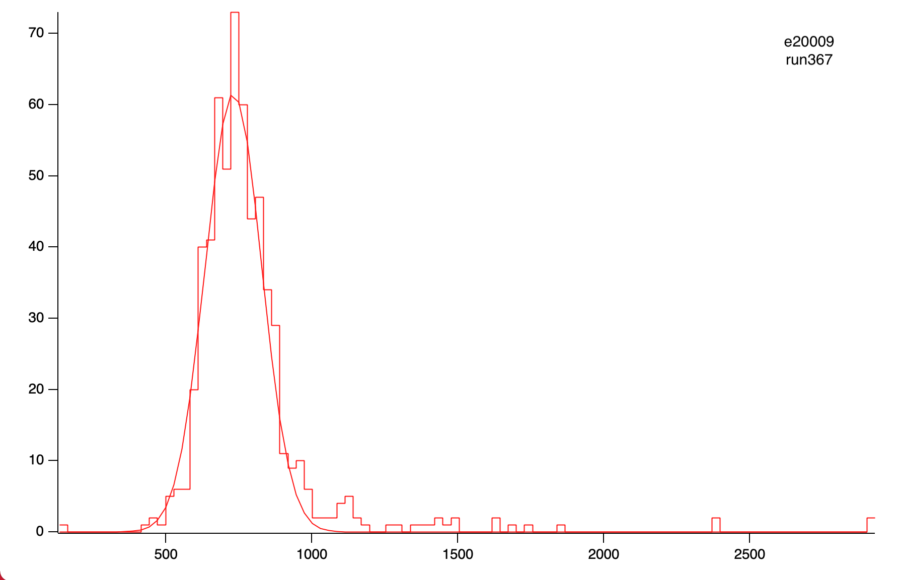
¹⁰Be(d,p) beam purity
¹⁰Be
¹⁰Be
¹⁰B
¹⁰B
¹⁵N
¹⁰Be
Histograms where y axis is amplitude of IC signal that triggered SCA
Only a subset of beam events from these runs

