Slide 1
New description to soft modes in N-alpha cluster states as Bose-Einstein condensation based on quantum field theory with zero mode excitation
State of the Art in Nuclear Cluster Physics
May 13-18, 2018
Junichi Takahashi (Waseda Univ.)
Collaborators :
R. Katsuragi, Y. Kazama,
Y. Nakamura, Y. Yamanaka (Waseda Univ.)
S. Ohkubo (Univ. of Kochi, RCNP)
Paper 1
Paper 2
Notes:
I thank organizers for giving me an opportunity of this talk.
I’d like to talk about new soft modes that appear with N-alpha cluster condensation based on the quantum field theory.
Collaborators are these people (Katsuragi, Kazama, Nakamura, Y. Yamanaka at Waseda University and S. Ohkubo at Univ. of Kochi and RCNP).
We are preparing a paper on my talk and will finish it very soon.
Part of today’s presentation has already been published in PRC.

Slide 2
Stand point
Approach
  N-alpha cluster state → Bose-Einstein condensation (BEC)
  Phenomenological model of Quantum field theory
  Quantum field theoretical approach for finite system
  with spontaneous symmetry breaking
  (formulated in trapped cold atomic systems)
Distinctive features
  Order parameter of BEC is given by
  vacuum expectation value of field operator
  Quantum fluctuation of order parameter
  (described by new operators) gives the physical effects
  ⇒ New discrete zero mode states in the energy spectrum
Y. Nakamura, J.T, and Y. Yamanaka, Phys. Rev. A. 89, 013613 (2014)
Notes:
Our standpoint is as follows.
We consider the N-alpha cluster state as Bose-Einstein condensation.
And, we take a phenomenological model and use the quantum field theoretical approach for finite system with spontaneously symmetry breaking.
We first formulated this approach in trapped cold atomic systems in this paper (PRA).
There are two distinctive features of our approach.
First, an order parameter of BEC is given by the vacuum expectation value of field operator.
Second, quantum fluctuation described by new operators related to the order parameter gives the physical effects.
New discrete states in the energy spectrum is an example of this effects.

Slide 3
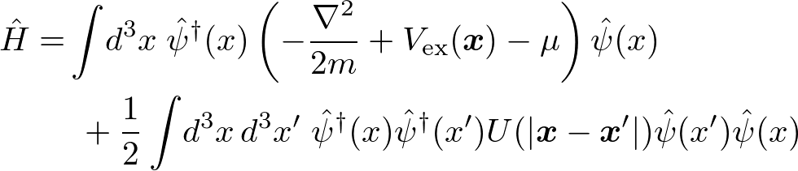







Phenomenological model
Number of alpha particles：
Hamiltonian
Order parameter
  Defined by vacuum expectation value of field operator
describes alpha particles
Phenomenological potentials
  Confinement : external HO potential
  alpha-alpha interaction : Ali-Bodmer potential
Finite system
× plane wave expansion
Number of condensate particles：
Condensate rate：
Notes:
We start with the phenomenological model.
The Hamiltonian is here.
The psi is the field of the alpha cluster.
M is the mass of the alpha cluster, and Mu is the chemical potential.
<pointing at a picture>
We suppose that the alpha clusters are trapped inside the nuclei by the external harmonic potential.
And the alpha-alpha interaction is given by the Ali-Bodmer potential.
I’d like to stress that this system is finite and has no translational invariance.
So, we cannot use the plane wave expansion.
When the alpha particles are condensed, the order parameter is given by vacuum expectation value of the field operator.
The order parameter is related to the condensed particle number.

Slide 4


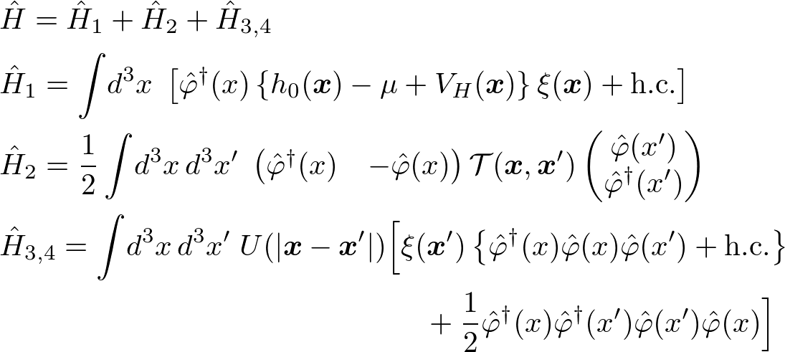
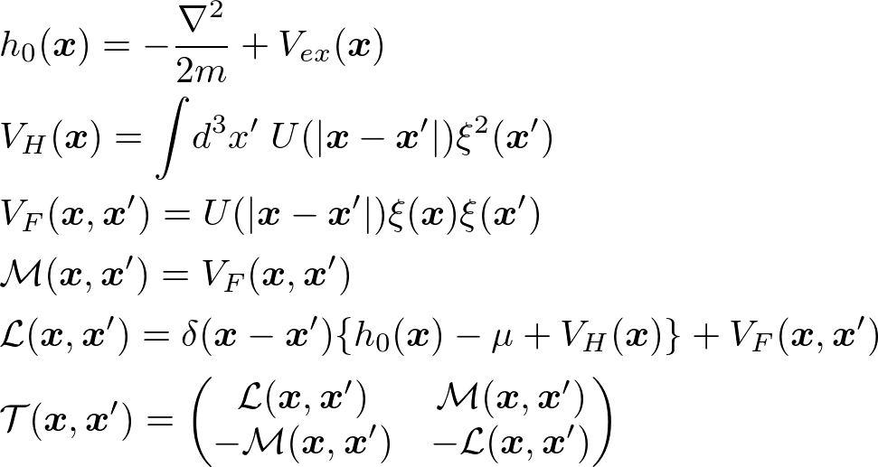

Rewriting Model Hamiltonian
Field operator excluding order parameter
Rewriting Hamiltonian in terms of
  Stationary condition for ground state :
Notations:
Gross-Pitaevskii equation :
Notes:
Next, we introduce a field operator phi, excluding the order parameter and rewrite the Hamiltonian in terms of phi.
We classify the Hamiltonian according to power degree of phi as follows.
We impose the stationary condition for a ground state.
From this condition, H1 term vanishes, and we obtain the Gross-Pitaevskii equation.

Slide 5

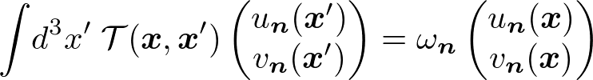


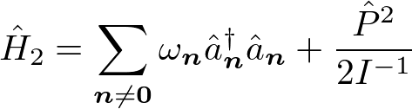

Diagonalization of Hamiltonian
Considered as the field is “small” ⇒
Diagonalization for Hamiltonian
  Completely orthonormal set :
  eigenfunctions of Bogoliubov-de Gennes (BdG) equations
  Expanded field operator
Diagonalized Hamiltonian
playing crucial role
in our approach
Notes:
Let us diagonalize the Hamiltonian.
We consider as the phi field is small, and the H3,4 can be ignored.
To diagonalize the Hamiltonian, we expand the field operator by the complete orthonormal set of the Bogoliubov-de Gennes eigenfunctions.
The field includes the creation-annihilation operators and canonical operators.
And, the Hamiltonian is diagonalized as follows.
It is the sum of harmonic oscillator type and free Hamiltonian.
These operators are playing a crucial role in our approach.
So, let us pay attention to Q and P.

Slide 6


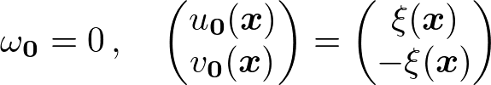


Source of
Nambu-Goldstone theorem in finite system
  NG theorem asserts :
  There should exist an eigenfunction proportional to order parameter
Indeed, the eigenfunction of BdG eqs. with zero eigenvalue exists
Zero eigenvalue
Q appears with this eigenfunction
Necessary to satisfy
CCR of
Zero mode (ZM) operators
Notes:
The source of Q, P is the Nambu-Goldstone theorem in finite system.
This theorem asserts that there should exist the eigenfunction proportional to the order parameter xi.
Indeed, the eigenfunction with zero eigenvalue exists.
Therefore, the Q term appears in the expansion of field operator.
The P term is necessary to satisfy the canonical commutation relation of the field operator.
Eta is given by this.
We call Q and P as the zero mode operators.

Slide 7


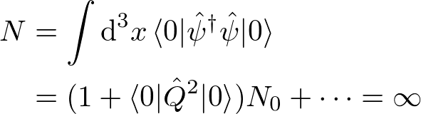
Difficulty with
Divergence of physical quantities for vacuum expectation
  Vacuum of zero mode operators
  Vacuum expectation of powers of Q diverges
  e.g.
  Physical quantities including powers of Q diverge
  e.g. number of alpha particles
Eigenstate with zero eigenvalue of P
Wrong result
in the finite system
Notes:
These Q and P induce the difficulty.
The difficulty is the divergence of physical quantities for vacuum expectation.
This reason is because the vacuum of the zero mode operators is defined by an eigenstate with zero eigenvalue of P, and the vacuum expectation values of powers of Q diverges.
So, the physical quantities including the power of Q diverge.
For example, the alpha particle number.

Slide 8



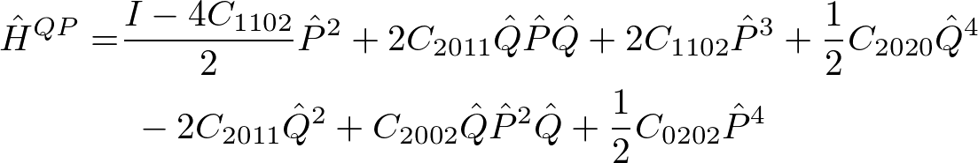
Overcoming difficulty from
Idea：ZM operators in are not “small” although is “small”
  is “small”
Taking H2 and all nonlinear terms in H3,4 consisting only to
Leading contributions
⇒
1D bound state problem
Vacuum = Bound state
⇒ no-divergence in vacuum expectation value
Y. Nakamura, J.T, and Y. Yamanaka, Phys. Rev. A. 89, 013613 (2014)
Notes:
To overcome the difficulty from ZM operators, we propose the following idea.
The zero mode operators Q, P in the field are not small although a is small.
So, we take the H2 and all nonlinear terms in H3,4 consisting only to ZM operators instead of only H2 as the Hamiltonian.
New ZM operator terms in Hamiltonian is follows.
Leading contributions of Hqp are P^2/2I^{-1} + C_{2020} Q^4/2.
Then, Hqp describes the 1-dimensional bound state problem.
So, the vacuum becomes the bound states.
As a result, there are no-divergence in the vacuum expectation value.

Slide 9




Distinctive feature of our proposal
Appearance of new soft mode states from
  Eigenstate of Hamiltonian
Eigenstate of
Eigenstate of
Zero mode equation
: BdG excited mode states
appear as a new spectrum
: ZM states
New soft mode !
Notes:
The distinctive feature of our proposal is an appearance of new soft mode from ZM operators.
The eigenstates of the Hamiltonian are described by the direct product of the Fock space and the eigenstates of a zero mode equation.
The eigenstates of the zero mode equation appear as a new spectrum, and are called the zero mode states, which are new soft modes.

Slide 10




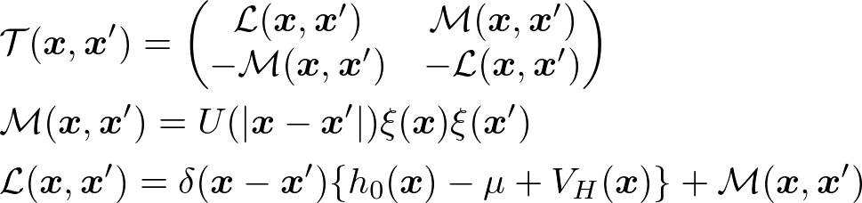


Flow of calculation for energy spectra and wave functions
1. Set parameters in phenomenological potentials
2. Solve GP equation
3. Solve BdG and ZM equations
Low-cost calculation!
Easy to extend to N-alpha system
Notes:
I explain the flow of calculation for energy spectra and wave function.
First, we set parameters in the phenomenological potentials.
Second, we solve the GP equation, and obtain the order parameter xi and chemical potential mu.
Finally, we solve BdG and ZM equations.
This is a low-cost calculation and easy to extend to N-alpha system.
no extra cost in extension!

Slide 11
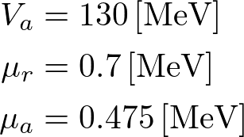






How to determine parameters
Parameters are determined by
  Fitting calculation { }
  Ali-Bodmer’s values { }
Fitting parameters determined by
Key parameter
determining radius
of condensate
Key parameter for preventing condensate
from collapsing
Remaining parameters
are not important as
N-alpha
Experimental data
rms radius of Hoyle state
Energy of state
Assumption
rms radius of Hoyle-like states
behave as
(similarly as ordinary nuclei )
Notes:
Next, I will explain how to determine the parameters.
We determine the omega and Vr by fitting calculation, and remaining parameters by using the Ali-Bodmer’s values.
This is because, omega is a key parameter that determines the radius, and Vr is an important parameter that prevent condensate from collapsing.
Two inputs, that is, rms radius of Hoyle state, and Energy of 03+ state, determine omega and Vr.
Or, in case of N-alpha, we determine the parameters, considering that omega and Vr may depend on N, with an assumption that the rms radius of Hoyle-like states behave as r-bar is proportional to the cube root of the alpha particle number.
It is similar as the ordinary nuclei.

Slide 12
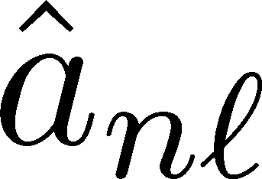

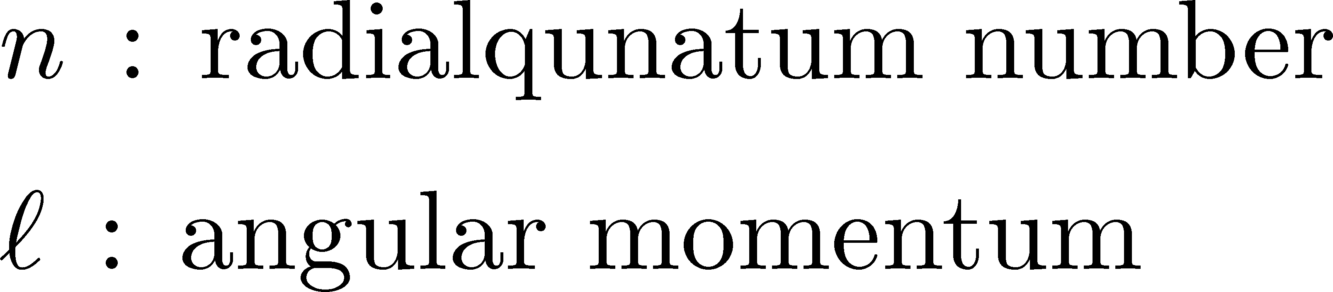
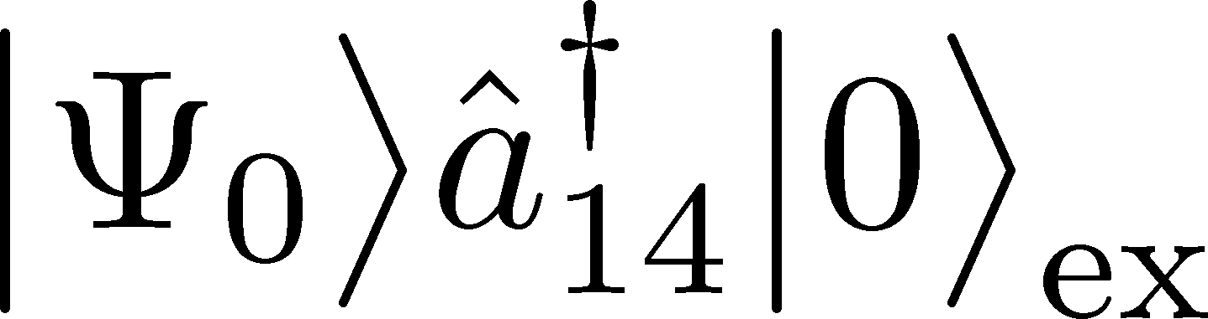
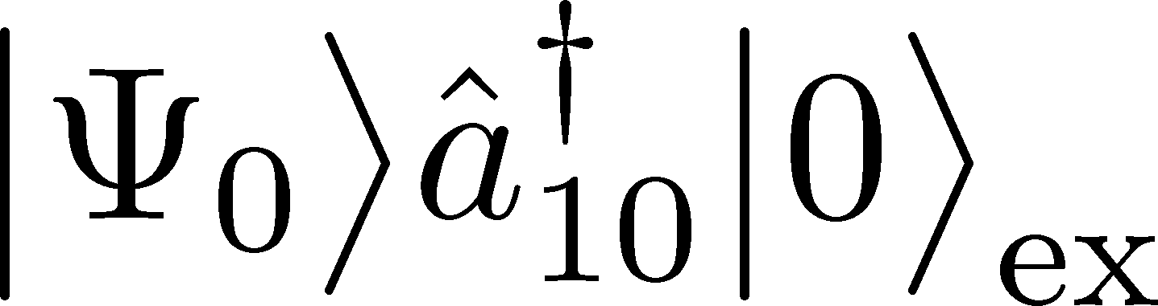
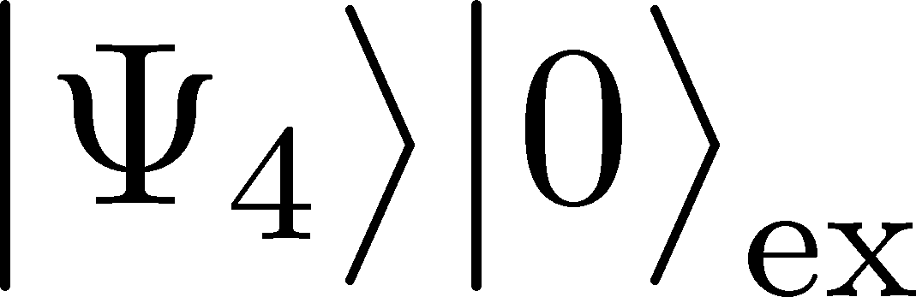

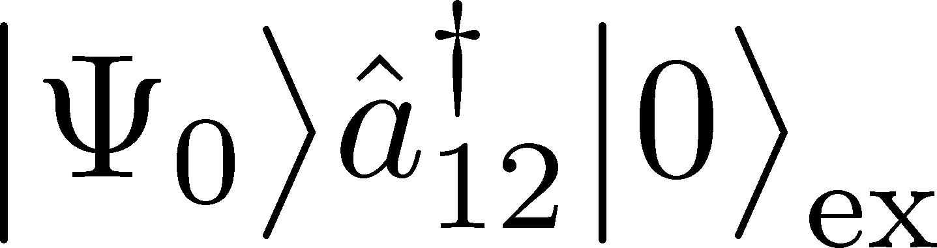

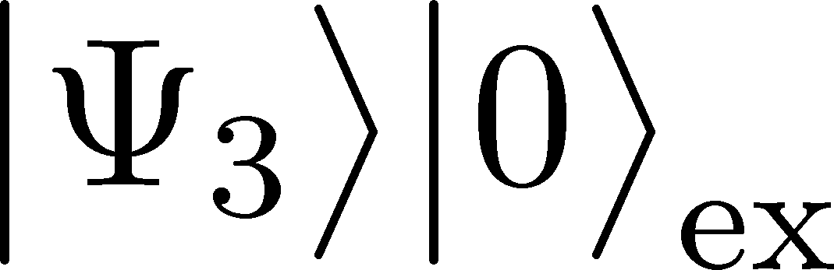
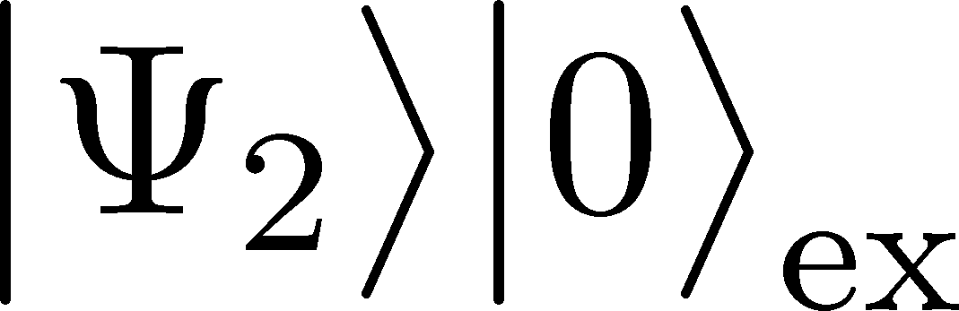
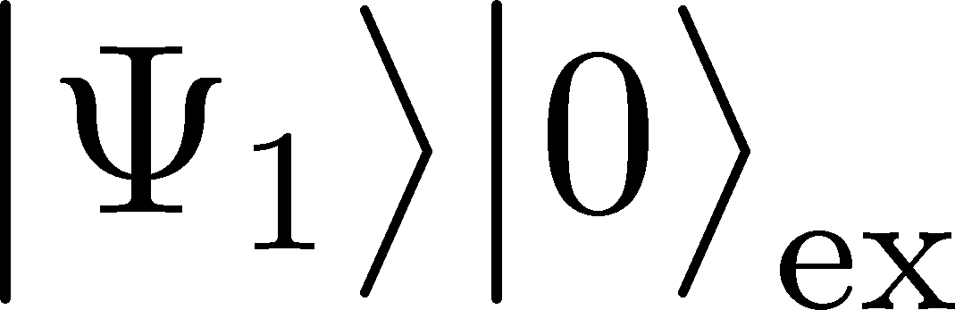
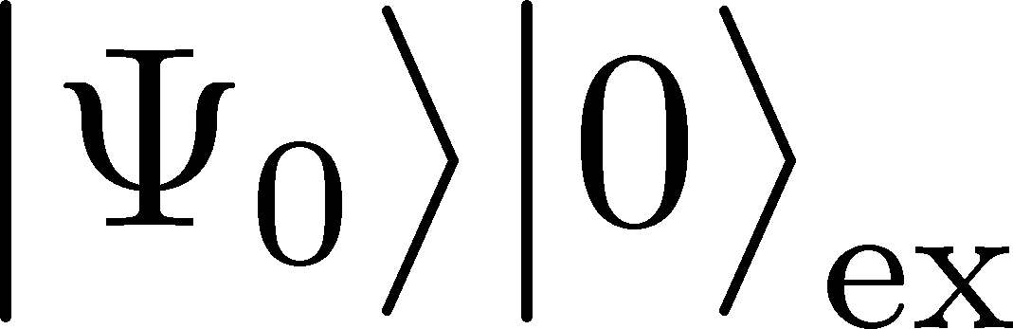
Result for
Fitting condition
rms radius of Hoyle state
Energy of state
Condensation rate : 70%
Result
: ZM states
: BdG states
⇒ Our prediction
Energy spectra is Robust to change in
  rms radius
  condensation rate
  (not shown here)
(Hoyle state)
rms radius of Hoyle state
Notes:
Here are numerical results for 12C when condensation rate is 70%.
The left side of the figure is the experimental value and the right side is the calculated value.
The horizontal axis is the rms radius of Hoyle state.
It shows a good agreement with experiment.
There 03+ and 04+ are identified as the zero mode states, and 22+ and 41+ are identified as the BdG excited mode states.
The other spectra are our prediction. The undiscovered energy levels.
Moreover, this result shows that the energy spectra is robust to change in rbar.
Although not shown here, it is also robust to change in the condensation rate.

Slide 13

Result for N-alpha
Fitting condition
rms radius of Hoyle-like states
behave as
(similarly as ordinary nuclei )
Condensation rate : 70%
Result
Spectrum of
low-lying ZM states
becomes very similar independent of N
⇒ Energy spectra is
Robust to change in N
It is expected to be observed by experiment
Notes:
Next is the numerical results for N-alpha.
The horizontal axis is the alpha particle number, carbon 12 to iron 52.
Please, pay attention to these low-lying energy level.
The spectrum of low-lying zero modes becomes very similar independent of N.
It implies that the energy spectra are robust to change in the alpha particle numbers.
It is expected to be observed by experiment.

Slide 14
Summary
Approach
  N-alpha cluster state → Bose-Einstein condensation
  Phenomenological model of Quantum field theory
  Quantum field theoretical approach for finite system with SSB
Result
  Calculating the energy spectra for N-alpha state
  ZM states appear in the energy spectra as new soft mode
  Good agreement with experiment ( )
  Existence of undiscovered energy levels
  Energy spectra are robust to rms radius, condensation rate, and N
  γ-decay width (not shown today’s presentation)
  sensitive to condensation rate
Paper 1
Paper 2
Notes:
I summarize my presentation.
We consider the N-alpha cluster state as Bose-Einstein condensation.
And, we take a phenomenological model and use the quantum field theoretical approach for finite system.
With this approach, the following was found.
The zero mode states appear in the energy spectra as new soft mode. For 12C, the results are in a good agreement with experiment.
Moreover, we found that appearances of the undiscovered energy spectrum and robust energy spectra in change to the rms radius of Hoyle state, condensation number, and alpha-particle number.
Although not shown in my presentation, the gamma decay width is sensitive to condensate rates.
Thank you very much for your attention.

Slide 15
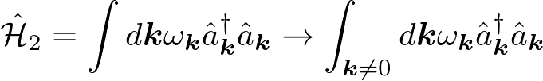
Are there difficulty of Q, P in uniform systems ?
Answer : Yes. But, one can avoid this difficulty.
We can ignore the k=0.
Because, k=0 is the point of integration
Bogoliubov approximation
Now, we consider the finite system,
so this approximation is invalid

Slide 16
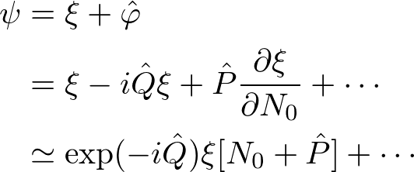
Interpretation of Q and P
phase fluctuation
Condensed particle numbers fluctuation
These are quantum fluctuations
of the order parameter (or classical field)

Slide 17
Result: wave functions

Slide 18
Result: decay widths
Funaki’s result
Kanada’s result

Slide 19
Is the condensation for system with a small particle number possible?
  One can see instabilities when a situation is unphysical.
    No solution in GP eq.
    Complex (dynamical instability) or
    negative (Landau instability) energies in BdG eq.
    Not spectrum bounded from below
  No sign of the instabilities for the parameters chosen
  in our calculations
    B) and C) are seen for weaker repulsive force

Slide 20
Comments
Definition of vacuum = wave packet
The wave packet collapses with time.
⇒ The physical quantities diverge with time
The reason that we do not include mixing term (e.g. PQa ) in the Hamiltonian
a is “small” compared by Q and P.
Therefore, these terms are “small” compared by the only P and Q terms.
The reason that using the energy by fitting
This state is the first 0+ state above the Hoyle state.
⇒ We expect that this state is to be the excitation state from Hoyle state.
Differences from other theories.
Our approach is faithful to the QFT.
We do not use approximation ignoring PQ terms.
So-called Bogoliubov approximation.

Slide 21
Comments in our paper

