Slide 1
Systematic analysis of inelastic alpha scattering off self-conjugate A = 4n nuclei
Satoshi Adachi
Research Center for Nuclear Physics (RCNP),
Osaka, Japan

Slide 2
Contents
Introduction
Inelastic alpha scattering
Missing monopole problem
Experiment
DWBA calculation
Comparison with the exp. Data
Discussion
Summary
Core collaborators
T. Kawabata (Kyoto Univ.)
K. Minomo (RCNP)
N. Yokota (Kyoto Univ.) & T. Kadoya (Kyoto Univ.)
S. Adachi et al. PRC 97, 014601

Slide 3
Introduction

Slide 4
Inelastic alpha scattering
Excitation energy and transition strength to the excited state in the target nucleus
Experimental observable
theoretical calculation of the nuclear structure
very important to determine experimentally
Especially, for the isoscalar natural-parity transition,
inelastic alpha scattering is effective probe
Are
Compared with
Therefore
Alpha particle (⁴He)
Spin S = 0, Isospin T = 0
Selectivity to the
ΔS = 0, ΔT = 0
transition from the ground state

Slide 5
Characteristic of inelastic alpha scattering
Following characteristics are recognized widely
Reactions mechanism simple
Good linearity at around E_{α} > 100 MeV
Cross section Transition strength
Theoretical calc. with folding model
Reasonable description of the cross section
Single folding (α – N in the target nucleus)
Double folding (N in alpha – N in the target nucleus)
M(Eλ) : transition matrix element

Slide 6
Multipole decomposition analysis (MDA)
Transition strength to the target excited state
needed to be deduced from the exp. data
MDA is one of the widely used methods
MDA is …
assuming the characteristics of inelastic alpha scattering
able to separate the each component of the transferred angular momentum (ΔL)
able to extract the transition strength
applicable to the continuous region
Are
To extract,

Slide 7
Isoscalar monopole (IS E0) transition
Selectivity due to alpha particle (ΔS = 0, ΔT = 0)
Separation of the ΔL by MDA
Very useful to extract and determine the transition strength of isoscalar monopole transition (E0) (ΔS = 0, ΔT = 0, and ΔL = 0)
Examples
Measurement for the nuclear incompressibility
Search for the nuclear cluster states
IS E0 strength

Slide 8
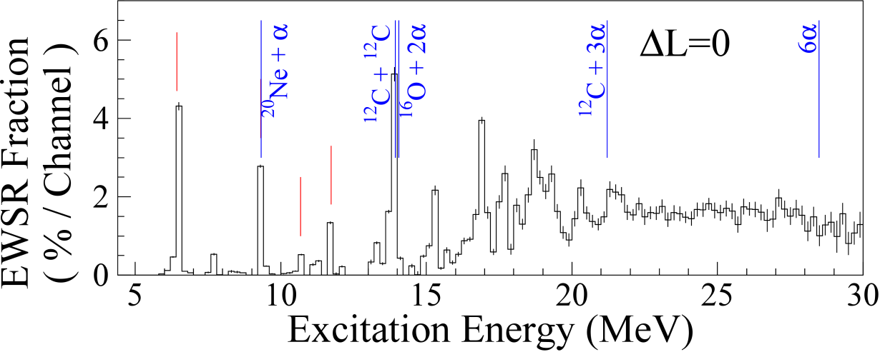
Search for the nuclear cluster states
T. Kawabata, J. Phys. Conf. Ser. 321, 012012 (2011).
²⁴Mg(α,α’) E_{α} = 386 MeV & MDA
Inelastic alpha scattering & MDA
IS E0 transition is effectively extracted
Compared with theoretical calc.
Calc. on ²⁴Mg with AMD w.f.
Y. Chiba and M. Kimura, PRC 91, 061302 (2015).

Slide 9
Problem: “Missing monopole strength”
Inelastic alpha scattering & MDA are widely used to study the nuclear structure.
Assumption: good linearity
there are the contradictory results for Hoyle state : (e,e’) and (α,α’).
However,
¹²C(e,e’) → 14% of the EWSR strength
M. Chernykh et al., PRL 105, 022501 (2010). Exp. @ TU Darmstadt
?
¹²C(α,α’) → 7.6% of the EWSR strength
B. John et al., PRC 68, 014305 (2003). Exp. @ Texas A&M

Slide 10
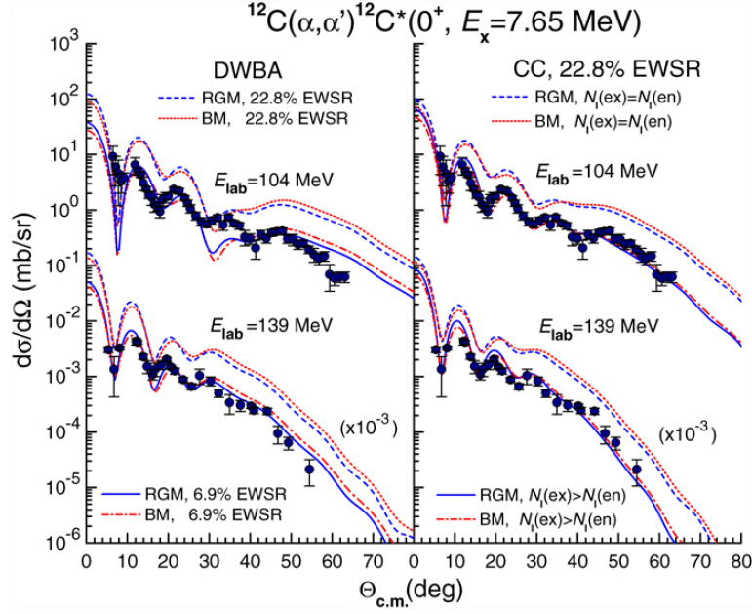
Microscopic calc. of the (α,α’) cross section
Khoa et al. calculated the cross section for ¹²C(α,α’) based on N-N int.
D. T. Khoa and D. C. Cuong,
PLB 660, 331 (2008).
Interaction
CDJLM (based on M3Y-Paris)
Transition density
3α RGM (Kamimura)
22.8% EWSR for 0₂⁺
Breathing model
Strength → 6.9% for DWBA calc.,
N_{I} → larger for CC calc.
to reproduce the exp.
→ Effect of the final state α+¹²C(0₂⁺)
‘‘Missing monopole strength’’

Slide 11
Situation of inelastic alpha scattering
The assumption to extract the transition strength from (α,α’) cross section may not be valid if Khoa’s argument is true.
Linearity: cross section & transition strength ?
“Missing monopole strength” in ¹²C ?
Analysis of the exp. data is really appropriate?
Interaction?
Transition density?
DWBA or CC?
Systematic check has not been performed yet using the exp. data!

Slide 12
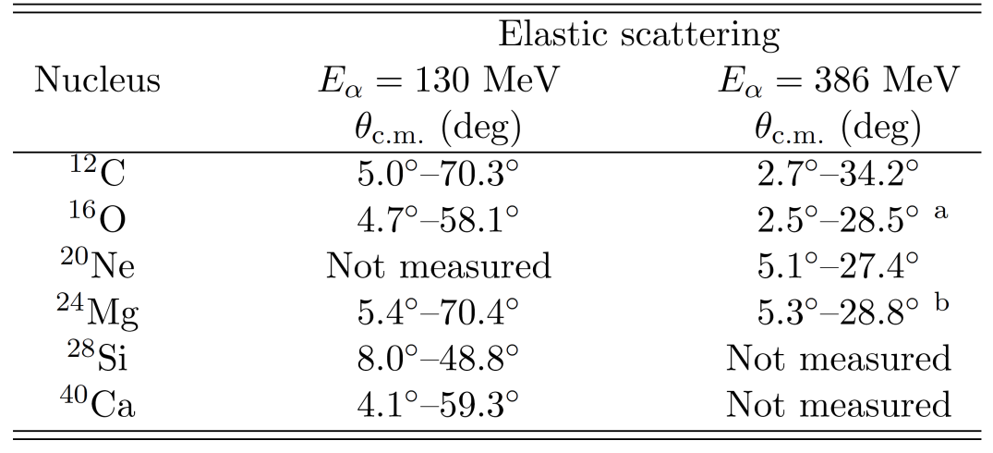
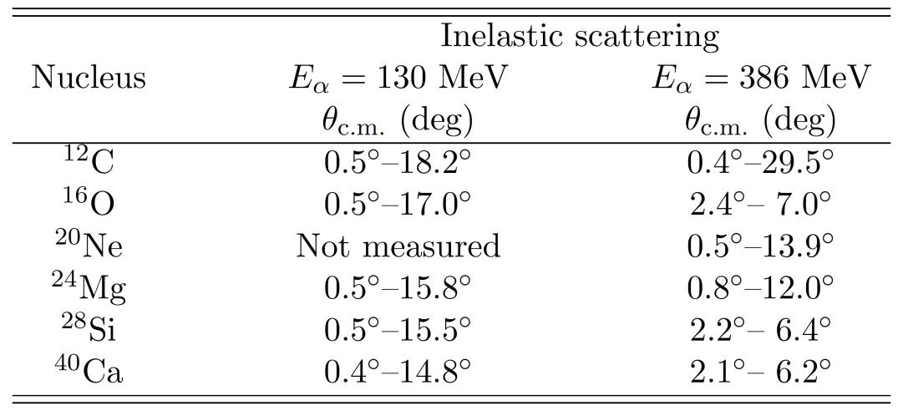
Systematic measurement of inelastic alpha scatterirng
Target nuclei: ¹²C, ¹⁶O, ²⁰Ne, ²⁴Mg, ²⁸Si, ⁴⁰Ca
Incident energy of ⁴He: 130 & 386 MeV
Angular range
N = Z & even – even, or self-conjugate A=4n, stable nuclei
elastic
inelastic
Inelastic scatterings were measured at forward angle
including 0 degrees.
Many excited states below E_{x} ~ 10 MeV were analyzed.

Slide 13
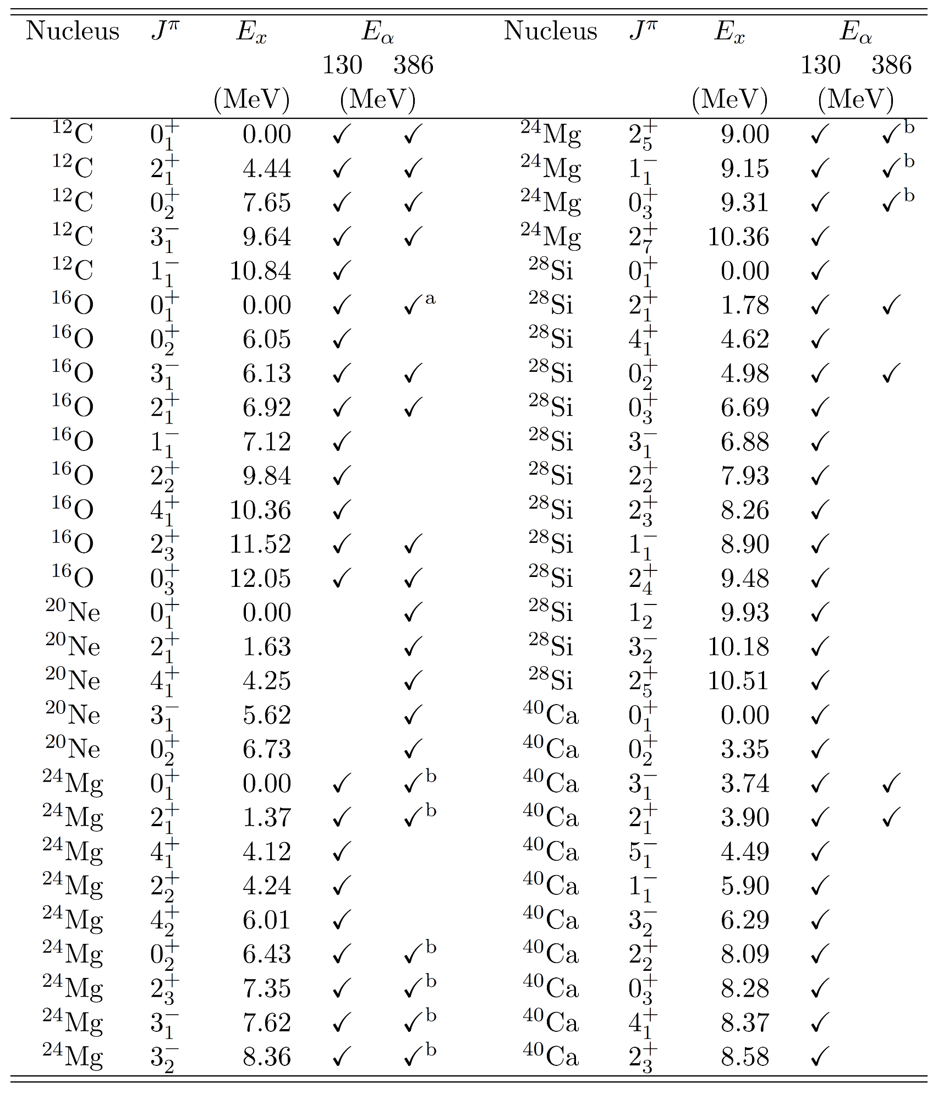
Results of the measurements
Measured excited states (differential cross section)
First systematic study
for such a lot of excited states!
and more …

Slide 14
DWBA calc.

Slide 15
Optical potential & effective αN int.
Optical pot. Calculated with single folding model
Here, is an effective αN int. which is widely used to analyze the exp. data (,but most simple form)
Nuclear matter density of the target nuclei
$v, w, β, α_{v}, α_{w}$: Int. parameter
Expecially, $β$ is the density-dependence parameter

Slide 16
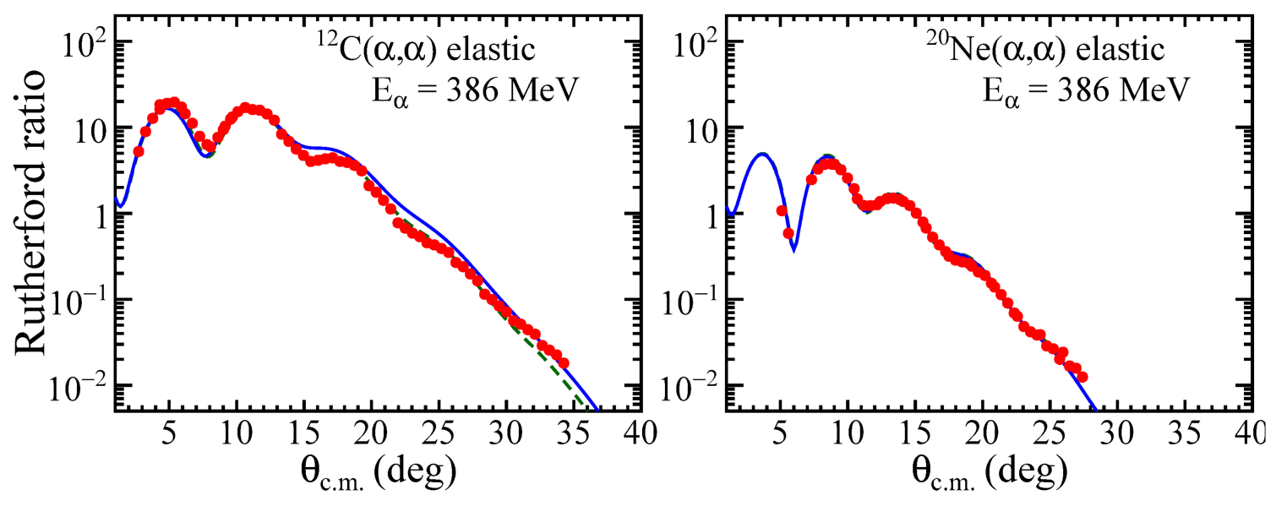
Interaction parameters
Parameters of int. → determined to reproduce the elastic scattering data parameter-free
DD : dashed
DI : solid
We imposed the condition $α_{v}=α_{w}$ to simplify.
DD (Density Dependent): $β=−1.9$
DI (Density Independent): $β=0.0$
Widely used value

Slide 17
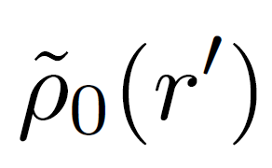
Transition density and its strength
Macroscopic transition density
L=0: Breathing model
Here, is the charge density dist., not the matter density dist. of the target nuclei.
Strength
set to be the known strength determined by (e,e’) exp.
parameter-free
Therefore
Our DWBA calc. are completely parameter-free for the inelastic scatterings.

Slide 18
Exp. data & DWBA calc.

Slide 19
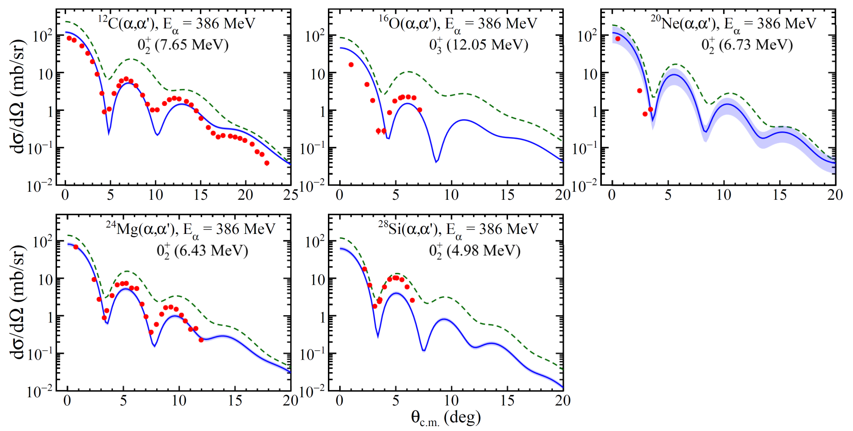
ΔL = 0 (E0) @ E_{α} = 386 MeV
Solid: DI(Density Independent) & Dashed: DD
Large difference b/w DD & DI
DI reproduces the exp. more.

Slide 20
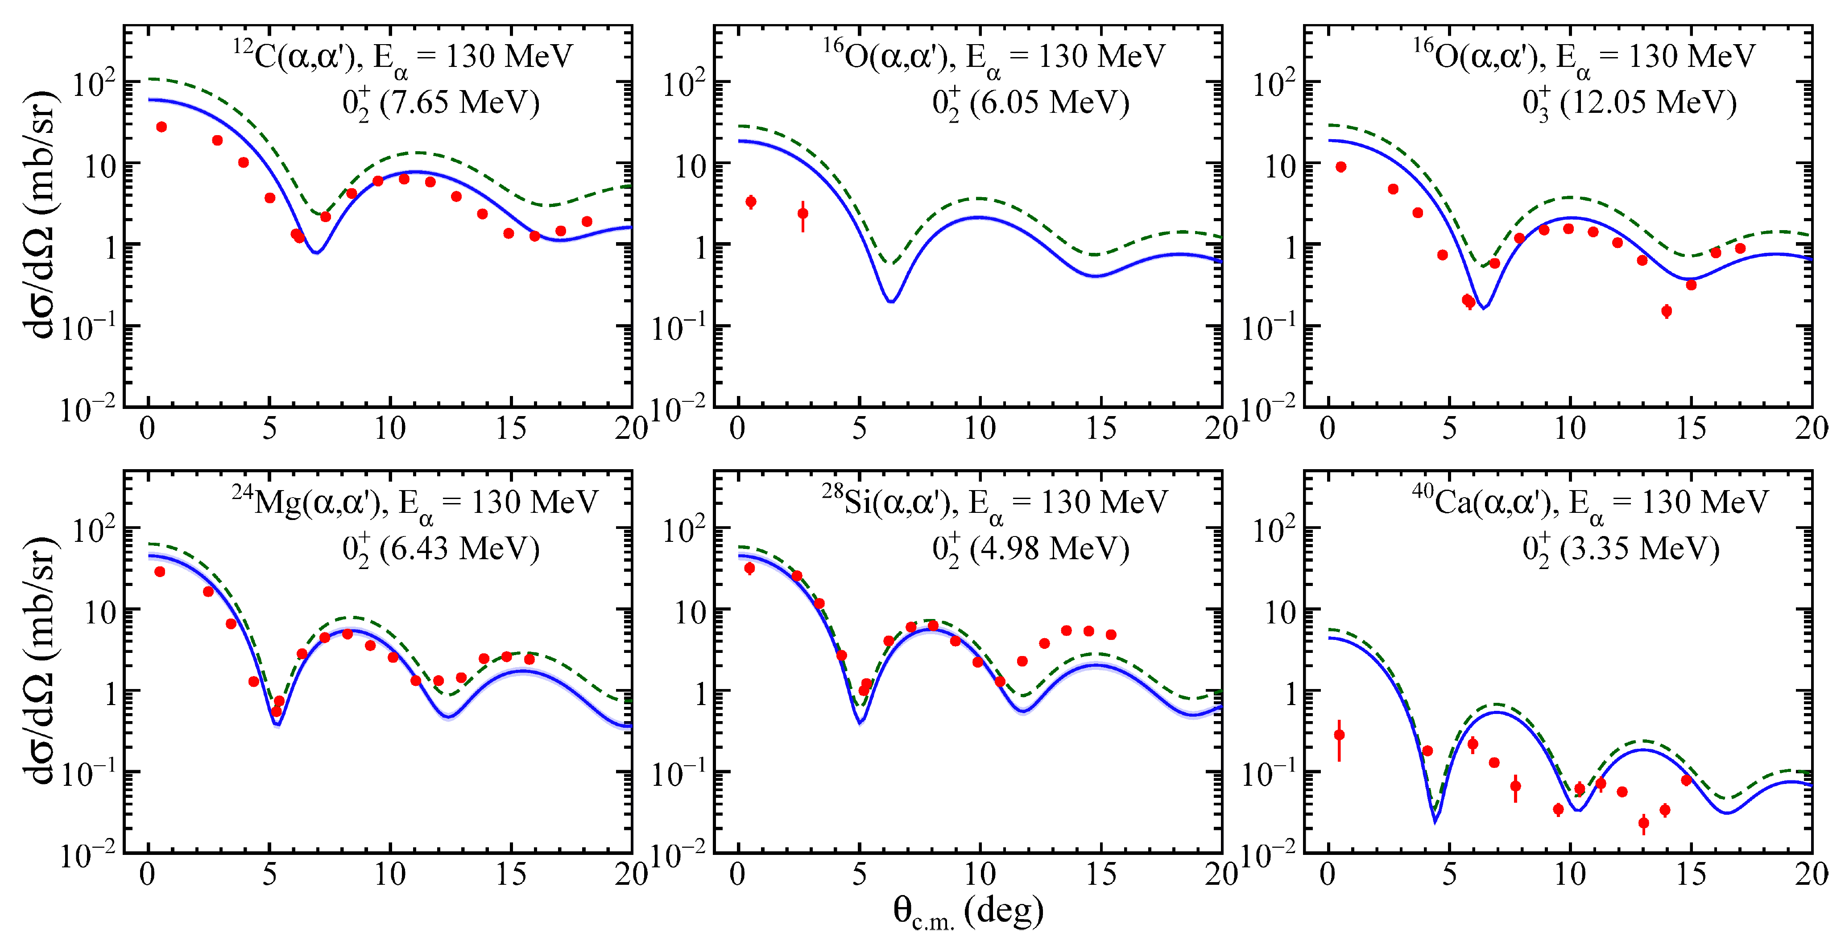
ΔL = 0 (E0) @ E_{α} = 130 MeV
About 10 times smaller
These two are special?

Slide 21
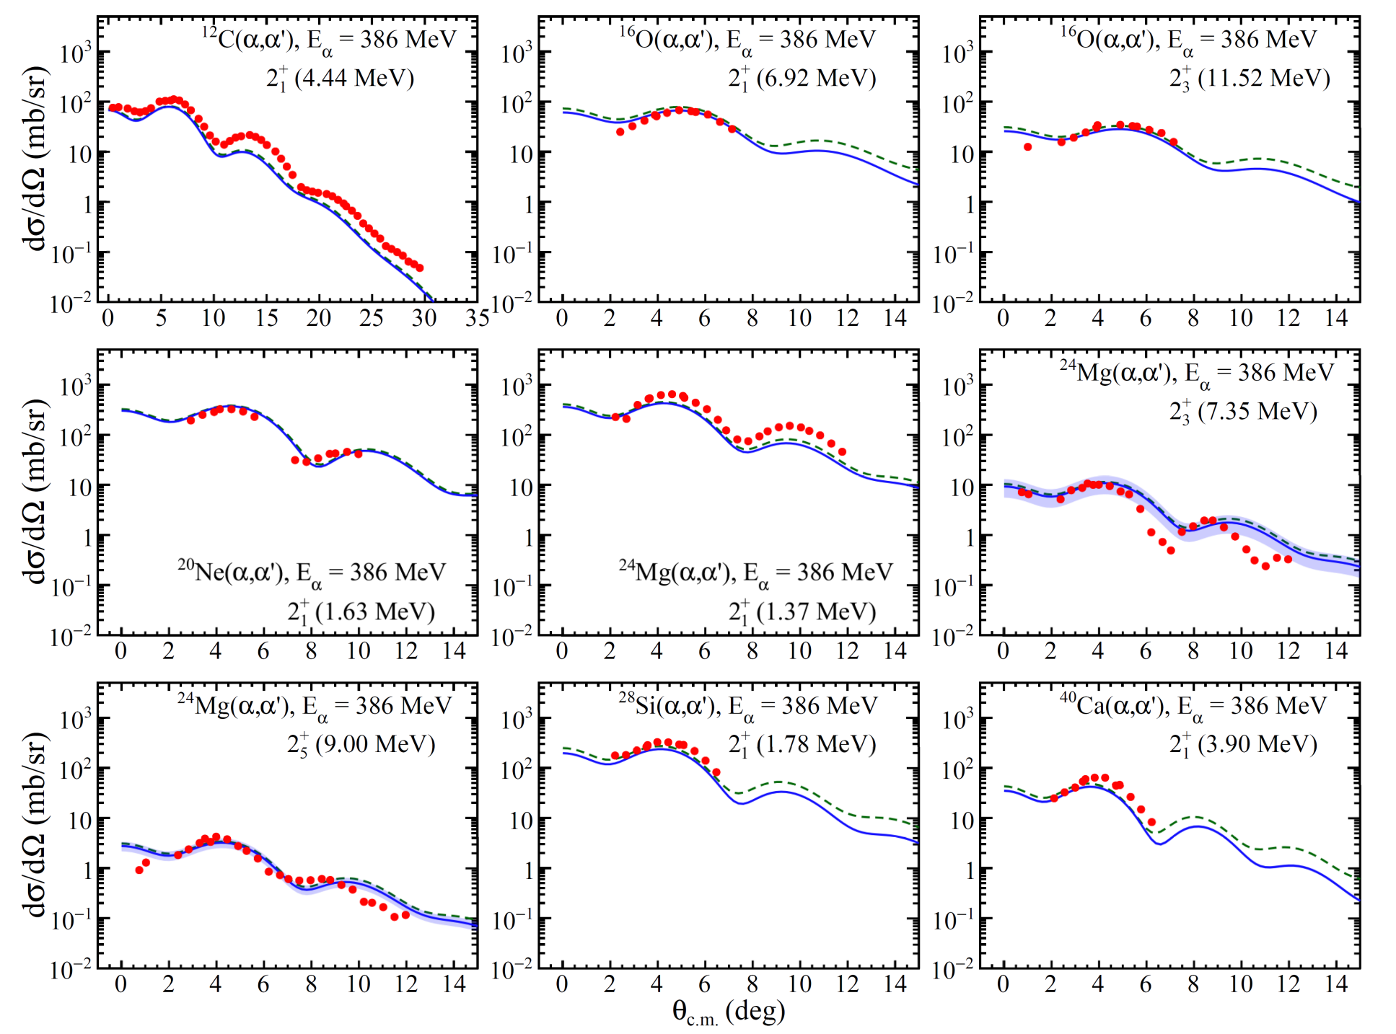
ΔL = 2 (E2) @ E_{α} = 386 MeV
Both DI & DD reproduce the exp. well
Differences b/w DI & DD are small

Slide 22
Comparison with the exp. data & present DWBA calc.
ΔL = 0 transition
Large difference b/w DD & DI
DI reproduces the exp. data more
Two exception:
¹⁶O 0₂⁺ and ⁴⁰Ca 0₂⁺: the first excited states in the doubly magic nuclei?
ΔL = 2 transition (& ΔL = 3: not shown today)
Difference b/w DD & DI is small
Both reproduce the exp. well.
DWBA calc. with DI int. @ E_{α} = 386 MeV are better to reproduce the exp. data.
DWBA calc. with DI int. @ E_{α} = 386 MeV are better to reproduce the exp. Data.

Slide 23
Discussion

Slide 24
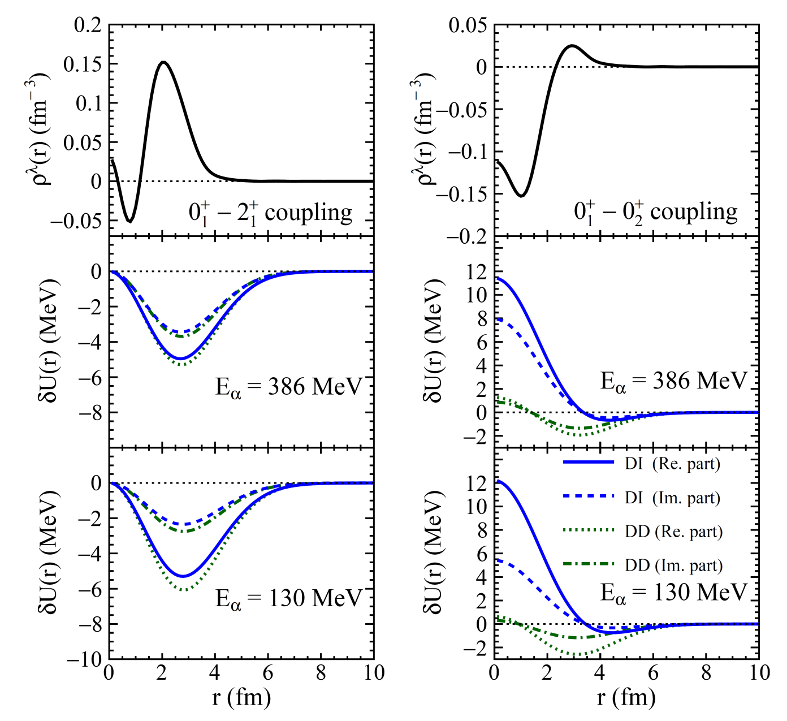
Characteristic of macroscopic transition density & our int. 1/2
Example of ¹²C(α,α’)
Why DD & DI differ so much?
2₁⁺ state
Transition density
0₂⁺ state
2₁⁺ state
Transition density is small around r ~ 0 fm
→ Difference b/w transition pot. by DI & DD is small
→ Effect on C/S is small
0₂⁺ state
Transition pot.
Transition density is large around r ~ 0 fm
→ Difference b/w transition pot. by DI & DD is large
→ Effect on C/S is large

Slide 25
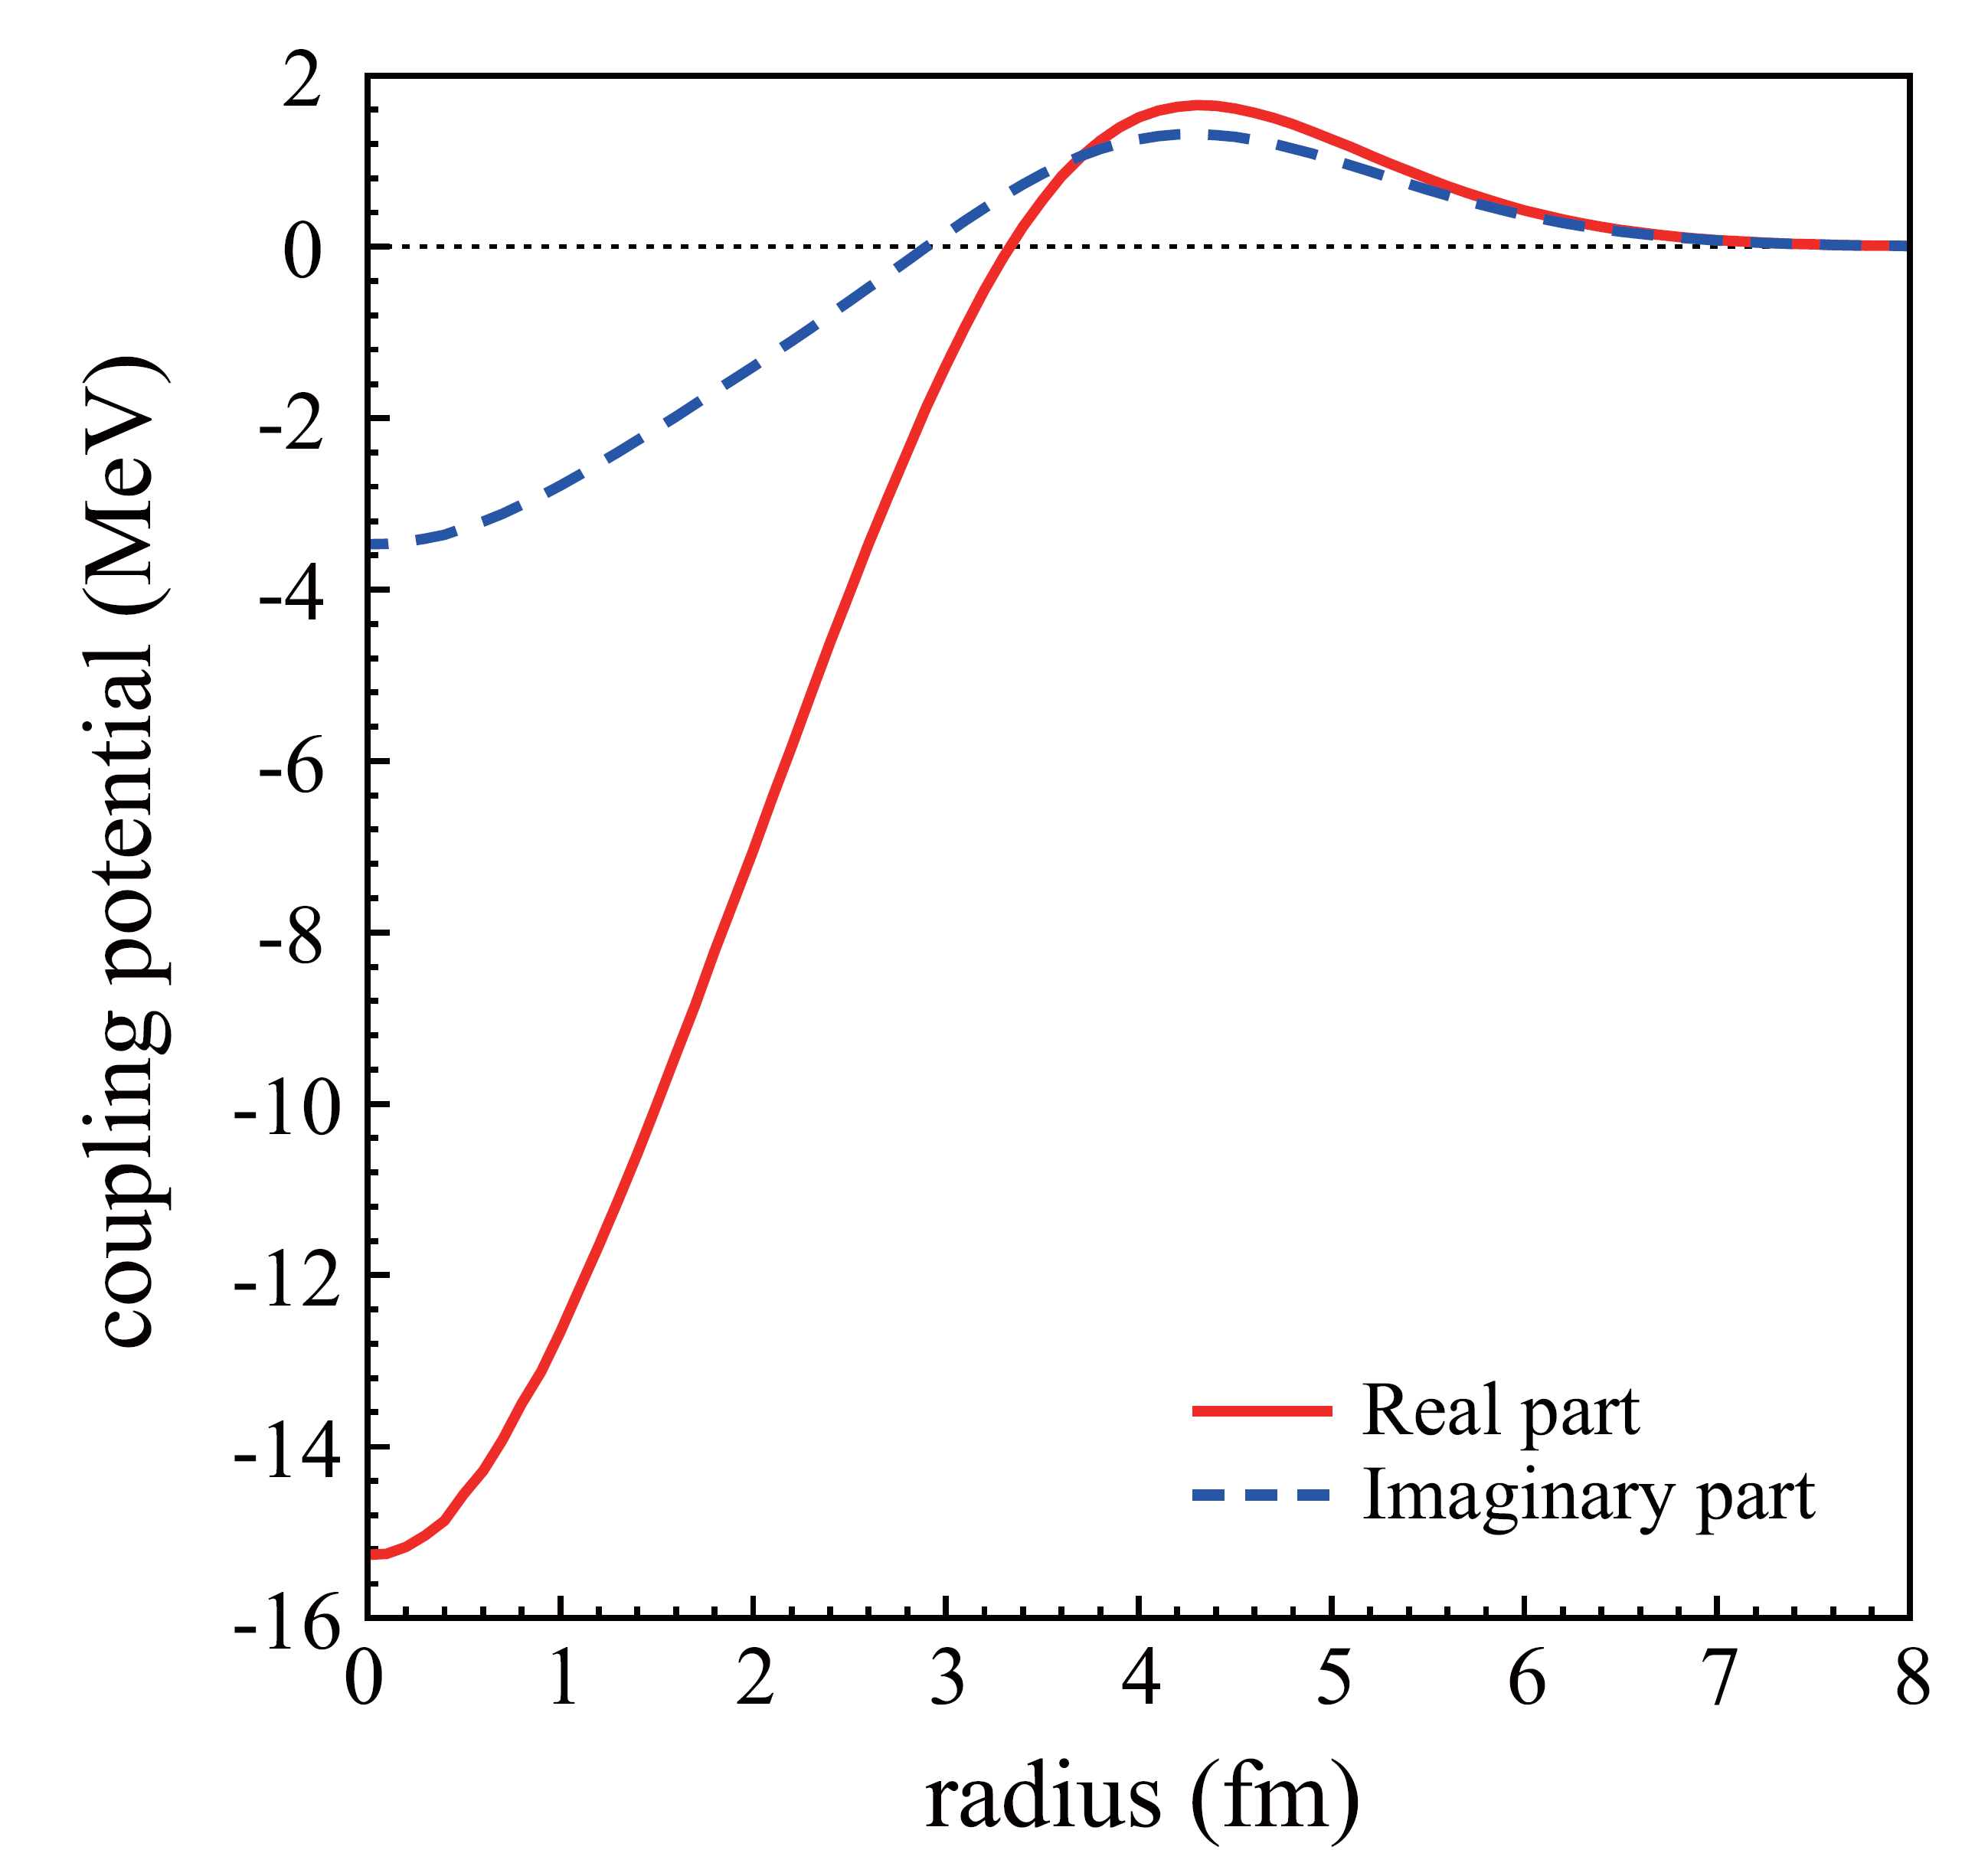
Characteristic of macroscopic transition density & our int. 2/2
Compare with the microscopic calc.
Transition density
Calc. with Melbourne G-matrix int.
Calc. with our effective int.
0₂⁺ state
Reproduce the exp. data
Include the density dep.
K. Minomo and K. Ogata, PRC 93, 051601 (2016)
0₂⁺ state
Similar with the DI
Transition pot.
E_{α} = 172.5 MeV
Treatment of the density dep. is not good.

Slide 26
Uncertainty of the present DWBA
Transition density
Macroscopic model
$⟺$Microscopic model (by 3αRGM w.f. & THSR w. f.)
Distorting potential
Assuming entrance = exit
$⟺$Realistic exit channel by the microscopic model
Interaction
Effective αN int. with the gaussian type
$⟺$Microscopic NN int. (Melbourne G-matrix)
Coupled-channel effect
No channel coupling
$⟺$CC calc. with microscopic w. f.
Skip today
We checked these effect for ¹²C,
of which the microscopic w.f. are available.

Slide 27
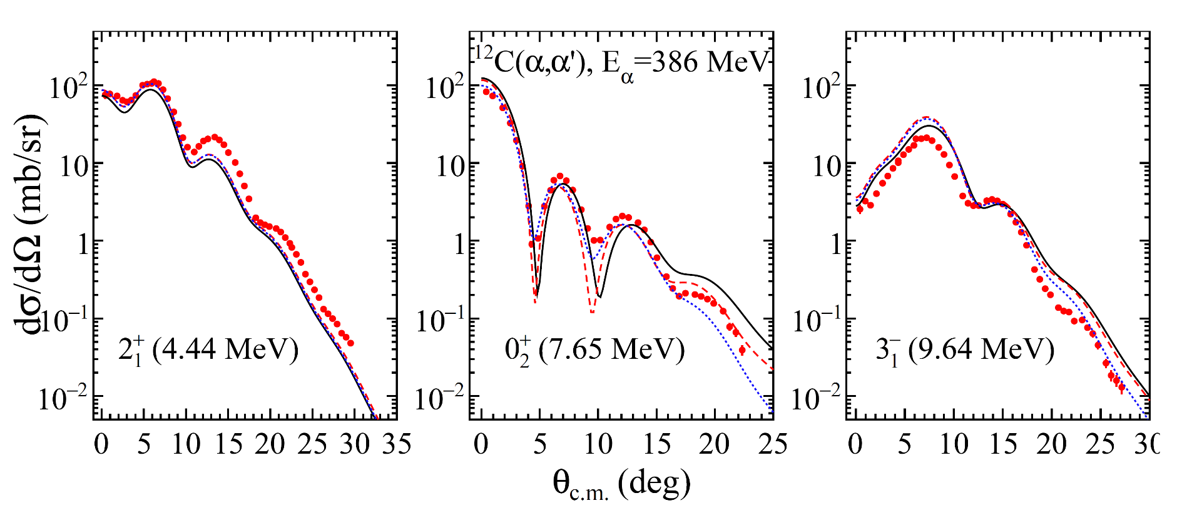
Transition density & Distorting pot.
Solid: “standard” DWBA
Dashed: Solid & replace the transition density
Dotted: Dashed & replace the distorting pot. = “microscopic”
NO significant effect on the absolute value

Slide 28
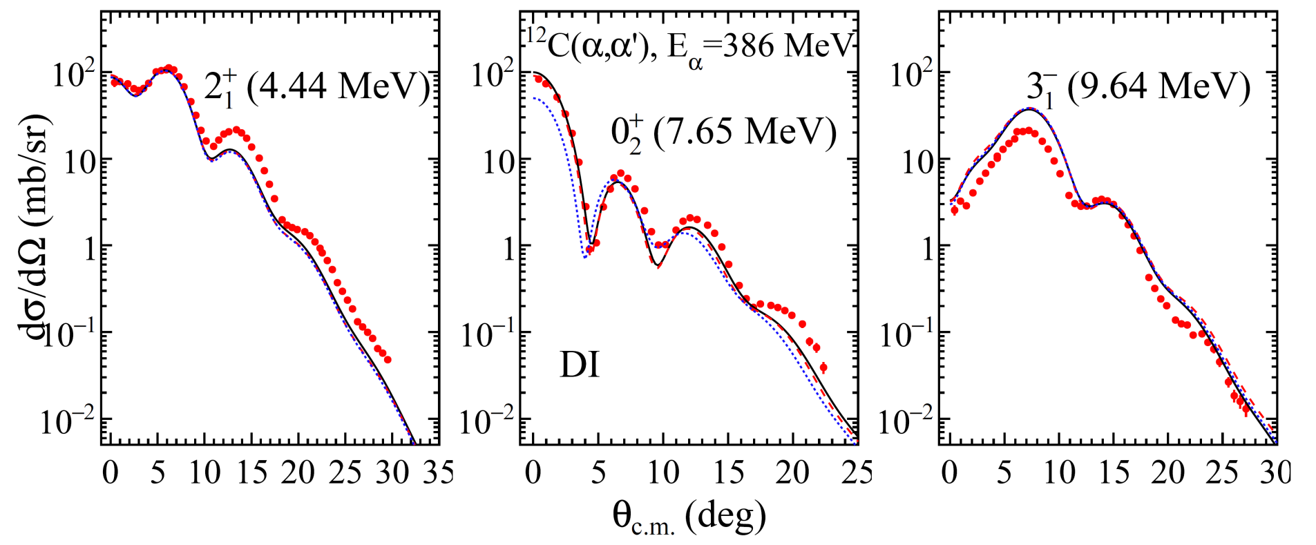
Effect of the coupled channel
Coupling 0₂⁺ ←→2₂⁺ is predicted to be strong for ¹²C.
Solid: “microscopic” DWBA
Dotted: without 2₂⁺
Dashed: 0₁⁺ $↔$ 2₁⁺ $↔$ 0₂⁺ $↔$ 3₁⁻ $↔$ 2₂⁺ $↔$ 4₁⁺
Effect is limited, but not negligible

Slide 29
Summary
First systematic study for the widely-used analysis method (effective int. + macroscopic transition density)
“Missing monopole problem” is not special, but exists for all the ΔL = 0 transitions.
Due to how to include the density dependence
Density independent int. at E_{α} ~ 100 MeV/u is considered to be more appropriate than others.
More sophisticated formalism for the analysis is required.

Slide 30
Backup

Slide 31
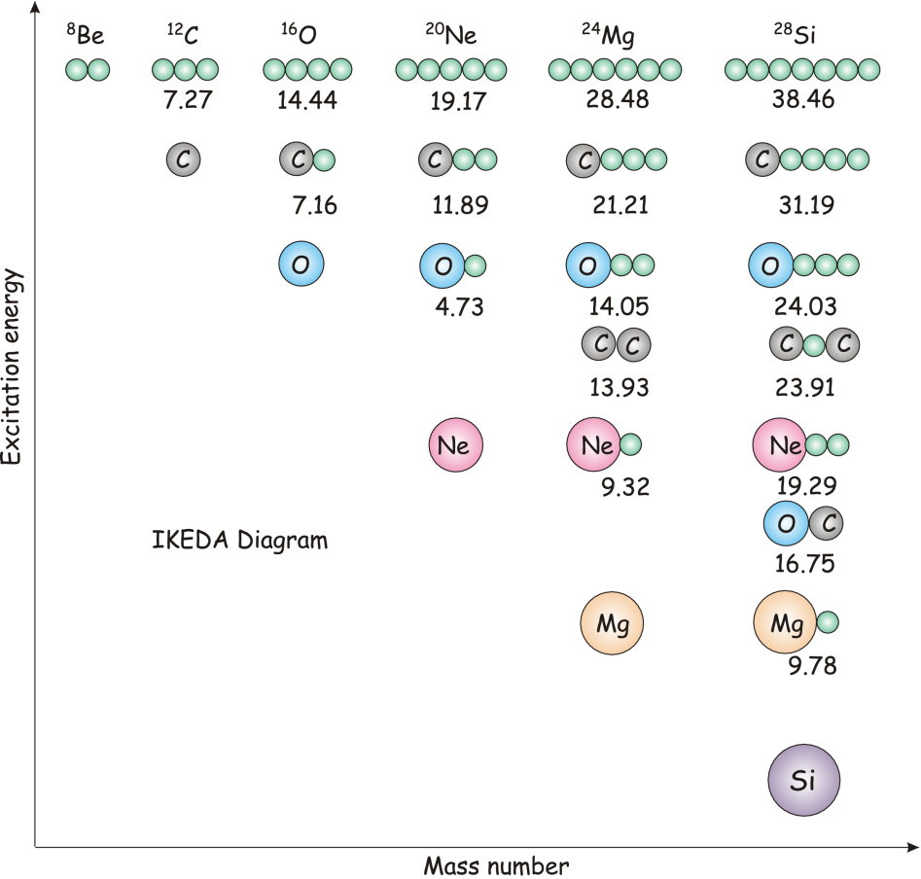
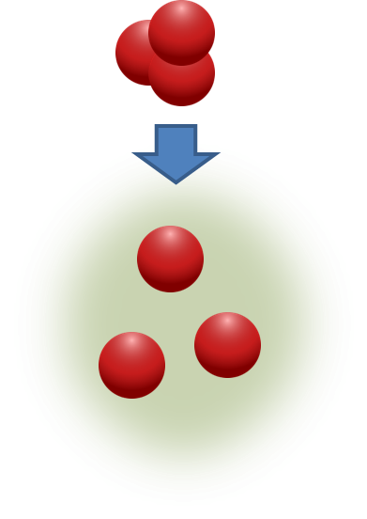
Search for the nuclear cluster states
Cluster structure
Predicted to appear near the decay threshold
Ikeda diagram
Self-conjugate A=4n nuclei
Predicted to exist the alpha condensed states
Hoyle state (0₂⁺ at 7.65 MeV in ¹²C)
Isoscalar monopole (IS E0) transition
is predicted to be strong for spatially developed cluster states
About 3 times larger than the single particle unit to Hoyle state
M. Freer and H. O. U. Fynbo,
Prog. in Part. Nucl. Phys. 78, 1 (2014).
G.S.
Ex. state
Shell-model like
compact structure
Spatially developed cluster state
r² : E0 operator

Slide 32
Multipole decomposition analysis (MDA)
Transition strength to the target excited state
needed to be deduced from the exp. data
MDA is one of the widely used methods
MDA is …
assuming the characteristics of inelastic alpha scattering
able to separate the each component of the transferred angular momentum (ΔL)
able to extract the transition strength
applicable to the continuous region
Are
To achieve,
Selectivity due to alpha particle (ΔS = 0, ΔT = 0) &
Separation of the transferred angular momentum by MDA (ΔL)
Exp. & Analysis have the strong selectivity for the final state spin & parity ( J^{π} )
Therefore

Slide 33
ΔL = 0 (E0) @ E_{α} = 386 MeV

Slide 34
ΔL = 0 (E0) @ E_{α} = 130 MeV

Slide 35
ΔL = 2 (E2) @ E_{α} = 386 MeV

Slide 36
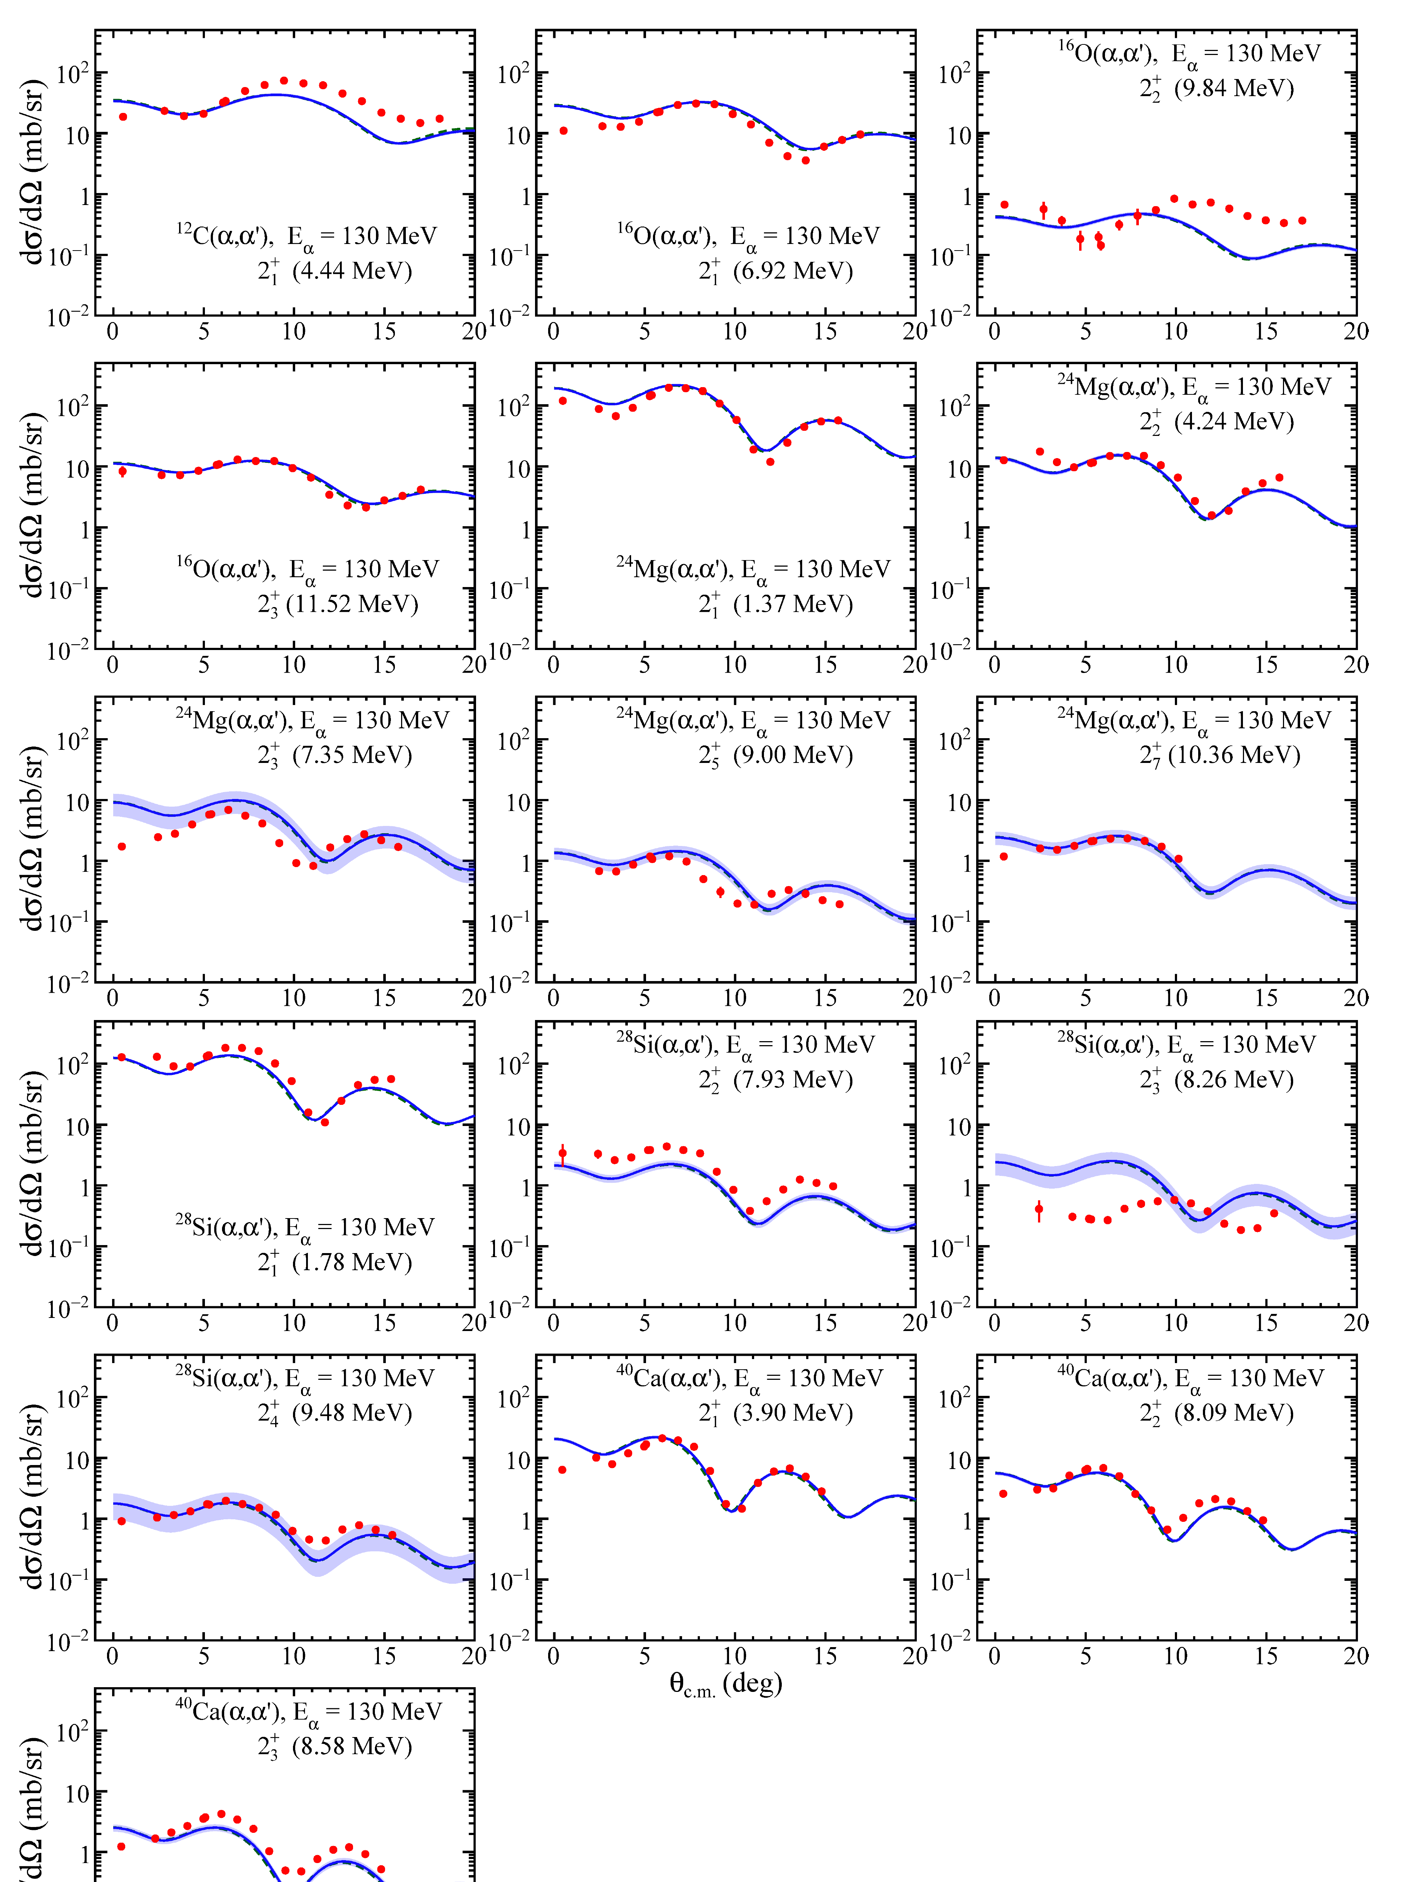
ΔL = 2 (E2) @ E_{α} = 130 MeV

Slide 37
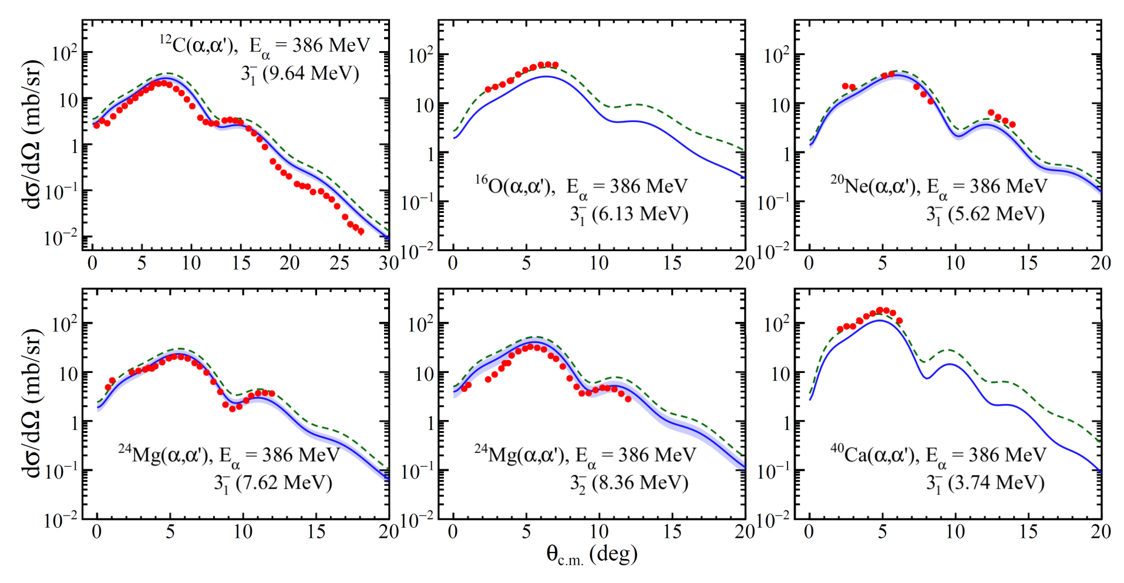
ΔL = 3 (E3) @ E_{α} = 386 MeV

Slide 38
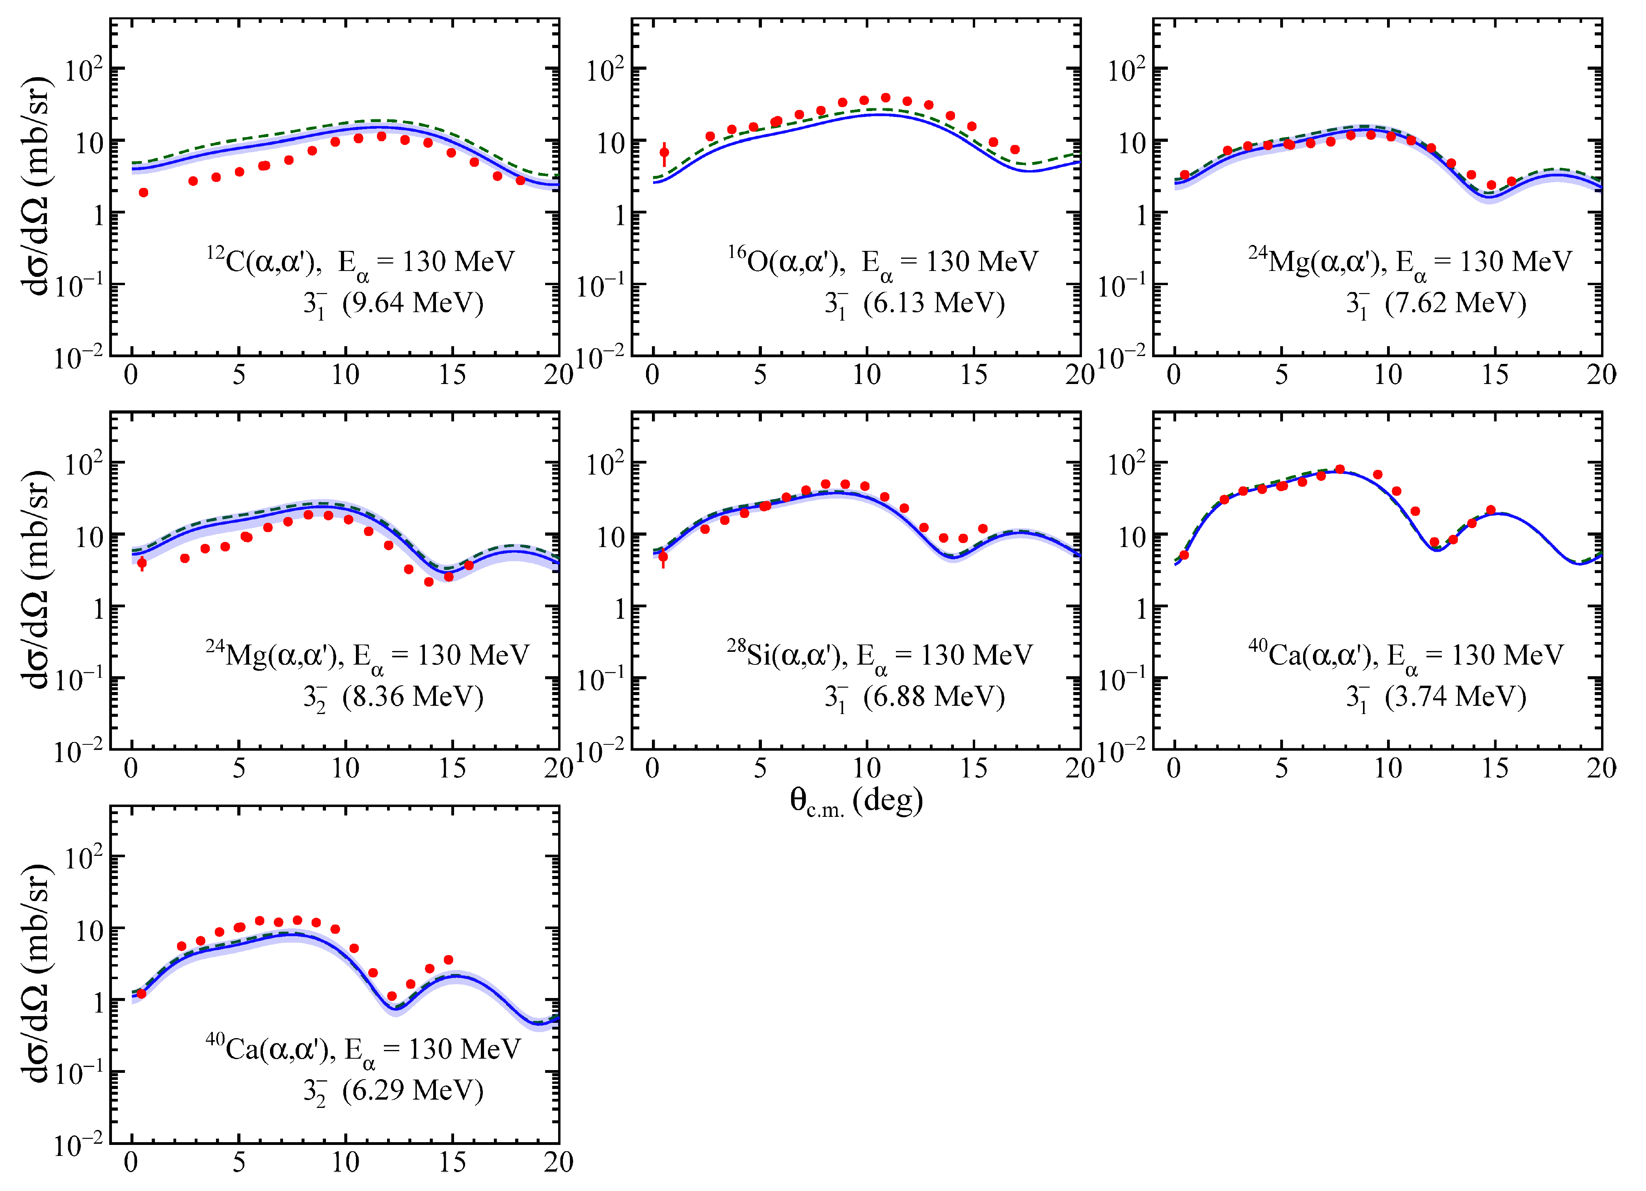
ΔL = 3 (E3) @ E_{α} = 130 MeV

Slide 39
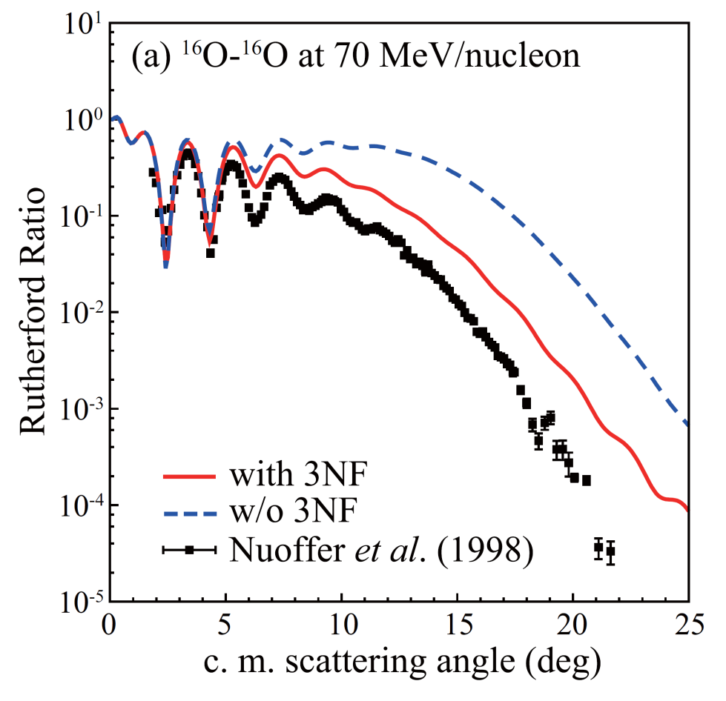
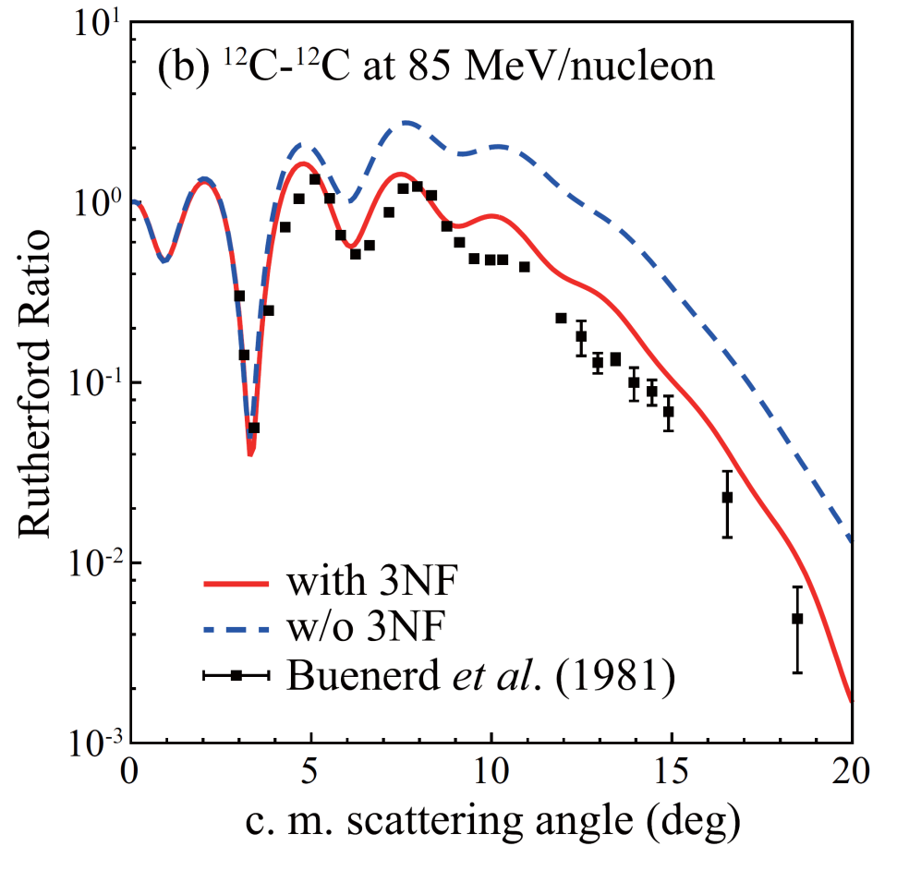
Recent theoretical work 1
On the other hand,
Melbourne G matrix interaction with and without 3 nucleon force
Microscopic calc., Target Density Approximation (TDA)
K. Minomo et al., PRC 90, 051601 (2014)

Slide 40
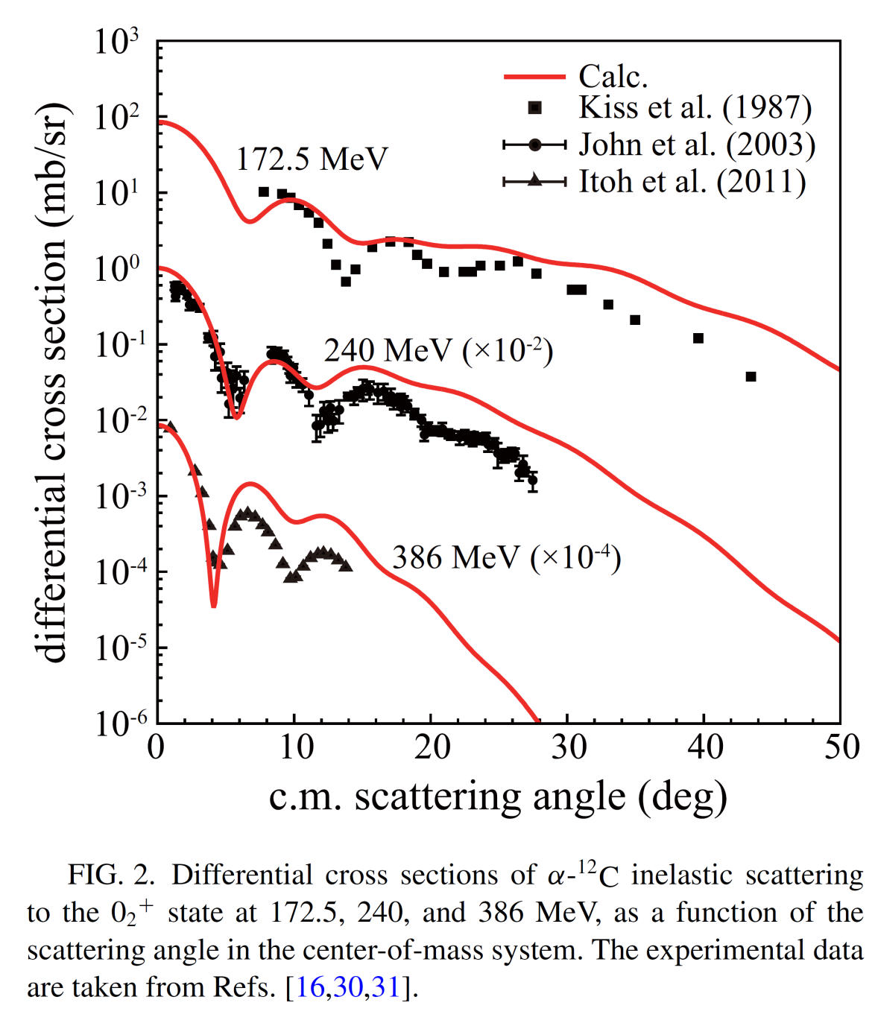
Recent theoretical work 2
“Missing monopole problem”
Minomo-san et al. recently studied this problem.
Interaction based on Melbourne G matrix
without 3NF
Transition densities from 3α RGM w.f.
The authors concluded that there is no room for the missing monopole problem.
K. Minomo et al., PRC 93 051601 (2016)

Slide 41
Dependency on the target size

