Slide 1
Alpha Decaying Heavy Elements Produced in Multi-Nucleon Transfer Reactions of Heavy Nuclei
K. Hagel
State of the Art in Nuclear Cluster Physics
14-May-2018

Slide 2
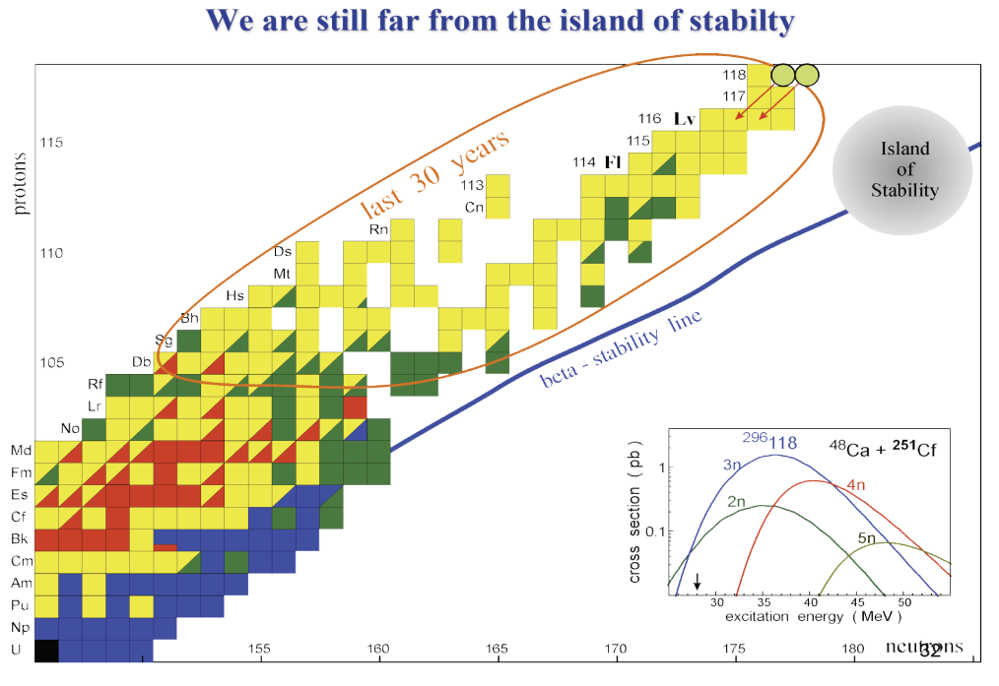
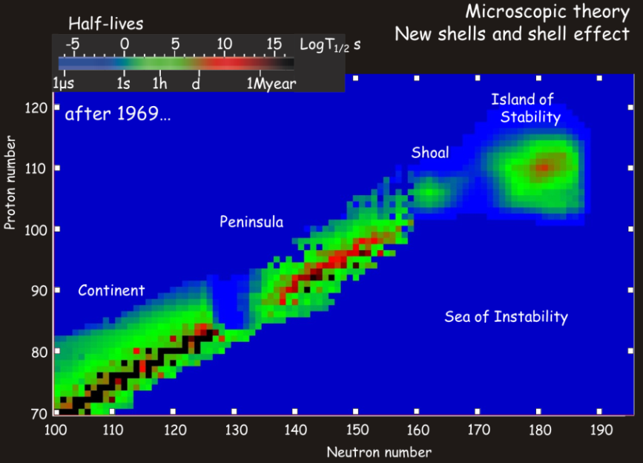
Search for Heavy Nuclei
Predictions
  New stabilizing shell structures
  Exotic shapes such as toroids and bubbles
Provide stringent new tests of our understanding of relativistic effects in electron structure
Island of stability
  Fission barriers mitigate against spontaneous fission decay of those isotopes. Thus the main modes of decay in and near these islands are predicted to be alpha and beta decay

Slide 3
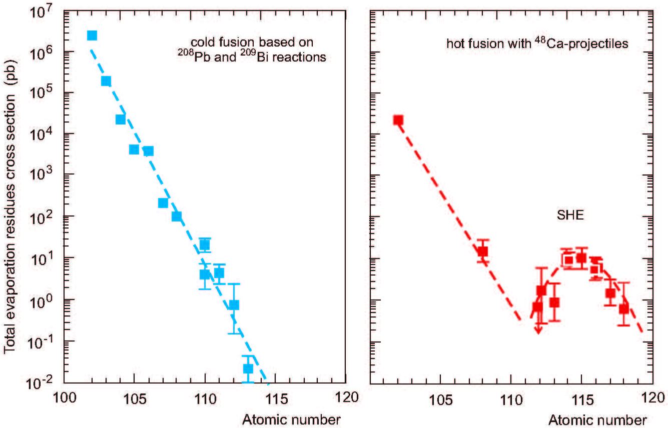
Previous Work
Fusion techniques
  Fusion of a heavy target nucleus with a light to medium projectile nucleus.
  Discovery of Og (Z=118)
    Fusion of ⁴⁸Ca projectiles on trans-uranium target nuclei
  Excitation energies which favor fission.
    Production probability for heavy nuclei decreases rapidly with increasing atomic number of the fused system.
    σ_{Og} ~ 0.5 pb
  Light projectiles are symmetric, so heavy nuclei produced tend towards neutron deficient side of the valley of stability. Products are neutron deficient even though ⁴⁸Ca is not symmetric.
Rep. Prog. Phys. 78 (2015) 036301
Strong increase in survivability is already evident in the experimental fusion cross section data

Slide 4
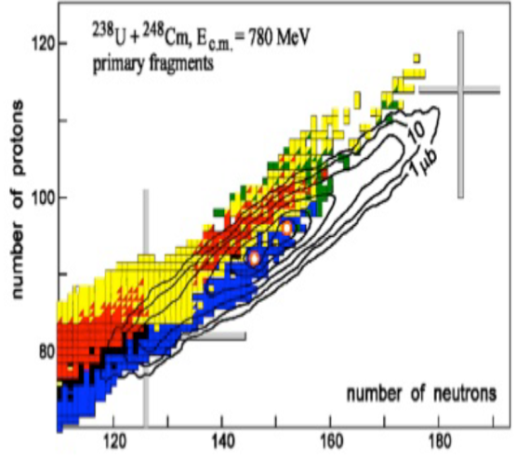
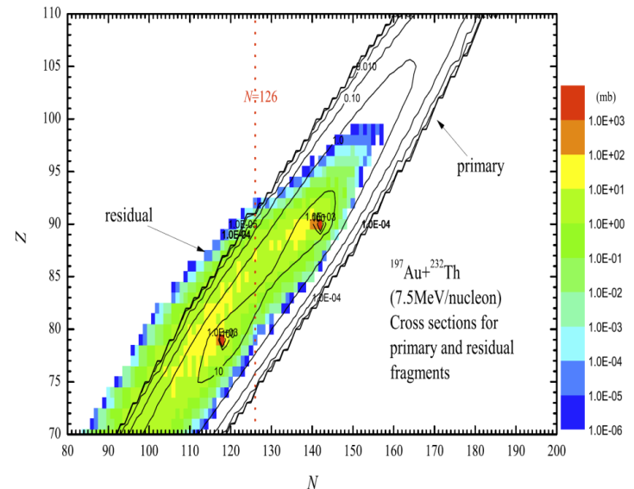
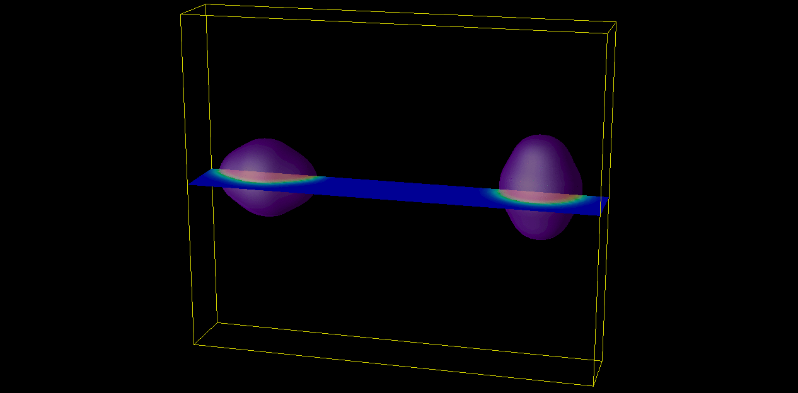
Alternative reaction mechanisms
Production of neutron rich heavy and super-heavy isotopes
Multi-nucleon transfer reactions between pairs of heavy nuclei
  Allow nature to select the N/Z ratio needed to produce super heavy nuclei
Theoretical studies calculating fission rates indicate high survival probabilities in and near the island of stability
  statistical models
  microscopic model
Zagrebaev and Greiner
ImQMD + HIVAP
Zhao et al., Bejing
TDHF Calculation; A. Wakhle

Slide 5
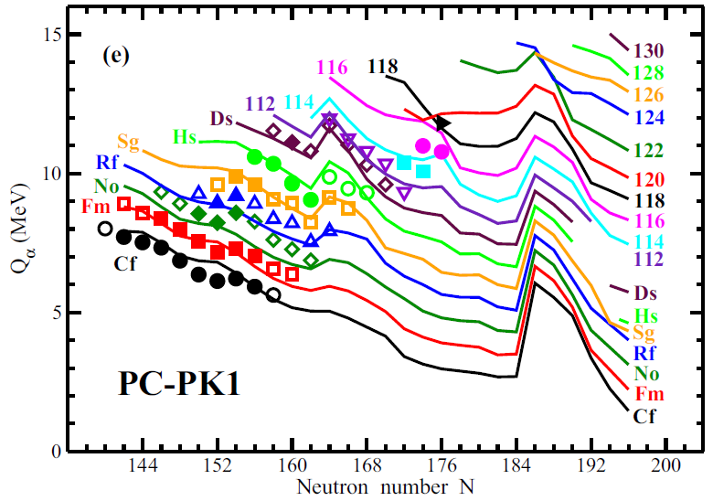
Experimental Technique
7.5 MeV/u ²³⁸U + ²³²Th
  Target 10 mg/cm², so sample beam energy from 7.5 to 6.1 MeV/u
Detector Setup
  Active Catcher (coverage from ~16º to ~65º)
    YAP scintillators
    Radiation hard;
    pulse shape discrimination
  Ionization Chamber-Si telescopes
    Arranged to allow detection only of products from Active Catcher
    Target not in view
    One IC-Si telescope blinded to evaluate contribution due to neutrons
Beam pulsing
  Turn beam off in order to observe decays
  We used beam on/off 30/30ms and 100/30ms
    Build alpha emitters during beam on
    Watch for decay during beam off
    Time between RF cycles
  High energy trigger from silicon detector
    Turn beam off for 20s if a signal in detector higher than 6 MeV is recorded.

Slide 6
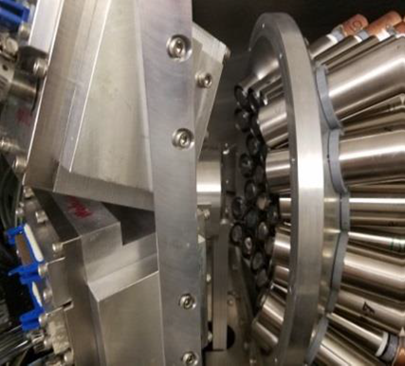
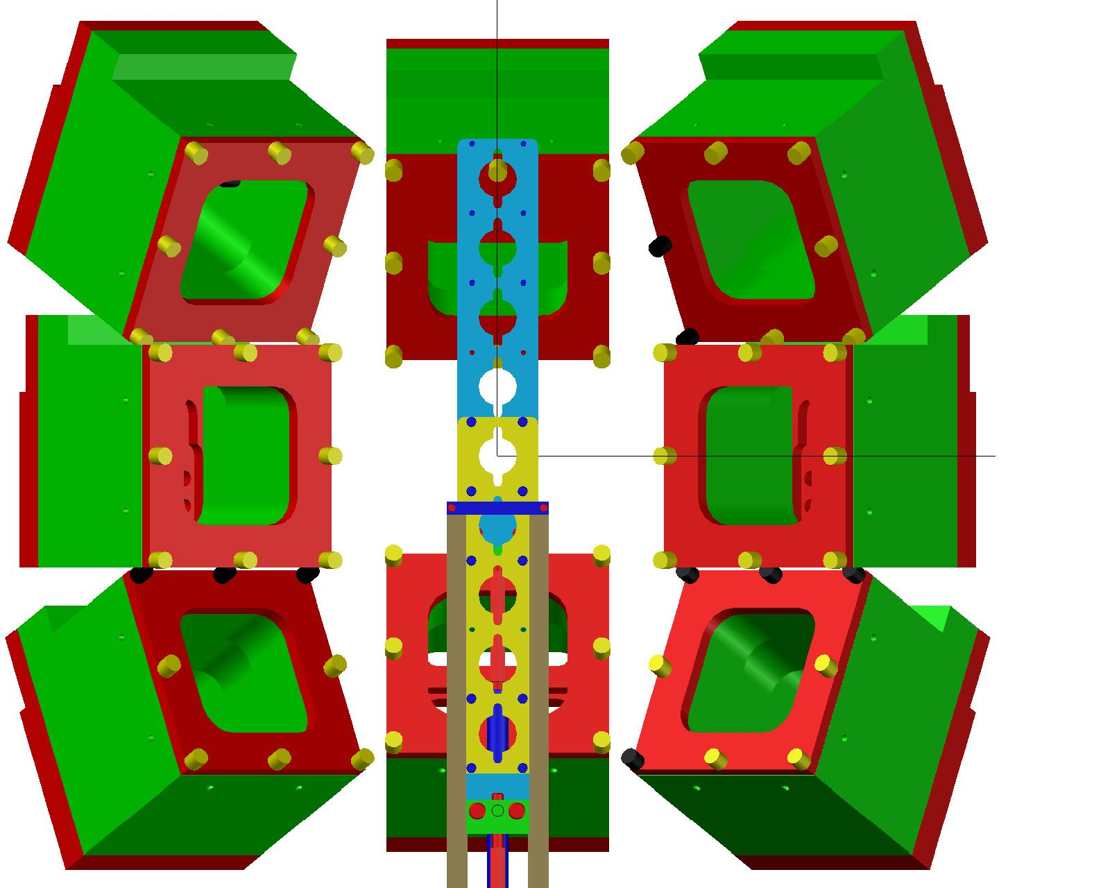
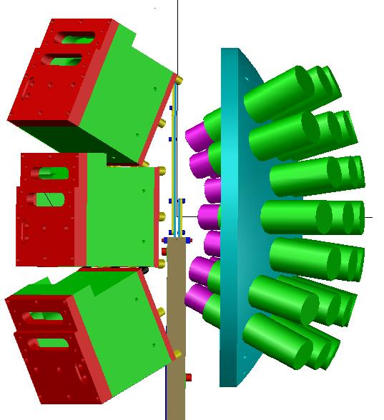
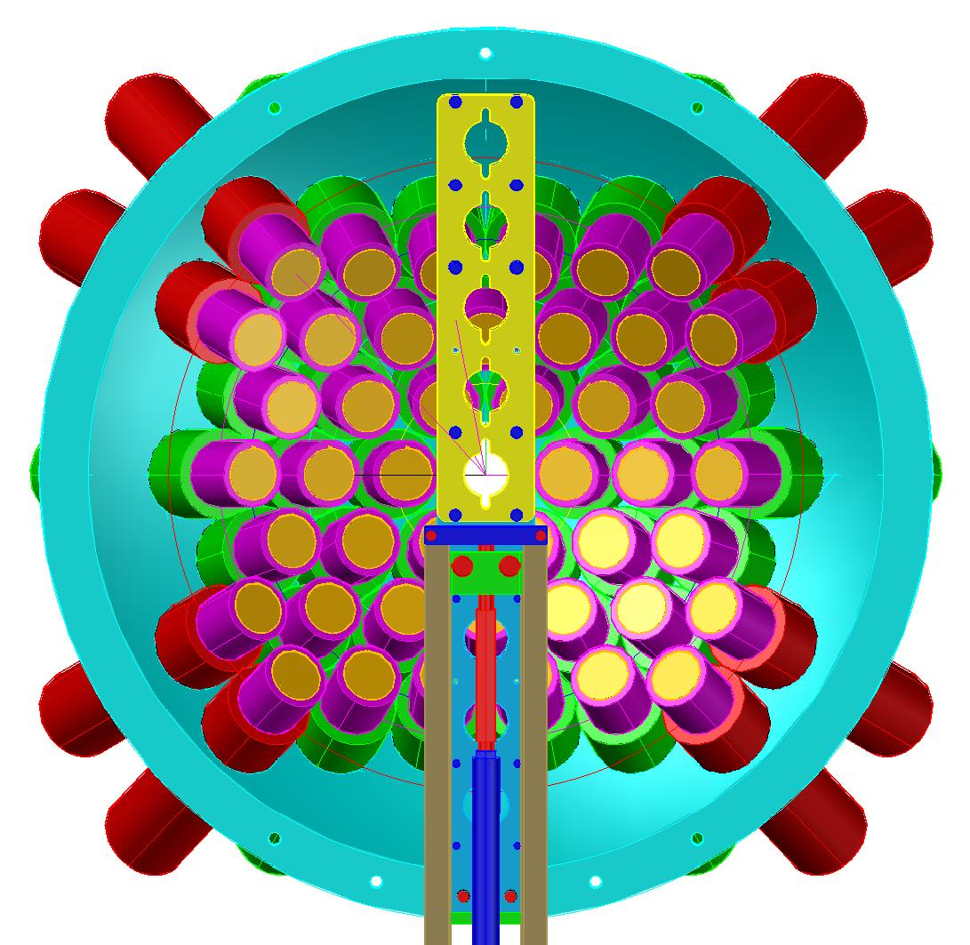
Experimental Setup
Beam

Slide 7
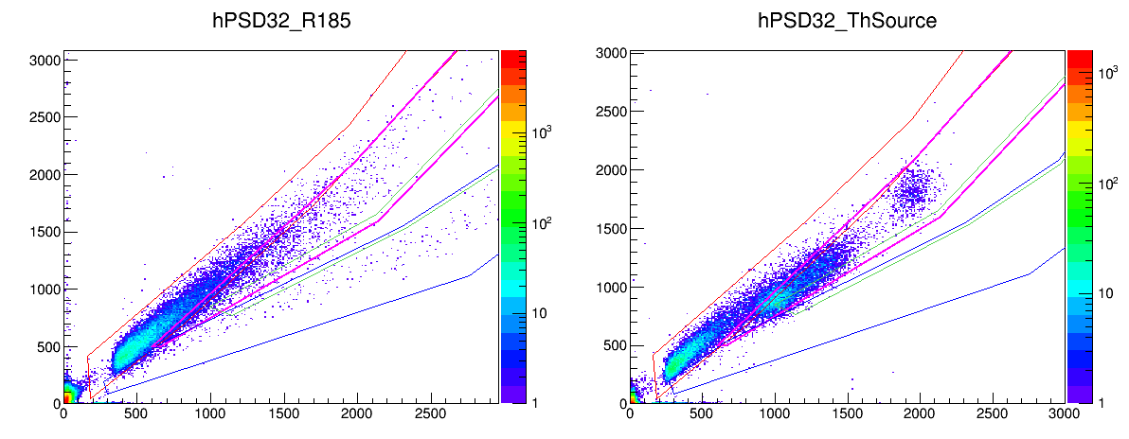
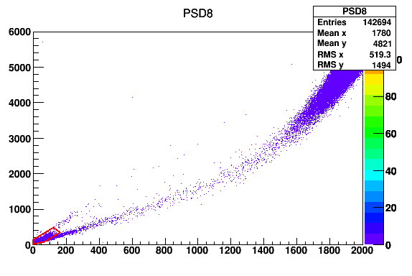
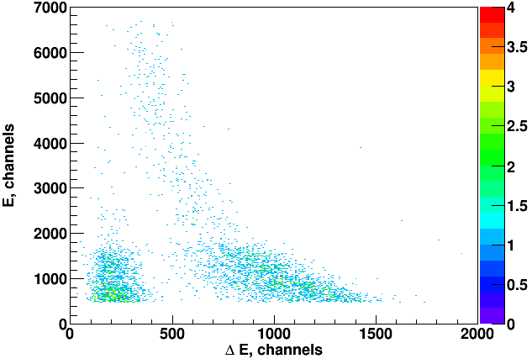
Detector Performance
Cf source

Slide 8
Triggering and timing
SIS 3316 Waveform Digitizers
  Generate triggers
    Trigger configuration can be changed event by event
  Provide timestamp
  Waveform read in for analysis
    Multiple peaks in a waveform
Triggers
  Beam on
    Silicon
  Beam off
    AC
  High Energy Silicon Trigger
    Turn beam off for 20s
    Use AC triggers during that period
    Change waveform readout length to 160us (max that we could do with our software)
Clocks
  Flash ADC timestamp
  RF Clock
    ~50 ns resolution; runs continuously independent of computer dead time

Slide 9
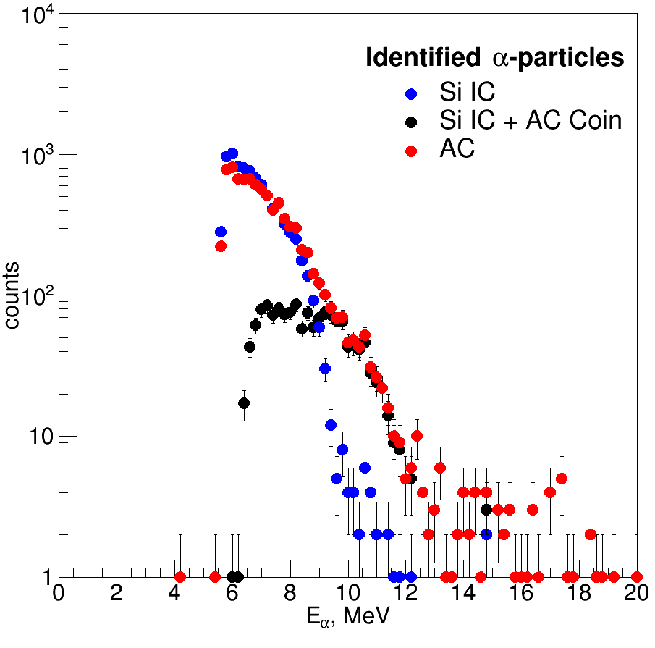
Alpha particle Energy spectra

Slide 10
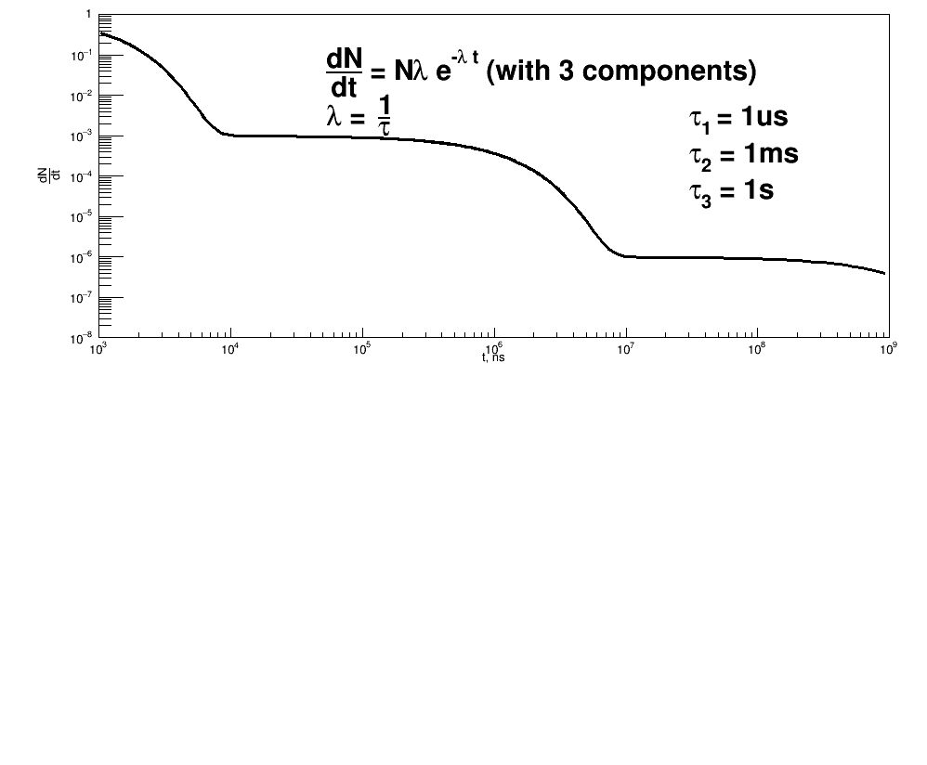
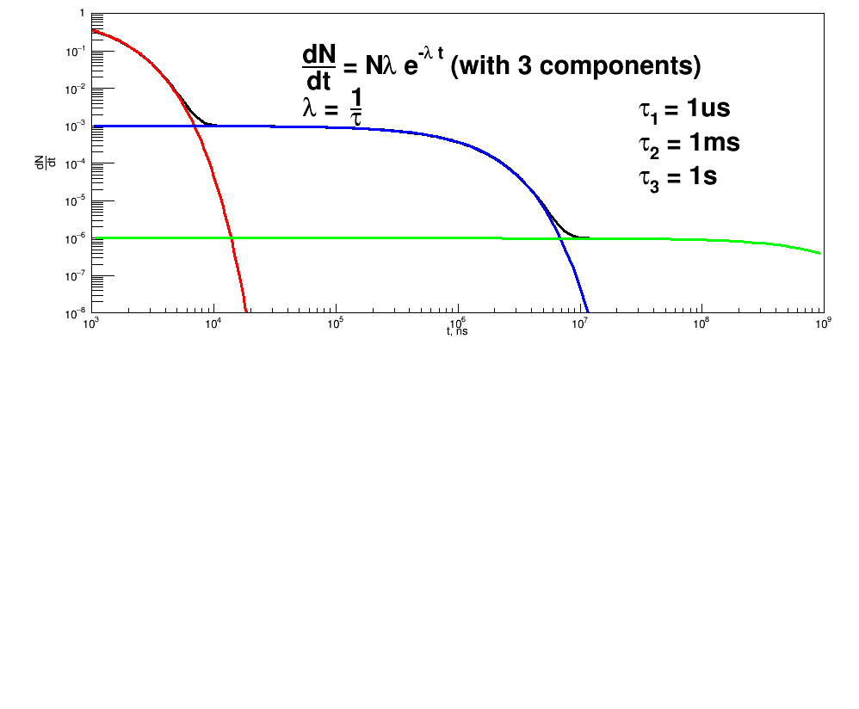
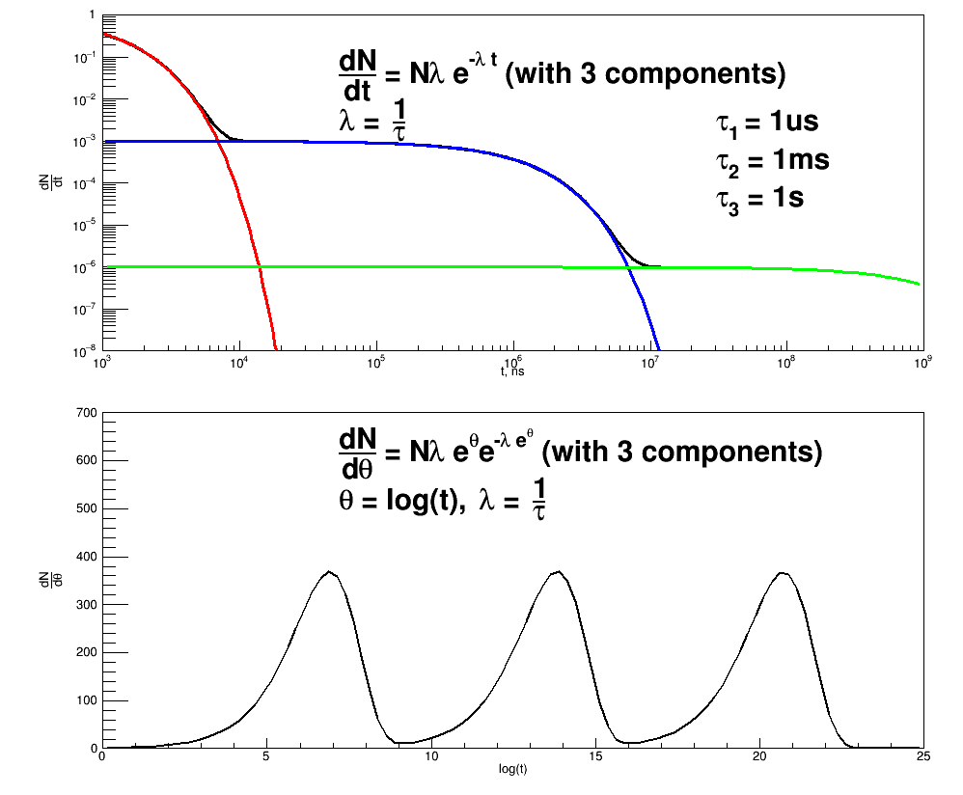
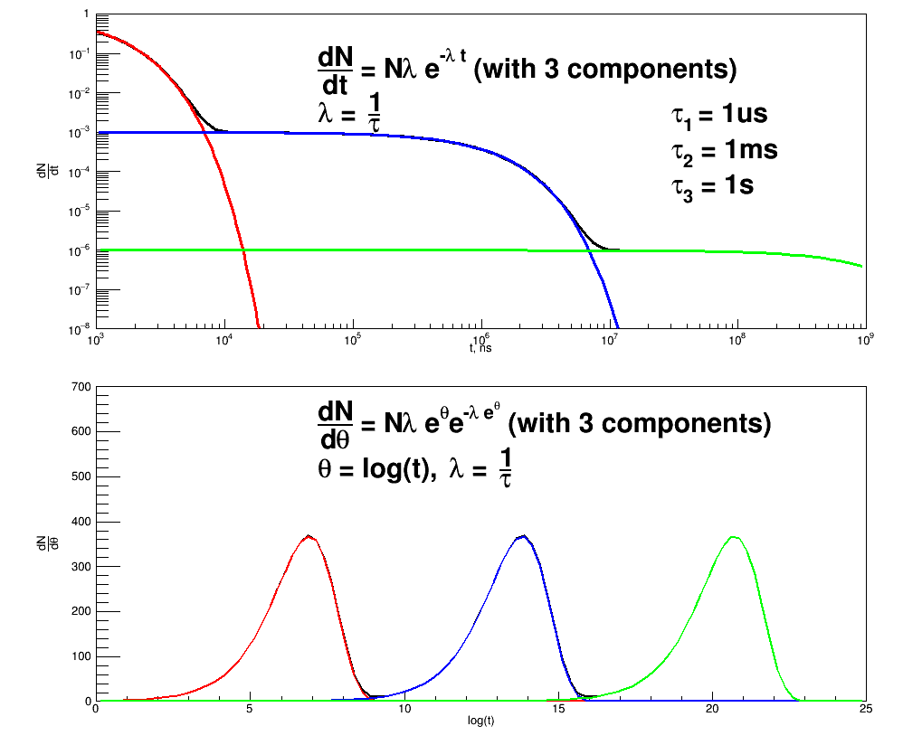
Fitting
Fit decay curves in order to learn about lifetimes
There can be a span of times over orders of magnitude (ns to s) leading to numeric problems in fitting.
Introduce θ=log(t) and transform equation. (Z. Phys. A 316, 19 (1984))
Peaks of dN/dθ give mean time directly

Slide 11
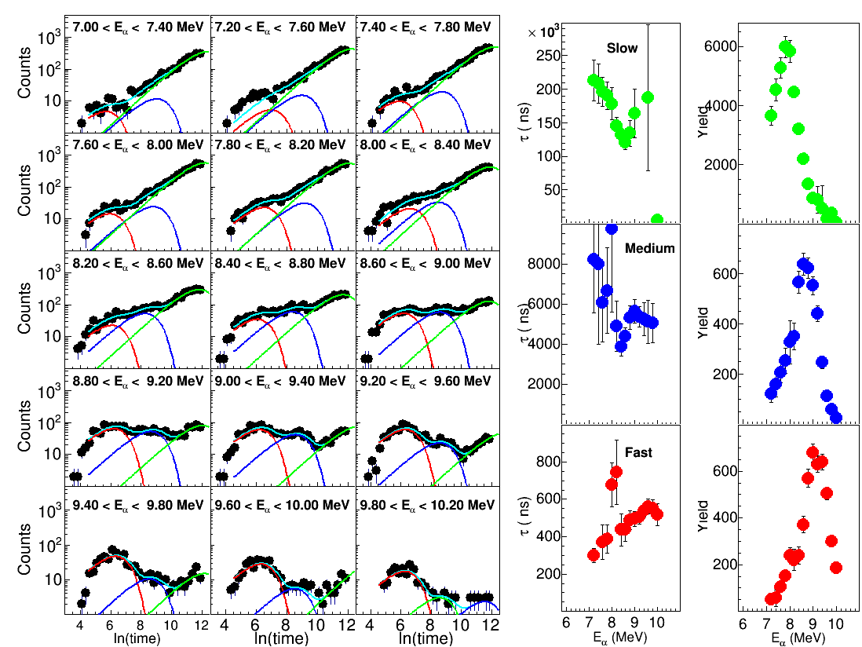
Lifetime Fitting

Slide 12
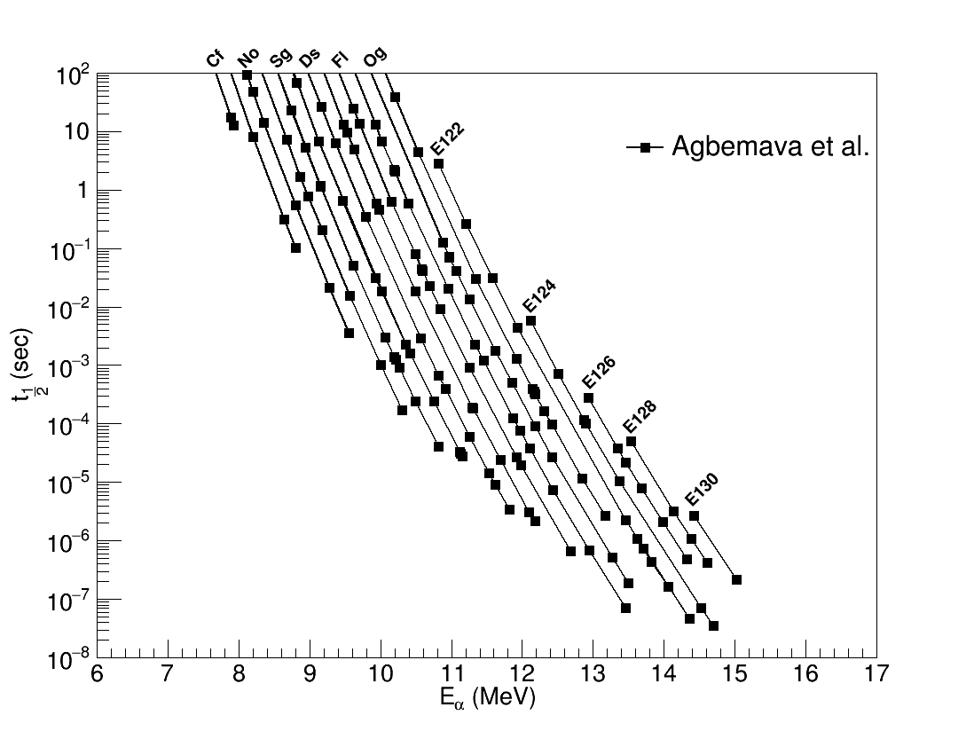
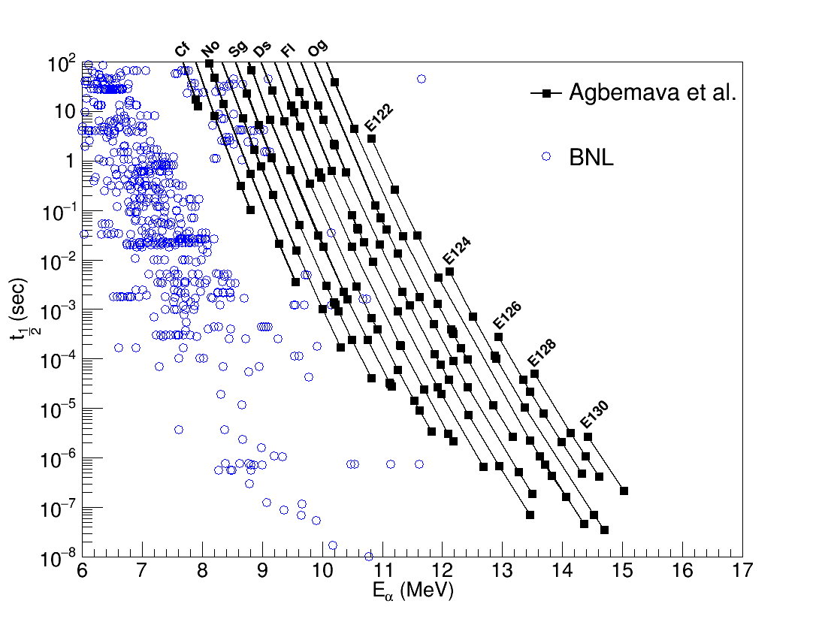
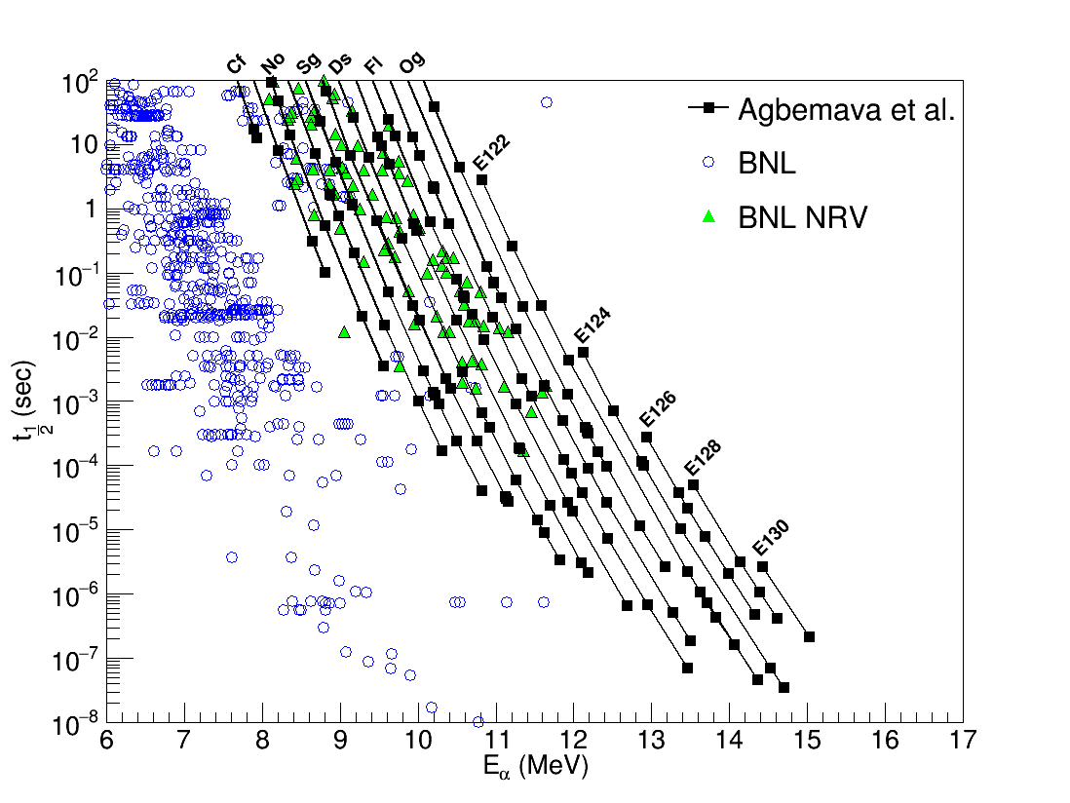
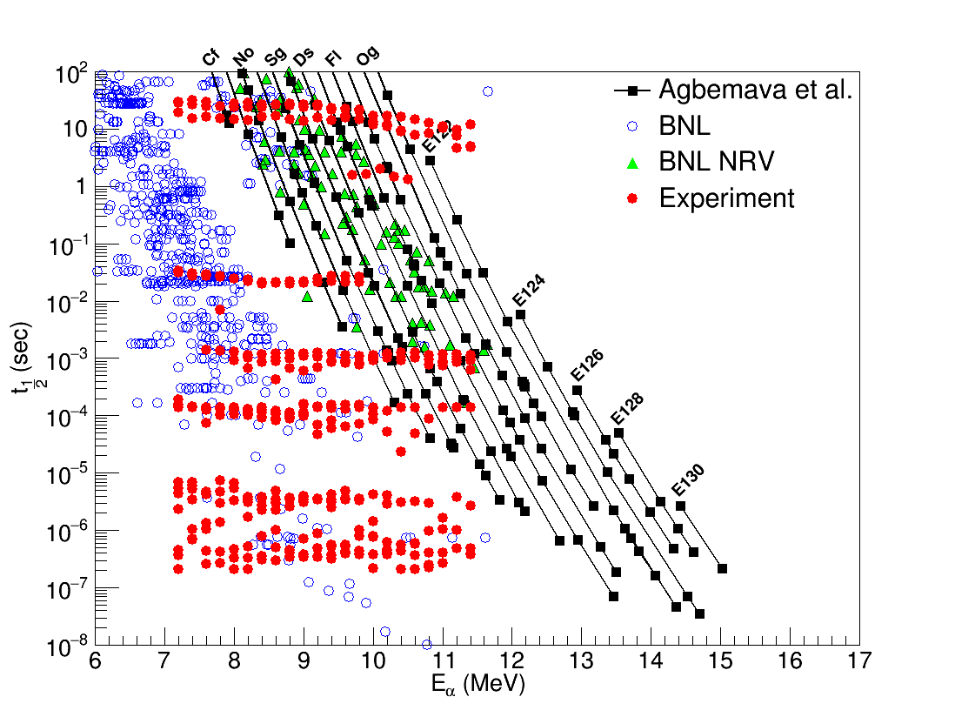
PRC 92, 054310 (2015)

Slide 13
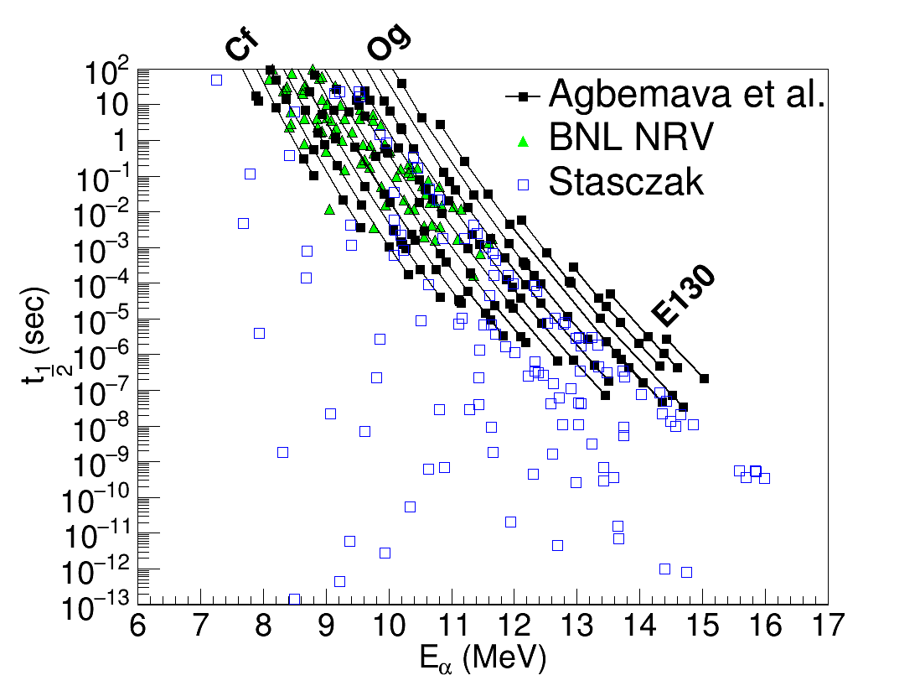

Slide 14
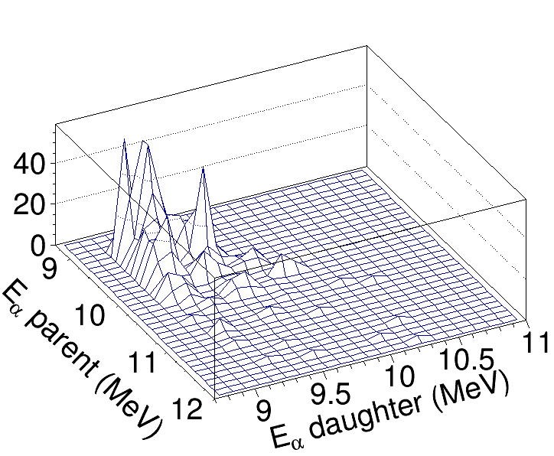
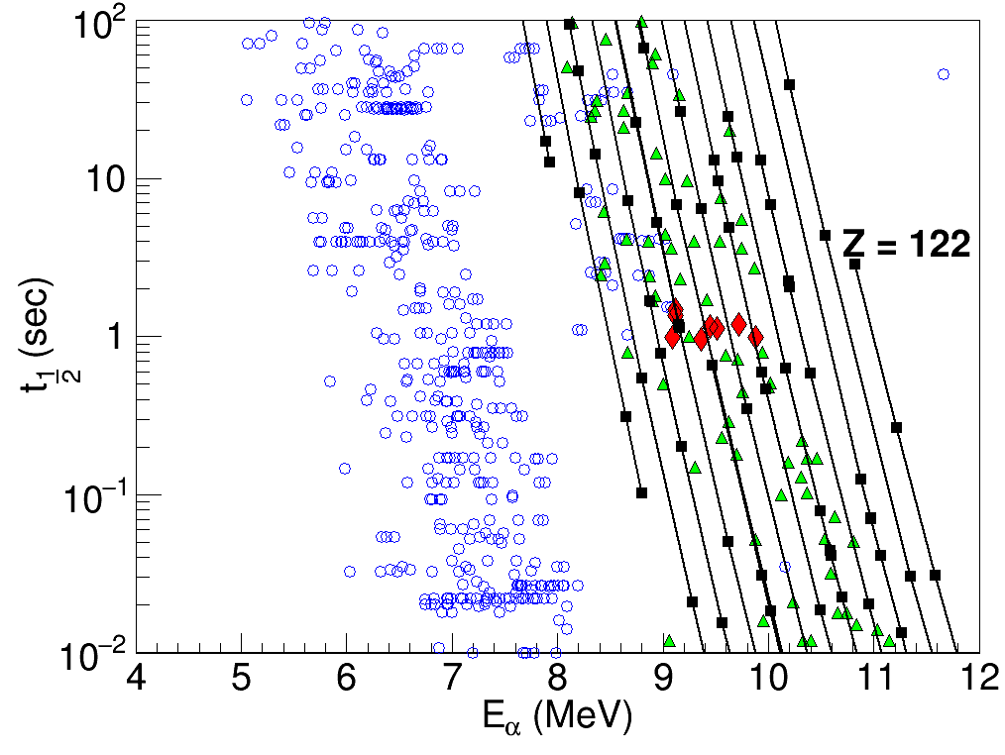
Can we observe chains?
Observing decay chains would prove that we are not observing new isomeric states that have decay energies different from those of their ground state counterparts and thus exhibit a different T_{1/2} –energy correlation
Parent-daughter relationships
Difficult because of large number of products and detector resolution.
We employed correlation methods analogous to those used in gamma-decay spectroscopy together with a peak searching software package in ROOT
Suggests daughters in the range of Z=106-114. (Parent would be 2 higher)

Slide 15
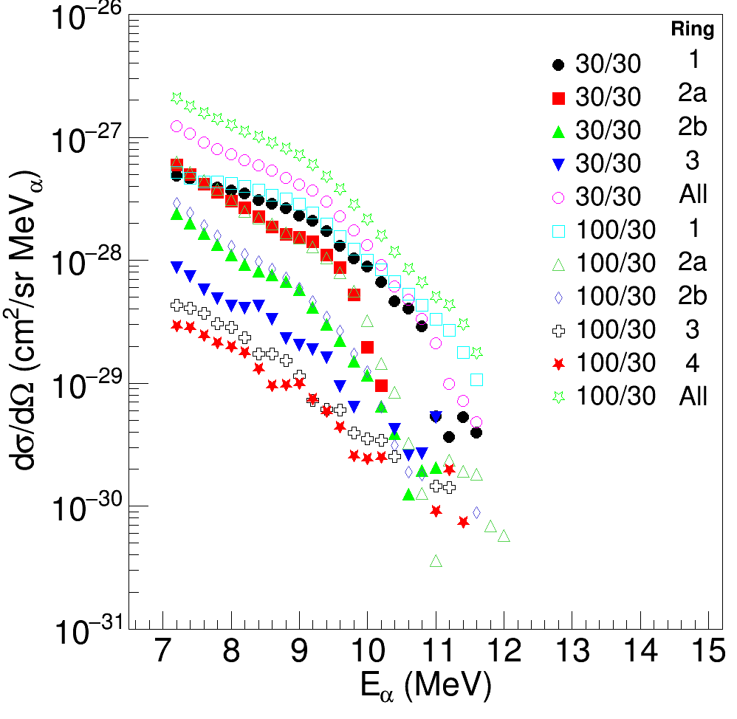
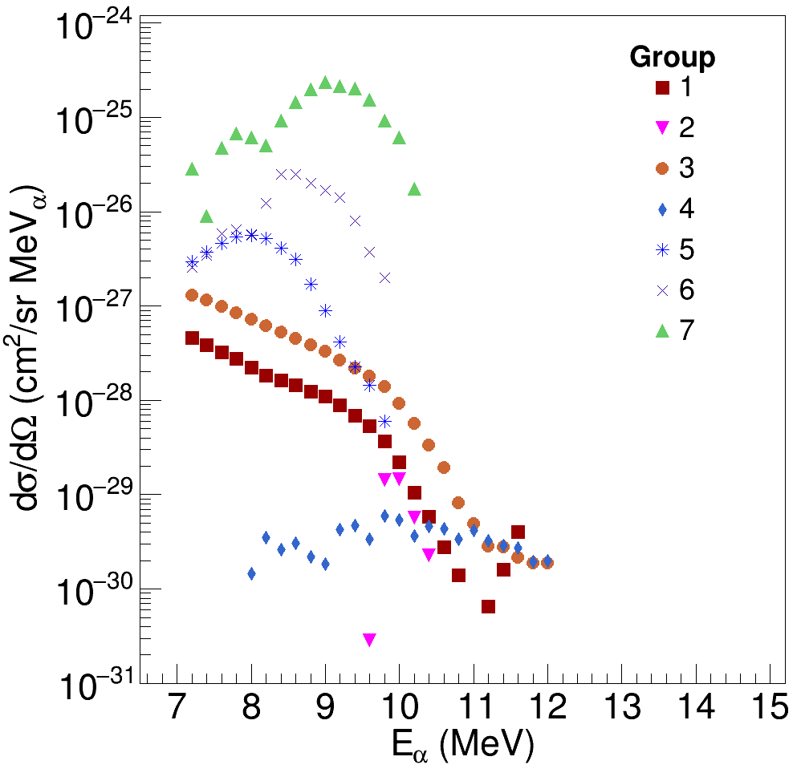
Cross sections
Average cross sections derived assuming that entire energy range from incident energy to Coulomb barrier is contributing.
More than one isotope in general contributes to energy windows.
Decrease in cross section with increasing alpha energy is consistent with increase of alpha energy with increasing Z.
Qualitatively consistent with trends predicted by multi-nucleon transfer models.

Slide 16
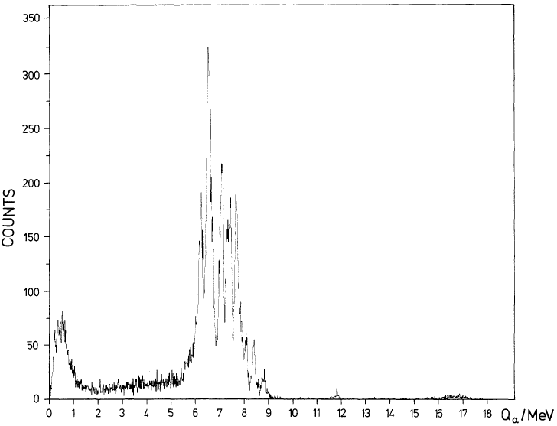
Why not observed before?
Experiments ²³⁸U with²³⁸U in the late 1970s
  In beam detection and radiochemical studies
  Time delay inherent in radiochemical and gas jet techniques
Rotating wheel collection experiment
  Only spontaneous fission activities were searched for
  Implanation depths of products
Freiseleben et al. (Z. Phys. A 292,171 (1979) )
  In beam experiment
  Thin target, so reaction energy was a very narrow window near 7.42 MeV/u
  A few high energy signals were observed, but discounted because of inadequate discrimination against pile up events.
  Present experiment measures from 7.5 MeV/u to around 6 MeV/u because of thicker target
  Present experiment employed Flash ADCs which allowed for about 16ns time resolution reducing the possibility of pileup.
  Recording of individual detector signal traces allowed inspection of individual detector signals

Slide 17
Summary
Multinucleon transfer reactions product heavy elements
  High energy alpha particles detected
Products with a variety of lifetimes were measured.
Using lifetime and energies and comparing to model calculations, products with atomic numbers beyond Z=120 are indicated.
Comparing to calculations where fission competition is taken into account would imply even higher atomic numbers detected for shorter lived isotopes
Effort to observe decay chains

Slide 18
Collaborators
S. Wuenschel, J. B. Natowitz, M. Barbui, J. Gauthier, K. Hagel, X. G. Cao, R. Wada, E. J. Kim, Z. Majka,
Z. Sosin, A. Weiloch, S. Kowalski, K. Schmidt,
K. Zelga, C. Ma, G. Zhang

