Slide 1
Evidence for Resonances in the 7α Disassembly of ²⁸Si
K. Hagel (for Xiguang Cao)
State of the Art in Nuclear Cluster Physics 16-May-2018

Slide 2
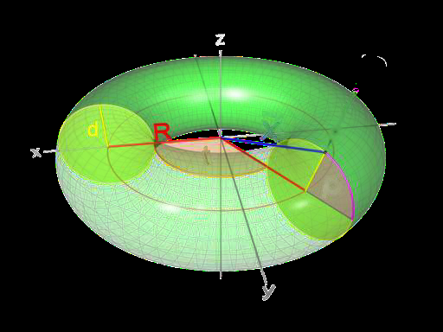
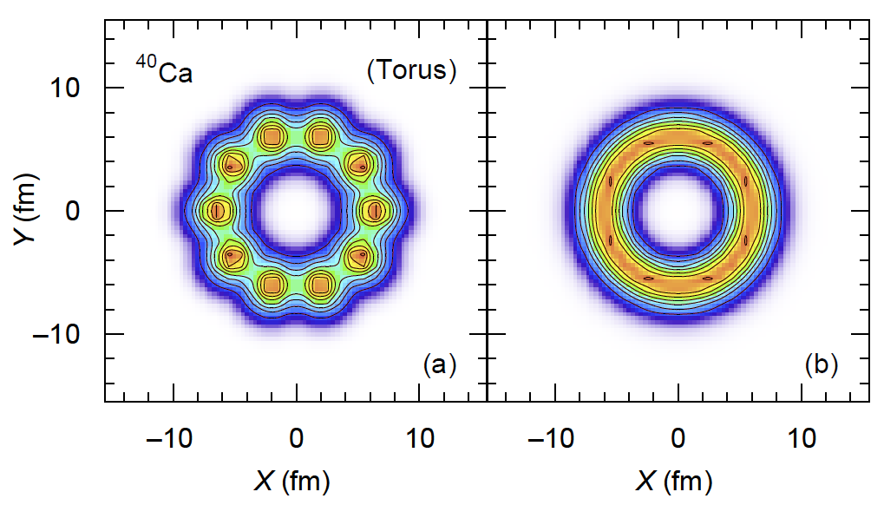
Predictions of Toroidal Nuclei
Nuclei could assume toroidal shapes under certain conditions. (Wheeler, 1963)
J. A. Wheeler, “We physicist should think about where such behavior might occur and look for it.”
Excited toroidal shapes for 40 < A < 70 (Wong, 1972, 1973)
Toroidal configurations for high angular momenta nuclei (Wong, 1978)
Microscopic techniques predict existence of toroidal isomers in light nuclei (Zhang, Ichikawa et al., Staszczak and Wong)
d
R
d
A toroidal nucleus ^{A}Z is characterized by R/d, I_{z}=I

Slide 3
Origin of light toroidal isomers
Light toroidal nuclei have magic numbers arising from large energy gaps between single particle levels
Stability associated with toroidal magic numbers leads to local energy minimum that stable against expansion and contraction of major radius.
Spinning toroidal nucleus
Rotational energy tends to expand toroid
Energy associated with bulk properties tends to contract toroid.
Balance gives rise to local toroidal energy minimum.

Slide 4
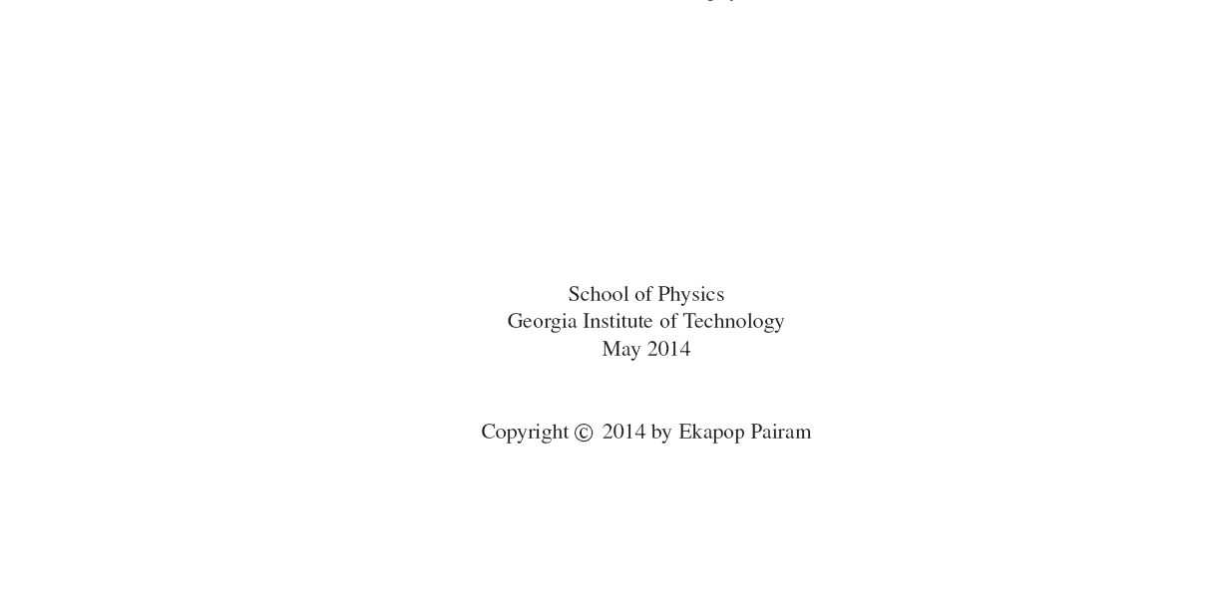
Toroids- Two Immiscible Liquids
THESIS

Slide 5
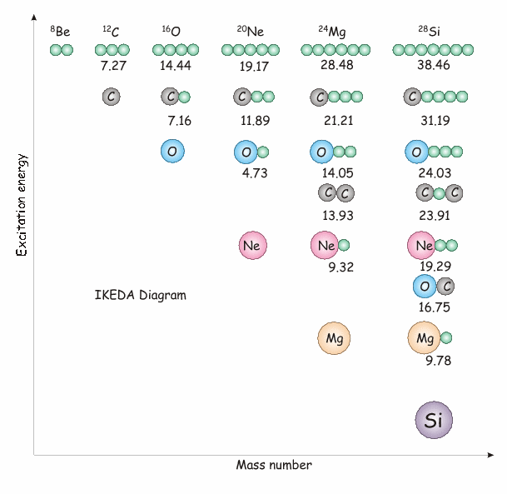
Alpha clustering in nuclei
Ikeda diagram
K. Ikeda, N. Takigawa, and
H. Horiuchi, Prog. Theor.
Phys. Suppl. Extra
Number, 464, 1968.)

Slide 6
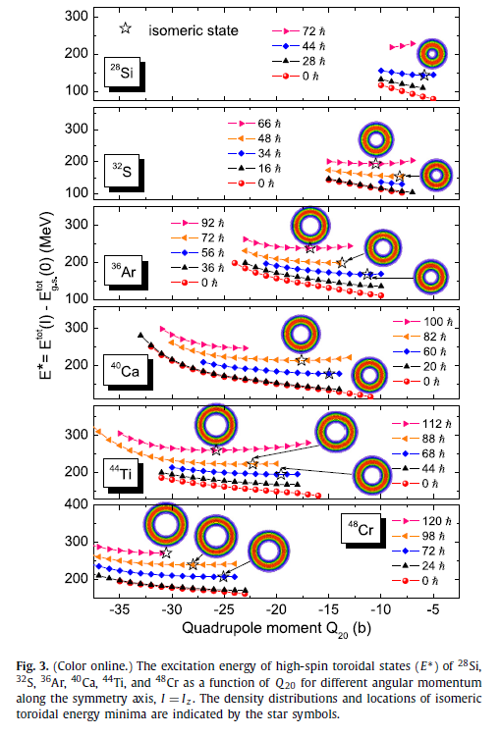
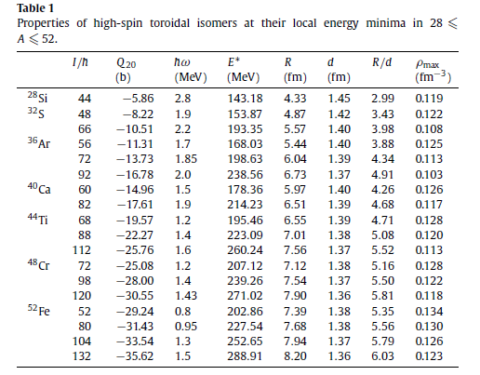
Toroidal high-spin isomers may be possible in light mass A~40 region
Skyrme–Hartree–Fock–Bogoliubov (HFB) calculations
Identify high spin toroidal isomeric states
Phys Lett B. 738 401 (2014).

Slide 7
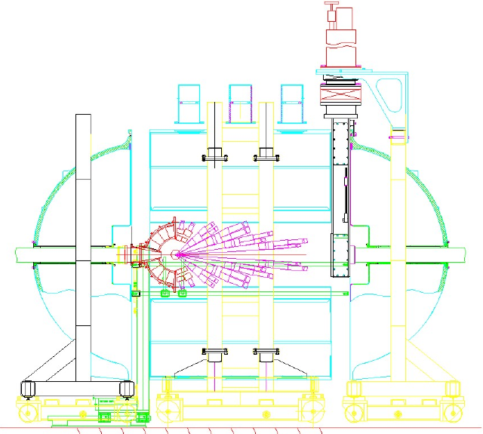
Beam Energy:
Reactions:
35 MeV/u
²⁸Si + ¹²C
NIMROD
14 Concentric Rings
3.6-167 degrees
Silicon Coverage
Neutron Ball
beam
S. Wuenschel et al., Nucl. Instrum. Methods. A604, 578–583 (2009).

Slide 8
Data Analysis
Select events that had 7 α-particles
Construct an excitation energy distribution of the 7α system in the frame of mass of that system.
Construct 7α events by using α-particles from different events (event mixing)

Slide 9
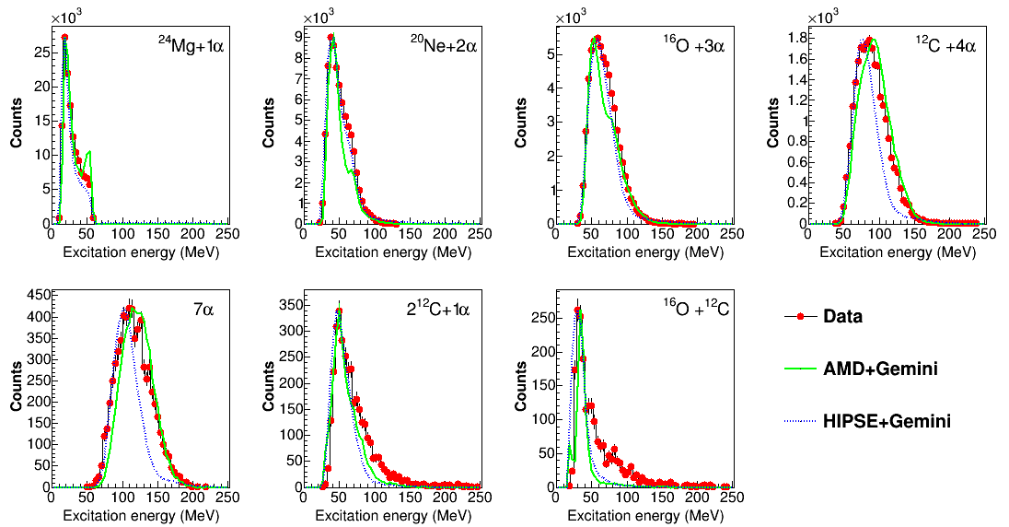

Slide 10
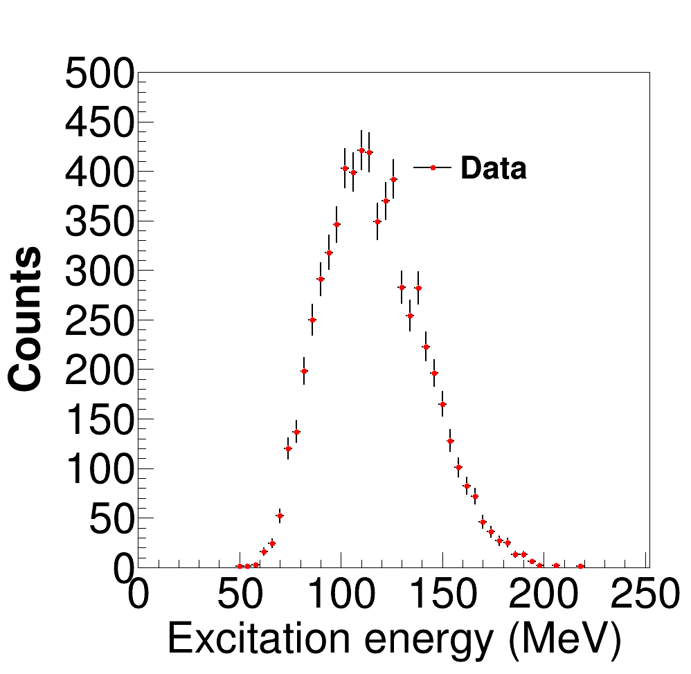
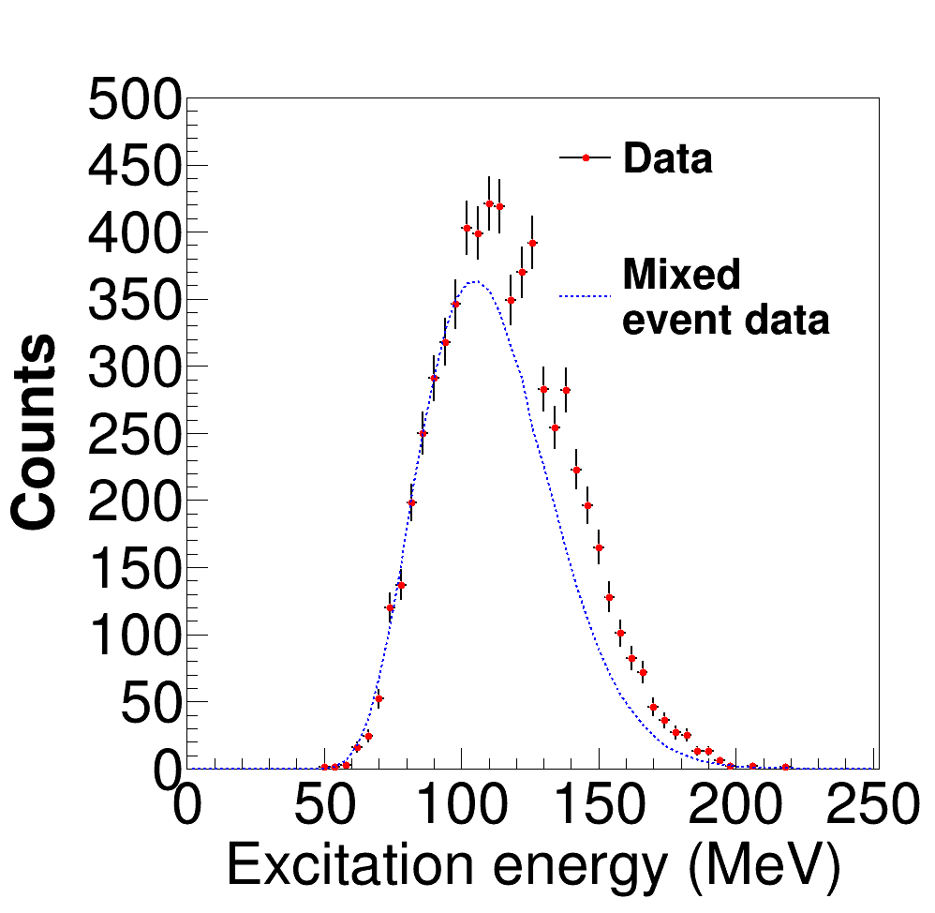
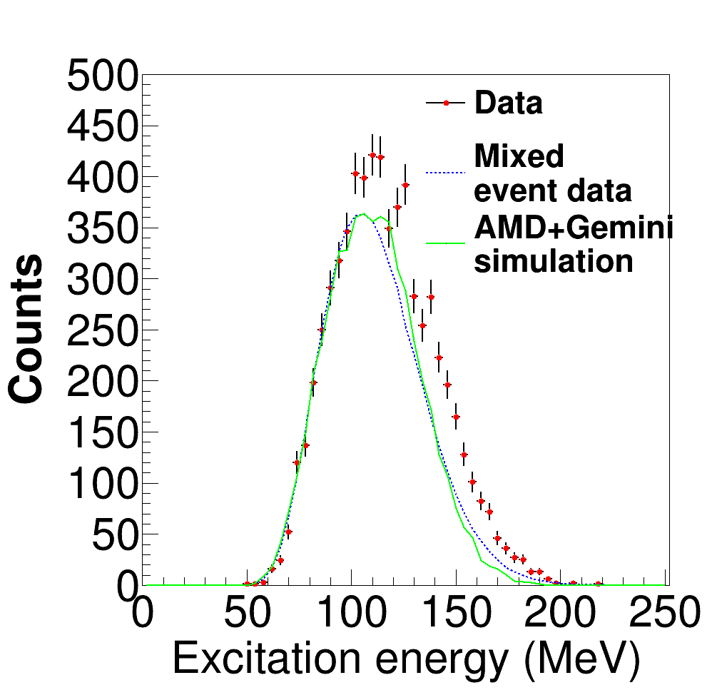

Slide 11
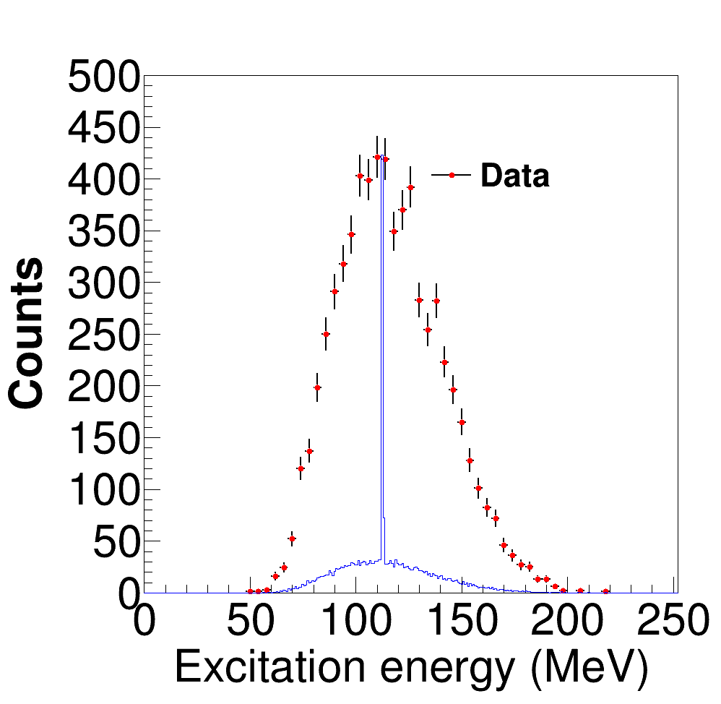
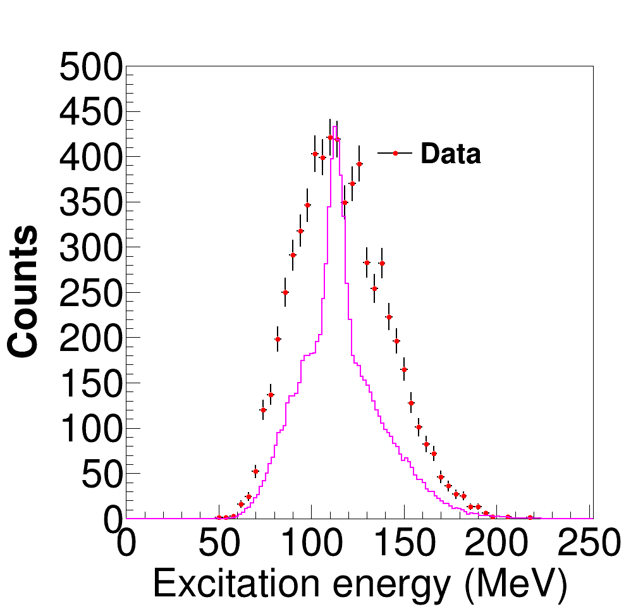
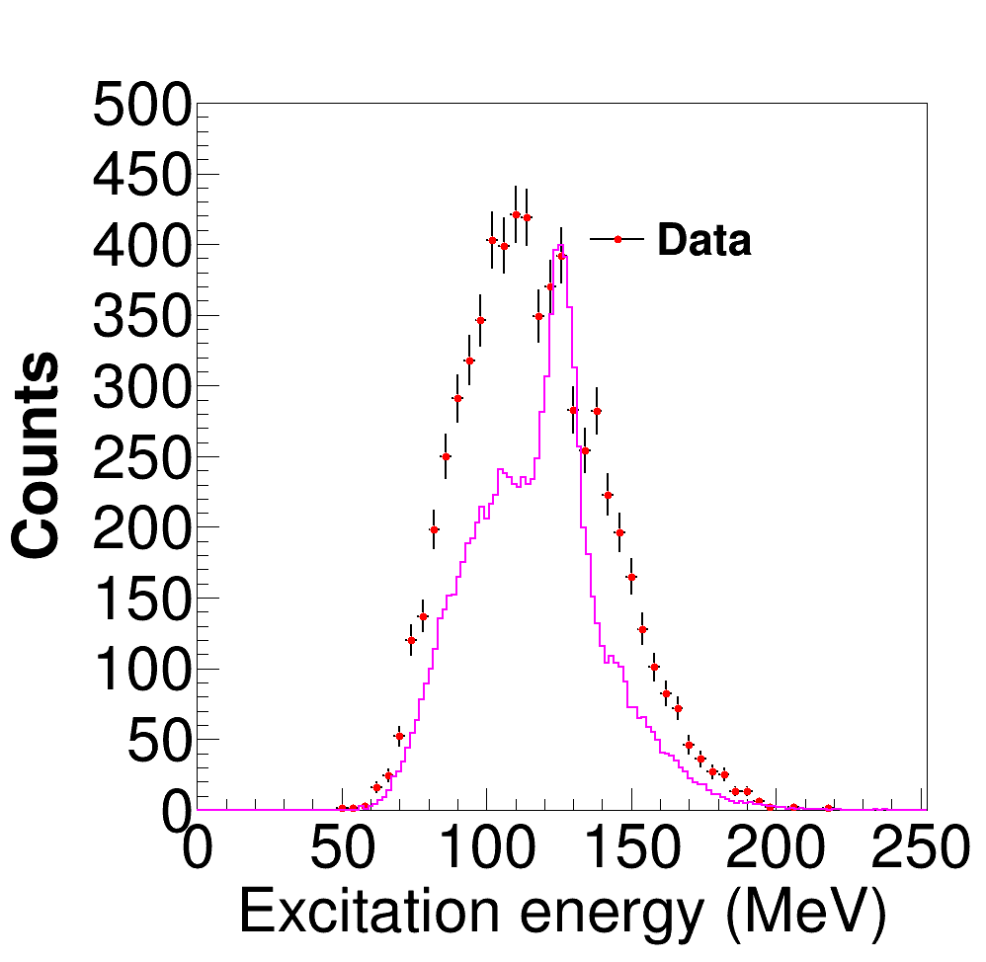
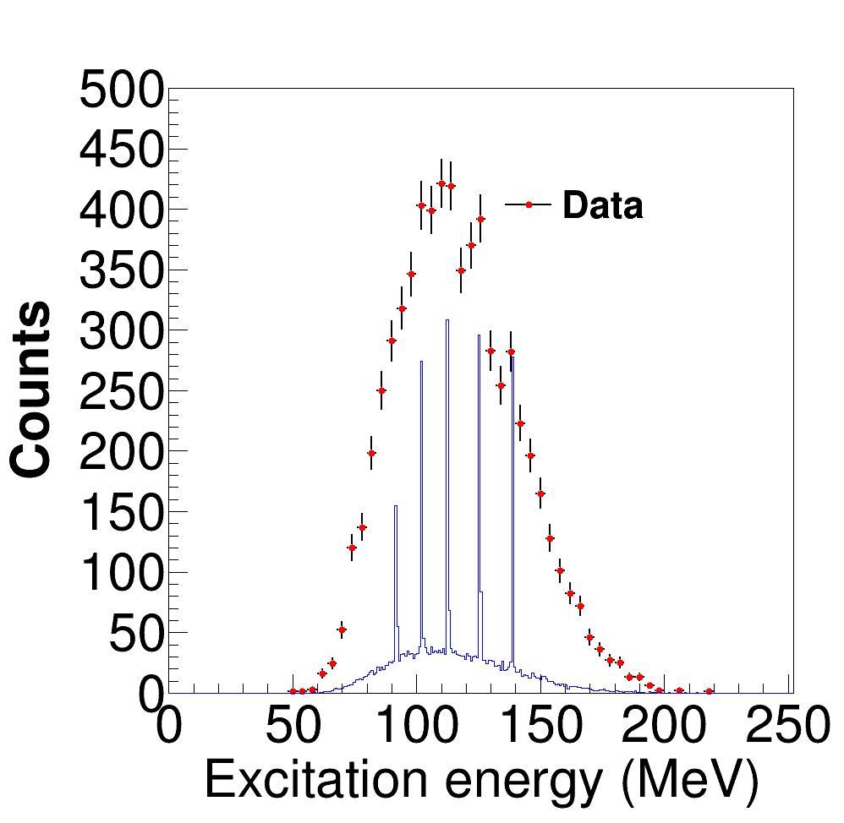
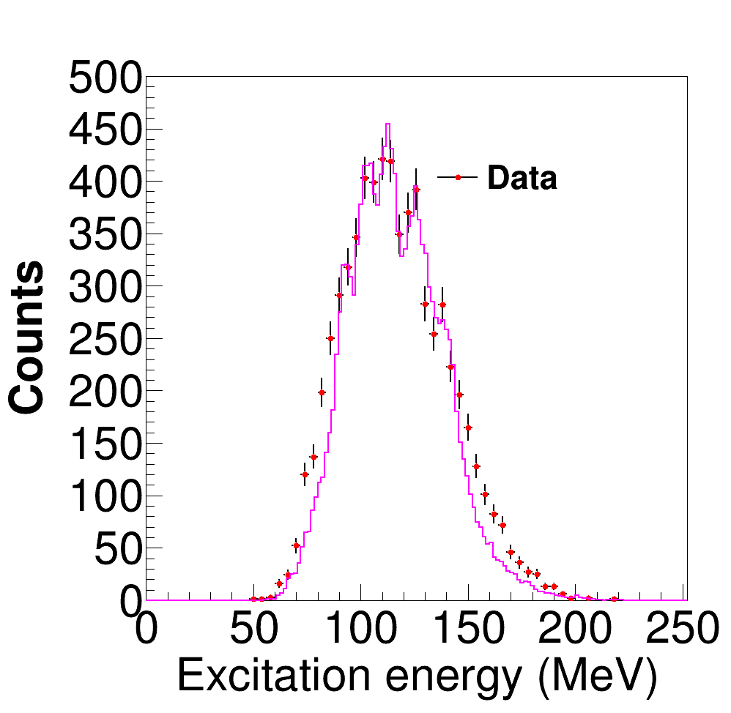
Effect of detector acceptance on possible resonance peaks

Slide 12
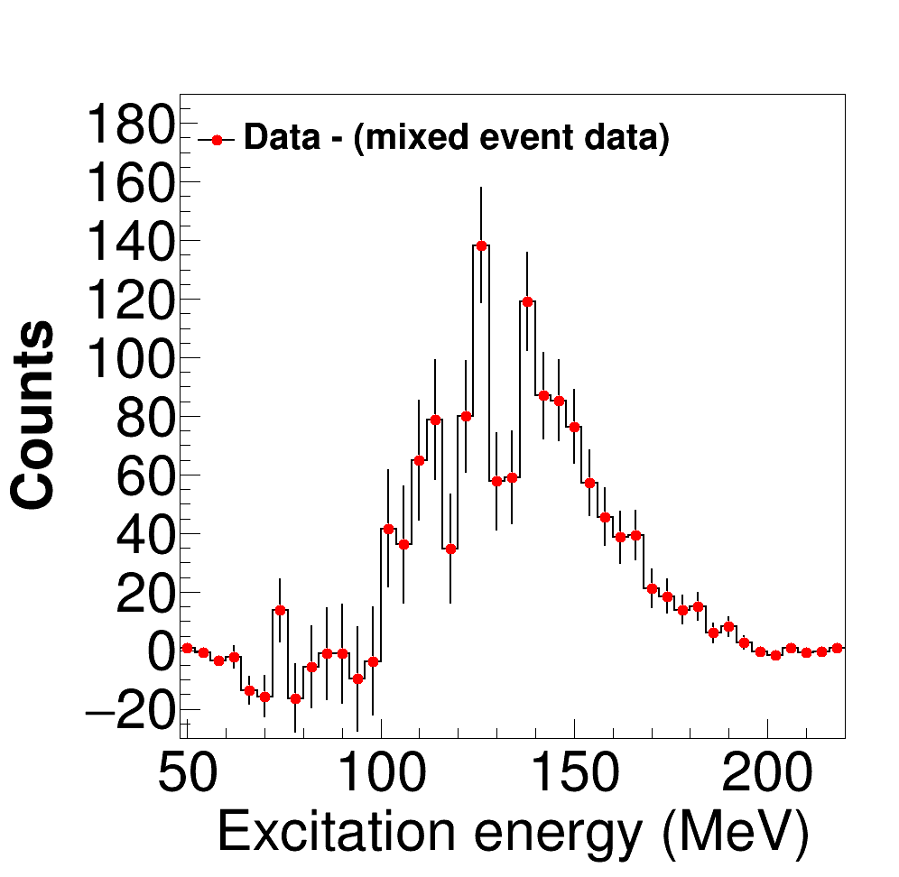
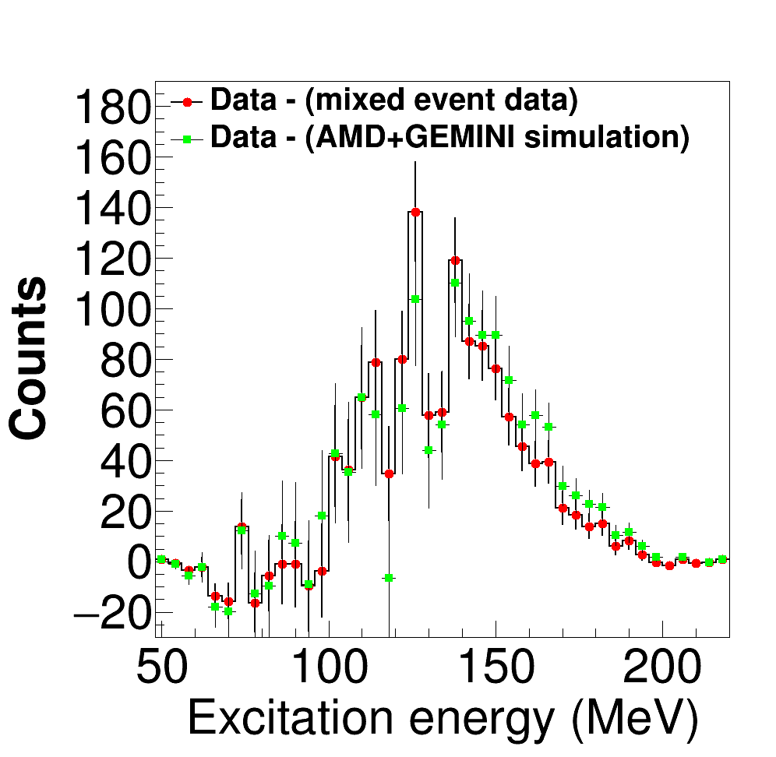
Data background subtraction
Statistical Significance
114 MeV – 4.2σ
126 MeV – 6.0σ
138 MeV – 6.6σ

Slide 13
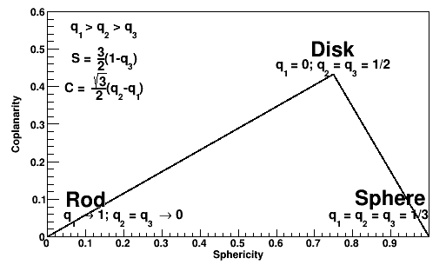
Event shape analysis
Experimental data
Much of the region populated
AMD+Gemini
After deexcitation – Similar to experimental data
Before deexcitation (300 fm/c) – More disk-rod like structures
Population in data can be result of deexcitation

Slide 14
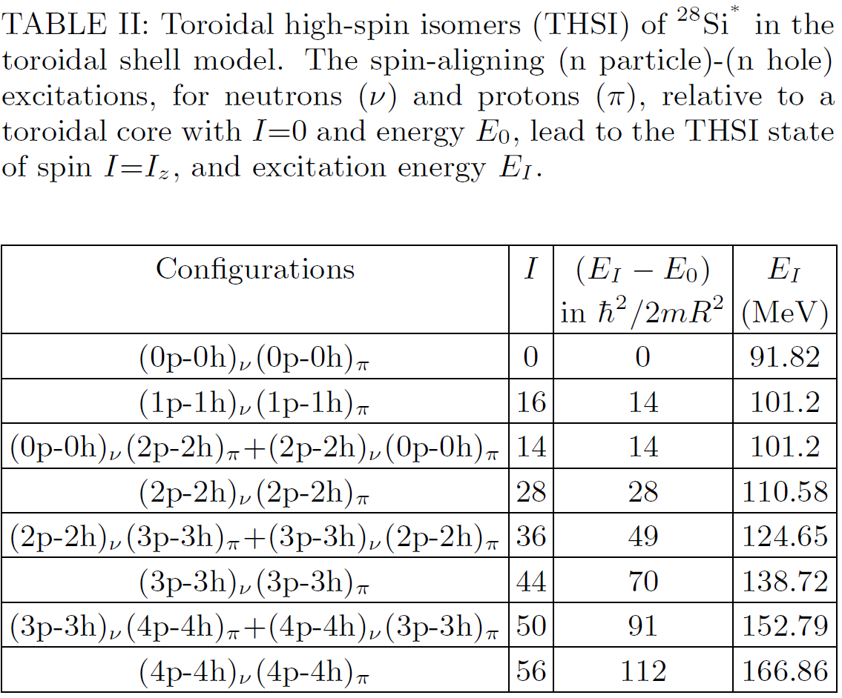
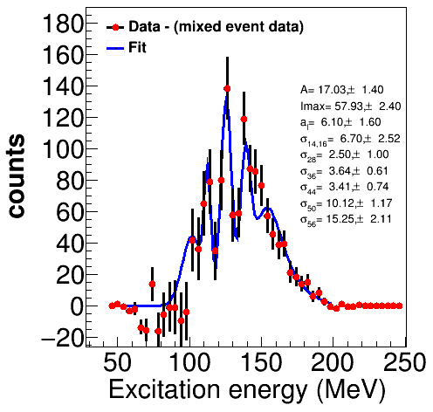
Semi-empirical cross section model
$$σ_{toroidal}\left(E_{x},7α\right)=A\sum_{I=I_{toroid}}{\frac{g_{I}I}{1+exp\{(I−I_{max})/a\}}×\frac{1}{\sqrt{2π}σ_{I}}exp⁡\{{−{(E}_{x}−E_{I}^{})}^{2}/2}σ_{I}^{2}$$
Lower energy peaks are narrow(er)
Higher energy peaks are wider
Particle-hole excitations of high lying states may involve promoting particles to populate states with large intrinsic widths near particle drip line
Caveat: Statistical and background uncertainities???

Slide 15
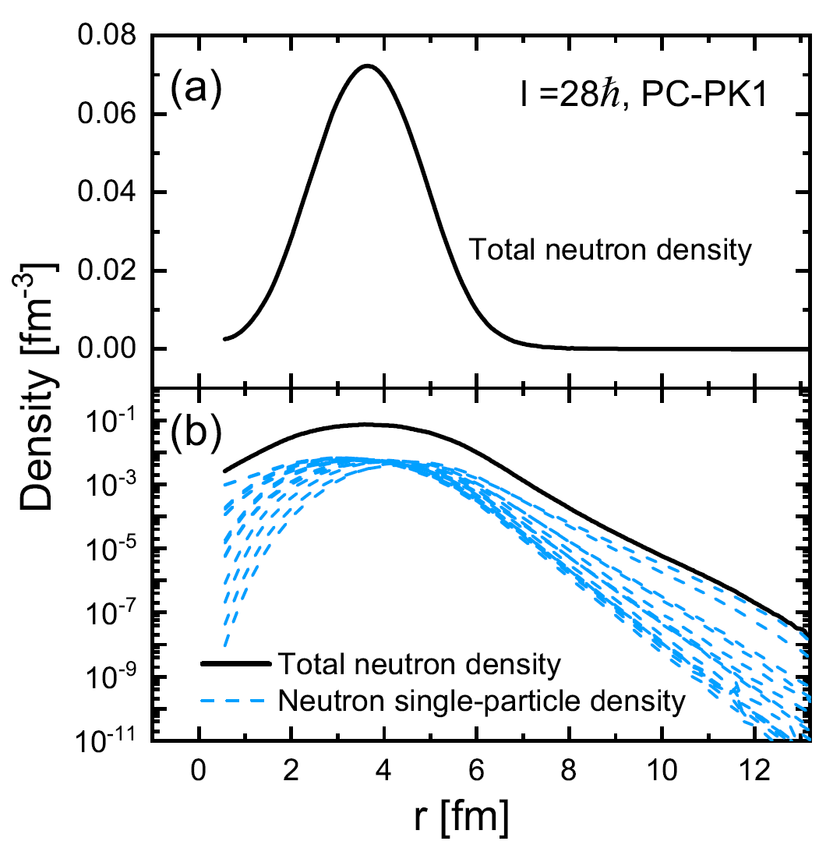
Covariant Density Functional Theory (CDFT) calculations applied to toroidal nuclei.
PC-PK1 and DD-ME2 density functional used.
Several toroid configurations identified.
E* and I similar to those experimentally identified
Radial density distributions are localized
Stability of toroidal isomer against particle emission

Slide 16
Other examples of “toroidal” clusterization
Rotating Bose Einstein Condensate , S. Eckel et al., PRX 8, 021021 (2018)
Supernova 1984

Slide 17
Conclusions
Disassembly of excited ²⁸Si into 7 alphas is not a simultaneous process- but stepwise through alpha conjugate intermediates
Peaks observed in 7α excitation energy distributions appear at excitation energies consistent with predicted toroidal states.
If confirmed, studies of toroidal nuclei can offer new insights into alpha matter at low densities

Slide 18
Outlook
Enhance experiment with position sensitivity.
Finite size detectors degrade angular resolution
FAUST at TAMU now equipped with DADL position sensitive silicon detectors

Slide 19
Collaborators
J. B. Natowitz, X. Cao, K. Schmidt, J. Gauthier,
K. Hagel, R. Wada, S. Wuenschel, E. J. Kim,
M. Barbui, G. Giuliani, L. Qin, Z. Kohley, N. Blando,
S. Shlomo, A. Bonasera, G. Röpke, S. Typel, Z. Chen, M. Huang, J. Wang, H. Zheng, S. Kowalski,
M. R. D. Rodrigues, D. Fabris, M. Lunardon,
S. Moretto, G. Nebbia, S. Pesente, V. Rizzi, G. Viesti, M. Cinausero, G. Prete, T. Keutgen, Y. El Masri,
Z. Majka, and Y. G. Ma

