Slide 1
An overview of some recent experimental results in nuclear cluster physics
………A personal ultra-short journey
Emanuele Vardaci
Dipartimento di Fisica
Università di Napoli “Federico II”
INFN – Sezione di Napoli

Slide 2
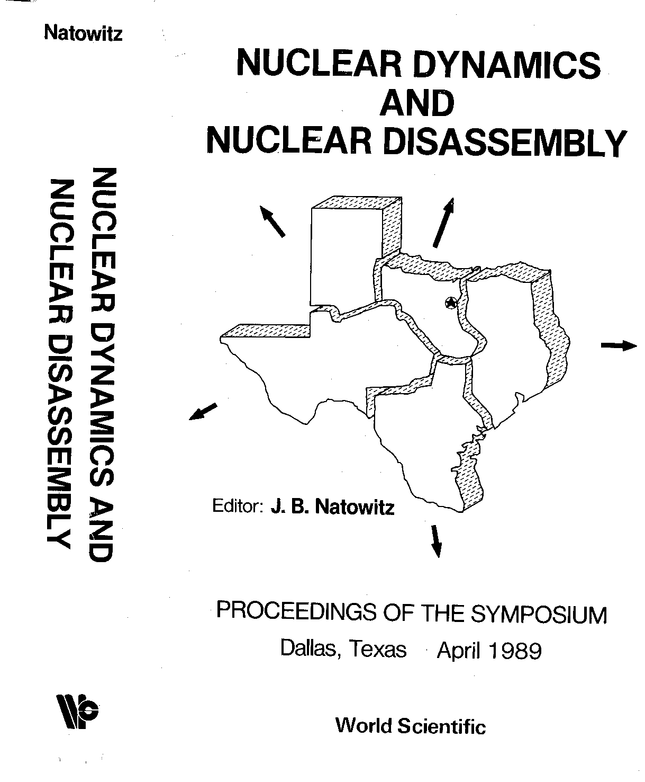

Slide 3
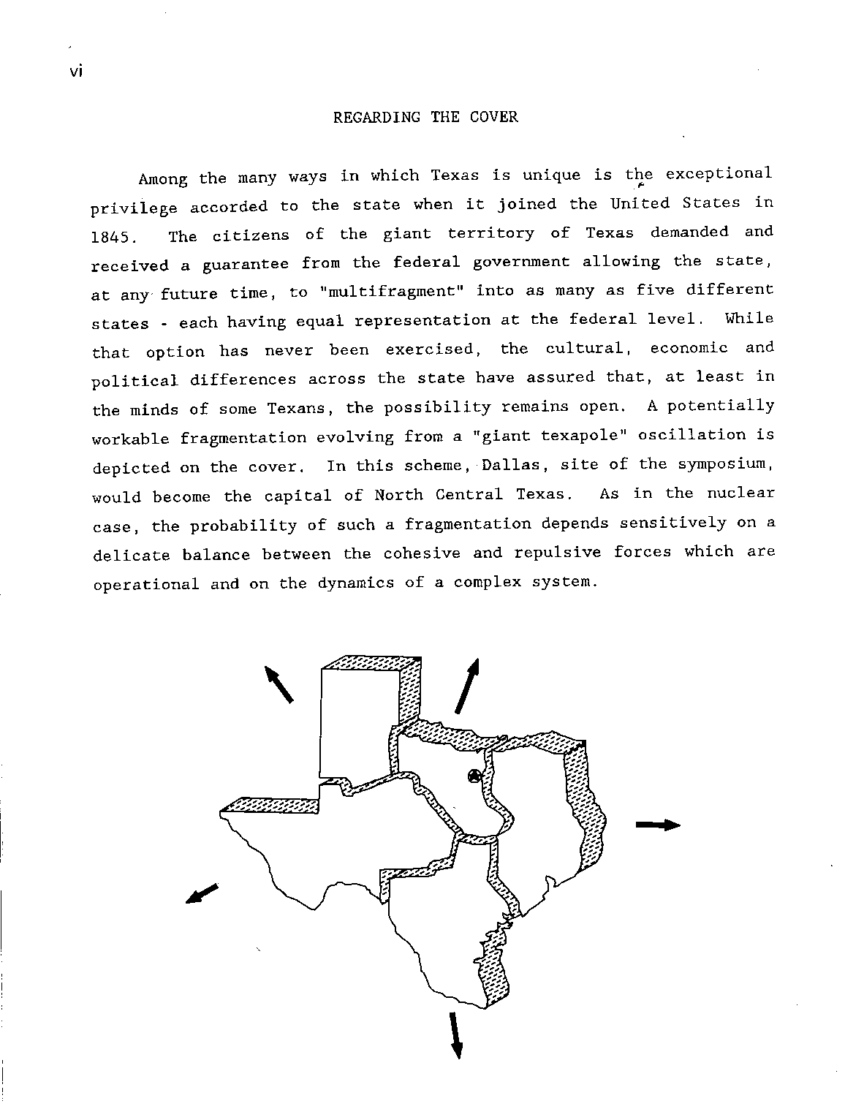

Slide 6
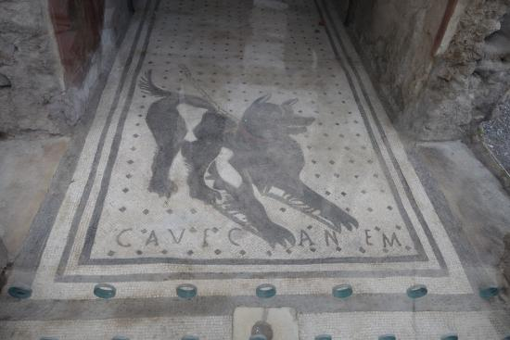
Experiments in Nuclear Cluster Physics 1/3
The goal is to search for signatures of cluster structures in atomic nuclei
Beware:
«In bound states, clustering is not an observable»
(D. Baye, SOTANCP3)
The goal is to search for signatures «to be linked to the existence» of cluster structures in atomic nuclei
Experimental evidence is therefore only indirect: to validate nuclear clustering, theory and experiment must meet

Slide 7
Main Reaction Channels
Elastic and inelastic scattering
Compound nucleus reactions
Direct reactions
Coulomb excitation
Surrogate reactions (i.e. THM)
……

Slide 8
Experiments in Nuclear Cluster Physics 2/3
Evidence is based on the trend of observables and their correlations: Which observables?
Charged particle spectroscopy (energy, momentum, ang. distr., TOFs, many-fold coincidences, invariant mass…)
Gamma spectroscopy (level and band searching…)
n spectroscopy (rarely explored)
Mostly “traditional” nuclear methods and instrumentation, however, more precision is needed!
Newer setups: TEXAT or TTIK, OPC, STELLA, MAIKo…

Slide 9
Experiments in Nuclear Cluster Physics 3/3
Clustering in self and non-self conjugated nuclei
Clustering in reactions mechanisms
Clustering in Nuclear Astrophysics
Cluster radioactivity
Clustering in super-heavy research

Slide 10
The ¹²C Hoyle State case
Two “simultaneous” experiments provide the most precise upper limit to date of the Hoyle state direct decay into 3α.
$\frac{Γ_{3α}}{Γ}=0.043$%
$\frac{Γ_{3α}}{Γ}=0.047$%

Slide 11
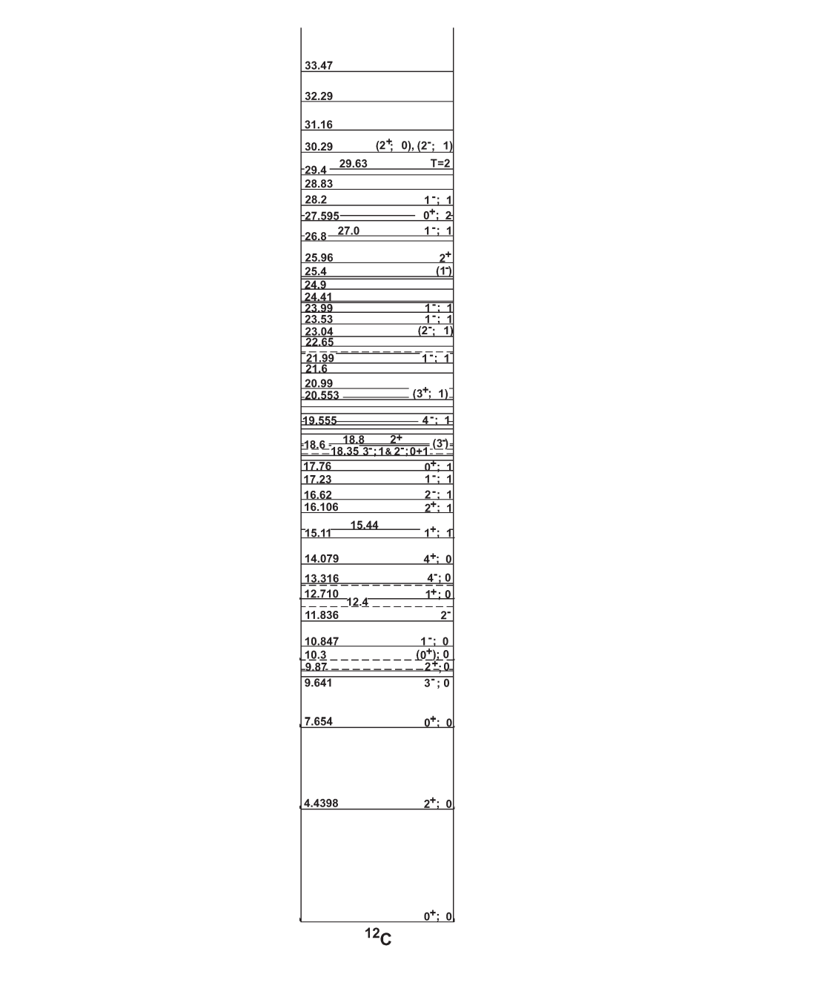
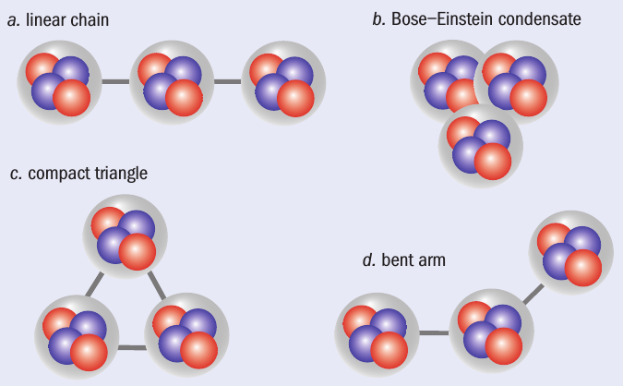
A very special case: the Hoyle state in ¹²C
The structure of ¹²C
Cluster state of ¹²C located at 7.654 MeV (0⁺) → characterized by a pronounced cluster nature → quite unusual and not well understood properties → challenging open question in nuclear physics.
E_{x} = 7.654 MeV J^{π} = 0⁺
from Ajzenberg-Selove
18.722
¹¹C + n
D. Jenkins and O. Kirsebom, The Secret of Life,
Physics World Feb. 2013
15.957
¹¹B + p
4⁺ $≈$14 MeV
M. Freer et al., Phys. Rev. C 83, 034314 (2011)
4⁺
(a) linear chain: α-cluster model
(b) Bose-Einstein condensate: microscopic models (GCM, RGM)
(c) compact triangle: ACM
(d) bent-arm: microscopic models (Faddev three-body formalism)
(e) (THSR) → Hoyle state radius 1.35 – 1.60 times the ground state one.
Hoyle band
2⁺ 9.75 MeV
2⁺
7.367
⁸Be + α
0⁺
$$E_{x}=\frac{ℏ^{2}}{2I}J(J+1)$$
M. Itoh et al., Phys. Rev. C 84, 054308 (2011).
M. Freer et al., Phys. Rev. C 80, 041303 (2009).
W. R. Zimmerman, N. E. Destefano, M. Freer,
M. Gai, and F. D. Smith, Phys. Rev. C 84, 027304 (2011).
Courtesy of Daniele Dell’Aquila
Notes:
The decay properties of this state strongly affect the synthesis of carbon or heavier elements
in the burning as well as the evolution of the stars. In nuclear structures, the H. state is crucial
to understand clustering in nuclei.
Theoretical calculations show different hypothesis regarding its spatial configurations.
Some models are able to predict the sequential-to-direct decay BR of the H. state.
Precise knowledge of the exp. BR has a capital importance to serve as a benchmark of theoretical models.

Slide 12
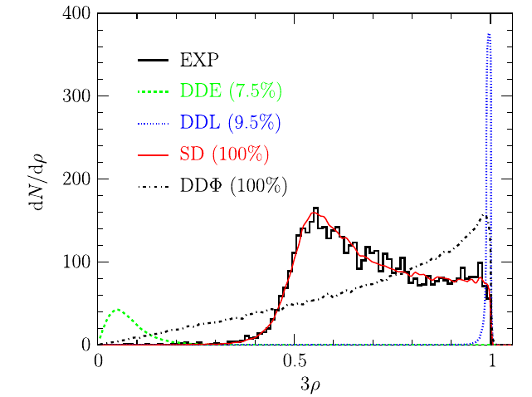
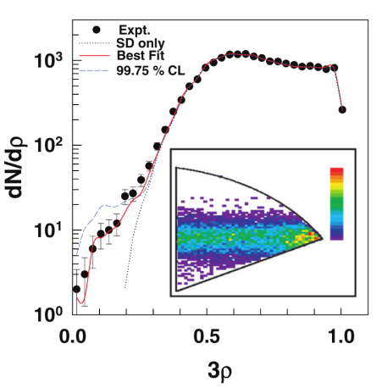
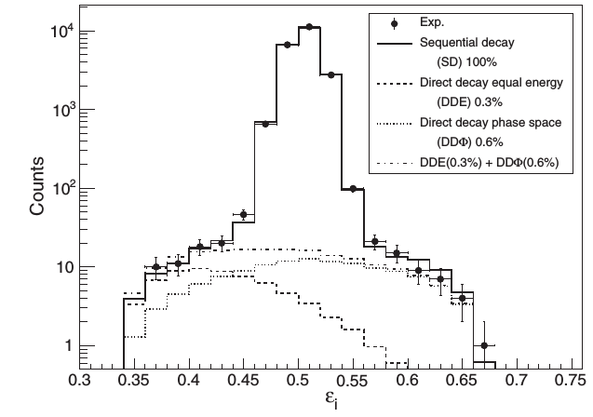
The Hoyle state in ¹²C: the non-resonant decay branch
⁸Be
α
α
¹²C*
sequential
α
O.S. Kirsebom et al.
$≈5000$ events → no evidence of direct decays → upper limit of 0.5% to direct branching ratios.
α
α
α
direct
α
α
α
Experiment | $$Γ_{3α}/Γ (\%)$$
[1] M. Freer et al. | $$<4$$
[2] Ad.R. Raduta et al. | $$17.0±5.0$$
[3] J. Manfredi et al. | $$0.45$$
[4] O.S. Kirsebom et al. | $$<0.5$$
[5] T.K. Rana et al. | $$0.91±0.14$$
[6] M. Itoh et al. | $$<0.2$$
[7] L. Morelli et al. | $$1.1±0.8$$
T.K. Rana et al.
$≈20000$ events → non-vanishing direct decay branching ratio
$$\frac{Γ_{3α}}{Γ}=0.91±0.14$$
Univ. degli Studi di Napoli Federico II & INFN - Napoli
M. Itoh et al.
$≈20000$ events → direct decay under the sensitivity of the experimental sensitivity → <0.2%
[1] M. Freer et al., Phys. Rev. C 49, R1751 (1994). [2] Ad. R. Raduta et al., Phys. Lett. B 705, 65 (2011). [3] J. Manfredi et al., Phys. Rev. C 85, 037603 (2012). [4] O. S. Kirsebom et al., Phys. Rev. Lett. 108, 202501 (2012). [5] T. K. Rana et al., Phys. Rev. C 88, 021601(R) (2013). [6] M. Itoh et al., Phys. Rev. Lett 113, 102501 (2014). [7] L. Morelli et al., J. Phys. G: Nucl. Part. Phys. 43, 045110 (2016).
Courtesy of Daniele Dell’Aquila
Notes:
A potentially sensitive probe into the structure of the Hoyle state is to examine
the ways that it decays in three alpha particles.
It may break up through a sequential process, where an alpha particle is emitted leaving
8Be in its ground state, or through a direct decay process where the three alpha particles
share the decay energy in a more complicated way.
Quantifying the likelihood of the direct decay and the energy distribution of the three
emitted α particles may lead to an understanding of their initial configuration in the nucleus.

Slide 13
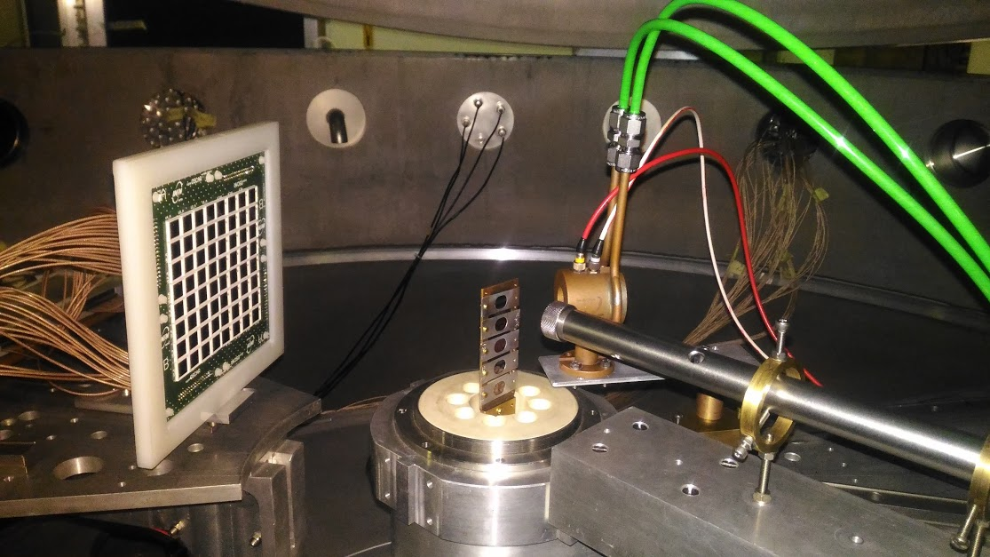
High-precision probe of the Hoyle state direct decay width
¹⁴N(d,α)¹²C
E_{d}=10.5 MeV
SuperOSCAR
anticoincidence
telescope
3α
C₃N₆H₆
α
d
100
~28000 H.S. decays events
3α
¹²C*
α
d
¹⁴N
Dell’Aquila’s talk on tuesday
D. Dell’Aquila et al., Phys. Rev. Lett. 119, 132501 (2017)
Courtesy of Daniele Dell’Aquila

Slide 14
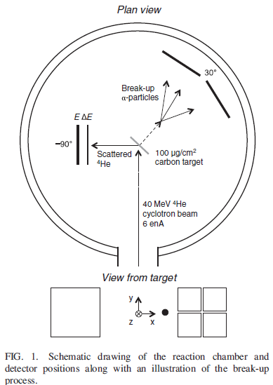
¹²C(α,α’)¹²C*
E_{α}=40 MeV
~24000 H.S. decays events
Bishops’s talk on wednesday
R. Smith et al., Phys. Rev. Lett. 119, 132502 (2017)

Slide 15
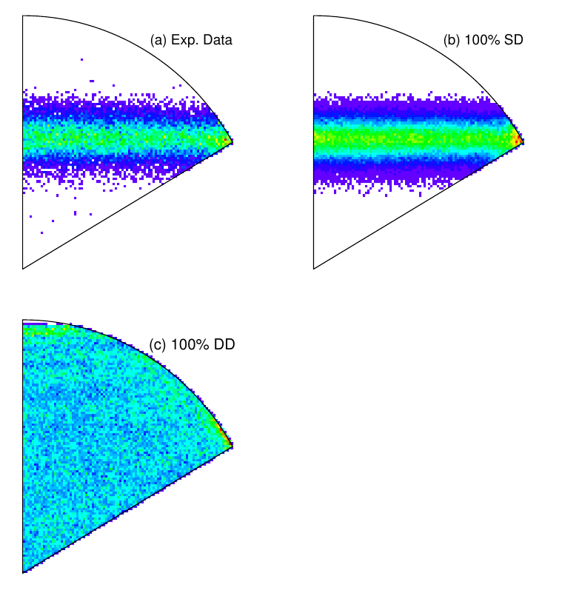
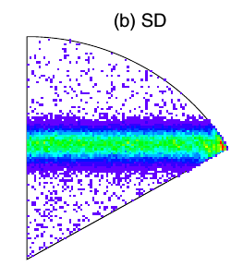
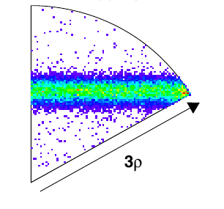
Sequential vs. Direct
$$ε_{i,j,k}=E_{i,j,k}/(E_{i}+E_{j}+E_{k})$$
$$ε_{i}>ε_{j}>ε_{k}$$
$$x=\sqrt{3}(ε_{j}−ε_{k})$$
$$y=2ε_{i} −ε_{j}−ε_{k}$$
simulation 100% SD
M. Itoh et al.
Dell’Aquila et al
simulation 100% DD
Experimental data
simulation 100% SD
28000 counts under the sequential decay peak → compatible with fully sequential process!

Slide 16
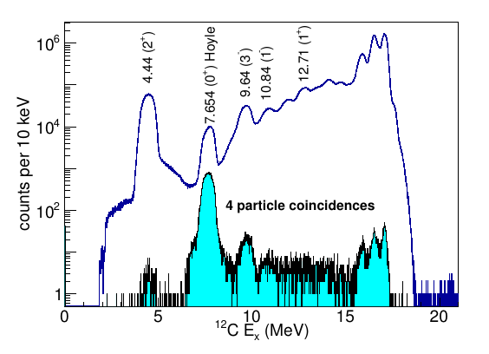
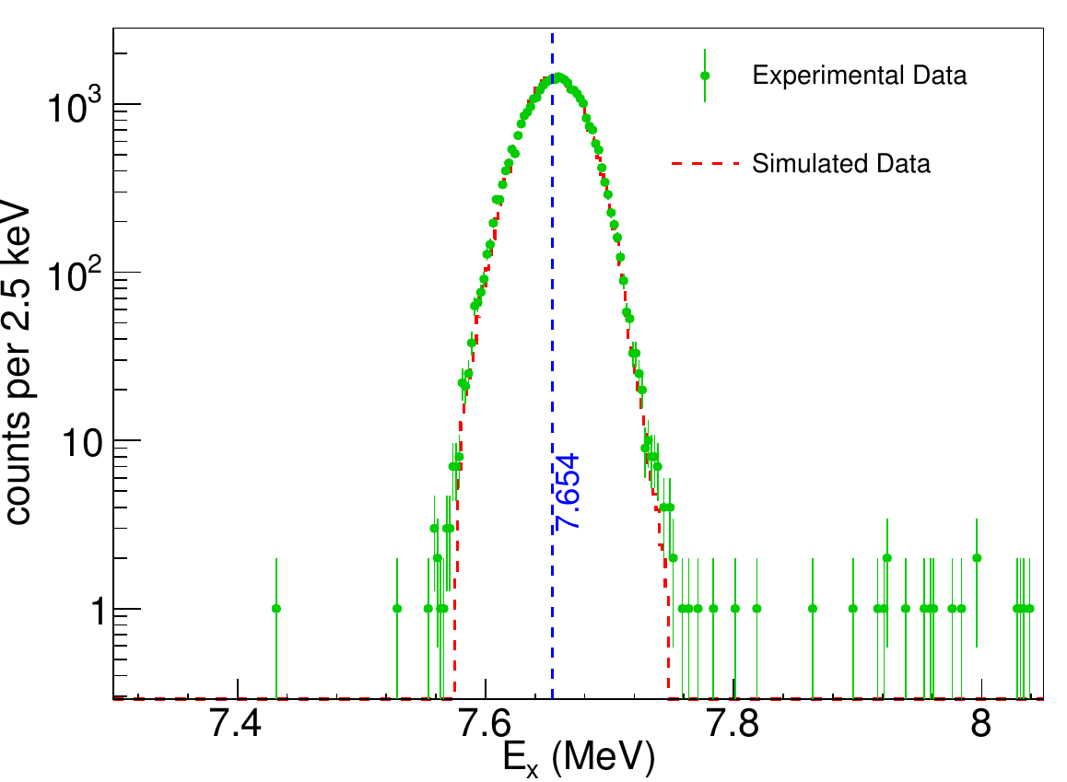
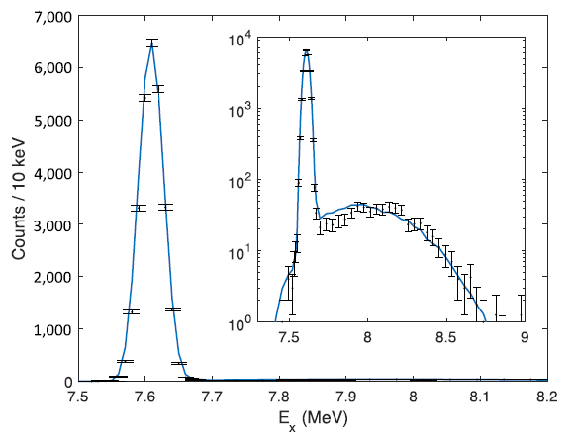
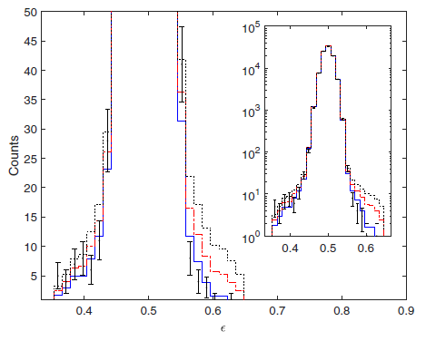
New upper limit DD < 0.043 % with a C.L. of 2σ.
D. Dell’Aquila et al.
1 out of 2500 triple decays
New upper limit DD < 0.047 % with a C.L. of 2σ.
R. Smith et al.

Slide 17
What are the consequences of such striking results on our understanding of the Hoyle state structure ?
More stringent test for theoretical models
How to connect the internal structure with decay properties?
These two experiments seem to rule out the hypothesis of the Hoyle state as a B.E.C.
…but

Slide 18
(1)
Phys. Lett. B779, 460 (2018)
(2)
Phys. Lett. B779, 414 (2018)
Both approaches focus on Coulomb effects:
Decay through tunneling (1) and final state Coulomb interactions (2) can hide the true structure of Hoyle state.

Slide 19
Phys. Lett. B779, 460 (2018)
Simplifying….
Tunneling model: it favors seq. decay (two steps process)
$Γ_{3α}/Γ$ one order of magnitude smaller than exp. upper limit
DD more probable with increasing E* (10% at ~10MeV)
An Efimov State (ES) at E*=7.458 MeV might exist (3α with equal energy)
SD of Efimov State still dominant but emitted α’s have equal energies both in DD and SD!

Slide 20
Phys. Lett. B779, 414 (2018)
Simplifying….Refsgaard et al. (2) (Refsgaard’s talk on wednesday)
R-matrix toy model for SD
$Γ_{3α}/Γ$ agrees with exp. upper limit
Coulomb effects (final state interaction) heavily influence the phase space distribution in DD
Interference between SD and DD channels (no pure SD or DD )

Slide 21
Search for rare γ-decay mode in ¹²C
At T > 10⁹ K, the states above the Hoyle state become important.
₂+₂
9.84 MeV
₃-
9.64 MeV
1
8.87 MeV
⁸Be(2⁺₁)+α
₀+₂
7.65 MeV
7.37 MeV
7.27 MeV
Hoyle state
⁸Be(g.s.)+α
3α
γ
γ
$Γ_{y}$(H.S.) = 3.7 ± 0.5 meV
2
+
4.44 MeV
1
$Γ$(H.S.) = 8.5 ± 1.0 eV
γ
At T> 10⁹ K, 3⁻ and 2⁺ play a role
₀+₁
g.s.
¹²C levels
M. Tsumura et al, J.Phys. Conf. Series 863 012075 (2017)
Notes:
The triple alpha reaction is one of the most important reactions for nucleosynthesis in the universe
because it is a doorway reaction to synthesize heavier elements.
An alpha particle is captured by 8Be, which is a two alpha resonant state, to form a triple alpha resonant state.
Most of such triple alpha resonant states decay back to 3alpha particles, but a tiny fraction of those states
decays to the ground state in 12C by emitting gamma rays.
The branching ratio between the gamma and the alpha decay of the triple resonant states is a key parameter
to decide the triple alpha resonant reaction rates.
The triple alpha reaction proceeds via the Hoyle state at normal stellar temperature,
but the high-energy triple alpha resonant states such as the 3− and 2+ states in 12C play
a very important role at higher temperature T9 > 1 like supernovae, first stars, and so on.
Nevertheless, the gamma decay probability of the 3− state is still unknown.

Slide 22
γ-decay of 3⁻₁ in ¹²C
-
3 ₁
9.64 MeV
7.65 MeV (Hoyle state)
α decay threshold
₀+₂
Direct decay
Γγ₀ = 0.31±0.04 meV lower limit for Γγ
E1
₂+₁
Cascade via the Hoyle state little contributes to Γγ
Cascade via 2⁺₁ might be the main contribution
4.44 MeV
known
Measuring survival probability of ¹²C*(3⁻) against 3α decay, instead of direct γ-rays
100%
₀+₁
g.s.
M. Tsumura et al, J.Phys. Conf. Series 863 012075 (2017)
¹²C

Slide 23
γ-decay of 3⁻₁ in ¹²C
Grand Raiden spectrometer
γ
3α
12
C
Telescope
p
p
Hydrogen
Target
¹²C Beam
¹²C Beam
(a) α-decay events
(b) γ-decay events
branching ratio
M. Tsumura et al, J.Phys. Conf. Series 863 012075 (2017)

Slide 24
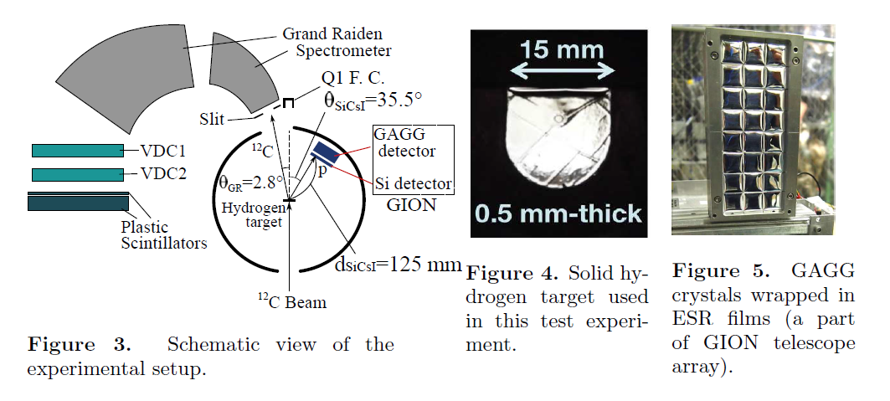
γ-decay of 3⁻₁ in ¹²C
M. Tsumura et al, J.Phys. Conf. Series 863 012075 (2017)

Slide 25
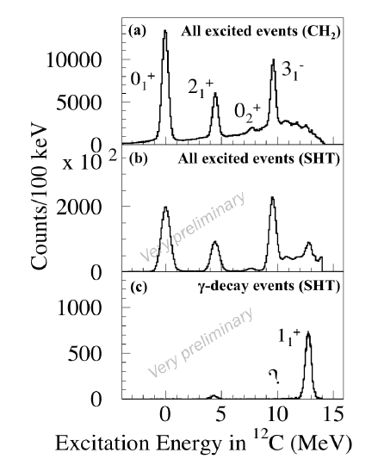
γ-decay of 3⁻₁ in ¹²C
Kawabata talk’s on Tuesday for news on the project
Tsumura et al, J.Phys. Conf. Series 863 012075 (2017)

Slide 26
Clustering & Size of Nuclei
Do analogue states of Hoyle state exist in other nuclei? i.e. in ¹⁶O?
Analogue states are predicted for ¹⁶O,²⁰Ne,²⁴Mg,²⁸Si at E* slightly above the relative multiple alpha decay thresholds
How to search for them?
Measuring the radii of excited states
Search for breakup of excited states into many alpha particles (Barbui’s and Cao’s talks)

Slide 27
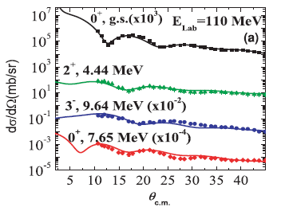
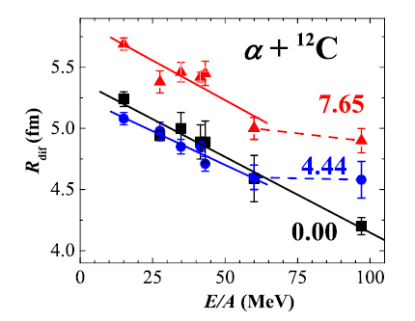
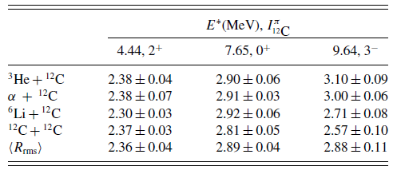
Measuring the Radii of Excited States
MDM: Modified Diffraction Method
Danilov et al., Phys.Rev. C80 054603 (2009)
< R_{gs} > = 2.34 fm
Check also M.Ito’s talk on Thuesday morning

Slide 28
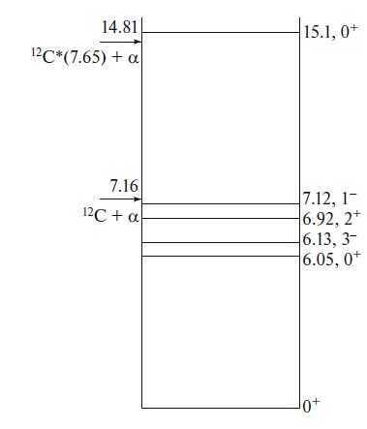
What about a Hoyle analogue state in ¹⁶O?
0⁺₆ near 4α threshold

Slide 29
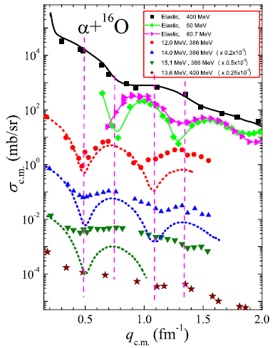
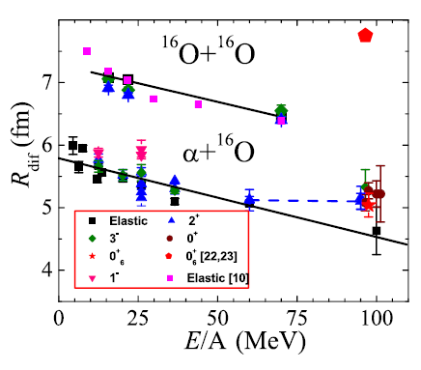
What about an analogue state in ¹⁶O?
Oglobin et al, Phys.Rev. C94 051602(R) (2016)
0⁺₆ not an analogue state of the Hoyle state in ¹²C as predicted by αBEC

Slide 30
Cluster effects in fragment emission
Nuclei with cluster structure might be emitted with larger probability with respect to predictions of statistical model of evaporation
¹²C (80 MeV) + ¹²C → ²⁴Mg*
E* ~ 54 MeV
¹³C (78.5 MeV) + ¹²C → ²⁵Mg*
Reaction | Channel 1 | Channel 2 | Channel 3
¹²C + ¹²C | ⁷Be + ¹⁷O | ⁸Be + ¹⁶O | ⁹Be + ¹⁵O
¹³C + ¹²C | ⁷Be + ¹⁸O | ⁸Be + ¹⁷O | ⁹Be + ¹⁶O
Any effect on the production of ⁷Be, ⁸Be and ⁹Be ?
S. Manna et al, Phys. Rev C 94 051601 (R) (2016)

Slide 31
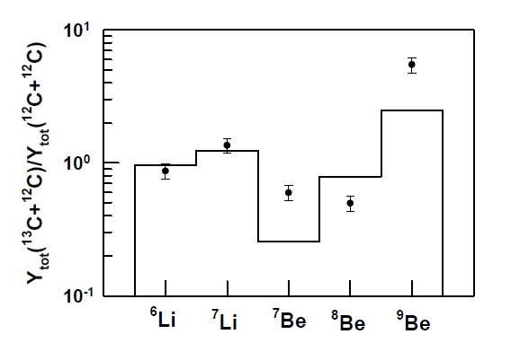
Cluster effects in fragment emission
CASCADE
¹⁶O/ ¹⁵O
¹⁸F/ ¹⁷F
¹⁹F/ ¹⁸F
¹⁸O/ ¹⁷O
¹⁷O/ ¹⁶O
Boost in the yield when one of the final partner is a clustered nucleus
Phase space is modified

Slide 32
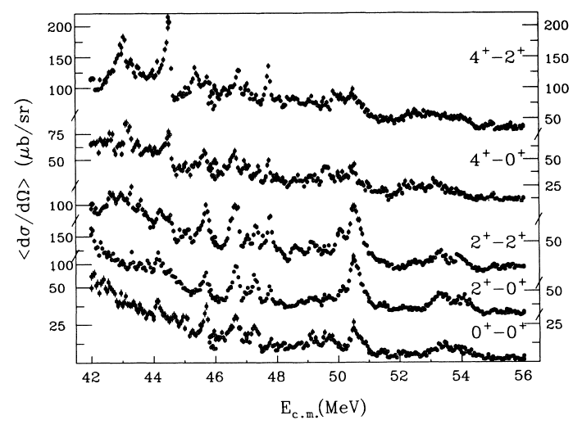
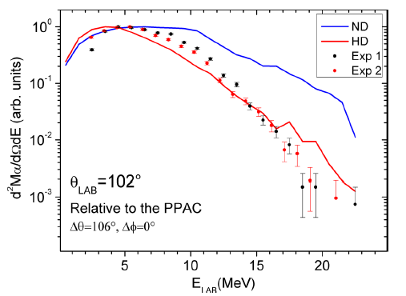
Symmetric α-like Clustered Systems
¹²C + ¹²C, ¹⁶O + ¹⁶O, ²⁴Mg + ²⁴Mg, ²⁸Si + ²⁸Si
Presence of strong resonances in the inelastic channel
J^{π} > L_{cr}
J^{π} > L_{gr}
²⁴Mg(²⁴Mg, ²⁴Mg*)²⁴Mg*
Highly deformed systems
²⁴Mg + ²⁴Mg
Di Nitto, E. Vardaci et al, Phys. Rev C 93 044602 (2016)
Important in astrophysical scenarios, deep sub-barrier
S.Courtin talk, S. Pirrie’s talks for other molecular structure i.e. ¹⁴C+ α

Slide 33
Clusters In Astrophysics
Cluster structures are of “strategic” paramount importance at all temperature scales
Many dedicated talks at SOTANCP4
R.J. de Boer for a dedicated overview
M. Wiescher on Clusters and Mirrors
A. Tumino has important news

Slide 34
Exp. with Multidetector Setup @iThembaLAB

Slide 35
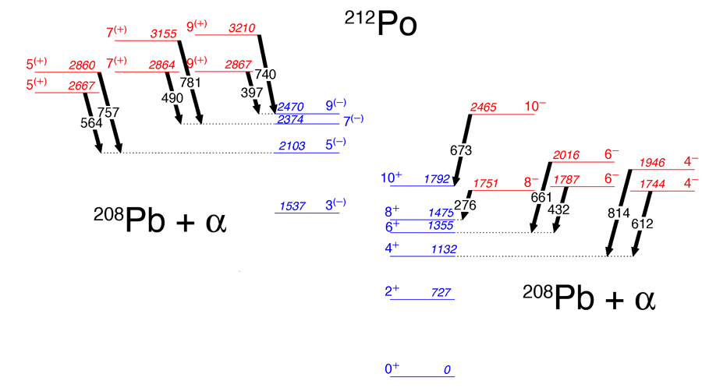
Clustering in Heavier Nuclei
²⁰⁸Pb (¹⁸O, ¹⁴C)
Two sets of levels with non-natural parity that only decay to the yrast states, having the same J value, by very enhanced E1 transitions
Oscillatory motion of the α-core distance around the equilibrium position
Astier et al., Phys. Rev. Lett 104 042701 (2010)

Slide 36
Clustering in Heavy and Super-Heavy Nuclei
“In heavy nuclear systems tightly packed nuclei (such as ¹³²Sn or ²⁰⁸Pb) may lead to energetically favorable two (and even three) center configurations.
These cluster configurations play an important role both in the structure of heavy nuclear systems and in the low-energy nuclear dynamics.”
V. Zagrebaev and W. Greiner, “Giant Nuclear Systems of Molecular Type”, Cluster in Nuclei Vol. 1, C. Beck Editor

Slide 37
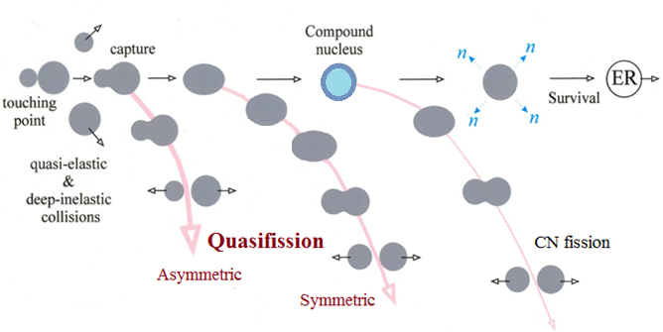
Reaction channels in the collisions of heavy ions

Slide 38
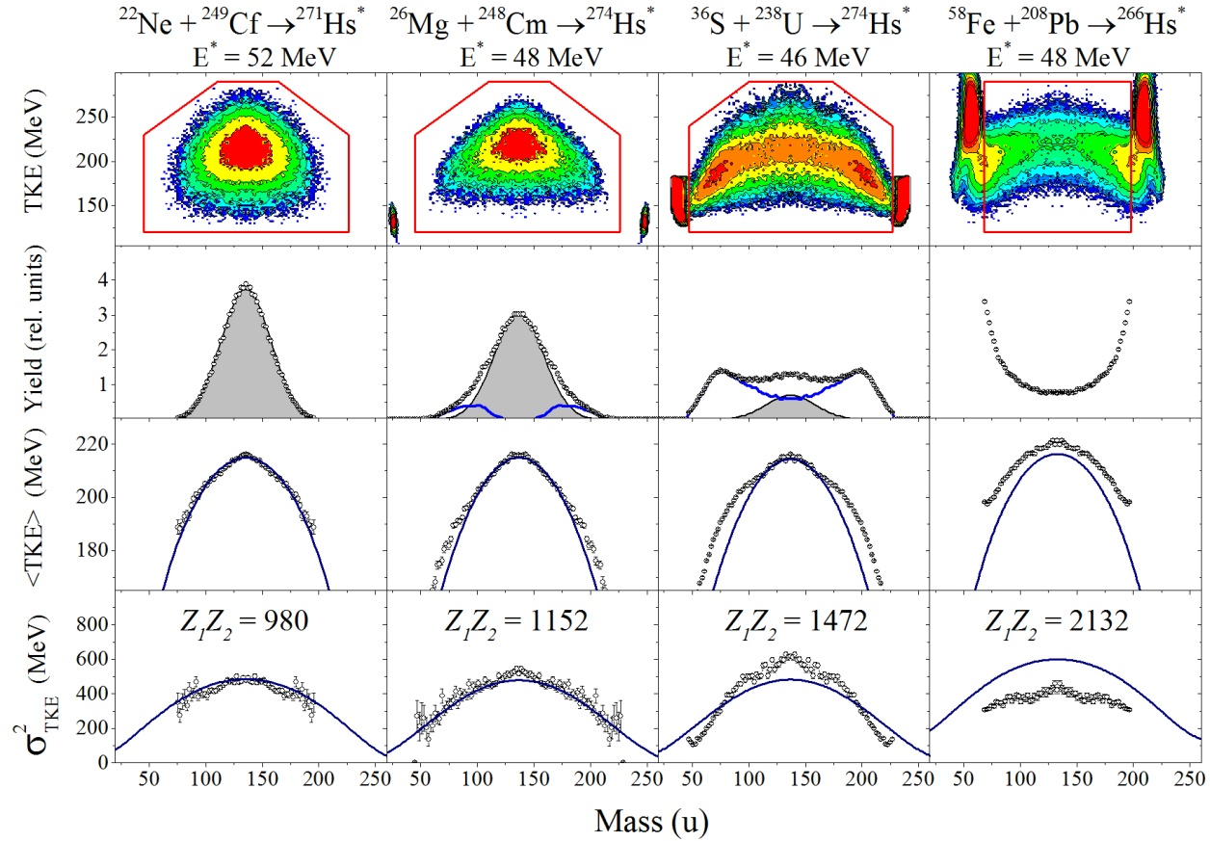
Fission and Quasi Fission: Hs (Z=108)

Slide 39
Mass and Energy distributions in the Ca-induced reactions

Slide 40
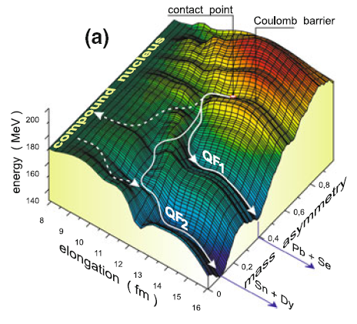
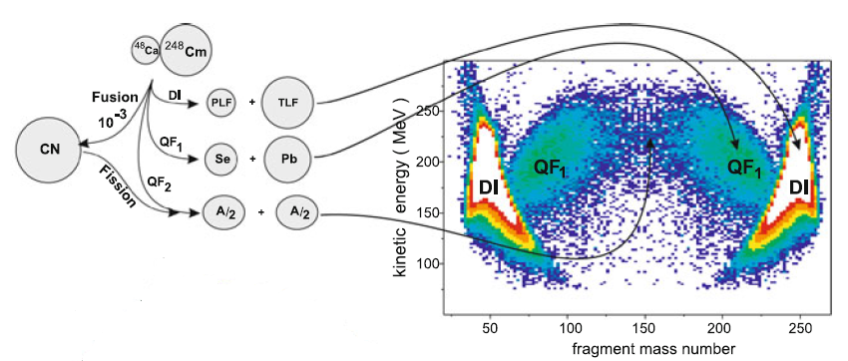
Shell manifestation:
Potential Energy Landscape and FF/QF Paths
V. Zagrebaev and W. Greiner, “Giant Nuclear Systems of Molecular Type”, Cluster in Nuclei Vol. 1, C. Beck Editor

Slide 41
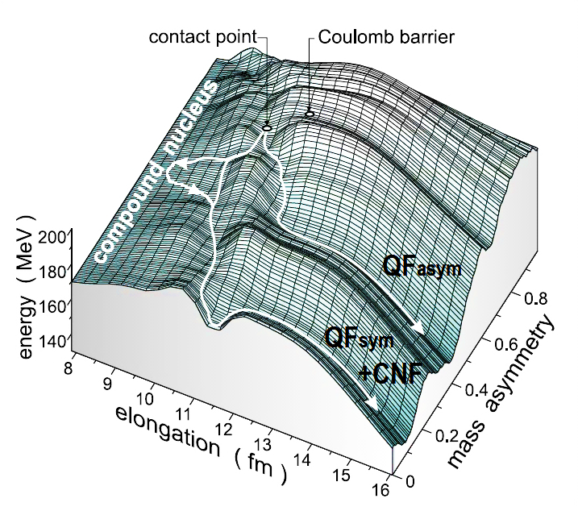
TKE deconvolution
CNF
QF_{asym}
QF_{sym}
A_{CN} /2±20 u
Courtesy of Iulia Itkis

Slide 42
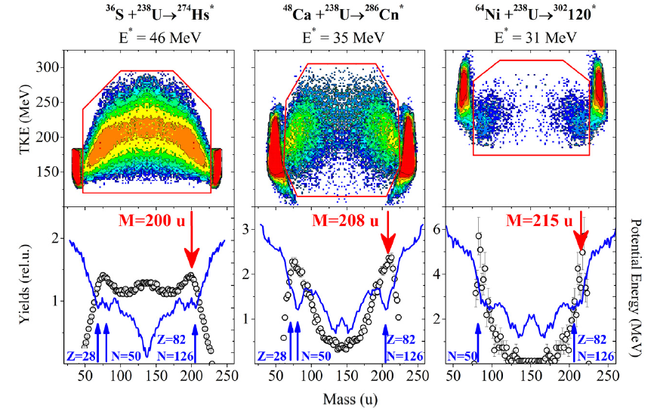
Shell Effects - 1
M.G. Itkis, E. Vardaci, I.M. Itkis, G.N. Knyazheva, E.M. Kozulin, Nucl. Phys. A 944 (2015) 204

Slide 43
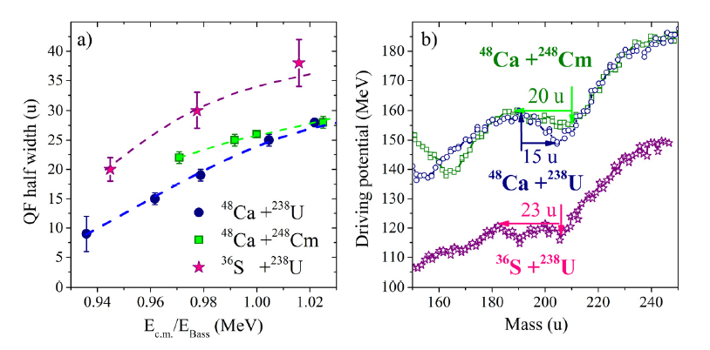
Shell Effects - 2
M.G. Itkis, E. Vardaci, I.M. Itkis, G.N. Knyazheva, E.M. Kozulin, Nucl. Phys. A 944 (2015) 204

Slide 44
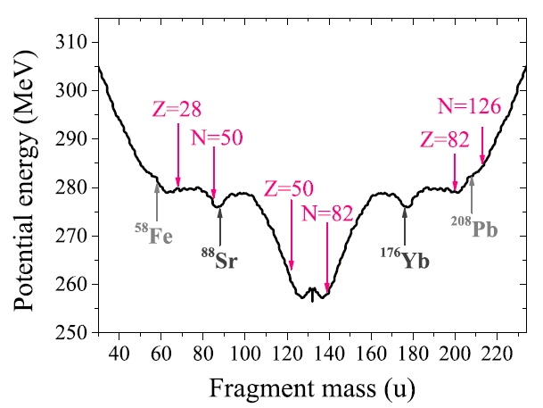
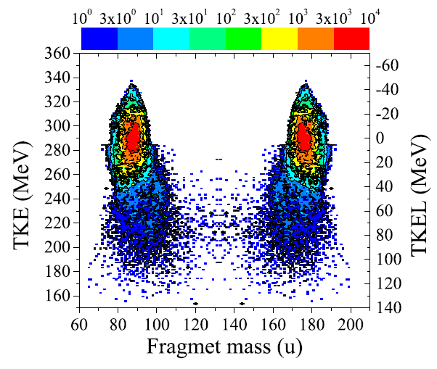
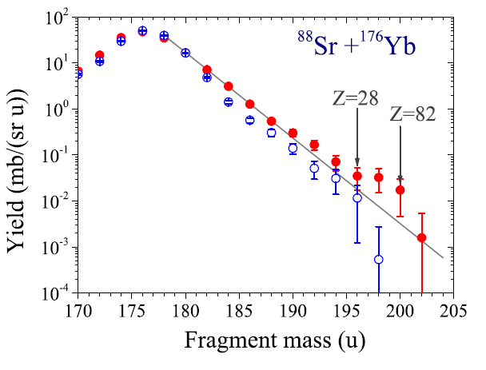
Shell Effects - 3

Slide 45
Reactions with ⁴⁸Ca
E*≈ 33 MeV
¹³²Sn
²³⁸U
Yield,%
Fragment mass (u)
Notes:
The sharp change of the MED triangular shape for the reaction ⁴⁸Ca + ²⁰⁸Pb, where Fusion-Fission process dominates, to the Quasifission shape of MED for the ²⁸⁶112-²⁹⁶116 nuclei.
The wide two-humped mass distribution with high peak of heavy fragment near double magic lead (M_{H}≈208) for the Quasifission process.
In spite of the dominating role of the Quasifission process for these reactions we assume that in the symmetric region of the fragment masses (A/2±20) FF process coexists with QF.
The Fusion-Fission mass distribution is asymmetric in shape with mass of the light fragment M_{L}≈132-134 amu (see on the framings)

Slide 46
FISSION MODES
spontaneous
fission
²⁶⁸Rf/Db
fission of
excited nuclei
²⁵⁸Fm-²⁶⁰Md
low energy
fission
²⁵²Cf
we pass through the
point of the symmetric masses around of ²⁶⁴Fm where the mode
of nuclear fission changes
M.G. Itkis, E. Vardaci, I.M. Itkis, G.N. Knyazheva, E.M. Kozulin, Nucl. Phys. A 944 (2015) 204

Slide 47
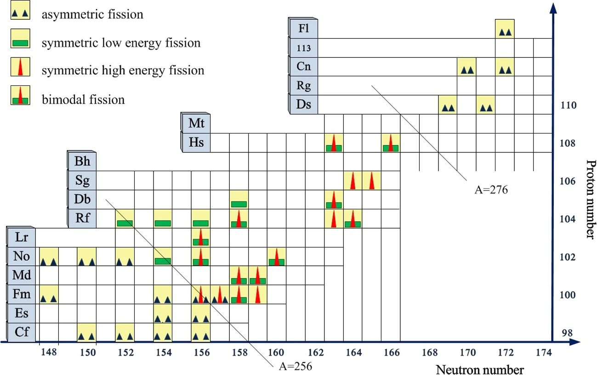
M.G. Itkis, E. Vardaci, I.M. Itkis, G.N. Knyazheva, E.M. Kozulin, Nucl. Phys. A 944 (2015) 204

Slide 48
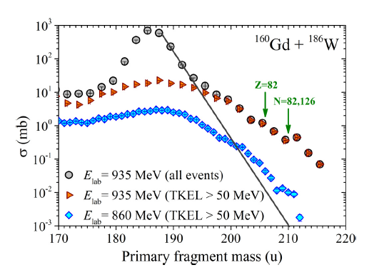
Inverse Quasifission
‘Normal’ QF
‘Inverse’ QF
Kozulin et al. Phys.Rev. C 96 064621 (2017)

Slide 49
Thank you note to Ivano Lombardo and Daniele Dell’Aquila for useful discussions
This talk is dedicated to the memory of V. Zagrebaev
W. Greiner
P.R. Gomes
and …. M. Kaplan, my supervisor at CMU

Slide 50
Thank you for your kind attention

Slide 52
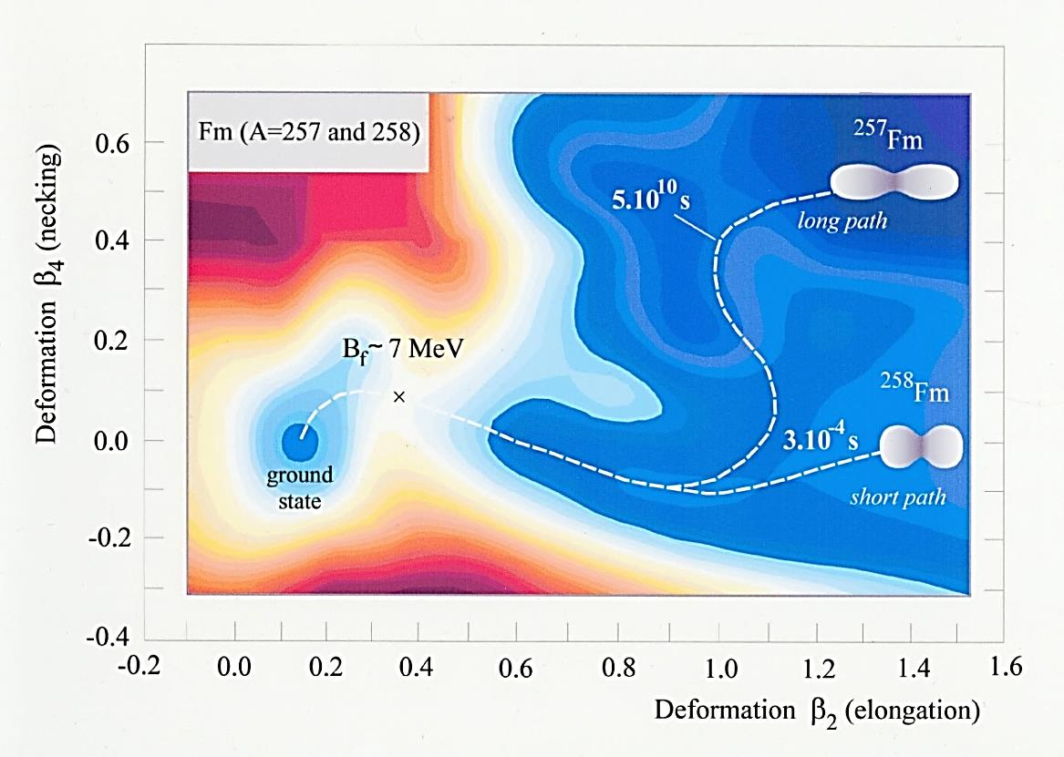
Bimodal fission
Z₁ = Z₂ ≈ 50
N₁ = N₂ ≈ 82
E.K. Hulet et al., Phys. Rev. Lett. 56, 313 (1986)
M.G. Itkis, E. Vardaci, I.M. Itkis, G.N. Knyazheva, E.M. Kozulin, Nucl. Phys. A 944 (2015) 204

