Slide 1
tetraneutron resonance: THEORY
Andrey Shirokov
Lomonosov Moscow State University
State of the Art in Nuclear Cluster Physics
Galveston, May 2018

Slide 2
Collaborators:
J. Vary, P. Maris (Iowa State University)
A. Mazur, I. Mazur (Pacific National University)
G. Papadimitriou (LLNL)
R. Roth, S. Alexa (Darmstadt)
I. J. Shin, Y. Kim (RISP, Daejeon, Korea)

Slide 3
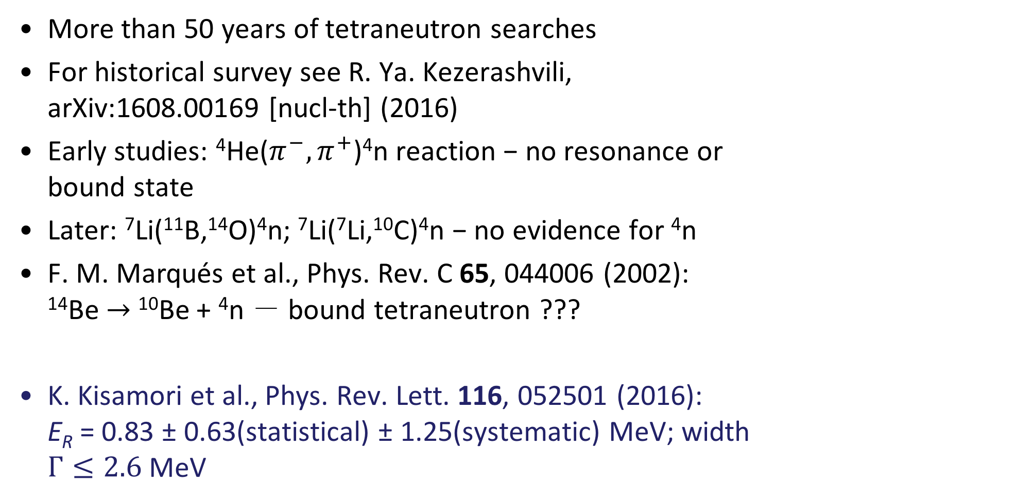
Tetraneutron experiment: history
More than 50 years of tetraneutron searches
For historical survey see R. Ya. Kezerashvili, arXiv:1608.00169 [nucl-th] (2016)
Early studies: ⁴He($π^{−},π^{+}$)⁴n reaction − no resonance or bound state
Later: ⁷Li(¹¹B,¹⁴O)⁴n; ⁷Li(⁷Li,¹⁰C)⁴n − no evidence for ⁴n
F. M. Marqués et al., Phys. Rev. C 65, 044006 (2002): ¹⁴Be $→$ ¹⁰Be + ⁴n － bound tetraneutron ???
K. Kisamori et al., Phys. Rev. Lett. 116, 052501 (2016): E_{R} = 0.83 ± 0.63(statistical) ± 1.25(systematic) MeV; width $Γ≤2.6$ MeV
Not confirmed... Experimental program stopped...

Slide 4
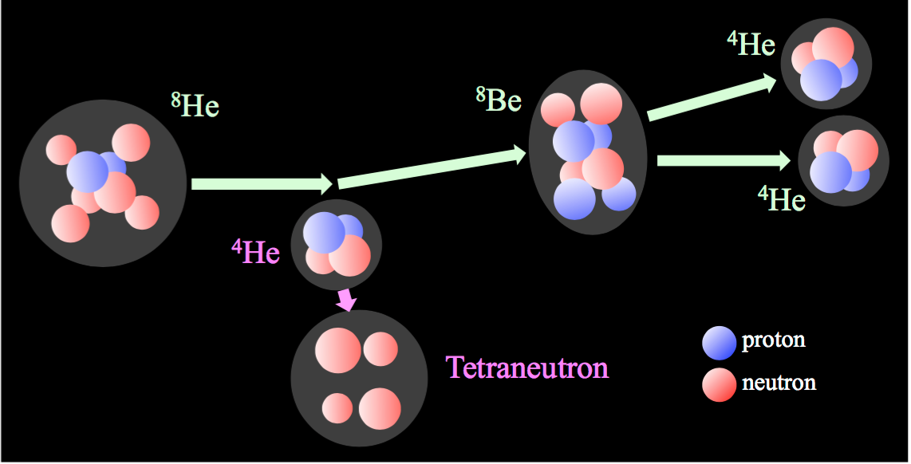
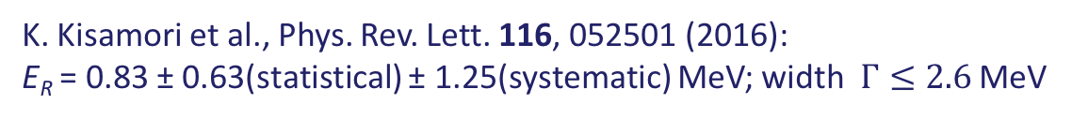
Tetraneutron
K. Kisamori et al., Phys. Rev. Lett. 116, 052501 (2016):
E_{R} = 0.83 ± 0.63(statistical) ± 1.25(systematic) MeV; width $Γ≤2.6$ MeV
More data from this experiment is expected
Other experiments are starting

Slide 5
Tetraneutron theory: history
For a historical survey see R. Ya. Kezerashvili, arXiv:1608.00169 [nucl-th] (2016)
There was a lot of theoretical studies of tetraneutron starting from 1970’s with various NN and NNN interactions within various approaches: democratic decay (hyperspherical approach), Faddeev−Yakubovsky equations, Gamow shell model, complex scaling, analytic continuation in the coupling constant, various bound state techniques…
An undoubtful conclusion: no tetraneutron bound state
No indication in previous studies of a resonance at low enough energies and narrow enough to be detected experimentally from numerous studies allowing for continuum
There were, however, some indication on a possible low-lying tetraneutron resonance from some bound-state calculations…

Slide 6
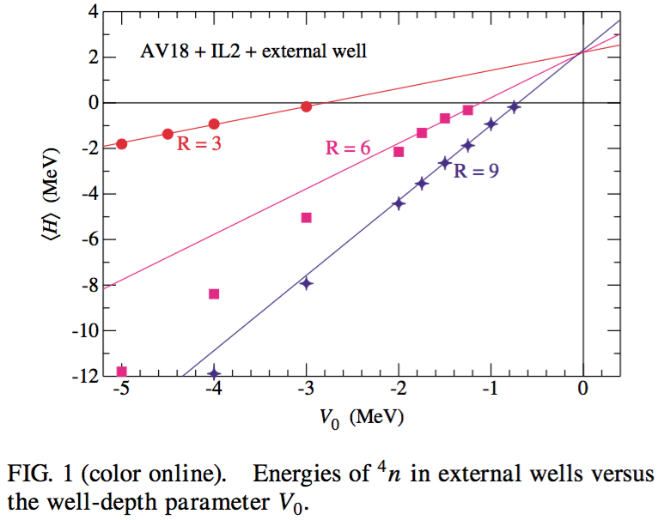
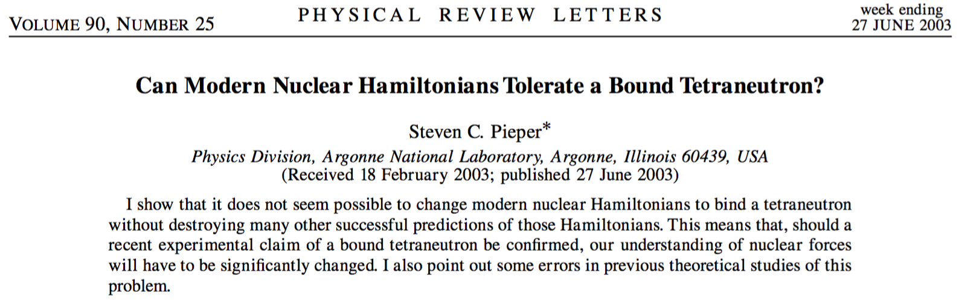
Tetraneutron: an example of an indication on a possible low-lying tetraneutron resonance from GFMC bound-state calculations

Slide 7
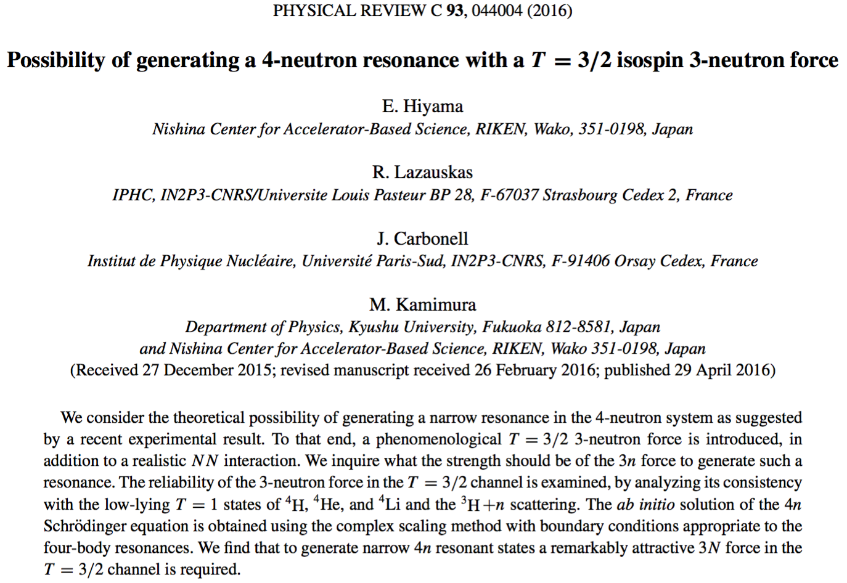
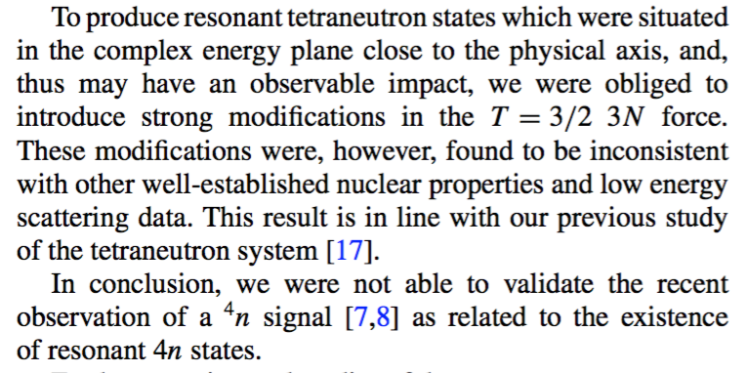
Tetraneutron: an example of a recent study of a possible low-lying tetraneutron resonance

Slide 8
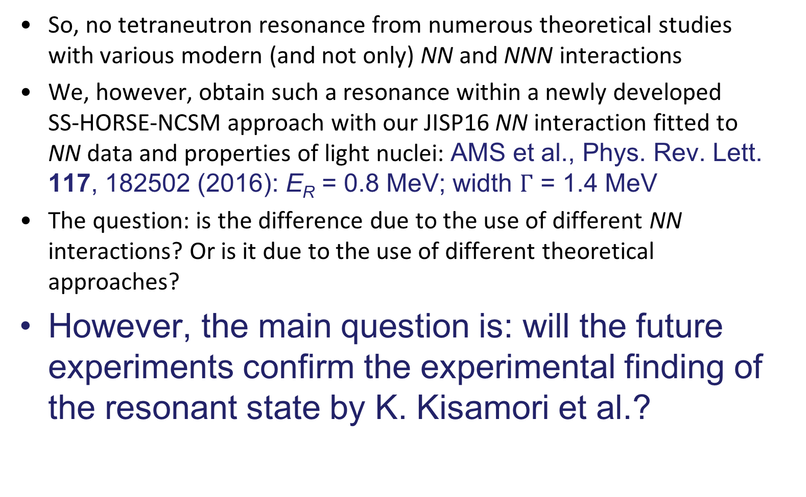
Tetraneutron theory
So, no tetraneutron resonance from numerous theoretical studies with various modern (and not only) NN and NNN interactions
We, however, obtain such a resonance within a newly developed SS-HORSE-NCSM approach with our JISP16 NN interaction fitted to NN data and properties of light nuclei: AMS et al., Phys. Rev. Lett. 117, 182502 (2016): E_{R} = 0.8 MeV; width $Γ$ = 1.4 MeV
The question: is the difference due to the use of different NN interactions? Or is it due to the use of different theoretical approaches?
However, the main question is: will the future experiments confirm the experimental finding of the resonant state by K. Kisamori et al.?

Slide 9
General idea:
NCSM + HORSE = continuum spectrum

Slide 10
No-core Shell Model
NCSM is a standard tool in ab initio nuclear structure theory
NCSM: antisymmetrized function of all nucleons
Wave function:
Traditionally single-particle functions are harmonic oscillator wave functions
N_{max} truncation makes it possible to separate c.m. motion

Slide 11
No-core Shell Model
NCSM is a bound state technique, no continuum spectrum; not clear how to interpret states in continuum above thresholds − how to extract resonance widths or scattering phase shifts
HORSE (J-matrix) formalism can be used for this purpose

Slide 12
No-core Shell Model
NCSM is a bound state technique, no continuum spectrum; not clear how to interpret states in continuum above thresholds − how to extract resonance widths or scattering phase shifts
HORSE (J-matrix) formalism can be used for this purpose
Other possible approaches: NCSM+RGM; Gamov SM; Continuum SM; SM+Complex Scaling; …
All of them make the SM much more complicated. Our goal is to interpret directly the SM results above thresholds obtained in a usual way without additional complexities and to extract from them resonant parameters and phase shifts at low energies.

Slide 13
J-matrix (Jacobi matrix) formalism in scattering theory
Two types of L² basises:
Laguerre basis (atomic hydrogen-like states) — atomic applications
Oscillator basis — nuclear applications
Other titles in case of oscillator basis:
HORSE (harmonic oscillator representation of scattering equations),
Algebraic version of RGM

Slide 14
J-matrix formalism
Initially suggested in atomic physics (E. Heller, H. Yamani, L. Fishman, J. Broad, W. Reinhardt) :
H.A.Yamani and L.Fishman, J. Math. Phys 16, 410 (1975). Laguerre and oscillator basis.
Rediscovered independently in nuclear physics (G. Filippov, I. Okhrimenko, Yu. Smirnov):
G.F.Filippov and I.P.Okhrimenko, Sov. J. Nucl. Phys. 32, 480 (1980). Oscillator basis.

Slide 15
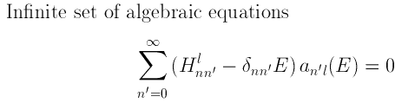
General idea of the
HORSE formalism

Slide 16
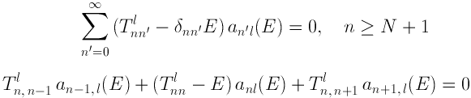
General idea of the
HORSE formalism

Slide 17

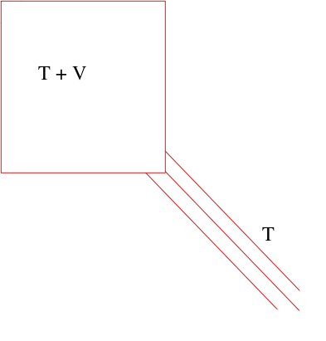

General idea of the
HORSE formalism

Slide 18
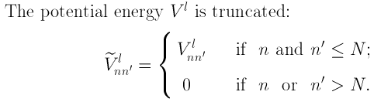
General idea of the
HORSE formalism

Slide 19

General idea of the
HORSE formalism

Slide 20
General idea of the
HORSE formalism

Slide 21
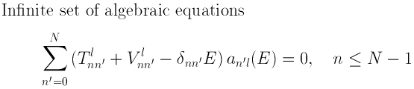
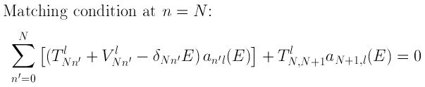
General idea of the
HORSE formalism
This is an exactly solvable algebraic problem!

Slide 22
General idea of the
HORSE formalism
And this looks like a natural extension of SM where both potential and kinetic energies are truncated
This is an exactly solvable algebraic problem!

Slide 23




HORSE solutions
Schrödinger equation
Inverse Hamiltonian matrix:
Phase shifts:
$S_{Nl}(E)$ and $C_{Nl}\left(E\right)$ are the functions which can be expressed analytically

Slide 24
Problems with direct HORSE application
A lot of E_{λ} eigenstates needed while SM
codes usually calculate few lowest states only
One needs highly excited states and to get
rid from CM excited states.
are normalized for all states including the CM excited ones, hence renormalization is needed.
We need for the relative n-nucleus coordinate r_{nA} but NCSM provides for the n coordinate r_{n} relative to the nucleus CM. Hence we need to perform Talmi-Moshinsky transformations for all states to obtain in relative n-nucleus coordinates.
Concluding, the direct application of the HORSE formalism in n-nucleus scattering is unpractical.

Slide 25
Single-state HORSE
(SS-HORSE)
Suppose E = E_{λ}:
Calculating a set of E_{λ} eigenstates with different ħΩ and N_{max} within SM, we obtain a set of values which we can approximate by a smooth curve at low energies.

Slide 26
Single-state HORSE
(SS-HORSE)
Suppose E = E_{λ}:
Calculating a set of E_{λ} eigenstates with different ħΩ and N_{max} within SM, we obtain a set of values which we can approximate by a smooth curve at low energies.
Note, information about wave function disappeared in this formula, any channel can be treated

Slide 27
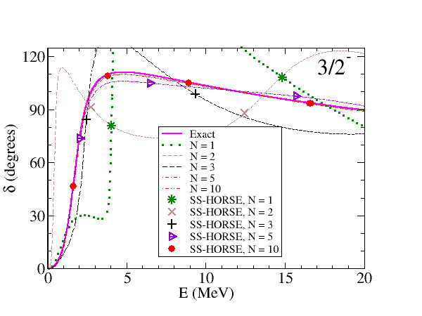
Convergence: model problem

Slide 28
S-matrix at low energies
Symmetry property:
Hence
As
Bound state:
Resonance:

Slide 29
How it works

Slide 30
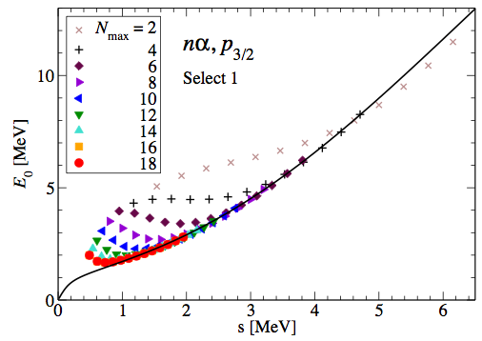
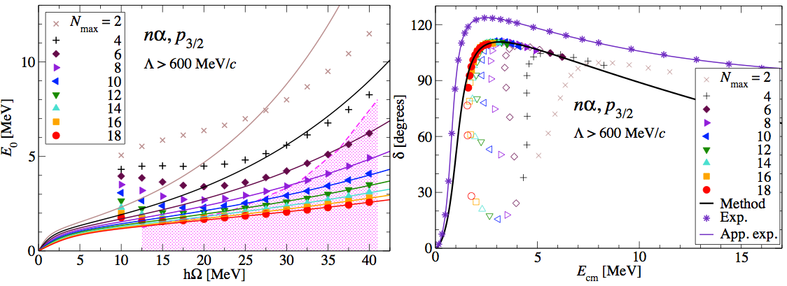
nα scattering: NCSM, JISP16

Slide 31
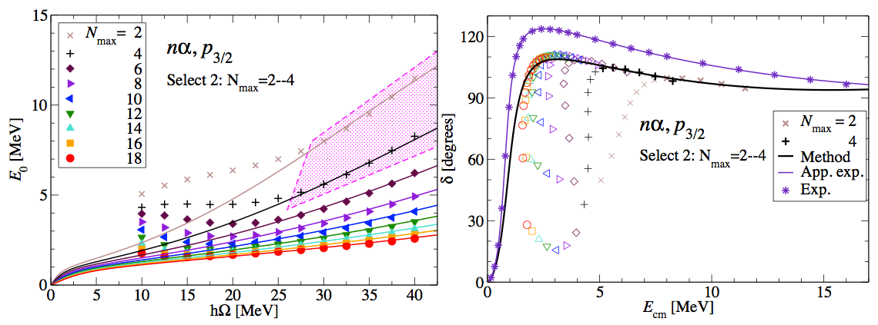
nα scattering: NCSM, JISP16

Slide 32
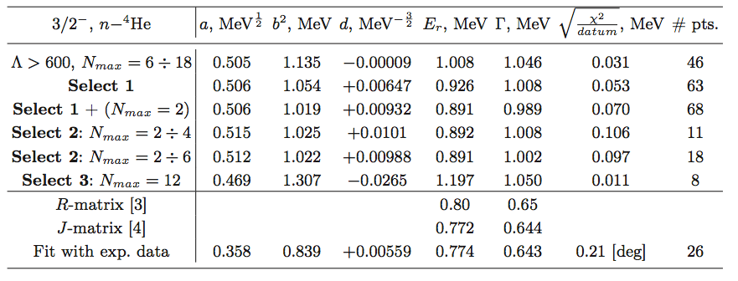
nα scattering: NCSM, JISP16

Slide 33
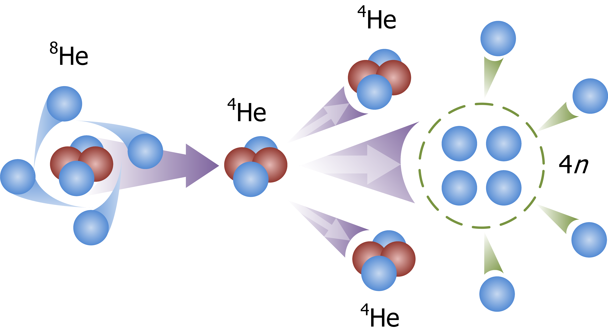
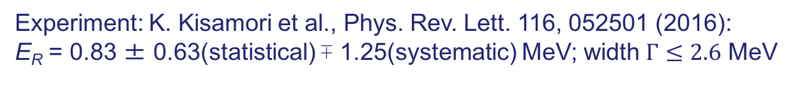
Tetraneutron
Experiment: K. Kisamori et al., Phys. Rev. Lett. 116, 052501 (2016):
E_{R} = 0.83 ± 0.63(statistical) ∓ 1.25(systematic) MeV; width $Γ≤2.6$ MeV

Slide 34
Tetraneutron
Democratic decay (no bound subsystems)
Hyperspherical harmonics:

Slide 35
Tetraneutron

Slide 36
Tetraneutron, JISP16

Slide 37
Tetraneutron, JISP16
Resonance parameters:
E_{r} = 186 keV, Γ = 815 keV.
A resonance around E_{r} = 850 keV with width around Γ = 1.3 MeV is expected!
Can it be a virtual state?
No.

Slide 38
Tetraneutron, JISP16
Can it be a combination of a
false pole and resonant pole:
Yes!
Resonance parameters:
E_{r} = 844 keV, Γ = 1.378 MeV,
E_{false} = -55 keV.

Slide 39
Tetraneutron, JISP16
Options:
Resonance parameters:
E_{r} = 844 keV, Γ = 1.378 MeV,
E_{false} = -55 keV.
Or
E_{r} = 186 keV, Γ = 815 keV ???

Slide 40
Tetraneutron, Daejeon16
.
Resonance parameters:
E_{r} = 0.997 MeV, Γ = 1.60 MeV,
E_{false} = -63.4 keV.
Similar results with
SRG-evolved Idaho N3LO

Slide 41
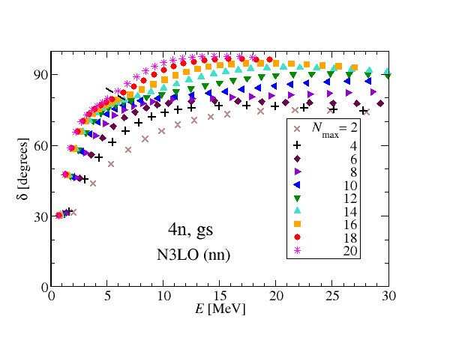
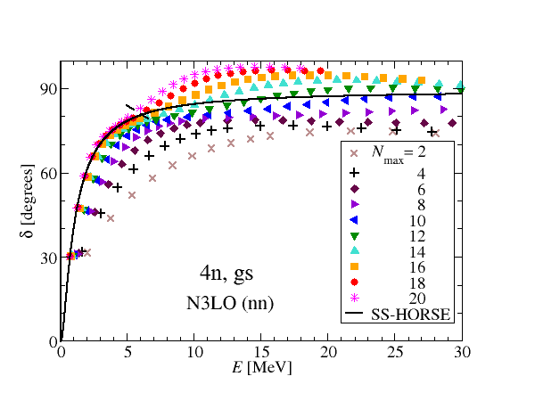
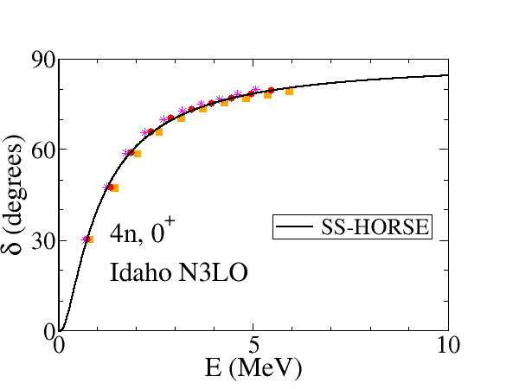
Tetraneutron, Idaho N3LO
.
No resonance!
There is a virtual state at 15.2 keV
(maybe some around 10 MeV)

Slide 42
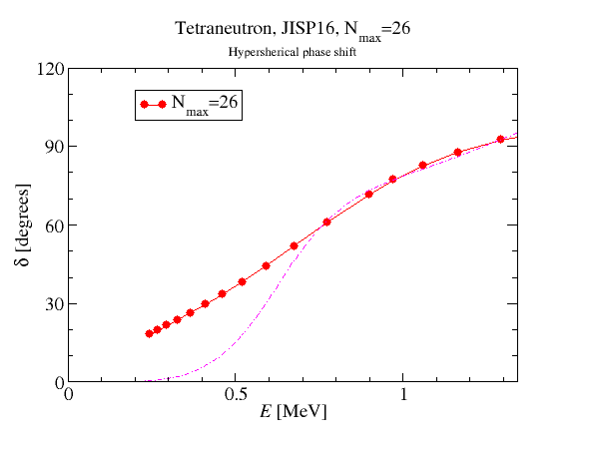
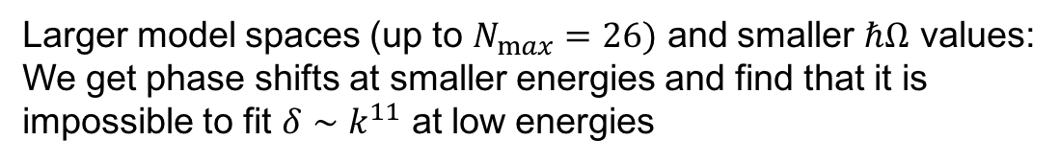
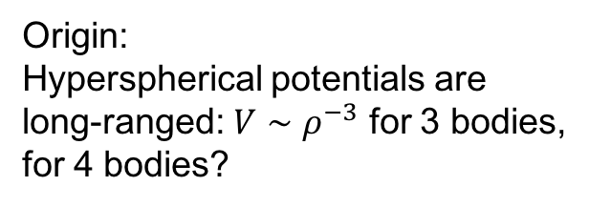
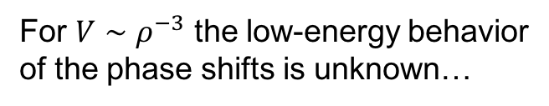
The 2018 (preliminary) results
Larger model spaces (up to $N_{max}=26)$ and smaller $ℏΩ$ values:
We get phase shifts at smaller energies and find that it is
impossible to fit $δ∼k^{11}$ at low energies
Origin:
Hyperspherical potentials are
long-ranged: $V∼ρ^{−3}$ for 3 bodies,
for 4 bodies?
Such a slow decrease of the interaction
spoils the phase shifts at low energies
For $V∼ρ^{−3}$ the low-energy behavior
of the phase shifts is unknown…

Slide 43
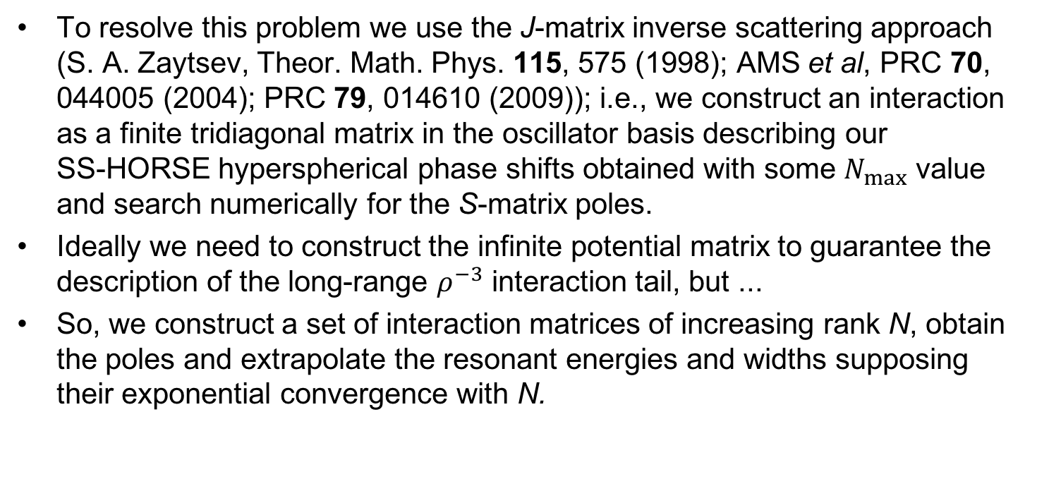
The 2018 (preliminary) results
To resolve this problem we use the J-matrix inverse scattering approach (S. A. Zaytsev, Theor. Math. Phys. 115, 575 (1998); AMS et al, PRC 70, 044005 (2004); PRC 79, 014610 (2009)); i.e., we construct an interaction as a finite tridiagonal matrix in the oscillator basis describing our SS-HORSE hyperspherical phase shifts obtained with some $N_{max}$ value and search numerically for the S-matrix poles.
Ideally we need to construct the infinite potential matrix to guarantee the description of the long-range $ρ^{−3}$ interaction tail, but ...
So, we construct a set of interaction matrices of increasing rank N, obtain the poles and extrapolate the resonant energies and widths supposing their exponential convergence with N.

Slide 44
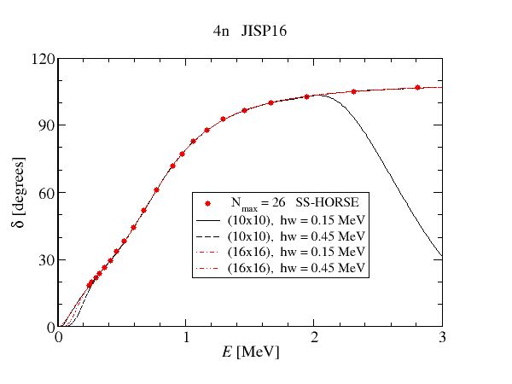
The 2018 (preliminary) results: inverse scattering phase shifts

Slide 45
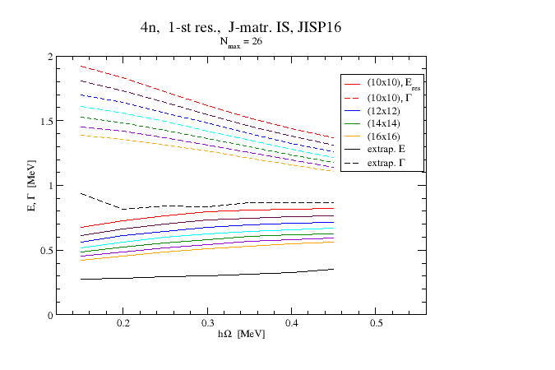
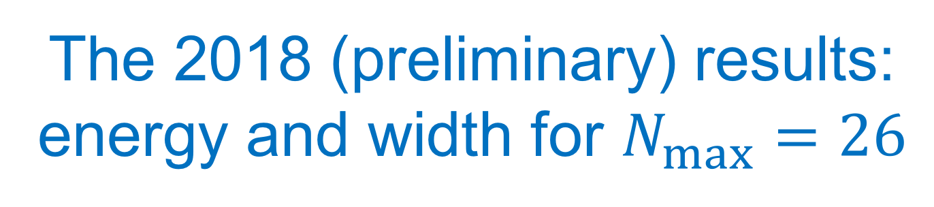
The 2018 (preliminary) results: energy and width for $N_{max}=26$

Slide 46
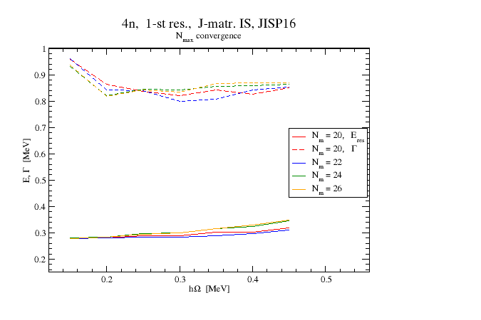
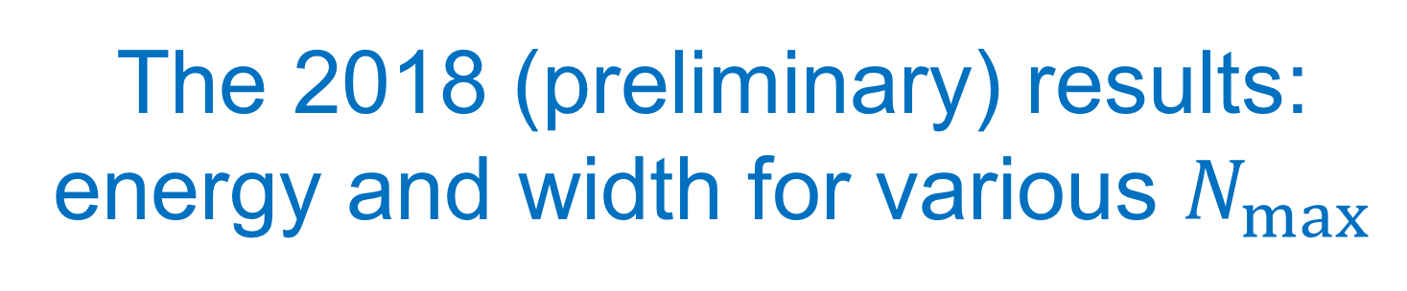
The 2018 (preliminary) results: energy and width for various $N_{max}$

Slide 47
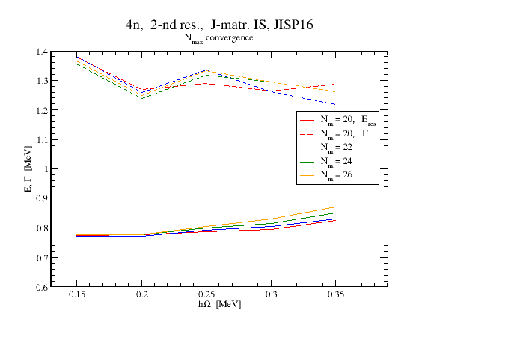
The 2018 (preliminary) results: surprisingly, we have two resonances

Slide 48
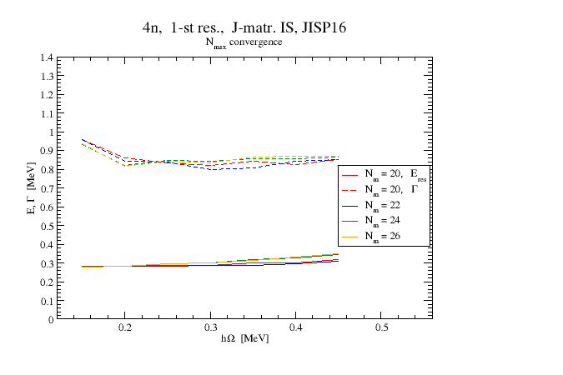
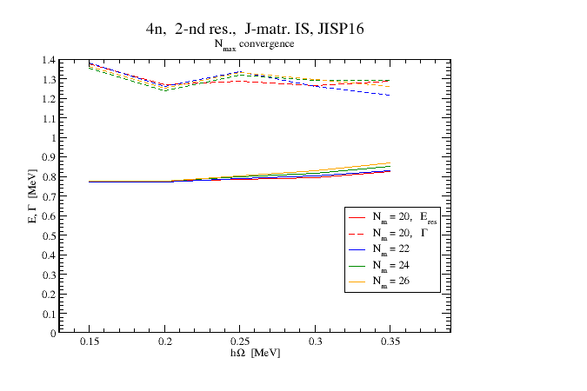
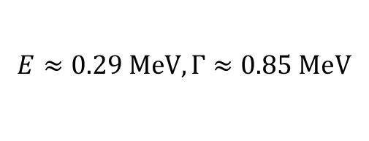
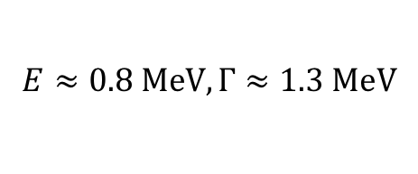
The 2018 (preliminary) results: surprisingly, we have two resonances
$$E≈0.29 MeV, Γ≈0.85 MeV$$
$$E≈0.8 MeV, Γ≈1.3 MeV$$

Slide 49
Summary
Low-lying narrow tetraneutron resonances are predicted with JISP16, Daejeon16 and SRG-evolved Idaho N3LO interactions; with unperturbed Idaho N3LO there seems to be no resonance but a very low-lying virtual state. Further studies with other interactions including NNN forces are on the way.
Reaction mechanism is very important and should be examined. Experimentalists do not measure S-matrix poles but the cross sections.
New experimental data are very desired and are expected soon.
…

Slide 50
Thank you!

