Slide 1
Role of the tensor force on the proton-neutron correlation in N=Z nuclei
4th International workshop on “State of the Art in Nuclear Physics” SOTANCP4, May 13-18, 2018, Galveston, USA
Hiroshi MASUI
Kitami Institute of Technology
Collaborator:
Masaaki KIMURA, Hokkaido Univ.
SOTANCP4, 13-18 May 2018, Galveston, USA

Slide 2
Proton-neutron with a core nucleus
Neutron
Proton
proton-neutron correlation changes due to:
Spin-Orbit force: Splitting the orbits
Pauli-Principle: Selection rule to the orbits
0d_{3/2}
1s_{1/2}
Core nucleus
0d_{5/2}
0p_{1/2}
0p_{3/2}
Core+p+n Picture
0s_{1/2}
Core nucleus
SOTANCP4, 13-18 May 2018, Galveston, USA

Slide 3
Correlation of T=0 and T=1 channels
Bertsch et al.
G. F. Bertsch and Y. Lin,Phys. Rev. C 81, 064320 (2010)
T=1 pairing is favored
HFB calculation
Typical size:
R_{rms} 〜 9 fm
Nuclear size
Spin-orbit splitting: Large
Small
Correlation energy:
S=0 (T=1) > S=1 (T=0)
S=1 (T=0) > S=0 (T=1)
SOTANCP4, 13-18 May 2018, Galveston, USA

Slide 4
Correlation of T=0 and T=1 channels
Sagawa et al.
H. Sagawa, Y. Tanimura and K. Hagino, Phys. Rev. C 87, 034310 (2013)
T=1 pairing is favored
HF calculation
Interaction: pairing-type
T=1:
T=0:
SOTANCP4, 13-18 May 2018, Galveston, USA

Slide 5
(Continued)
H. Sagawa, Y. Tanimura and K. Hagino, Phys. Rev. C 87, 034310 (2013)
Single-Particle Levels
L=1
L=3
For the same correlation energy,
We need f=1.4 〜1.7
1. Large S.O. splitting
2. Different Fermi energy surfaces
SOTANCP4, 13-18 May 2018, Galveston, USA

Slide 6
Experimental situation for core+p+n
¹⁸F (¹⁶O+p+n)
⁴²Sc (⁴⁰Ca+p+n)
⁵⁸Cu (⁵⁶Ni+p+n)
1.04MeV
(T=1)
0.61MeV
0.20MeV
(T=1)
(T=0)
(T=0)
(T=1)
(T=0)
SOTANCP4, 13-18 May 2018, Galveston, USA

Slide 7
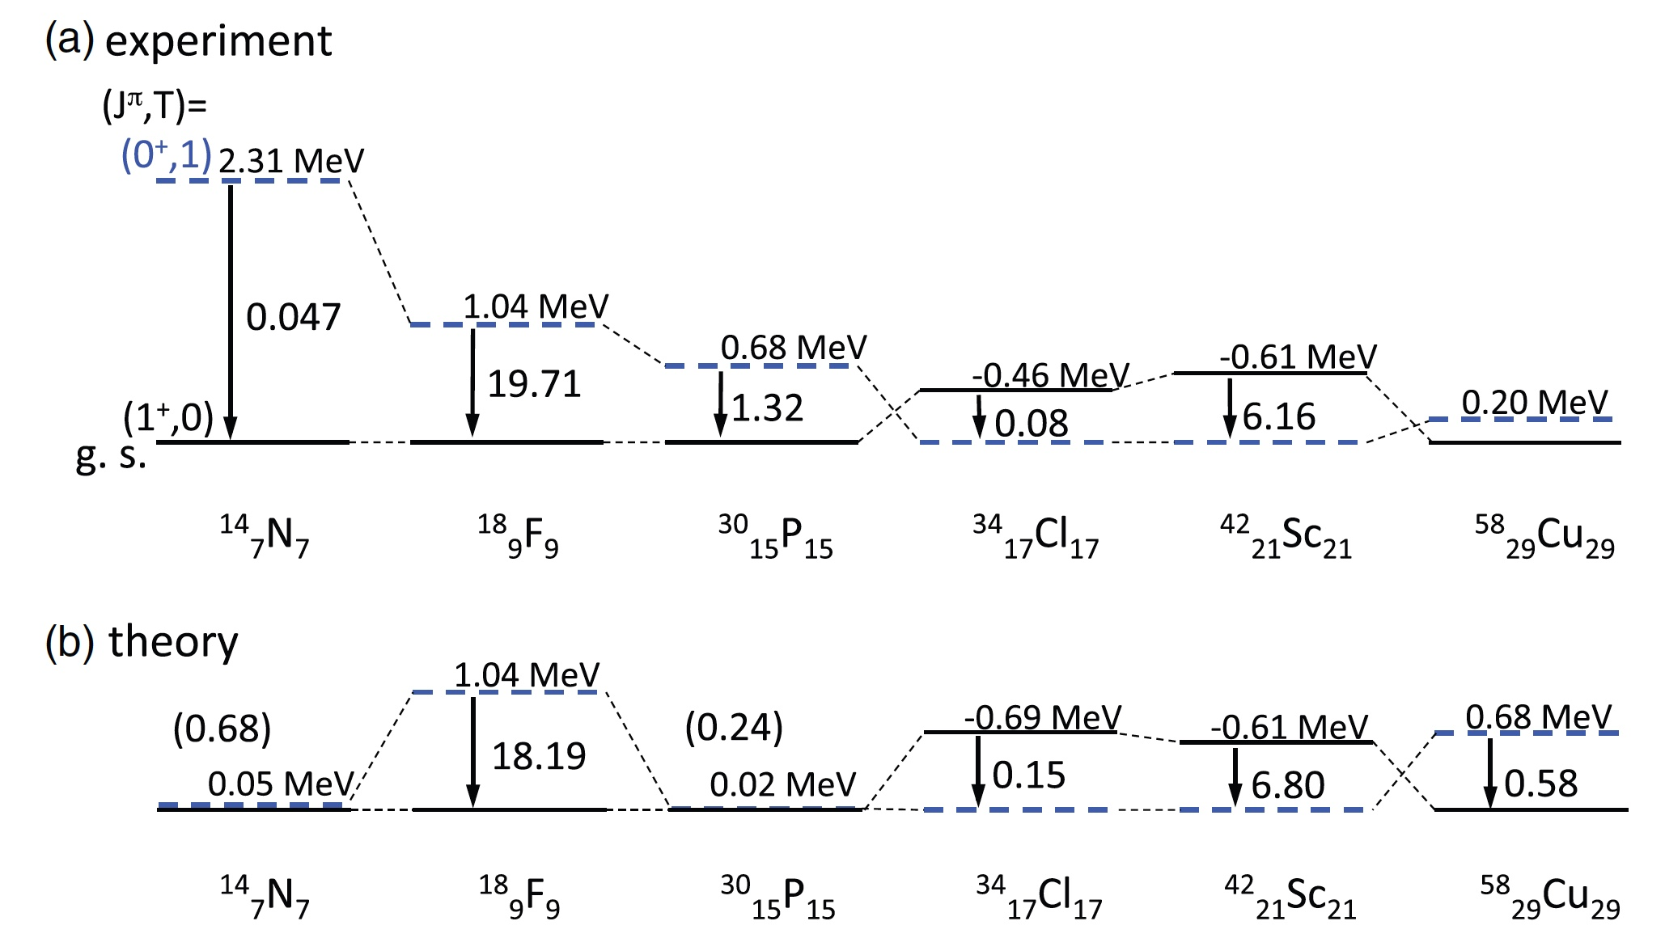
Three-body calculation with core+p+n
An effective interaction model (contact, density-dependent type)
Y. Tanimura, H. Sagawa and K. Hagino, PTEP, 2014, 053D02 (2014)
・Inversion of the 1⁺ - 0⁺ in ⁴²Sc
・B(M1) value for ¹⁸F, ³⁴Cl, ⁴²Sc
SOTANCP4, 13-18 May 2018, Galveston, USA

Slide 8
Proton-neutron correlation in Core+p+n model
1⁺ (S=1, T=0)
0⁺ (S=0, T=1)
¹⁸F
⁴²Sc
0⁺ (S=0, T=1)
1⁺ (S=1, T=0)
⁵⁸Cu
S=0
S=1
“Pairing-type”
“Deuteron-type”
SOTANCP4, 13-18 May 2018, Galveston, USA

Slide 9
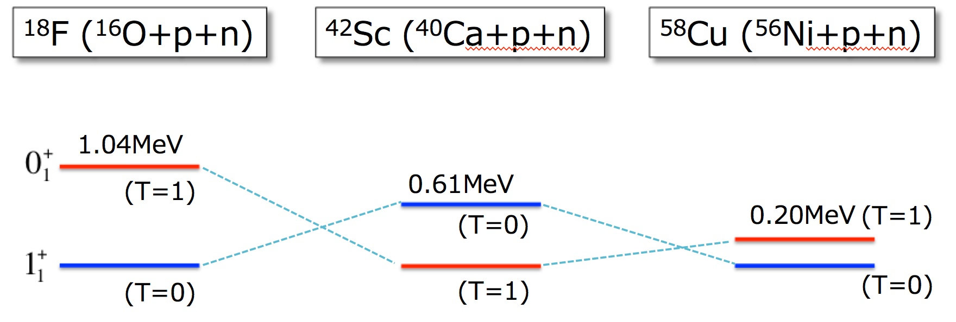
Expected scenario
without tensor force
with tensor force
1⁺
¹⁸F
⁴²Sc
⁵⁸Cu
“Pairing-type”
“Pairing-type”
⁴²Sc
1⁺
0⁺
0⁺
⁵⁸Cu
1⁺
¹⁸F
1⁺
“Deuteron-type”
SOTANCP4, 13-18 May 2018, Galveston, USA

Slide 10
Role of the Central Force
SOTANCP4, 13-18 May 2018, Galveston, USA

Slide 11
“COSM with GEM”
Hamiltonian (COSM)
Cluster-Orbital Shell Model [1]
Center of mass motion is subtracted form the Hamiltonian
Recoil term :
[1] Y. Suzuki and K. Ikeda, Phys. Rev. C 38, 410 (1988)
Basis function (GEM)
Gaussian Expansion Method [2]
1
2
Effect of continua is correctly taken into account
Gaussian basis
r₁
r₂
core
[2] E. Hiyama, Y. Kino and M. Kamimura, Prog. Part. Nucl. Phys. 51, 223 (2003).
SOTANCP4, 13-18 May 2018, Galveston, USA

Slide 12
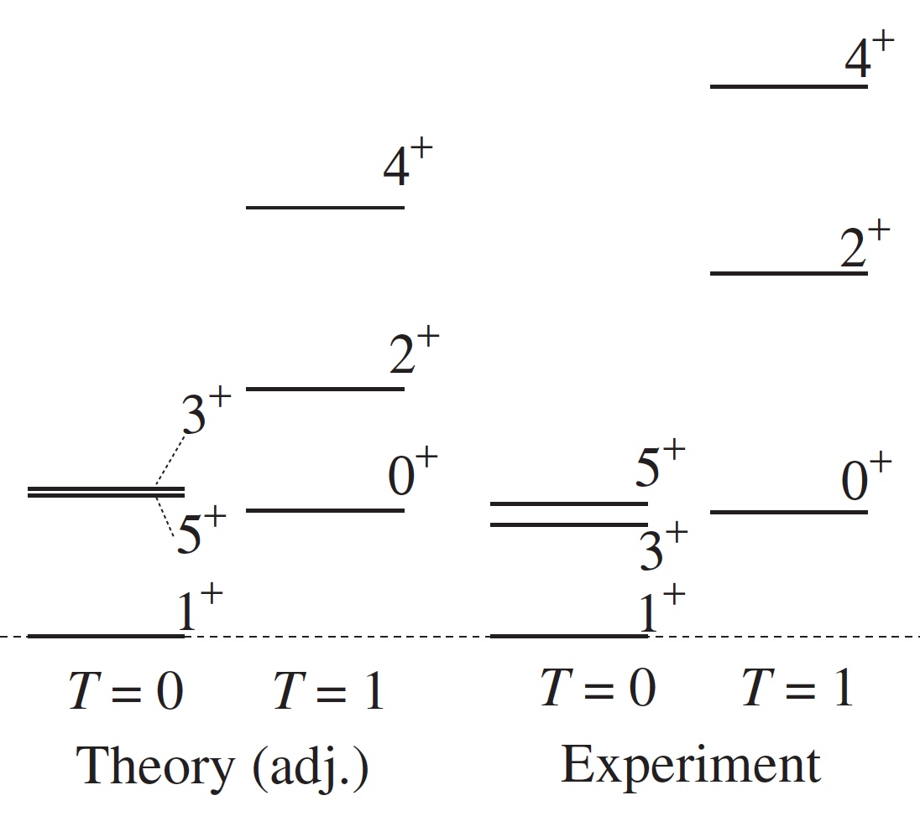
Spatial correlation of the proton and neutron in ¹⁸F
H. Masui, M. Kimura, Prog. Theor. Exp. Phys. 2016, 053D01 (2016)
MN
N-N: Minnesota
(Central force)
Core-N: Folding + LS + OCM
Fold+LS+OCM
Adjusted to ¹⁷O, ¹⁷F (5/2⁺, 1/2⁺, 3/2⁺)
Continuum
SOTANCP4, 13-18 May 2018, Galveston, USA

Slide 13
1⁺-coupling with the central force
Cross-shell conf.
¹⁸F
0d_{3/2}: j< (L+2)
0d_{3/2}: j< (L+2)
Strong
ΔL=0
weak
ΔL=2
1s_{1/2}: j’ (L)
1s_{1/2}: j’ (L)
0d_{5/2}: j> (L+2)
0d_{5/2}: j> (L+2)
SOTANCP4, 13-18 May 2018, Galveston, USA

Slide 14
Correlation energy of ¹⁸F
Changing the strength of LS-int.
1⁺
0⁺
4.96
E_{corr}
E_{corr}
4.67
3.61
3.10
3.22
3.56
ΔL=0 coupling
Comp w.f.
Comp w.f.
SOTANCP4, 13-18 May 2018, Galveston, USA

Slide 15
Correlation energy
¹⁸F(1⁺): (a)+(b)
¹⁸F(0⁺): (a)
¹⁸F(1⁺): (a)
SOTANCP4, 13-18 May 2018, Galveston, USA

Slide 16
Magnetic moment of 1⁺
For the pure L=0, S=1 case
(L=0), S=1
μ^{L} = 0
(μ_{N})
μ^{S} = 0.880
(μ_{N})
(μ_{p} + μ_{n})
(L_{R}=0)
Presnt(COSM)
Three-body(1) [1]
Three-body (2) [2]
0.811
0.834
0.82
(μ_{N})
¹⁶O
μ^{L} = 0.090
(μ_{N})
μ^{S} = 0.721
(μ_{N})
[1] Y. Tanimura, H. Sagawa and K. Hagino, Prog. Theor. Exp. Phys. 2014, 053D02 (2014)
[2] Y. Kanada-En'yo and F. Kobayashi, Phys. Rev. C 90, 054332 (2014).
SOTANCP4, 13-18 May 2018, Galveston, USA

Slide 17
¹⁸F (¹⁶O+p+n)
⁴²Sc (⁴⁰Ca+p+n)
⁵⁸Cu (⁵⁶Ni+p+n)
Minnesota
1.00MeV
0.36MeV
0.27MeV
“Houston, we have a problem”
Experiment
1.04MeV
0.61MeV
0.20MeV
SOTANCP4, 13-18 May 2018, Galveston, USA

Slide 18
Correlation in the 1⁺ states with the central force
0f_{5/2}: j< (L+2)
Cross-shell conf.
0d_{3/2}: j< (L+2)
1p_{1/2}: j<‘ (L)
ΔL=0
1p_{3/2}: j>‘ (L)
ΔL=0
0f_{5/2}: j> (L+2)
1s_{1/2}: j’ (L)
ΔL=0
ΔL=0
1p_{1/2}: j<‘ (L)
0d_{5/2}: j> (L+2)
0f_{7/2}: j> : (L+2)
1p_{3/2}: j>’ (L)
¹⁸F (¹⁶O+p+n)
⁴²Sc (⁴⁰Ca+p+n)
⁵⁸Cu (⁵⁶Ni+p+n)
Large SPE
Large SPE
Large SPE
NN-corr. (ΔL=0)
NN-corr. (ΔL=0)
NN-corr. (ΔL=0)
SOTANCP4, 13-18 May 2018, Galveston, USA

Slide 19
Role of the Tensor Force
SOTANCP4, 13-18 May 2018, Galveston, USA

Slide 20
Theoretical calculation
Deuteron
V_{NN}: Minnesota (MN)
Central
Neutron
Proton
V_{NN}: AV8’
Central
Spin-Orbit
Tensor
Binding Energy: 2.25 MeV
R_{rms}: 1.95 fm
Relative Ratio of the expectation values
<V_{C}>
<V_{LS}>
<V_{T}>
S-wave: 0.942
---
---
MN
1.00
D-wave: 0.058
AV8’
0.20
0.05
0.75
SOTANCP4, 13-18 May 2018, Galveston, USA

Slide 21
1⁺-coupling with the tensor force
¹⁸F
0d_{3/2}: j< (L+2)
0d_{3/2}: j< (L+2)
ΔL=0
Strong
ΔL=2
1s_{1/2}: j’ (L)
1s_{1/2}: j’ (L)
0d_{5/2}: j> (L+2)
0d_{5/2}: j> (L+2)
Central
Central+Tensor
E_{B}(¹⁸F:1⁺): 9.72 MeV
9.71 MeV
Basis function
Omit ΔL=2 conf.
(L_{max}=5)
E_{B}(¹⁸F:1⁺): 9.69 MeV
8.13 MeV
SOTANCP4, 13-18 May 2018, Galveston, USA

Slide 22
Inclusion of a tensor interaction to N-N
Tensor force for particles in two different orbits
j< - j’>
Attractive
j> - j’>
Repulsive
T. Otsuka, T. Suzuki, R. Fujimoto, H. Grawe and Y. Akaishi, Phys. Rev. Lett. 95, 232502 (2005).
Cross-shell conf.
becomes more important
SOTANCP4, 13-18 May 2018, Galveston, USA

Slide 23
Making a nuclear dependence for 1⁺
ΔL=2 coupling with the tensor force
Cross-shell conf.
0f_{5/2}: j< (L+2)
ΔL=2
0d_{3/2}: j< (L+2)
1p_{1/2}: j<‘ (L)
ΔL=2
1p_{3/2}: j>‘ (L)
0f_{5/2}: j> (L+2)
1s_{1/2}: j’ (L)
1p_{1/2}: j<‘ (L)
0d_{5/2}: j> (L+2)
0f_{7/2}: j> (L+2)
ΔL=2
1p_{3/2}: j>’ (L)
¹⁸F (¹⁶O+p+n)
⁴²Sc (⁴⁰Ca+p+n)
⁵⁸Cu (⁵⁶Ni+p+n)
SPE
Small SPE
Large SPE
NN-corr. (ΔL=0, 2)
NN-corr. (ΔL=2)
NN-corr. (ΔL=0, 2)
Attractive
Less-attractive
Attractive
SOTANCP4, 13-18 May 2018, Galveston, USA

Slide 24
Effective N-N interaction
“Wigner”
“Majonara”
“Bartlett”
“Heisenberg”
Direct
Particle ex.
Spin ex.
Isospin ex.
Tensor force with the spin-isospin dependence
“Volkov No.2 potential”
A. B. Volkov, Nucl. Phys. 74, 33 (1965).
SOTANCP4, 13-18 May 2018, Galveston, USA

Slide 25
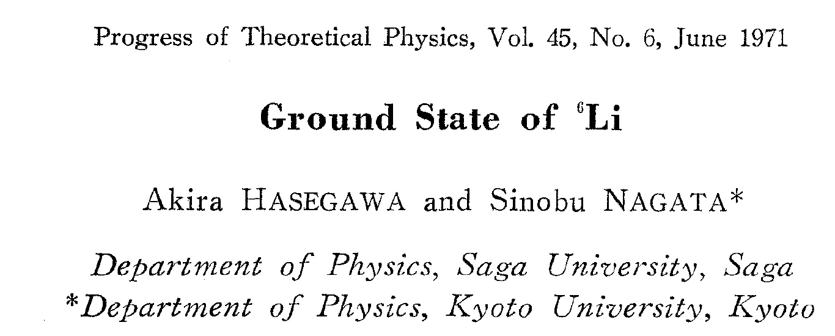
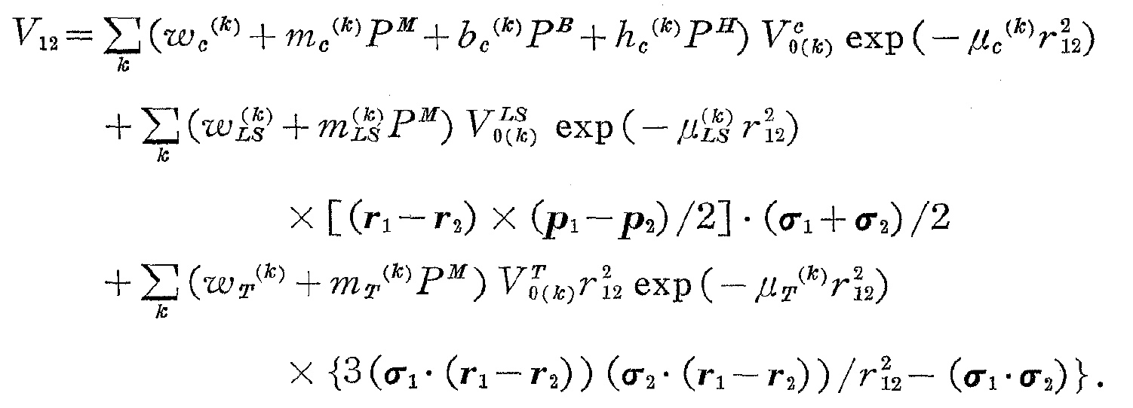
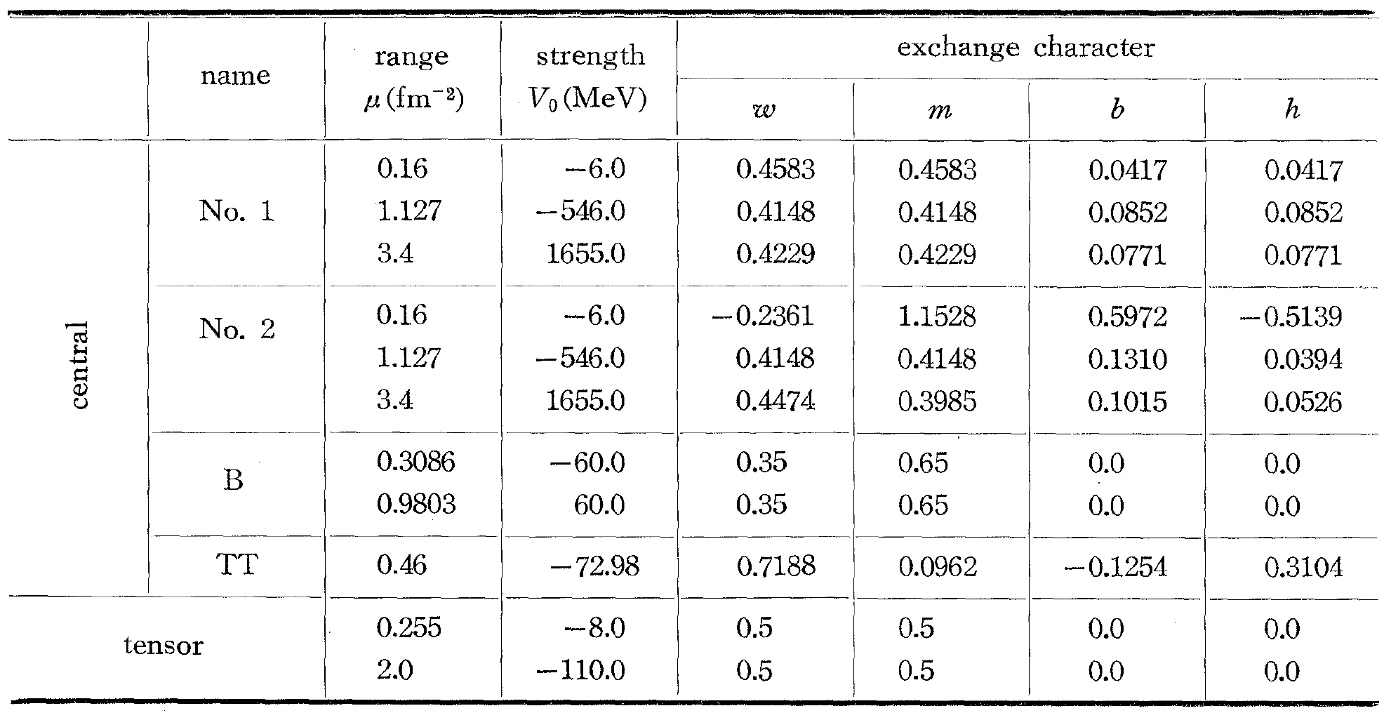
Tensor force
SOTANCP4, 13-18 May 2018, Galveston, USA

Slide 26
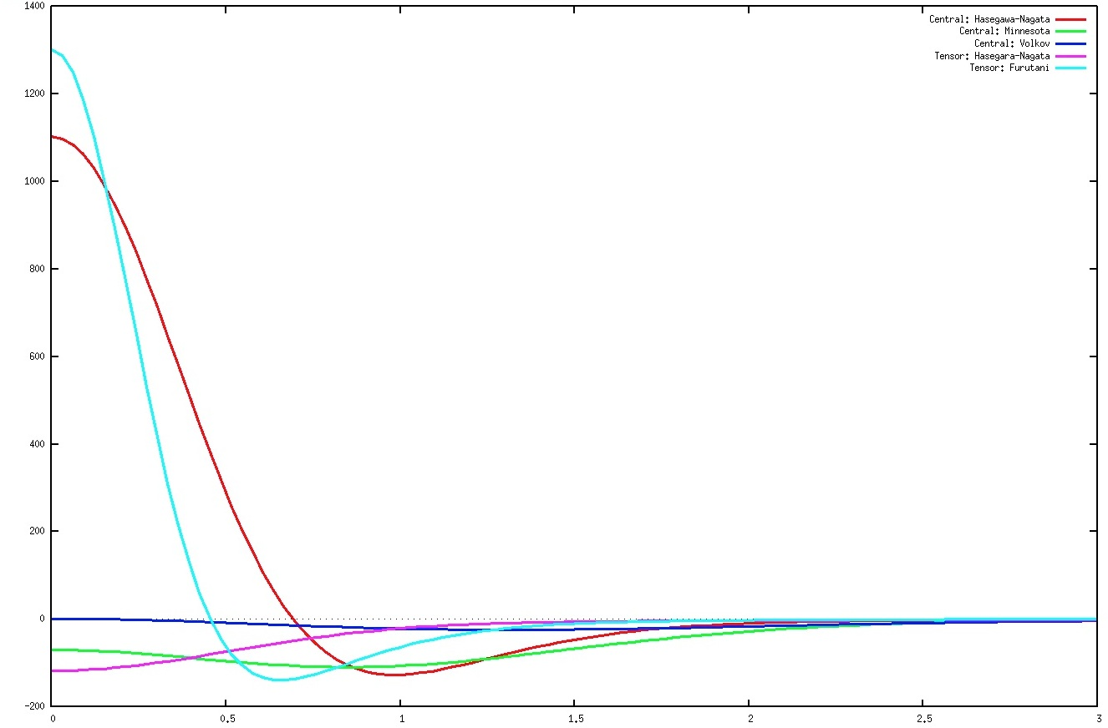
Hasegawa-Nagata (Central)
Furutani (Tensor)
Minnesota (Central)
Hasegawa-Nagata (Tensor)
Volkov No.2 (Central)
SOTANCP4, 13-18 May 2018, Galveston, USA

Slide 27
NN-Potential
0⁺, 1⁺:
1⁺
-7.79MeV
0⁺
-8.79MeV
0⁺
-8.79MeV
¹⁸F
1⁺
-9.78MeV
SOTANCP4, 13-18 May 2018, Galveston, USA

Slide 28
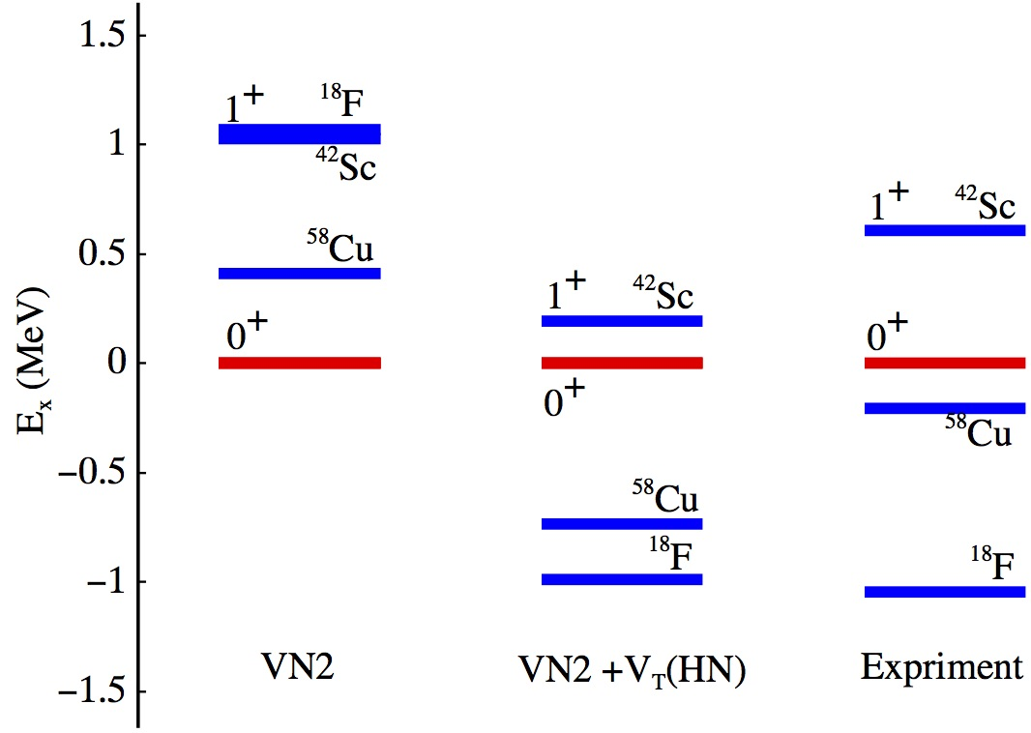
SOTANCP4, 13-18 May 2018, Galveston, USA

Slide 29
Deuteron-like correlation with Volkov No.2
Volkov No.2
Volkov No.2
without tensor force
with tensor force
1⁺
¹⁸F
⁴²Sc
⁵⁸Cu
“Pairing-type”
“Pairing-type”
⁴²Sc
1⁺
0⁺
0⁺
⁵⁸Cu
1⁺
¹⁸F
1⁺
“Deuteron-type”
SOTANCP4, 13-18 May 2018, Galveston, USA

Slide 30
Matrix element of NN-int.
(MeV)
Minnesota
Volkov No.2 + Tensor
¹⁸F
⁴²Sc
⁵⁸Cu
¹⁸F
⁴²Sc
⁵⁸Cu
1⁺
-7.94
-3.51
-4.10
1⁺
-9.50
-3.92
-5.83
0⁺
-4.77
-2.24
-2.98
0⁺
-5.00
-3.34
-3.42
(0⁺ - 1⁺)
3.17
1.17
1.12
(0⁺ - 1⁺)
4.50
0.58
2.41
Central
-5.60
-2.71
-3.63
Tensor
-3.90
-1.21
-2.20
SOTANCP4, 13-18 May 2018, Galveston, USA

Slide 31
Summary
Spatial correlation
Coupling of j>-j< in the same orbit enhances the spatial correlation.
The central force plays an essential role to make the coupling of
j>-j< in the same orbit.
Continua equally contribute to the spatial correlation.
Role of the tensor force
The level inversion for 1⁺ and 0⁺ in ⁴²Sc can be explained
by taking the tensor force into the interaction.
The coupling j>-j’< in the different orbits plays the key role.
SOTANCP4, 13-18 May 2018, Galveston, USA

