Slide 1
Nuclear Molecules in neutron-rich nuclei
+
Comment on 12C
(urgently added by the request of Peter)
M. Kimura (Hokkaido University)
M. Kimura, T. Suhara and Y. Kanada-En’yo, EPJA 52, 373 (2016).
Notes:
First of all, I’d like to thank to organizers for giving me an opportunity to report our recent works on nuclear clustering. This is my collaborators.

Slide 2
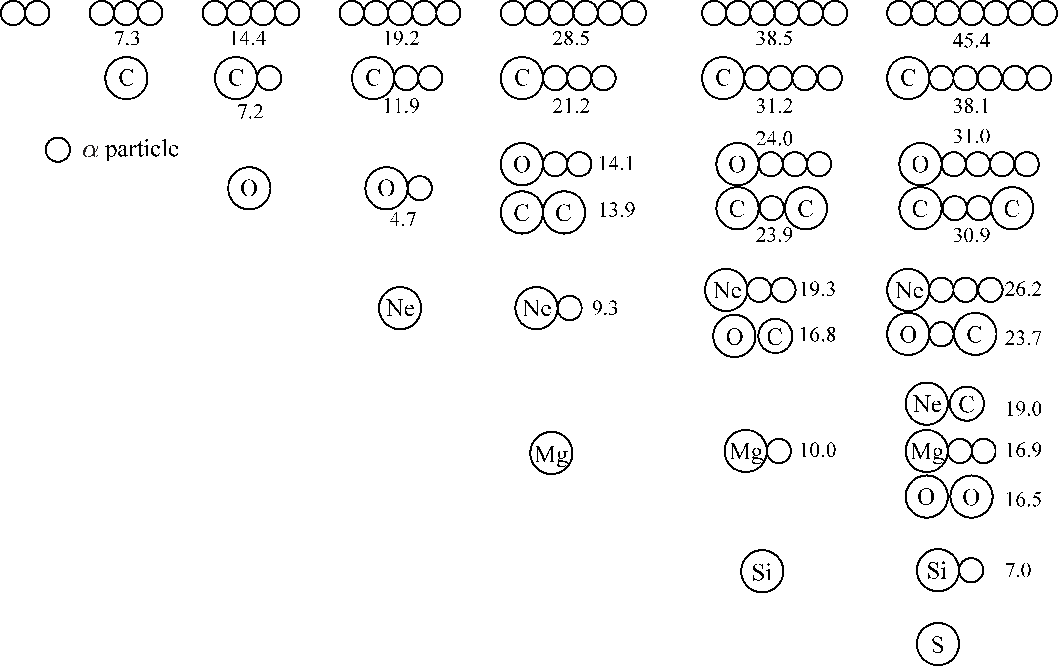
50th anniversary of Ikeda diagram
K. Ikeda et al., PTPS Ex. 464(1968)
Clustering in neutron-rich nuclei
is not included in this diagram
○ Clusters in neutron-rich nuclei
studied in the past decades
○ State-of-the-art topics in this decade
- Linear Chains
- Reflection asymmetric clusters

Slide 3
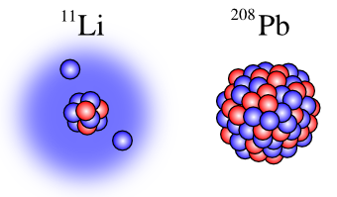
What will happen in neutron-rich nuclei?
○ Ikeda diagram is based on the fundamental nuclear
properties, saturation of energy/matter density
○ But saturation property is lost in neutron-rich nuclei.
Hence, Ikeda diagram cannot be applied straightforwardly
11Li
208Pb
So, what will happen?
○ Energy/Matter density should be kept constant
○ Symmetry energy should be minimized

Slide 4
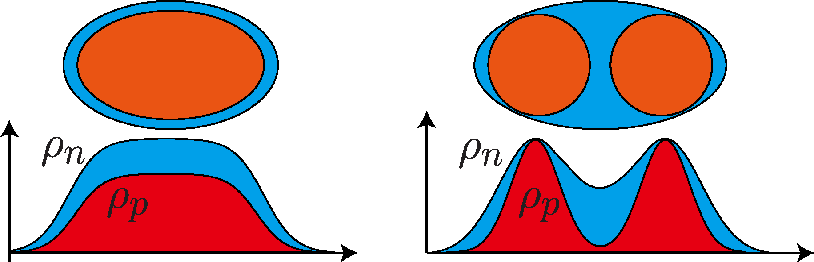
“MF with neutron skin” v.s. “Clustering”
There are two solutions
1. Mean-field with neutron skin
○ Densities are globally kept
almost constant
○ Symmetry energy is globally
minimized
2. Clusters with valence neutrons
○ Densities are locally kept constant
○ Symmetry energy is locally
minimized
Which is better for deeper binding?

Slide 5
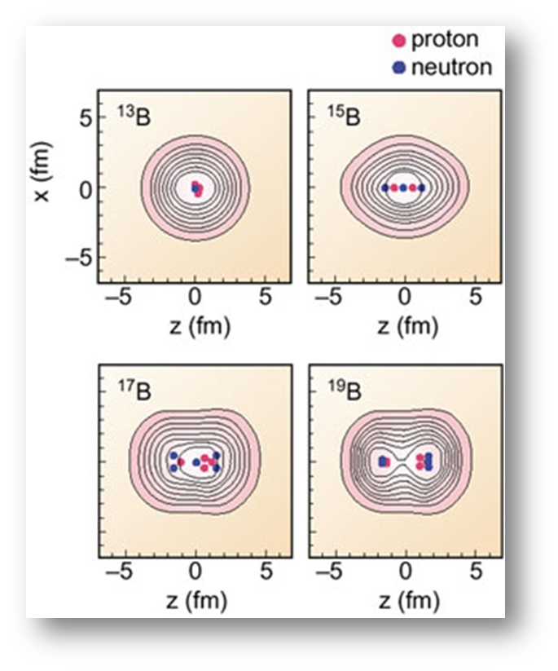
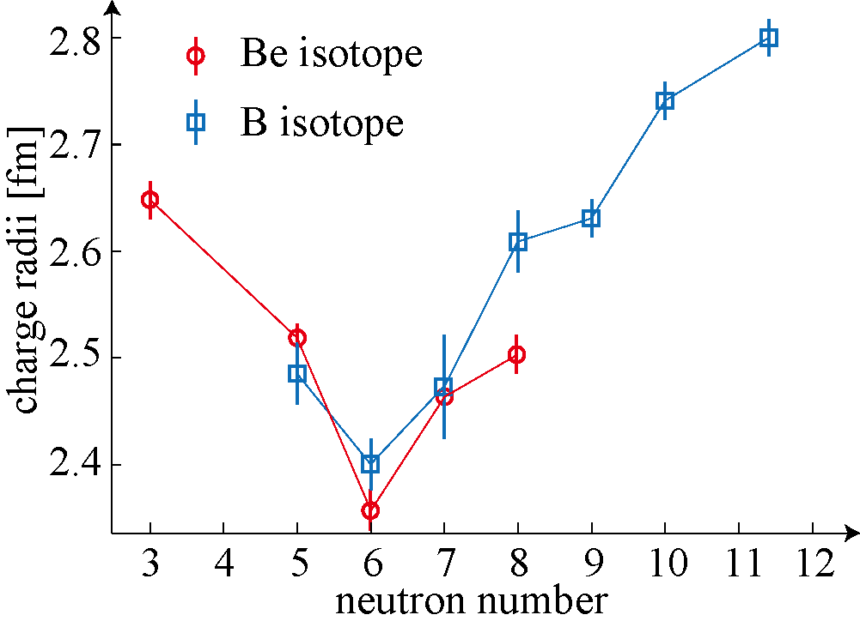
“MF with neutron skin” v.s. “Clustering”
A possible answer in light nuclei: mean-field ⇒ cluster
Y. Kanada-En’yo and H. Horiuchi, PRC52, 647(1995).
Charge radii of Be and B isotopes
can be a signature of clustering
Clustering sharply depends on neutron number
A. Krieger, et al., PRL108, 142501 (2012)
A. Estrade, et al., PRL113, 132501 (2014)
What is the origin of this dependence?

Slide 6
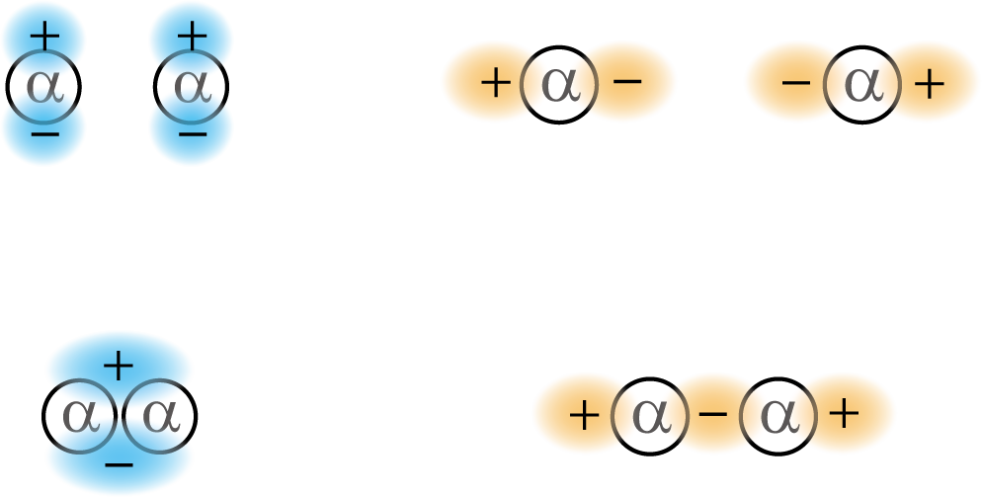

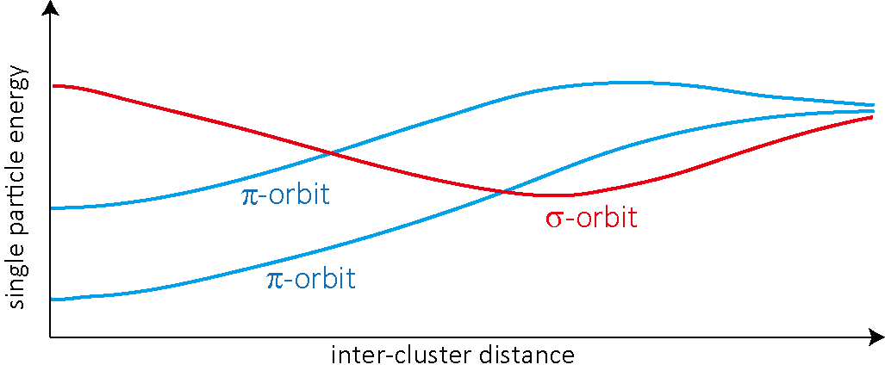
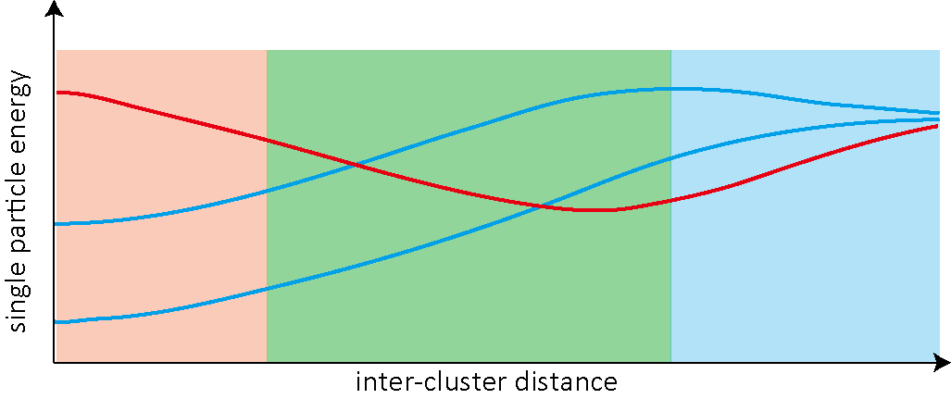
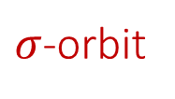

Molecular Orbits
Underlying quantum shell effect; “Molecular Orbits (MO)”
A special class of neutron orbits (MO) are formed around the clustered core
W. von Oertzen et al., Phys. Rep. 432, 43 (2006).
$π$-orbit
$σ$-orbit
One center
Covalent (two center)
Ionic (two center)

Slide 7
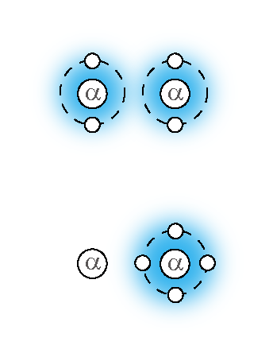
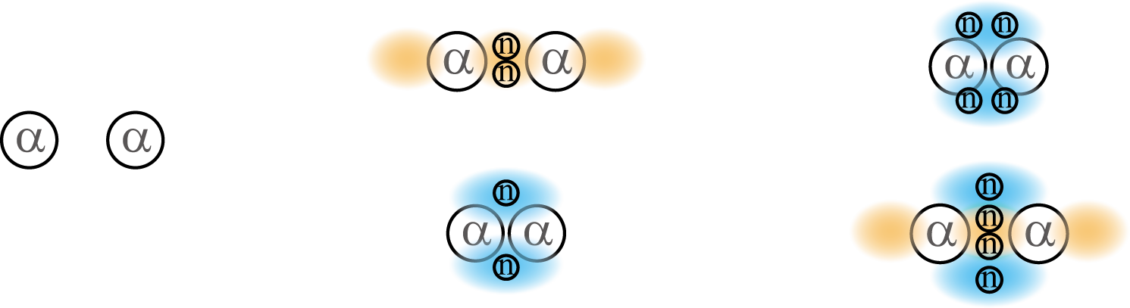
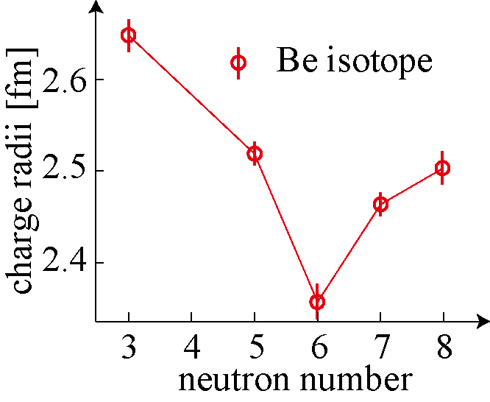
MO in Be isotopes
MO explains the increase of charge radii in 12Be
Evolution from covalent bonding
to ionic bonding was
theoretically predicted and experimentally identified
π2
6He+6He
10Be
AMD/FMD, Cluster model calc.
4He+8He
reduced cluster
M. Ito, et al., PRL100, 182502(2008).
Z.H. Yang, et al., PRL112, 162501 (2014)
excited states (ionic)
Increase of charge radii
12Be
Monopole transition
π2σ2
10Be
12Be
12Be
pronounced cluster
ground state (covalent)
A. Krieger, et al., PRL108, 142501 (2012)

Slide 8
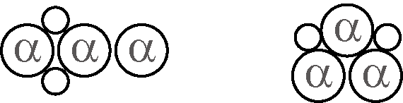
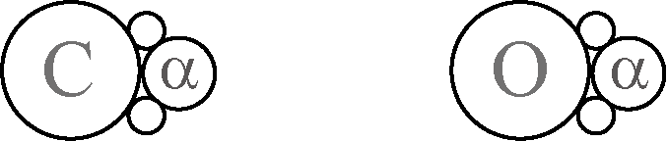
Review of MO in the past decades
What we learned from light neutron-rich nuclei
○ MO is a new binding mechanism of clusters
It stabilizes clusters by its glue-like role
○ MO generates a new types of clustering (covalent, ionic, …)
which do not follow ordinary Ikeda diagram
⇒ “extended Ikeda diagram” by von Oertzen
○ Large scale SM is confirming this in an ab-initio way
State-of-the-art Molecular Orbits
Topic 1 Three center systems (Chains and Triangles)
Topic 2 Parity asymmetric MO and its impact on astrophysics

Slide 9
Topic 1
Linear Chains
Talks by T. Suhara and T. Baba in this session for detail
References
T. Suhara et al., PRC 82, 044301 (2010), PRC84, 024328 (2018).
T. Baba et al., PRC90, 064319 (2014), PRC94, 044303 (2016)
PRC95, 064318 (2017), PRC in print (2018).

Slide 10
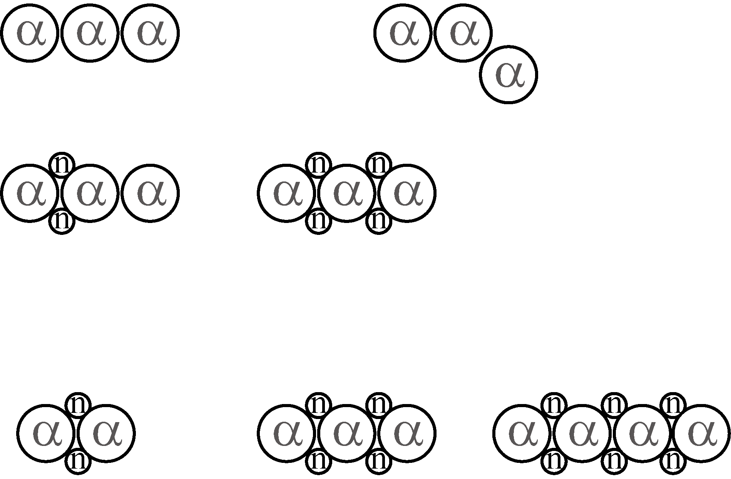
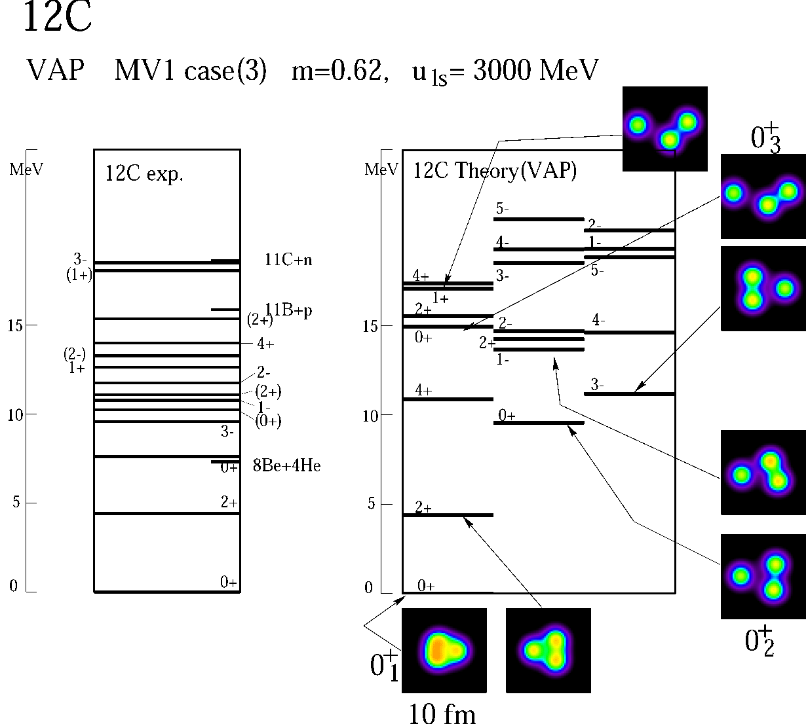
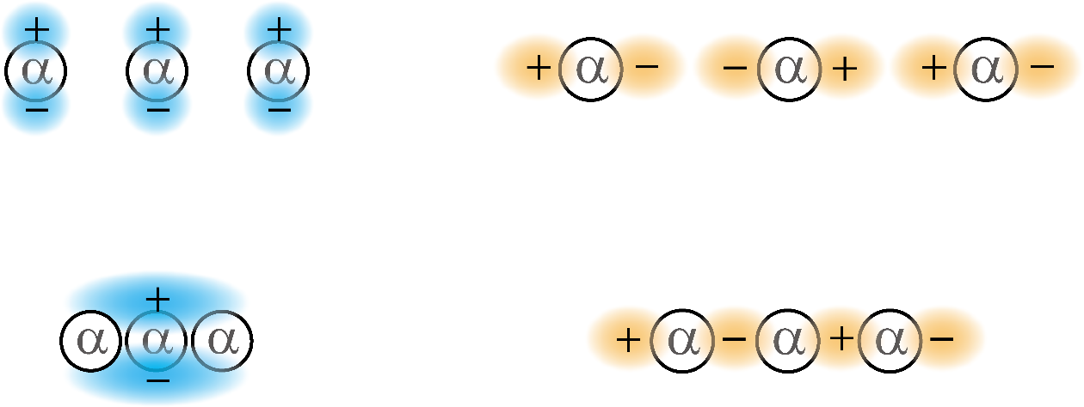
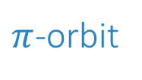

Linear Chains with MO
An interesting extension of MO is linear-chain of 3α
H. Morinaga, Phys. Rev. 101, 254 (1956).
○ Linear chain of 3α does not exist in 12C
AMD: Y. Kanada-En’yo, PRL81,
FMD: T. Neff et al, PRL105
0+ state above the Hoyle state is bent-armed 3$α$ (not linear!)
○ MO will stabilize the chain in 3α + neutrons system
A pilot study by N. Itagaki et al., PRC64, 014301 (2001)
$π$-orbit
$σ$-orbit
○ Theoretical studies by T. Suhara and T. Baba and
recent experiments finally showed that
the linear-chain formation in 14C is rather convincing

Slide 11
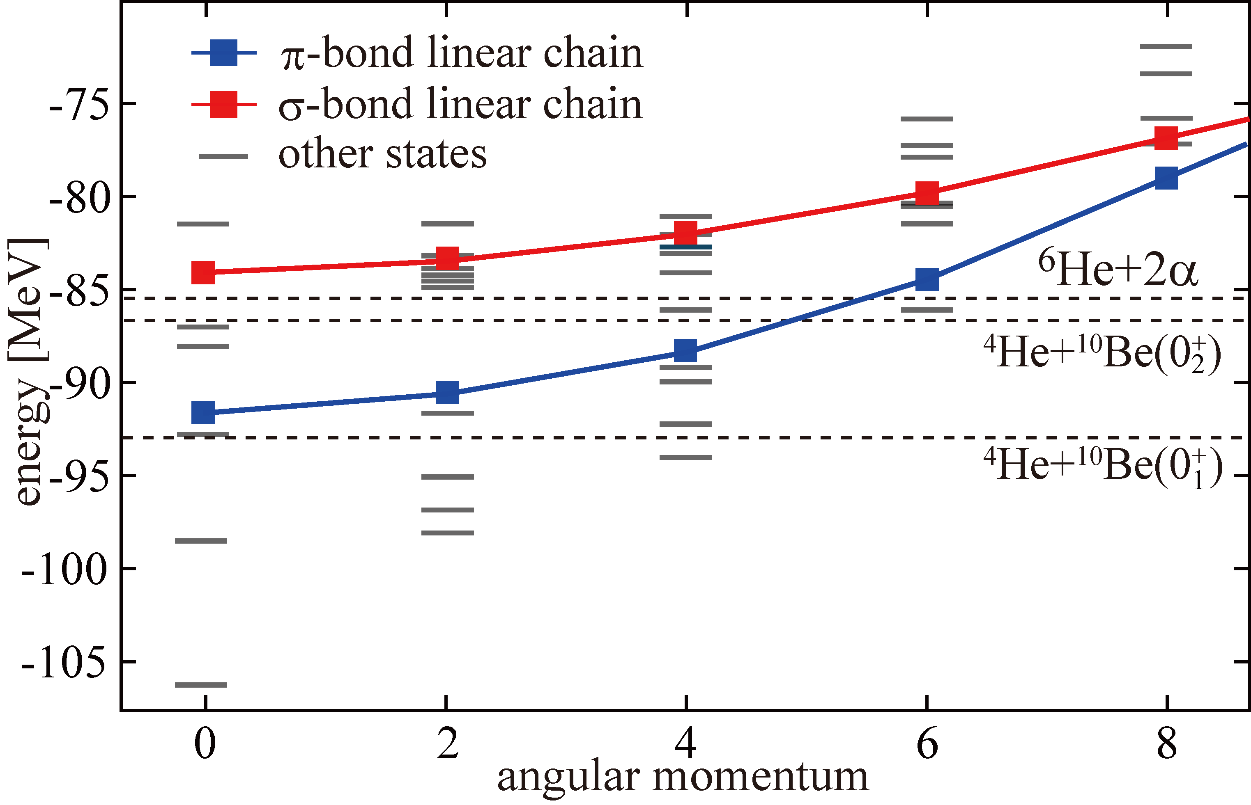
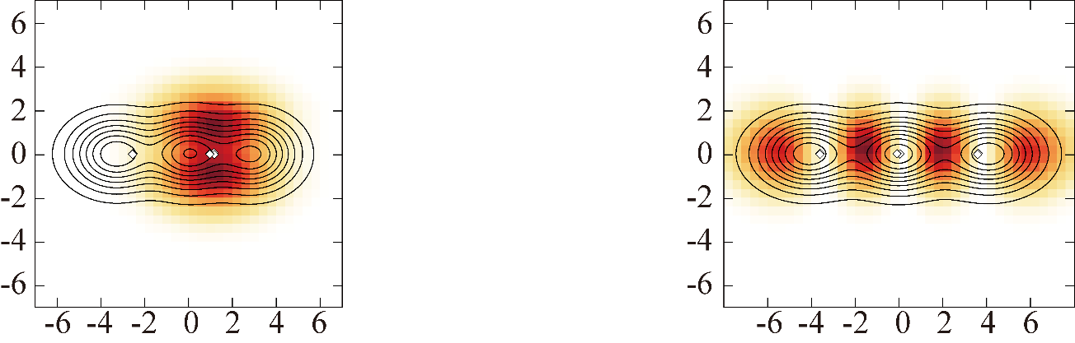


Linear chains in 14C (Theory)
T. Baba et al., PRC94, 044303 (2016) , PRC95, 064318 (2017)
$σ$-orbit
$π$-orbit
○ AMD calculation predicts two linear-chain bands
○ Valence neutron orbits are interpreted as
π- and σ-orbits which are introduced by Itagaki.

Slide 12
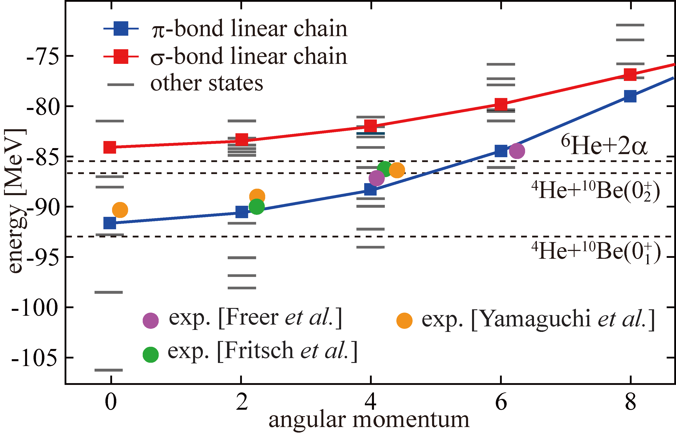
Linear chains in 14C (Theory)
M. Freer et al., PRC90 (2014), Fritsch et al., PRC93 (2016), H. Yamaguchi et al., PLB766 (2017)
$σ$-orbit
$π$-orbit
○ Observed resonances (α+10Be resonant scattering) agree with
π-bond linear chain ⇒ Huge moment-of-intertia !

Slide 13
Linear chains in 14C (Experiment)
○ Another evidence is the decay pattern
1. Linear chain should decay by the 4He emission
2. Linear chain should primary
decay to the 10Be(2+) (not to the g.s.),
because of strong angular correlation.
Li et al., PRC95, 021303(R), (2017)

Slide 14
Linear chains in 14C (Summary)
○ Excitation energy, huge moment-of-inertia and decay pattern
of linear chains are consistent between theory and experiment
○ Thus, the linear-chain formation in 14C looks plausible
○ Another story for σ-bond linear chain will be discussed by Baba
○ Linear chains in neighboring nuclei will be discussed by Suhara
Perspectives (challenge to experimentalists)
○ Theories predict the most prominent linear-chain in 16C
(both of π and σ-orbits are occupied and the LC is stabilized)
○ Theories predict triangular states in 14C.
“spinning triangle” model should work better for 14C!
T. Baba et al., PRC90, 064319 (2014)
N. Itagaki et al., PRL92, 142501 (2004)

Slide 15
Topic 2
Reflection asymmetric systems
References
M. K. et al., PRC75, 034312 (2007), PRC83, 044304 (2011)
N. Furutachi et al., PTP119, 403 (2008)

Slide 16
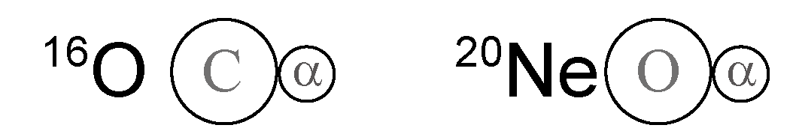
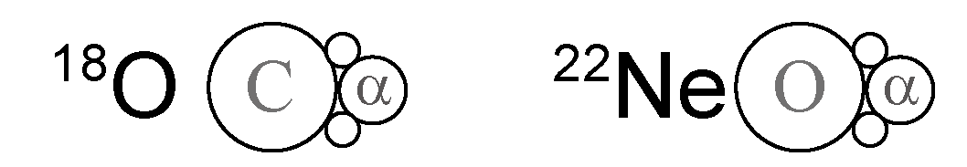
Reflection asymmetric clusters with MO
Discussion of MO can be extended to heavier systems
◎ An interesting target is O and Ne isotopes
○ Clustering of 16O and 20Ne is well known (reflection asymmetric)
○ Some of them are related to the astrophysical processes
14C(α,γ)18O, 18O(α,γ)22Ne, …
Reflection asymmetric clusters may have strong impact
on the astrophysical processes
○ They have much longer isotope chain than Be isotopes

Slide 17
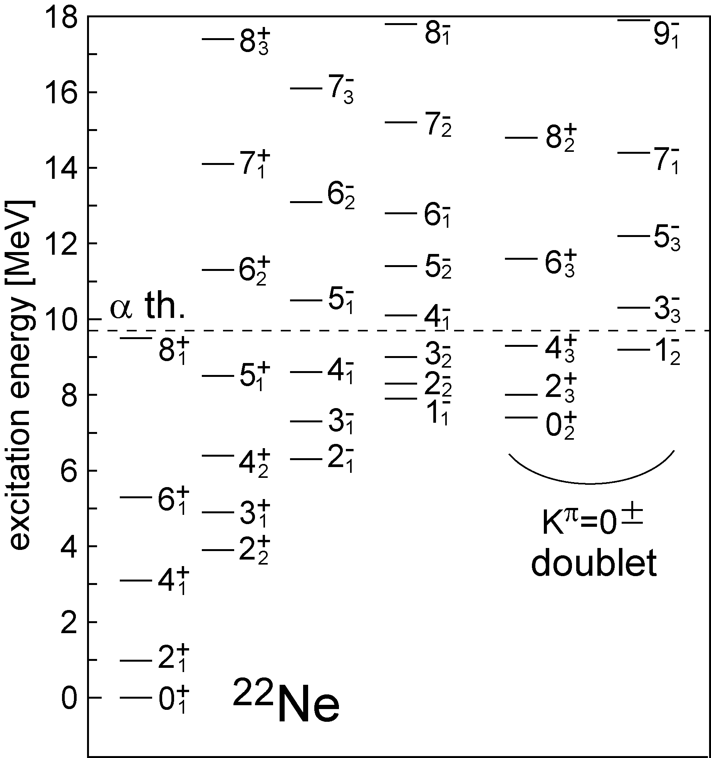
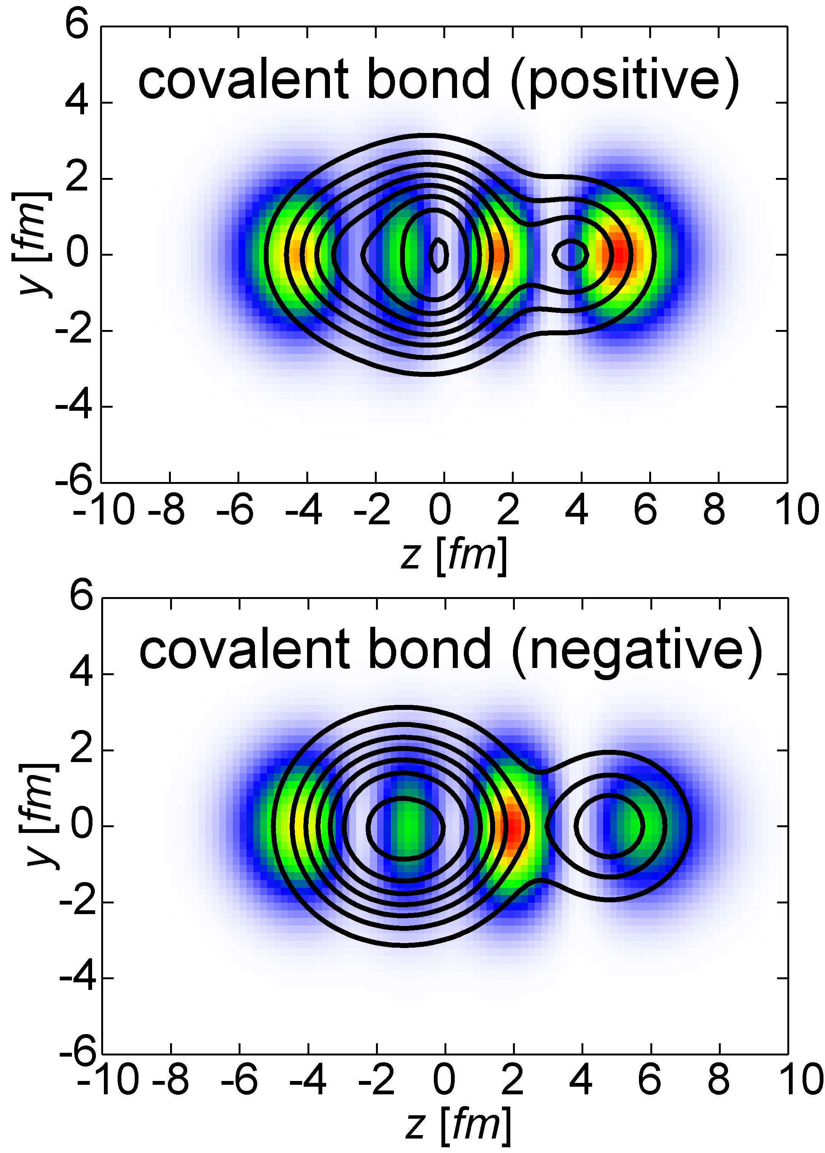
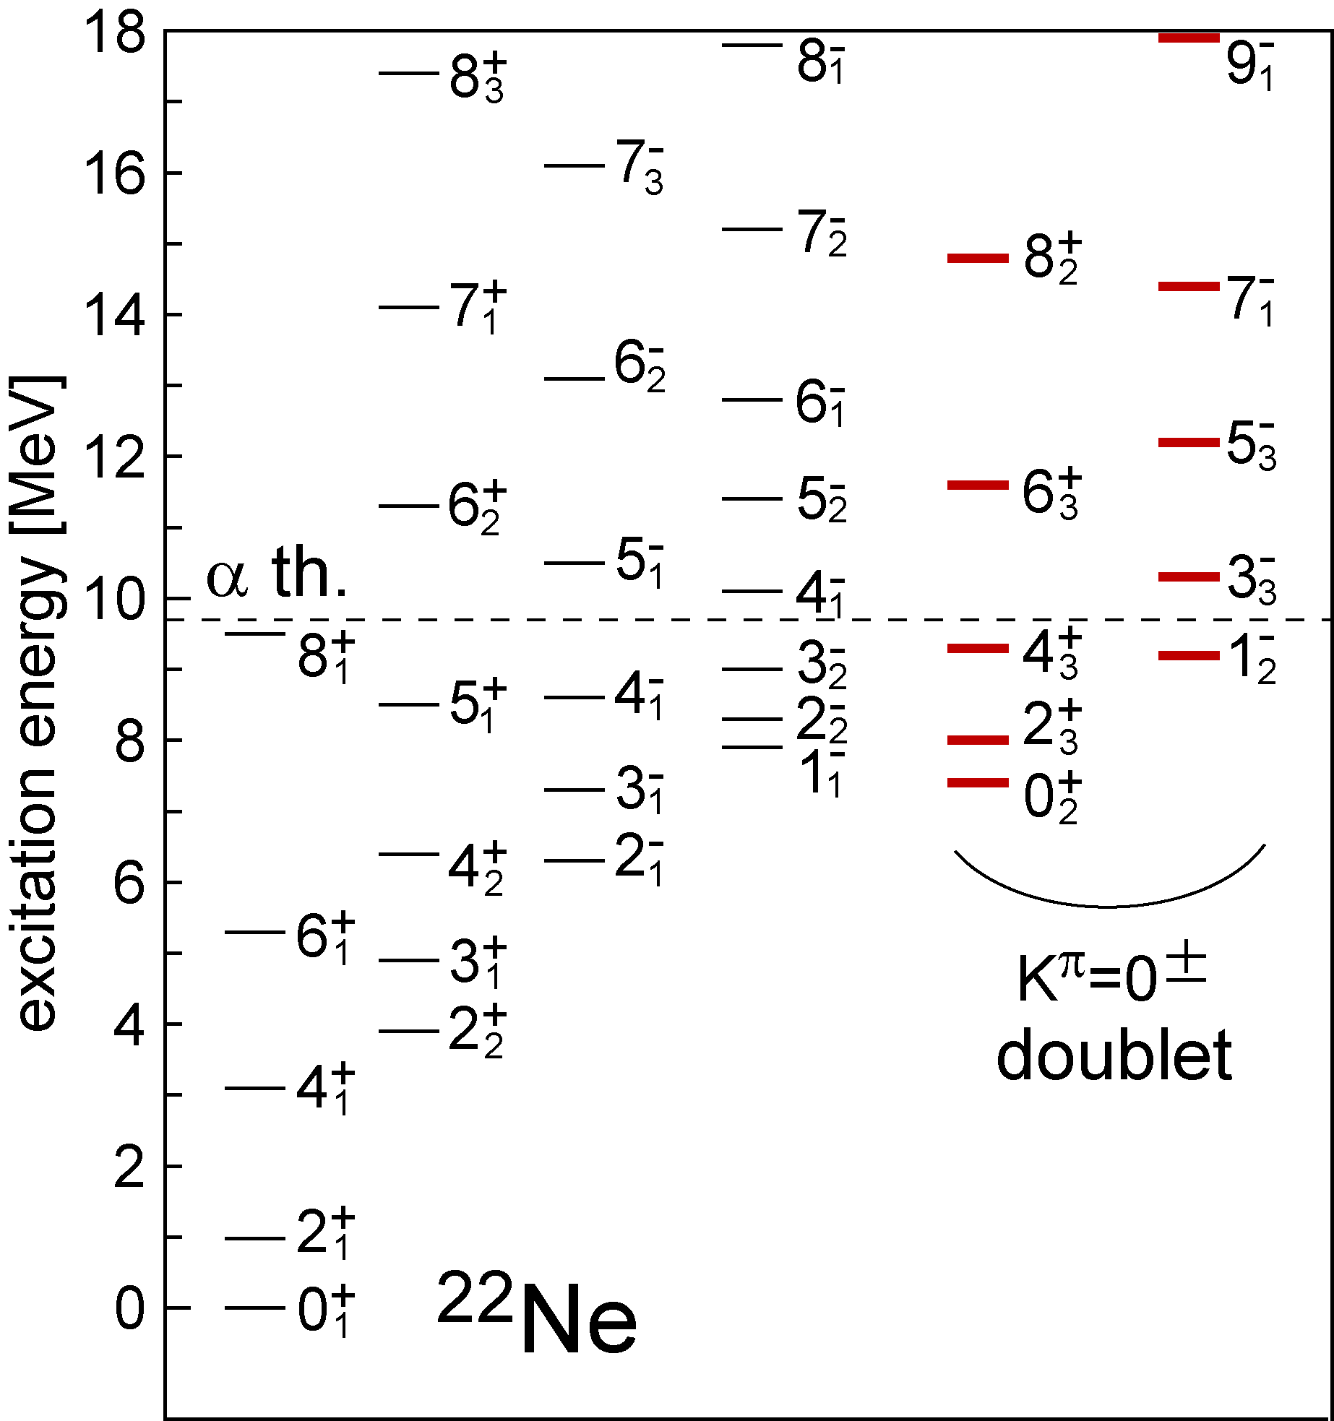
MO in 22Ne
A pair of cluster bands (positive & negative) in 22Ne
M.K., PRC 75, 034312 (2007)

Slide 18
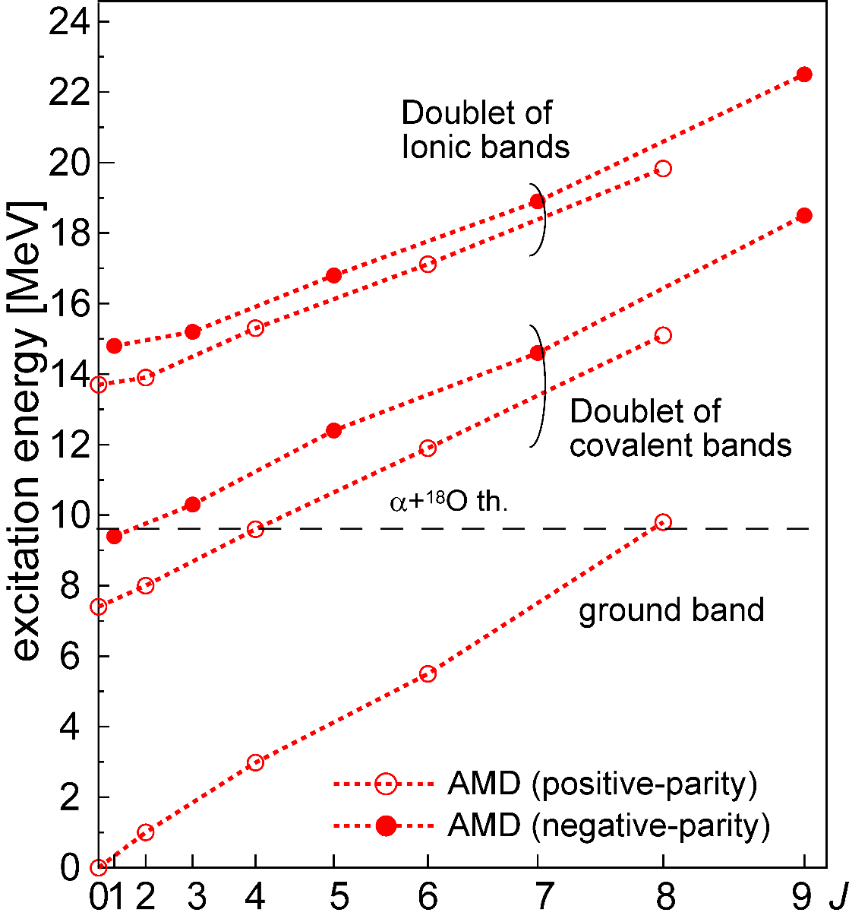
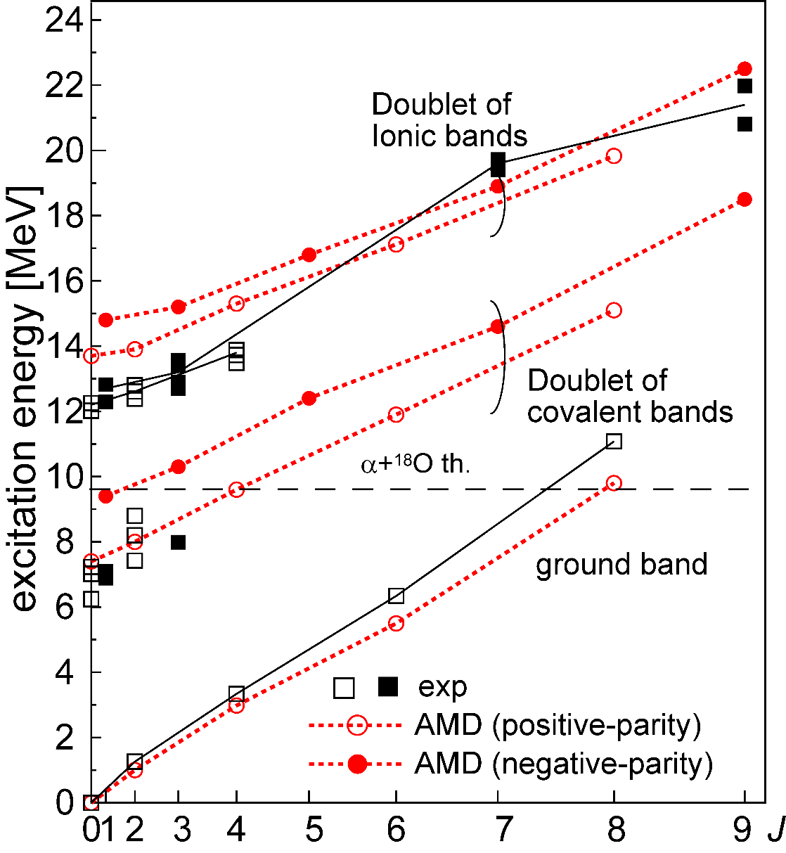
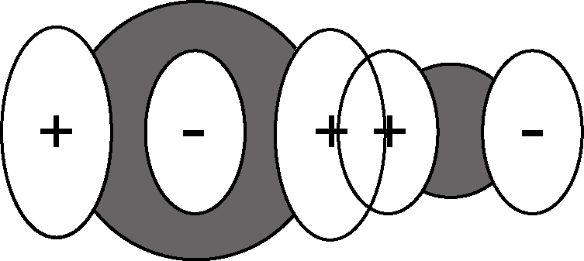
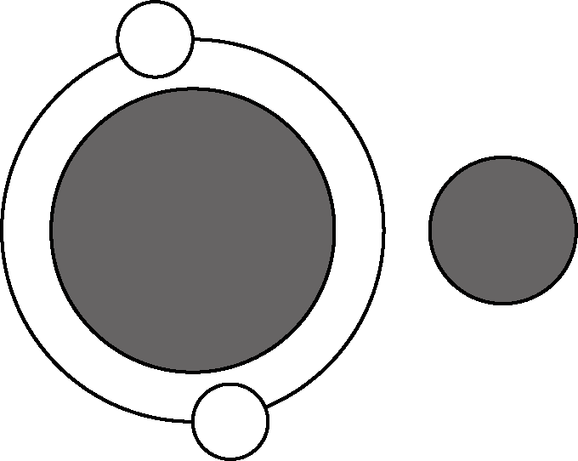
Covalent and Ionic bonding in 22Ne
Theory predicts two cluster doublets
○ Doublet of covalent bands
(α + 16O+ σ-orbit)
Candidate
W. Scholz, et al.,
PRL 22, 949 (1969), PRC 6, 893 (1972).
○ Doublet of ionic bands
(α + 18O)
Identified by exp.
G. V. Rogachev, et al., PRC 64 051302 (2001).
N. Curtis, et al., PRC66 024315 (2002).
V.Z.Goldberg, et al., PRC 69, 024602 (2004).

Slide 19
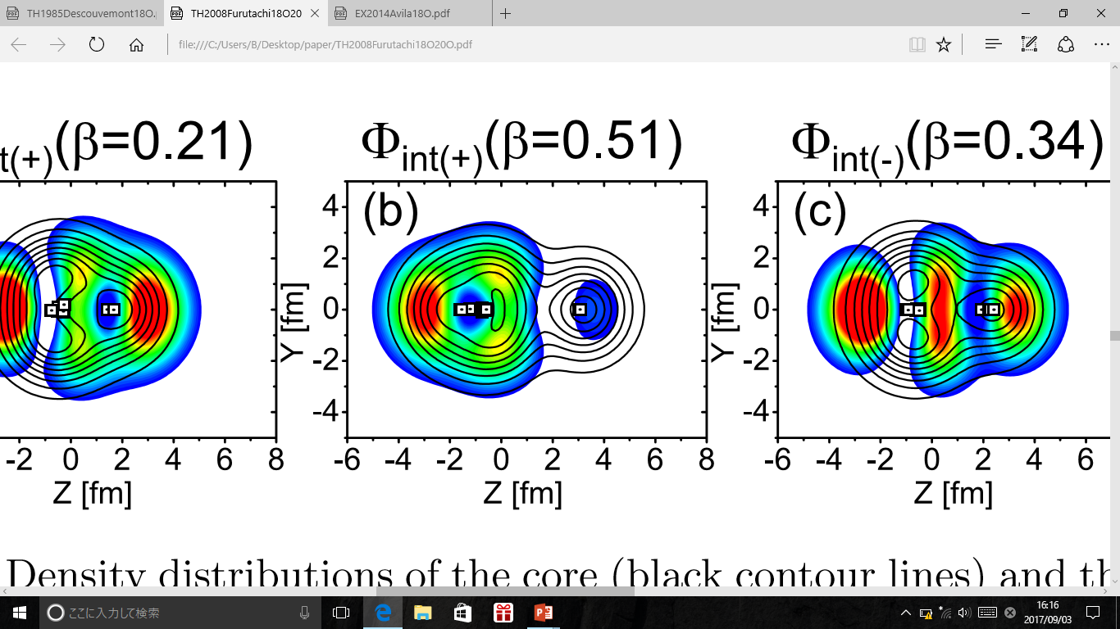
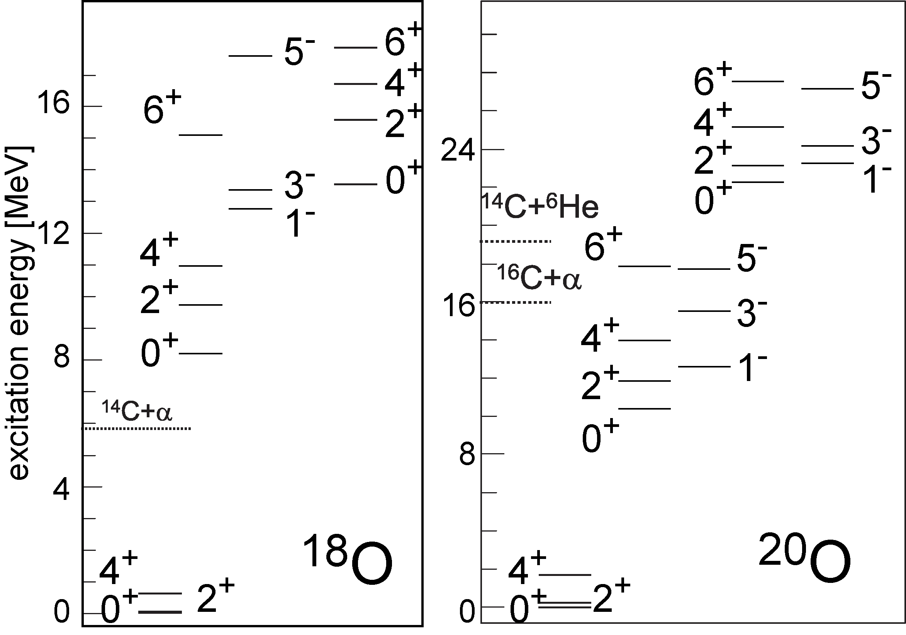
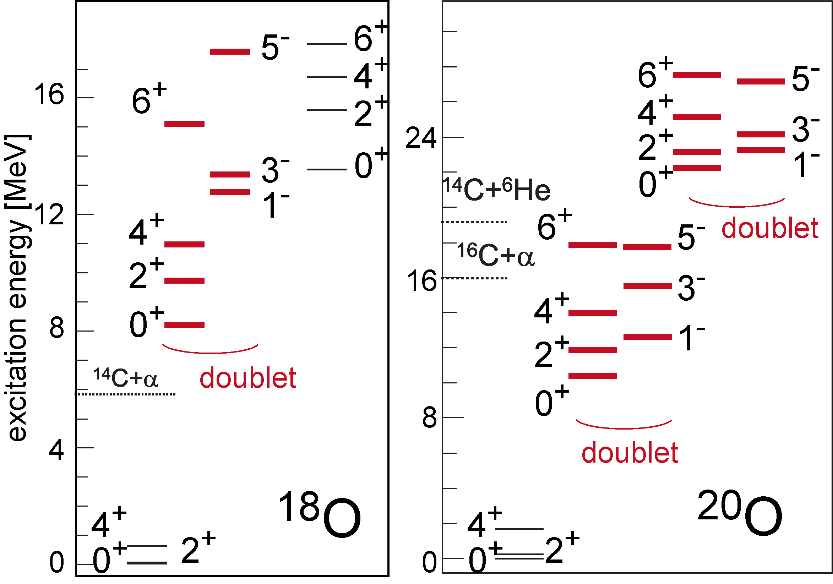
MO in Oxygen
N. Furutachi, et al., Prog. Theor. Phys. 119, 3 (2008).
14C+α
Oxygen isotopes also have doublets
MO should exist in many nuclei

Slide 20
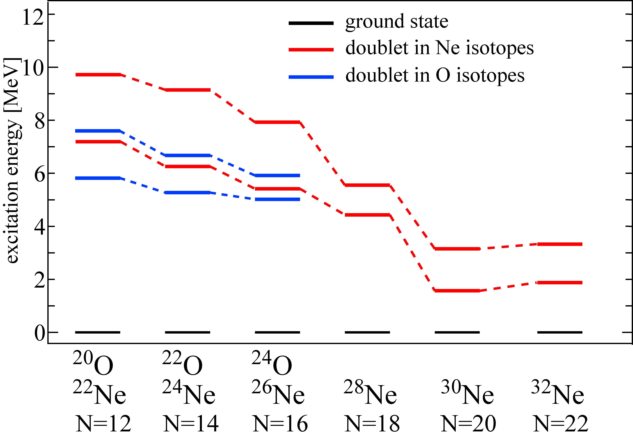
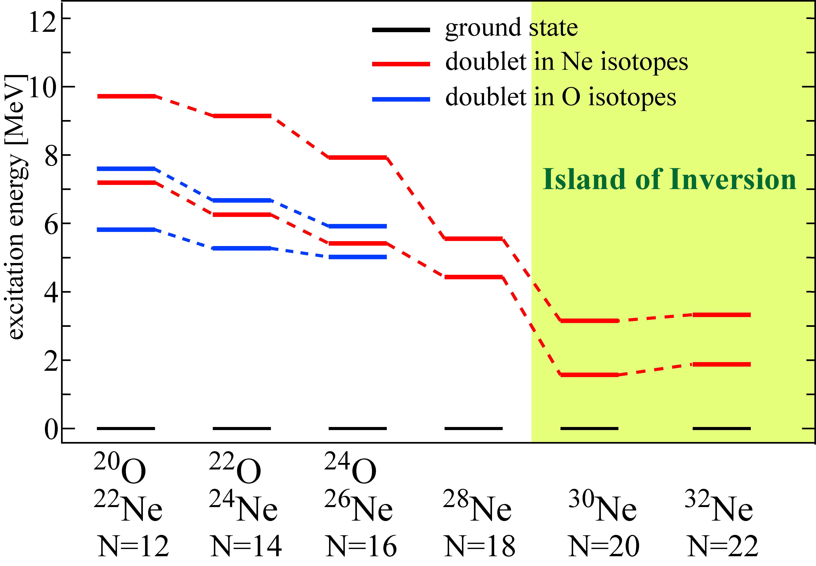
Evolution of MO toward drip-line
○ Energy of MO doublet of O and Ne isotopes
becomes very low in the Island of Inversion

Slide 21
Evolution of MO toward drip-line
○ Cooperative effect of the “Breaking of N=20 magic number”
and “Molecular Orbit” drastically reduces the energy
ｰ Breaking of N=20 magic number lowers the σ-orbit (pf-shell)
ｰ Neutrons in σ-orbit induces strong clustering and deformation
ｰ Strong deformation further lowers σ-orbit energy
○ A similar result was also reported by a DFT calculation
P. Marevic et al., PRC97 024334 (2018).
○ Experimental survey is in need. Strong octupole transition!

Slide 22
Topic 3
Comment on 12C
R. Imai et al., arXiv:1802.03523
Reference:

Slide 23
Now, some comment on 12C
○ Recently, we have developed a brand new method to
study the alpha-gas states.
And we obtained some new insight for 12C
So, I’ll introduce the new method and explain new insight
(very shortly)
1. Introduction of the new method
2. Comment #1: Gas-state v.s. bent-armed
3. Comment #2: New family of the gas-state

Slide 24
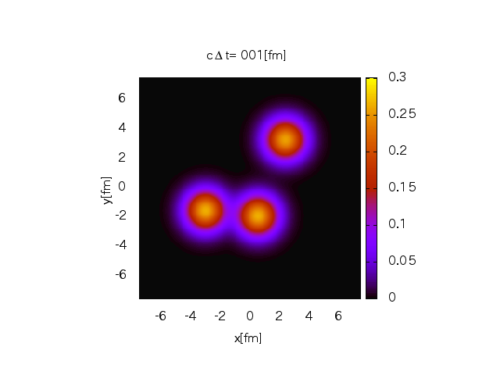




1. Introduction of the new method
○ The new method exploits the equation-of-motion (EOM)
of Gaussian wave packets.
① We describe the α cluster system using Gaussian wave packets
(Brink wave function)
$${\vec{Z}}_{2}$$
$${\vec{Z}}_{3}$$
$${\vec{Z}}_{1}$$
o
② And derive EOM for wave packet centroids and solve it
We obtain

Slide 25
1. Introduction of the new method
③ Although the EOM looks classical, the ensemble of the time-
dependent wave function has very nice properties
○ It has ergodic nature
○ It follows quantum statistics (micro canonical ensemble)
J. Schnack and H. Feldmeier, NPA601, 181 (1996).
A. Ono and H. Horiuchi, PRC53, 845 (1996), PRC53, 2341 (1996).
④ This mean that the superposition of the time-dependent
wave functions should give good description of the quantum state
○ The result should be converged after the long-time propagation
○ The results should not depend on the initial condition

Slide 26
1. Introduction of the new method
○ The result is converged after the long-time propagation
○ The results independent of the initial condition
R. Imai et al., arXiv:1802.03523

Slide 27
1. Introduction of the new method
○ The result is identical to the THSR! (positive-parity)
○ Many negative-parity states
○ Everything come from only single ensemble (high-performance)
R. Imai et al., arXiv:1802.03523

Slide 28
Comment #1: Gas v.s. bent-armed
○ Level crossing occurs
by changing space size
○ With smaller space size
bent-armed state appears
lower than the gas-state
○ This might explain
why bent-armed state
appears in Lattice calc.

Slide 29
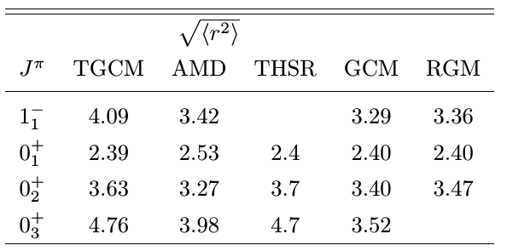
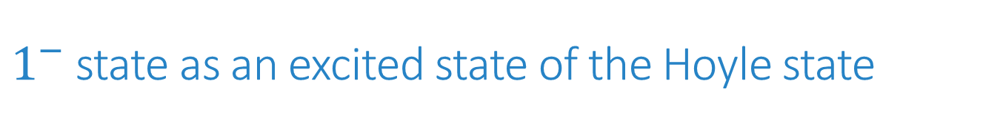
Comment #2: Negative-parity gas-state
$1^{−}$ state as an excited state of the Hoyle state
Huge radius
REM
Enhanced dipole transition

Slide 30
Summary and Perspective
○ MO is a novel type of clustering and binding mechanism
in neutron-rich nuclei
○ Study of MO is extending to C, O and Ne isotopes
exploring “new Ikeda diagram” in neutron-rich nuclei
○ Linear-chains in 14C look plausible
- Huge moment-of-inertia, decay patterns
(See talks by Suhara & Baba)
○ Reflection asymmetric MO is predicted in O and Ne isotopes
Their impact on astrophysical processes is expected
○ Further theoretical and experimental studies are in need
to establish “new Ikeda diagram”
Thank you for your attention

