Slide 1
Use of a Nucleation Based Ternary Fission Model to Reproduce Neck Emission in Heavy-Ion Reactions
Jerome Gauthier
Cyclotron Institute, Texas A&M University
SOTANCP4 May 2018

Slide 2
Ternary fission: about 0.3% of heavy nucleus fissions produce a third fragment coming from the low density neck region.
²⁴¹Pu
Fission Fragment
Ternary Fission

Slide 3
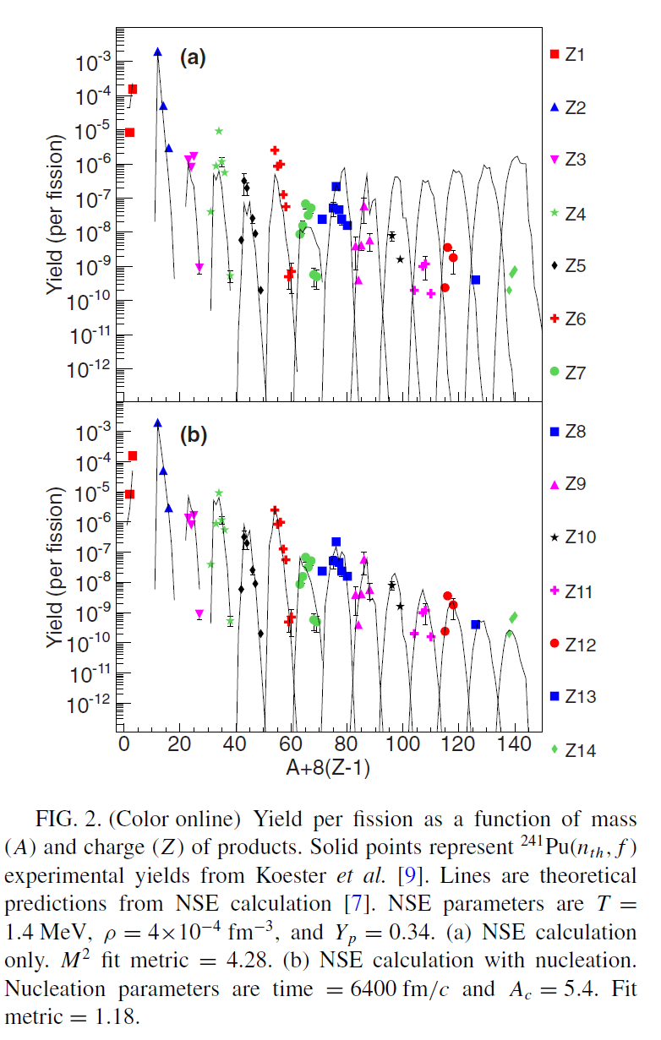
Most of those fragments are α particles.
A high yield of tritons relative to protons is
observed and the heavy fragment yields are
decreasing with Z.
The use of a nuclear statistical equilibrium
(NSE) model based on the chemical potential for low density and temperature is in pretty good agreement with experimental observations for A≤15.
To reproduce the heavier fragment yields, one
has to take into account the reaction time and the critical cluster size (nucleation).
S. Wuenschel et al., Physical Review C 90, 011601 (2014)

Slide 4
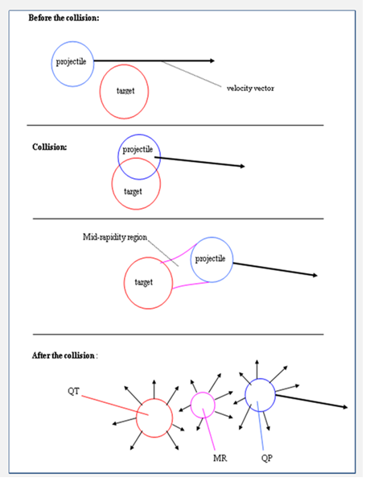
This behavior should not be restricted to fission necks and is more likely to be a general nuclear matter property. It thus needs to be studied at higher temperature.
Mid-peripheral collisions with a heavy system like ¹²⁴Sn+¹²⁴Sn are similar to the fission process but at higher temperature and density.
We want to see if NSE with nucleation (NESC) calculation can reproduce the mid-rapidity (ternary fission like) isotopic yields.
We use ¹²⁴Sn+¹²⁴Sn and ¹²⁴Sn+¹¹²Sn at 26A MeV from the December 2007 NIMROD experiment.

Slide 5
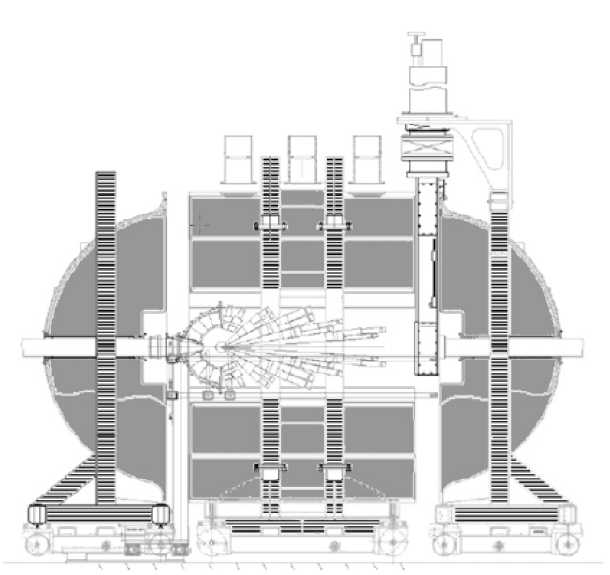
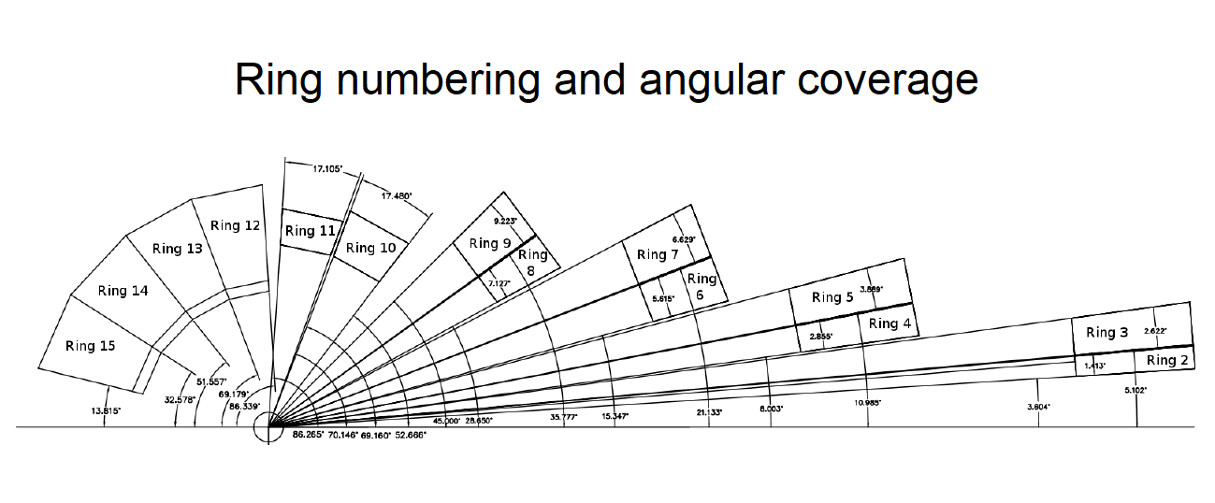
Nimrod Detection Array
Neutron Ball
156 CsI(Tl) distributed on 11 rings from 3 to 100º.
100 Si (300µm)-CsI(Tl) telescopes from ring 2 to 9.
30 Si(150µm)-Si(500µ)-CsI(Tl) super telescopes from ring 2 to 9.
4π neutron detector array (Neutron Ball).

Slide 6
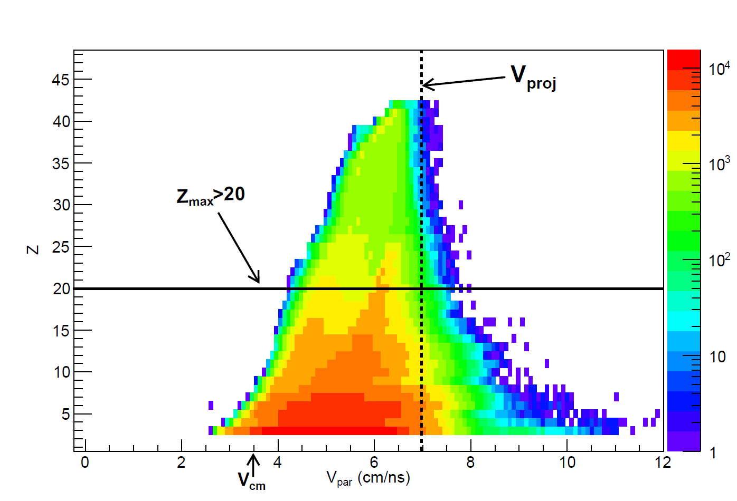
Peripheral and mid-peripheral event selection:
Z_{max} > 20
Multiplicity > 1

Slide 7
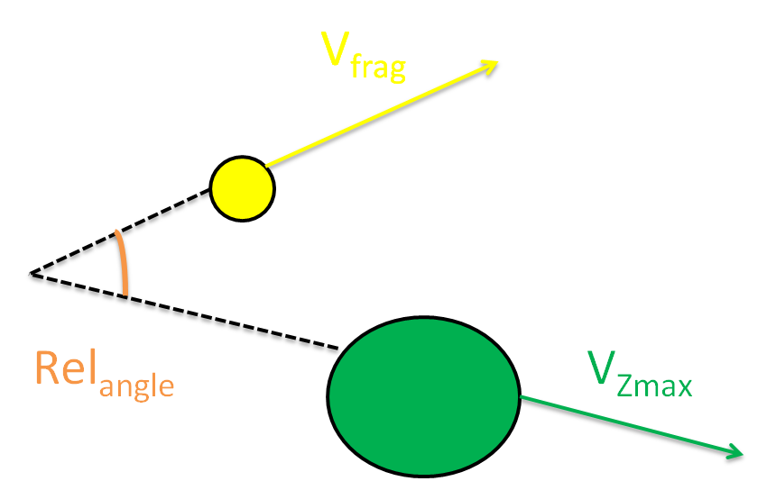
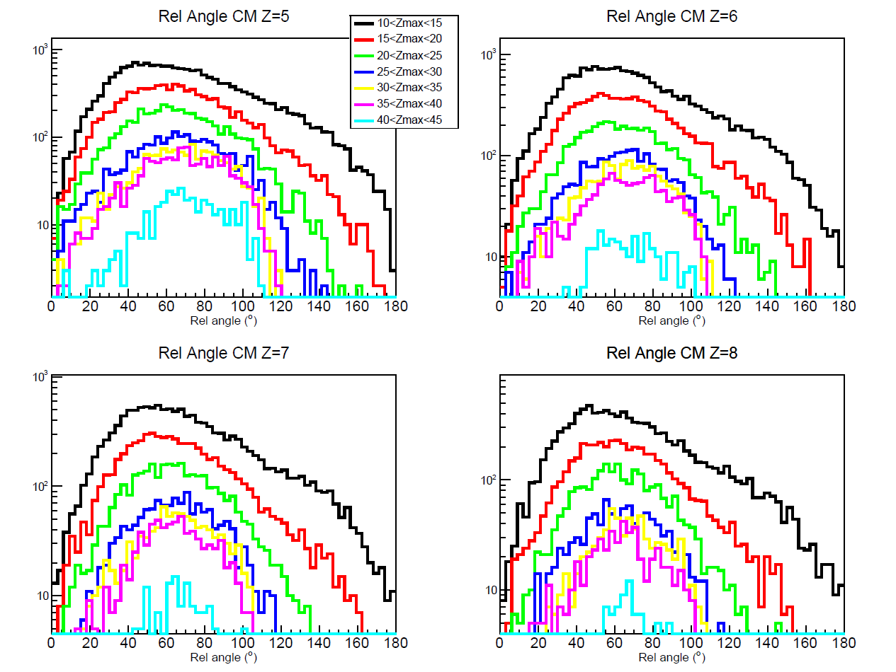
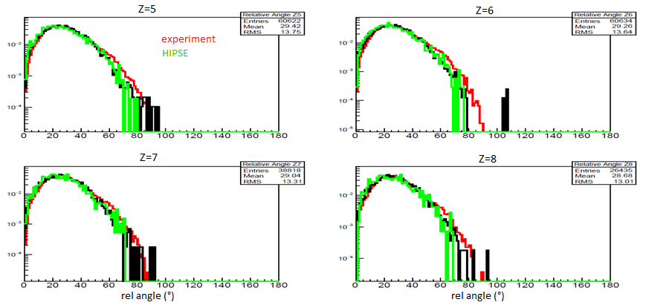
Relative angle selection
The relative angle between the biggest fragment (Z_{max}) and the fragment of interest velocity vectors is calculated in order to select the mid-rapidity emission.
Laboratory frame
CM frame

Slide 8
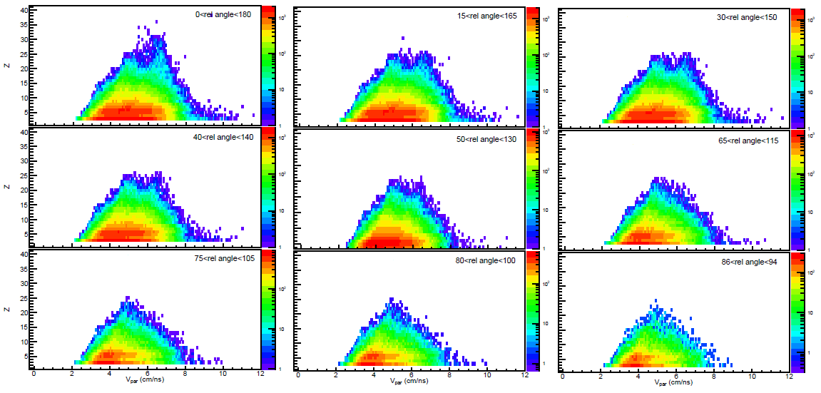
Charge versus parallel velocity for several relative angle windows centered at 90º in the center of mass.
Relative Angle Window Selection
V_{cm}
V_{proj}

Slide 9
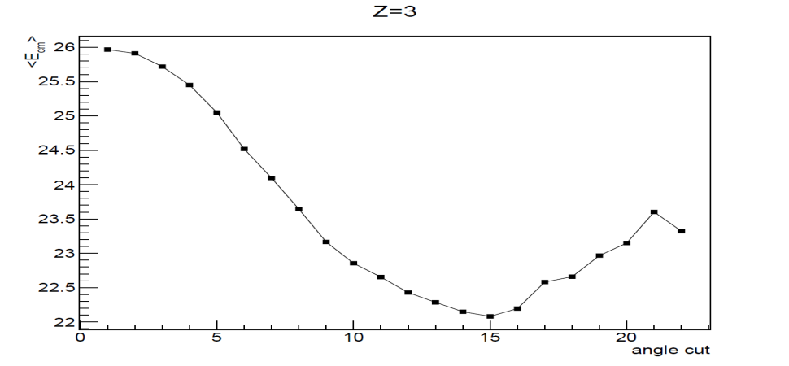
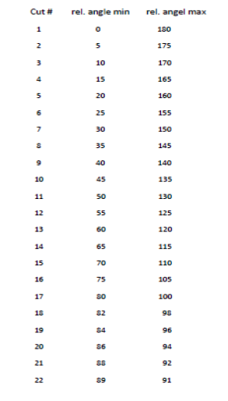
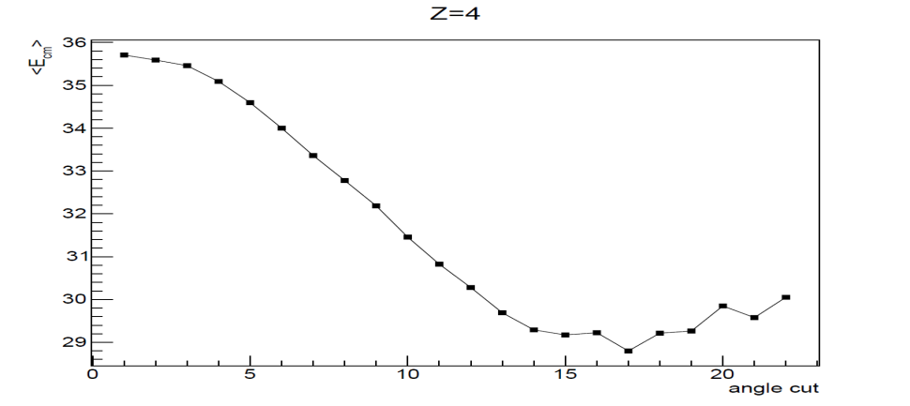
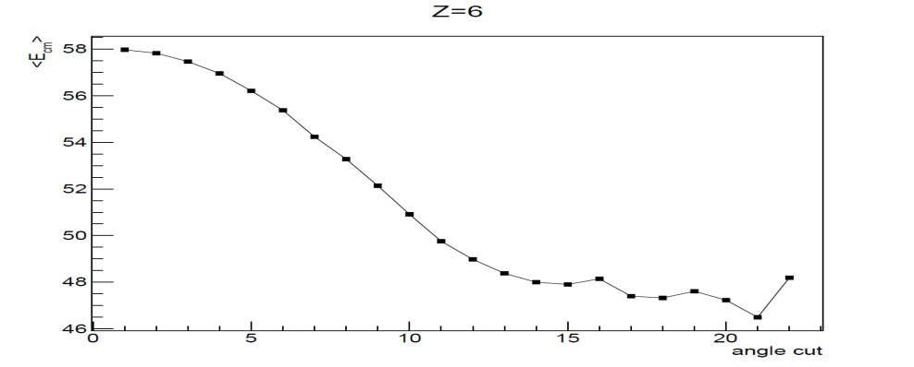
Relative Angle Window Selection
To select the ternary-like-fragments the
relative angle (in the center of mass) should be close to 90º.
But the statistic goes
down very quickly when shrinking that window.
To maximize the statistic, we select the interval for which <E_{cm}> stops to drop. The 50-130º selection seems to be a good compromise.

Slide 10
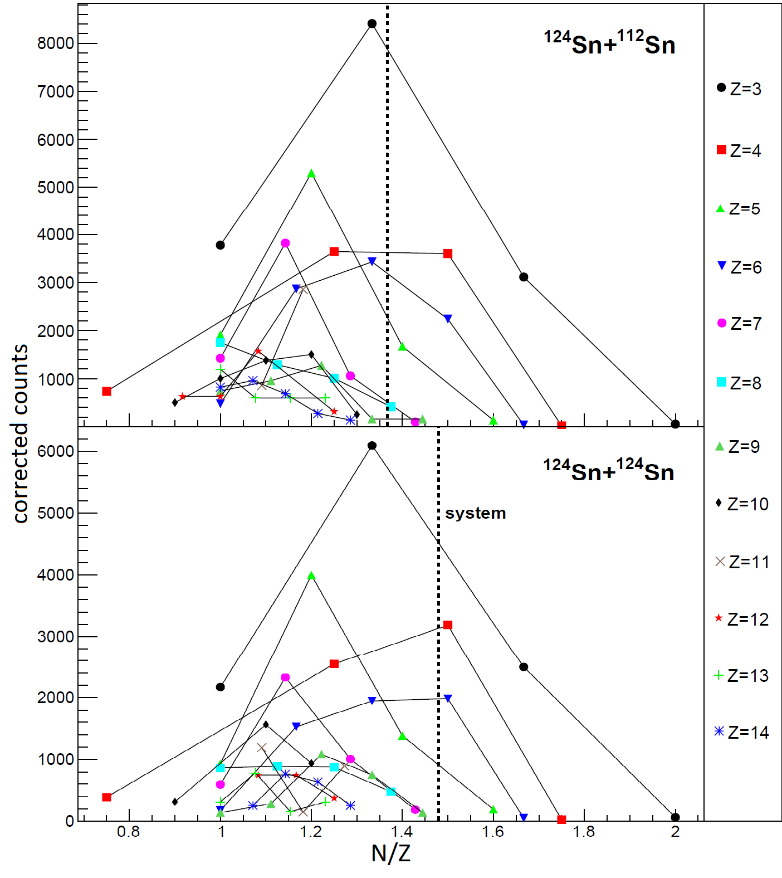
Isotopic Yield Evaluation
Each isotope count of a particular Z is multiplied by a correction factor to take into account:
missing detectors
imperfect isotopic identification
energy thresholds

Slide 11
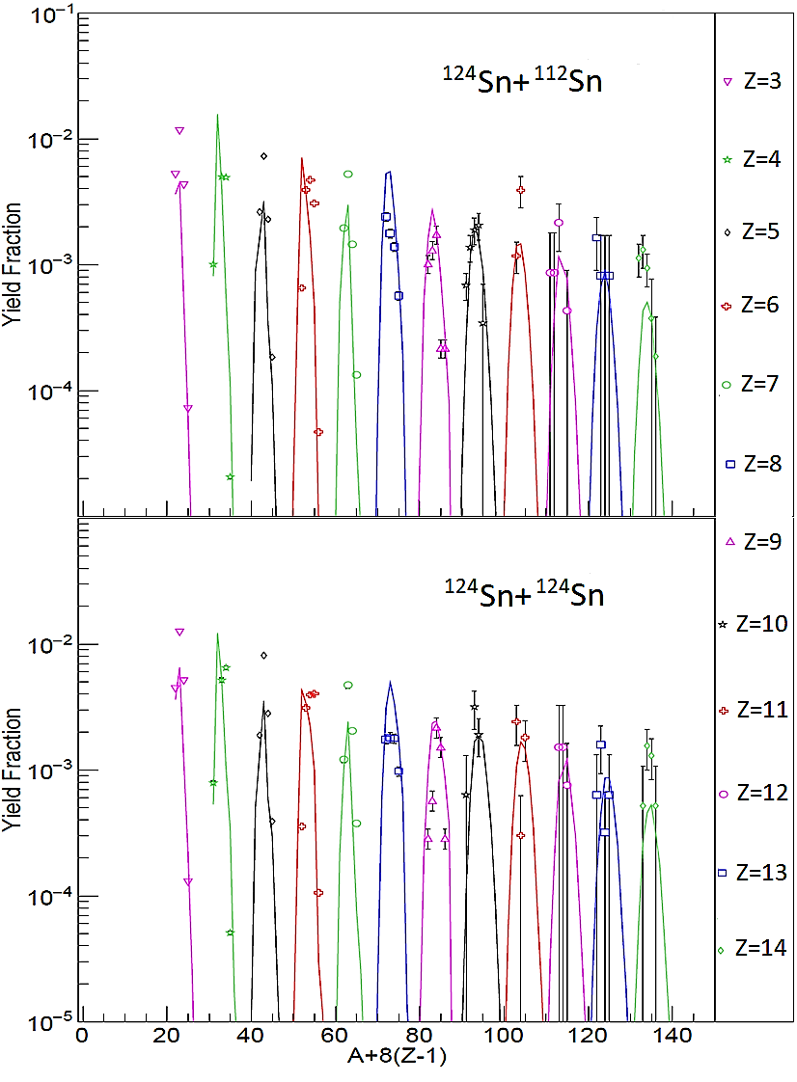
Fit free parameter values for Z<15 minimization:
T = 2.76 MeV
Time = 6000 fm/c
ρ = 18.67x10⁻⁴ fm⁻³
Z/A=0.47
A_{c} = 15.8
M² (for Z<15)=1.11
NSEC Fitting (colored lines)
Li
Be
B
C
N
O
Na
F
Ne
Mg
Al
Si
T = 2.72 MeV
Time = 7300 fm/c
ρ = 16.38x10⁻⁴ fm⁻³
Z/A=0.44
A_{c} = 16.1
M² (for Z<15)=1.07
Li
Be
B
C
N
O
Ne
Mg
F
Na
Al
Si

Slide 12
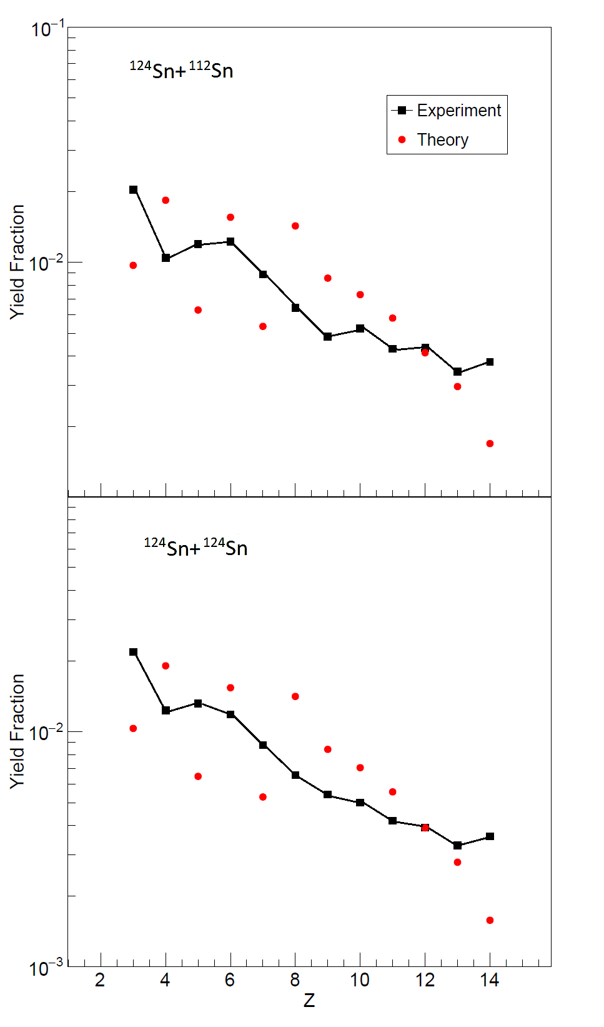
NSEC Fitting (Z only)
Fit free parameter values for Z only minimization:
T = 2.33 MeV
Time = 9 600 fm/c
ρ = 14.2x10⁻⁴ fm⁻³
Z/A=0.42
A_{c} = 16.0
M² =0.29
T = 2.35 MeV
Time = 9 600 fm/c
ρ = 14.2x10⁻⁴ fm⁻³
Z/A=0.42
A_{c} = 16.0
M² =0.28

Slide 13
NSEC Fit Parameters
System | ¹²⁴Sn+¹¹²Sn | ¹²⁴Sn+¹²⁴Sn | ²⁴¹Pu
Selection | Isotope | Isotope | Isotope | A
Temperature (MeV) | 2.76 | 2.72 | 1.4 | 1.4
Density (10-4 fm-3) | 18.67 | 16.38 | 4 | 4
Time (fm/c) | 6000 | 7300 | 6400 | 6400
Ac | 15.8 | 16.1 | 5.4 | 5.4
Proton ratio (system) | 0.47 (0.42) | 0.44 (0.40) | 0.34 (0.39) | 0.34 (0.39)
Fit Metric | 1.11 | 1.07 | 1.18 | 0.561
Using Albergo light
particle yield ratio
temperature measurement*:
*S. Albergo et al.,
Il Nuovo Cimento, vol. 89 A, N. 1 (1985).

Slide 14
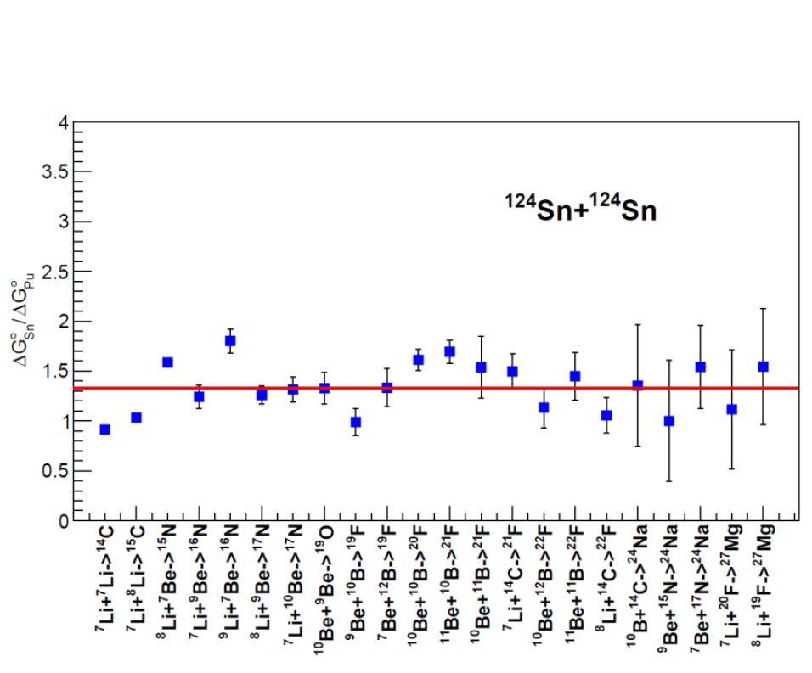
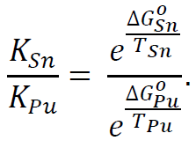
Equilibrium constant
We calculate several K using the Sn+Sn system (K_{Sn}) and ²⁴¹Pu fission (K_{Pu}).
We know K_{Sn}, K_{Pu}, T_{Sn}, T_{Pu}, and assuming ground states for Pu (first approximation) we know ΔGº_{Pu}, so we can extract ΔGº_{Sn}.
ΔGº_{Sn} is 33% higher than ΔGº_{Pu} (in average).
Work still in progress

Slide 15
Summary
We are able to apply the NSEC model to heavy-ion collisions with reasonable results.
Most of the fit parameters are in a realistic range.
Equilibrium constant ratio calculation results are promising.
Collaborators to this work
J. Gauthier, M. Barbui, X. Cao, K. Hagel, R. Wada, S. Wuenschel and J. B. Natowitz.
Special thanks to Alan McIntosh and Sherry Yennello for useful discussions and advices.

Slide 16
Thank you for being listening!

Slide 17
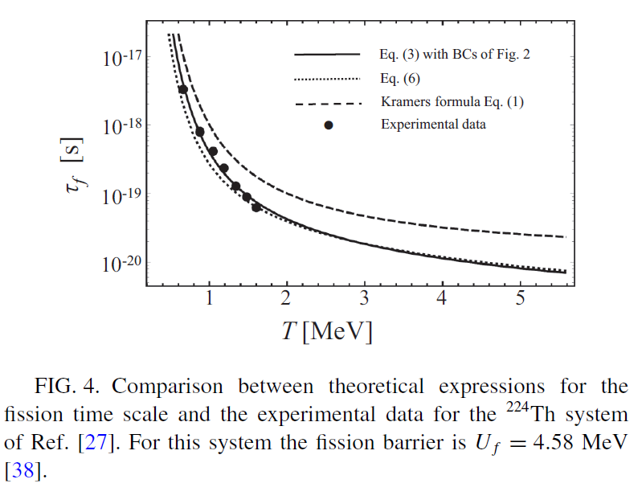
C. Eccles et al., Physical Review C 96, 054611 (2017).

