Slide 1
Searching for states analogous to the ¹²C Hoyle state in heavier nuclei using the thick target inverse kinematics technique.
Marina Barbui
5/17/2018, Galveston, TX

Slide 2
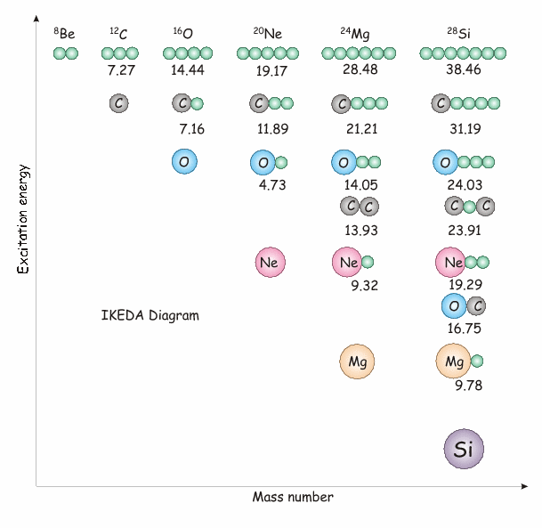
Alpha clustering in nuclei
Estimated limit N = 10α for self-conjugate nuclei(Yamada PRC 69, 024309)
Ikeda diagram (K. Ikeda, N. Takigawa, and H. Horiuchi, Prog. Theor, Phys. Suppl. Extra Number, 464, 1968.)
Many theoretical works have brought to the picture of alpha cluster nuclei described as a diluted gas of alphas in the lowest S state. (PRL 87, 192501; PRC 75, 037303).
Possible existence of alpha condensates in nuclear matter.
Experimentally only few not conclusive works are available for ¹⁶O or heavier
Look for states analogous to the ¹²C Hoyle state using the thick target inverse kinematics technique

Slide 3
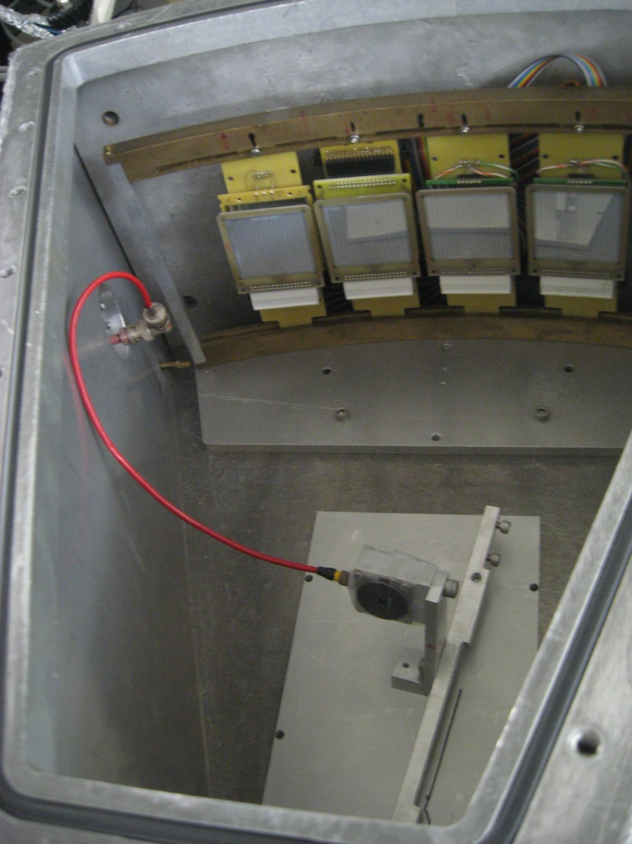
The thick target inverse kinematics technique
Pressurized chamber
⁴He gas, pressure sufficient to stop the beam before the detectors
Allows covering a large range of incident energies in the same experiment.
In the inverse kinematics, the reaction products are focused at forward angles.
Allows measuring reaction products emitted at 0º.
This Method has been used several times to study resonant elastic scattering or transfer reactions and is used here for the first time to detect multiple alpha emission.
Limit: The position of the interaction point inside the gas has to be reconstructed with some assumptions
4 ΔE-E telescopes
Monitor detector
²⁰Ne Beam
9.7 and 12 AMeV
Havar window

Slide 4
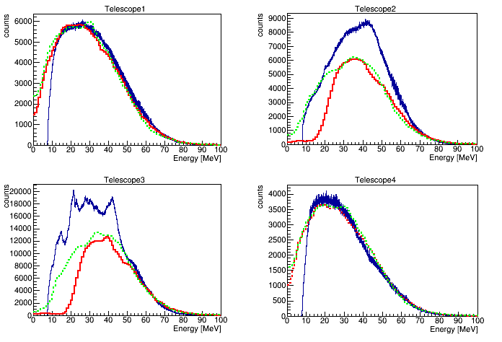
Events with alpha multiplicity 1
At 12AMeV the statistical evaporation plays an important role. This contribution is estimated using the PACE4 code and the HIPSE, both run with beam energy steps of 0.5 MeV/nucleon

Slide 5
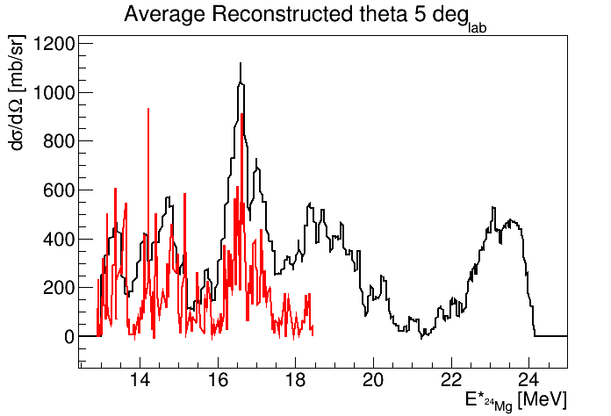
Events with alpha multiplicity 1
The resonant elastic scattering is our reference reaction. We can compare the result with existing cross sections and have a double check for the beam intensity obtained from the monitor.
This data
PRC 43(1991)2523
Comparison with the excitation function measured in 10-15 keV energy steps in normal kinematics at 168º in the center of mass By R. Abegg and C.A. Davis

Slide 6
Events with alpha multiplicity 2
12AMeV
Contribution from statistical evaporation estimated using PACE4

Slide 7
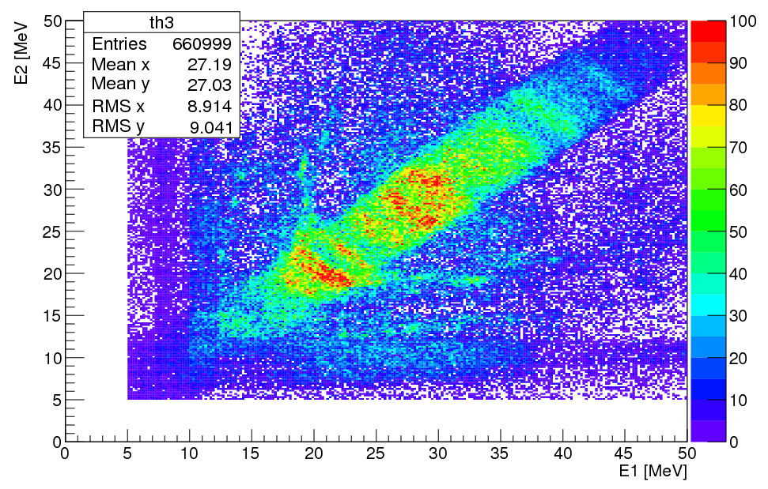
Events with alpha multiplicity 2
9.7 AMeV
After subtracting the contribution from statistical evaporation

Slide 8
Events with alpha multiplicity 2
α
²⁰Ne @ 12 and 9.7 AMeV +⁴He
2 alphas in the same event are correlated in time ΔT<30 ns
²⁰Ne
⁸Be
α
α
¹⁶O
Reconstruction of the interaction point with a recursive calculation based on conservation of energy and momentum and the assumptions:
The 2 alphas come from a ⁸Be
The ¹⁶O is in the ground state
Ek_α_lab -> Ek(⁸Be)
E*(⁸Be) = E_{cm}_α₁+E_{cm}_α₂+ Qgg
Since the 2 alphas have similar and quite large energy in the laboratory and travel similar flightpaths the energy loss correction almost cancels out when we calculate ⁸Be excitation energy specially at energies close to the threshold.

Slide 9
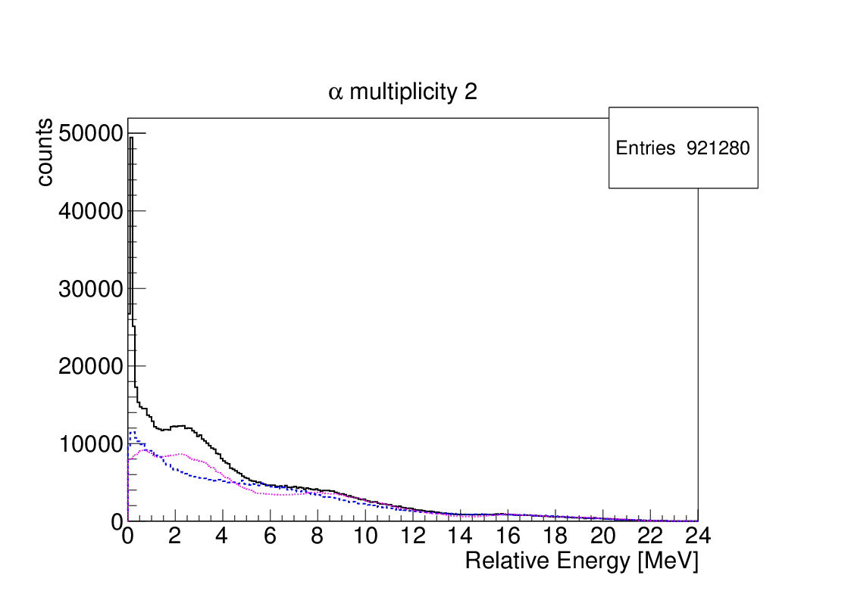
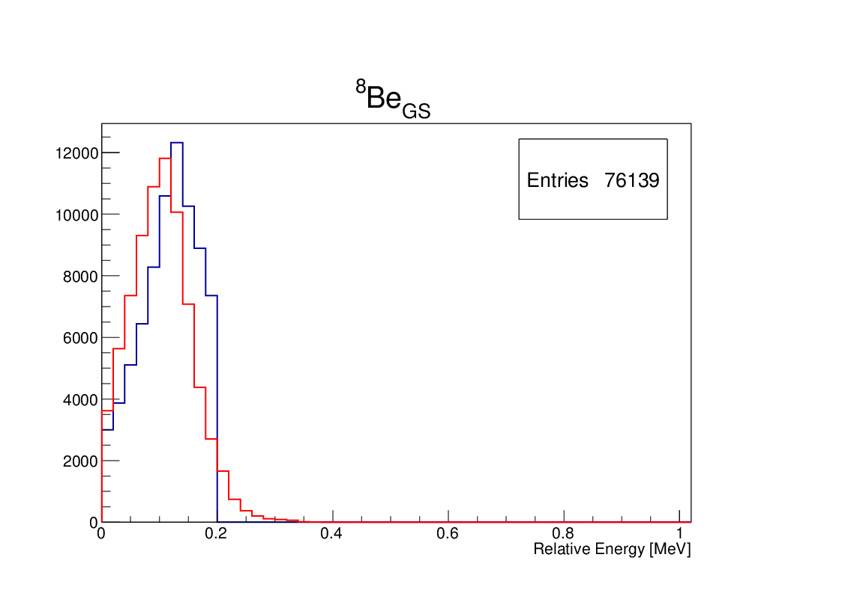
Events with alpha multiplicity 2
12 AMeV beam
PACE4
Mixed events
Fixed interaction point at 27 cm from the window
Background due to statistical evaporation estimated with PACE4
The background is also estimated by mixing alpha particles from different multiplicity two events

Slide 10
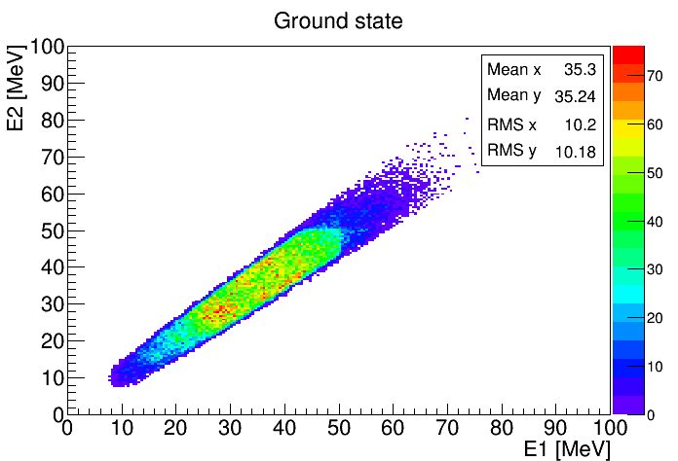
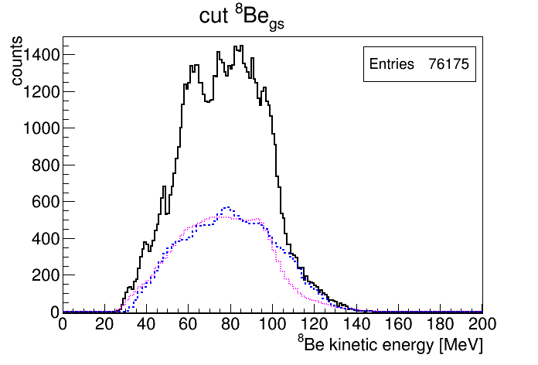
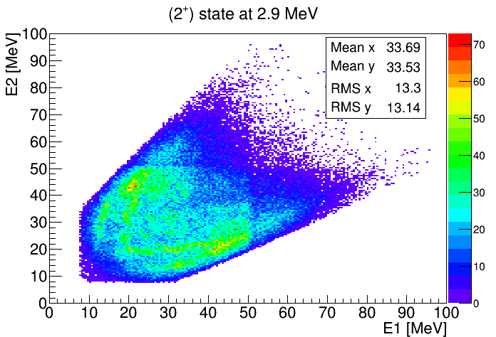
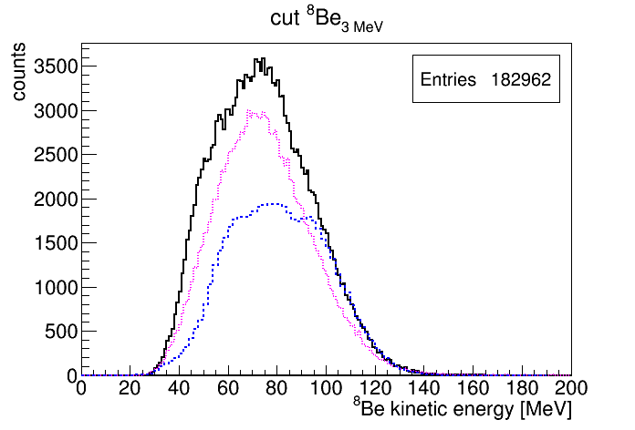
Events with alpha multiplicity 2
Data
PACE4
Mixed
events
Data
PACE4
Mixed
events

Slide 11
Events with alpha multiplicity 3
α
²⁰Ne @ 12 AMeV +⁴He
3 alphas in the same event are correlated in time ΔT<30 ns
²⁰Ne
¹²C₁
α
α
α
¹²C₂
Reconstruction of the interaction point with a recursive calculation based on conservation of energy and momentum and the assumptions:
The 3 alphas come from a ¹²C with enough excitation energy to break into 3 alpha particles
The other ¹²C is in the ground state
Ek_α_lab -> Ek(¹²C₁)
E*(¹²C₁) = E_{cm}_α₁+E_{cm}_α₂+E_{cm}_α₃+ Qgg (7.26MeV)
Since the 3 alphas have similar and quite large energy in the laboratory and travel similar flightpaths the energy loss correction almost cancels out when we calculate ¹²C excitation energy specially at energies close to the threshold.

Slide 12
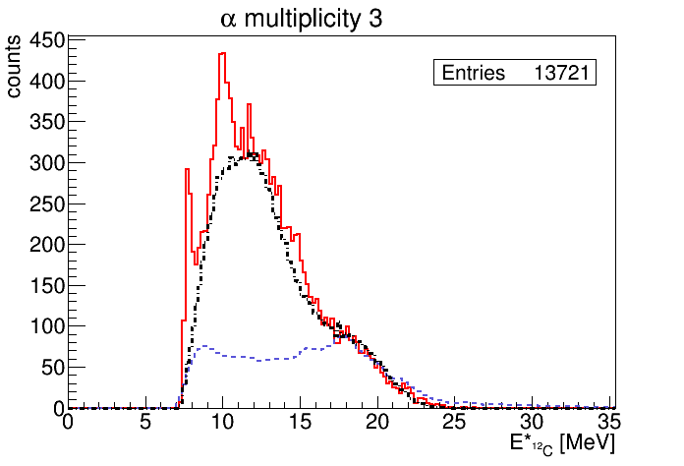
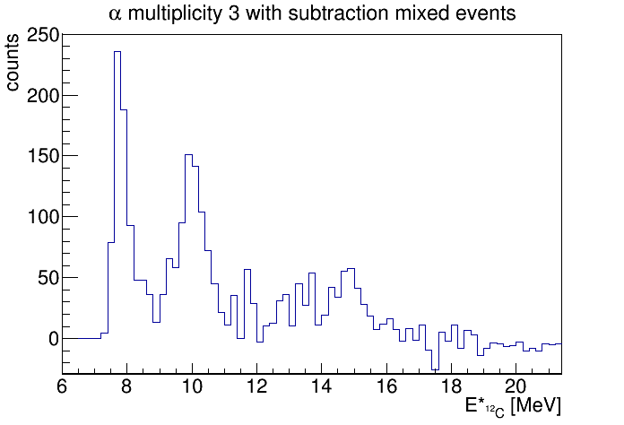
Events with alpha multiplicity 3
Data
PACE4
Mixed
events
Hoyle
Relative energy of the three couples of alpha particles -> Tells us if the decay is proceeding through the ⁸Be ground state.
Dalitz Plot -> Information about the energy and momentum of the emitted alpha particles.
(3-) at 9.64 MeV

Slide 13
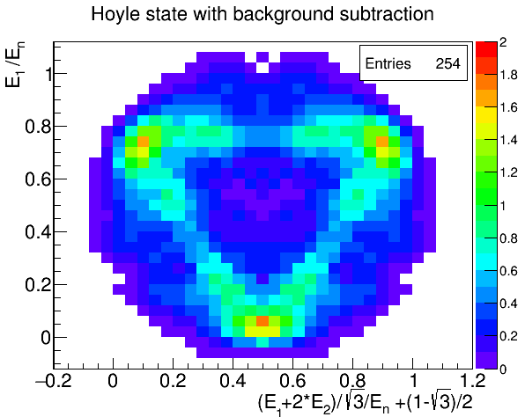
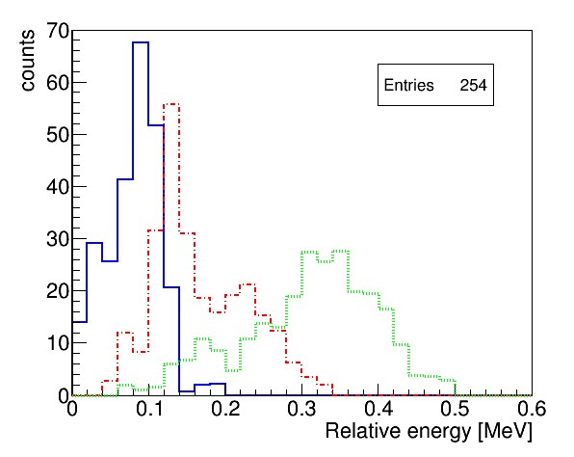
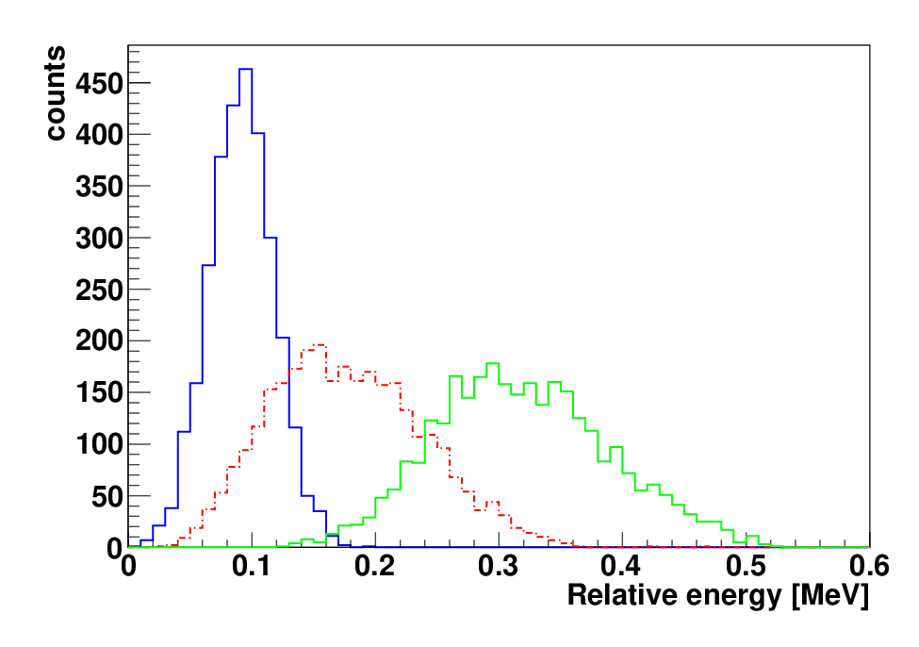
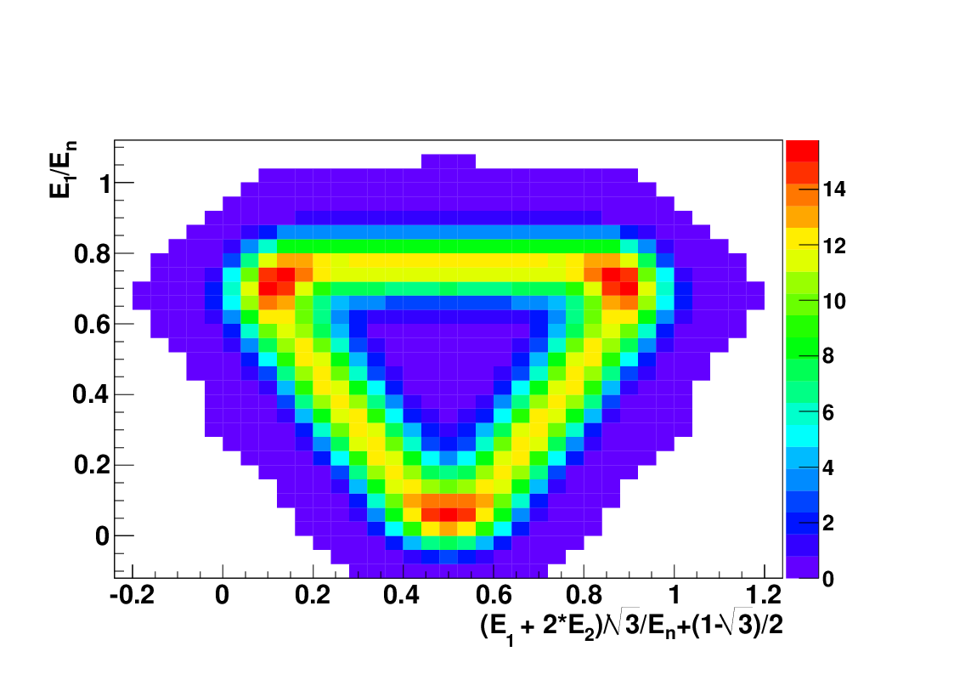
7.65 MeV (0+) Hoyle State decays through ⁸Be_{gs}
Experiment
In agreement with Monte Carlo simulation of the Hoyle state decaying through the ⁸Be ground state
Simulation

Slide 14
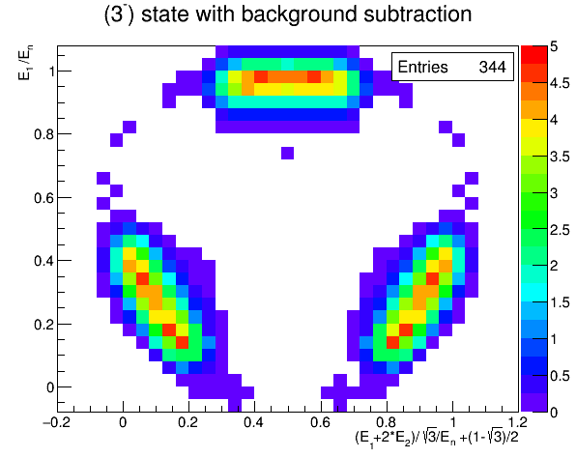
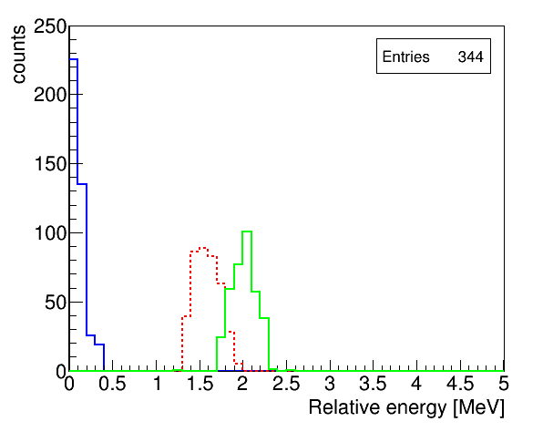
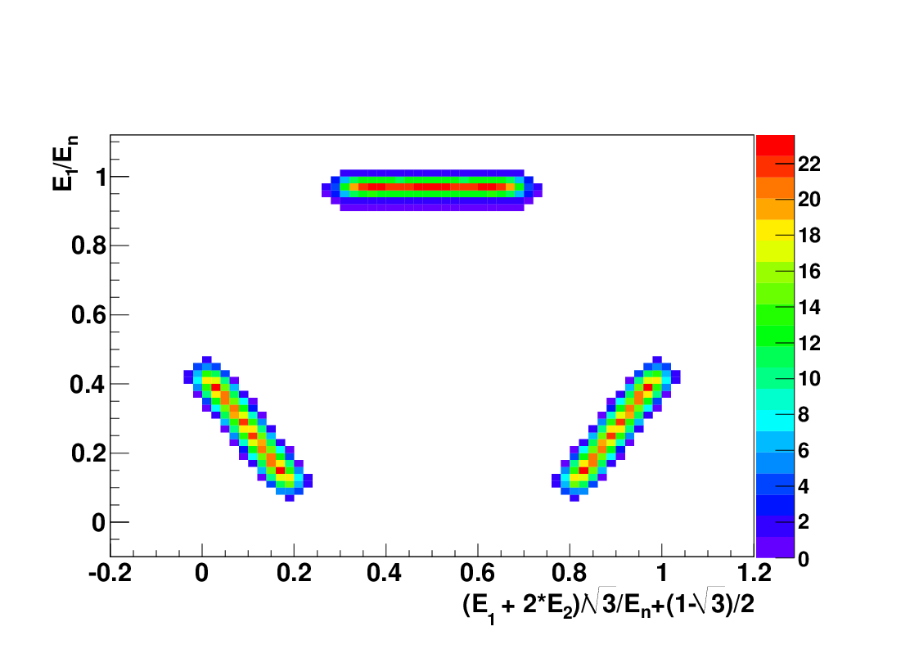
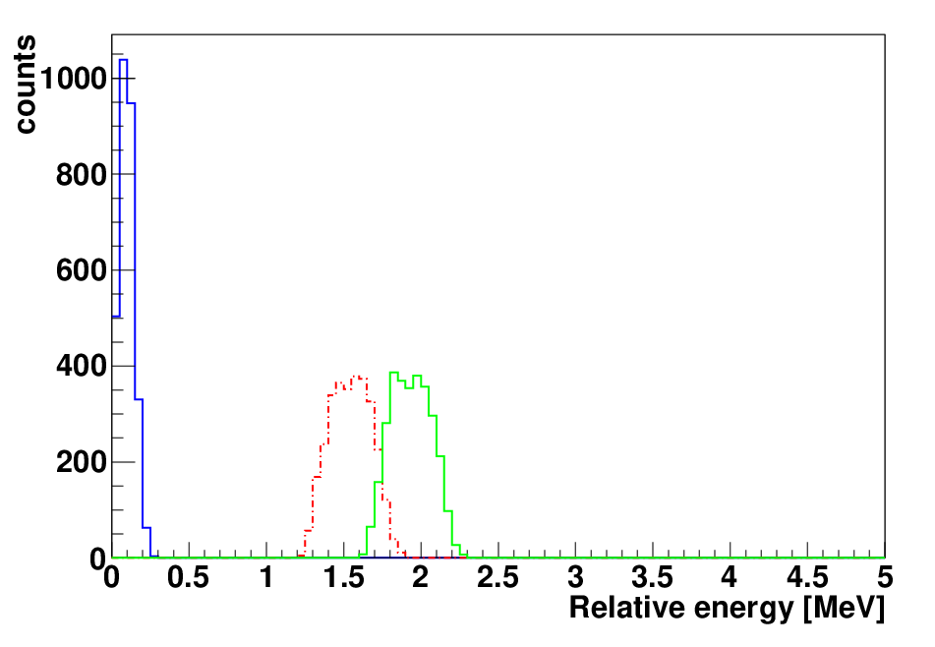
9.64 MeV (3-) decays through ⁸Be_{gs}
Experiment
In agreement with Monte Carlo simulation of a 3- state decaying through the ⁸Be ground state
Simulation

Slide 15
Events with alpha multiplicity 4
α
²⁰Ne @ 12 and 9.7 AMeV +⁴He
4 alphas in the same event are correlated in time ΔT<30 ns
²⁰Ne
¹⁶O
α
α
α
α
⁸Be
α
α
Reconstruction of the interaction point with a recursive calculation based on conservation of energy and momentum and the assumptions:
The 4 alphas come from a ¹⁶O with enough excitation energy to break into 4 alphas
The ⁸Be is in the ground state
Ek_α_lab -> Ek(¹⁶O)
E*(¹⁶O) = E_{cm}_α₁+E_{cm}_α₂+E_{cm}_α₃+E_{cm}_α₄+ Qgg (14.4 MeV)
Only α-particles with energy larger than 13 MeV are selected in order to cut those from the ⁸Be emitted in opposite direction.

Slide 16
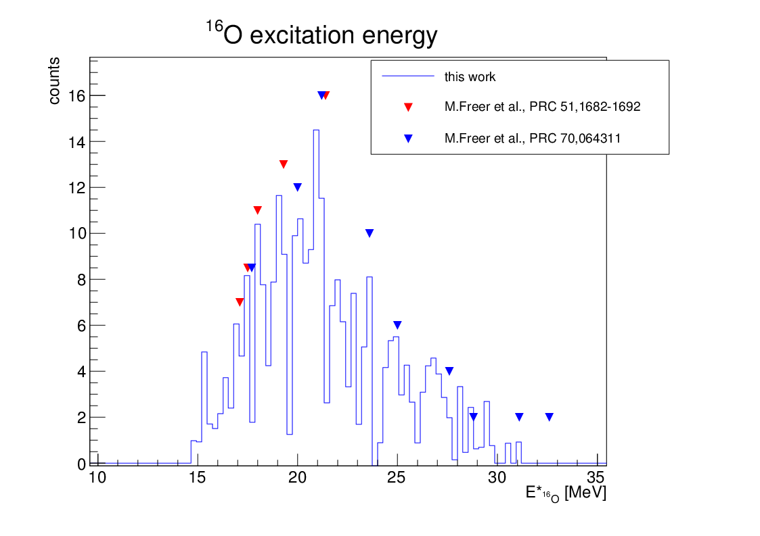
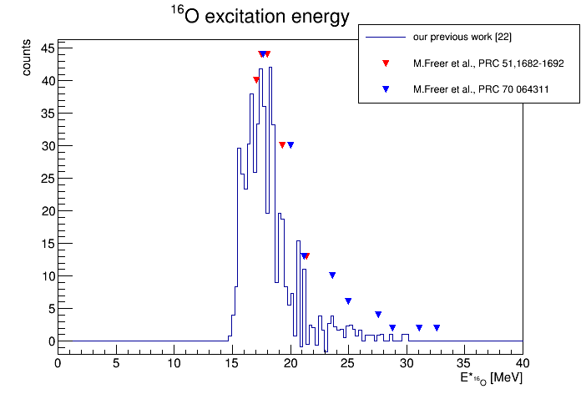
Events with alpha multiplicity 4
Interesting structure at 15.2 MeV
8 events
Interesting structure at 15.2 MeV
83 events
²⁰Ne 12 AMeV
²⁰Ne
9.7 AMeV
Energy | Γ(Be)/ Γ(Hoyle) This work 12 AMeV | Γ(Be)/ Γ(Hoyle) This work 9.7 AMeV | Γ(Be)/ Γ(Hoyle) Freer et al. PRC 51, 1662
15.2±0.2 | 1±0.7 | 0.96 ± 0.3
17.1 | 0.6±0.3 | 0.7 ± 0.3 | 0.65 ± 0.16
17.5 |  | 0.6 ± 0.3 | 0.72 ± 0.18
19.7 | 0.43±0.2 | 0.6 ± 0.5 | 0.47 ± 0.15
21.4 | 5.3±2.8 | 3 ± 1 | >3 ± 1.1

Slide 17
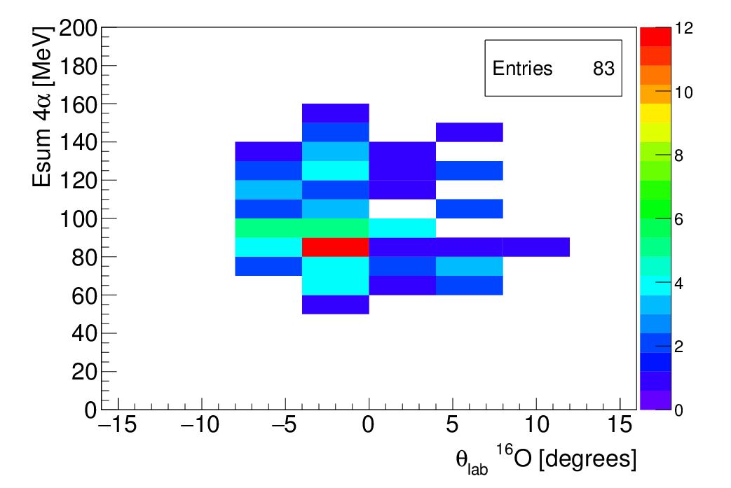
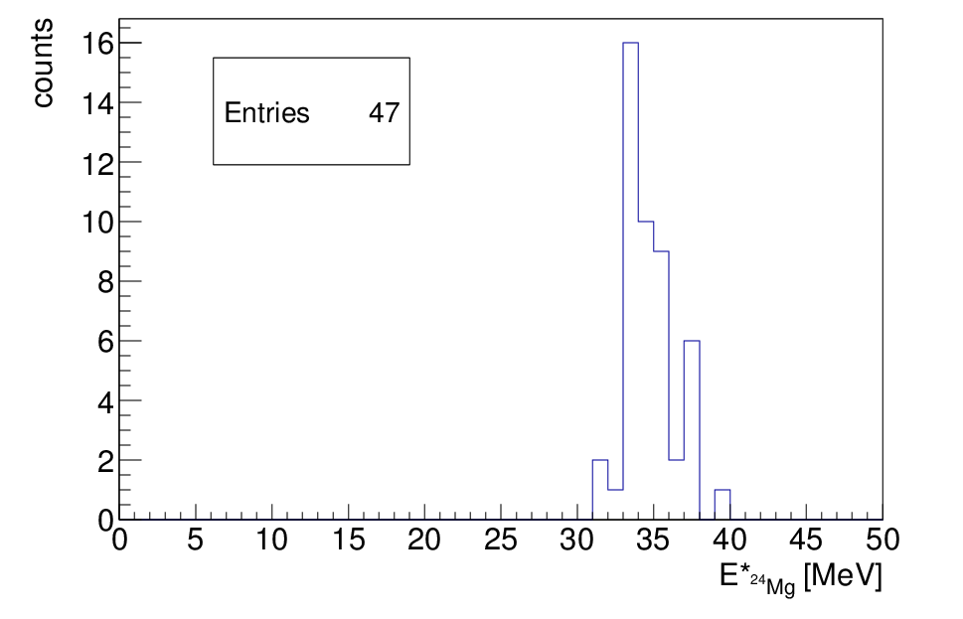
²⁰Ne 9.7 AMeV
Further analysis for the peak at 15.2 MeV
34 MeV
Yamada et al. predicted an excited state in ²⁴Mg analogous to the Hoyle state at 33.42 MeV, 4.94 MeV above the 6 alpha particles threshold.

Slide 18
Conclusions
Using the suggested technique it is possible to identify states near the alpha decay threshold in ⁸Be and ¹²C.
4α events -> show a structure at 15.2 MeV possible candidate for a state analogous to the Hoyle state in ¹⁶O (candidate 0+ state predicted at Ex 15.1 MeV). The few events in this peak decay equally into
- alpha + ¹²C_{(Hoyle)}
- 2 ⁸Be_{(gs)}

Slide 19
Thank you for your attention!
M. Barbui, K. Hagel, J. Gauthier, R.Wada, S. Wuenschel, X-G. Cao V.Z Goldberg and J.B. Natowitz (Cyclotron Institute, Texas A&M University, College Station, TX, USA )
R. T. deSouza, S. Hudan (Indiana University, Bloomington, IN, USA)
D. Fang (Shanghai Institute of Applied Physics (SINAP), Chinese Academy of Sciences, Shanghai, China)

