Slide 1
Evidence of enhanced 3α radius in ¹²C
probed by nuclear reactions
M. Ito¹, M. Nakao¹, Y. Funaki², T. Yamada²
¹Department of Pure and Applied Physics, Kansai University
²College of Science and Engineering, Kanto Gakuin University
1. Background: Probe of 3α size through ¹²C⇒ 3α inelastic scattering
Present status and problem
2. Our viewpoint and analysis: Comparison of common spin parity states
3. Results(1): α + ¹²C inelastic scattering: 2₁⁺ vs 2₂⁺ in ¹²C
4. Results(2): ¹³C(K⁻,π⁻)¹³_{Λ}C reaction: 1/2₁⁺ vs 1/2₂⁺ in ¹³ _{Λ}C
5. Summary and future studies: Application to ¹⁶O = 4α

Slide 2
Excited 0₂⁺
Background
There are several studies that try to get the signature of the
enhanced 3α radius in the inelastic scattering of ¹²C_{g.s.}→¹²C(0₂⁺)
Radius
3.47[fm]
A. Diffraction model
Radius
2.40[fm]
p + ¹²C: K. Iida et al., MPLA27 (2012)
light-ion + ¹²C: A. N. Danilov et al., PRC80 (2009)
Ground 0₁⁺
Enhanced diffraction radii are derived in the transition of ¹²C_{g.s.}→¹²C(0₂⁺)
B. Microscopic coupled-channel calculations
α + ¹²C inelastic scattering: S. Ohkubo et al., PRC70 (2004)
Evolution of Airy structures are confirmed in the ¹²C_{g.s.}→ ¹²C(0₂⁺) scattering
Criticism by M. Takashina et al., PRC78 (2008), PRC74 (2006)
⇒ Inelastic scattering to Hoyle state does NOT reflect the size of the 3α radius directly
Angular distribution is mainly determined by the size of the coupling potential

Slide 3
Problem to get a sign of enhanced 3α radius in ¹²C inelastic scattering
1. Comparison of 0₁⁺ with 0₂⁺
0₂⁺ ⇒ Inelastic scattering
0₁⁺ ⇒ Elastic scattering
2₂⁺
⇒Invalid comparison !
3₁⁻
10.3
9.64
0₂⁺
2. Comparison of 2₁⁺, 3₁⁻ with 0₂⁺
7.65
2₁⁺
There are finite-spin effects in
the 2₁⁺ and 3₁⁻ channels
4.44
0₁⁺
2₂⁺ EXP.
⇒Unfair comparison !
0.00
M. Itoh, PRC84 (11)
M. Freer, PRC80 (09)
Our viewpoint
Theory, Y. Funaki, EPJ24,321 (05)
We consider comparisons of 2₁⁺ with 2₂⁺ channels (Fair comparison)
The difference of the 2₁⁺ and 2₂⁺ channels is just a size of their matter radius

Slide 4



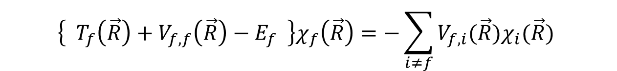
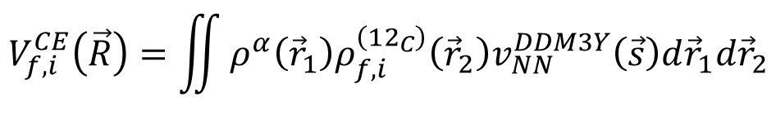


Framework of α + ¹²C inelastic scattering
Coupled-channel equation
α particle
Coupling potential
$$V_{f,i }\left(\vec{R}\right)= V_{f,i}^{CE}\left(\vec{R}\right)−iW\left(R\right)δ_{f,i}$$
phenomenological WS potential
real potential
$$V_{f,i}^{CE}\left(\vec{R}\right)=\iint{ρ^{α}\left({\vec{r}}_{1}\right)ρ_{f,i}^{\left({12}_{C}\right)}\left({\vec{r}}_{2}\right)v_{NN}^{DDM3Y}\left(\vec{s}\right)d{\vec{r}}_{1}d{\vec{r}}_{2}}$$
α+¹²C：Folding pot.
$$v_{NN}^{DDM3Y}\left(\vec{s}\right)$$
: DDM3Y effective NN interaction
THSR: Y. Funaki et al., PPNP 82, 78(2015)
: ¹²C density ⇒ Hybrid of THSR + 3α RGM Channels: 0₁⁺,0₂⁺,0₃⁺,2₁⁺,2₂⁺,3₁⁻
THSR Density
RGM Density (M. Kamimura)
All the transitions for 0⁺ ⇔ 2⁺
Transition to 3⁻ state
⇒ We can expect promient improvements in the transitions to 0₃⁺ and 0₄⁺

Slide 5
Results of the differential cross section in α + ¹²C
Bec-ver2
E_{lab} = 386 MeV
●：experimental data (M. Itoh, PRC84) Blue curves: Coupled-channels
elastic
Ex=10 MeV
0₂⁺
7°～12°region
Is improved
dσ/dΩ ( mb )
dσ/dΩ ( mb )
2₂⁺
2₁⁺
3₁⁻
0₃⁺
dσ/dΩ ( mb )
θ_{c.m.} ( degree )
θ_{c.m.} ( degree )
θ_{c.m.} ( degree )

Slide 6

Comparison of α + ¹²C(0₁⁺) ⇒α + ¹²C(2_{1,2}⁺) ; E_{α} = 386 MeV
$$L=kR$$
0₁⁺ ⇒ 2₁⁺
dσ/dΩ ( a.u. )
θL=Const
Scattering Probability ( no dim. )
0₁⁺ ⇒ 2₂⁺
0₁⁺ ⇒ 2₁⁺
0₁⁺ ⇒ 2₂⁺
Scattering angle ( degree )
Incident orbital spin L
Distribution of 2₂⁺ is Shrunk
Distribution of 2₂⁺ is Extended
Extension of production area of 2₂⁺ is due to the extended nuclear radius of 2₂⁺
L = kR ⇒ ΔR = R(2₂⁺) – R(2₁⁺) ～ 0.6 fm (E_{α} = 386 MeV), ΔR～1 fm (E_{α} ≦ 240 MeV)

Slide 7
Relation of scattering radius and 3α matter radius
In a naïve consideration, we can image the following relation,
R_{matter}(2₂⁺) ≧ R_{matter}(2₁⁺) + ΔRsc(2⁺)
≒
＝
R_{matter}(0₁⁺)
～ 1 fm
Results obtained
at E_{α} ≦ 240 MeV
= 2.4 fm
We can speculate the lower limit of the matter radius of 2₂⁺
R_{matter}(2₂⁺) ≧ 3.4 fm
Comparison of the common J^{π} states(2₁⁺ and 2₂⁺) is a basic analysis

Slide 8

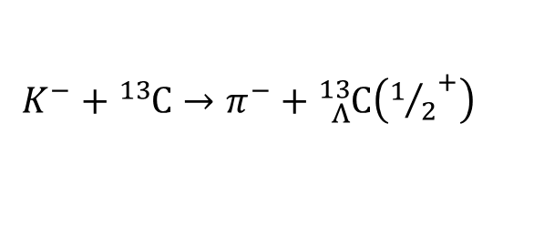




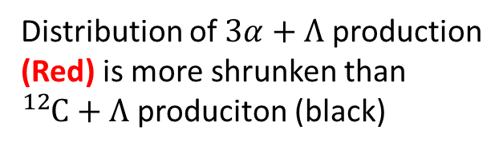
Extension : DWIA calculation of ¹³C(K-, π-)¹³_{Λ}C
$${}_{Λ}^{13}C$$
$K^{−}+{}_{ }^{13}C→π^{−}+{}_{Λ}^{13}C\left({1/2}^{+}\right)$
Λ
Λ
1/2₁⁺
1/2₂⁺
Incident $K^{−}$:
$$P_{K^{−}}=800[MeV/c]$$
Emitted $π^{−}$:
$$P_{π^{−}}=690[MeV/c]$$
Distribution of $3α+Λ$ production (Red) is more shrunken than ${}_{ }^{12}C+Λ$ produciton (black)
¹³C ⇒ ¹²C + Λ (1/2₁⁺)
¹³C ⇒ 3α + Λ (1/2₂⁺)
Evidence of enhanced radius of 1/2₂⁺
Application of Fraunhoffer Formula (K. iida et al., Mod. Phys. Lett. A27)
Diffraction Radius：a(1/2₁⁺) = 2.6 fm, a(1/2₂⁺)=3.1 fm ⇒ Δa = 0.5 fm
Δa is comparable
to ΔR !
Difference in density radius：ΔR = 0.7 fm

Slide 9
Summary
Makoto Ito, Phys. Rev. C97, 044608 (2018).
We have performed analyses of
① α + ¹²C inelastic scattering ② ¹³C + K⁻ ⇒ π⁻ + ¹³_{Λ}C
Enhancement of nuclear radius is estimated from differential X sections
Results
Differential cross sections of cluster channel show shrunken structures
⇒ Evidence of extended radius in ¹²C(2₂⁺) and ¹³_{Λ}C(1/2₂⁺) with 3α structure
Nuclear radius of 2₂⁺ is expected to be enhanced by 0.6～1fm
⇒ Inconsistent to abinitio cal. R(2₂⁺)～R(0₁⁺) (E. Epelbaum et al., PRL109 (2012))
Conclusion and future subject
Comparison of the common spin parity states in reactions is essential (This procedure is independent of a type of reactions)
Application to ¹⁶O = 4α state; α + ¹⁶O → α + ¹⁶O(4α)

Slide 11
Results of the differential cross section in α + ¹²C
C.F.,S. Ohkubo et al., PRC70 (2004)
( incident energy E_{lab} = 240 MeV )
●：experimental data blue line：DDM3Y+multi channel
2₁⁺
3₁⁻
dσ/dΩ ( mb )
Elastic 0₁⁺
θ_{c.m.} ( degree )
θ_{c.m.} ( degree )
θ_{c.m.} ( degree )
0₂⁺
0₃⁺
PRMs of Imaginary pot.
for 0₂⁺, 0₃⁺, 2₂⁺ are
set to be common
dσ/dΩ ( mb )
We can predict the cross
section of 2₂⁺ channel
θ_{c.m.} ( degree )
θ_{c.m.} ( degree )

Slide 12
Differential and Partial cross sections
α + ¹²C(0₁⁺) ⇒α + ¹²C(2⁺)
0₁⁺ ⇒ 2₂⁺
0₁⁺ ⇒ 2₁⁺
0₁⁺ ⇒ 2₁⁺
Probability ( no dim. )
0₁⁺ ⇒ 2₂⁺
Probability ( no dim. )
Θ c.m. ( degree )
L (Incident Orbital Spin)
Distribution of 2₂⁺ is shrunk
Distribution of 2₂⁺ is Extended
Uncertainty Relation: ( Fraunhoffer’s Diffraction )

Slide 13
Systematics of the coupling potential: 0₁⁺ ⇒ 2₁⁺, 2₂⁺
α + ¹²C
¹⁶O + ¹²C
(X 2.2)
(X 2.0)
0₁⁺ ⇒ 2₂⁺
0₁⁺ ⇒ 2₂⁺
V(R) ( MeV )
0₁⁺ ⇒ 2₁⁺
0₁⁺ ⇒ 2₁⁺
R ( fm )
R ( fm )

Slide 14
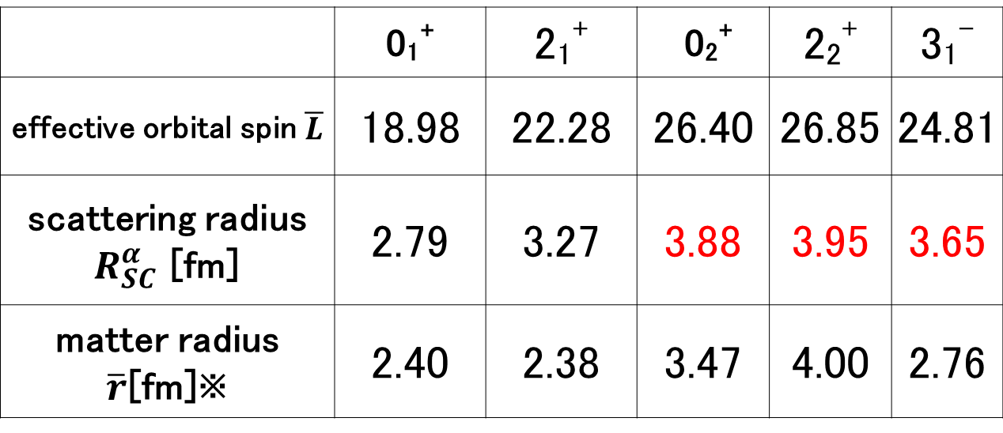
Scattering radius in α + ¹²C ( E_{lab} = 386 MeV )
: scattering radius
Effective
orbital spin
Incident
orbital spin
Partial cross
section
Ref.: M. Tomita et al., PRC89 (2014)
 | 0₁⁺ | 2₁⁺ | 0₂⁺ | 2₂⁺ | 3₁⁻
 | 22.87 | 29.67 | 33.83 | 33.69 | 31.76
 | 3.53 | 4.58 | 5.21 | 5.20 | 4.90
 | 2.40 | 2.38 | 3.47 | 4.00 | 2.76
※M. Kamimura, NPA351 (1981).
R_{SC}( 2₂⁺ ) is more enhanced by about 0.62 fm than R_{SC}( 2₁⁺ ) ⇒ 3α structure in 2₂⁺

Slide 15
Energy systematics of enhancement of R_{sc}(2⁺)
Difference of
matter radii
(Theory of structure)
ΔR_{m} = R_{m}(2₂⁺) － R_{m}(2₁⁺)
( fm )
ΔR_{SC} = R_{SC}(2₂⁺) － R_{SC}(2₁⁺) ～ 1 fm
R_{m}(2₂⁺) ≧3.4 fm
Difference of
scattering radii
ΔR_{CP} = V_{PEAK}(2₂⁺) － V_{PEAK}(2₁⁺)
Size difference of
coupling potential;
V_{PEAK}(0₁⁺→2⁺)

Slide 16
Transition density of ¹⁰Be (0₁⁺ ⇒ 2⁺)
We can clearly confirm in the shrinkage in F.T. transition density to 2₃⁺
2₃⁺
Cluster
7.52 MeV
Shrinkage and forward shift
α-th.
7.41 MeV
0₁⁺ ⇒ 2₁⁺
2₂⁺
5.96 MeV
Compact + Cluster
Fourier Tr. of transition density ( a. u. )
2₁⁺
3.37 MeV
0₁⁺ ⇒ 2₃⁺
Compact
0₁⁺ ⇒ 2₂⁺
0₁⁺
q ( fm⁻¹ )
¹⁰Be

Slide 17
Transition densities and coupling potential: 0₁⁺ ⇒ 2₁⁺, 2₂⁺
¹²C transition density
α + ¹²C Folding potential
(X 2.2)
0₁⁺ ⇒ 2₁⁺
0₁⁺ ⇒ 2₂⁺
r²ρ_{tr}(r) ( fm⁻¹ )
V(R) ( MeV )
0₁⁺ ⇒ 2₁⁺
0₁⁺ ⇒ 2₂⁺
r ( fm )
R ( fm )
The coupling potential to 2₂⁺ is extended by about 0.5 fm in comparison to 2₁⁺
The extension of the coupling pot. of 2₂⁺ is due to the developed 3α structure

Slide 18
Comparison of experiment and Theory ( Elab = 386 MeV )
prm4
Present calculations
Exp. MDA by M. Itoh et al., PRC84 (2011)
ΔRsc = 0.55 fm
2₁⁺
2₁⁺
dσ/dΩ ( mb )
2₂⁺
2₂⁺
θ_{c.m.} ( degree )
θ_{c.m.} ( degree )
In the 2₂⁺ distribution, shrinkage and rapid fall down can be clearly observed
ΔR_{SC} = Rsc( 2₂⁺ ) －R_{SC}( 2₁⁺ ) = 0.55 fm ( ΔR_{sc} ～ 1 fm, Elab≦240 MeV )

Slide 20

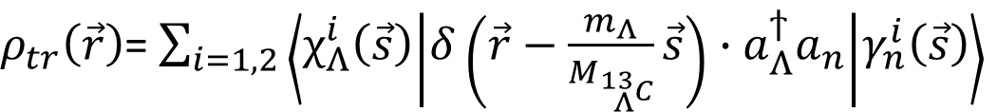

Framework: DWIA of ¹³C(K－,π－)¹³_{Λ}C
Distorted waves：Eikonal approx. (T. Yamada et al., PRC38 (1988))
N or Λ
$$s_{}$$
$ρ_{tr}\left(\vec{r}\right)$= $\sum_{i=1,2}{\left\langle χ_{Λ}^{i}\left(\vec{s}\right) | δ\left(\vec{r}−\frac{m_{Λ}}{M_{{}_{Λ}^{13}C}}\vec{s}\right)∙a_{Λ}^{ϯ}a_{n} | γ_{n}^{i}\left(\vec{s}\right)\right\rangle }$
$${}_{ }^{12}C$$
Coupled-channels calc. of
( ¹²C(0₁⁺) + Λ ) + ( ¹²C(0₂⁺) + Λ )
T. Yamada et al., PTP suppl. 81
3α + N OCM calculation
T. Yamada et al., PRC92 (2016)
Reduced width of
Λ wave functions;
¹²C density: THSR density
R(1/2₁⁺) = 2.2 fm, R(1/2₂⁺) = 2.9 fm
⇒ Reproduce 4 body H-THSR calc.
Y. Funaki et al., PLB773 (2017)

Slide 21
Result (1) : Transition density of ¹³C ⇒ ¹³_{Λ}C
Assumption: Conversion of n ⇒ Λ occurs in valence neutron of ¹²C + n
Coordinate space
Momentum space
¹³C ⇒ ¹²C + Λ (1/2₁⁺)
¹³C ⇒ 3α + Λ (1/2₂⁺)
¹³C ⇒ ¹²C + Λ (1/2₁⁺)
¹³C ⇒ 3α + Λ (1/2₂⁺)
Transition density of 3α+Λ production
is spatially extended by about 0.3 fm
Transition density of 3α+Λ is shrunken
in momentum space
⇒ Originated from the extended radius (0.7fm)
⇒ Possible to detect in ¹³_{Λ}C production ?

Slide 23
Sensitivity to the size of the final state
α + ¹²C(0₁⁺) ⇒ α + ¹²C(2₂⁺)
α + ¹²C(0₁⁺) ⇒ α + ¹²C(0₂⁺)
Larger R_{m}(2₂⁺)
Larger R_{m}(0₂⁺)
Differential cross sections ( a. u. )
R_{m}(2₂⁺)=2.54 fm
R_{m}(0₂⁺)=2.97 fm
R_{m}(2₂⁺)=3.87 fm
R_{m}(0₂⁺)=3.80 fm
R_{m}(2₂⁺)=5.03 fm
R_{m}(0₂⁺)=5.65 fm
Scattering angle ( degrees )
Scattering angle ( degrees )
In α scattering, 0₂⁺ cross section is INSENSITIVE to size of final 0₂⁺ state
⇒ consistent to previous work (M. Takashina, PRC78)
Is it invariable feature ?

Slide 24
Comparison of 2_{1,2}⁺ channels in p + ¹²C at E_{lab} = 53 MeV
Distribution of 2₂⁺ is Shrunk
Distribution of 2₂⁺ is Extended
0₁⁺ ⇒ 2₁⁺
0₁⁺ ⇒ 2₁⁺
dσ/dΩ ( a.u. )
Scattering Probability ( no dim. )
0₁⁺ ⇒ 2₂⁺
0₁⁺ ⇒ 2₂⁺
Scattering angle ( degree )
Incident orbital spin L
Shrunk structure is observed in 2₂⁺ channel but it is not so prominent
⇒ Due to small particle scattering (small contribution of incident L)

Slide 25
Results of the differential cross section in p + ¹²C
kami-prm4
E_{lab} = 53 MeV
●：experimental data (Y. Fujikawa et al.) Blue curves: Coupled-channels
elastic
0₂⁺
Ex=10 MeV
dσ/dΩ ( mb )
dσ/dΩ ( mb )
0₃⁺
2₂⁺
3₁⁻
2₁⁺
dσ/dΩ ( mb )
θ_{c.m.} ( degree )
θ_{c.m.} ( degree )
θ_{c.m.} ( degree )

Slide 26
Comparison of monopole transition: p + ¹²C vs α + ¹²C
p + ¹²C(0₁⁺) ⇒ p + ¹²C(0₂⁺)
α + ¹²C(0₁⁺) ⇒ α + ¹²C(0₂⁺)
R_{m}(0₂⁺)=2.97 fm
R_{m}(0₂⁺)=3.80 fm
R_{m}(0₂⁺)=5.65 fm
Differential cross sections ( a. u. )
Δθ～10°
R_{m}(0₂⁺)=2.97 fm
Δθ～2°
Larger R_{m}(0₂⁺)
R_{m}(0₂⁺)=3.80 fm
R_{m}(0₂⁺)=5.65 fm
Larger R_{m}(0₂⁺)
Scattering angle ( degrees )
Scattering angle ( degrees )
In proton scattering, dip position of cross section is SENSITIVE to size of 02+ state
⇒ Characteristic feature in proton scattering ? (analysis is underprogress)

Slide 27
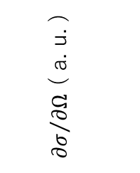
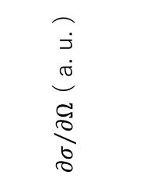
◎非弾性散乱微分断面積の角度分布の理論計算
p + ¹²C(0₁⁺) ⇒ p + ¹²C(0₂⁺)
p + ¹²C(0₁⁺) ⇒ p + ¹²C(2₂⁺)
${∂σ}/{∂Ω}$ ( a. u. )
${∂σ}/{∂Ω}$ ( a. u. )
R_{m}(2₂⁺)=2.54 fm
R_{m}(0₂⁺)=2.97 fm
R_{m}(2₂⁺)=3.87 fm
R_{m}(0₂⁺)=3.80 fm
R_{m}(2₂⁺)=4.25 fm
R_{m}(0₂⁺)=4.38 fm
R_{m}(2₂⁺)=5.03 fm
R_{m}(0₂⁺)=5.65 fm
散乱角 ( degrees )
散乱角 ( degrees )

Slide 29
Results of the differential cross section in α + ¹²C
prm8
E_{lab} = 386 MeV
●：experimental data (M. Itoh, PRC84) Blue curves: Coupled-channels
elastic
0₂⁺
Ex=10 MeV
dσ/dΩ ( mb )
dσ/dΩ ( mb )
2₂⁺
2₁⁺
3₁⁻
0₃⁺
dσ/dΩ ( mb )
θ_{c.m.} ( degree )
θ_{c.m.} ( degree )
θ_{c.m.} ( degree )

Slide 30
Comparison of α + ¹²C(0₁⁺) ⇒α + ¹²C(2_{1,2}⁺)
0₁⁺ ⇒ 2₁⁺
θL=Const
0₁⁺ ⇒ 2₂⁺
0₁⁺ ⇒ 2₁⁺
0₁⁺ ⇒ 2₂⁺
Distribution of 2₂⁺ is shrunk
Distribution of 2₂⁺ is Extended
R_{SC}( 2₂⁺ ) = 5.2 fm, R_{SC}( 2₁⁺ )= 4.6 fm,
ΔRsc = R_{SC}( 2₂⁺ ) ― R_{SC}( 2₁⁺ ) = 0.6 fm ⇒ 3α structure in 2₂⁺

Slide 31
Comparison of experiment and Theory ( Elab = 386 MeV )
prm8
Present calculations
Exp. MDA by M. Itoh et al., PRC84 (2011)
ΔRsc = 0.6 fm
2₁⁺
2₁⁺
dσ/dΩ ( mb )
2₂⁺
2₂⁺
θ_{c.m.} ( degree )
θ_{c.m.} ( degree )
In the 2₂⁺ distribution, shrinkage and rapid fall down can be clearly observed
ΔR_{SC} = Rsc( 2₂⁺ ) －R_{SC}( 2₁⁺ ) = 0.6 fm ( ΔR_{sc} ～ 1 fm, Elab≦240 MeV )

Slide 32
Scattering radius in α + ¹²C ( E_{lab} = 240 MeV )
: scattering radius
Effective
orbital spin
Incident
orbital spin
Partial cross
section
Ref.: M. Tomita et al., PRC89 (2014)
 | 0₁⁺ | 2₁⁺ | 0₂⁺ | 2₂⁺ | 3₁⁻
 | 18.98 | 22.34 | 26.50 | 27.08 | 24.52
 | 3.71 | 4.37 | 5.18 | 5.30 | 4.80
 | 2.40 | 2.38 | 3.47 | 4.00 | 2.76
※M. Kamimura, NPA351 (1981).
R_{SC}( 2₂⁺ ) is more enhanced by about 0.93 fm than R_{SC}( 2₁⁺ ) ⇒ 3α structure in 2₂⁺

Slide 33





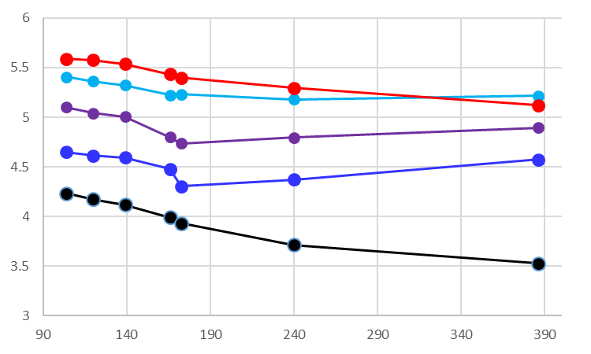
Incident energy dependence of α+¹²C scattering
In α scattering, the scattering radii weakly depend
on the incident energy.
¹²C
3α
6
2₂⁺
prm4
0₂⁺
5
3₁⁻
Scattering radii ( fm )
2₁⁺
4
0₁⁺
3
90
190
290
390
E_{lab} ( MeV )

Slide 34
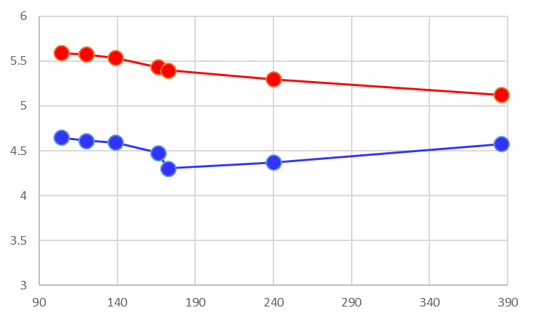
Incident energy dependence of α+¹²C scattering
In α scattering, the scattering radii weakly depend
on the incident energy.
¹²C
3α
6
6
2₂⁺
2₂⁺ data
By M. Itoh
PRC84 (11)
5
5
Scattering radii ( fm )
2₁⁺
4
4
prm4
ΔR_{SC} = Rsc( 2₂⁺ ) －R_{SC}( 2₁⁺ ) = 0.9 fm in average
3
3
90
190
290
390
90
190
290
390
E_{lab} ( MeV )

Slide 35
Results of the differential cross section in α + ¹²C
prm4
E_{lab} = 386 MeV
●：experimental data (M. Itoh, PRC84) Blue curves: Coupled-channels
elastic
0₂⁺
Ex=10 MeV
dσ/dΩ ( mb )
2₂⁺
dσ/dΩ ( mb )
2₁⁺
3₁⁻
0₃⁺
dσ/dΩ ( mb )
θ_{c.m.} ( degree )
θ_{c.m.} ( degree )
θ_{c.m.} ( degree )

Slide 36
Scattering radius
total spin
Incident orbital spin
We characterize the spatial size of scattering area.
（1）General scattering theory
0⁺
⇒partial cross section
⇒We calculate the radius of the scattering area from .
（2）Definition of the scattering radius
cf. mean matter radius
Effective orbital spin of an incident wave
:matter density
k, incident wave number
⇒ scattering radius:
⇒We can always define the scattering radius in the standard scattering calculation.

Slide 37
Black sphere limit of the scattering radius
We consider the high energy scattering by a black sphere potential
Black sphere potential
Partial cross section of the BS scattering
W(r)
r
for
r.m.s of Black sphere
for
Effective orbital spin and the scattering radius
A. Kohama et al.
PRC69 (2009)
( high Energy limit )

Slide 38
Sensitivity to the size of the 2₂⁺ state
α + ¹²C ⇒ α + ¹²C(2₂⁺)
Same as 2₁⁺
Orthogonal
to 2₁⁺
Differential cross sections ( a. u. )
R_{m}(2₂⁺)=2.54 fm
Rapid
Fall down
R_{m}(2₂⁺)=3.87 fm
R_{m}(2₂⁺)=5.03 fm
Larger R( 2₂⁺ )
Scattering angle ( degrees )

Slide 39
Final state distortion and CC effect
 | 2ch. w/o Distortion | 2ch. With Mono-Dis. | 2ch. With Full-Dis. | Full CC calculation
Rsc(2₁⁺) | 3.92 | 4.37 | 4.36 | 4.37
Rsc(2₂⁺) | 4.42 | 5.15 | 5.16 | 5.30
ΔRsc | 0.50 | 0.78 | 0.80 | 0.93
ΔR(Vcp) | 0.60 | 0.60 | 0.60 | 0.60
VCP:54%, Distortion:33%, CC-effect:13%

Slide 40

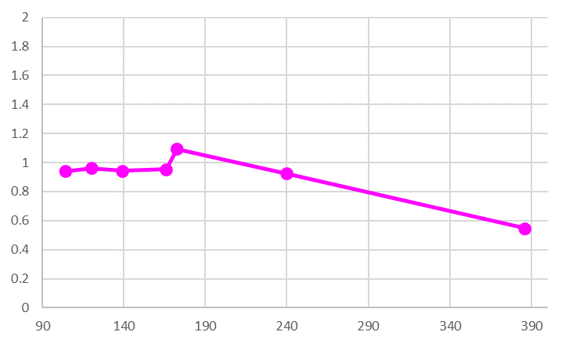
Incident energy dependence of α+¹²C scattering
Energy systematic of ΔR_{SC}
Δrms = rms( 2₂⁺ ) －rms( 2₁⁺ )
Rsc(22+) －Rsc(21+) ( fm )
ΔRVcp = RVcp( 2₂⁺ ) －RVcp( 2₁⁺ )
Elab ( MeV )

Slide 41
Systematics of the coupling potential: 0₁⁺ ⇒ 2₁⁺, 2₂⁺
α + ¹²C
¹⁶O + ¹²C
(X 2.2)
(X 2.0)
0₁⁺ ⇒ 2₂⁺
0₁⁺ ⇒ 2₂⁺
V(R) ( MeV )
0₁⁺ ⇒ 2₁⁺
0₁⁺ ⇒ 2₁⁺
R ( fm )
R ( fm )

Slide 42
Differential and Partial cross sections: ¹⁶O + ¹²C
¹⁶O + ¹²C(0₁⁺) ⇒ ¹⁶O + ¹²C(2⁺)
0₁⁺ ⇒ 2₁⁺
0₁⁺ ⇒ 2₁⁺
0₁⁺ ⇒ 2₂⁺
Probability ( no dim. )
Probability ( no dim. )
0₁⁺ ⇒ 2₂⁺
Θ c.m. ( degree )
L (Incident Orbital Spin)
Distribution of 2₂⁺ is shrunk
Distribution of 2₂⁺ is Extended
Uncertainty Relation:

Slide 43
Differential and Partial cross sections: 1H + 12C
p+ ¹²C(0₁⁺) ⇒ p + ¹²C(2⁺)
0₁⁺ ⇒ 2₁⁺
0₁⁺ ⇒ 2₂⁺
0₁⁺ ⇒ 2₁⁺
Probability ( no dim. )
Probability ( no dim. )
0₁⁺ ⇒ 2₂⁺
Θ c.m. ( degree )
L (Incident Orbital Spin)
Distribution of 2₂⁺ is shrunk
Distribution of 2₂⁺ is Extended
Uncertainty Relation:

Slide 44
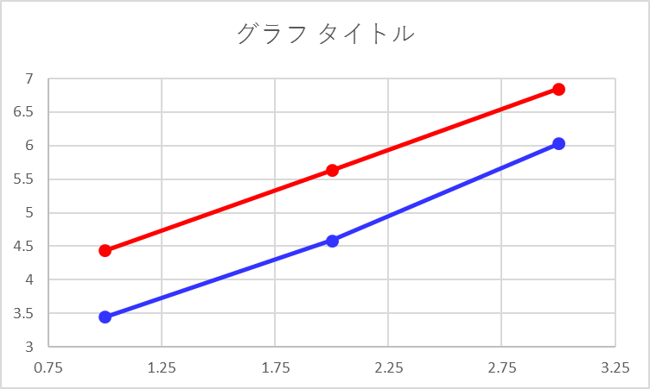
Systematics of the scattering radii (1)
Target dependence of Rsc
Rsc( 2₂⁺ )
Rsc( 2₁⁺ )
Scattering radii ( fm )
P + ¹²C
E/A=40 MeV
α + ¹²C
E/A=30 MeV
¹⁶O + ¹²C
E/A=38 MeV
ΔR_{SC} = Rsc( 2₂⁺ ) －R_{SC}( 2₁⁺ ) = 1.0 fm in average

Slide 45
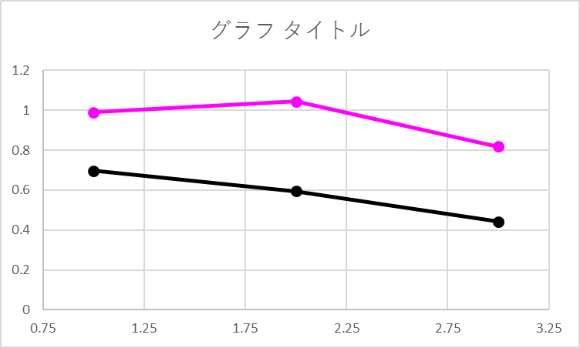
Systematics of the scattering radii (2)
Comparison of Rsc and coupling potential
ΔR_{SC}
Difference of radii ( fm )
ΔR(V_{CP})
P + ¹²C
E/A=40 MeV
α + ¹²C
E/A=30 MeV
¹⁶O + ¹²C
E/A=38 MeV
ΔR_{SC} is about 1.3～2 times larger than ΔR(V_{CP})

Slide 46
¹H+¹²C coupling potential: 0₁⁺ ⇒ 2₁⁺, 2₂⁺
(X 2.3)
0₁⁺ ⇒ 2₂⁺
V(R) ( MeV )
0₁⁺ ⇒ 2₁⁺
R ( fm )

Slide 47
Itoh
prm4

Slide 48
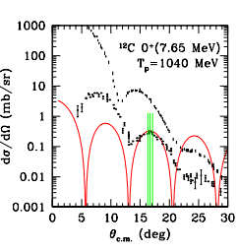

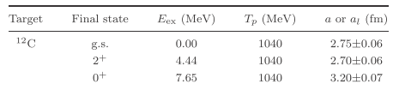
Previous works (1): Diffraction model （p+¹²C）
K. Iida, A. Oyamatsu, A. Kohama, MPLA27 (2012)
In ¹²C_{g.s.}→¹²C(0₂⁺) , diffraction radius is enhanced in the 3α final channel.
Formula of the inelastic Fraunhofer diffraction
Inelastic
elastic
Diff. radius
Enhanced radius in 3α
Inelastic Fraunhofer diff. pattern
The enhancement of the diffraction radius is clearly confirmed,
but the relation of the 3α wave function and diffraction radius still remains unclear.
Diff. radius ⇒ the size of the coupling potential ?? (Pointed out by Takashia).

Slide 49
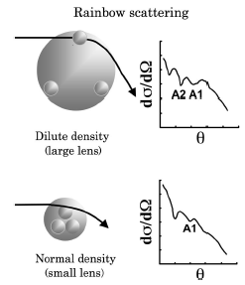
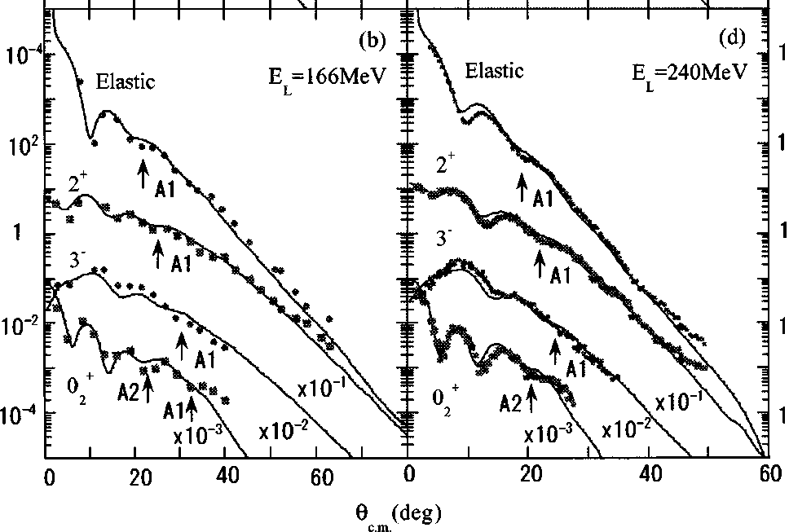
Previous works (2): Microscopic coupled-channel (α+¹²C)
S. Ohkubo and Y. Hirabayashi, Phys. Rev. C70, 041602(R) (2004)
The microscopic coupled-channel calculation is performed for an α scattering by ¹²C
( Folding model with 3a RGM w.f. + DDM3Y NN int. )
Diff. X-sec (mb/sr)
Airy min.
In ¹²C_{g.s.}→ ¹²C(0₂⁺), Evolution of the Airy minima is observed.
⇒ Evolution is a sign of the enhanced attraction at the surface region of the 3a state !?

Slide 50
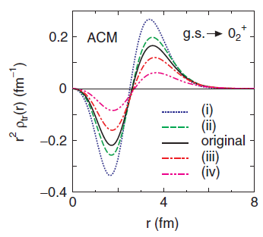
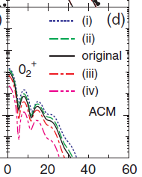
Previous works (3): Analysis of the MCC（⁴He+¹²C）
M. Takashina and Y. Sakuragi, Phys. Rev. C74, 054606 (2006)
In the microscopic coupled-channel calculation, the sensitivity of the angular
distribution to the size of the 3α state is investigated.
small
Diff. X-sec (mb/sr)
3α radius
large
Oscillating pattern is quite INSENSITIVE to the radius of the final 3α state
Oscillation is quite SENSITIVE to a size of the transition potential of ¹²C_{g.s.}→ ¹²C(0₂⁺)

Slide 51
Comparison of the transition density
Monopole: 0₁⁺ ⇒ 0₂⁺
Quadrupole: 0₁⁺ ⇒ 2₂⁺
r ( fm )

Slide 52
Sensitivity of the transition density to the matter radius
Monopole: 0₁⁺ ⇒ 0₂⁺
Quadrupole: 0₁⁺ ⇒ 2₂⁺
Peak position of r²ρ_{tr}(r) ( fm )
Matter Radius ( fm )
Radius of 0₁⁺

