Slide 1

State of the Art in the Nuclear Cluster Physics 4 Galveston, TX, 18/05/2018
Closing remarks
Matko Milin
Faculty of Science,
University of Zagreb,
Croatia

Slide 2
Wiser men quotes…
Daniel Baye (SOTANCP3):
„Summarizing the talks presented at a conference is of course an impossible task…”
Wilton Catford (Cluster10):
„..summary can’t be complete … and any non-exhaustive summary will inevitably represent a personal perspective.”
State of the Art in the Nuclear Cluster Physics 4 Galveston, TX, 18/05/2018

Slide 3

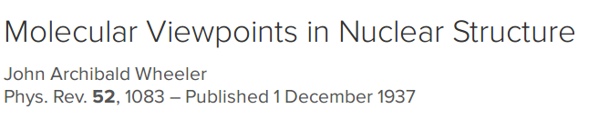
A bit of history
80 years ago…
State of the Art in the Nuclear Cluster Physics 4 Galveston, TX, 18/05/2018

Slide 4
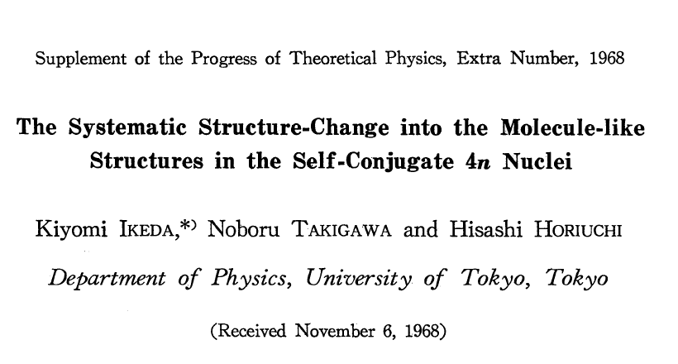
A bit of history
50 years ago…
State of the Art in the Nuclear Cluster Physics 4 Galveston, TX, 18/05/2018

Slide 5
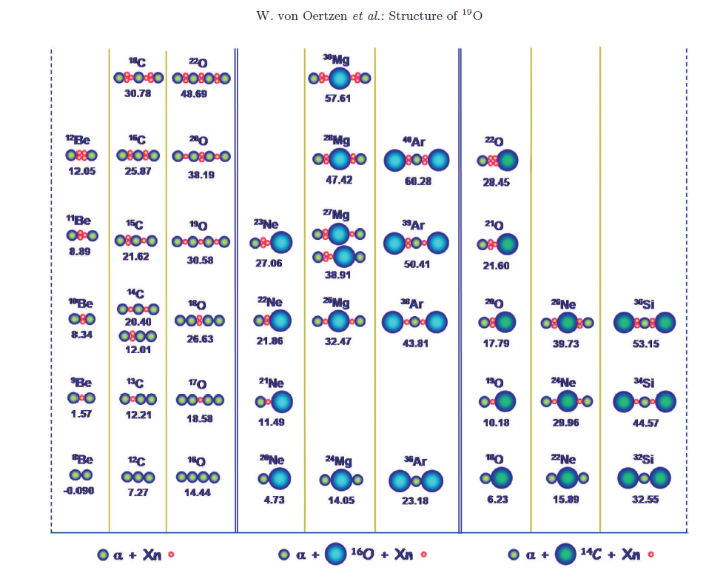
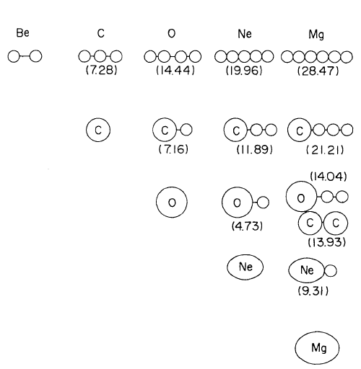
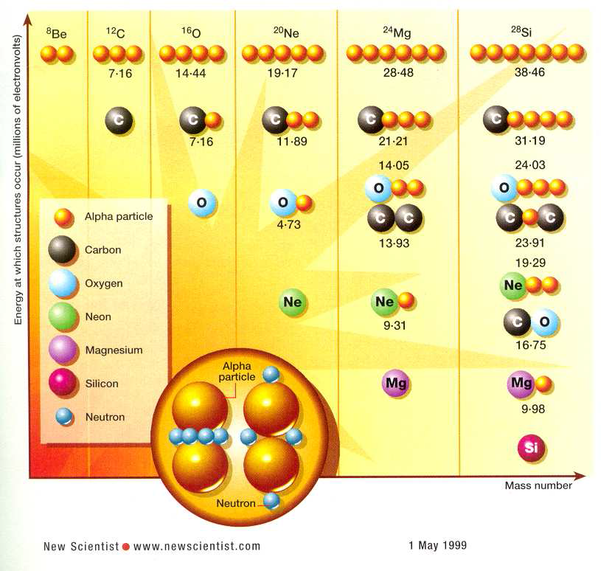
A bit of history
State of the Art in the Nuclear Cluster Physics 4 Galveston, TX, 18/05/2018

Slide 6
A bit of statistics
60 talks:
  experiment: 24
  theory: 36
  Japan: 18
  EU: 16.5
  USA: 15.5
  China: 5
  F: 8
  M: 52
State of the Art in the Nuclear Cluster Physics 4 Galveston, TX, 18/05/2018

Slide 7
A bit of statistics
60 talks:
  ¹²C: 37
  Hoyle: 26 (in 12 abstracts, in 5 titles, in 2 photos!)
  ¹⁶O: 11
  BEC: 8
  Ikeda diagram: 7
  ab initio: 6
  …
State of the Art in the Nuclear Cluster Physics 4 Galveston, TX, 18/05/2018

Slide 8
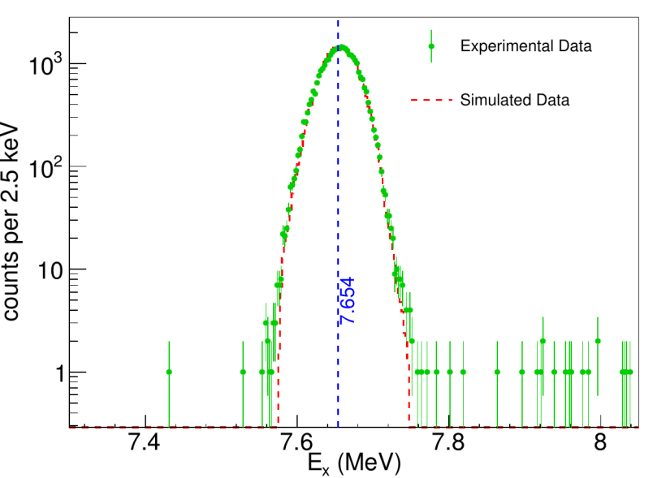
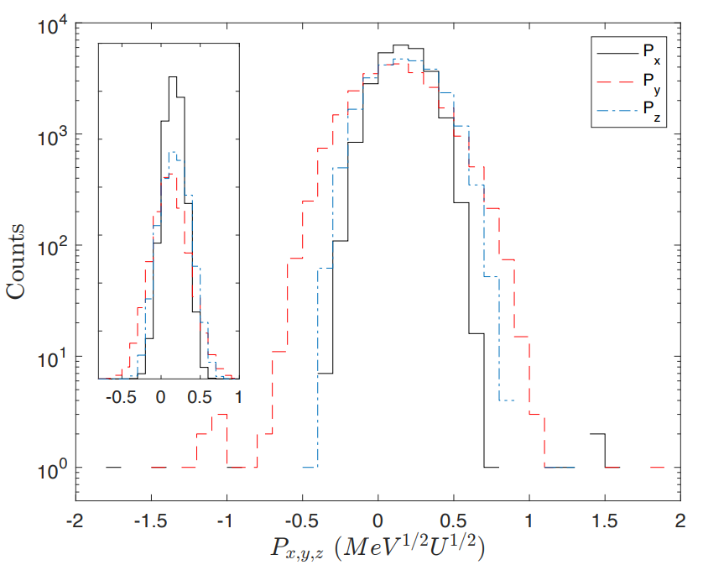
¹²C, Hoyle state, BEC, …
something inherently difficult about these experiments!
  strong need for comprehensive and precision measurements (summary M. Freer @ Cluster11)
  major steps in that direction:
    D. Dell’Aquila et al.
    J. Bishop et al.
DD<0.043%
J. Refsgaard et al.
DD<0.047%

Slide 9
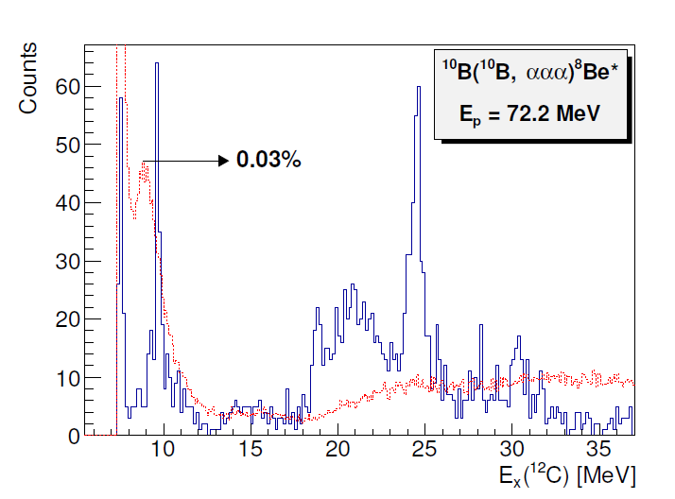
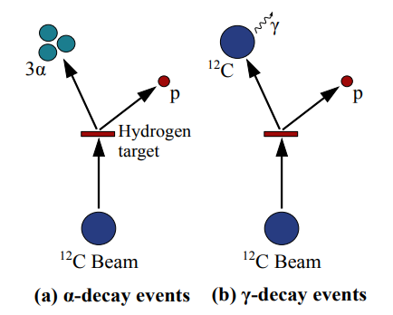
¹²C, Hoyle state, BEC, …
something inherently difficult about these experiments!
  strong need for comprehensive and precision measurements (summary M. Freer @ Cluster11)
  major steps in that direction:
    T. Kawabata et al.
      (rare decays, new state?)
State of the Art in the Nuclear Cluster Physics 4 Galveston, TX, 18/05/2018

Slide 10
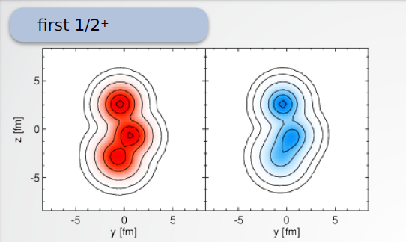
¹²C – neighboring nuclei
states analog to the Hoyle one in A= 9, 11 or 13:
- T. Neff
- V.S. Vasilevsky et al.
- K. Kato et al.
¹⁶O:
- M. Ito et al.
- Y. Funaki
- M. Barbui et al.
- J.A. Swartz et al.
¹¹C
State of the Art in the Nuclear Cluster Physics 4 Galveston, TX, 18/05/2018-

Slide 11
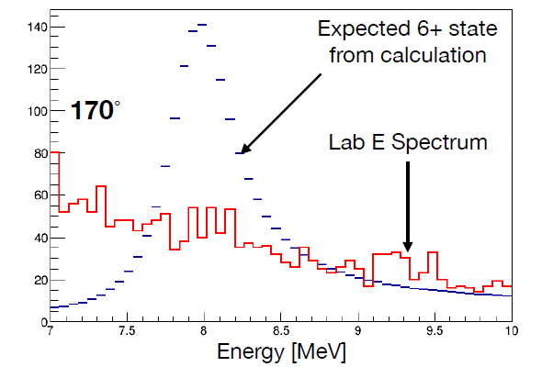
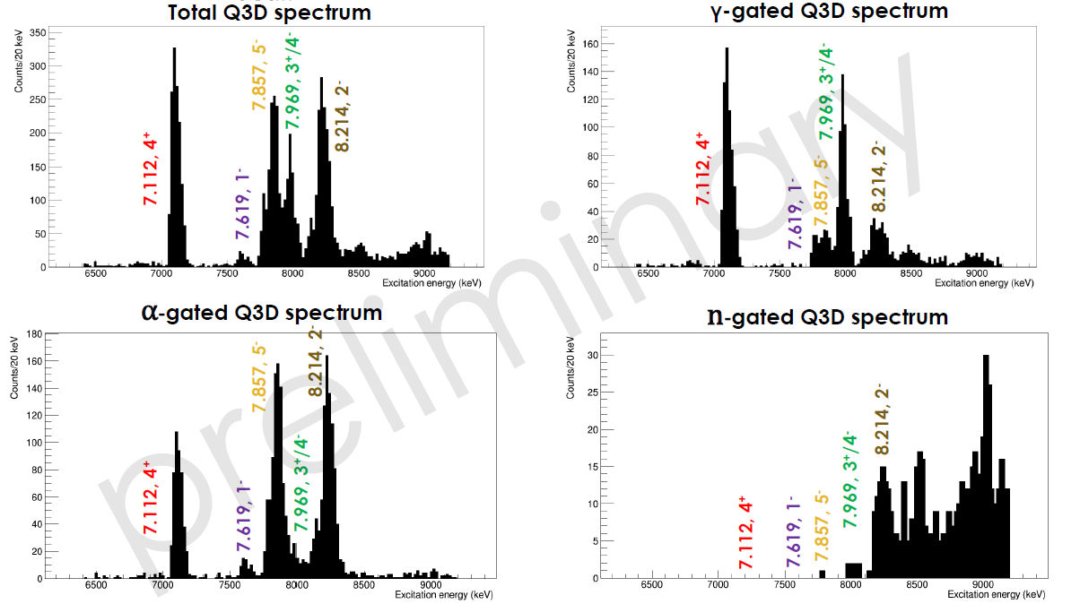
Alpha and ⁶He decays of light nuclei
S. Upadhyayula et al.
N. Soić et al.
J.S. Wang et al.
D.K. Nauruzbayev et al.
S. Pirrie et al.
2⁺!
State of the Art in the Nuclear Cluster Physics 4 Galveston, TX, 18/05/2018-

Slide 12
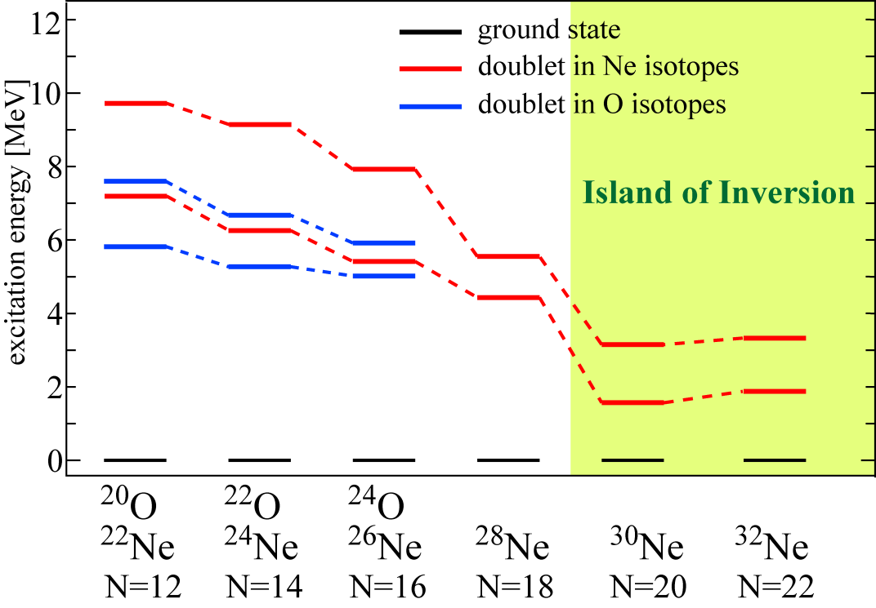
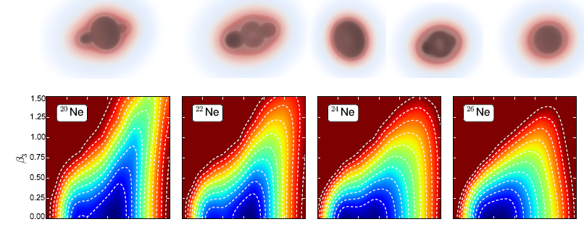
Systematics for light isotope chains
M. Kimura, T. Suhara, T. Baba
…
P. Marević et al.
State of the Art in the Nuclear Cluster Physics 4 Galveston, TX, 18/05/2018-

Slide 13
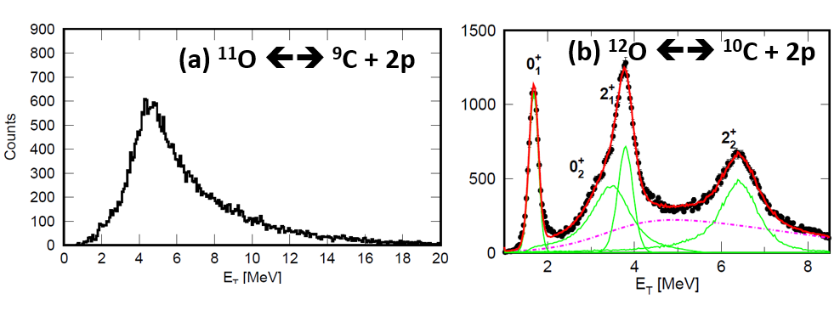
Exotic nuclei, isobar analogue states
L. Sobotka et al: „end of nuclear spectroscopy”
R. Lazauskas et al: ⁵H
A.M. Shirokov: tetraneutron resonance
X. Cao et al: resonances in the 7α disassembly of ²⁸Si
State of the Art in the Nuclear Cluster Physics 4 Galveston, TX, 18/05/2018-

Slide 14
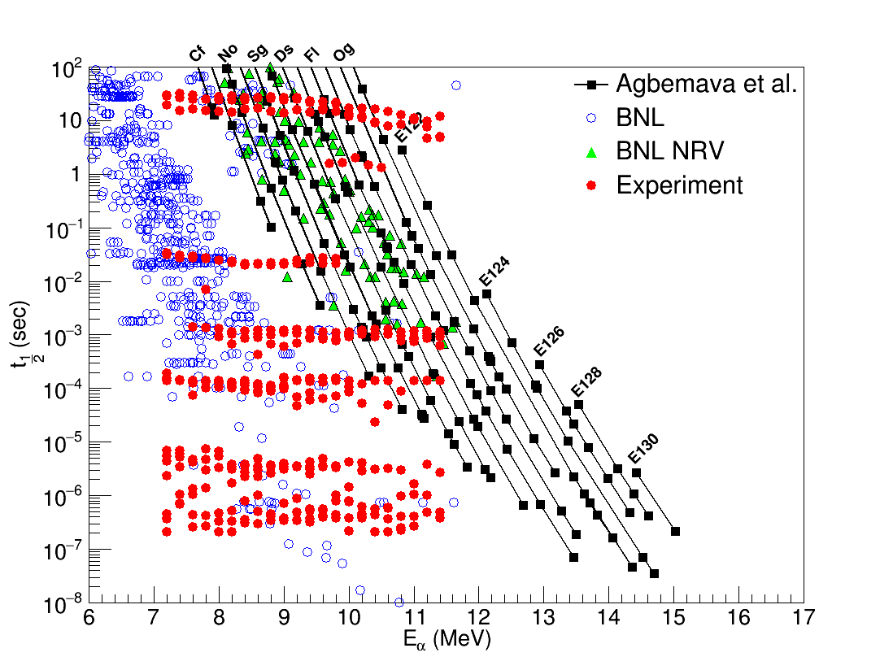
Heavy and superheavy
K. Hagel et al.
  (U+Th)
J. Gauthier et al. – ternary fission
G. Röpke - ²¹²Po: α on top of ²⁰⁸Pb
State of the Art in the Nuclear Cluster Physics 4 Galveston, TX, 18/05/2018-

Slide 15
Clustering in reactions
B. Schuetrumpf et al.: pre-compound nuclei in TDDFT
T. Ahn et al.: ³He(α,γ)⁷Be
M. Munch et al.: ⁷Li(p,γ)⁴He⁴He
Z. Chen et al.: fragmentation
M. Schmidt et al.: EFT & reactions of halo nuclei
T. Furumoto et al.: Li elastic scattering
U. Datta et al.: ⁹⁶Ru cluster states in ⁹²Mo+³²S and fusion-evaporation…
D. Bai et al.: p, α and cluster radioactivity in strong laser electromagnetic fields
State of the Art in the Nuclear Cluster Physics 4 Galveston, TX, 18/05/2018

Slide 16
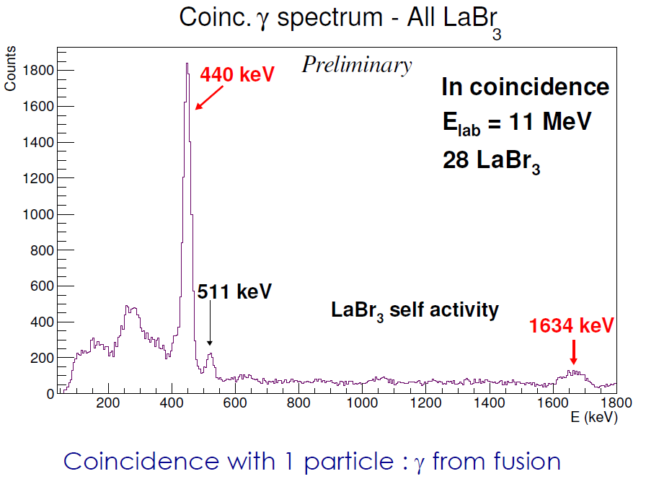
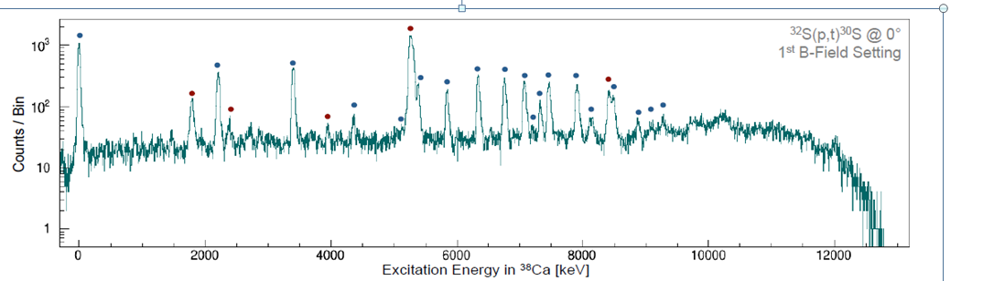
Astrophysics
M. Wiescher et al.
A. Tumino et al.
S. Courtin et al.
J. deBoer et al.
State of the Art in the Nuclear Cluster Physics 4 Galveston, TX, 18/05/2018

Slide 17
Ab initio
T. Otsuka
K. Launey
R. Baker
A. C. Dreyfuss
A. Volya
symmetry-adapted no-core shell model
²⁰Ne
State of the Art in the Nuclear Cluster Physics 4 Galveston, TX, 18/05/2018

Slide 18
Progress in theoretical methods
THSR: Y. Funaki, B. Zhou
AMD: Y.Chiba, T. Myo, Y. Taniguchi, H. Morita, Y. Taniguchi
TDDFT: B. Schuetrumpf
EDF: R.-D. Lasseri, P. Marević
QFT: J. Takahashi
A. Volya: configuration interaction technique + RGM
S. Adachi: multipole decomposition analysis
H. Masui: cluster-orbital shell model
State of the Art in the Nuclear Cluster Physics 4 Galveston, TX, 18/05/2018

Slide 19
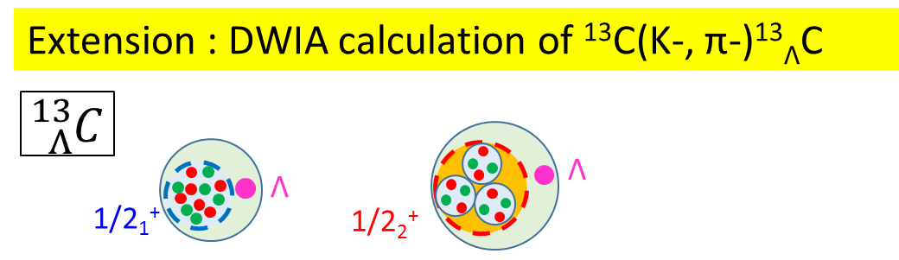
Clustering in hypernuclei
W. Horiuchi et al. - kaonic nuclear systems
M. Ito:
State of the Art in the Nuclear Cluster Physics 4 Galveston, TX, 18/05/2018

Slide 20
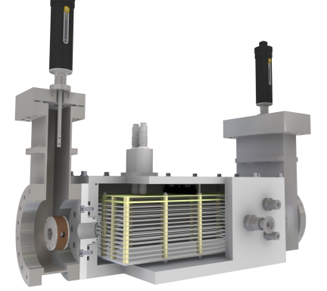
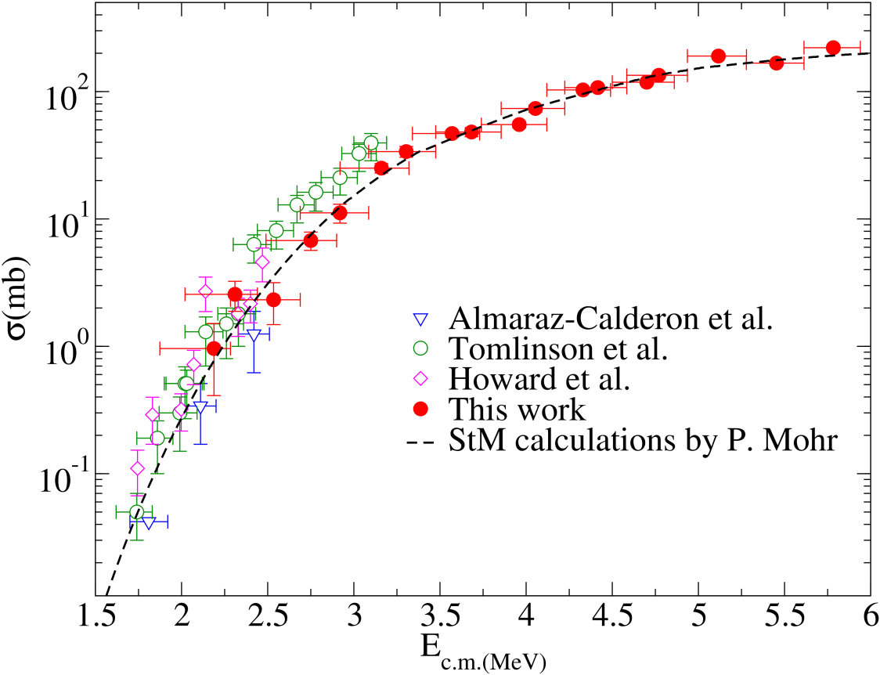
New instrumentation and methods
D. Dell’Aquila & J. Bishop et al.
Kawabata et al.
M. Avila et al.
²³Na(α,p)²⁶Mg
State of the Art in the Nuclear Cluster Physics 4 Galveston, TX, 18/05/2018

Slide 21
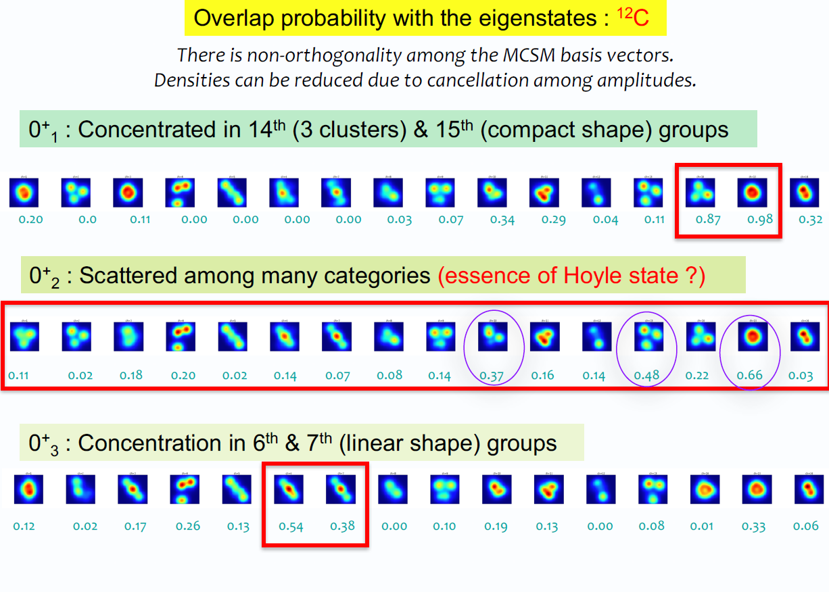
A.I.
T.Otsuka
State of the Art in the Nuclear Cluster Physics 4 Galveston, TX, 18/05/2018

Slide 22
Summary of the summary
need for comprehensive and precise new results…
important steps made, new to be expected soon!
so see you all in Split, Croatia, in 2022.!
State of the Art in the Nuclear Cluster Physics 4 Galveston, TX, 18/05/2018

Slide 23
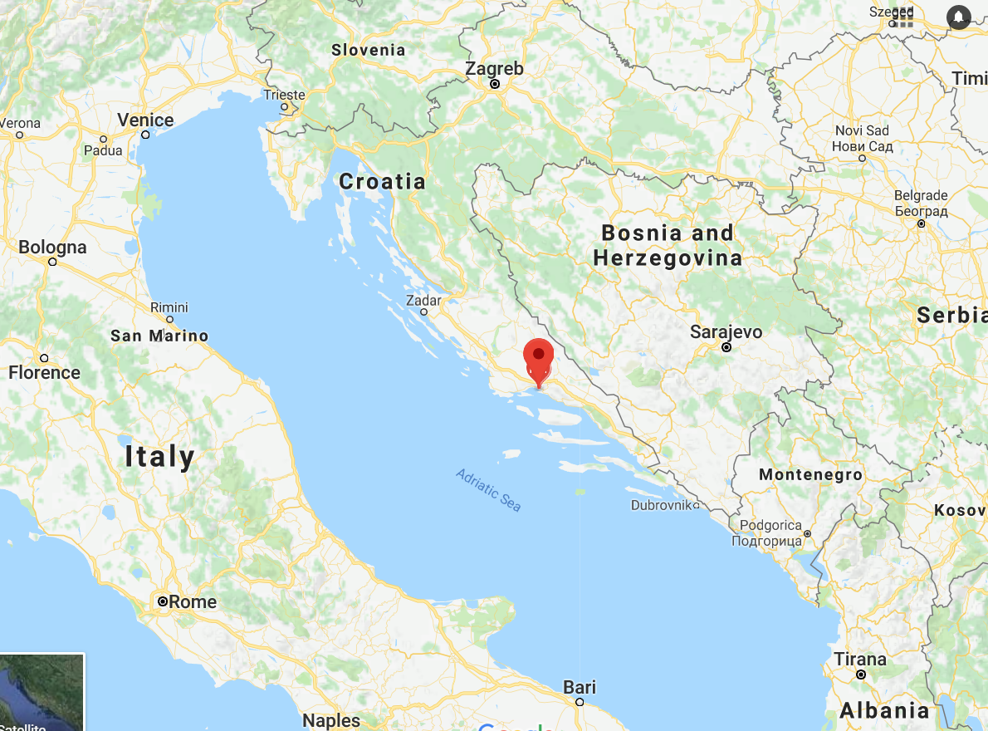
SOTANCP5
Split – well connected! (including low-cost airlines)

Slide 24
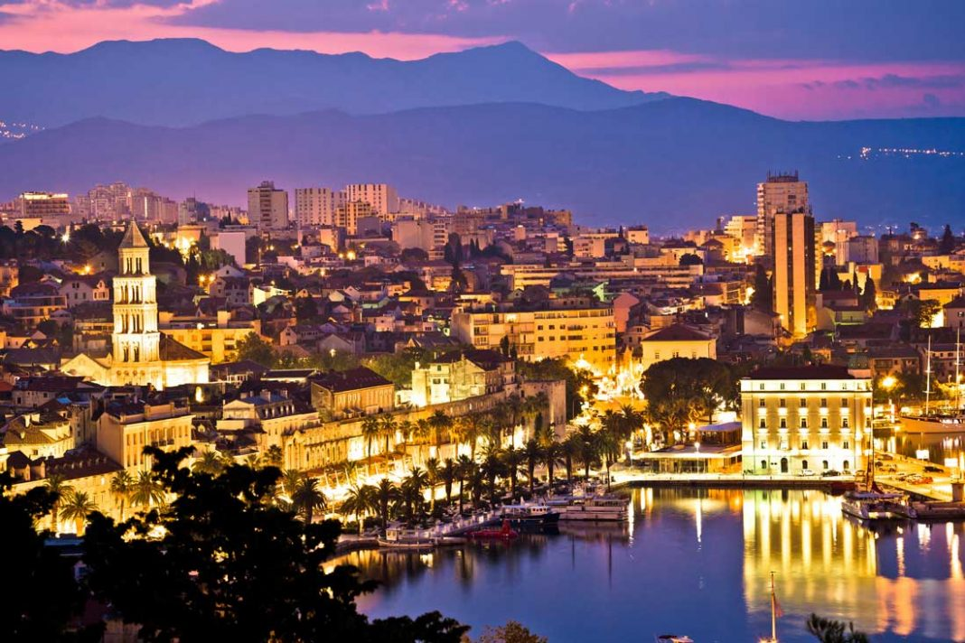
SOTANCP5
Split – second largest Croatian city

Slide 25
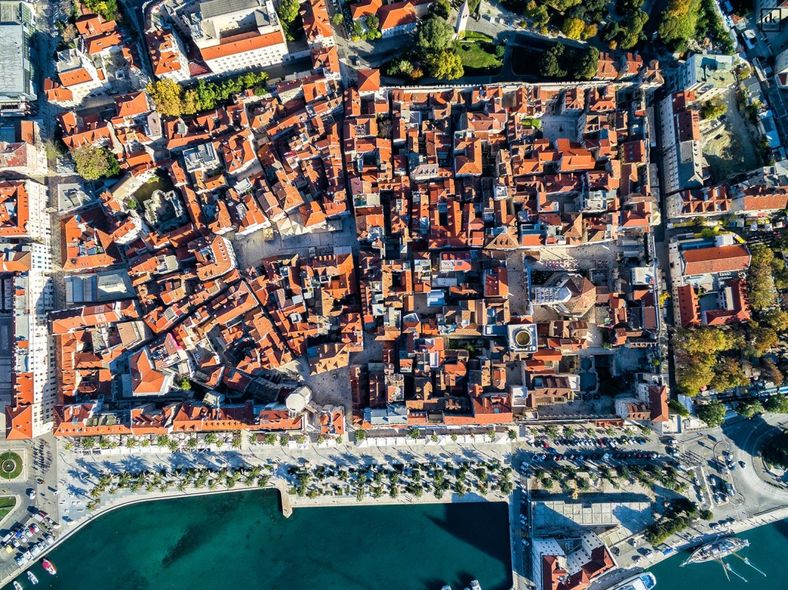
SOTANCP5
Split – Diocletian's Palace

Slide 26
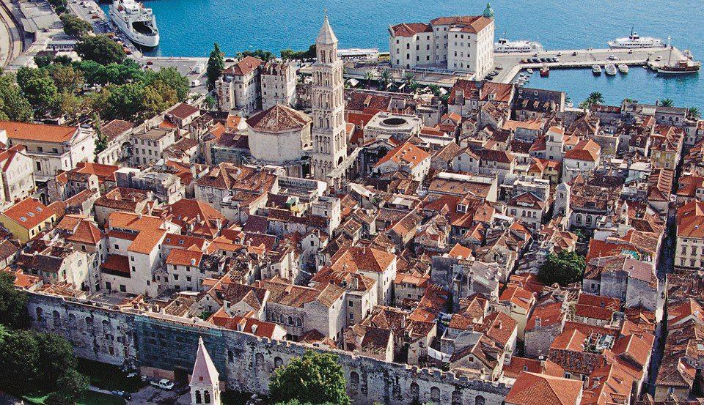
SOTANCP5
Split – Diocletian's Palace

Slide 27
Thank you!
Grisha,
Marina,
Josh, Curtis, Teja,
Vlad Goldberg, Joe Natowitz,
Jeremy Holt, Gregory Christian,
Cody Folden,
…

