Slide 1
Description of the resonant
states in ⁵H
In collaboration with:
J. Carbonell (IPN Orsay, France)
E. Hiyama (Kyushu uni., RIKEN, Japan)
R. Lazauskas

Slide 2
Contents
⁵H system short summary of the experimental & theoretical results
Broad resonances: some misconceptions in interpreting experimental data
Solution of the 5 body Faddeev-Yakubovsky equations for nuclear systems
Methods to extract resonance positions
Resonances in ⁵H
n
¹S₀
p
n
n
n
³H
18/05/2018
2
2
R. Lazauskas
Notes:
2

Slide 3
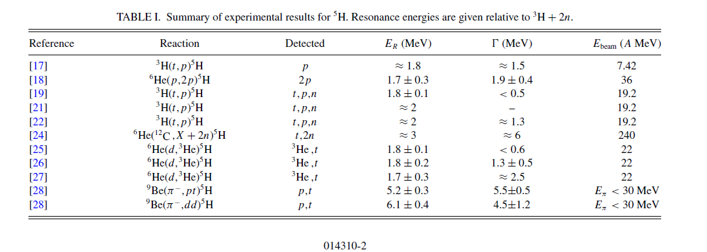
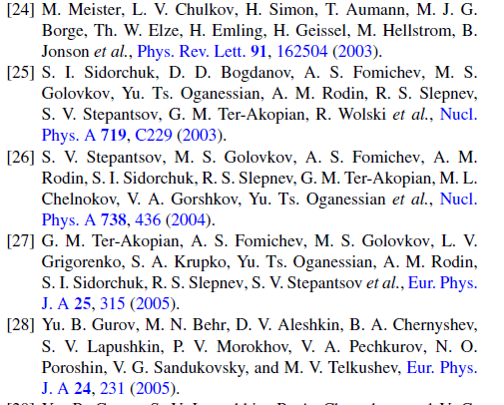
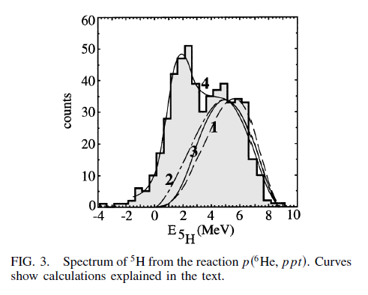
⁵H resonant states: experiment
18/05/2018
3
3
R. Lazauskas
R. Lazauskas
Notes:
3

Slide 4
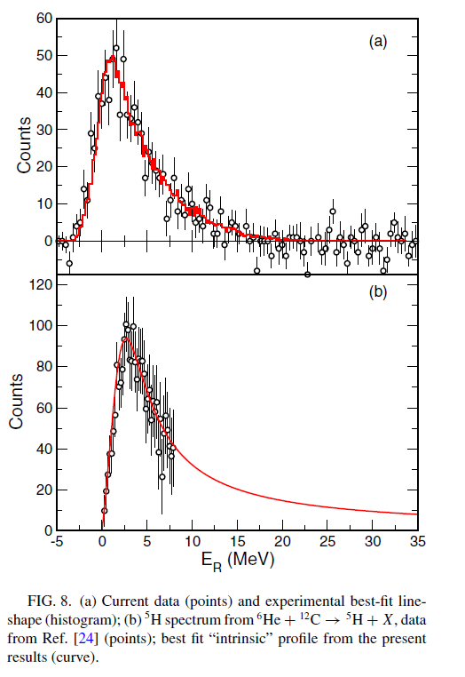
⁵H resonant states: experiment
⁶He(d,³He)⁵H : E_{R}=2.4(3) MeV; G=5.3(4) MeV
A. H. Wuosmaa et al.,Phys. Rev. C95, 014310 (2017)
18/05/2018
4
4
R. Lazauskas
R. Lazauskas
Notes:
4

Slide 5
Trajectory of the ⁴H resonance(s)
n-³H scattering total cross section
T.W. Philips et al., Phys. Rev. C 22 (1980) 384
p
n
n
³H
n
Repulsive S-waves, due to the Pauli blocking
dnn
1⁻
0⁻
Presence of the attractive P-waves,
producing resonant states in ⁴H
J^{π}(⁴H ) | E(⁴H)-E(³H) (MeV) R-matrix
2⁻ 1⁻ 0⁻ 1⁻ | 3.19-2.71i 3.40-3.37i 5.27-4.46i 6.02-6.50i
1⁻
2⁻
D.R. Tilley et al., Nucl. Phys. A541 (1992) 1
18/05/2018
5
R. Lazauskas
R. Lazauskas
Notes:
5

Slide 6
Trajectory of the ⁴H resonance(s)
P-wave resonance trajectory as a function of the coupling constant λ
V _{λ} = λ V_{nt}
λ=1.75
18/05/2018
6
6
R. Lazauskas
R. Lazauskas
Notes:
6

Slide 7
Contents
P-wave resonance trajectory as a function of the coupling constant λ
V _{λ} = λ V_{nt}
λ=1.5
18/05/2018
7
7
R. Lazauskas
R. Lazauskas
Notes:
7

Slide 8
Contents
P-wave resonance trajectory as a function of the coupling constant λ
V _{λ} = λ V_{nt}
$$Ψ(r)$$
V(r)
r
λ=1.5
18/05/2018
8
8
R. Lazauskas
R. Lazauskas
Notes:
8

Slide 9
Contents
P-wave resonance trajectory as a function of the coupling constant λ
V _{λ} = λ V_{nt}
λ=1.25
18/05/2018
9
9
R. Lazauskas
R. Lazauskas
Notes:
9

Slide 10
Contents
P-wave resonance trajectory as a function of the coupling constant λ
V _{λ} = λ V_{nt}
Potential with λ=1 reproduces n-³H J^{π}=2⁻ scattering phaseshifts
λ=1
S-matrix | R-matrix
1.27-2.00i | 3.19-2.71i
18/05/2018
10
10
R. Lazauskas
R. Lazauskas
Notes:
10

Slide 11
Contents
P-wave resonance trajectory as a function of the coupling constant λ
V _{λ} = λ V_{nt}
Potential with λ=0.75 closely reproduces n-³H J^{π}=0⁻ scattering phaseshifts
λ=0.75
S-matrix | R-matrix
0.74-3.53i | 5.27-4.46i
18/05/2018
11
11
R. Lazauskas
R. Lazauskas
Notes:
11

Slide 12
Contents
Non-unique signature of the broad resonances in the physical observables
$$A_{R}\left(E\right)\sim <ψ\left(E\right)\left|{\hat{O}}^{†}\left(E\right) \right|ψ_{R}>\frac{1}{E−E_{R}}<ψ(E)\left|\hat{O}\left(E\right)\right|ψ_{R}>$$
Important differences between resonance positions provided by S-matrix & phenomenological R-matrix approaches
Why?
Different goals:
S-matrix : analytical properties of the Hamiltonian,
phenomenological R-matrix: efficiency of the data fit !
Breit-Wigner ~$\frac{1}{{\left(E−Re\left(E_{R}\right)\right)}^{2}+{\left(Im\left(E_{R}\right)\right)}^{2}}$
Observable dependent
18/05/2018
12
12
R. Lazauskas
R. Lazauskas
Notes:
12

Slide 13
⁵H resonant states: theory
Predictivity?
⁵H states does not appear naturally
Cluster models, involvig approximations for 5-body dynamics
³H+n+n models: without n-antisymetrization between the core &valence
³H+n+n models: including n-antisymmetrization, however by freezing ³H core
18/05/2018
13
13
R. Lazauskas
R. Lazauskas
Notes:
13

Slide 14
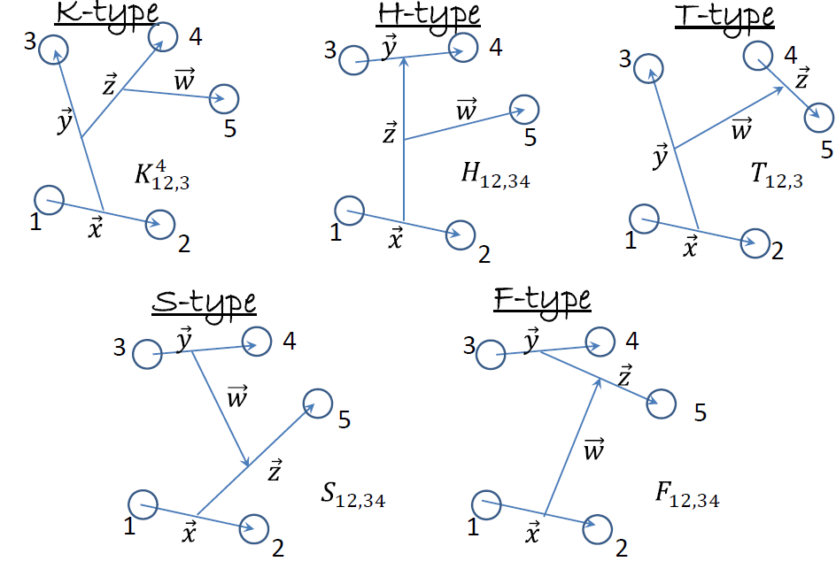
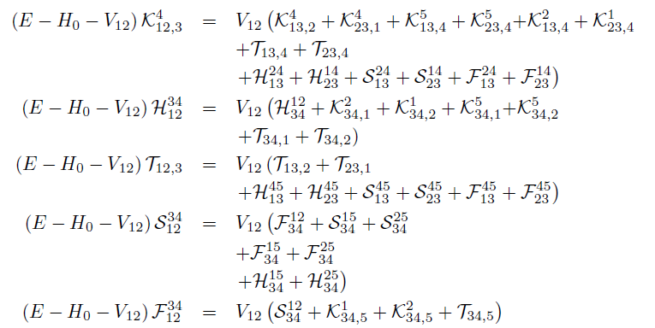
Faddeev-Yakubovsky eq
Open systems in the continuum
In configuration space wave functions extend to infinity!
Increasingly complex asymptotic behaviour for A>2 systems!!
Important to describe properly disintegration channels
…
L. D. Faddeev, Zh. Eksp. Teor. Fiz. 39, 1459 (1960). [Sov. Phys. JETP 12, 1014(1961)].
O. A. Yakubovsky, Sov. J. Nucl. Phys. 5, 937 (1967).
18/05/2018
14
14
R. Lazauskas
R. Lazauskas
Notes:
14

Slide 15
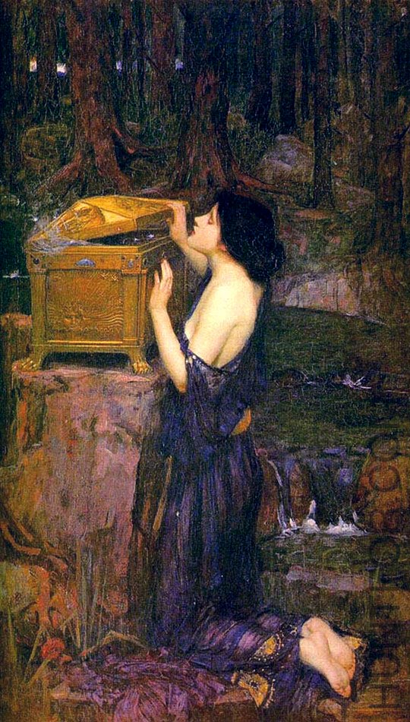
Faddeev-Yakubovsky eq
NUMERICAL SOLUTION
*R.L., PhD Thesis, Université Joseph Fourier, Grenoble (2003).
PW decomposition of the components K,H,T,S,F
Radial parts expanded using Lagrange-mesh method (D. Baye, Physics Reports 565 (2015) 1)
Resulting linear algebra problem solved using iterative methods
MERITS
Simple handling of the symmetries
Boundary conditions for the binary channels
Easy reduction to subsystems
Price
Overcomplexity
Problem | Number eq. (identical particles) | Number eq. (different particles)
A=2 | 1 | 1
A=3 | 1 | 3
A=4 | 2 | 18
A=5 | 5 | 180
A=6 | 15 | 2700
A=N |  | $$\frac{N!\left(N−1\right)!}{2^{N−1}}$$
J.W. Waterhouse : « Pandora »
18/05/2018
15
15
R. Lazauskas
R. Lazauskas
Notes:
15

Slide 16
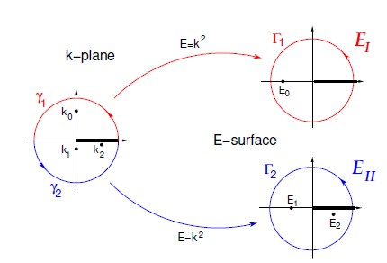
Extrapolation is a flourishing business
In QM scattering problem the « Energy manifold » E is not an axis, but a two-dimensional Riemann sheet!
When moving from bound state region (axis!) to continuum one should take into account the proper analytical behavior: branching points + non-trivial dependence in $k(λV)$
Trajectory of the S-matrix pole with a coupling constant $λ$ with $k\left(λ_{0}\right)=0$
Algebraic branching point $λ{=λ}_{0}$
Bound state
$$λ{>λ}_{0}$$
Anti-resonance
$$λ{<λ}_{0}$$
Resonance
$$λ{<λ}_{0}$$
Analytic behavior in the vicinity of the branching point
$$k(λ→ λ_{0})\sim i\sqrt{λ\text{−} λ_{0}}$$
18/05/2018
16
16
R. Lazauskas
R. Lazauskas
Notes:
16

Slide 17
ACCC method
ACCC method (V.I. Kukulin et al., « Theory of resonances », Kluwer AP 1989)
Add artificial binding potential to Hamiltonian $V\left(r\right)$
Calculate several binding energies of the system E_{i}$($_{i})
Determine accurately $0$such that E$(0$)=0 !
Extrapolate E_{res}=E($$=0) using E_{i}$($_{i}) and $0$ values, knowing that
$\sqrt{E_{res}(λ→λ_{0})}\sim i\sqrt{λ−λ_{0}}$
Padé extrapolation is used:
$$\sqrt{E_{res}(λ→λ_{0})}=iP\left[n,m\right]\left(\sqrt{λ−λ_{0}}\right)$$
$$P\left[n,m\right](q)=\frac{a_{1}q+a_{1}q^{2}+..+a_{n}q^{n}}{1+b_{1}q+..+b_{m}q^{m}}$$
2b-example
$$V\left(l=1\right)=\frac{1.8}{r}\left({1438.72e}^{−3.11r}{−626.885e}^{−1.55r}\right)$$
$$λV(r)=λr^{2}e^{−r^{2}/3.5}$$
18/05/2018
17
17
R. Lazauskas
R. Lazauskas
Notes:
17

Slide 18
ACCC method
ACCC method (V.I. Kukulin et al., « Theory of resonances », Kluwer AP 1989)
Add artificial binding potential to Hamiltonian $V\left(r\right)$
Calculate several binding energies of the system E_{i}$($_{i})
Determine accurately $0$such that E$(0$)=0 !
Extrapolate E_{res}=E($$=0) using E_{i}$($_{i}) and $0$ values, knowing that
$\sqrt{E_{res}(λ→λ_{0})}\sim i\sqrt{λ−λ_{0}}$
Padé extrapolation is used:
$$\sqrt{E_{res}(λ→λ_{0})}=iP\left[n,m\right]\left(\sqrt{λ−λ_{0}}\right)$$
$$P\left[n,m\right](q)=\frac{a_{1}q+a_{1}q^{2}+..+a_{n}q^{n}}{1+b_{1}q+..+b_{m}q^{m}}$$
2b-example
$$V\left(l=1\right)=\frac{1.8}{r}\left({1438.72e}^{−3.11r}{−626.885e}^{−1.55r}\right)$$
$$λV(r)=λr^{2}e^{−r^{2}/3.5}$$
18/05/2018
18
18
R. Lazauskas
R. Lazauskas
Notes:
18

Slide 19
ACCC method
ACCC method (V.I. Kukulin et al., « Theory of resonances », Kluwer AP 1989)
Add artificial binding potential to Hamiltonian $V\left(r\right)$
Calculate several binding energies of the system E_{i}$($_{i})
Determine accurately $0$such that E$(0$)=0 !
Extrapolate E_{res}=E($$=0) using E_{i}$($_{i}) and $0$ values, knowing that
$\sqrt{E_{res}(λ→λ_{0})}\sim i\sqrt{λ−λ_{0}}$
Padé extrapolation is used:
$$\sqrt{E_{res}(λ→λ_{0})}=iP\left[n,m\right]\left(\sqrt{λ−λ_{0}}\right)$$
$$P\left[n,m\right](q)=\frac{a_{1}q+a_{1}q^{2}+..+a_{n}q^{n}}{1+b_{1}q+..+b_{m}q^{m}}$$
2b-example
$$V\left(l=1\right)=\frac{1.8}{r}\left({1438.72e}^{−3.11r}{−626.885e}^{−1.55r}\right)$$
$$λV(r)=λr^{2}e^{−r^{2}/3.5}$$
18/05/2018
19
19
R. Lazauskas
R. Lazauskas
Notes:
19

Slide 20
ACCC method
ACCC method (V.I. Kukulin et al., « Theory of resonances », Kluwer AP 1989)
Add artificial binding potential to Hamiltonian $V\left(r\right)$
Calculate several binding energies of the system E_{i}$($_{i})
Determine accurately $0$such that E$(0$)=0 !
Extrapolate E_{res}=E($$=0) using E_{i}$($_{i}) and $0$ values, knowing that
$\sqrt{E_{res}(λ→λ_{0})}\sim i\sqrt{λ−λ_{0}}$
Padé extrapolation is used:
$$\sqrt{E_{res}(λ→λ_{0})}=iP\left[n,m\right]\left(\sqrt{λ−λ_{0}}\right)$$
$$P\left[n,m\right](q)=\frac{a_{1}q+a_{1}q^{2}+..+a_{n}q^{n}}{1+b_{1}q+..+b_{m}q^{m}}$$
2b-example
$$V\left(l=1\right)=\frac{1.8}{r}\left({1438.72e}^{−3.11r}{−626.885e}^{−1.55r}\right)$$
$$λV(r)=λr^{2}e^{−r^{2}/3.5}$$
18/05/2018
20
20
R. Lazauskas
R. Lazauskas
Notes:
20

Slide 21
Exterior complex scaling method
Im(r)
exp. bound if 0<θ<π
for resonance arg(E_{R})/2<θ<π
Complex scaling:
J. Nuttal and H. L. Cohen, Phys. Rev. 188 (1969) 1542; D. Hartree 1940’s
$$θ$$
Numerical complications when transforming short ranged
potentials
Re(r)
$$V(r)→V(re^{iθ})$$
Im(r)
Exterior complex scaling:
$$r→r r<r_{0}$$
$r→r_{0}+\left(r−r_{0}\right)e^{iθ}$ $r>r_{0}$
$$θ$$
B. Simon. Phys. Letters A, 71 (1979) 211
Im(r)
r₀
Re(r)
Numerical instabilities due to non-analyticity (sharpness) of
the transformation
Smooth exterior complex scaling (SECSM):
$$r→r r≪r_{0}$$
$r→r_{0}+\left(r−r_{0}\right)e^{iθ}$ $r≫r_{0}$
$$θ$$
r₀
Re(r)
18/05/2018
21
21
R. Lazauskas
R. Lazauskas
Notes:
21

Slide 22
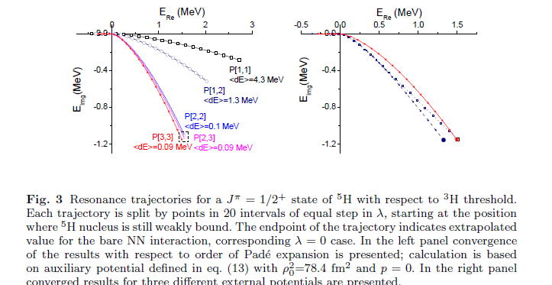
⁵H(J=1/2⁺)
nn interaction described by the MT I-III potential
auxilliary potential for ACCC
$$\sum_{i=1}^{5}{{r_{i}}_{}^{2}}$$
$ρ^{2}=x^{2}+y^{2}+z^{2}+w^{2}$=2
E(⁵H)-E(³H)=1.4(1)-i1.2 (1)
E(⁵H)-E(³H)=1.7(2)-i1.2 (1)
18/05/2018
22
22
R. Lazauskas
R. Lazauskas
Notes:
22

Slide 23
⁵H(J=1/2⁺ & 5/2⁺ )
nn interaction described by the MT I-III potential
J=1/2⁺ (L=0⁺, S=1/2)
ACCC:
SECSM:
E(⁵H)-E(³H)=1.4(1)-i1.2 (1)
E(⁵H)-E(³H)=1.6(2)-i1.2 (1)
J=5/2⁺ (L=2⁺, S=1/2)
SECSM:
E(⁵H)-E(³H)=2.50(15)-i1.90 (15)
Negative parity states & ones with S=3/2 are much broader
To compare with ⁴H resonances:
1.08(1)-i2.04 (2) (S=1, L=1⁻)
0.88(3)-i2.20(4) (S=0, L=1⁻)
E(⁴H)-E(³H)=
18/05/2018
23
23
R. Lazauskas
R. Lazauskas
Notes:
23

Slide 24
⁵H(J=1/2⁺)
INOY Potential
N₃LO Potential
E(⁵H)-E(³H)=1.65(5)-i1.26(6)
SECSM: 1.8(1)-i1.2(1)
E(⁵H)-E(³H)=1.8(1)-i1.15(15)
SECSM: 1.85(10)- i1.20(5)
To compare with ⁴H resonances J=2⁻:
E(⁴H)-E(³H)=1.31(3)-2.08(2)
E(⁴H)-E(³H)=1.17(3)-1.99(3)
18/05/2018
24
24
R. Lazauskas
R. Lazauskas
Notes:
24

Slide 25
Conclusion
FY eq. formalism remains reference in few-body scattering calculations.
The first solution of 5-body FY equations is presented.
Resonant states of ⁵H nucleus have been studied for the first time using full 5-body dynamics. Presence of the broad resonant states reconfirmed.
It is not obvious if naive cluster models (without full antisymmetrization of neutron states) may describe this system.
Acknowledgements: The numerical calculations have been performed at IDRIS (CNRS, France). We thank the staff members of the IDRIS computer center for their constant help.
25
R. Lazauskas
Notes:
25

