Slide 1
D+D and D+Li Reactions in Plasma Induced by Lasers
Changbo Fu
Shanghai Jiao Tong University
18May2018

Slide 2
Outline
Why D+⁷Li Reactions
Laser Plasma “Collider”
  D+D and D+⁷Li
  S-factor of D+⁷Li (Preliminary)
Summary

Slide 3
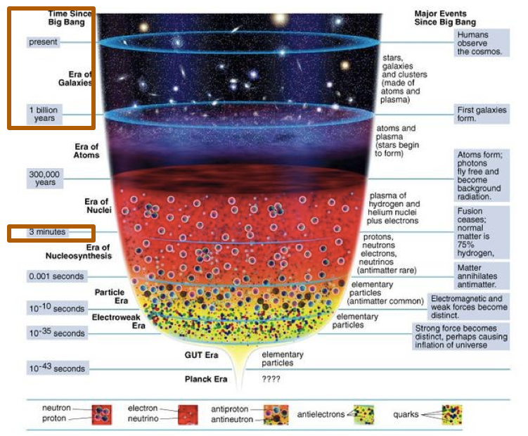
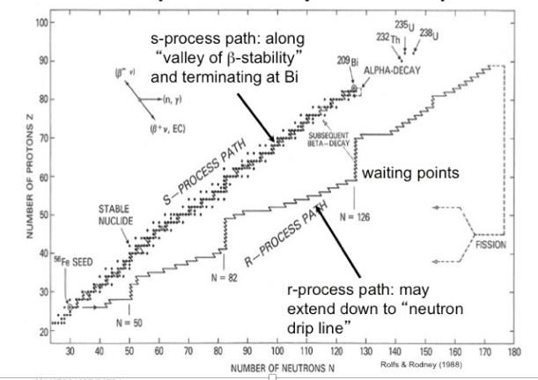
Nucleosynthesis
A<8 in the Big Bang
8<A<56:
  p, n Capture Q-value>0
A>56,
  P, n capture Q-Value<0

Slide 4
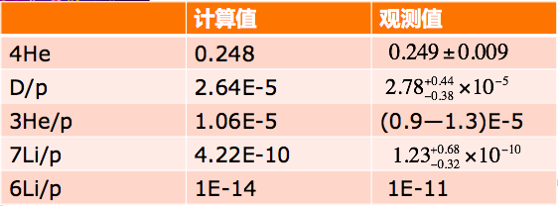
Lithium Abundance Puzzle

Slide 5
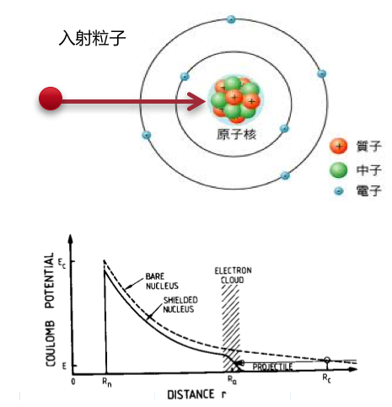
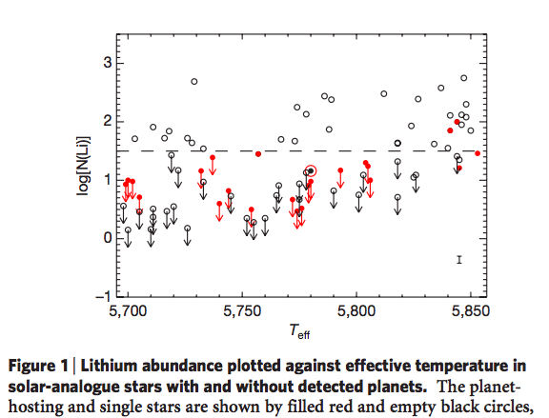
“Plasma”Makes Difference
Life time may diff.
  ⁷Be^{neutral} t_{1/2} =52d； ⁷Be⁴⁺ : Stable！
Potentials are diff.
  e screening
Collisionless shock acc.
Even the planets makes Diff
  Astr. observation:

Slide 6
“Laser Nucl. Phys” New Phys?
Lasers bring new extreme environment
  High pressure, temp., current…
  Plasma, -----e cloud free.
Exp. Methods
  Coulomb Explosion.
  Laser Acc. + LaserPlasma Targets
  “Laser Plasma Collider”

Slide 7
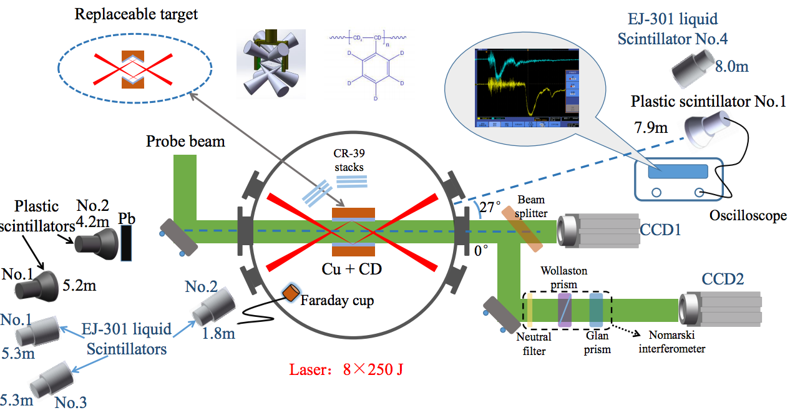
Exp. Setup

Slide 8
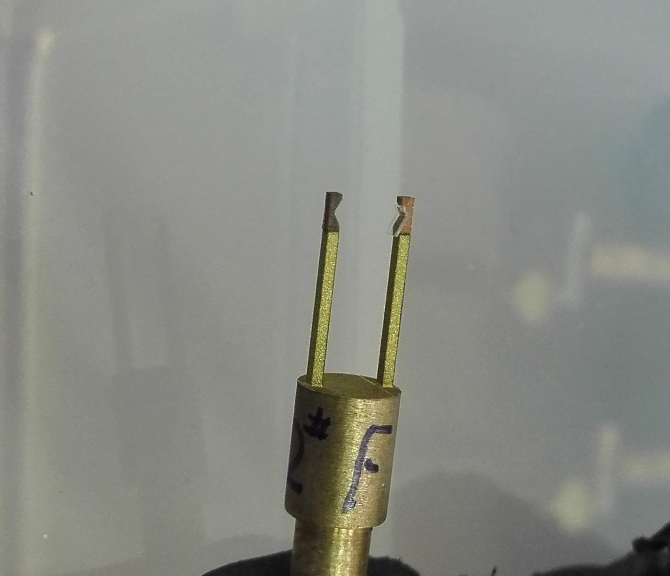
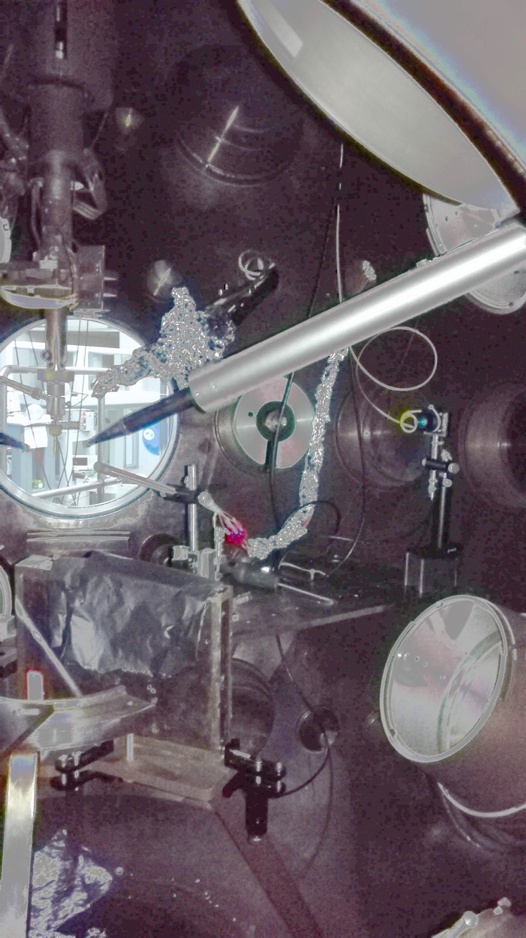
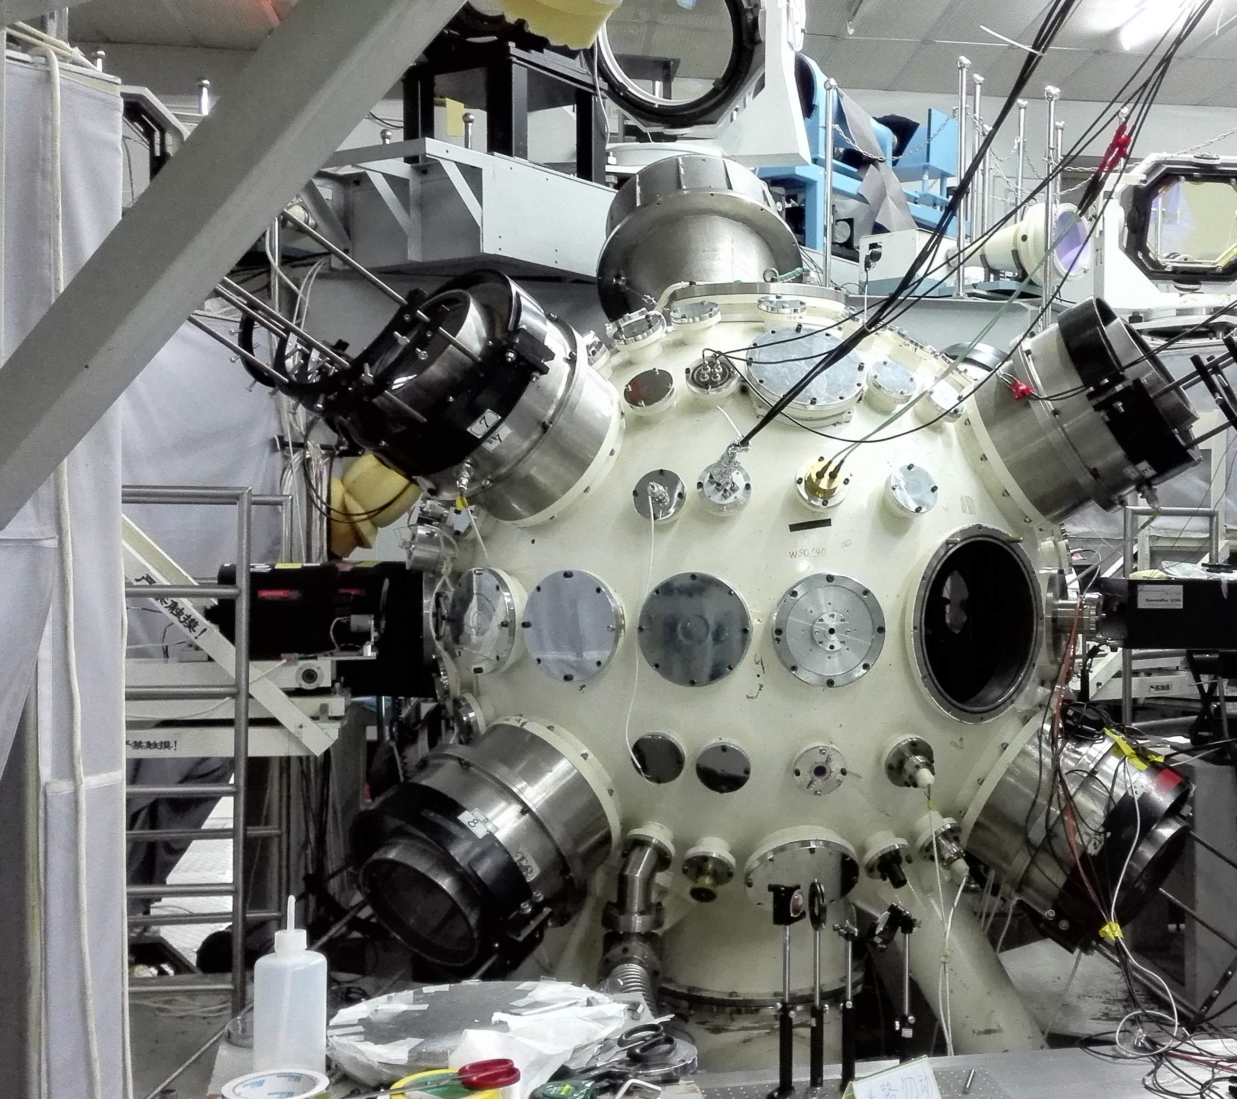
a

Slide 9
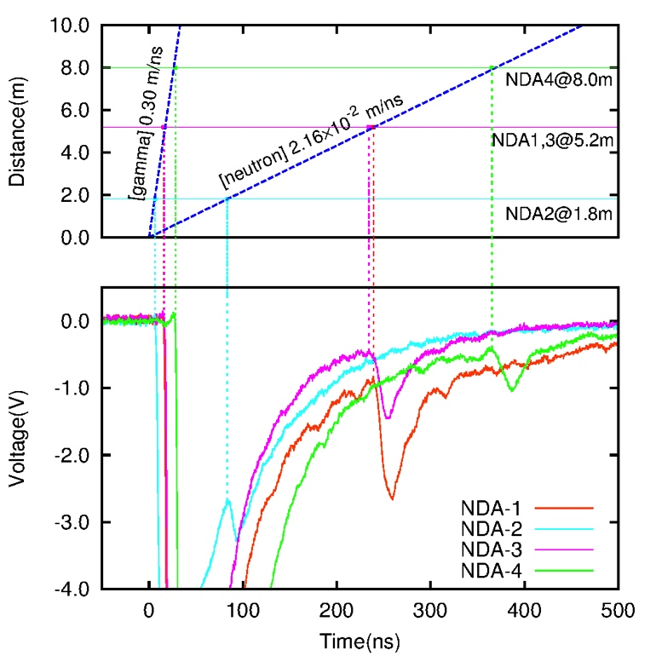
Neutron Spectra in D(d,n)

Slide 10
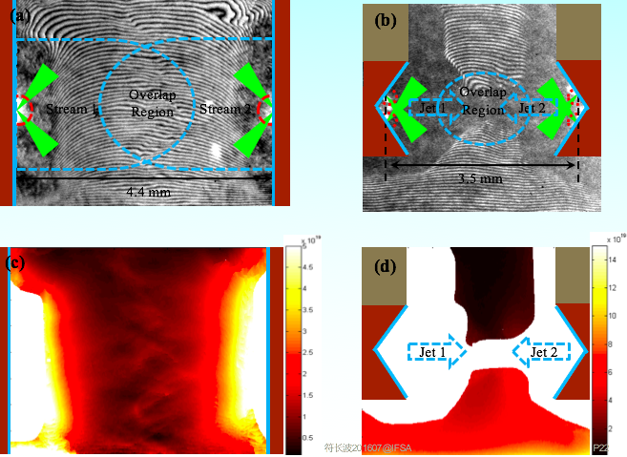
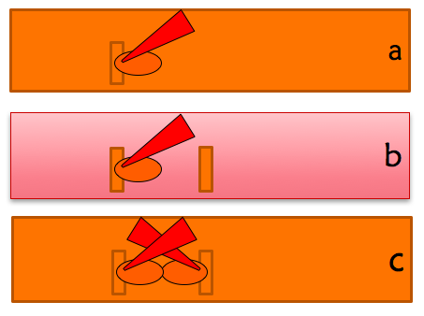
Where did the n products come from?

Slide 11
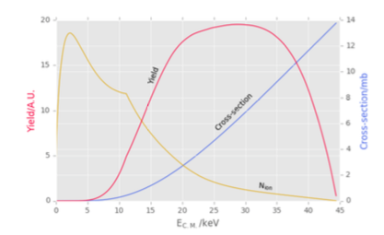
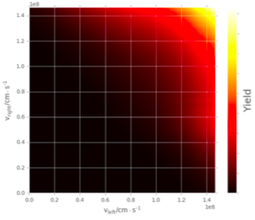
Neutron products in d(d,n)
The diff between theory and exp. is as large 8 times!
This may come from
  Plasma density
  Magnetic Field

Slide 12
Weibel instabilities
Electron (NOT Ion) obtains high energy from Laser field
Electrons fly away, Drag the Ions together
e-e; e-i; i-i scattering
E field
M field strength
Reynolds Number >20
Our neutron Yields consistent with the prediction
PRL.111(2013)235003

Slide 13
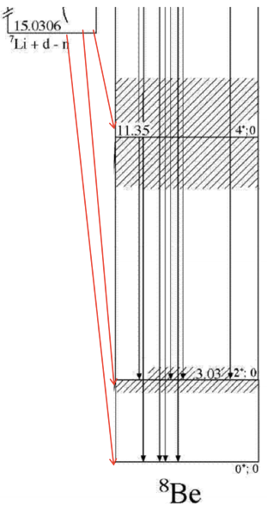
Li(d, n)
Three body reaction?
D+⁷Li→g.s. (0+)
    →1st e.s.(2+)
    →2nd e.s.(4+)

Slide 14
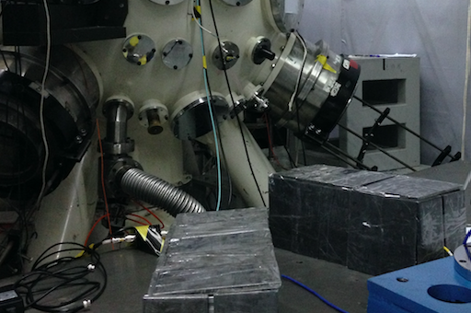
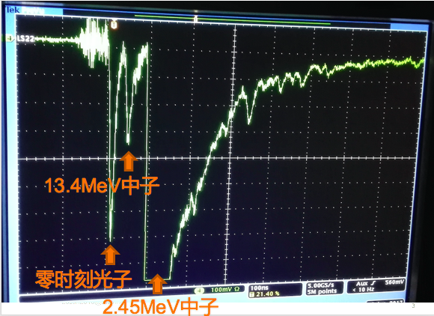
Pb shielding
Lead Shielded
Neutron Detectors
By using the Lead Shielding, the strong signals from t=0 is compressed
D+D neutrons (2.45MeV) 和 D+⁷Li neutorn (13.4MeV) were identified.
The date is useful for solving the Big Bang Lithium Puzzle
It provides a probe to detect the Ion Temperature in the Plasma.
13.4MeV neutron
Signal @ T=0
2.45MeV neutorns

Slide 15
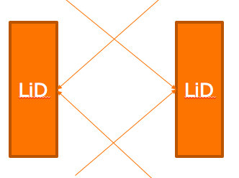
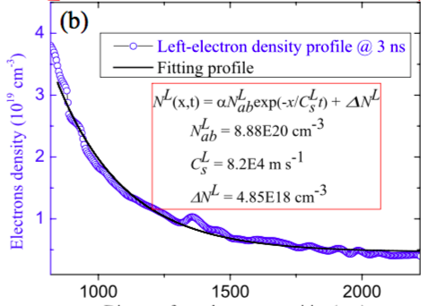


D-D and D-Li products Ratio
Incoming CH.: Total numbers
Incoming CH.: Spectra
Outgoing CH.: Spec.,
Outgoing CH.: tot. numbers.
m/q(7Li) =2.33
m/q(D)=2

Slide 16
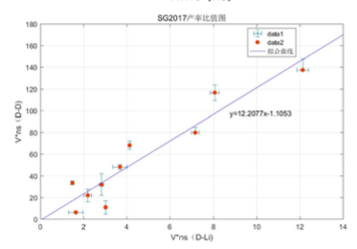
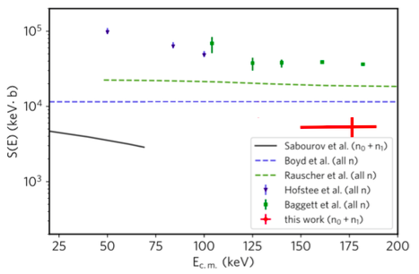
Exp. Results
DD and DLi Ratio
S-factor of D-Li7

Slide 17
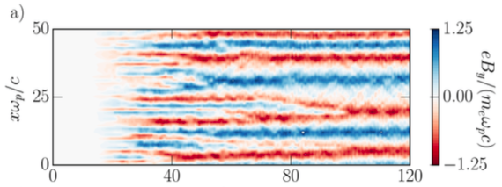
Discussion
Plasma may play important rule!
  e screening
  Magnetic field!

Slide 18
Summary
Laser+Nuclear Physcs➔ New field
  Plasma Enviroment
  “collisionless Plasma Enviroment
D+D和D+Li （The Big Bang Lithium Puzzle）
  Measure the S-factor of DLi7 in Plasma, 1st time.
  Mag. Structure may cause huge reaction rate changing.
The “plasma collider” was proved to be useful tool for nuclear astrophysics.

Slide 19
Collaborators
Changbo Fu, Yang Sun, Liang Li, Xiaopeng Zhang, Ji Zhang (Shanghai Jiao Tong U.)
Yutong Li, Liming Chen, Jiarui Zhao, Baojun Zhu, Guoqian Liao, Yanfei Li (Inst. Phy., CAS)
Jianjun He, Shiwei Xu(Inst. of Mod. Phys. CAS)
Jie Bao, Long Hou(China Inst. of Atomic Eng.)
Yongjoo Rhee (Nucl. Data Center, Korea)
Dawei Yuan, Gang Zhao (Nat.Astro. Obs. CAS)
Jianqiang Zhu(SH Inst. Op.& Fine Mech., CAS)

