Slide 1
Cluster structure of excited ⁹Li
Fourth International Workshop on “State Of the Art in Nuclear Cluster Physics”
May 13-18, 2018
Galveston, TX, USA
Jian-Song Wang, Wei-Hu Ma, D. Patel et al.
INSTITUTE OF MODERN PHYSICS, CHINESE ACADEMY OF SCIENCES

Slide 2
Outline
Experimental studies of nuclear cluster physics at RIBLL1
t + ⁶He structure of ⁹Li*
  Experimental details
  Data analysis
  Discussion
Summary &Outlook

Slide 3
Current Main Exp. Setups at HIRFL-CSR
SHANS
Spectrometer of Heavy Atoms & Nuclear Structure
RIBLL 1
RIBs produced via PF & transfer with primary beams up to Kr
ETF
RIB Physics at intermediate energy
EOS of asymmetric nuclaer matter
High baryon density matter
CSRe
Mass measurement
Decay spectroscopy
Atomic physics with cooling storage ring
SHANS
HIRFL - CSR
SFC: ≤ 10 AMeV (A/q=2)
SSC: ≤ 100 AMeV (A/q=2)
CSRm: ≤1.0 AGeV (A/q=2)
CSRe: ≤ 0.76 AGeV (A/q=2)
SSC
SFC
CSRe
CSRm
RIBLL 1
ETF
CSRe

Slide 4
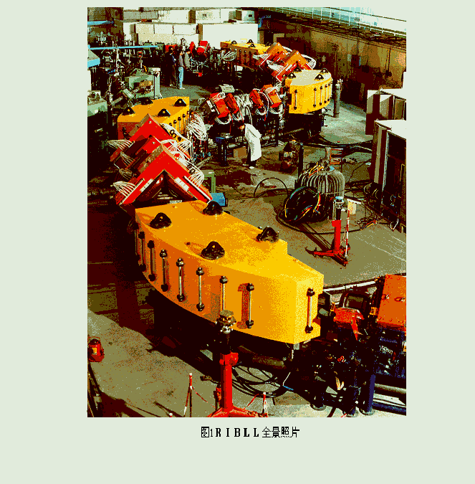
Radioactive Ion Beam Line in Lanzhou (RIBLL)
Particle Identification by
dE vs T1-T2
High mass resolution
Normal RIB intensity
Also be used as a spectrometer
Particle Identification by
dE vs RF-T1
Low mass resolution
High RIB intensity

Slide 5
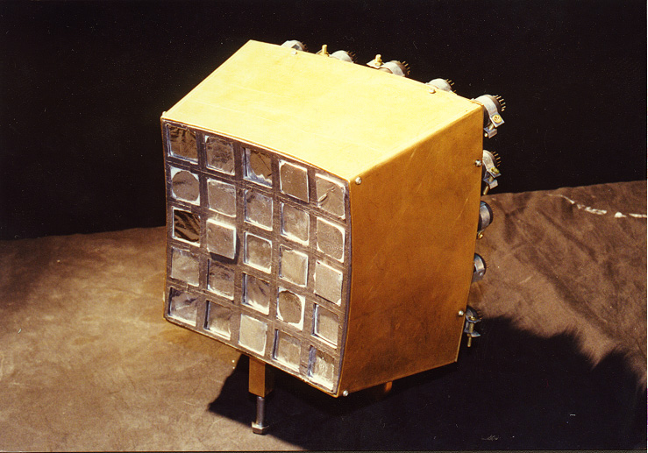
Experimental setup for ⁶He,⁶Li Reactions
Beams of ⁶He，⁶Li
40º
film
collimator
⁹Be target
Scintillating counter
24-unit CsI array
Beam Energy：55MeV/u ⁶He; 52MeV/u ⁶Li Target thickness: 1mm

Slide 6
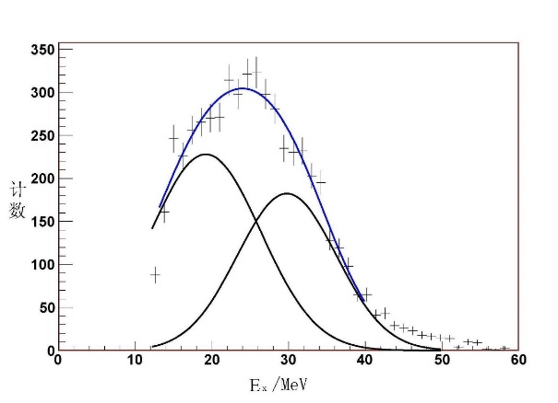
Clustering States of ⁶He (t+t)
 | E_{x}(MeV) | Γ(MeV) | E_{x}(MeV) | Γ(MeV)
RGM | 18.1 |  | 25.6
Akimune^{a)} | 18.0±0.5 | 7.7±1 | 25.5±1.0 | 12
This work | 19.2±0.4 | 16.9±2.0 | 29.8±0.8 | 15.2±1.6
a) H. Akimune et al., PRC67(2003)051302R
Hui Gao’s PhD thesis, 2007

Slide 7
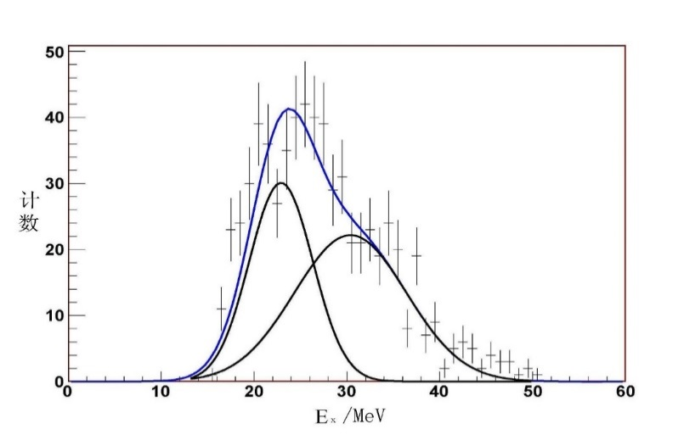
Clustering States of ⁶Li(³H+³He)
 | RGM | CSRGM | Ventura^{a)} | Vlastou^{b)} | Mondragon^{c)} | Nakayama^{d)} | This work
E_{x}(MeV) | 21.3(¹P₁) 22.3(³P_{0,1,2}) | 17.1 16.9 |  | 21.0 21.5 | 17.89 | 18.022 | 22.9±0.8
Γ(MeV) | 6.9 9.3 | 4.4 5.5 |  |  | 3.0 | 2.08 | 3.4±0.4
E_{x}(MeV) | 28.9(¹F₃) 29.8 (³F_{2,3,4}) | 25.9 26.3 | 26.2 26.7 | 25.7 26.7 | 24.8~26.6 | 29±2 | 30.3±1.6
Γ(MeV) | 5.9 7.5 | 9.5 11.1 |  |  | 5.3~8.7 | 10±2 | 6.0±0.6
E. Ventura et al., NPA173(1971)p1
R. Vlastou et al., NPA292(1977)p29
A. Mondragon et al., PRC41(1990)p1975
S. Nakayama et al., PRC69(2004)041304R
Hui Gao’s PhD thesis, 2007

Slide 8
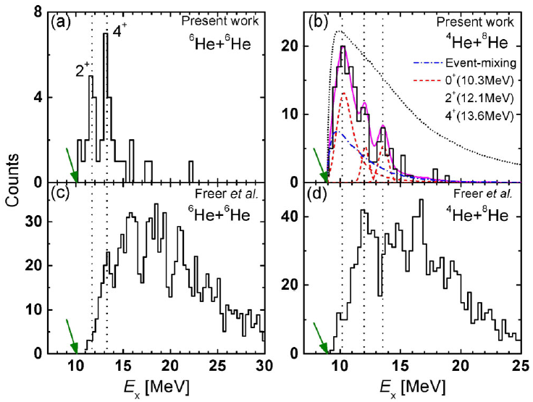
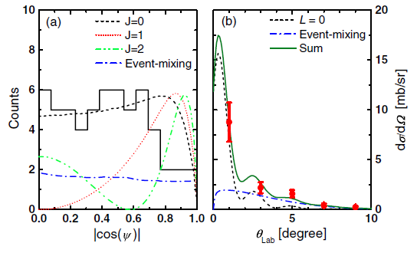
Clustering Study of ¹²Be
A large monopole transition matrix element of 7.0± 1.0 fm² and a large cluster-decay width were determined for ⁴He+⁸He molecular rotation at about 10.3MeV of excited ¹²Be for the first time.
Zero degree detection technique is crucial.
Z.H.Yang et al., Phys. Rev. Lett 112, 162501 (2014),Z.H.Yang et al., Phys. Rev. C 92, 024304 (2015)

Slide 9
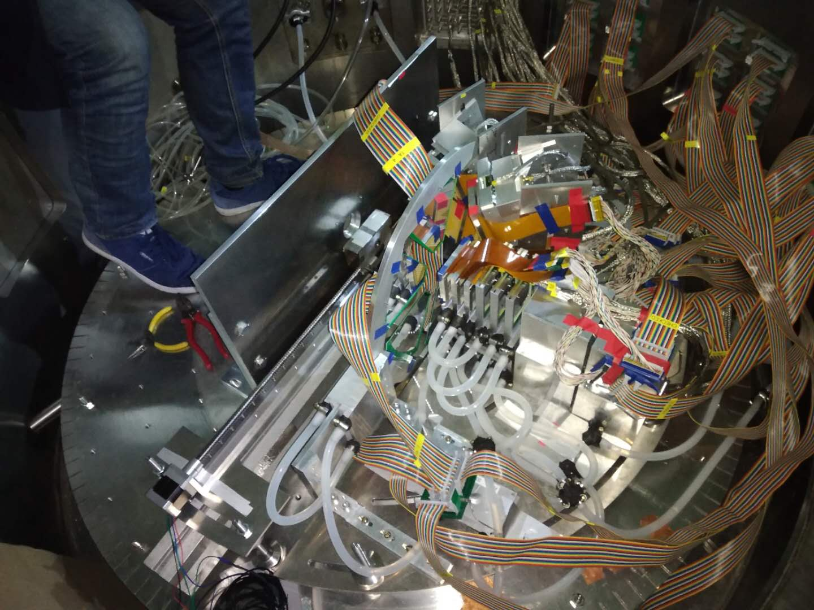
Other experiments done at RIBLL1
Mar. 2015 ²⁰O
Sep. 2016 ¹⁴C
Apr. 2018 ¹⁶C
Prof. Yan-Lin Ye’s group

Slide 10
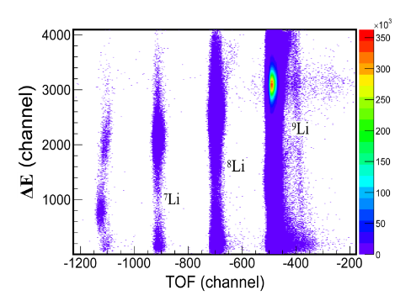
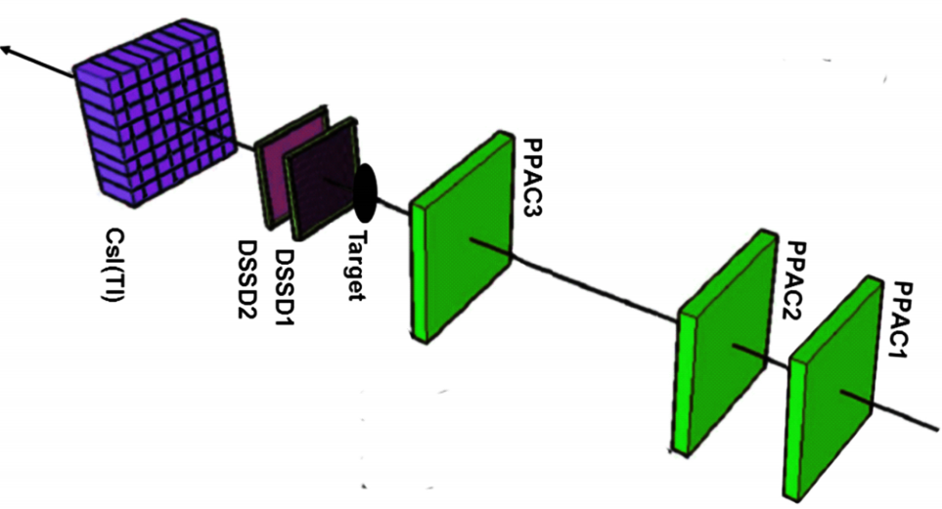
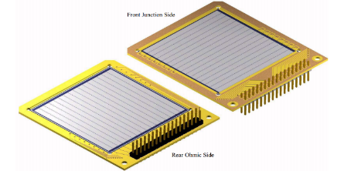
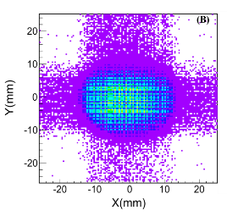
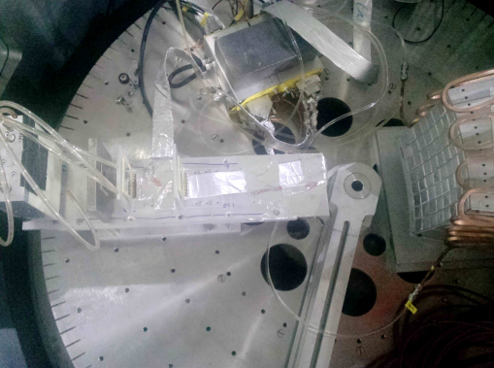
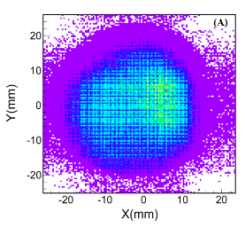
Experimental Setup of ⁹Li
450 mm 93 mm 40 mm 91.55 mm 905 mm 390 mm
Primary：¹²C@ 53.7 MeV/u
Target：⁹Be（3038 μm）
RIB：⁹Li@295 MeV
Intensity：1.1x10³ particles/s
Purity：99%

Slide 11
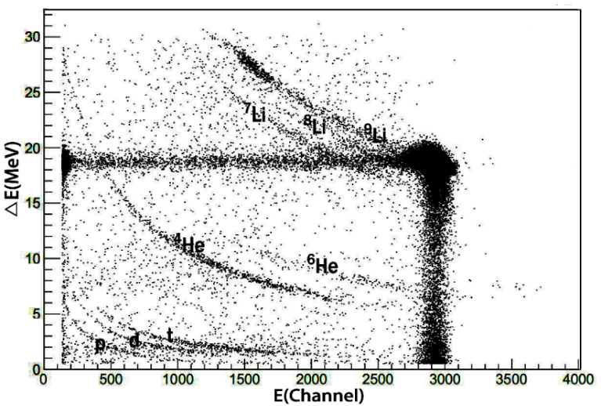
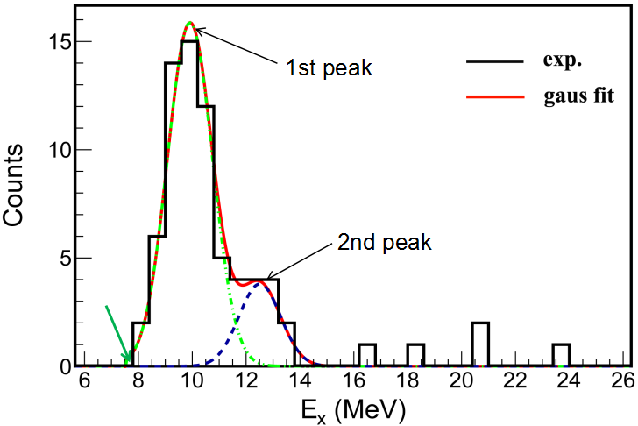
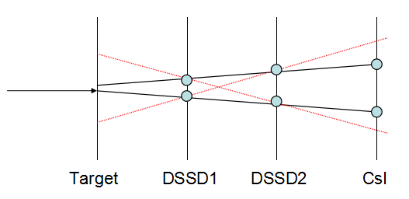
Event Selection and Reconstruction
Invarant mass:
Excitation energy:
m₁
Relative energy:
M
θ₁₂
m₀
m₂
Threshold energy of ⁶He+t : E_{thr}=7.588 MeV

Slide 12


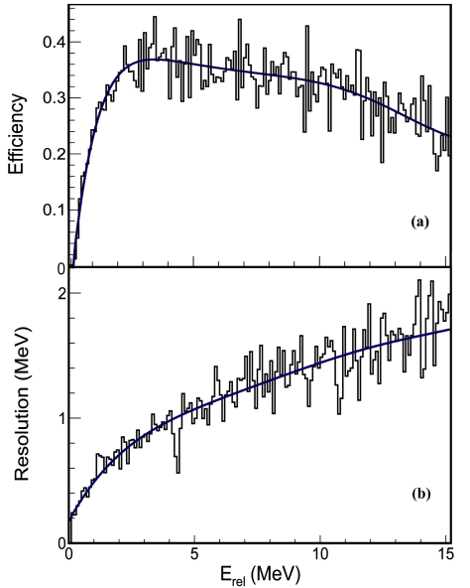
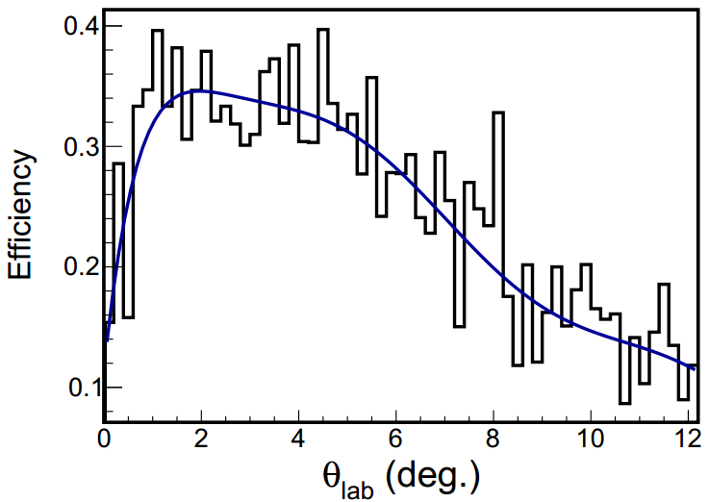
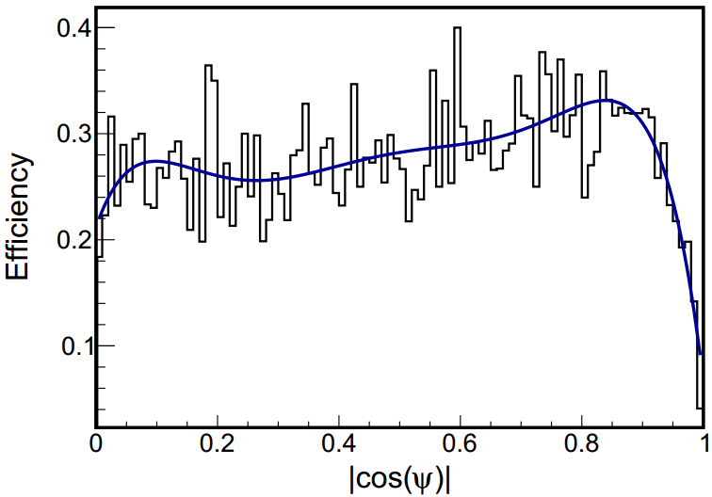
Simulation of Detector efficiency
A Monte Carlo simulation is performed to determine the detection efficiency according to the geometry, assuming isotropic emission of the fragments in the center of mass frame.

Slide 13
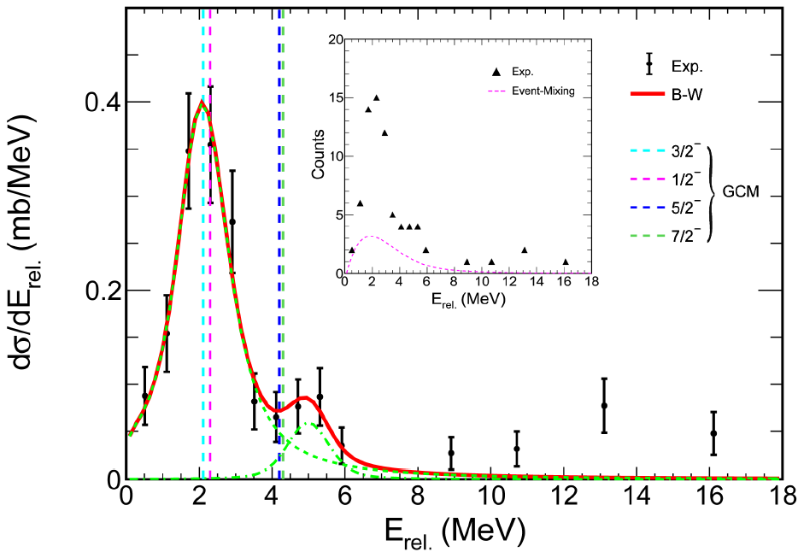
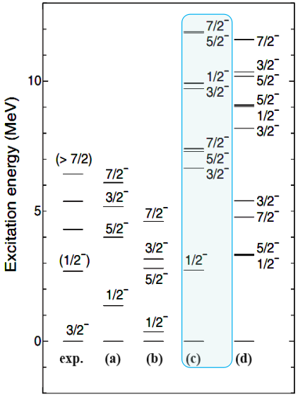
Comparison with GCM predictions
E_{R} (MeV) | Γ (MeV) | χ²
9.8±0.2 | 1.4±0.5 | 0.98
Y. Kanada-En’yo and T. Suhara, PRC 85, 024303(2012).
Yoshiko Kanada-En’yo, PRC 94, 024326 (2016).

Slide 14
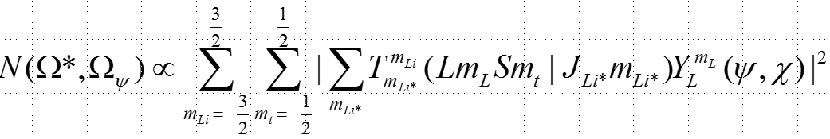
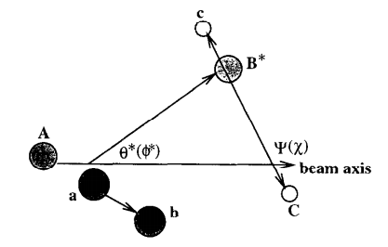
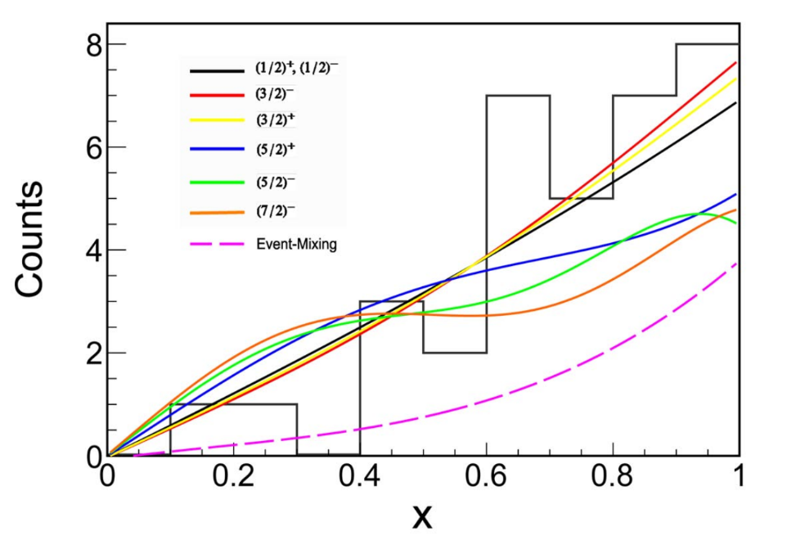
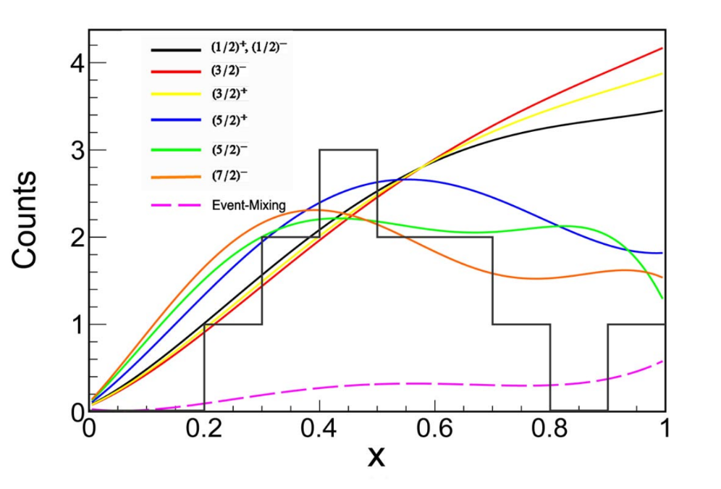
Angular Correlation Analysis
x=sin(ψ)
The relative momentums of the two clusters are determined to be 1 for the 1st peak and 2 for the 2nd peak respectively.
1st peak
2nd peak
G. Finkel et al., Phys. Rev. C19 (1979) 1782

Slide 15
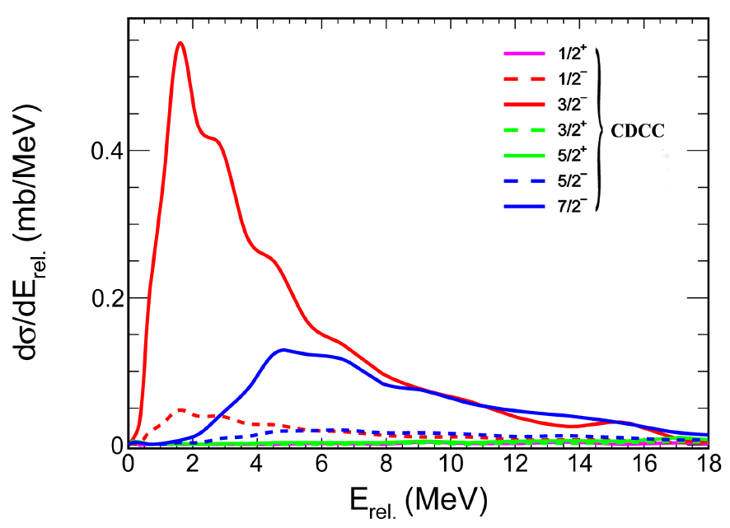
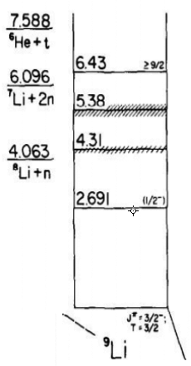
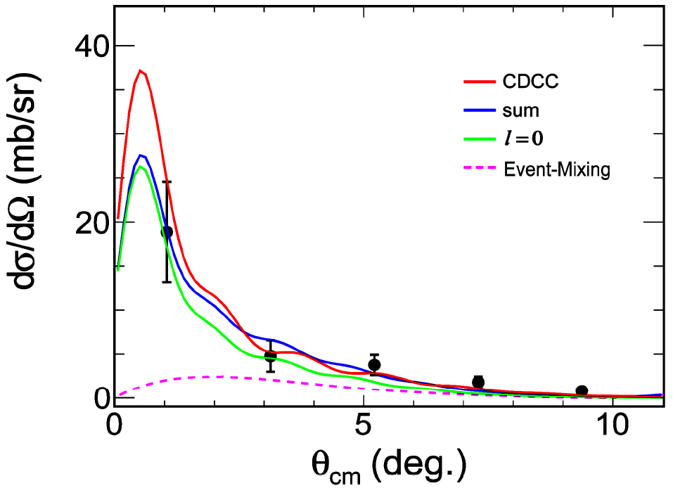
CDCC Analysis
⁹Li modeled as 2-body projectile
t (1/2⁺) valence
⁶He(0⁺)
core
²⁰⁸Pb target
⁹Li ground state p3/2⁻

Slide 16
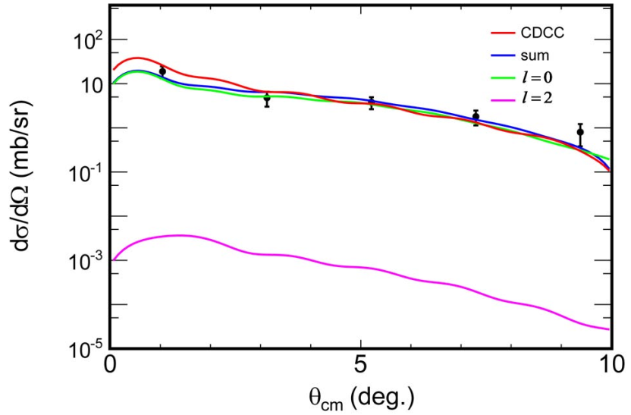
Multipole-Decomposition Analysis
the DWBA cross sections exhausting the full EWSR for the transferred angular momentum l
Monopole transition potential:
Quadrupole transition potential :
D. J. Horenet al.Phys Rev C 52(1995) 1554
B. Bonin et al., Nucl. Phys. A 430 (1984) 349-396
a₀=0.023(4)；M(IS0)=4.0±0.5(stat.) fm²

Slide 17
Summary & Outlook
The experimental methods are developed for studying α and t(³He) cluster structure of light unstable nuclei at RIBLL1
Two resonant states are clearly observed with the excitation energies at 9.8 MeV and 12.6 MeV and spin-parity of 3/2⁻ and 7/2⁻respectively.
A monopole transition matrix element about 4 fm² for the 3/2⁻ state is extracted with DWBA calculations.
These experimental results consist with the prediction of generator coordinate method (GCM), supporting the feature of clustering structure of two neutron-rich clusters in the ⁹Li*.
Experiment to study 3t cluster structure of ⁹Li is under consideration.

Slide 18
Thanks for your attention
Thanks to all collaborators:
Insitute of Modern Physics, CAS : Y. Y. Yang, J. B. Ma, S. L. Jin, P. Ma, Q. Hu, Z. Bai,,1 X. Q. Liu, Y. J. Zhou, J. Chen, Z. H. Gao, Q. Wang, Y. H. Zhang, H. S. Xu, and G. Q. Xiao
Peking University: Yan-Lin Ye, Zai-Hong Yang
Instituto de Fısica, Universidade Federal Fluminense, Brazil: J. Lubian
M.S. University of Baroda, India: S. Mukherjee
Southwest University, China: J. X. Li
BeiHang University, China: T. F. Wang, T. W. Wu, C. Ni
University of Science and Technology of China: X. Y. Ju
Chongqing University: Y. S. Yu, X. D. Jia, Q. B. Liu
We gratefully acknowledge Prof. Y. Kanada-En’yo, Prof. C. J. Lin and Prof. D. Y. Pang for the fruitful discussion.

