Slide 1
State of the Art in Nuclear Cluster Physics, Galveston (Texas, USA), 13-18 May 2018
Sezione di Napoli
A new measurement of the direct α-decay width of the
Hoyle state in ¹²C
Istituto Nazionale di Fisica Nucleare - Sezione di Napoli
Daniele Dell’Aquila¹
¹ INFN – Sezione di Napoli, Napoli, Italy
dellaquila.daniele@gmail.com
Galveston, May 15th 2018

Slide 2
In this talk…
⁸Be
α
¹²C* Hoyle
α
Outline of the talk:
The Hoyle state in Nuclear Structure and Nuclear Astrophysics;
The direct vs sequential decay branch: an overview of the previous experimental results;
High-precision investigation of the direct decay width of the Hoyle state: our experiment.
sequential
α
α
α
α
direct
α
α
α
Istituto Nazionale di Fisica Nucleare - Sezione di Napoli
Daniele Dell’Aquila (dellaquila.daniele@gmail.com) – Galveston, May 15th 2018

Slide 3
Exotic structures in light nuclei
Complexity of nuclear force → deviation from the sphericity: axial deformation (collective behaviours), spatial re-organization of nucleons in bounded sub-units (cluster model).
¹²O
¹³O
¹⁴O
¹⁵O
¹⁶O
¹⁷O
¹⁸O
¹⁹O
²⁰O
²¹O
²²O
¹¹N
¹²N
¹³N
¹⁴N
¹⁵N
¹⁶N
¹⁷N
¹⁸N
¹⁹N
²⁰N
²¹N
C
⁸C
⁹C
¹⁰C
¹¹C
¹²C
¹³C
¹⁴C
¹⁵C
¹⁶C
¹⁷C
¹⁸C
¹⁹C
²⁰C
α
B
⁸B
⁹B
¹⁰B
¹¹B
¹²B
¹³B
¹⁴B
¹⁵B
¹⁷B
¹⁹B
α
Istituto Nazionale di Fisica Nucleare - Sezione di Napoli
Be
⁷Be
⁸Be
⁹Be
¹⁰Be
¹¹Be
¹²Be
¹⁴Be
α
Li
⁶Li
⁷Li
⁸Li
⁹Li
¹¹Li
linear chain
¹⁰Be,¹³⁻¹⁴C,¹⁶C(?),…
He
³He
⁴He
⁶He
⁸He
¹H
²H
³H
α
α
n
core
α
α
α
core
neutron skin
⁸He,C
α-cluster
⁸Be
neutron halo
⁶He,¹¹Li,¹¹Be
dilute gas
¹²C 0⁺,¹⁶O,²⁰Ne(?)
Daniele Dell’Aquila (dellaquila.daniele@gmail.com) – Galveston, May 15th 2018

Slide 4
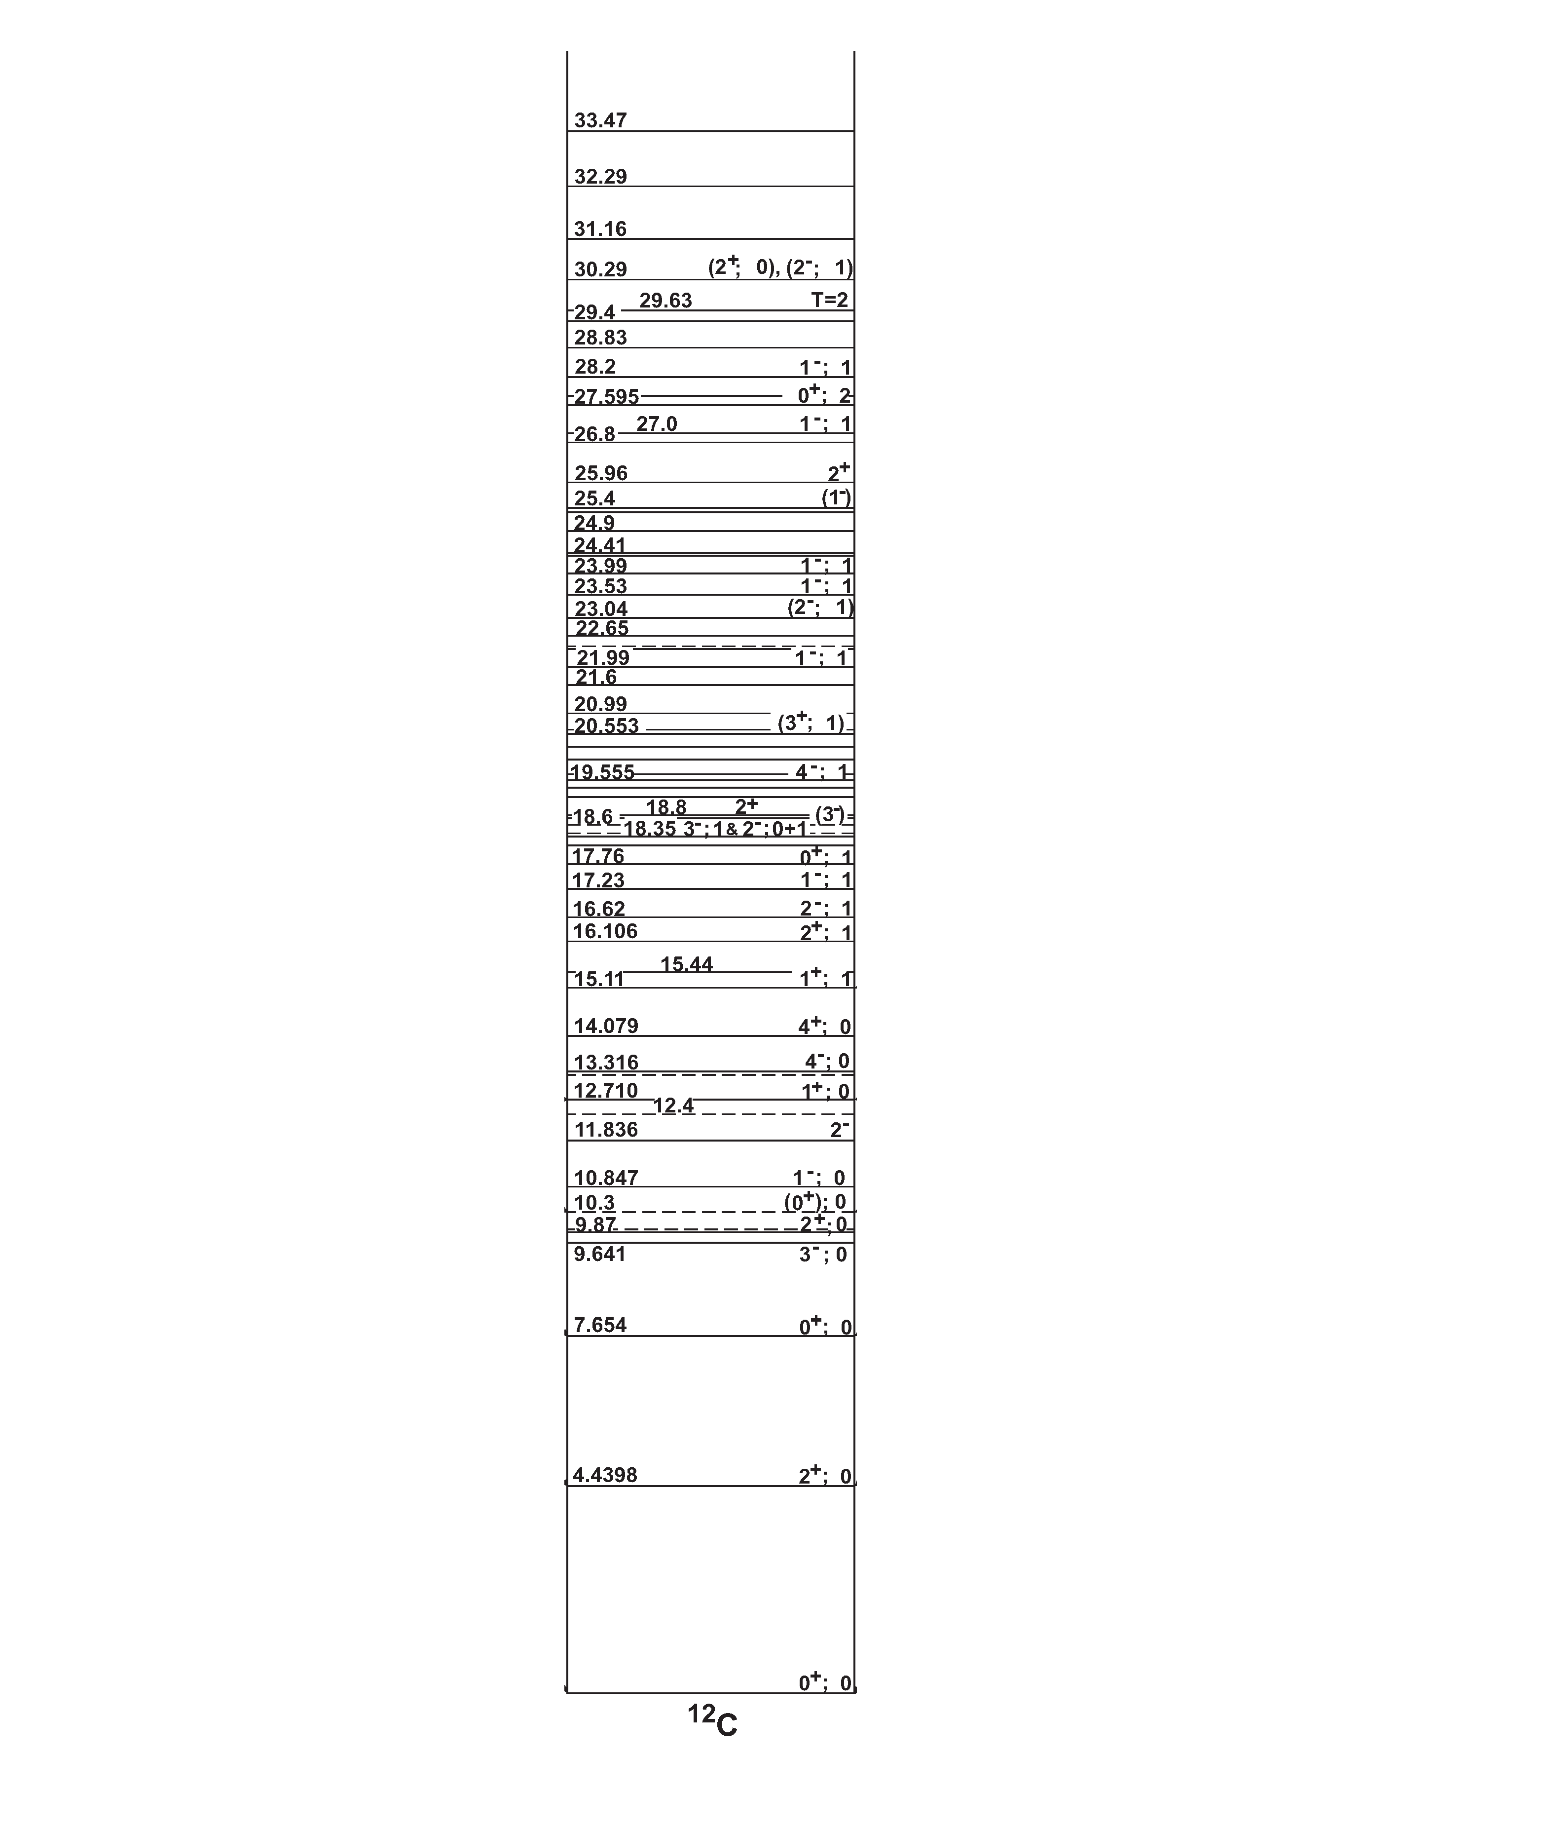
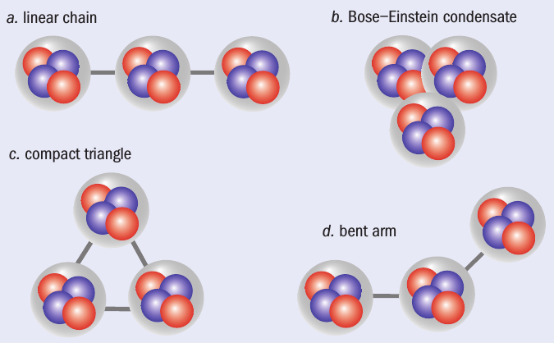
A very special case: the Hoyle state in ¹²C
The structure of ¹²C
Cluster state of ¹²C located at 7.654 MeV (0⁺) → characterized by a pronounced cluster nature → quite unusual and not well understood properties → challenging open question in nuclear physics.
E_{x} = 7.654 MeV
J^{π} = 0⁺
from Ajzenberg-Selove
Istituto Nazionale di Fisica Nucleare - Sezione di Napoli
18.722
¹¹C + n
15.957
¹¹B + p
D. Jenkins and O. Kirsebom, The Secret of Life,
Physics World Feb. 2013
4⁺ $≈$14 MeV
M. Freer et al., Phys. Rev. C 83, 034314 (2011)
4⁺
Hoyle band
(a) linear chain: α-cluster model
(b) Bose-Einstein condensate: microscopic models (GCM, RGM)
(c) compact triangle: ACM
(d) bent-arm: microscopic models (Faddev three-body formalism)
2⁺ 9.75 MeV
2⁺
7.367
⁸Be + α
0⁺
M. Itoh et al., Phys. Rev. C 84, 054308 (2011).
M. Freer et al., Phys. Rev. C 80, 041303 (2009).
W. R. Zimmerman, N. E. Destefano, M. Freer,
M. Gai, and F. D. Smith, Phys. Rev. C 84, 027304 (2011).
Daniele Dell’Aquila (dellaquila.daniele@gmail.com) – Galveston, May 15th 2018

Slide 5
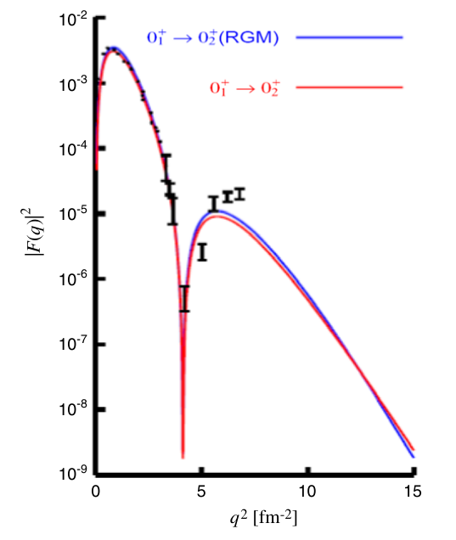
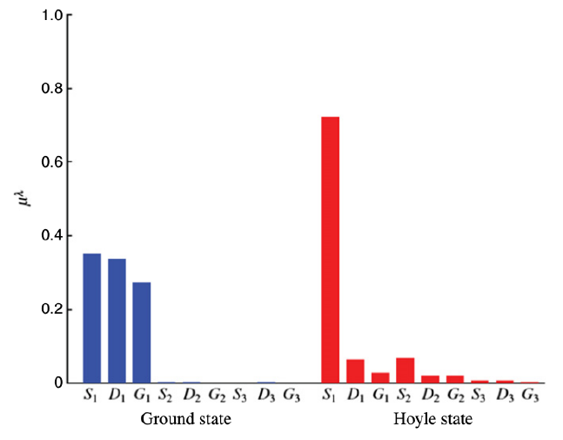
The Hoyle state in Nuclear Structure
I. Sick, J.S. McCarthy, Nuclear Phys. A 150 (1970) 631
A. Nakada et al., Phys. Rev. Lett. 27 (1971) 745
P. Strehl, Th.H. Schucan, Phys. Lett. B 27 (1968) 641
Bose-Einstein condensation phenomena in nuclei
Weakly bound system → an α may tunnel significantly into the barrier → increasing of the volume → the internal structure of a-particles is no longer important (antisymmetrization properties negligible) → the bosonic system may condensate → Bose Einstein Condensate (BEC).
electron inelastic scattering
Istituto Nazionale di Fisica Nucleare - Sezione di Napoli
Ground state
Hoyle state
Tohsaki, Horiuchi, Schuck and Röpke (THSR) wave-function method→ fit of the electron inelastic scattering 0⁺ $→$ 0⁺₂ → Hoyle state radius 1.35 – 1.60 times the ground state one.
$≈70\%$
S-orbital
amplitude
$$|Ψ_{THSR}〉=S_{1}|Ψ_{S_{1}}〉+D_{1}|Ψ_{D_{1}}〉+…$$
Dominant amplitude → BEC
- Taiichi Yamada and Peter Schuck, Eur. Phys. J. A26, 185 (2005)
- Y. Funaki, H. Horiuchi, W. von Oertzen, G. Röpke, P. Schuck, A. Tohsaki, and T. Yamada, Phys. Rev. C 80, 064326 (2009)
Daniele Dell’Aquila (dellaquila.daniele@gmail.com) – Galveston, May 15th 2018

Slide 6
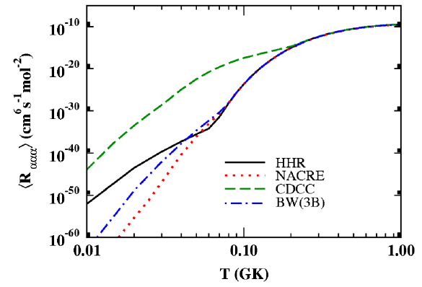
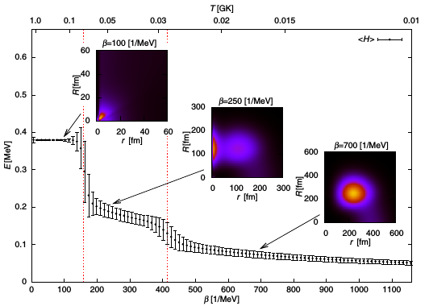
The Hoyle state in Nuclear Astrophysics
At stellar temperatures T>10⁸ K
N.B. Nguyen et al., Phys. Rev. Lett. 109 (2012) 141101
The energy needed to form a ⁸Be (92 keV) is extremely close to the Gamow window→
ex: T=10⁸ K → Gamow peak E_{G}=85 keV,
Γ_{G} = 60 keV → the process is resonant
the 3α reaction rate is related to the properties of the Hoyle state via (NACRE rate):
$$<σv> ∝\frac{Γ_{α}Γ_{rad}}{Γ}e^{−\frac{E_{R}}{K_{B}T}}$$
Istituto Nazionale di Fisica Nucleare - Sezione di Napoli
At stellar temperatures T<10⁸ K
3 α-particles do not have access to the intermediate resonances → non-resonant processes take place:
N.B. Nguyen et al., Phys. Rev. Lett. 109 (2012) 141101 → the triple α process proceeds through the 0⁺ continuum states to the 2⁺₁ ¹²C state (ex: T=0.02 GK → 7-20 orders of magnitude enhancement with respect to the NACRE rate!).
Akahori et al., Phys. Rev. C 92 (2015) 022801 → the process is direct at T<0.028 GK → calculated rate via imaginary-time formalism agrees with the NACRE empirical rate.
Akahori et al., Phys. Rev. C 92 (2015) 022801
Daniele Dell’Aquila (dellaquila.daniele@gmail.com) – Galveston, May 15th 2018

Slide 7
The Hoyle state in ¹²C: the non-resonant decay branch
⁸Be
α
α
¹²C*
sequential
α
α
α
α
direct
α
α
α
Experiment | $$Γ_{3α}/Γ (\%)$$ | C.L.
[1] M. Freer et al. | $$<4$$ | $$2σ$$
[2] Ad.R. Raduta et al. | $$17.0±5.0$$ | $$…$$
[3] J. Manfredi et al. | $<3.9$ (DDE < 0.45) | $$3σ$$
[4] O.S. Kirsebom et al. | $$<0.5$$ | $$2σ$$
[5] T.K. Rana et al. | $$0.91±0.14$$ | $$3σ$$
[6] M. Itoh et al. | $$<0.2$$ | $$2σ$$
[7] L. Morelli et al. | $$1.1±0.8$$ | $$…$$
Istituto Nazionale di Fisica Nucleare - Sezione di Napoli
J. Manfredi et al.
No evidence of equal energy sharing decays (<0.45 % with 99.75 % C.L.). Uniform phase space decay < 3.9% (99.75 C.L.).
[1] M. Freer et al., Phys. Rev. C 49, R1751 (1994). [2] Ad. R. Raduta et al., Phys. Lett. B 705, 65 (2011). [3] J. Manfredi et al., Phys. Rev. C 85, 037603 (2012). [4] O. S. Kirsebom et al., Phys. Rev. Lett. 108, 202501 (2012). [5] T. K. Rana et al., Phys. Rev. C 88, 021601(R) (2013). [6] M. Itoh et al., Phys. Rev. Lett 113, 102501 (2014). [7] L. Morelli et al., J. Phys. G: Nucl. Part. Phys. 43, 045110 (2016).
Daniele Dell’Aquila (dellaquila.daniele@gmail.com) – Galveston, May 15th 2018

Slide 8
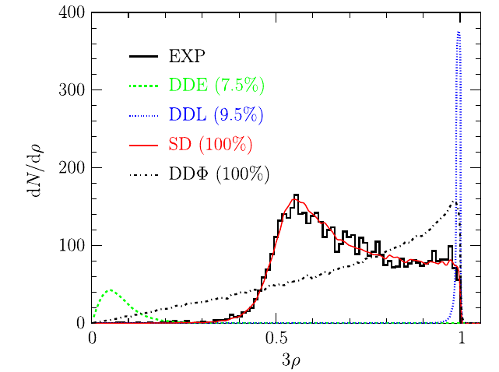
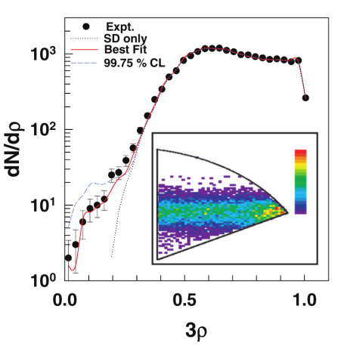
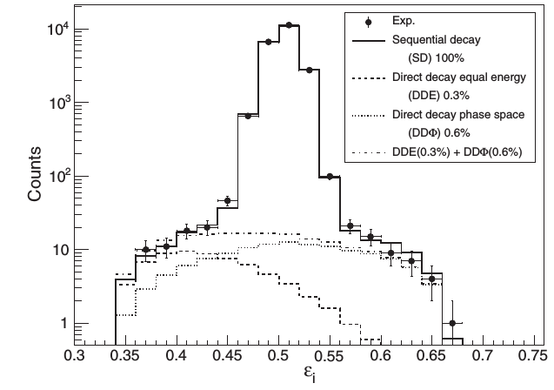
The Hoyle state in ¹²C: the non-resonant decay branch
⁸Be
α
α
O.S. Kirsebom et al.
$≈5000$ events → no evidence of direct decays → upper limit of 0.5% to direct branching ratios.
¹²C*
sequential
α
α
α
α
direct
α
α
α
Experiment | $$Γ_{3α}/Γ (\%)$$ | C.L.
[1] M. Freer et al. | $$<4$$ | $$2σ$$
[2] Ad.R. Raduta et al. | $$17.0±5.0$$ | $$…$$
[3] J. Manfredi et al. | $<3.9$ (DDE < 0.45) | $$3σ$$
[4] O.S. Kirsebom et al. | $$<0.5$$ | $$2σ$$
[5] T.K. Rana et al. | $$0.91±0.14$$ | $$3σ$$
[6] M. Itoh et al. | $$<0.2$$ | $$2σ$$
[7] L. Morelli et al. | $$1.1±0.8$$ | $$…$$
T.K. Rana et al.
$≈20000$ events → non-vanishing direct decay branching ratio
$$\frac{Γ_{3α}}{Γ}=0.91±0.14$$
Istituto Nazionale di Fisica Nucleare - Sezione di Napoli
M. Itoh et al.
$≈20000$ events → direct decay under the sensitivity of the experimental sensitivity → <0.2%
[1] M. Freer et al., Phys. Rev. C 49, R1751 (1994). [2] Ad. R. Raduta et al., Phys. Lett. B 705, 65 (2011). [3] J. Manfredi et al., Phys. Rev. C 85, 037603 (2012). [4] O. S. Kirsebom et al., Phys. Rev. Lett. 108, 202501 (2012). [5] T. K. Rana et al., Phys. Rev. C 88, 021601(R) (2013). [6] M. Itoh et al., Phys. Rev. Lett 113, 102501 (2014). [7] L. Morelli et al., J. Phys. G: Nucl. Part. Phys. 43, 045110 (2016).
Daniele Dell’Aquila (dellaquila.daniele@gmail.com) – Galveston, May 15th 2018

Slide 9
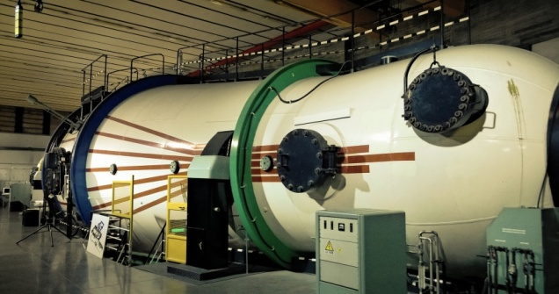
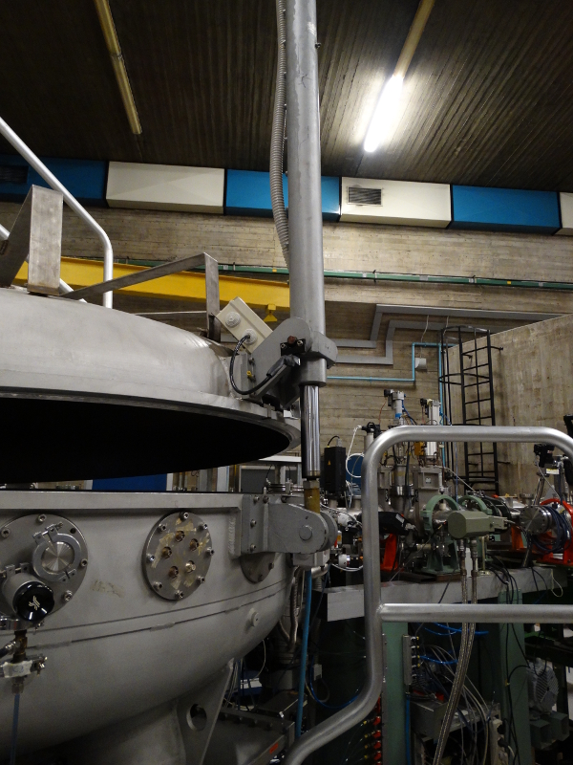
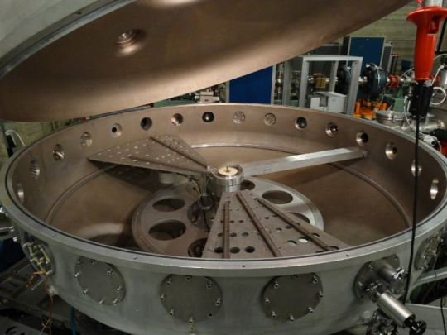
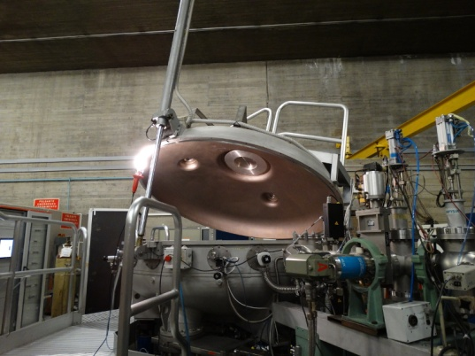
High-precision probe of the Hoyle state direct decay width
The HOYLE (Hodoscope Oriented Yield Loader Experiment) experiment at INFN-LNS → a new high statistics and low background investigation of the HOYLE state by means of the ¹⁴N(d,α₂)¹²C(7.654) reaction.
Tandem 15MV
Istituto Nazionale di Fisica Nucleare
LNS - Laboratori Nazionali del Sud
CT-2000 chamber INFN-LNS
Istituto Nazionale di Fisica Nucleare - Sezione di Napoli
d beam at E_{d} = 10.5 MeV;
C₃N₆H₆ target (40 μg/cm²) + 5/10 μg/cm² backing C;
$I_{d}≈4enA$;
$≈30 days$ of beam time;
$θ_{lab}=125°$ anti-telescope + superOSCAR hodoscope (31.4°).
Daniele Dell’Aquila (dellaquila.daniele@gmail.com) – Galveston, May 15th 2018

Slide 10
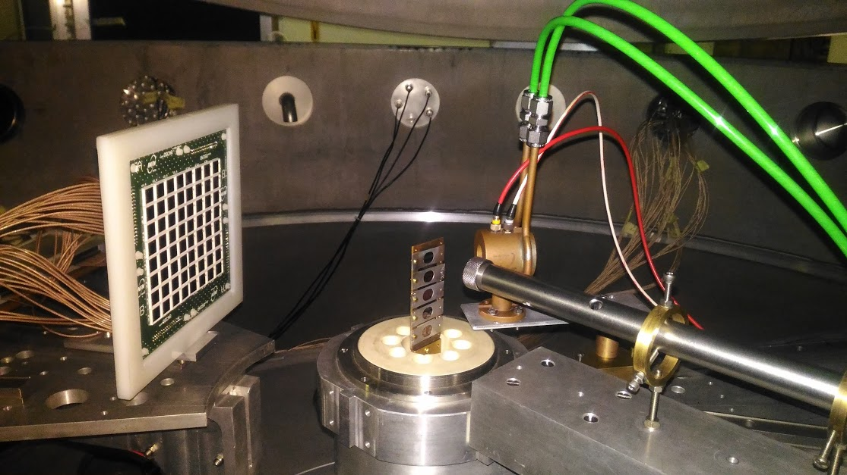
High-precision probe of the Hoyle state direct decay width
Basic idea and experimental layout
anticoincidence
telescope
SuperOSCAR
3α
C₃N₆H₆
α
d
E_{d}=10.5 MeV
Istituto Nazionale di Fisica Nucleare - Sezione di Napoli
3α
¹²C*
α
d
¹⁴N
Daniele Dell’Aquila (dellaquila.daniele@gmail.com) – Galveston, May 15th 2018

Slide 11
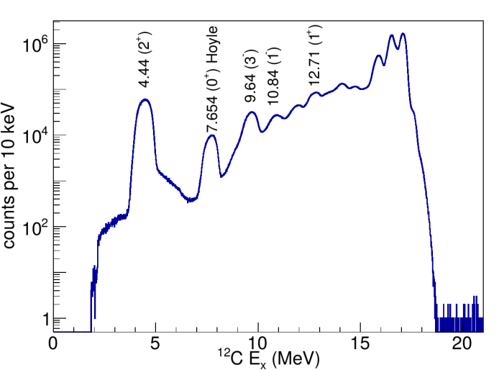
High-precision probe of the Hoyle state direct decay width
The anti-coincidence technique
single-particle energy spectrum with the anti-telescope
anticoincidence
telescope
Istituto Nazionale di Fisica Nucleare - Sezione di Napoli
100
Very precise selection of Hoyle states…
Daniele Dell’Aquila (dellaquila.daniele@gmail.com) – Galveston, May 15th 2018

Slide 12
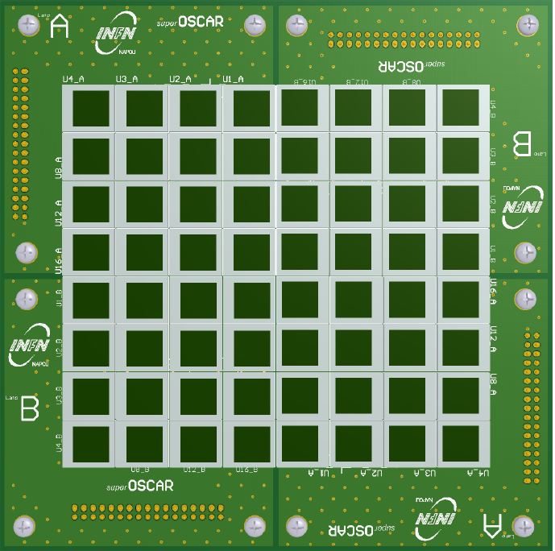
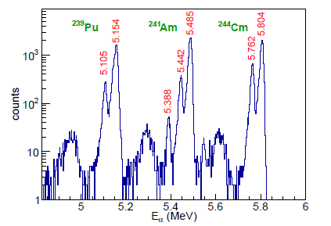
High-precision probe of the Hoyle state direct decay width
The superOSCAR hodoscope
64 Hamamatsu S-3590 300μm silicon pads (1cmx1cm active area);
$≈0.125 cm$ ceramic frame;
4 modules 4x4 pads in 2x2 configuration;
4 pre-amplifiers Net Instruments NPA-16FE (16 chs);
3a source →
0.2% energy resolution.
Istituto Nazionale di Fisica Nucleare - Sezione di Napoli
single-particle energy spectrum in the anti-telescope
Daniele Dell’Aquila (dellaquila.daniele@gmail.com) – Galveston, May 15th 2018

Slide 13
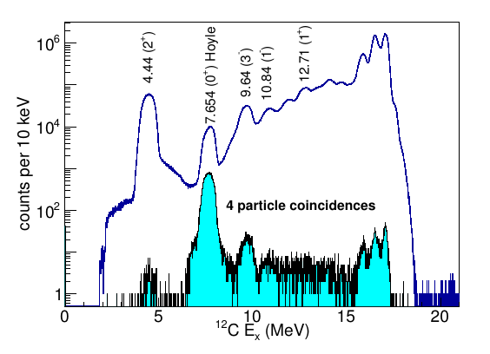
High-precision probe of the Hoyle state direct decay width
The superOSCAR hodoscope
64 Hamamatsu S-3590 300μm silicon pads (1cmx1cm active area);
$≈0.125 cm$ ceramic frame;
4 modules 4x4 pads in 2x2 configuration;
4 pre-amplifiers Net Instruments NPA-16FE (16 chs);
3a source →
0.2% energy resolution.
Istituto Nazionale di Fisica Nucleare - Sezione di Napoli
single-particle energy spectrum in the anti-telescope
single-particle energy spectrum (4-particles fully-reconstructed events → superOSCAR)
Daniele Dell’Aquila (dellaquila.daniele@gmail.com) – Galveston, May 15th 2018

Slide 14
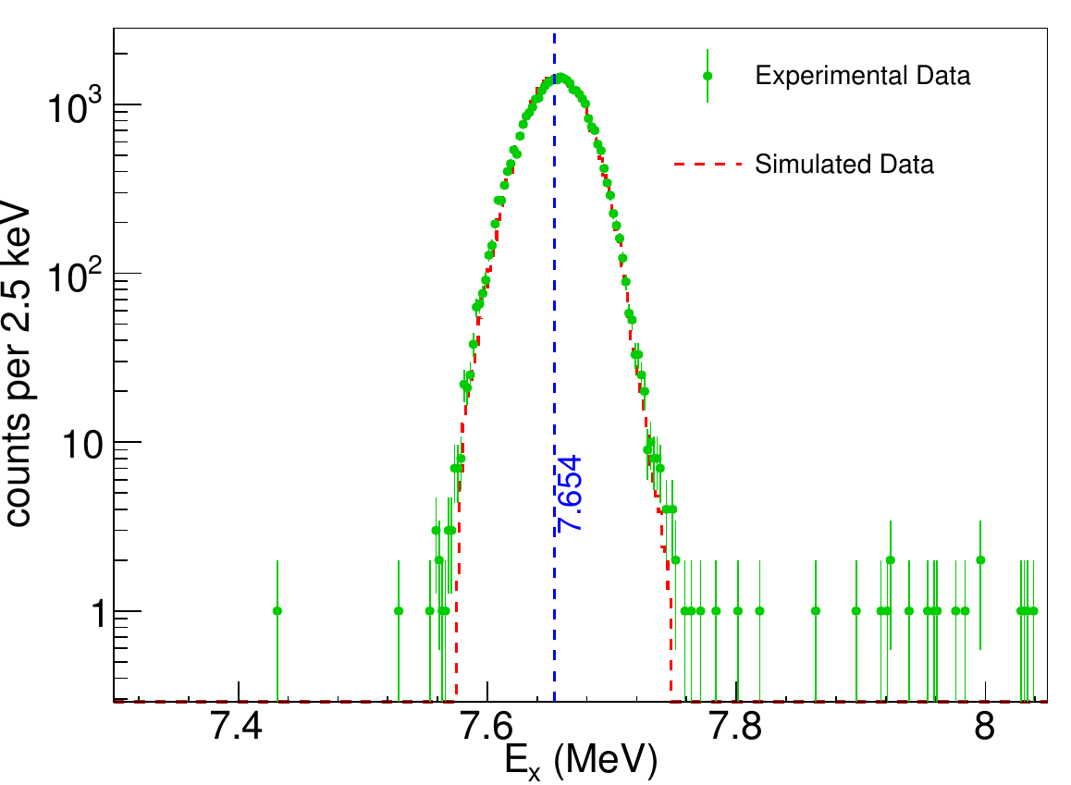
High-precision probe of the Hoyle state direct decay width
To select fully reconstructed (4α) good events → cuts on:
Coincidence times;
Q-value;
E_{x}.
Istituto Nazionale di Fisica Nucleare - Sezione di Napoli
Invariant mass Ex spectrum → Very low background level, of the order of 0.03% of the total integral of the peak.
Narrow peak centered at 7.654 MeV!!!
$σ≈20keV$.
Daniele Dell’Aquila (dellaquila.daniele@gmail.com) – Galveston, May 15th 2018

Slide 15
High-precision probe of the Hoyle state direct decay width
Study of sequential vs direct mechanism: Symmetric Dalitz Plot
$$ε_{i,j,k}=E_{i,j,k}/(E_{i}+E_{j}+E_{k})$$
Normalized energies in the ¹²C emitting reference frame
⁸Be
α
$$ε_{1}$$
α
¹²C*
sequential
$$ε_{α}≈0.5$$
$$ε_{i}>ε_{j}>ε_{k}$$
→ data collaps into one sector
α
α
α
α
direct
α
α
Istituto Nazionale di Fisica Nucleare - Sezione di Napoli
α
$$ε_{α}≈?$$
$$ε_{1}=0.5$$
Q₁
Q₂
$$12C^{∗}→α+8Be→3α$$
$$\left\{\begin{aligned}\frac{1}{2}m_{α}v_{α}^{2}+\frac{1}{2}m_{8Be}v_{8Be}^{2}=Q_{1} \\ m_{α}v_{α}^{}=m_{8Be}v_{8Be}^{}\end{aligned}\right.$$
$$ε_{3}=0.5$$
$$ε_{α}=\frac{Q_{1}m_{8Be}}{\left(m_{8Be}+m_{α}\right)}≈0.5$$
$$ε_{2}=0.5$$
$$ε_{3}$$
$$ε_{2}$$
Daniele Dell’Aquila (dellaquila.daniele@gmail.com) – Galveston, May 15th 2018

Slide 16
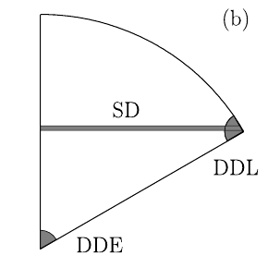
High-precision probe of the Hoyle state direct decay width
Study of sequential vs direct mechanism: Symmetric Dalitz Plot
$$ε_{i,j,k}=E_{i,j,k}/(E_{i}+E_{j}+E_{k})$$
Normalized energies in the ¹²C emitting reference frame
⁸Be
α
α
¹²C*
sequential
$$ε_{α}≈0.5$$
$$ε_{i}>ε_{j}>ε_{k}$$
→ data collaps into one sector
α
α
α
α
direct
α
α
Istituto Nazionale di Fisica Nucleare - Sezione di Napoli
α
$$ε_{α}≈?$$
Q₁
Q₂
$$12C^{∗}→α+8Be→3α$$
$$\left\{\begin{aligned}\frac{1}{2}m_{α}v_{α}^{2}+\frac{1}{2}m_{8Be}v_{8Be}^{2}=Q_{1} \\ m_{α}v_{α}^{}=m_{8Be}v_{8Be}^{}\end{aligned}\right.$$
$$ε_{α}=\frac{Q_{1}m_{8Be}}{\left(m_{8Be}+m_{α}\right)}≈0.5$$
Daniele Dell’Aquila (dellaquila.daniele@gmail.com) – Galveston, May 15th 2018

Slide 17
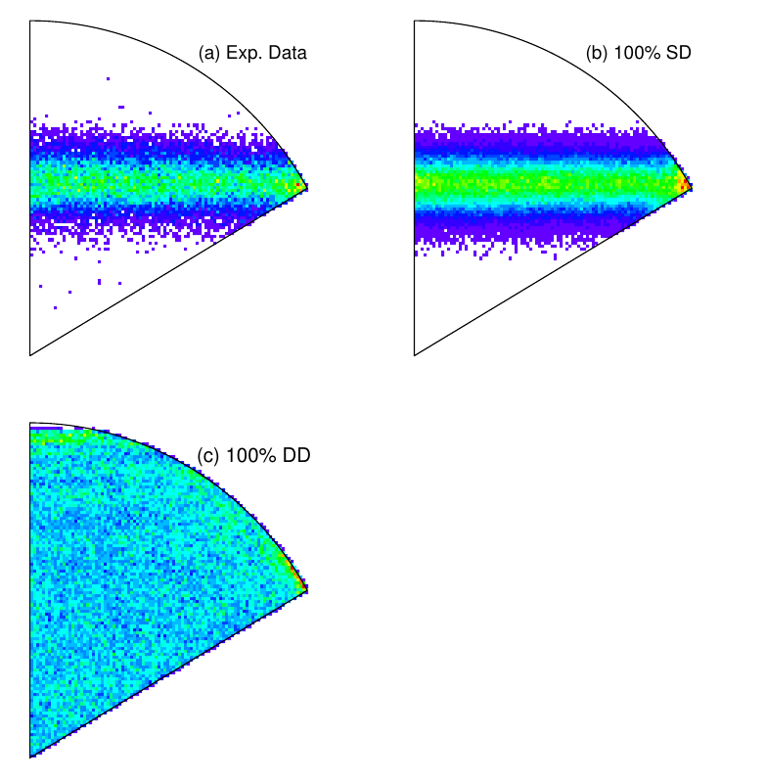
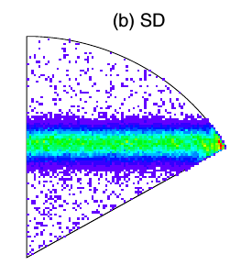
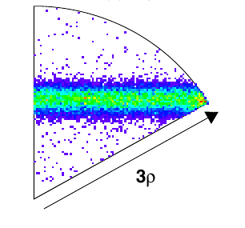
High-precision probe of the Hoyle state direct decay width
Study of sequential vs direct mechanism
$$ε_{i,j,k}=E_{i,j,k}/(E_{i}+E_{j}+E_{k})$$
$$ε_{i}>ε_{j}>ε_{k}$$
$$x=\sqrt{3}(ε_{j}−ε_{k})$$
$$y=2ε_{i} −ε_{j}−ε_{k}$$
simulation 100% SD
Istituto Nazionale di Fisica Nucleare - Sezione di Napoli
M. Itoh et al.
Our experiment
simulation 100% DD
Experimental data
simulation 100% SD
28000 counts under the sequential decay peak → compatible with fully sequential process!
Daniele Dell’Aquila (dellaquila.daniele@gmail.com) – Galveston, May 15th 2018

Slide 18
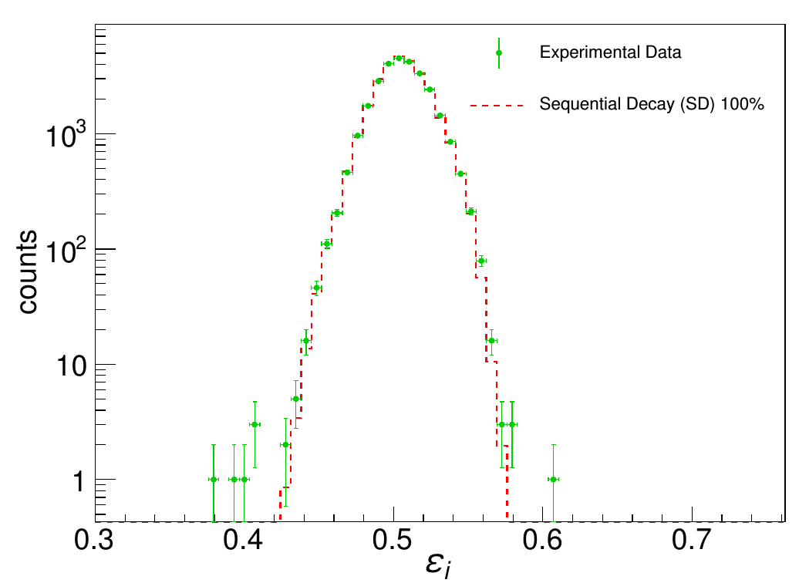
High-precision probe of the Hoyle state direct decay width
Study of sequential vs direct mechanism: Symmetric Dalitz Plot
Feldman and Cousin’s approach for small signals in presence of background
G.J. Feldman and R.D. Cousins, Phys. Rev. D 57, 3873 (1998).
Istituto Nazionale di Fisica Nucleare - Sezione di Napoli
New upper limit DD < 0.043 % with a C.L. of 2σ.
D. Dell’Aquila et al., Phys. Rev. Lett 119 (2017) 132501
Daniele Dell’Aquila (dellaquila.daniele@gmail.com) – Galveston, May 15th 2018

Slide 19
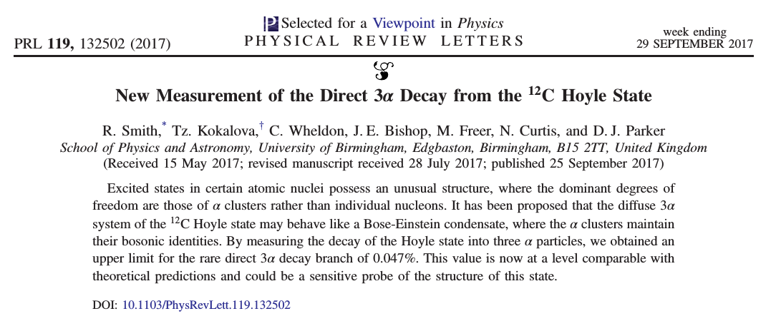
High-precision probe of the Hoyle state direct decay width
D. Dell’Aquila et al., Phys. Rev. Lett 119 (2017) 132501 (our results DD<0.043%)
Analogous results obtained by the Birmingham group in a parallel experiment: (DD<0.047 %)
R. Smith et al., Phys. Rev. Lett. 119 (2017) 132502 (see J. Bishop’s talk on Wednesday)
Istituto Nazionale di Fisica Nucleare - Sezione di Napoli
Significant successive theoretical works:
H. Zheng et al., Phys. Lett B 779 (2018) 460 (the direct decay width is more than 1 order of magnitude smaller than the current experiment sensitivity → need to improve the experimental sensitivity).
J. Refsgaard et al., Phys. Lett B 779 (2018) 414 (the current experimental limit is close to the point where coulomb FSI effects could be observed → WARNING: the phase-space distribution of sequential events might show direct decay features! → experiments needed!).
see J. Refsgaard’s talk on Wednesday
Daniele Dell’Aquila (dellaquila.daniele@gmail.com) – Galveston, May 15th 2018

Slide 20
Conclusions and Perspectives
Structure of ¹²C → a particularly remarkable example of clusters in light nuclei → detailed spectroscopic properties of the Hoyle state (7.654, 0⁺) → one of the most interesting open question in Nuclear Physics → Bose-Einstein condensate? Rotational band?
Possible existence of direct decay contributions → important consequences in Nuclear Structure and in Nuclear Astrophysics (helium burning at low temperatures);
We studied the Hoyle state in ¹²C by means of a high –precision experiment using the ¹⁴N(d,α₂)¹²C(hoyle) reaction at 10.5 MeV with the aim of improving the present knowledge of its non-resonant decay branch;
For obtaining a extremely low background we used the anti-telescope technique and we developed a new modular hodoscope: superOSCAR;
We obtained no-evidence of non-resonant decays of the Hoyle state for the first time with an almost vanishing background level → New upper limit to direct decay of 0.043% C.L. 2σ (about a factor 5 lower than the state of the art).
Istituto Nazionale di Fisica Nucleare - Sezione di Napoli
Thank you for your attention.
Daniele Dell’Aquila (dellaquila.daniele@gmail.com) – Galveston, May 15th 2018

Slide 21
Further Slides
Istituto Nazionale di Fisica Nucleare - Sezione di Napoli

Slide 22
High-precision probe of the Hoyle state direct decay width
J. Manfredi et al., Phys. Rev. C 85 (2012) 037603
Istituto Nazionale di Fisica Nucleare - Sezione di Napoli
Daniele Dell’Aquila (dellaquila.daniele@gmail.com) – Galveston, May 15th 2018

Slide 23
High-precision probe of the Hoyle state direct decay width
J. Refsgaard et al., Phys. Lett B 779 (2018) 414
Istituto Nazionale di Fisica Nucleare - Sezione di Napoli
Daniele Dell’Aquila (dellaquila.daniele@gmail.com) – Galveston, May 15th 2018

Slide 24
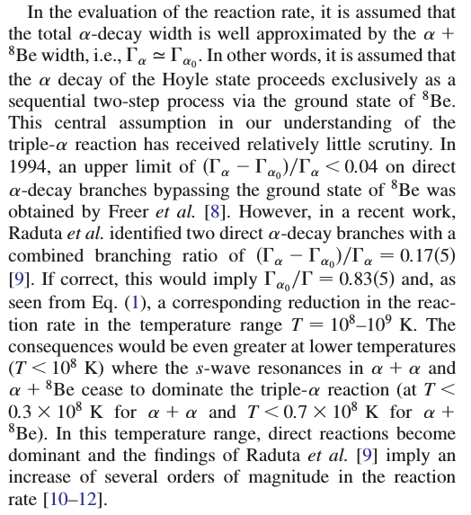
High-precision probe of the Hoyle state direct decay width
O. S. Kirsebom et al., Phys. Rev. Lett. 108, 202501 (2012)
N.B. Nguyen et al., Phys. Rev. C. 87(2013) 054615
Akahori et al., Phys. Rev. C 92 (2015) 022801
Istituto Nazionale di Fisica Nucleare - Sezione di Napoli
Daniele Dell’Aquila (dellaquila.daniele@gmail.com) – Galveston, May 15th 2018

Slide 25
High-precision probe of the Hoyle state direct decay width
Study of sequential vs direct mechanism: Symmetric Dalitz Plot
$$ε_{i,j,k}=E_{i,j,k}/(E_{i}+E_{j}+E_{k})$$
Normalized energies in the ¹²C emitting reference frame
$$ε_{1}$$
The Viviani theorem
$$\overline{AP}+\overline{BP}+\overline{CP}=const$$
→ all the data collaps into an equilateral triangle
A
Istituto Nazionale di Fisica Nucleare - Sezione di Napoli
B
From the conservation of energy:
$$ε_{1}+ε_{2}+ε_{3}=1$$
→ all data further collaps into the circle
P
$$ε_{3}$$
$$ε_{2}$$
C
Daniele Dell’Aquila (dellaquila.daniele@gmail.com) – Galveston, May 15th 2018

Slide 26
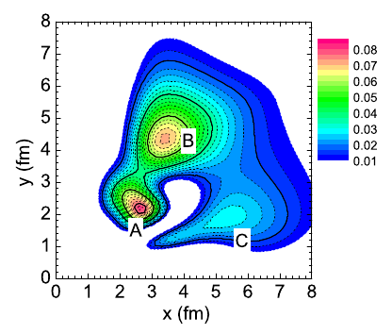
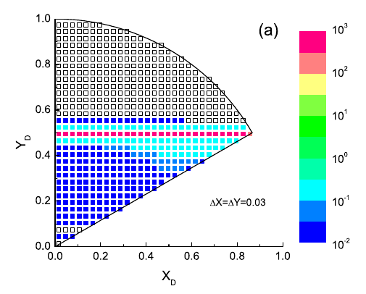
The Hoyle state in Nuclear Structure
S. Ishikawa, Phys. Rev. C 90, 061604(R) (2014)
Density distribution ρ(x,y) of the Hoyle state from microscopic calculations based on the Faddev three-body formalism → three distinct peaks → A-B inter-cluster distance lower than B-C and A-C → ⁸Be + α configuration.
Istituto Nazionale di Fisica Nucleare - Sezione di Napoli
Symmetric Dalitz plot → geometrical visualization of the decay of the Hoyle state in 3α → non-resonant decay less than 1% → new measurements needed.
Daniele Dell’Aquila (dellaquila.daniele@gmail.com) – Galveston, May 15th 2018

Slide 27
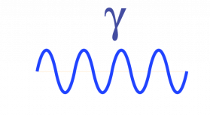
The Hoyle state in Nuclear Astrophysics
The Hoyle state in nucleosynthesis
1939, Bethe → formation of 12C from the collisions of three a-particles improbable → temperatures 50 times higher than the Sun required;
1951, Öpik → the nucleosynthesis of carbon occours in the Red Giant phase;
1952, Salpeter → the nucleosynthesis of carbon is a sequential two-steps process;
⁴He + ⁴He $→$ ⁸Be
⁸Be + ⁴He $→$ ¹²C + γ
Istituto Nazionale di Fisica Nucleare - Sezione di Napoli
⁸Be
α
α
α
¹²C
α
α
$$τ≈{10}^{−16}s$$
1953, Hoyle→ to reproduce the observed C/O abudance →the 3α process occours via an s-wave resonance → The Hoyle state (7.654 MeV, 0⁺);
1957, Cook → experimental confirmation of the existence of the Hoyle state.
Daniele Dell’Aquila (dellaquila.daniele@gmail.com) – Galveston, May 15th 2018

Slide 28
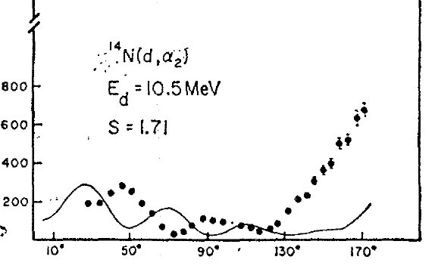
High-precision probe of the Hoyle state direct decay width
The anti-coincidence technique
J.R. Curry et al., Phys. Rev. 185 (1969) 1416
strong increasing of the ¹⁴N(d,α₂) cross section at backward angles → Study of the contaminant reactions at 125° detection angle → good compromise between expected rate and damage of the detectors.
$$θ_{cm}$$
Istituto Nazionale di Fisica Nucleare - Sezione di Napoli
Daniele Dell’Aquila (dellaquila.daniele@gmail.com) – Galveston, May 15th 2018

Slide 29
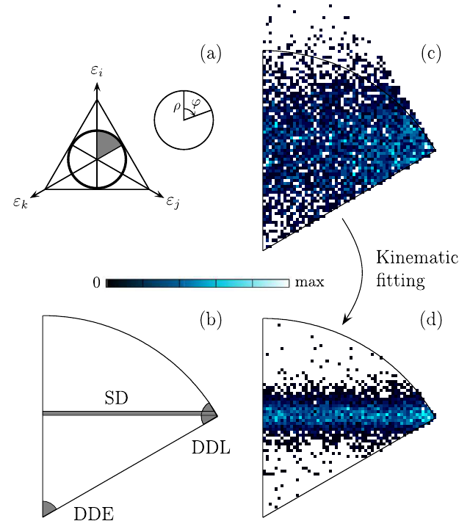
¹²C structure via the ¹⁴N(d,α) reaction: the HOYLE experiment
Univ. degli Studi di Napoli Federico II & INFN - Napoli
Daniele Dell’Aquila (dellaquila@na.infn.it) – Cocoyoc (Mexico), January 6th 2017

Slide 30
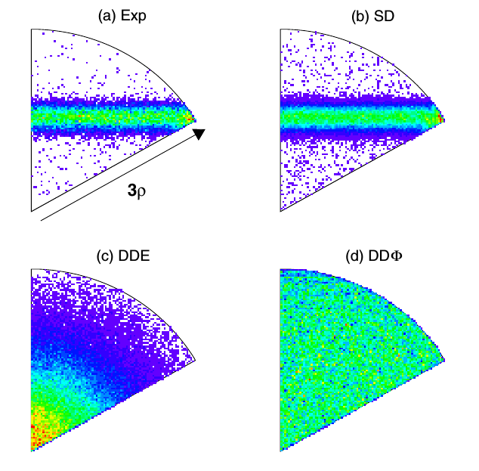
¹²C structure via the ¹⁴N(d,α) reaction: the HOYLE experiment
Univ. degli Studi di Napoli Federico II & INFN - Napoli
Daniele Dell’Aquila (dellaquila@na.infn.it) – Cocoyoc (Mexico), January 6th 2017

Slide 31
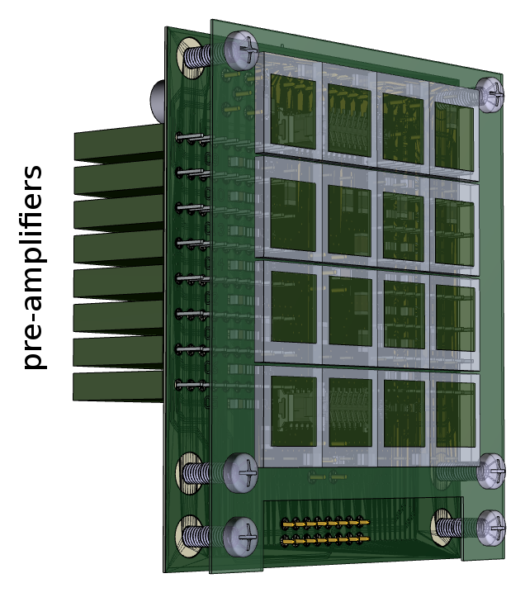
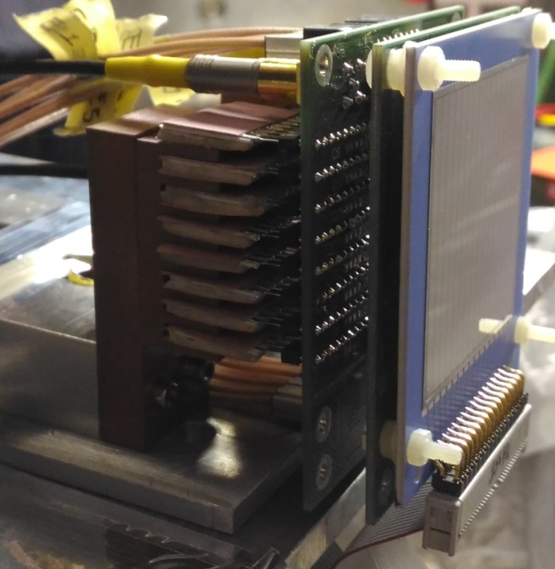
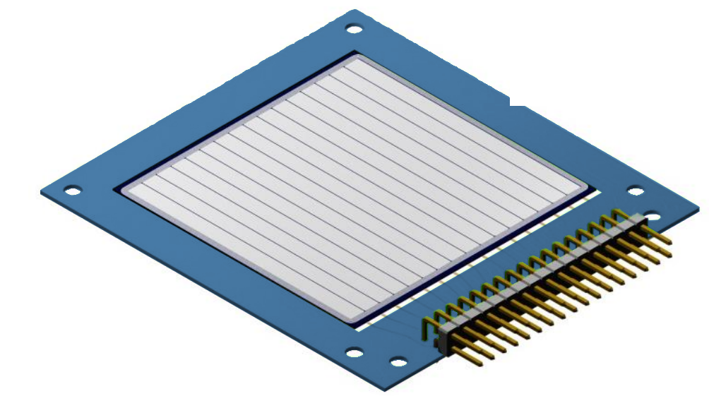
Development of new generation hodoscopes: OSCAR
OSCAR: Odoscopio di Silici per le Correlazioni e le Analisi di Reazioni
A new hodoscope for the analysis of nuclear reactions.
SSSSD (20μm, 16 strips 3mm + 0.125mm interstrip) + 16 silicon pads
Univ. di Napoli Federico II & Université Paris-Saclay
Developed with the INFN-Napoli SER.
Plug-and-play connections
on-board pre-amplifiers
modular and compact detector
low cross-talk levels and high resolutions
Daniele Dell’Aquila (dellaquila@na.infn.it) - Napoli, November 3rd 2016

Slide 32
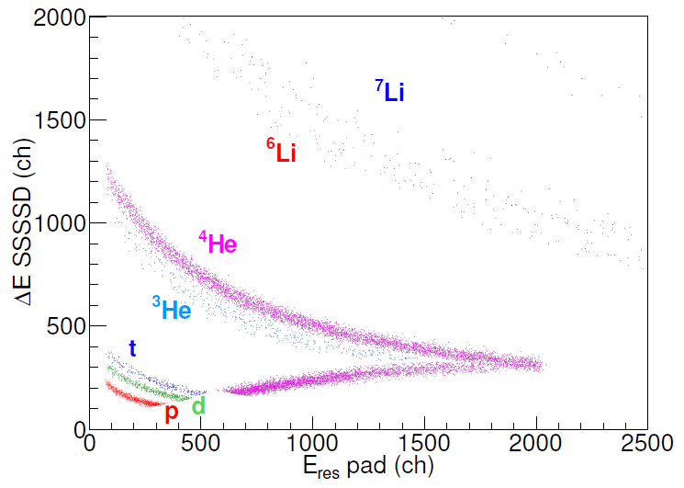
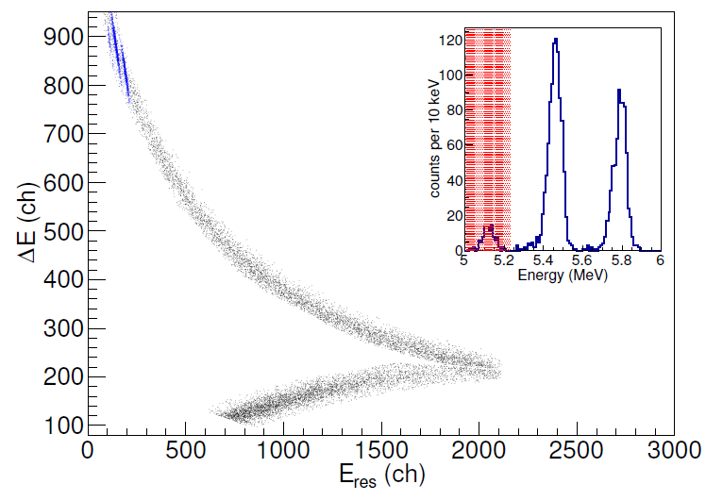
Development of new generation hodoscopes: OSCAR
TEST di OSCAR ai LNS: ^{40,48}Ca+^{40,48}Ca at 35 A MeV, 52º LAB
α source
Ca+Ca
Univ. di Napoli Federico II & Université Paris-Saclay
Good particles identification up to lithium isotopes via the DE-E technique.
Identification of very low energy particles with very good energy resolution. (a dedicated experiment has been performed at LNS for studiyng the effects of the silicon non-uniformity on the particle identifications and energy resolutions.
Daniele Dell’Aquila (dellaquila@na.infn.it) - Napoli, November 3rd 2016

Slide 33
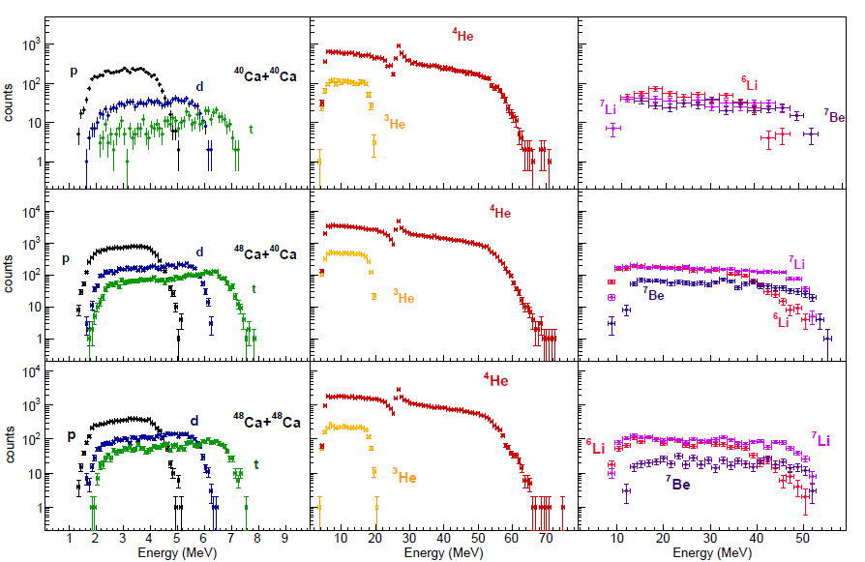
Development of new generation hodoscopes: OSCAR
Energy spectra of the lightest identified fragments obtained in 48Ca+48Ca collisions at 35MeV/u
Univ. di Napoli Federico II & Université Paris-Saclay
A route to SPES → development of high segmentated detectors with low detection thresholds and high modularity (ancillary detector).
to be submitted for publication…
Daniele Dell’Aquila (dellaquila@na.infn.it) - Napoli, November 3rd 2016

