Slide 1
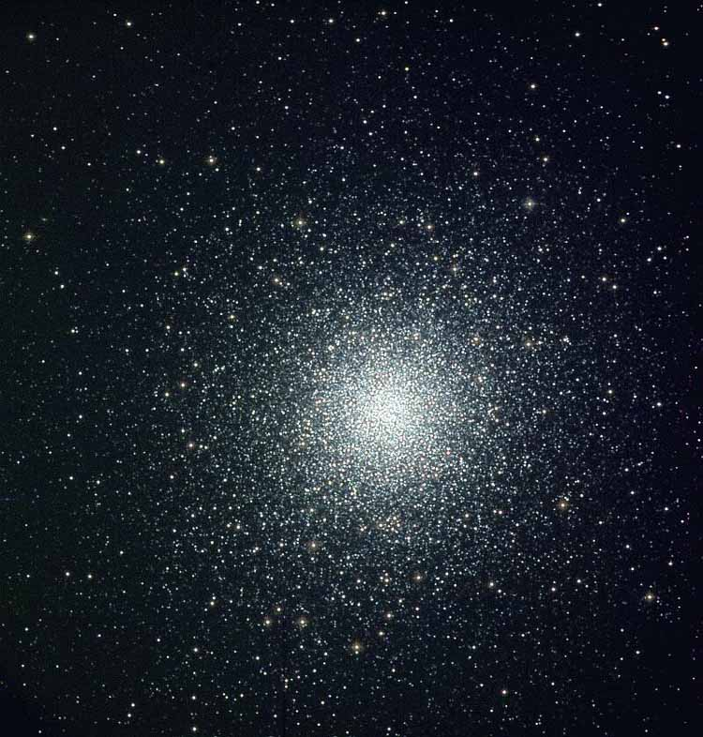
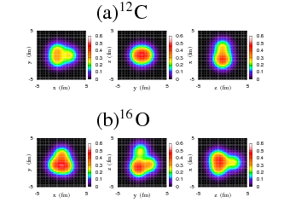
Clusters and Mirrors
Clusters in Nuclear Astrophysics
Michael Wiescher
University of Notre Dame
Department of Physics & Joint Institute of Nuclear Astrophysics

Slide 2
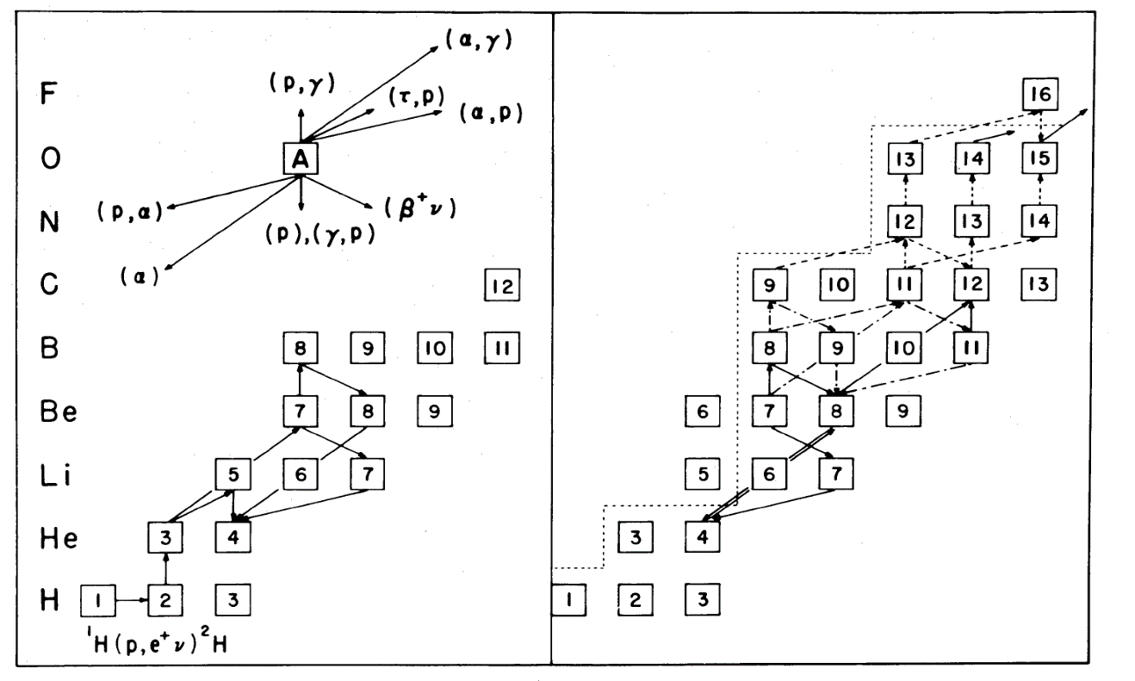
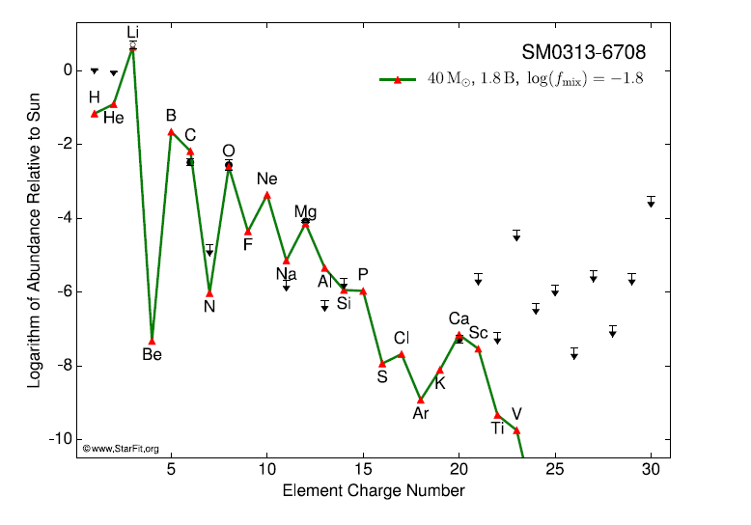
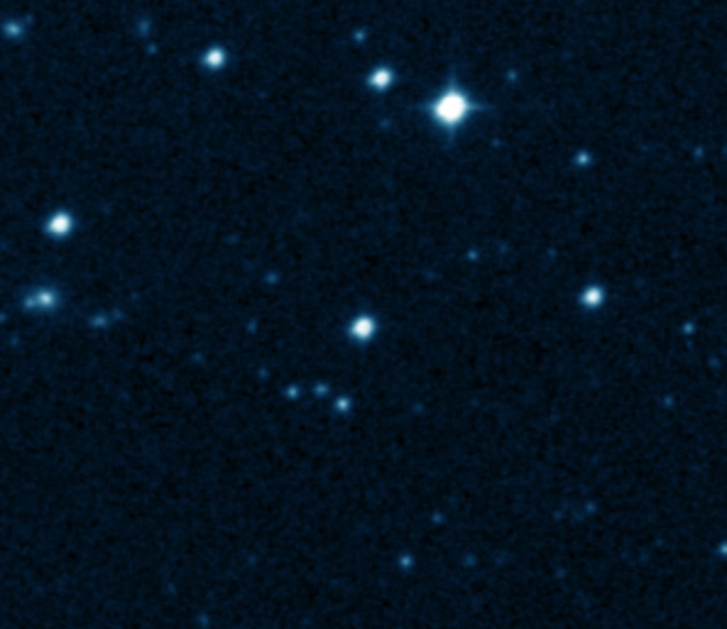
Cluster States facilitate formation of
¹²C and ¹⁶O in first star nucleosynthesis
Three ways to by-pass the mass 5 and mass 8 gaps:
hot pp-chains and
deuteron cycling
⁴He(2α,γ)¹²C(α,γ)¹⁶O
Alpha clusters as catalytic
compound structure
³He(α,γ)⁷Be(α,γ)¹¹C(α,γ)¹⁵O
A possible enhancement through alpha clusters resonances
alpha fusion
⁴He(d,γ)⁶Li(α,γ)¹⁰B(α,d)¹²C
Deuterons as catalyst isotope
The element abundance pattern for SMSS 0313–6708 compared
to model values.
SC Keller et al. Nature 000, 1-4 (2014) doi:10.1038/nature12990

Slide 3
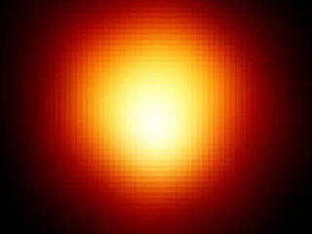
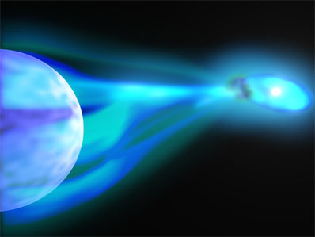
Clusters in Astrophysics
Formation of ¹²C and ¹⁶O from primordial matter in first stars
Cyclic Burning (CNO, NeNa) in massive main sequence stars
He burning in Red Giant Stars
Stellar Neutron Sources for the s-process
Carbon and Oxygen burning in late stellar evolution
Thermonuclear runaway in cataclysmic hydrogen burning
M. Wiescher, T. Ahn, Clusters in Astrophysics, in Nuclear Particle Correlations and Cluster Physics, ed. W.-U. Schröder, Word Scientific, 2017, 203-256

Slide 4
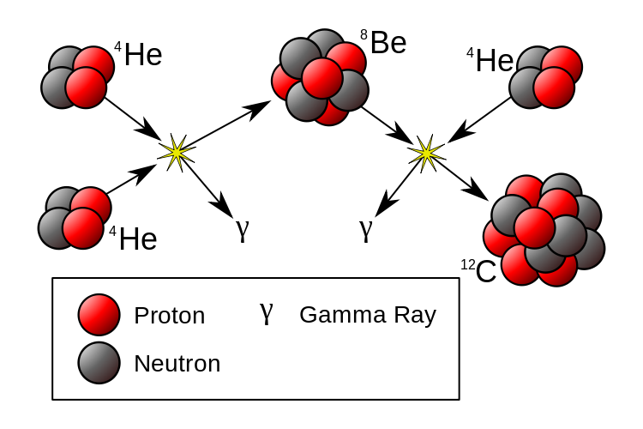
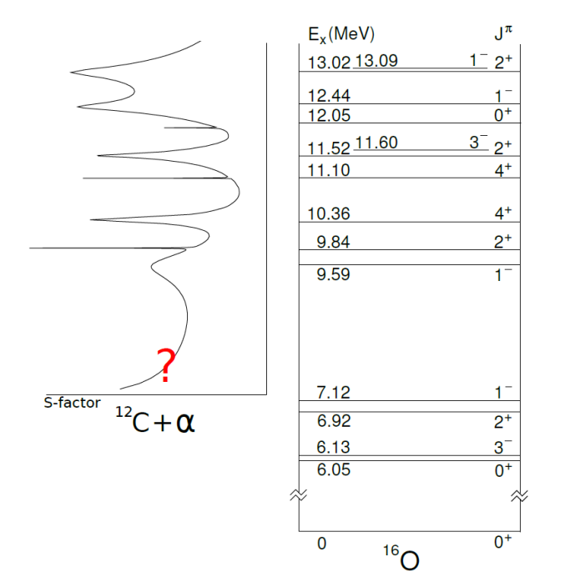
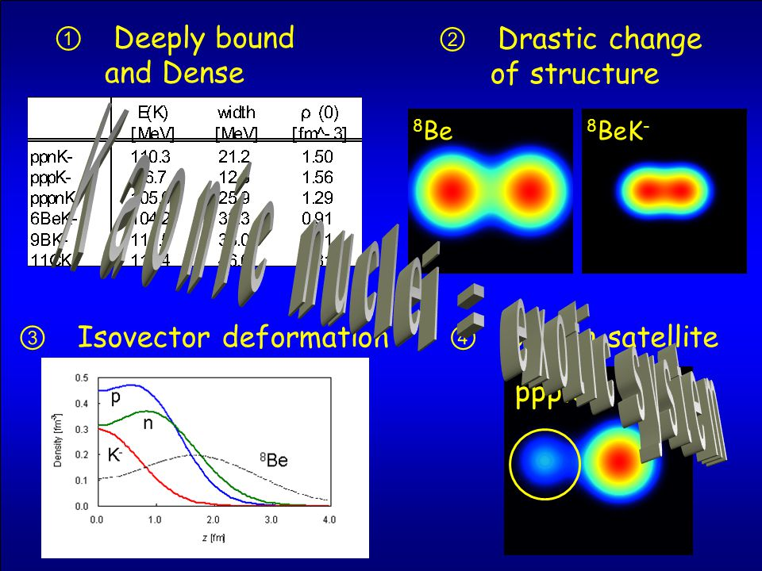
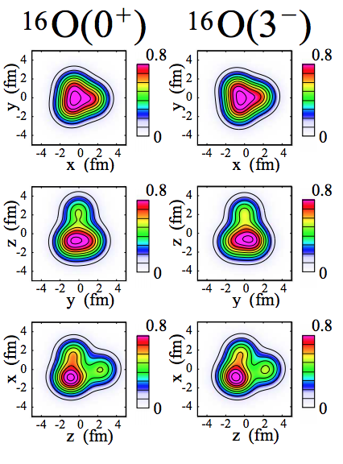
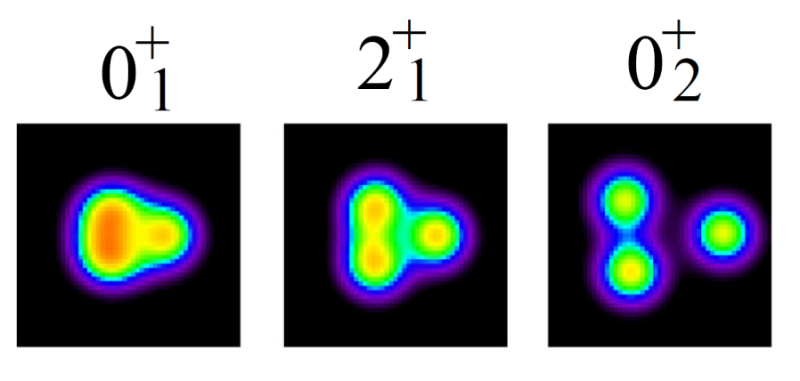
Reaction chains in He burning
The Triple-Alpha Process
The ¹²C(α,γ)¹⁶O
¹⁶O
Facilitated by the cluster structure of bound and unbound ¹⁶O states
Facilitated by the cluster structure of the ⁸Be and the ¹²C Hoyle State
¹²C
¹²C Hoyle
State
Y. Kanada En’yo, M. Kimura, A. Ono, Prog. of Theo. Exp.Phys..2012 (2012) 01A202

Slide 5
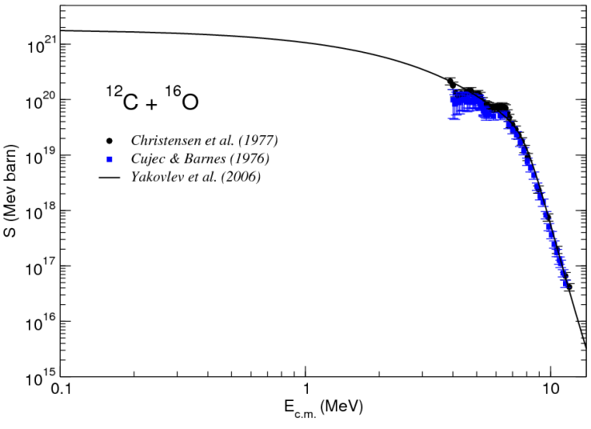
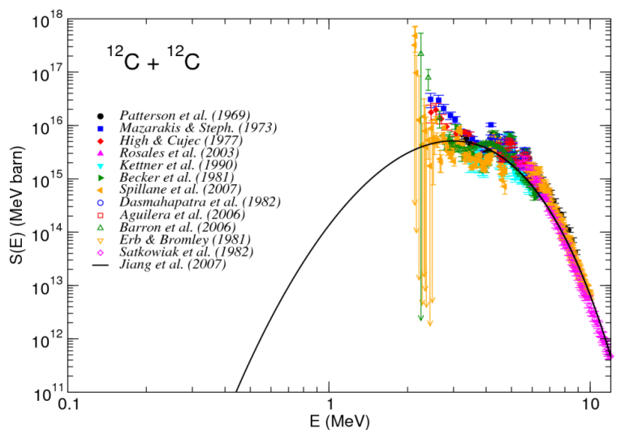
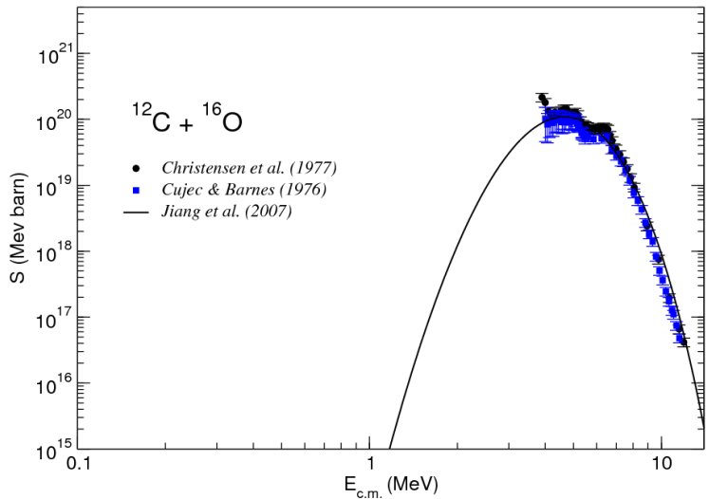
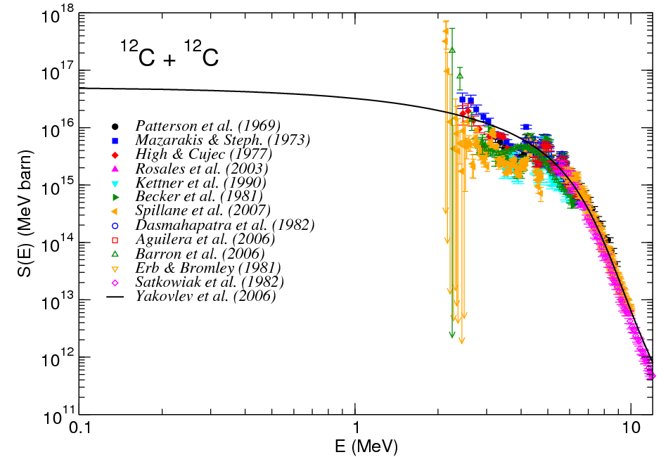
Fusion reactions in stellar Carbon burning
¹²C
¹²C
¹²C
¹⁶O
²⁴Mg
²⁸Si
¹H
⁴He
¹H
⁴He
²⁷Al
²⁴Mg
²³Na
²⁰Ne
Hindrance potential
Standard potential

Slide 6
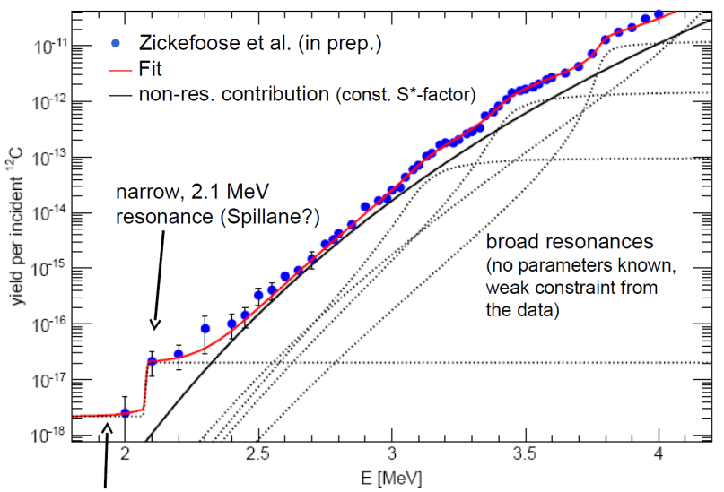
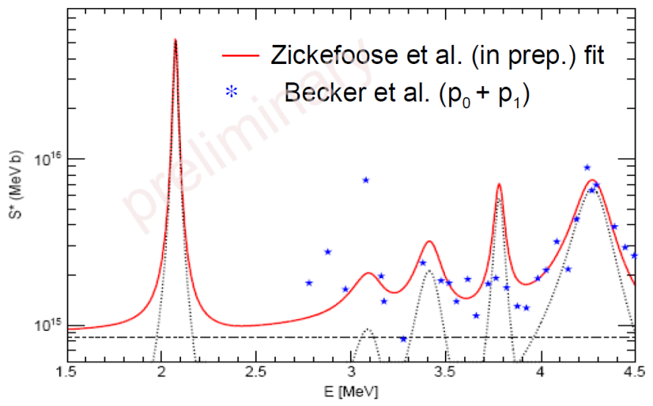
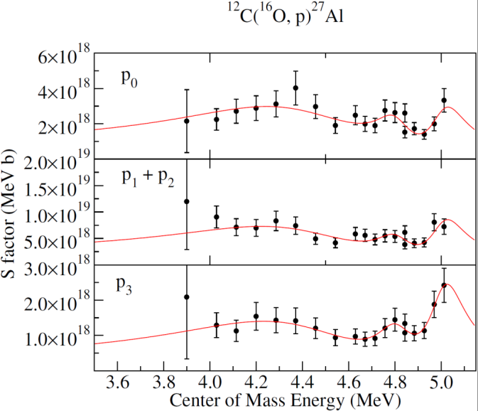


Molecular Cluster Resonances?
$$ωγ\sim ω∙\frac{Γ\left(12C\right)∙Γ\left(α\right)}{Γ\left(α\right)+Γ\left(p\right)}∝ω∙Γ(12C)$$
Resonance strength corresponds to the width of the fusion channel!
$$Γ\left(12C\right)∝Pℓ\left(E\right)∙\left|\left\langle φ(24Mg | H | (φ(12C⨂12C)\right\rangle \right|2$$
which in turn corresponds to the cluster configuration of the resonance level. Latest results also indicate possible resonance pattern in the ¹⁶O+¹²C channel
Much speculation about lower energy resonances at ~ 1.5 MeV, see next talk!
X. Fang et al. Phys. Rev. C 96 (2017) 045804
More studies towards lower energies are necessary!

Slide 7
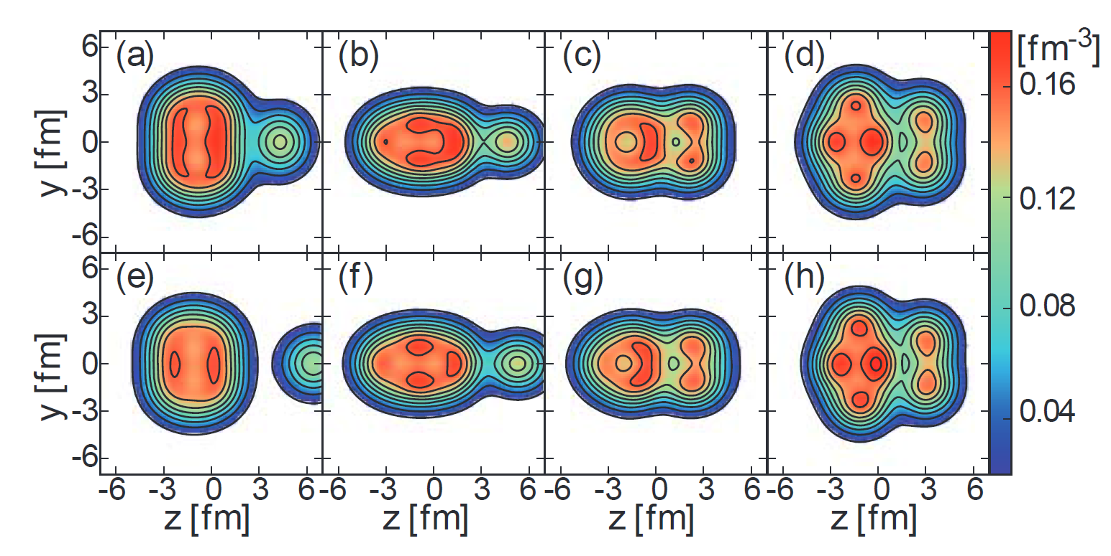
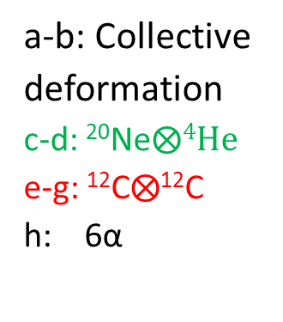
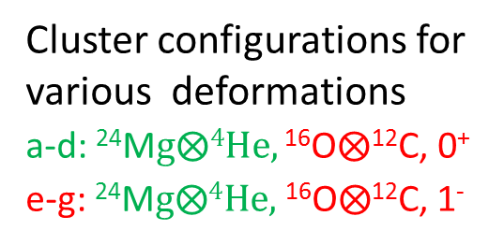
Cluster predictions in ²⁴Mg and ²⁸Si
a-b: Collective
deformation
c-d: ²⁰Ne$⨂4He$
e-g: ¹²C$⨂$¹²C
h: 6α
Y. Chiba, M. Kimura, Phys. Rev. C 91, 061302(R) (2015)
Cluster configurations for various deformations
a-d: ²⁴M$g⨂4He,\text{16}\text{O}⨂\text{12}\text{C}\text{, 0}\text{+}$
e-g: ²⁴M$g⨂4He,$¹⁶O$⨂$¹²C, 1⁻
Y. Chiba, Y. Taniguchi, M. Kimura, Phys. Rev. C 95, 044328 (2017)

Slide 8
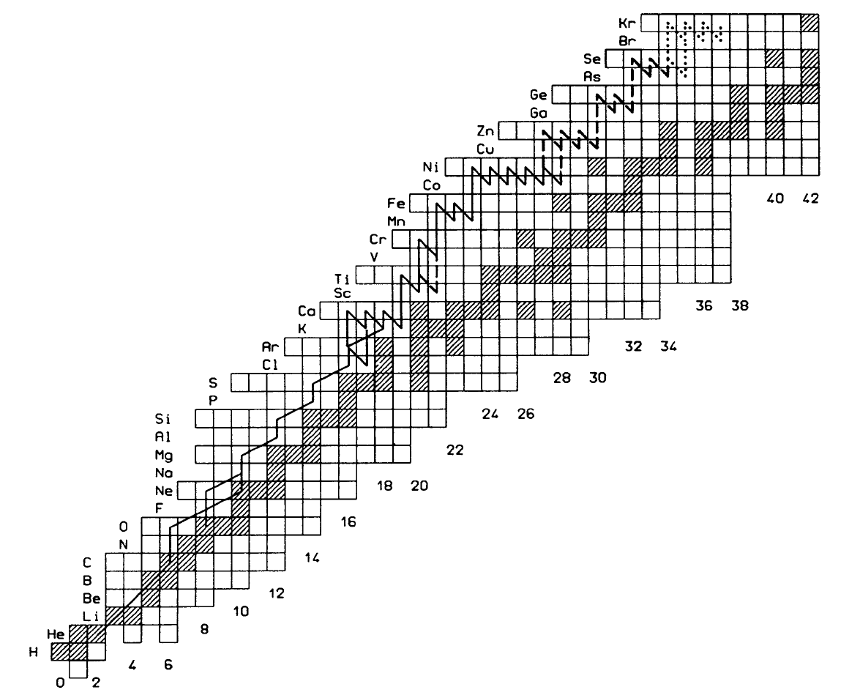
Clusters in Mirrors
The αp process facilitates the fast processing of light ⁴He and CNO material towards the Ca-Ti mass range
via reactions such as triple-α-process followed by
(α,p) reactions on T_{z}=-1 even-even nuclei:
¹⁴O(α,p)¹⁷F (compound ¹⁸Ne)
¹⁸Ne(α,p)²¹Na (compound ²²Mg)
²²Mg(α,p)²⁵Al (compound ²⁶Si)
²⁶Si(α,p)²⁹P (compound ³⁰S)
³⁰S(α,p)³³Cl (compound ³⁴Ar)
³⁴Ar(α,p)³⁷K (compound ³⁸Ca)
³⁸Ca(α,p)⁴¹Sc (compound ²²Ti)
The s-process is next to
the r-process the dominant
source for the origin of elements
above iron. The neutrons are originated
by (α,n) reactions on T_{z}=+1 even-even nuclei,
suppressed by competing (α,γ) radiative capture:
¹⁴C(α,γ)¹⁸O, ¹⁴C(α,n)¹⁷O (compound ¹⁸O)
¹⁸O(α,γ) ²²Ne, ¹⁸O(α,n)²¹Ne (compound ²²Ne)
²²Ne(α,γ)²⁶Mg, ²²Ne(α,n)²⁵Mg (compound ²⁶Mg)
²⁶Mg(α,γ)³⁰Si , ²⁶Mg(α,n)²⁹Si (compound ³⁰Si) etc

Slide 9
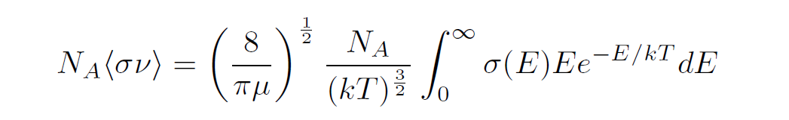
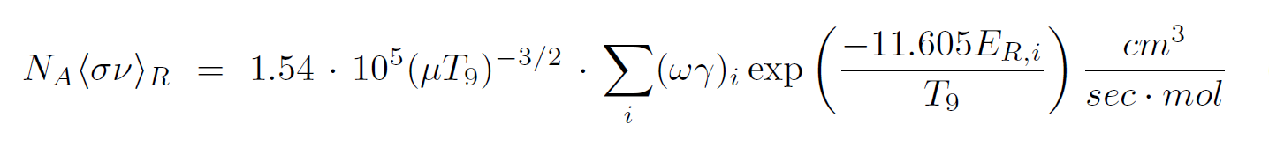
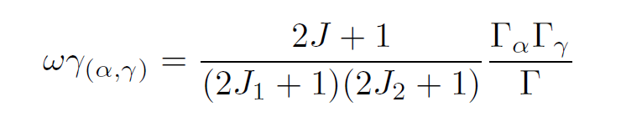
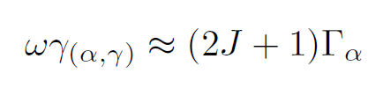


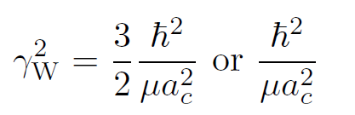
Formalism
The reaction rate corresponds to the integrated cross section and for resonant cases to the resonance strengths. It determines the timescale of the reaction process (thermonuclear runaway or neutron production rate in our specific cases).
The resonance strength is proportional to the α width, which is determined by the Coulomb penetrability and the reduced α width
Reduced width and spectroscopic factor are related through the Wigner limit!

Slide 10
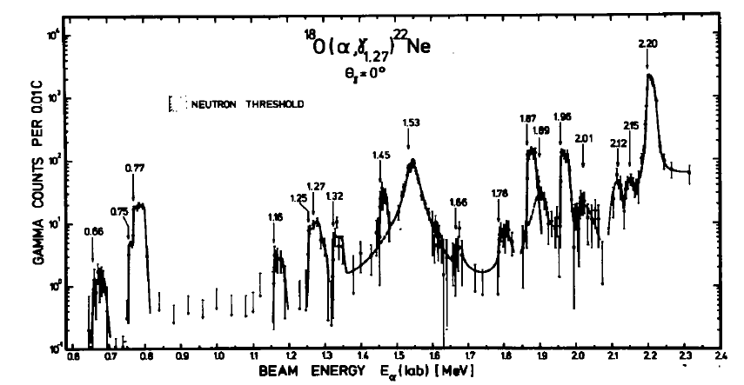
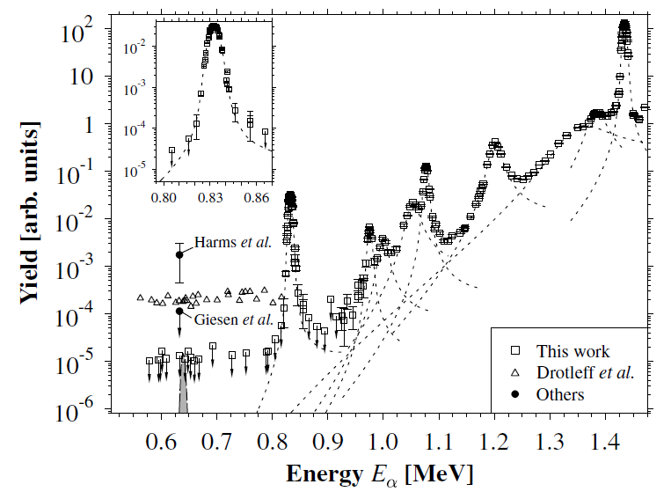
Direct measurements of cluster resonances in ²²Ne and ²⁶Mg
Trautvetter , M. Wiescher, K.-U. Kettner, C. Rolfs, W. Hammer, Nucl. Phys. A 297 (1978) 4891978
M. Jaeger, R. Kunz, A. Mayer, J. W. Hammer, et al.
Phys. Rev. Lett. 87, 202501 (2001)
Neutron threshold
¹⁸O(α,γ)²²Ne
Neutron threshold
²²Ne(α,n)²⁵Mg
Resonance strengths suggests values of ≈0.1-1.0 indicating a pronounced alpha cluster configurations. The uncertainty is in the spin assignments, for some of the low energy resonances.

Slide 11
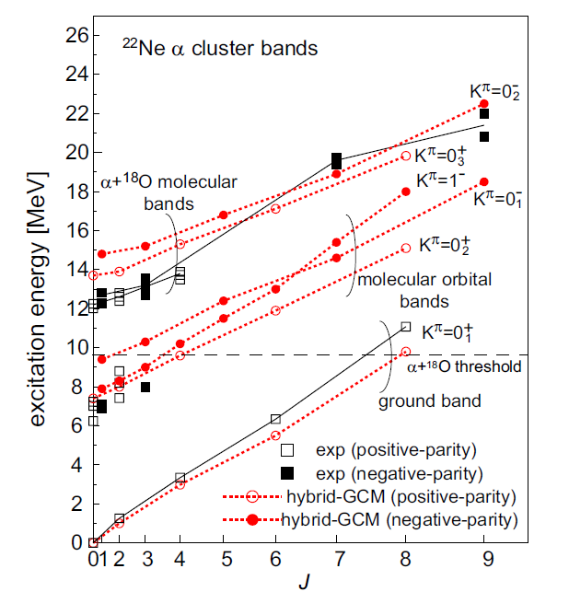
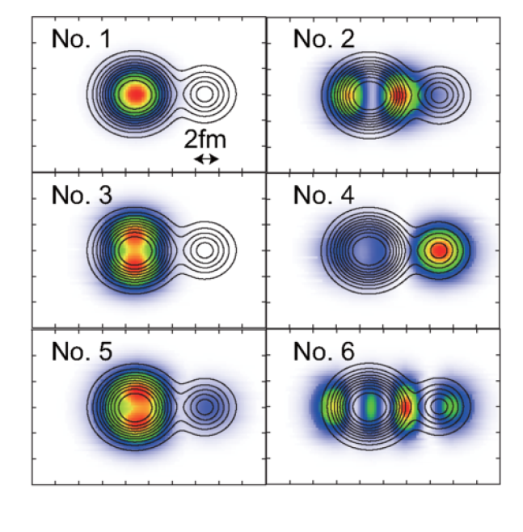
Theoretical Modeling of ²²Ne
H.P. Trautvetter et al. Nucl.Phys. A 297 (1978) 489
S. Dababneh et al. Phys.Rev. C 68 (2003) 025801
A. Best et al. Phys.Rev. C 87 (2013) 045806
Resonances with comparable strength in γ and n channel are dominated by α channel!
M. Kimura, N. Furutachi, Y. Kanada-En’yo, Nucl. Phys. A 834 (2010) 482c

Slide 12

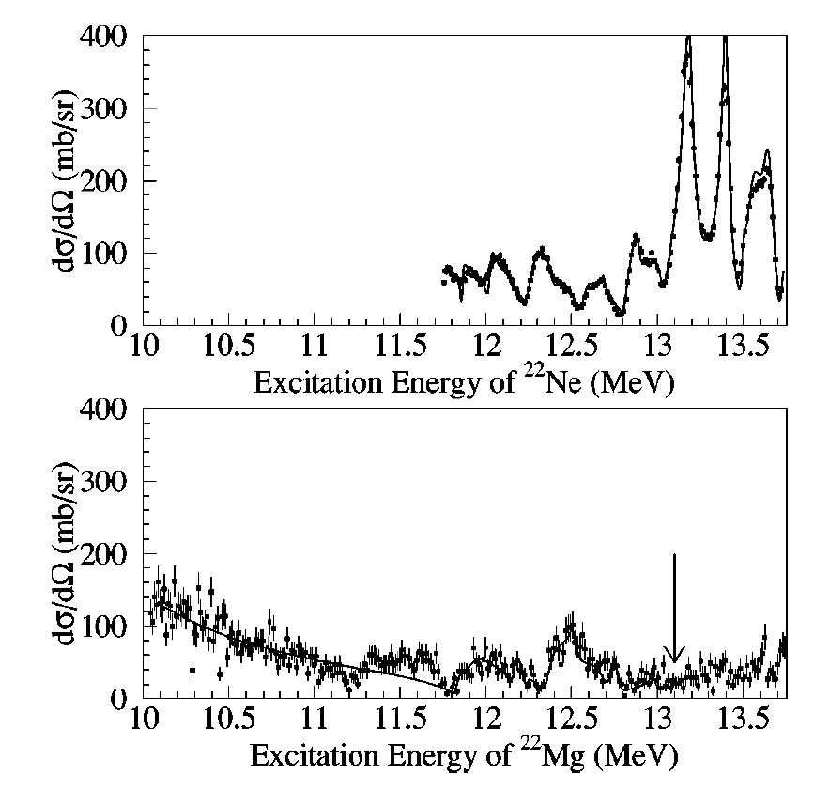
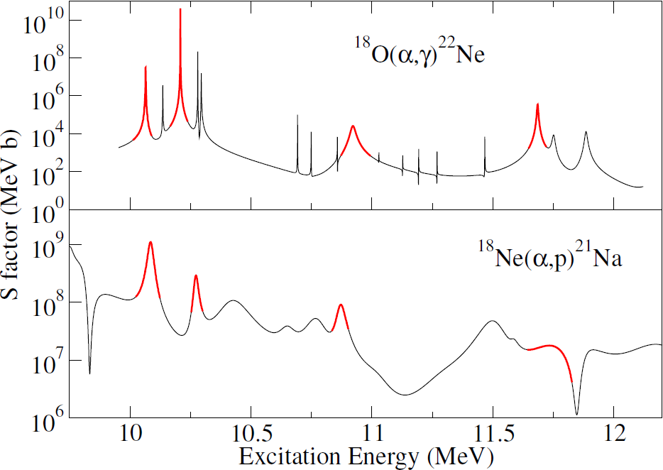
Mirror relations
V. Goldberg et al. Phys. Rev. C 69 (2004) 024602
A. Matic et al., Phys. Rev. C 80 (2009) 055804
¹⁸O(α,α)
¹⁸Ne(α,α)
Comparison is handicapped due to the different thresholds and the changes in the corresponding total widths of resonance states: Γ_{tot}=Γ_{α}+ Γ_{p} + Γ_{n} + Γ_{γ}.

Slide 13
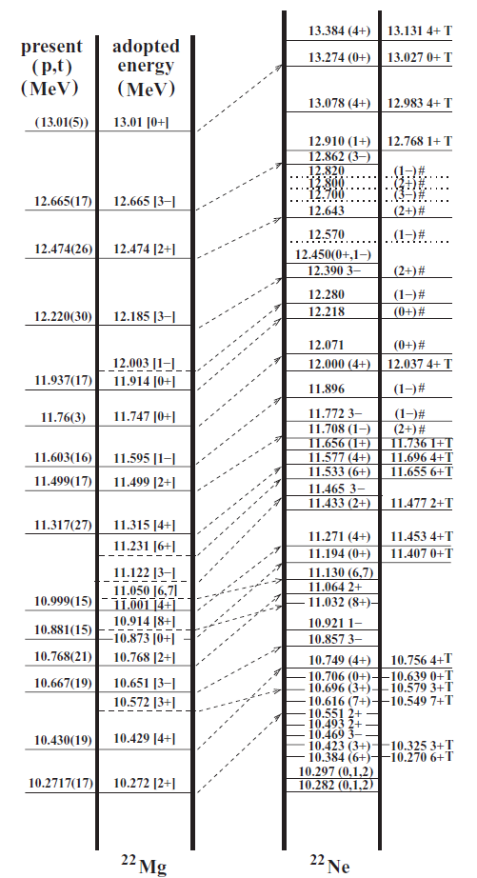
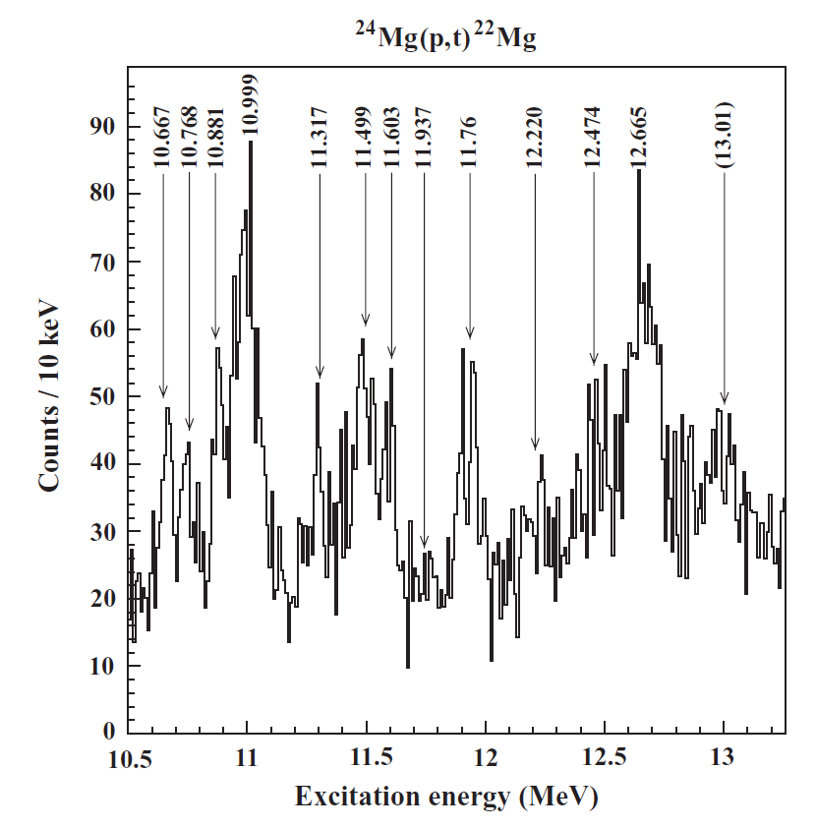
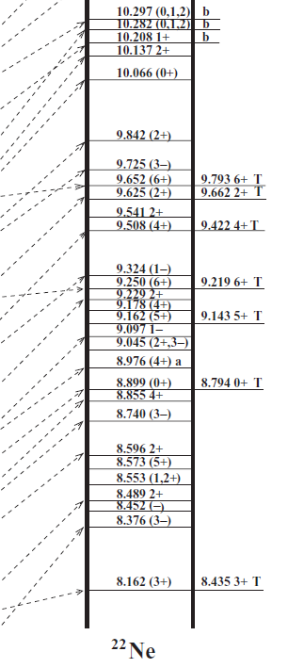
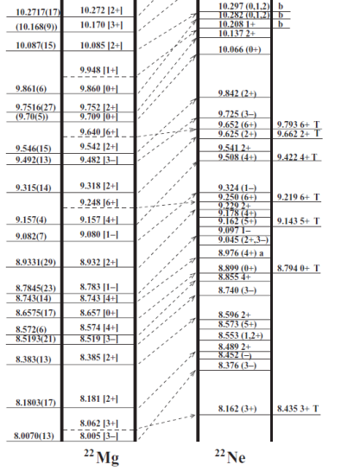
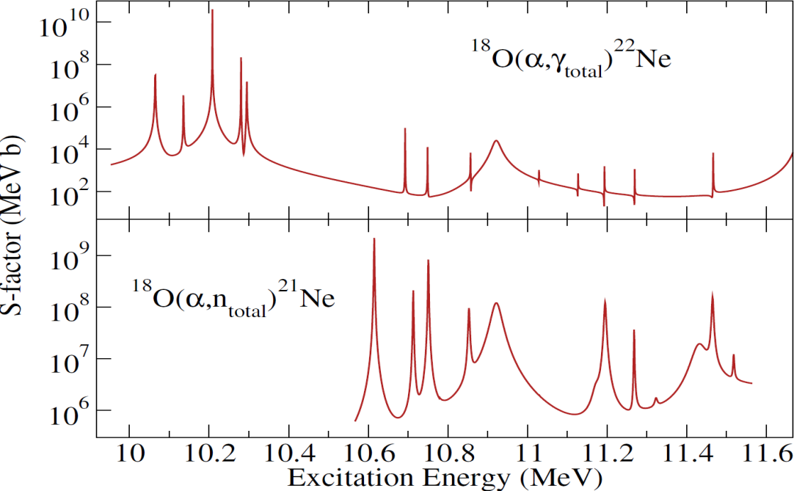
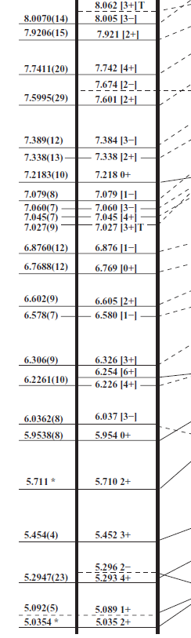
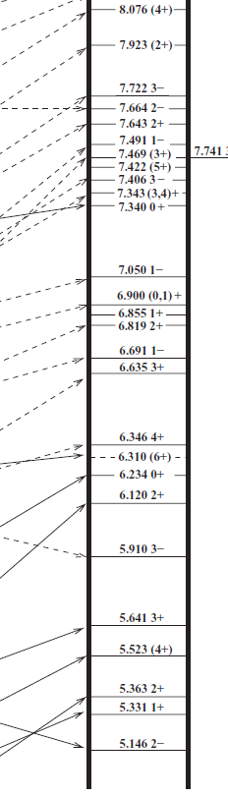

Are clusters mirrors?
¹⁸Ne(α,p)²¹Na
²¹Ne+n
10.37 MeV
¹⁸O+α
9.67 MeV
¹⁸Ne+α
8.14 MeV
D. Kurath, I. Towner Nucl. Phys. A222 (1974) 1
R. N. Boyd et al. Phys. Rev. C 14 (1976) 4
Close correlation between two-nucleon transfer and α transfer!
²²Ne+α→²⁶Mg ²²Mg+α→²⁶Si
²⁶Mg+α→³⁰Si ²⁶Si+α→³⁰S
³⁰Si+α→³⁴S ³⁰S+α→³⁴Ar
³⁴S+α→³⁸Ar ³⁴Ar+α→³⁸Ca
²¹Na+p
5.54 MeV

Slide 14
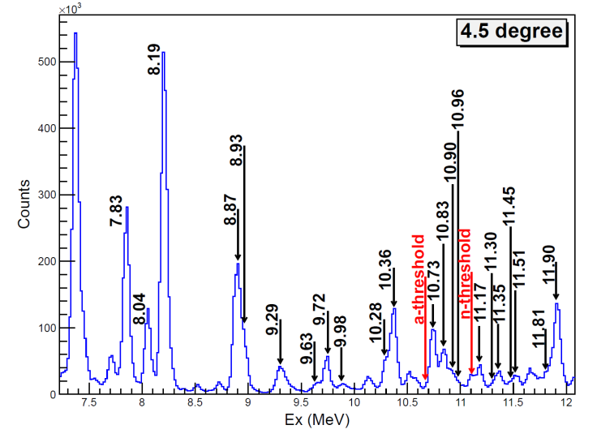
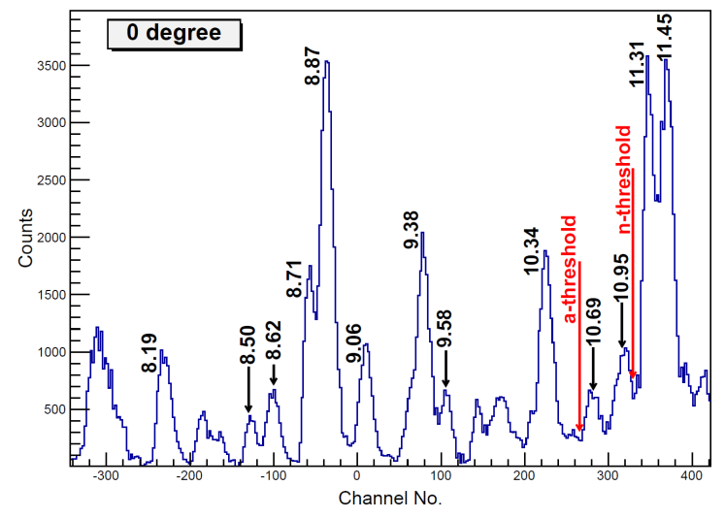
²²Ne(α,γ), ²²Ne(α,n)
The main nucleosynthesis product of stellar hydrogen burning besides ⁴He is ¹⁴N which is rapidly converted to ²²Ne by ¹⁴N(α,γ)¹⁸F(β⁺ν)¹⁸O(α,γ)²²Ne. The critical question is the strength of possible unobserved low-energy resonances in both reaction channels!
²⁶Mg(α,α’)²⁶Mg*
²²Ne(⁶Li,d)²⁶Mg
R. Talwar et al. Physical Review C, Volume 93 (2016) 055803

Slide 15
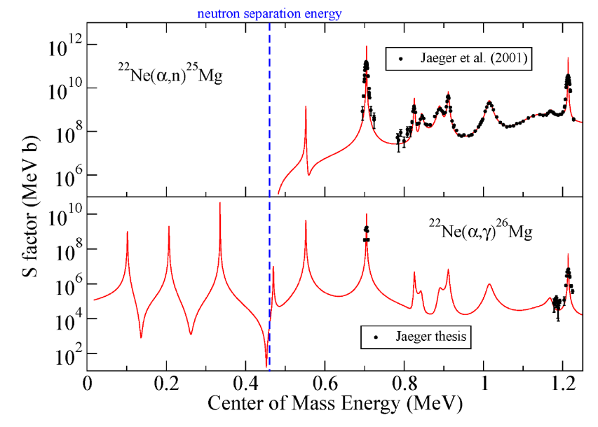
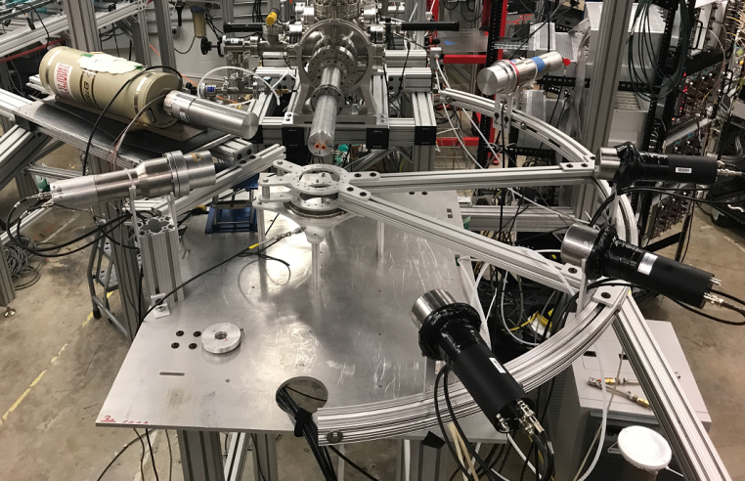
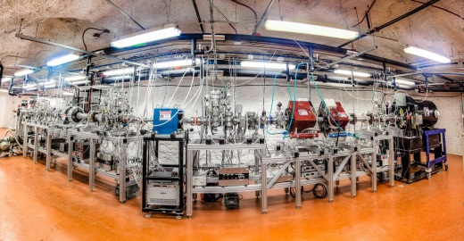
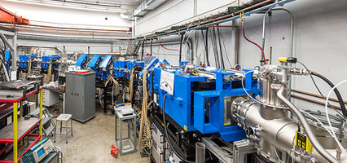
Direct low energy measurements
Resonances with comparable strength in γ and n channel are dominated by α channel!
Underground or inverse kinematic studies
D. Robertson et al. EPJWC 109 (2016) 09002
Z. Meisel et al. Nucl. Instr. Meth. A 850 (2017) 48

Slide 16
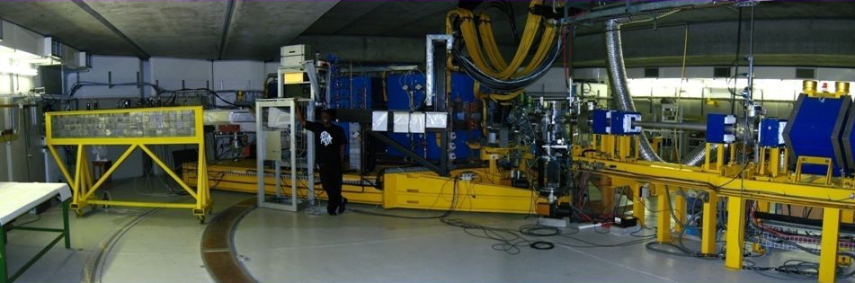
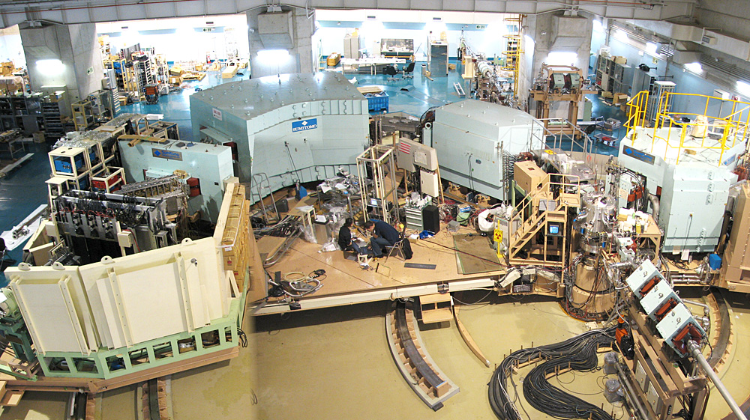
Probing natural parity mirror states in ²⁶Si (²⁶Mg) and ³⁰S (³⁰Si)with (p,t) reactions
Resolution within a few keV at the focal plane. Target thickness and energy loss effects of particles increases the resolution to 30-60 keV.
K-600 at i_Themba
The measurements were made by using two different magnet field settings to have two momentum bites, covering the entire excitation range.
Grand Raiden at RCNP, Osaka

Slide 17
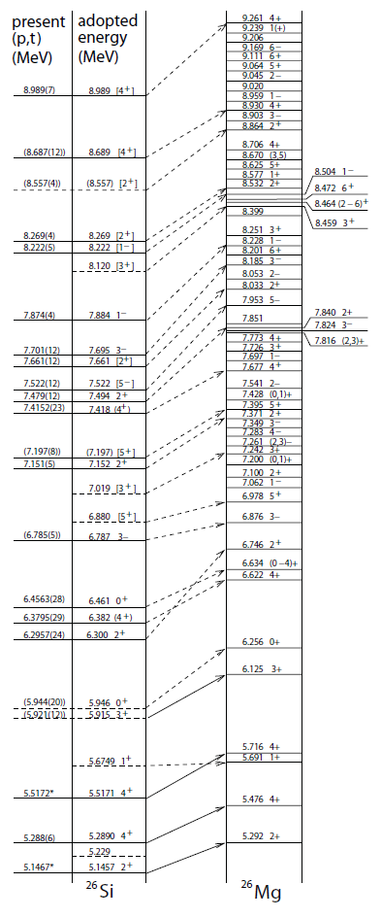



²⁶Mg - ²⁶Si mirrors
For determining
²²Mg(α,p)²⁵Al
²⁸Si(p,t)²⁶Si
A. Matic et al. Phys. Rev. C 82 (2010) 025807

Slide 18

The level density in ³⁰S ⇒ ²⁶Si(α,p)²⁹P mirror to ³⁰Si
A. Long et al., Phys. Rev. C accepted

Slide 19




The level parameters: spin, parity, partial widths
Spin distribution calculated using the back-shifted Fermi-Gas model
Level distribution, calculated using a nuclear cluster configuration shell model approach
A. Volya and Y. M. Tchuvil’sky, Physical Review C 91, 044319 (2015)

Slide 20


Impact on Reaction Rates
The reaction rates based on experimental and theoretical results are well below the HF model predictions.
²⁶Si(α,p)²⁹P
³⁰S(α,p)³³Cl
³⁴Ar(α,p)³⁷K
Similar suppression factor observed for α capture on T=0 ee nuclei:
T. Rauscher, F.K. Thielemann. J. Görres. M. Wiescher, Nucl. Phys. A675 (2000) 695

Slide 21
Summary
Alpha cluster states facilitate important burning processes in stellar helium and carbon burning.
Improved modeling of reaction contributions through cluster states is necessary
Direct alpha capture studies can help to experimentally identify near threshold cluster states
The cluster structure of T=1 e-e nuclei need to be studied for investigating stellar neutron sources and the αp-process!

Slide 22

Acknowledgement
Mary Beard
Georg Berg
James DeBoer
Joachim Görres
Dan Robertson
Xiadong Tang
Andreas Best
Xiao Fang
Alex Long
Andrija Matic
Elizabeth Strandberg
Rashi Talwar
And the rest of the research team at Groningen, Osaka, ORNL, and FSU

Slide 23



Experimental Problems
²⁶Mg(α,n)²⁹Si
NACRE
Too much beam-induced neutron background on target impurities and contamination such as: ⁹Be, ¹¹B, ¹³C, ^{17,18}O!
ND data points
after BG subtraction
upper limits

Slide 24


Predictive power for mirror structure?
Large variations in S-factor due to uncertainties in the spectroscopic factors for cluster states. Claim of a reasonably good comparison with the statistical HF model.
A. Matic et al., Phys. Rev. C 80 (2009) 055804
P. Mohr and A. Matic, Phys. Rev. C 87 (2013) 035801
P. Mohr, R. Longland, C. Iliadis, Phys. Rev. C90 (2014) 065806
P. J. C. Salter et al.,
Phys. Rev. Lett. 108 (2012) 242701

Slide 25





Future plans on αp-process
Mapping the αp-rp transition range ⁴²Ti, ⁴⁶Cr
Measuring inverse kinematics reaction cross sections with ANASEN (or SECAR) at ReA3

Slide 26

The level density in ³⁴Ar ⇒ ³⁰S(α,p)³⁵Cl mirror to ³⁴S
A. Long et al., Phys. Rev. C submitted

Slide 27

The level density in ³⁸Ca ⇒ ³⁴Ar(α,p)³⁹K mirror to ³⁸Ar
A. Long et al. Phys. Rev. C 95 (2017) 055803

