Slide 1



First Measurement of the
B(E2; 3/2⁻ → 1/2⁻) in ⁷Be:
A Test for Ab-Initio Models
Tan Ahn, S. Henderson, S. Aguilar, A. Simon, W. P. Tan,
D. W. Bardayan, M. Brodeur, M. Hall, J. J. Kolata, J. Long,
P. O’Malley, J. Allen, B. Frentz, S. Strauss
University of Notre Dame
SOTANCP 2018
Galveston, TX
May 14, 2018

Slide 2
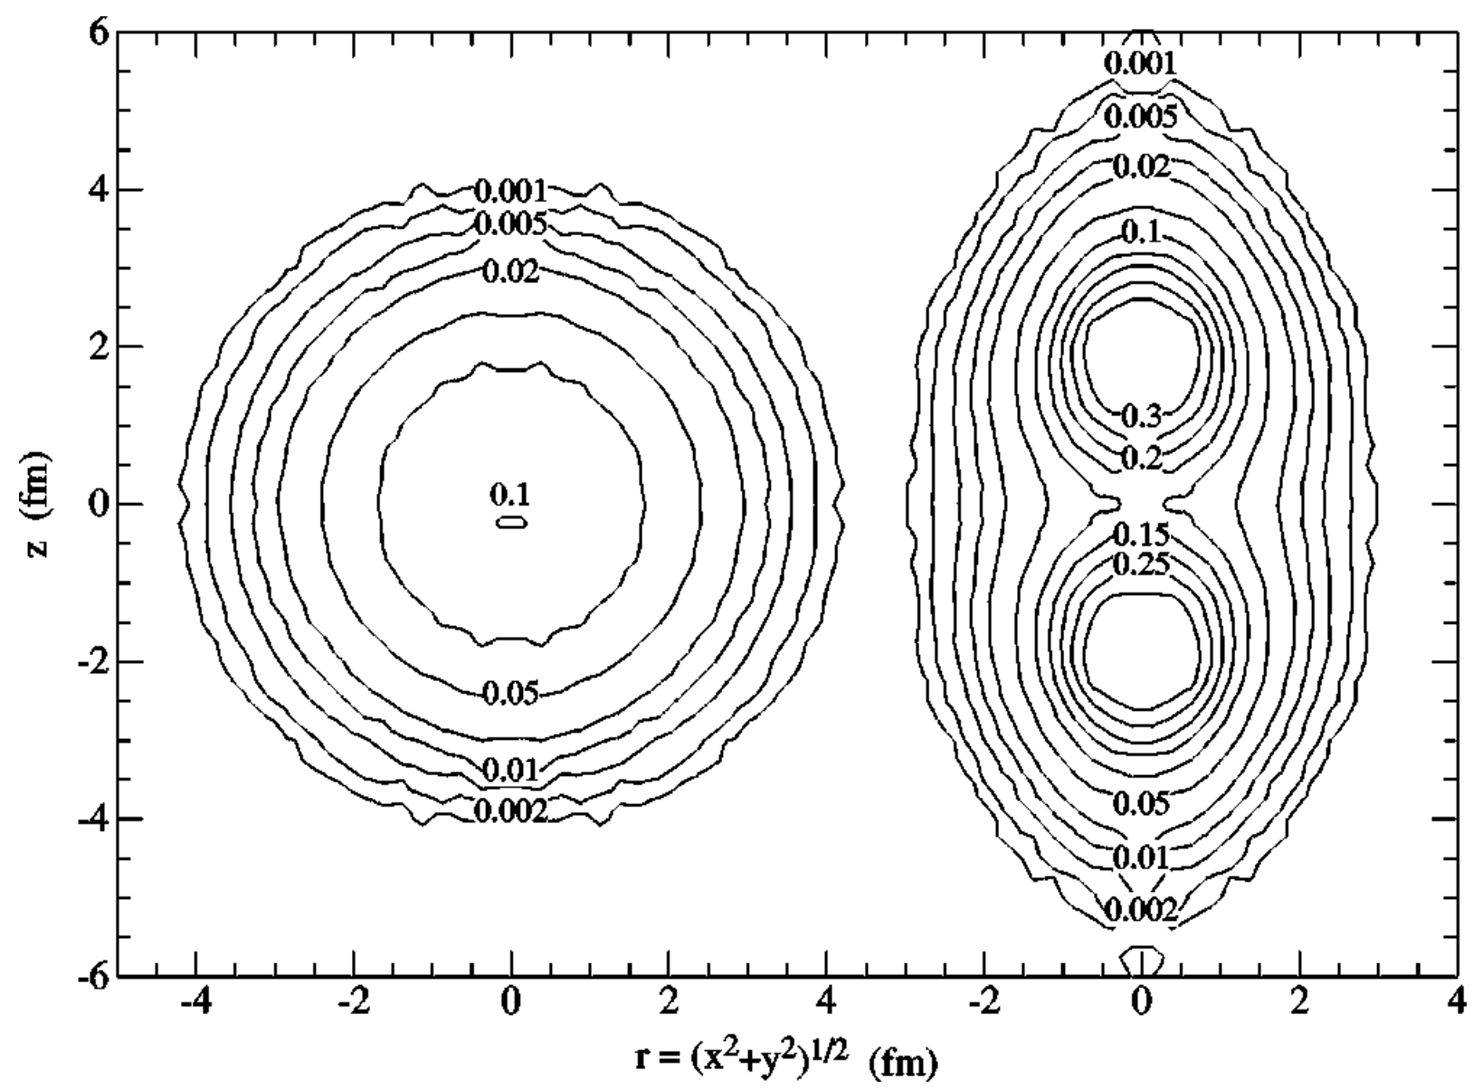
Cluster structure of light nuclei
³He
⁴He
  R. B. Wiringa, S. C. Pieper et al., PRC 62 014001 (2000)
Observables
  Large deformation, charge radii, low breakup thresholds
Ab-initio nuclear theory
  Must reproduce observables and clustering
  Number of Methods: Green’s Function Monte Carlo, NCSM, Fermionic Molecular Dynamics
Cluster degrees of freedom are important

Slide 3
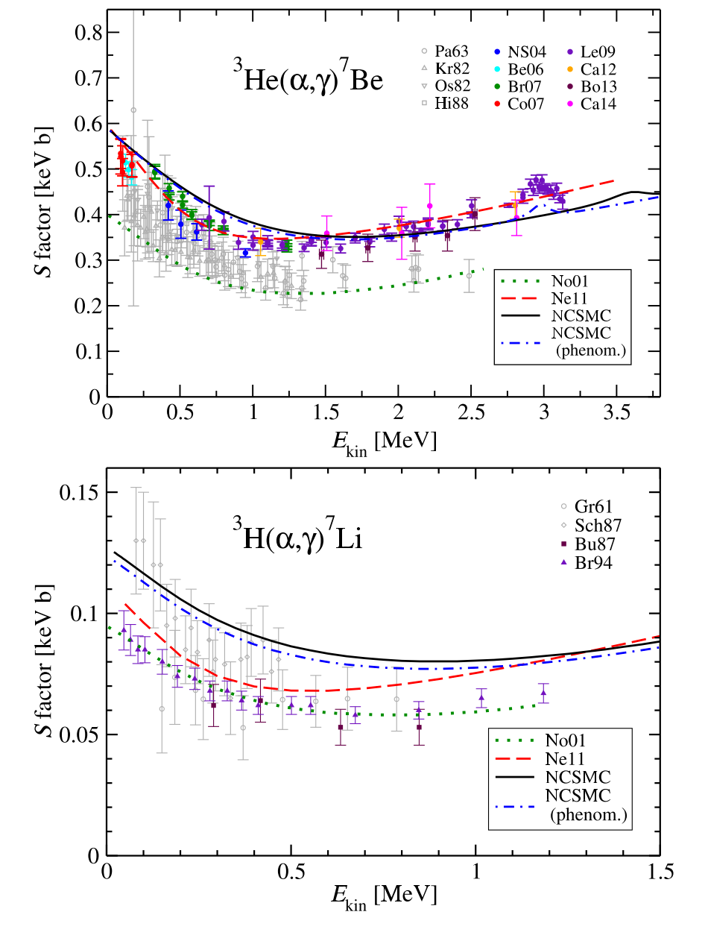
Clusters in Astrophysics
Radiative capture reactions
³H(α,γ)⁷Li
³He(α,γ)⁷Be
S-factors, stellar interiors
Need for predictive theoretical calculations
  Dohet-Eraly et al., Physics Letters B 757, 430 (2016)

Slide 4
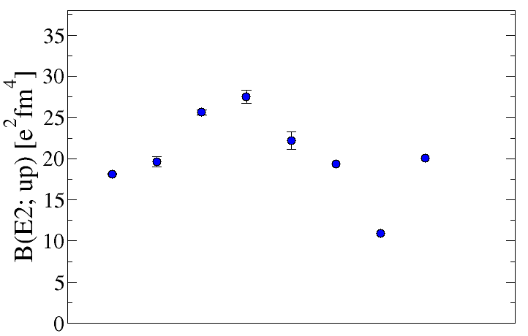
Theoretical Calculations of B(E2) in ⁷Be
1/2⁻
429.1 keV
⁷Be
M1/E2
γ
3/2⁻
VMC
GFMC
NCSM(C)
Calculated transition strengths from literature
E2 transition strength never measured
Coulomb Excitation measurement with ⁷Be radioactive beam

Slide 5
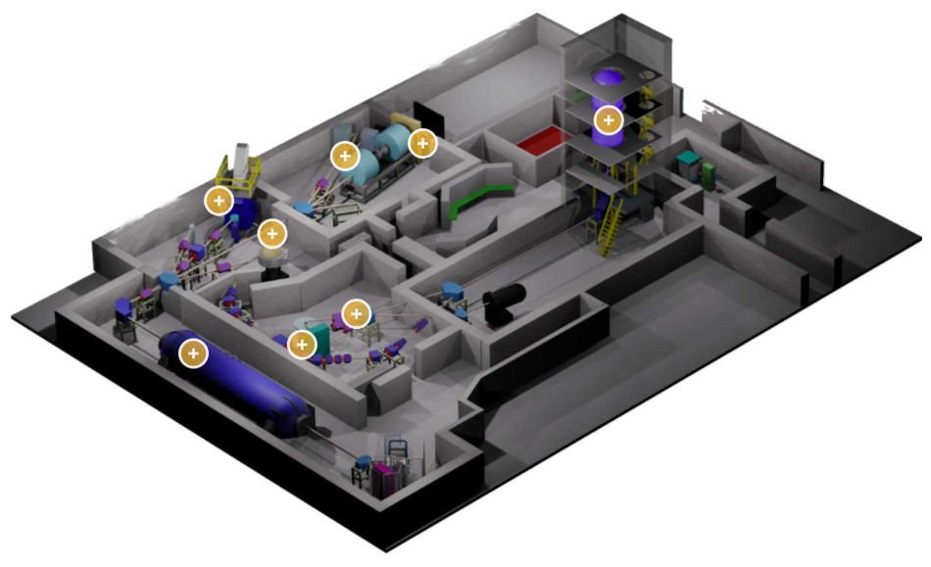
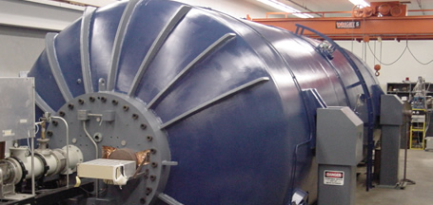
Institute for Nuclear Structure and Astrophysics at Notre Dame
10 MV FN Tandem Van de Graaff Accelerator
TwinSol Superconducting Magnets

Slide 6
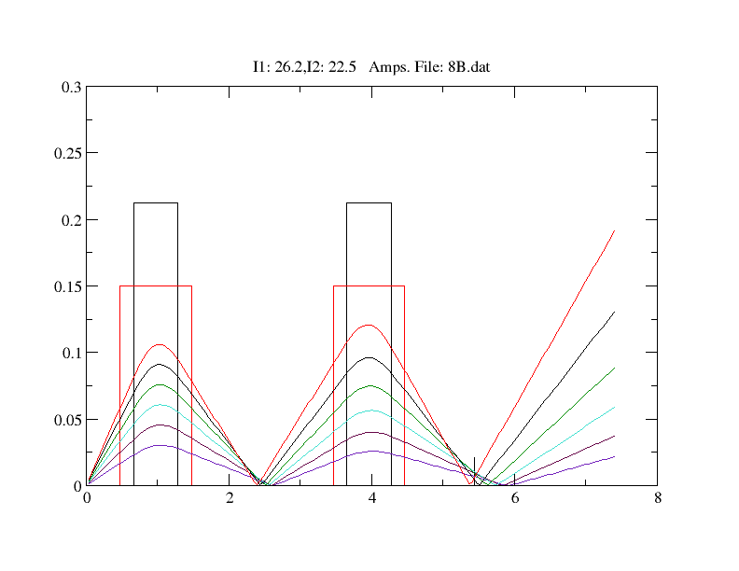
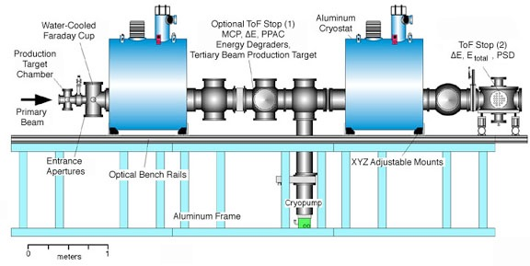
Making a ⁷Be beam at Notre Dame
In-flight reaction using d(⁶Li,n)⁷Be, 30.4 MeV
10⁵ pps
86% purity
F. Bechetti et al., NIM A 505, 377-380 (2003)
Notes:
100 mrad
1 – 10 deg
tracking

Slide 7
Coulomb Excitation Setup
HPGe Clover Detectors
⁷Be
⁷Be*
CD Si Detector
θ
γ-ray
  1 μm (1.9 mg/cm²) gold foil
  77% of Coulomb barrier
  S2 detector (300 um): 24 ring channels, 8 sectors
  6 HPGe Clover detectors (Cloveshare)

Slide 8
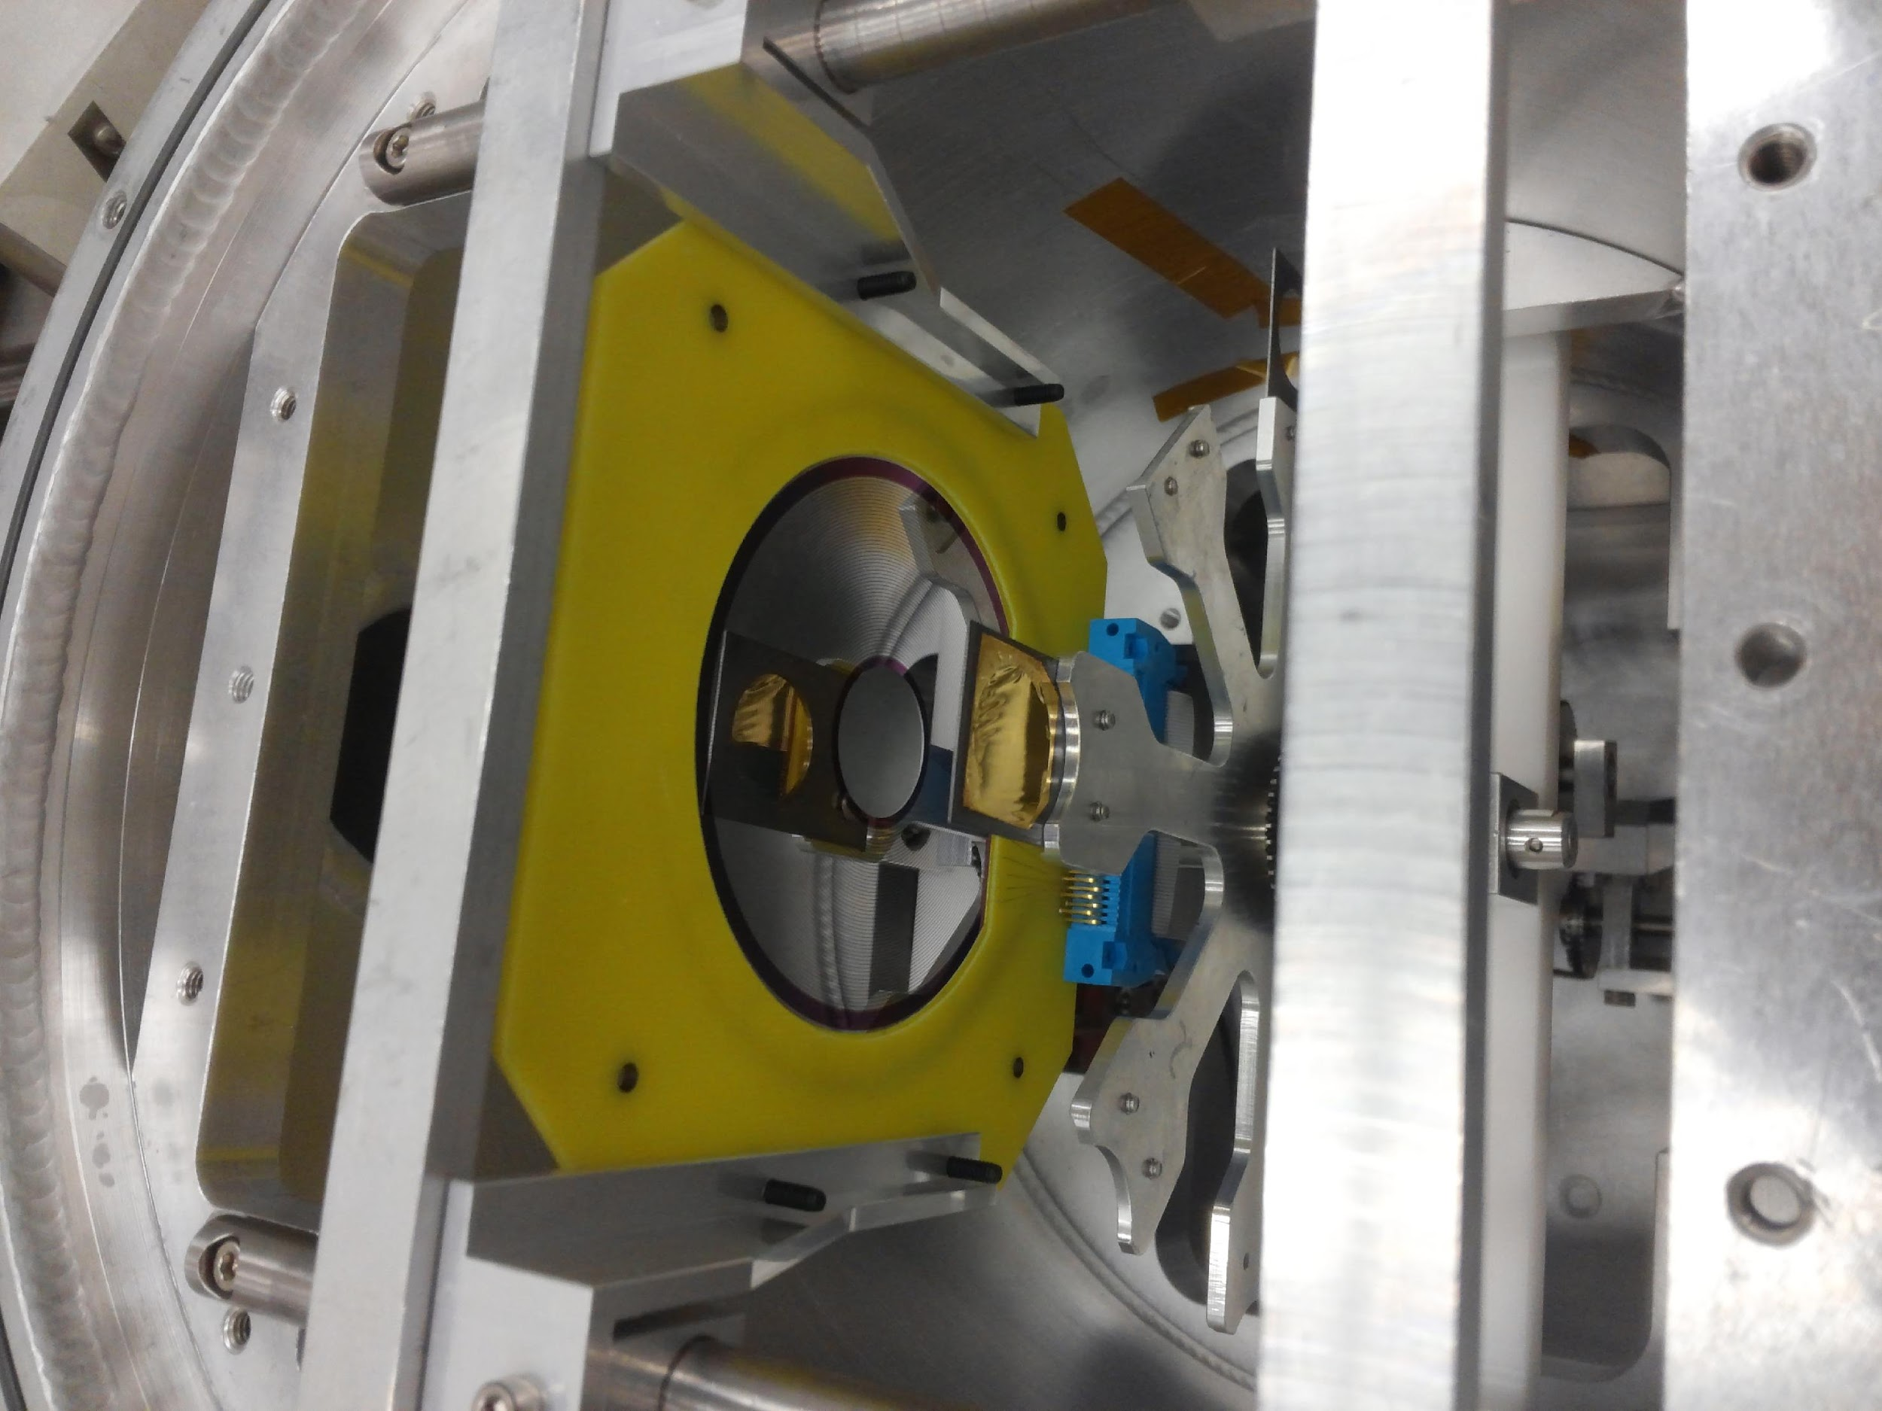
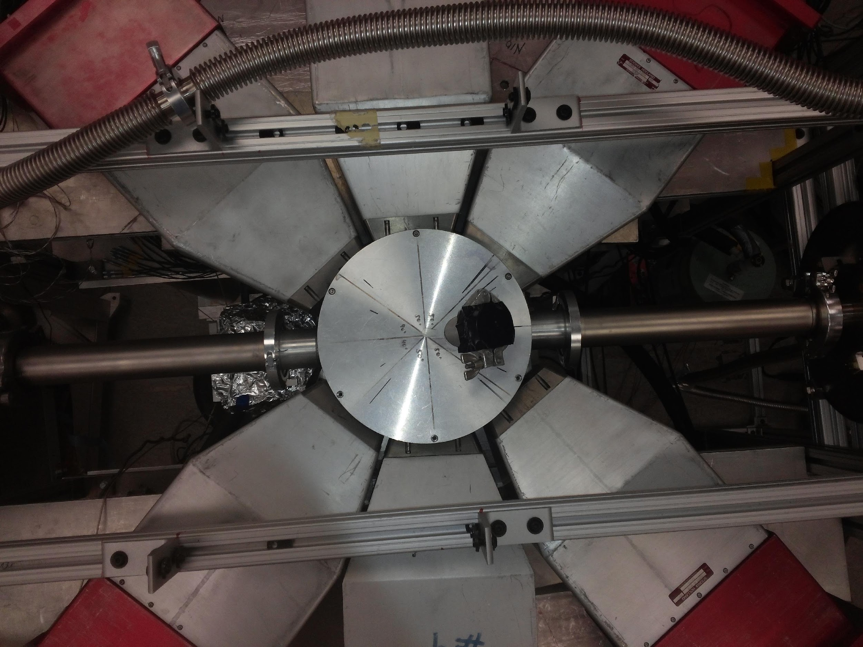
Experimental Set up
  Particle-gamma coincidence
  Digital DAQ
  3.5 days

Slide 9
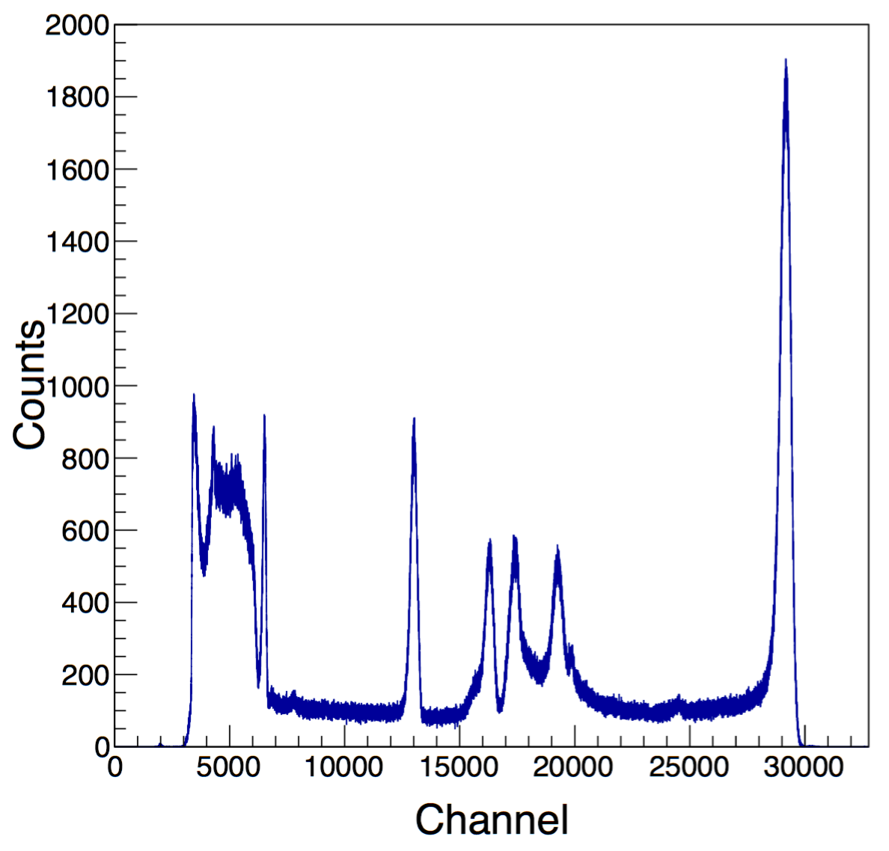
Particle spectrum
1 Ring energy spectrum
24 rings
18-24 degrees lab

Slide 10
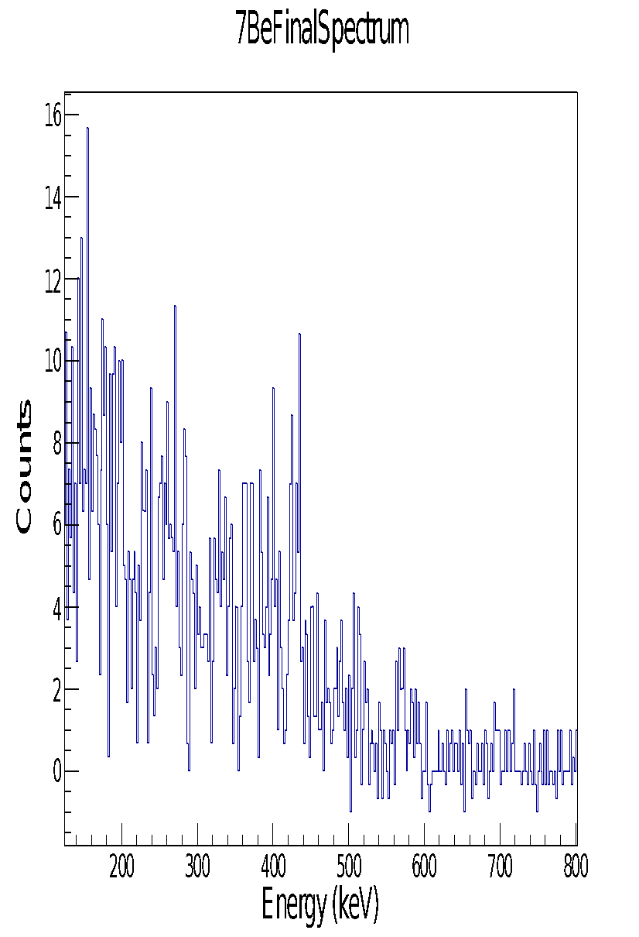
Doppler-corrected gamma spectrum
429 keV
Particle-gamma coincidence
Doppler correction
45(15) counts at 429 keV

Slide 11
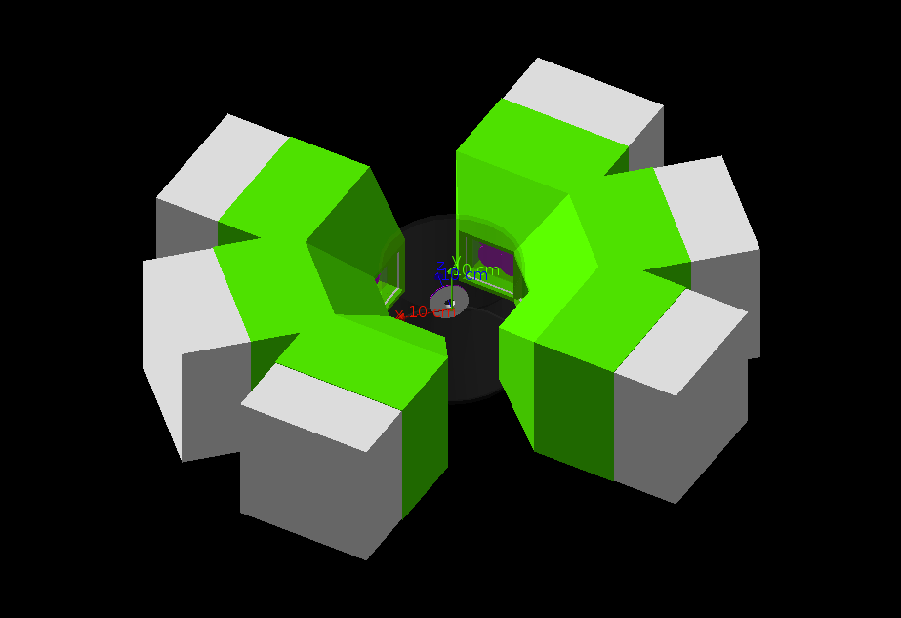
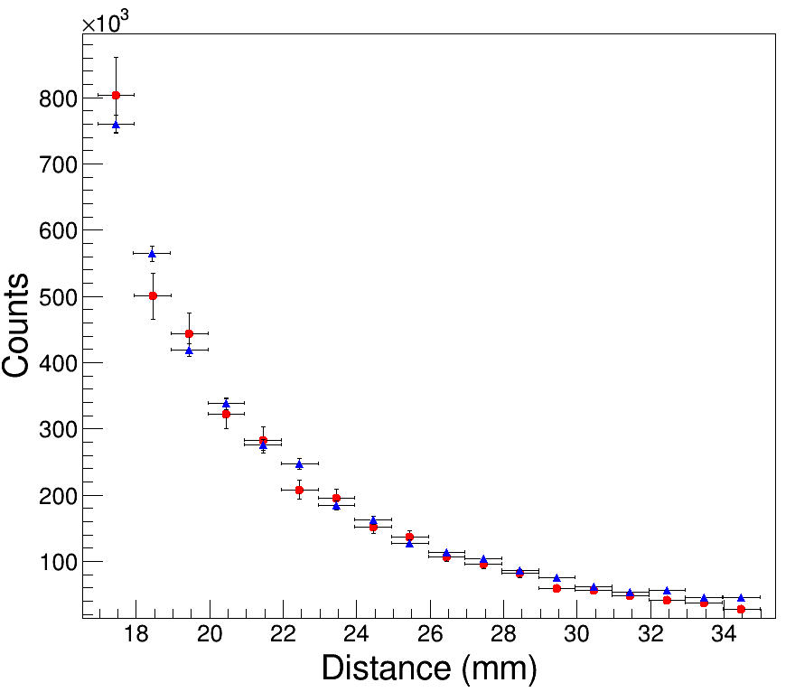
Geant4 Simulation
Red: Experiment
Blue: Geant4
Non-negligible beam width
Beam offset
1.2 x 10⁵ pps

Slide 12
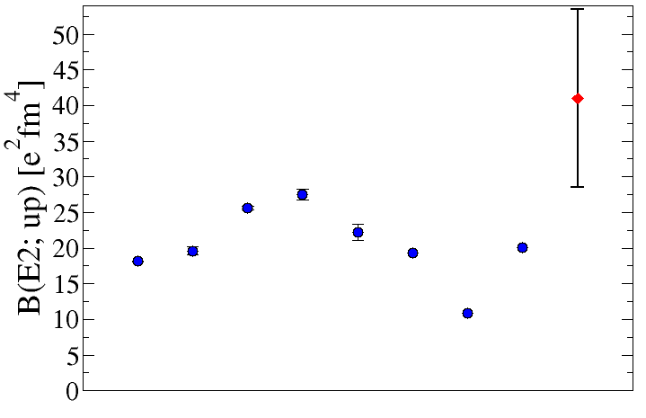
First ⁷Be B(E2) measurement results
Experiment
Theoretical calculations
Winther-de Boer Coulomb Excitation code
41(12)(4) e²fm⁴, (Preliminary!)

Slide 13
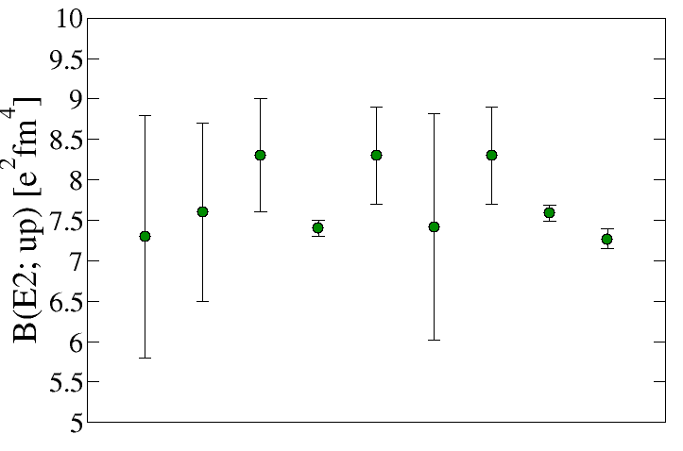
E1 polarizability in Light Nuclei: ⁷Li B(E2)
Contribution large due to low breakup threshold
Can be on the order of 10% in light nuclei
Important to know to determine absolution transition strengths

Slide 14
Summary and Outlook
First measurement of the B(E2; 3/2- to 1/2-) in ⁷Be
Constraint for ab-initio methods in nuclear theory
Importance of cluster degrees of freedom reaction rates of light elements in stellar interiors
Future Coulomb excitation measurements
⁷Be, higher statistics
⁷Li, constrain contribution from E1 dipole polarizability
⁸Li, neutron emission threshold

Slide 15
Collaborators
TwinSol Collaboration: Samuel Henderson, Sebastian Aguilar, Jim Kolata, Dan Bardayan, Patrick O’Malley, Oscar Hall, Matt Hall, Jacob Allen, Alan Howard, Amy Roberts, Maxime Brodeur, Jacob Long, James Kelly, Xuyang Li
Wanpeng Tan, Anna Simon
Funding: US National Science Foundation
  Thank you!

Slide 16
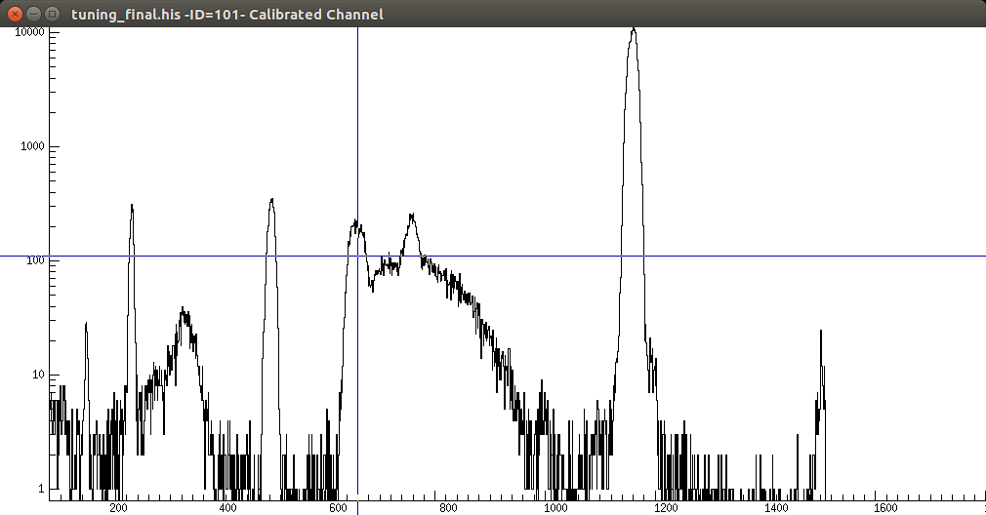
PID

Slide 17
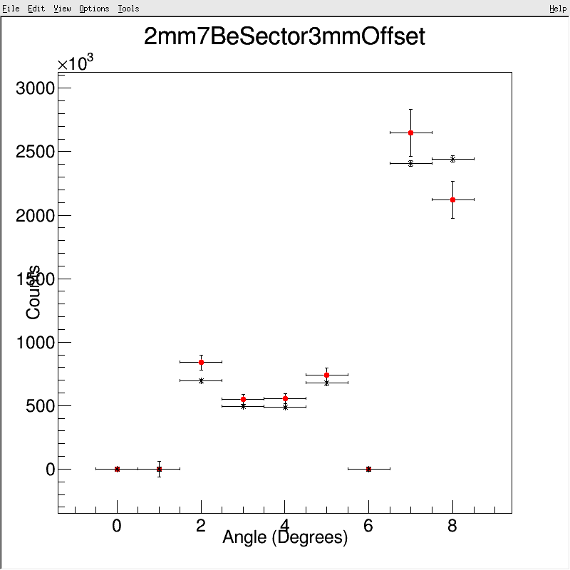

Slide 18
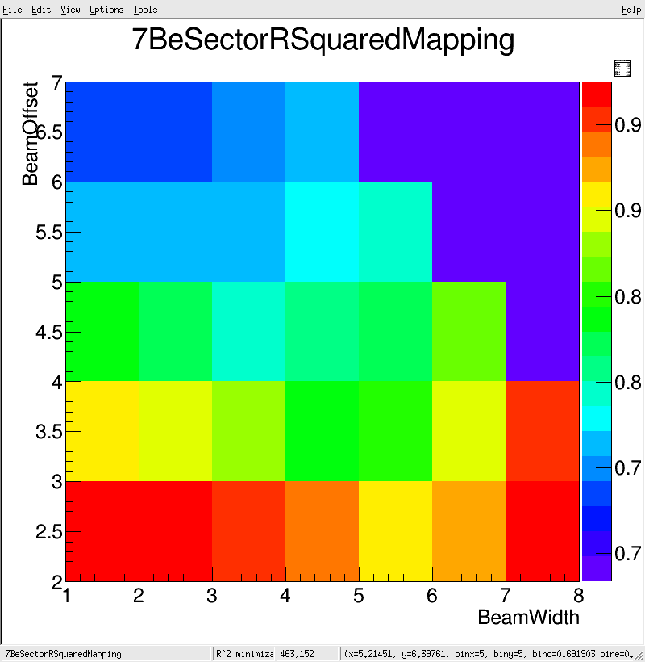

Slide 19
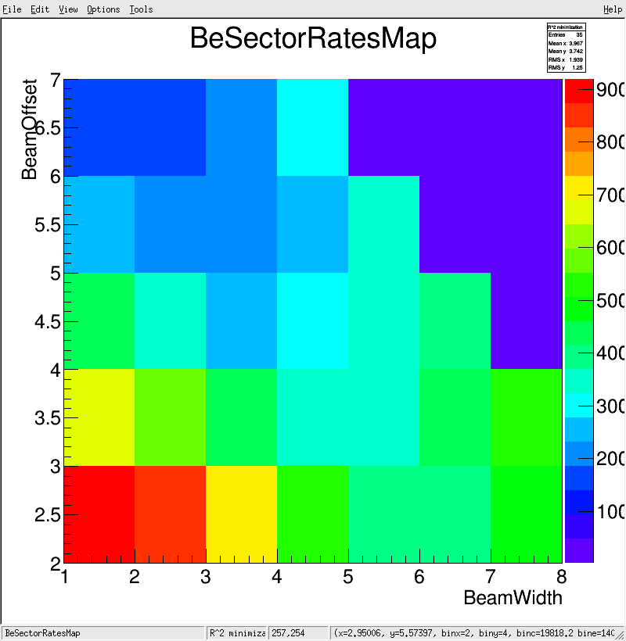

Slide 20
