Slide 1
Reduction of channel coupling effect on Li isotope elastic scatterings by glue-like behaviour of excess neutron
Fourth International Workshop on “State of the Art in Nuclear Cluster Physics” 13th-18th May 2018 @Galveston, Texas, USA
Yokohama National University
Takenori Furumoto
Collaborators
T. Suhara (Matsue College of Technology)
N. Itagaki (YITP, Kyoto U.)

Slide 2
Contents
Introduction
Formalism
Result
Summary

Slide 3
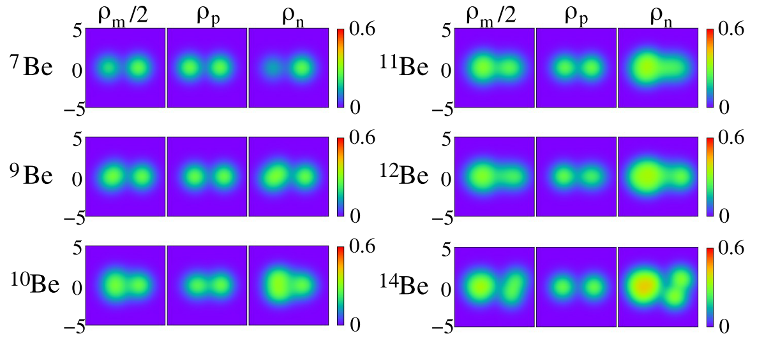
Introduction
⇨ The cluster feature in unstable nuclei is one of hot topics
M. Kimura, T. Suhara and Y. Kanada-En’yo, EPJA52, 373 (2016)

Slide 4
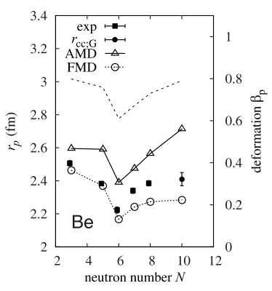
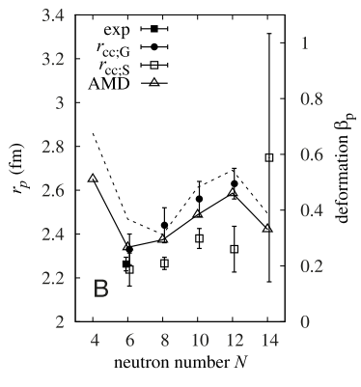
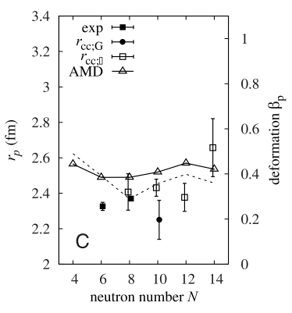
Introduction
By glue-like effect of the valence neutron(s)
⁸Be is unbound!
M. Kimura, T. Suhara and Y. Kanada-En’yo, EPJA52, 373 (2016)

Slide 5
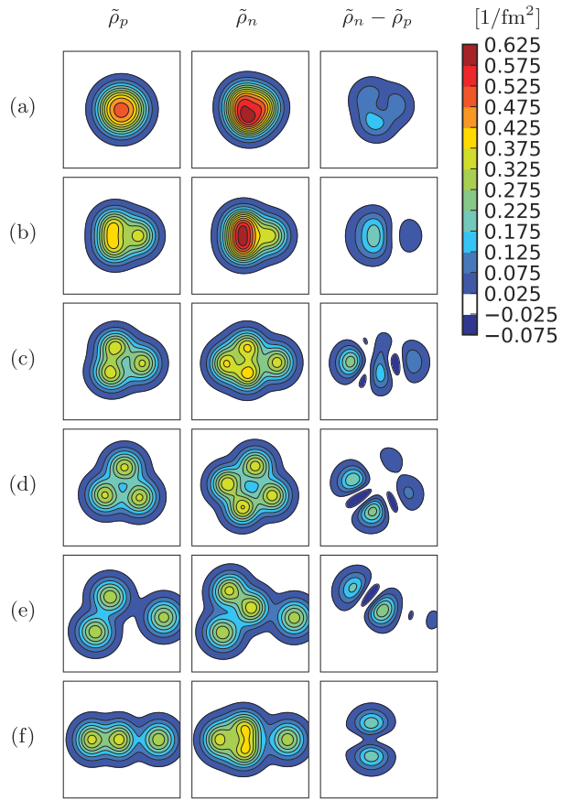
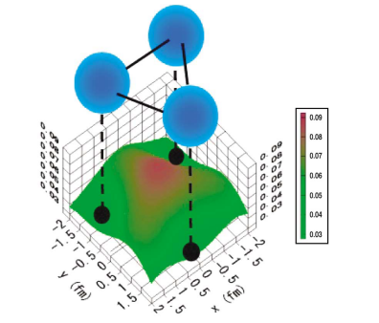
Introduction
⇨ The excess neutrons play a glue-like
role between alpha-clusters in ¹⁴C.
Equilateral-Triangular
N. Itagaki et al., PRL92, 142501 (2004)
Linear-chain
T. Suhara and Y. Kanada-En’yo, PRC82, 044301 (2010)

Slide 6
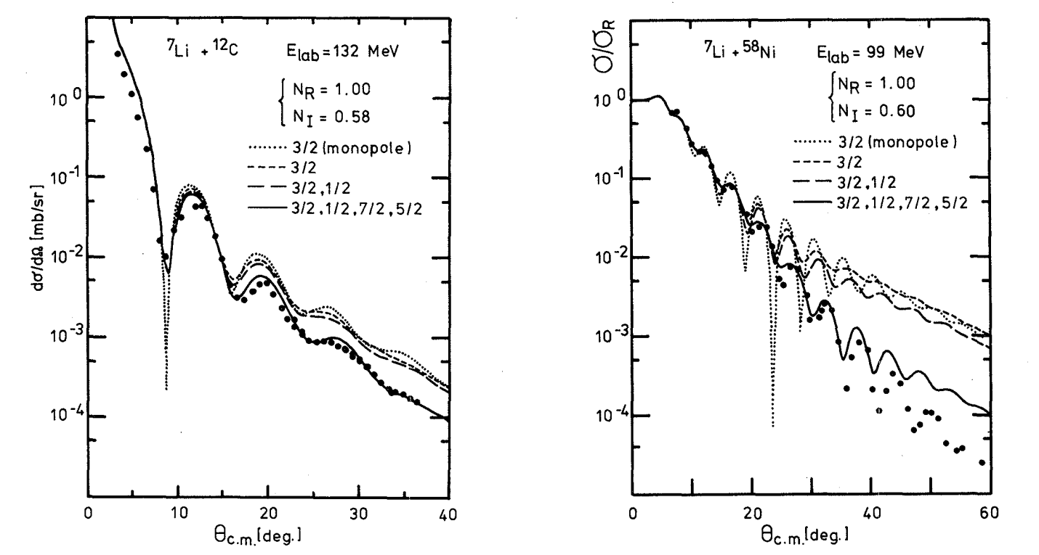
Introduction
⁷Li nucleus is loosely bound system as α + t clusters
⁷Li
t
α
⁷Li can be investigated directly.
Y. Sakuragi, M. Yahiro and M. Kamimura, PTP89, 136 (1986)

Slide 7
The purpose of this study
⁸Li
⁹Li
n₁
n₁
t
t
α
α
n₂
It is anticipated that the excess neutron(s) plays a glue-like role
to attract α and t clusters in the ⁸Li & ⁹Li nuclei.
⇨ Li isotopes will be suitable to investigate the glue-like role
from the viewpoint of the nuclear reaction.

Slide 8
Formalism (Structure)
⁹Li
n₁
Z
t
α
Cluster model + Stochastic multi-configuration mixing
n₂
Randomly fixed
Hamiltonian
Effective NN interaction
Central : Volkov No.2 (W=1-M)
LS : G3RS (V_{LS}=2000MeV)

Slide 9
Construction of the Li isotope
⁶Li
⁸Li
Z
n₃
Z
n₃
n₁
Z
n
t
α
p
α
α
p
n₂
⁷Li
⁹Li
n₁
Z
n₁
Z
t
p
α
α
n₂
n₂

Slide 10
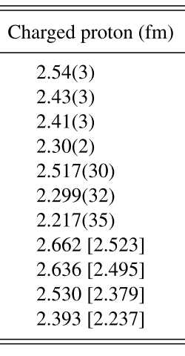
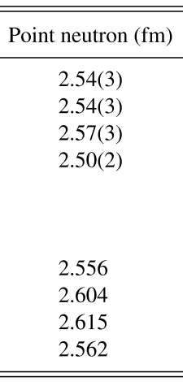
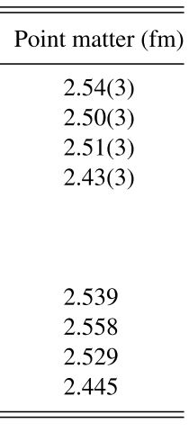
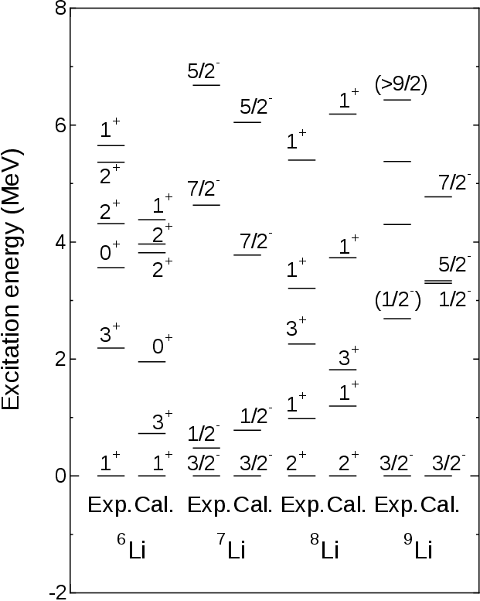
Comparison with data for excitation energy & radius
Proton radius becomes smaller and smaller.
[1] I. Tanihata et al., PRL55, 2676 (1985)
[52] R. Sanchez et al., PRL96, 033002 (2006)
T. Furumoto, T. Suhara, and N. Itagaki, PRC97, 044602 (2018)

Slide 11
Transition strength (B(IS2)) of Li isotope
6Li
B(IS2) (g.s. → 3₁) 57.13 fm⁴
(g.s. → 2₁) 54.78 fm⁴
(g.s. → 1₂) 33.56 fm⁴
7Li
B(IS2) (g.s. → 1/2₁) 54.47 fm⁴
(g.s. → 5/2₁) 22.06 fm⁴
(g.s. → 7/2₁) 96.78 fm⁴
8Li
B(IS2) (g.s. → 1₁) 16.24 fm⁴
(g.s. → 3₁) 47.96 fm⁴
(g.s. → 2₁) 7.384 fm⁴
(g.s. → 2₂) 15.68 fm⁴
9Li
B(IS2) (g.s. → 1/2₁) 19.26 fm⁴
(g.s. → 5/2₁) 19.19 fm⁴
(g.s. → 7/2₁) 31.55 fm⁴
By shrinking the density,
the transition strength becomes small.
Large
⇨ glue-like role by valence neutrons
Small
T. Furumoto, T. Suhara, and N. Itagaki, PRC97, 044602 (2018)

Slide 12
Formalism (Reaction)
Microscopic Coupled Channel (MCC)
The diagonal and coupling potentials are derived from microscopic view point.
transition density
MPa
v_{NN}(s)
r₂
Transition density
r₁
R
Projectile
Target

Slide 13
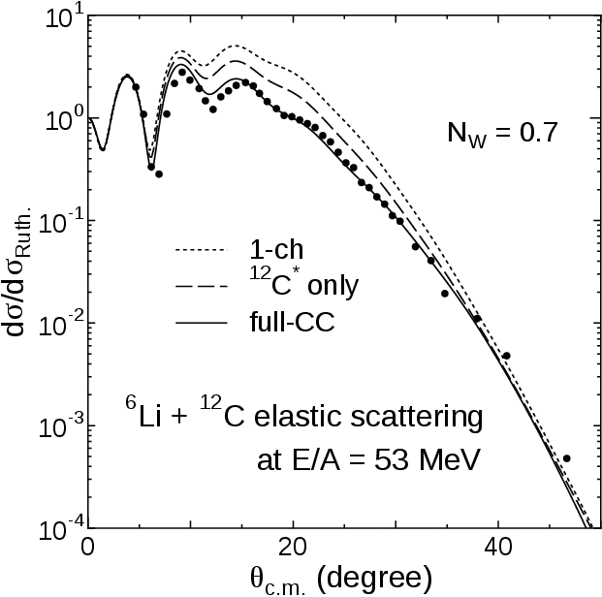
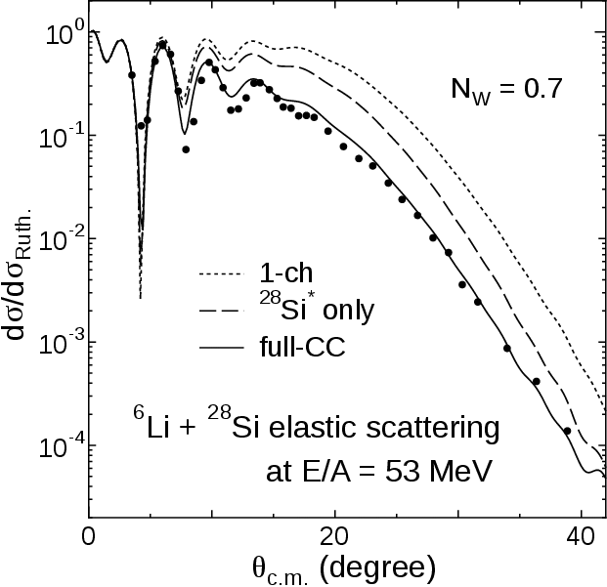
⁶Li elastic scattering by ¹²C and ²⁸Si at E/A = 53 MeV
T. Furumoto, T. Suhara, and N. Itagaki, PRC97, 044602 (2018)

Slide 14
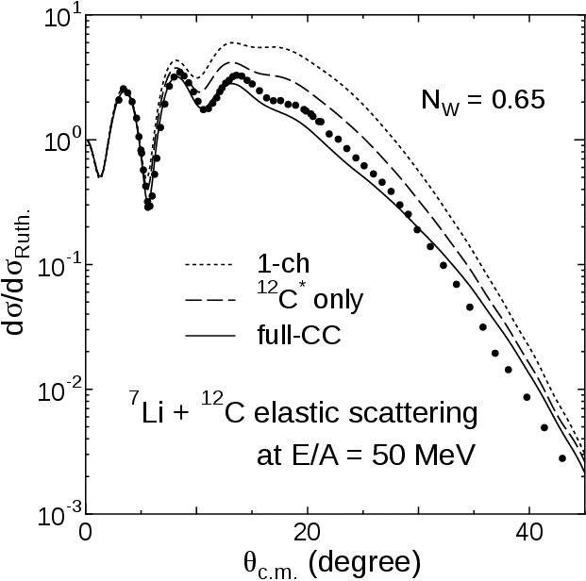
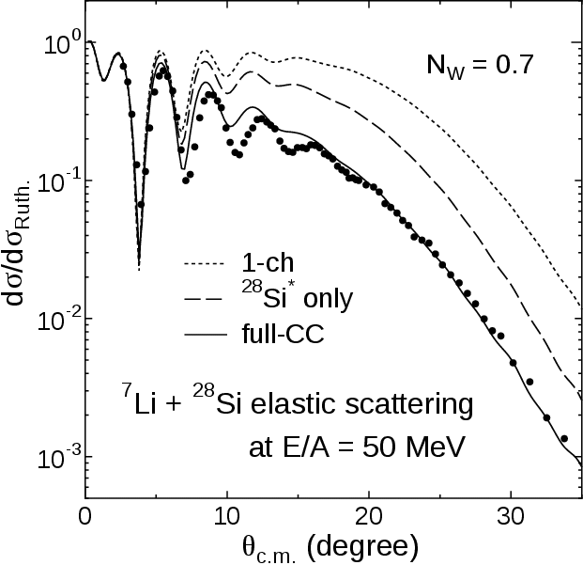
⁷Li elastic scattering by ¹²C and ²⁸Si at E/A = 50 MeV
T. Furumoto, T. Suhara, and N. Itagaki, PRC97, 044602 (2018)

Slide 15
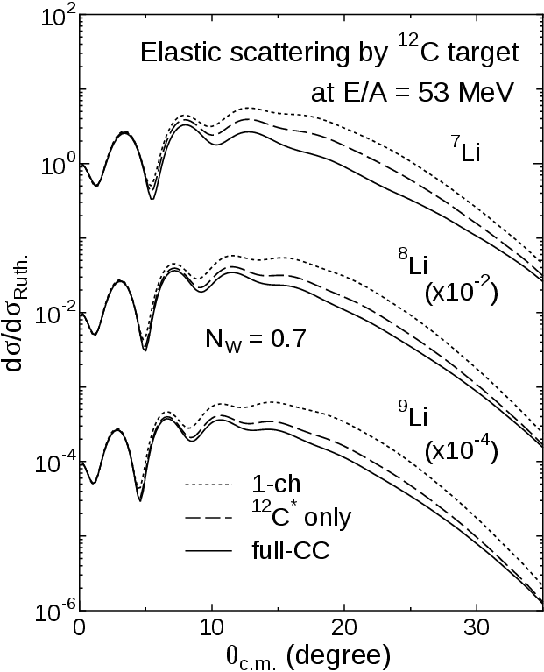
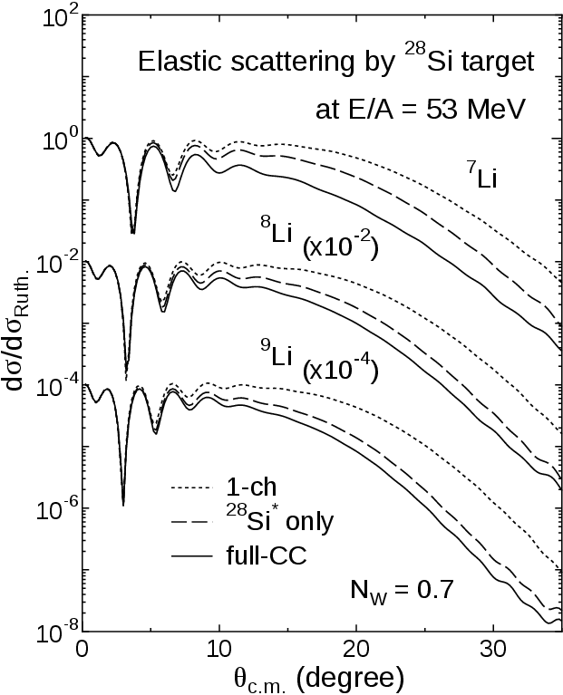
⁷⁻⁹Li elastic scatterings by ¹²C and ²⁸Si at E/A = 53 MeV
CC effect is small on ⁸Li and ⁹Li!
T. Furumoto, T. Suhara, and N. Itagaki, PRC97, 044602 (2018)

Slide 16
Summary
Construction of Li isotopes
⇨ performed with the cluster wave function microscopically.
Application to nuclear reaction
⇨ well reproduce the existing experimental data up to backward angles.
Feature of glue-like role in both of nuclear structure and reaction
⇨ The excess neutron(s) play a glue-like role between α and t clusters in Li isotopes
- Shrink of proton radius by adding valence neutron(s)
- Reduction of transition strength for ⁷Li and ⁹Li nuclei
- Scale down of CC effect by ⁸Li and ⁹Li nuclei

