Slide 1
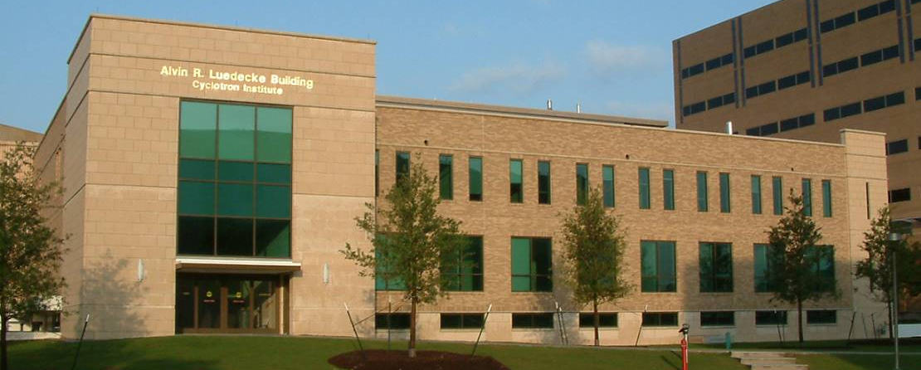
Neutron Ball Testing Part II
Comparing new Cave 4 configuration with old one
090418

Slide 2
Cave 4 Configuration
Andrea Jedele Progress in Research Cyclotron Institute

Slide 3
Cave 4 Configuration
Andrea Jedele Progress in Research Cyclotron Institute

Slide 4
Cave 4 Configuration
Andrea Jedele Progress in Research Cyclotron Institute

Slide 5
Cave 4 Configuration
Andrea Jedele Progress in Research Cyclotron Institute

Slide 6
Cave 4 Configuration
Andrea Jedele Progress in Research Cyclotron Institute

Slide 7
Cave 4 Configuration
Andrea Jedele Progress in Research Cyclotron Institute

Slide 8
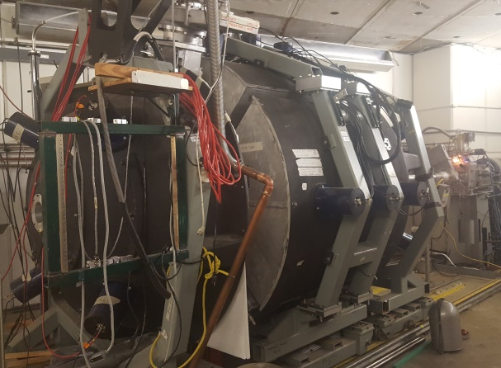
Introduction – Neutron Ball
6 segments/tanks
Filled with EJ-335 (pseudocumene and mineral oil) doped with 0.25% wt. nat. Gd
20 PMTs
4 top
12 middle
4 bottom
Beam
direction

Slide 9
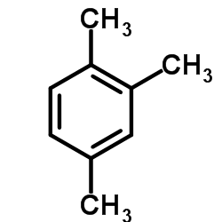
How does the Neutron Ball Work?
Neutrons enter tank
Neutrons interact with liquid
Thermalized
Thermalized n are captured by Gd
Emits several gamma rays (1-2 MeV range)
Pseudocumene scintillates
Photons are collected in PMTs

Slide 10
NBL testing
Test the new cave configuration Ar-40 beam @ 24.8 MeV/nuc
Used a Si detector as a trigger
6 consecutive 100 μs gates
Si Detector
Half
wall
Tuning
quads
Nstars Chamber
Target
Beam
dump
Neutron Ball

Slide 11
NBL testing
Tuning
quads
Si Detector
Half
wall
Nstars Chamber
Target
Beam
dump
Neutron Ball
600 nA on beam dump
8,000 counts/sec w/o beam
10,000 counts/sec through a blank target
Results show a multiplicity of 7-9 neutrons with a 55% efficiency
Neutron Count
Attenuation | 1st window | 2nd window | 3rd window | 4th window | 5th window | 6th window | Δx = (x₁-($\overline{x_{2−6}}$))
1 x 10⁻² | 10.96 $±$ 0.15 | 2.35 $±$ 0.09 | 2.13 $±$ 0.08 | 2.00 $±$ 0.08 | 1.91 $±$ 0.08 | 2.16 $±$ 0.10 | 8.85 $±$ 0.17
10⁻² - ps off | 11.02 $±$ 0.11 | 4.39 $±$ 0.11 | 4.36 $±$ 0.11 | 4.22 $±$ 0.11 | 3.90 $±$ 0.09 | 4.18 $±$ 0.11 | 6.81 $±$ 0.14
3 x 10⁻³ | 9.63 $±$ 0.24 | 1.77 $±$ 0.12 | 1.84 $±$ 0.16 | 2.29 $±$ 0.22 | 2.00 $±$ 0.18 | 1.91 $±$ 0.19 | 7.67 $±$ 0.30
1 x 10⁻³ | 9.02 $±$ 0.17 | 2.21 $±$ 0.17 | 2.15 $±$ 0.16 | 2.20 $±$ 0.16 | 2.14 $±$ 0.16 | 1.84 $±$ 0.13 | 6.91 $±$ 0.23
3 x 10⁻⁴ | 8.56 $±$ 0.24 | 1.76 $±$ 0.17 | 2.14 $±$ 0.22 | 1.97 $±$ 0.27 | 1.84 $±$ 0.17 | 1.82 $±$ 0.20 | 6.65 $±$ 0.32

Slide 12
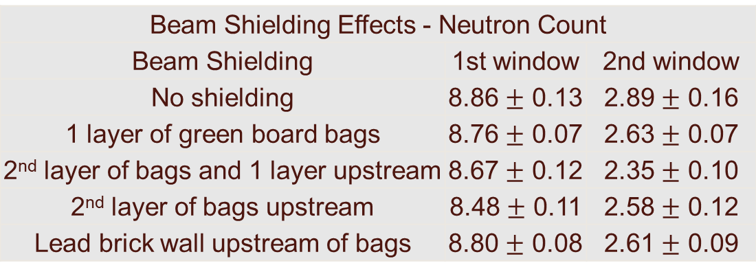
Beam Shielding studies
More shielding is better
Beam Shielding Effects - Neutron Count
Beam Shielding | 1st window | 2nd window
No shielding | 8.86 $±$ 0.13 | 2.89 $±$ 0.16
1 layer of green board bags | 8.76 $±$ 0.07 | 2.63 $±$ 0.07
2nd layer of bags and 1 layer upstream | 8.67 $±$ 0.12 | 2.35 $±$ 0.10
2nd layer of bags upstream | 8.48 $±$ 0.11 | 2.58 $±$ 0.12
Lead brick wall upstream of bags | 8.80 $±$ 0.08 | 2.61 $±$ 0.09

Slide 13
Beam pulser vs phase shifter
Beam pulser:
Deflects beam in injection line
50 μs
Most within 40 μs
Phase shifter:
Changes phase of cyclotron
100 μs
Most within 80 μs
(ms)
(ms)

Slide 14
NBL testing K150
Ne-22 beam @ 19 MeV/nuc w/ 10% efficiency 0.3 nA on FC02
In July
1,000 counts/sec
~2,000 counts/sec through blank target
60,000 counts/sec on 5.0 mg/cm² Sn target
In September
1,000 counts/sec
6,000 counts/sec through blank target
200,000 counts/sec on Sn target

