Slide 1
Neutron Ball Background Testing
Andrea Jedele
Kris Hagel, Alan McIntosh

Slide 2
Introduction – Neutron Ball
6 segments/tanks
Filled with EJ-335 (pseudocumene and mineral oil) doped with 0.25% wt. nat. Gd
20 PMTs
4 top
12 middle
4 bottom
Beam
direction

Slide 3
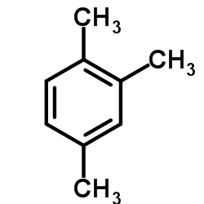
How does the Neutron Ball Work?
Neutrons enter tank
Neutrons interact with liquid
Thermalized
Thermalized n are captured by Gd
Emits several gamma rays (1-2 MeV range)
Pseudocumene scintillates
Photons are collected in PMTs

Slide 4
Motivation
Reconfiguration of Cave 4
AGGIE added where Hyperion was
Hyperion added behind neutron ball
New beam dump
Half-wall behind neutron ball removed
NIMROD remains the same
LLNL modifications
New liquid scintillator – changed mixture
New PMTs
Change the neutron ball background rate
How different is the rate?
How does this impact our measured neutron multiplicities?

Slide 5
Cave 4 Configuration
Drawing courtesy of S. Molitor

Slide 6
Geant simulations
Effect of half-wall
Effect of Half Wall and Beam Dump Shielding
10 MeV neutrons – Simulations courtesy of R. Wada

Slide 7
Background measurement with Previous configuration
Test ramping up time for K150
Background rate with Sn, Zn and blank
Sn, Zn

Slide 8
How do we measure neutrons?
Ne-22 at 19 MeV/nuc (K150)
Sn, Zn and blank targets
Phosphor
Si detector as trigger
Scalers
Counted neutrons in 6 100 μs gates
Neutron rate in 1st and 2nd 100 μs
Background rate in subsequent 100 μs gates
LED
Si
Camera
Target Wheel

Slide 9
Results from “Pulsing beam” – Clamping RF
Measured 4 different times between pulses
3 seconds between beam shut off and ramping up

Slide 10
Results for target
Sn
Beam-on Rate: ~60,000 neutrons/sec.
Neutron Multiplicity

Slide 11
Results for Blank target
Blank Target Rate: ~1,000 neutrons/sec.
Neutron Multiplicity

Slide 12
Phosphor testing
What effect does tuning on a phosphor have on the neutron ball?
Is the neutron ball activated?
Can we quantify the activation?
How long is the neutron ball activated?
100 pA on FC02
1 min irradiation
770 pA on FC02
1 min irradiation
Background
12 nA on FC02
1 min irradiation
88 nA on FC02
1 min irradiation

Slide 13
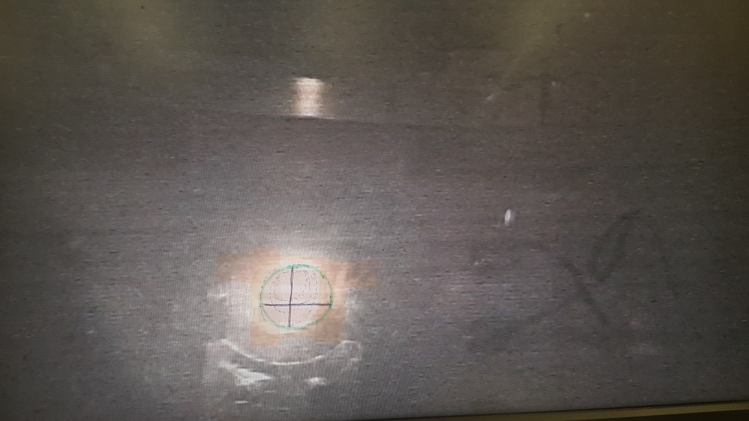
Extreme case
95 nA on FC02
Irradiated phosphor for 10 min
Monitored rate after beam turned off
Background
Neutron Multiplicity
Event Number

Slide 14
Next steps
Repeat the same measurement with new beam dump
Test with a higher energy beam

Slide 15
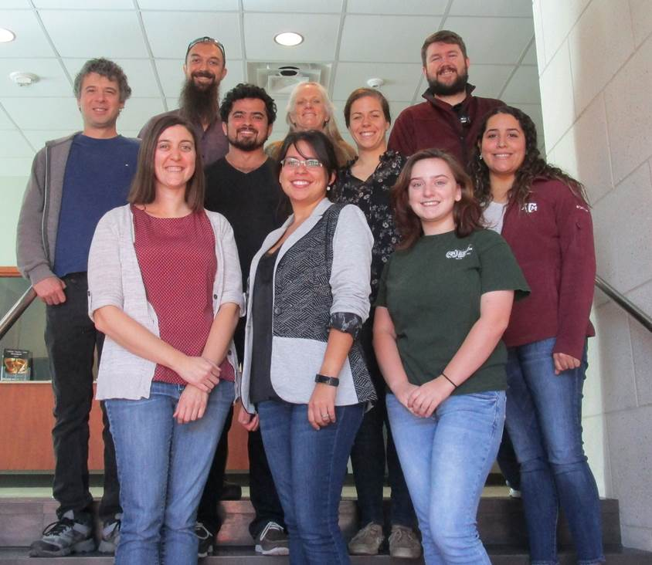
Thank you!
Alan and Kris
SJY group
Fred, leigh and george

Slide 16
Pulser trigger measurement
3 sec
3 sec
Si trigger
Pulser trigger
Tested configuration using pulser as trigger vs. Si detector

Slide 17
How do we measure neutrons?
Si as trigger
Si signal
LED
Si
Pre-Amp
Camera
Target Wheel
Amplifier
Discriminator
Logic Fan

Slide 18
How do we measure neutrons?
NBL-PMT
Scalers
Neutron rate in 1st 100 μs
Background rate in 2nd 100 μs
Fast Amp
Repeated 5x
CFD
Scaler
Linear Fan
Discriminator
Logic Fan
Coincidence
Module
Gate Generator (100μs)
Coincidence
Module
Gate Generator (100μs)
100μs Delay
Scaler
Si Discriminator

