Slide 1
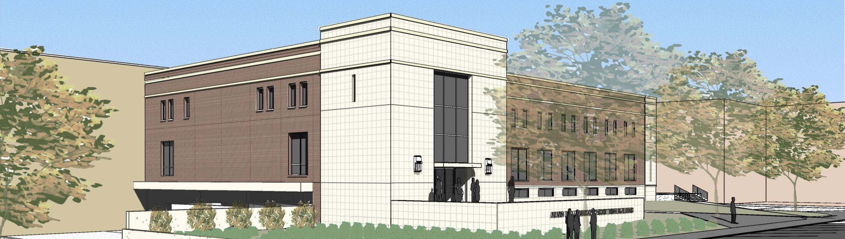
Status of the Radiation Effects Facility at the Texas A&M University Cyclotron Institute
Henry L Clark, PhD
Accelerator Physicist / Project Manager
http://cyclotron.tamu.edu/ref/

Slide 2
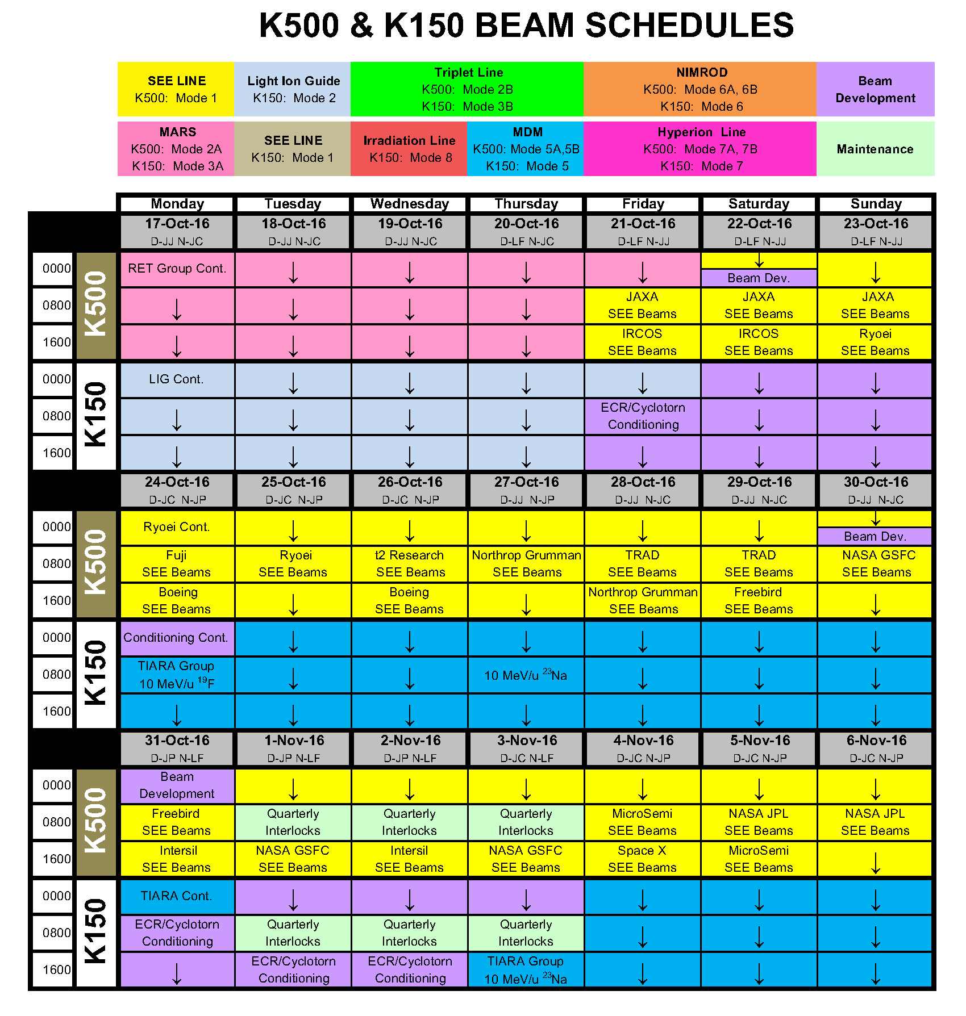
Typical Beam Schedule:
1 - 3 weeks SEE Testing (yellow)
1 – 3 weeks of Science Experiments (all other colors)
Schedule 6 – 8 weeks in advance
Two Cyclotrons to schedule….
4 modes of Science/SEE operation

Slide 3
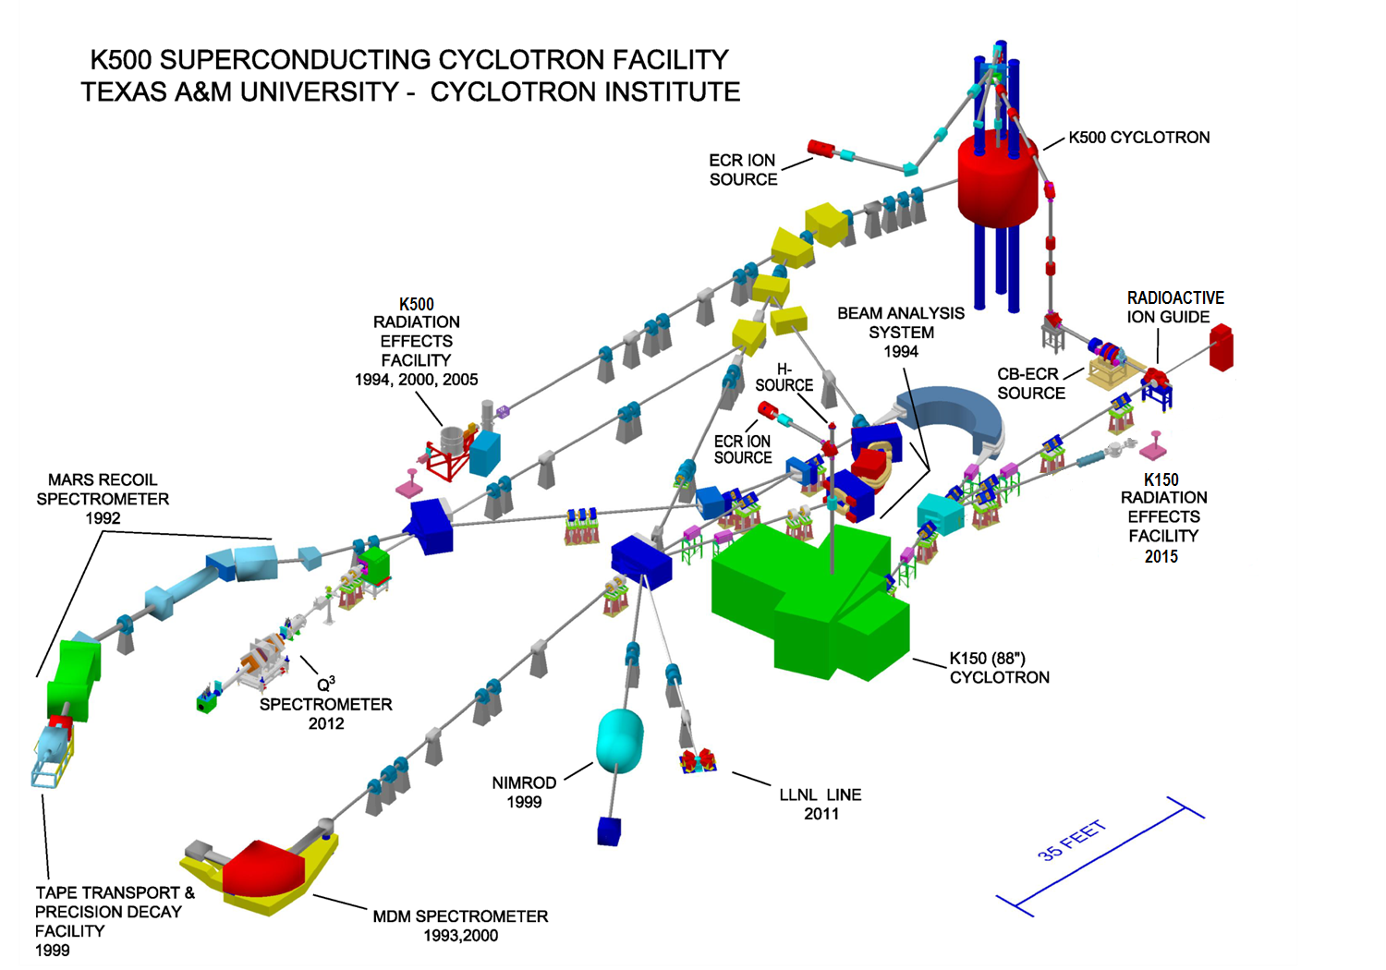
Mode 1
K500 – Science
K150 – Science

Slide 4
Mode 2
K500 – SEE
K150 – Science

Slide 5
Mode 3
K500 – Science
K150 – SEE

Slide 6
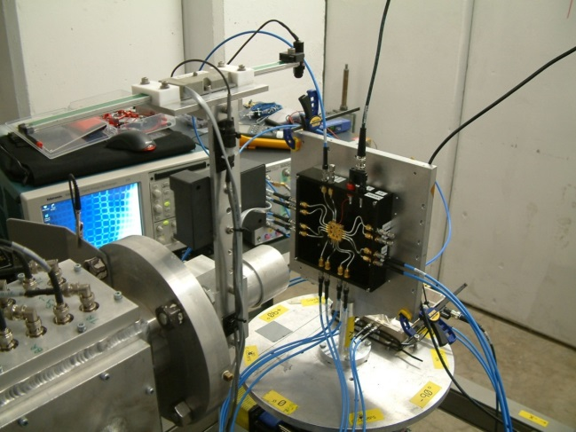
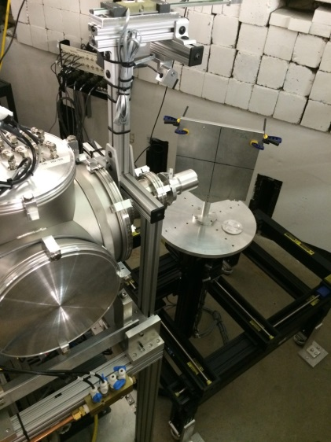
Mode 4
K500 – SEE
K150 – SEE
Heavy ions – K500 Cyclotron
Protons &
Heavy ions – K150 Cyclotron

Slide 7
ECR Ion Source Change Over

Slide 8
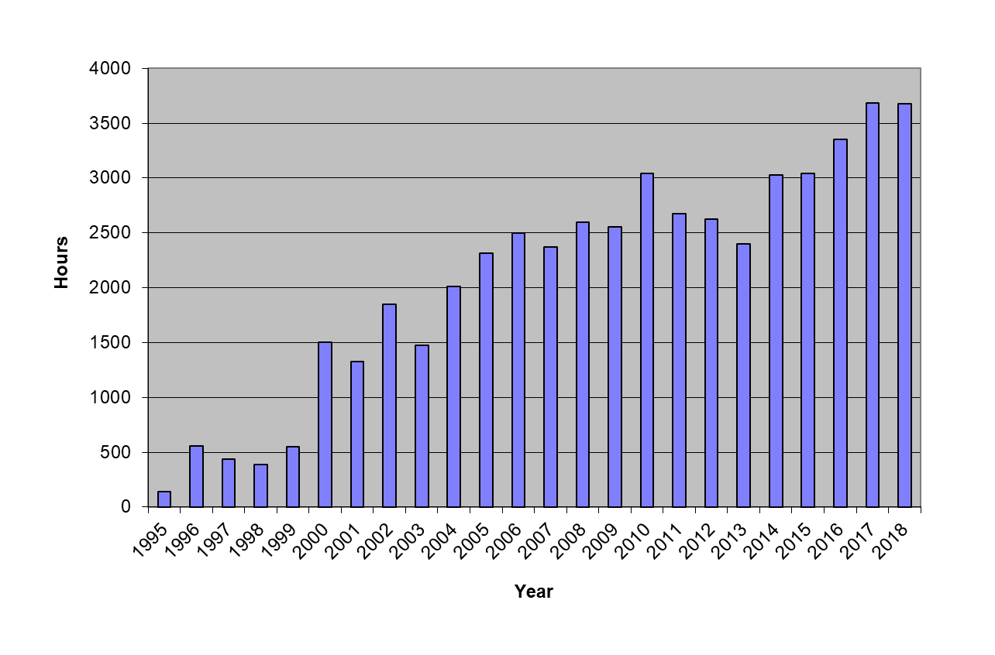
K500 + K150 SEE Hours at Texas A&M
50,092 hours over 24 years
K150 REF
High Energy Beams & In –Air Testing
Low Energy Beams
Notes:
8

Slide 9
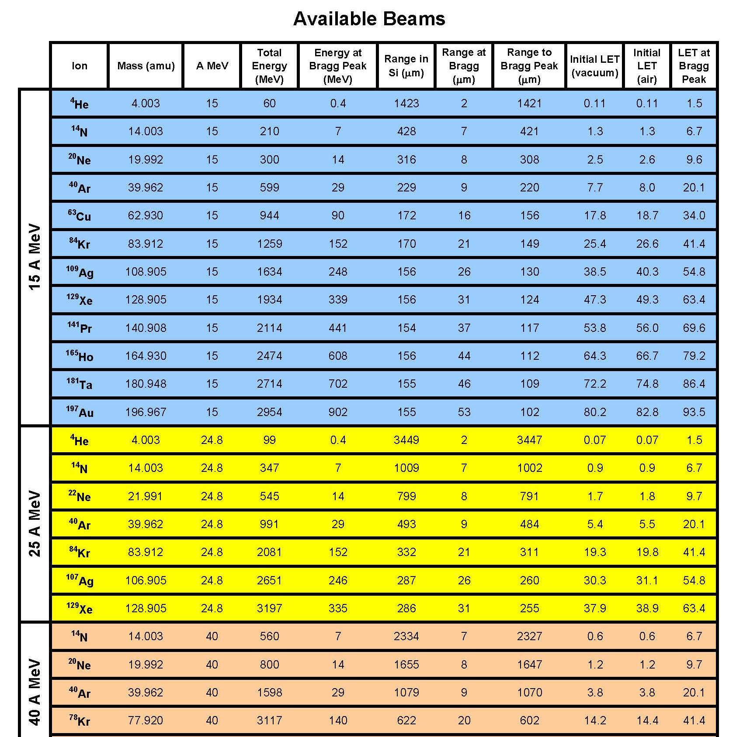
K500 Cyclotron Heavy-ions beams
95% - 15 MeV/u ions
4% - 25 MeV/u ions
1% - 40 MeV/u ions

Slide 10
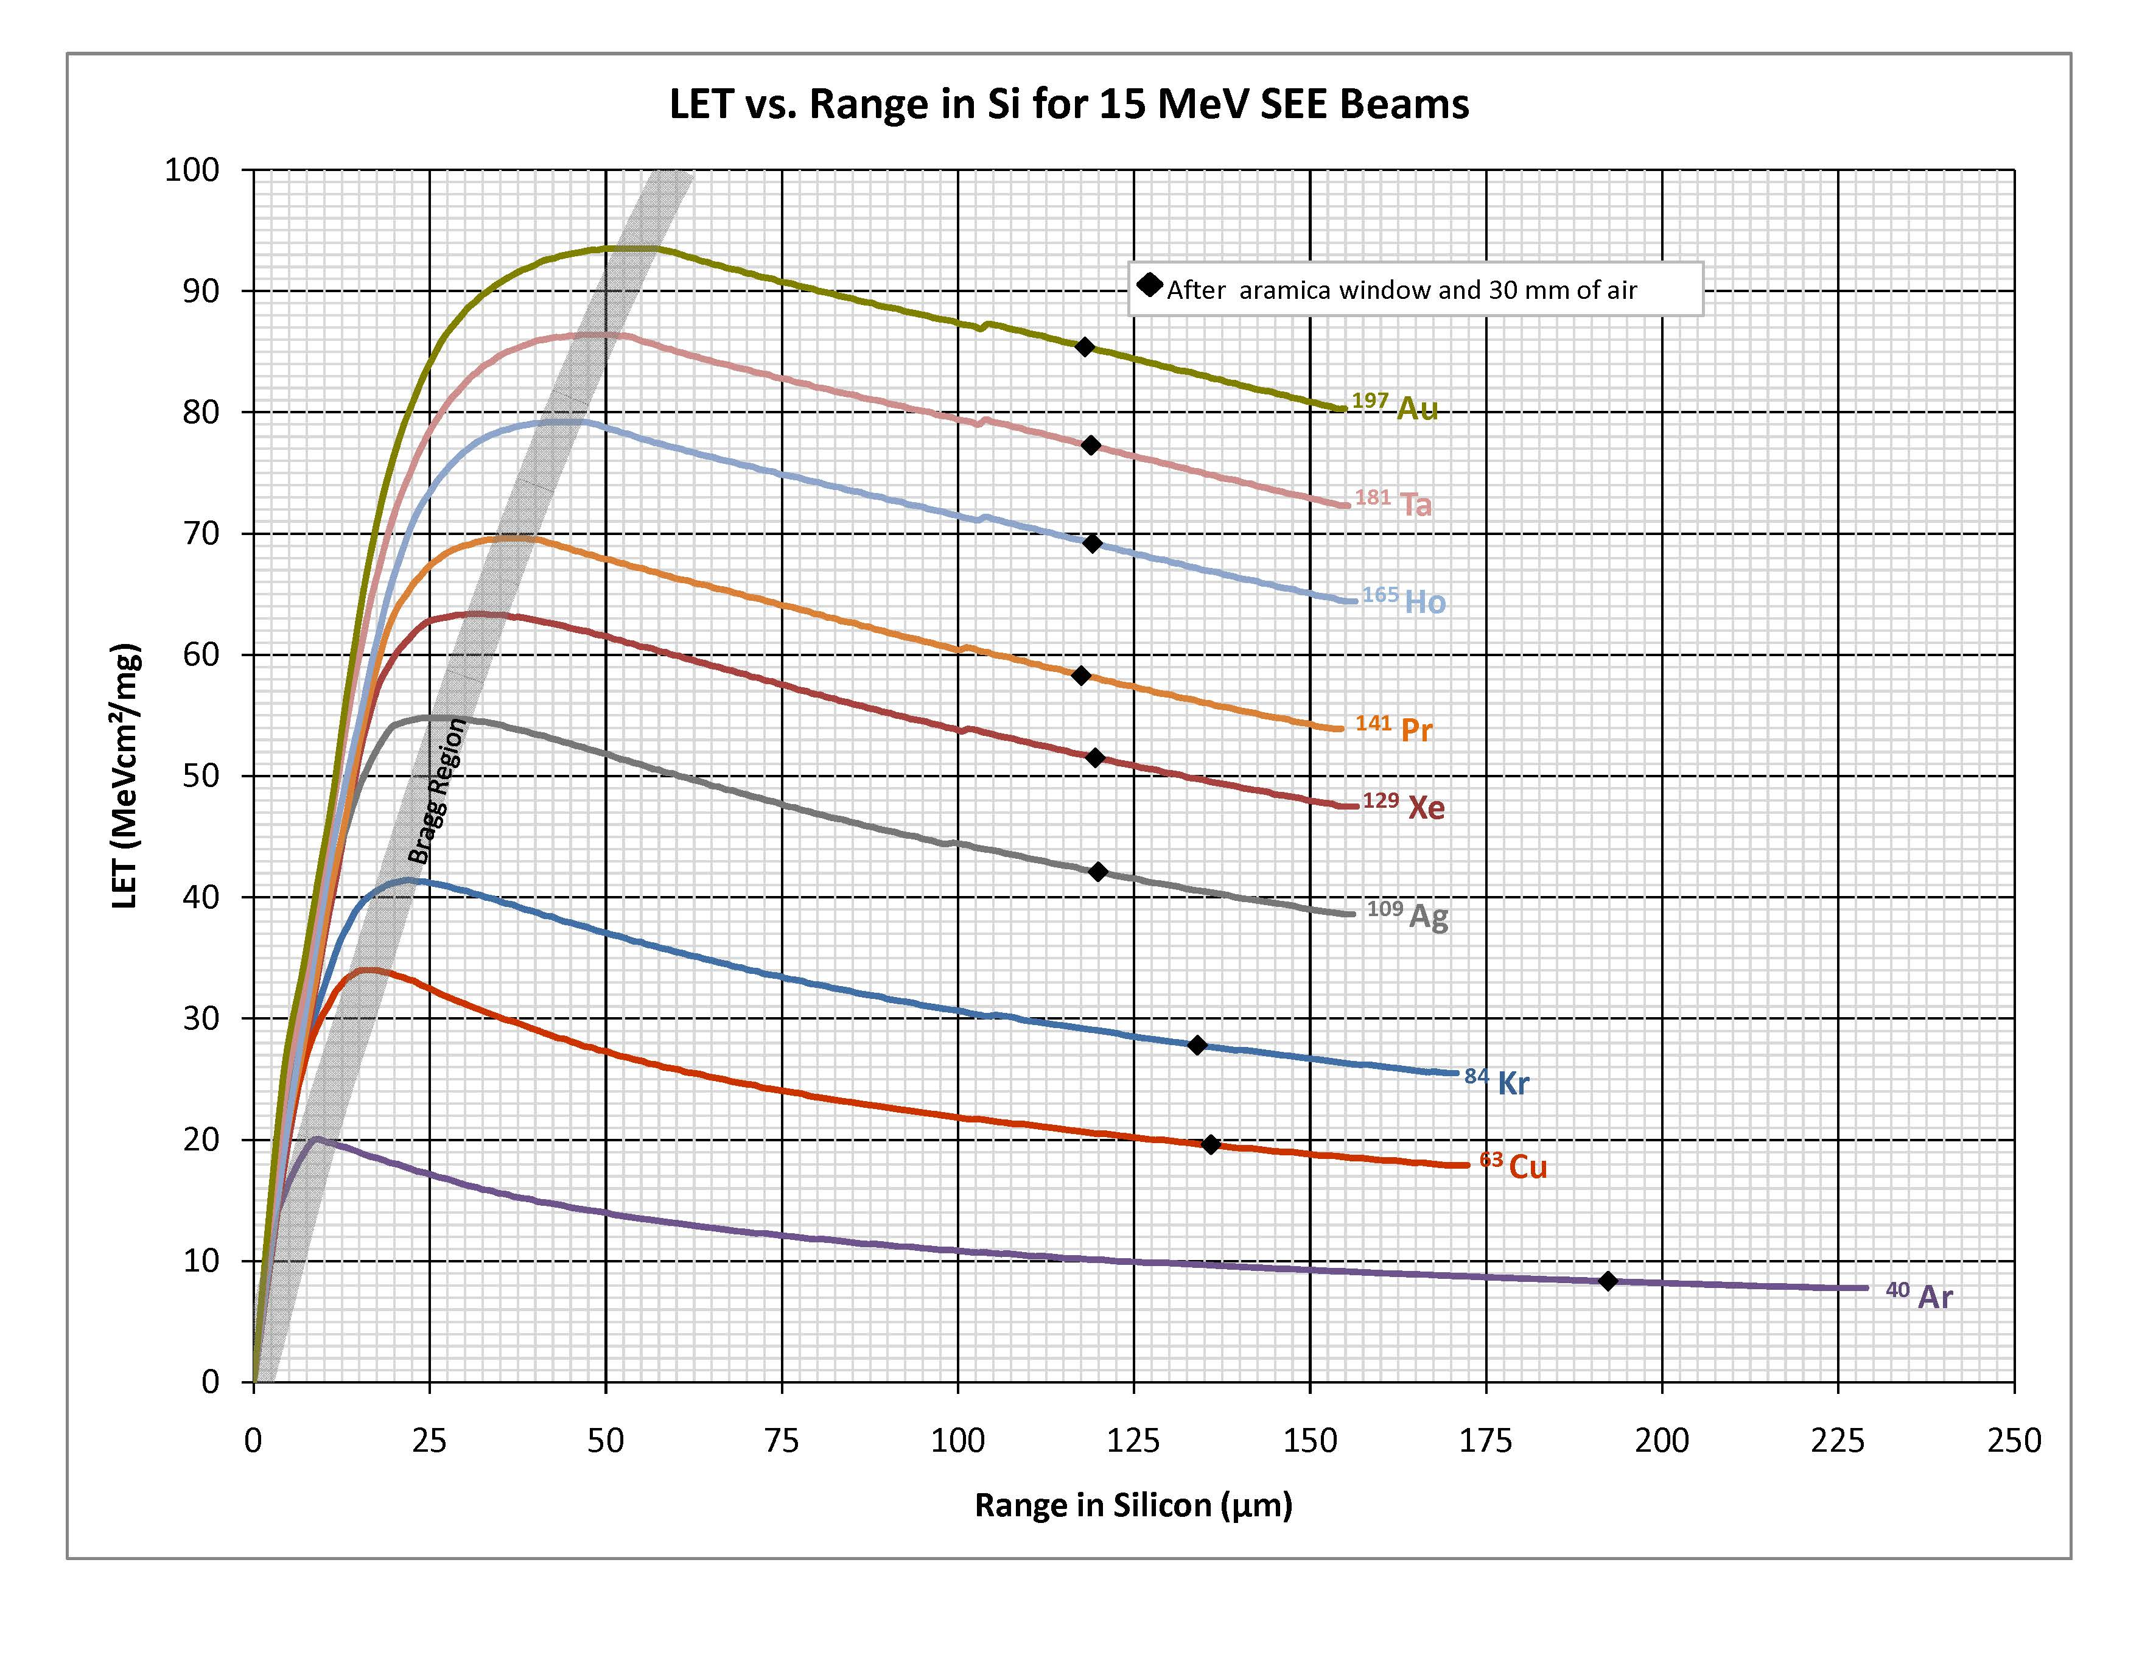
15 MeV/u Au, Xe, Ag are most requested

Slide 11
Proton beams
Real Beam Development Time

Slide 12
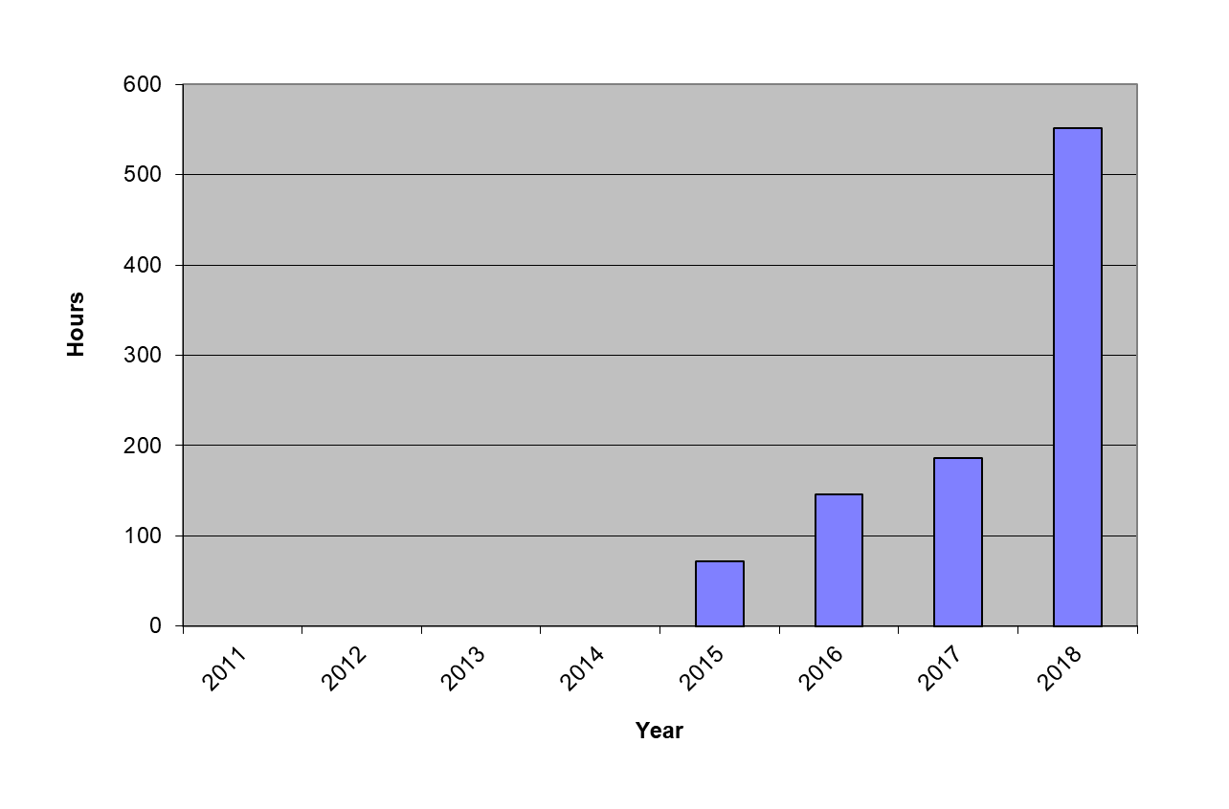
K150 SEE Hours at Texas A&M
956 hours over 4 years
K150 used for 1st Science Experiments
K150 REF
Notes:
12

Slide 13
K150 Cyclotron REF Details:
6 - 45 MeV protons (tunable/mono-energetic)
Energy (RF system) changes ~30 minutes
Energy degrader wheel for fast energy changes
Flux adjustable between 1E2 – 1E10 p/s-cm²
Uniform beam spots – 1”, 1.5”, 1.75” dia. (can be reduced to ¼” dia. with collimators)
In-air testing station – 10” x 10” frame remotely controlled (x, y, z, θ, roll angle)
New sliding shield door for fast access
New Data Room, Setup Area and Equipment
Can be scheduled with K500 Beam Time
15 MeV/u Heavy Ions…..coming soon!

Slide 14
K150 Cyclotron
Start at 12, 10 MeV/u Xe, Ag?
Ne, N, He not shown

Slide 15
Biggest Challenges Moving Forward:
How to offer most beam time possible:
K500 – 2nd ECR will reduce time lost to change over from Science beams to SEE beams
Utilize both K500 & current K150 beams offered
K150 Cyclotron Vacuum Development:
Higher vacuum is most important feature to heavy ion development
Add more external pumps? (Easiest)
Continue with LHe cryopanel system? (Expensive)
Break Cyclotron apart & replace O-rings? (Scary!)
Add more trained staff for additional shiftwork

Slide 16
Masters in Radiation Effects at Texas A&M:
Two year MS program Physics/Cyclotron Institute:
Coursework on relevant Physics/EE/ME topics
Lab work training – conduct SEE testing on well known parts (setup, take data, analyze)
Masters project – new part type, new technology, new testing procedure….TBD
Masters Project(s) – open to collaborative effort with any agency or company.
Masters Students would graduate with:
General knowledge in Radiation Effects
Hands on testing/laboratory experience

Slide 17
Visit our website at http://cyclotron.tamu.edu/ref/ Questions, contracting, scheduling contact Henry Clark at clark@comp.tamu.edu

